Slide 1
Making Assessment Doable with Google Sheets and a little R
AAEA Summer Conference
Dr. Kelli Langan
Notes:
Good morning. I'm Dr. Kelli Langan. I've spent 22 years in education, and for the last seven I've had the privilege of leading assessment for Springdale.
One thing I learned quickly...
Assessment isn't difficult.
Keeping everyone informed is.

Slide 2
Part 1: Why we Needed This
Notes:
How many of you have download and manipulate the same data set more than once during the testing window? Cause I know we are. Does it look something like:
ATLAS
↓
CSV
↓
Emails
↓
BTC
↓
Repeat tomorrow...
Then
There has to be a better way.

Slide 3
Testing Today
Testing all students grade K-10 plus EOC
We test ELA, Math, Science, Algebra, Geometry, Biology, ELPA, Civics, PSAT, ….
We test multiple times a year
Screeners, interims, summatives

Slide 4
So who is testing what?
Elementary
  Mandatory Screener, Interim (K-2), Summative
  Optional Testlets, Classroom Assessments
Middle
  Mandatory Summative
  Optional Interims, Classroom Assessments
High School
  Mandatory Summative, EOC
  Optional CCR assessments, Interims, Classroom Assessments
Notes:
ALthough it seems like we are testing all year, not every grade tkes every test.

Slide 5
Part 2: The Problem

Slide 6
Data?!?!
Where do we find all the data?
What data are important?
We have A LOT of data!
How do we communicate the data with our constituents?
Notes:
Where do we find all the data?
As a state we have done an excellent job with the new ATLAS portal. I can definitely give our state department, specifically the Assessment unit a shout out for that. We now how our summative, interim and K-2 assessments all under one roof which cuts down on having to learn multiple different platforms and how to pull data. We do have several different CCR platforms with a new one, CLT, having just joined us last year that we have to familiarize ourselves with. But fortunately, once you do acclimate yourself to the platform, obtaining the data, downloading the data, is about the same process on each.
What data are important?
After you have found and downloaded the data, the next step is to review all the available data and determine which variables are “important”. And all the data are important, they will just answer different questions. For the purpose of this presentation, our question is, “How many students still need to test?” So we need to deduce which variables will help me determine who has and hasn’t completed testing or maybe has only done some of testing, like maybe only completed 2 of the 4 ELPA domains.
How do we communicate the data to our constituents?
After I, as the DTC, have now determined who still needs to test, I need to communicate that with the BTC. You might be thinking can’t the BTC pull the information? Yes they can. But in the case of my district, that’s 30 different BTC having to pull the data each morning, culling the data to determine who has to test what. As the DTC, I like to take whatever I can off their plates because I know they are working hard to get everyone tested and that’s where they need to spend their efforts.
For the purpose of this presentation we are going to stick to data found in the ATLAS portal, but you can modify steps to pulling data from other sources such as College Board or ACT, for example.

Slide 7
Part 3: The Workflow

Slide 8
General Look
ATLAS
_____________________
│ │
Export Student File Export PMT File
▼
R
________________________________________
│ │ │ │
Clean Data Join Files Calculate Status Publish
▼
Google Sheets
▼
Interactive Dashboards
▼
Principals Teachers District Leaders

Slide 9
Part 4: Downloading Data
Notes:
So What’s going on behind the curtain. What are the step by step processes to get from A to Z. Let’s walk through that.

Slide 10

First you have to access TIDE
Navigate to atlasportal.org
Select “Teachers and Test Administrators
Notes:
Problem.

Slide 11
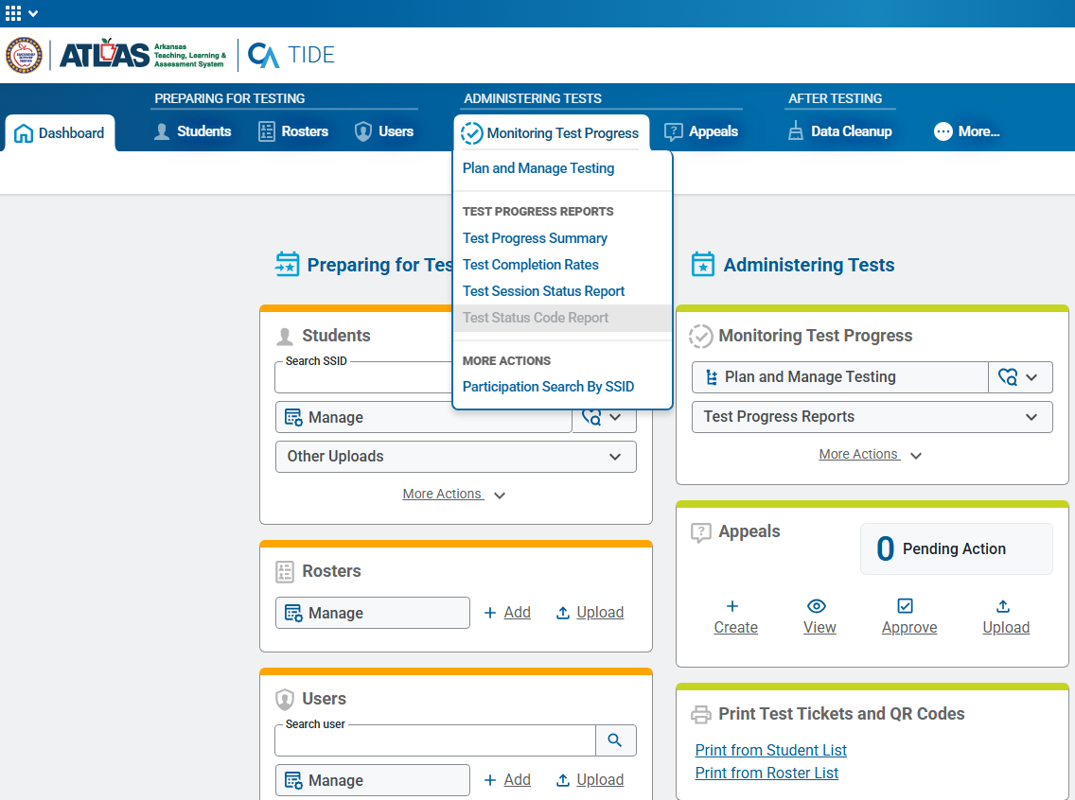
ATLAS Data Sources
Notes:
Navigate to “Test Status Code Report” under Monitoring Test Progress.

Slide 12
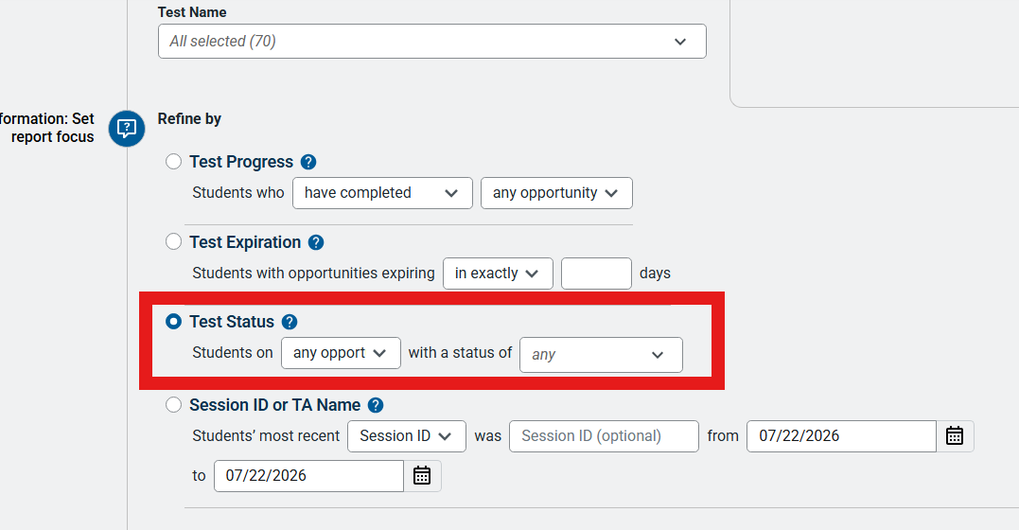
Exporting PMT Data
Notes:
PMT export.

Slide 13
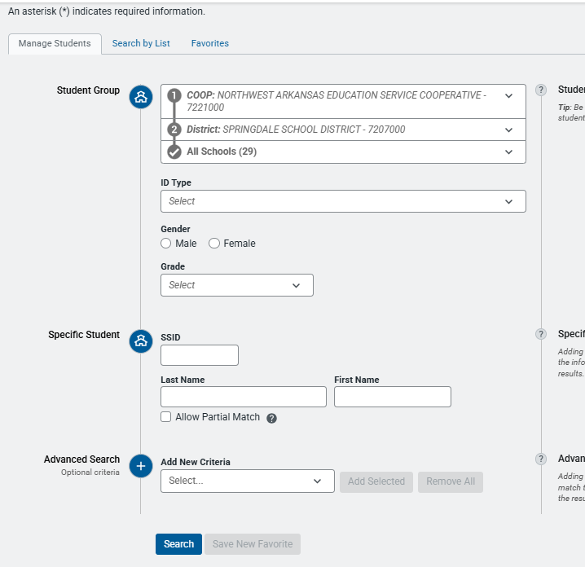
Exporting Student File
Manage Students

Slide 14
Part 5: R Code

Slide 15
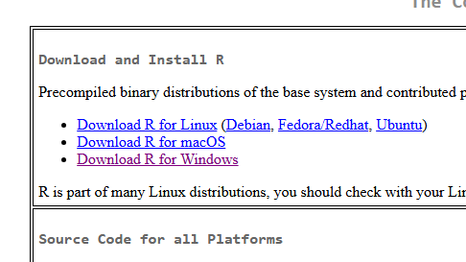
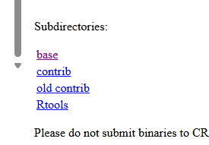
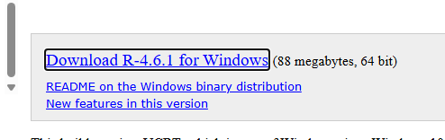
First, you need R
Navigate to Cran.r-project.org
Download R for Windows
Select Base
Download R-4.6.1 for Windows
Run

Slide 16
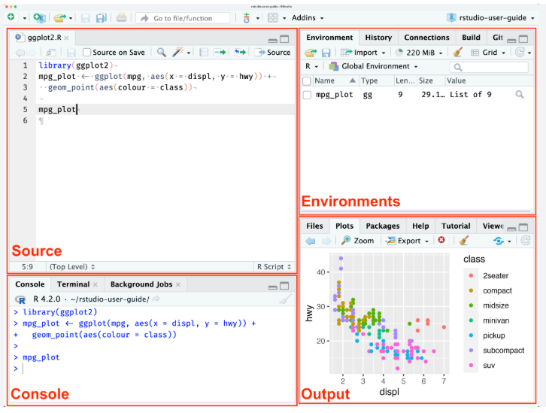
Familiarize Yourself with R

Slide 17
Needed Libraries
library(googlesheets4)
library(tidyverse)
library(googledrive)
gs4_auth("klangan@sdale.org")
drive_auth(“klanga@sdale.org”)

Slide 18
Reading in Your Data Set
students<-read_csv("path.csv",col_types=cols(.default='c'))
pmt<-read_csv("path.csv",col_types=cols(.default='c'))
Example:students<-read_csv("C:/Users/acrosby/Downloads/StudentSearch_SPRINGDALE SCHOOL DISTRICT_29_Schools_ 20260528.csv",col_types=cols(.default='c'))
*Path indicates the location of the dataset
Notes:
Import CSV.

Slide 19
Manipulate the Data sets
# You may need to modify for other things than 3-10 "standard" tests
pmt <- pmt |> mutate(Subject=word(Test,4))
#Investigatingn the values of subject
table(pmt$Subject)
#Looking at the first few rows of the data set
head(pmt)
# Convert to a single line per student with 4 subject areas (Reading, Writing, Rithmatic and Stience)
wide_pmt <- pmt |>
pivot_wider(id_cols='SSID',names_from=Subject,values_from=Status)
# Prepping to filter Students Table by investigation the values table(students$Grade)
# Filter to just those grades...
students<-students |> filter(Grade %in% c('03','04','05','06','07','08','09','10'))
# Get just the name part of the school w/o the DistID_LEA part
students<-students |>
mutate(
School=word(School,2,sep=' - '),
`Alternate Portfolio`=word(`Alternate Portfolio`,1,sep='-'),
RAELS=word(RAELS,1,sep='-'))

Slide 20
Preparing Student Data
#Select the variables you want
students<-students |>
select(
School,
SSID,
`Last Name`,
`First Name`,
Grade,
SPED =`IDEA Indicator`,
`504 Status`,
ELL =`English Learner Status`,
RAELS =`Recently Arrived English Learner (RAEL)`,
`Alternate Portfolio`,
# `Non-Participation Code (K-3 only)`,
# `EOC Eligibility`,
`Text-To-Speech`
)
pmt <- pmt |>
select(
SSID,
`Test`,
`Status`
)
Notes:
Clean/filter.

Slide 21

Merging Assessment Data
# Merge the student data with the test status
merged <- students |>
left_join(wide_pmt,
by=c("SSID"="SSID")
)
Notes:
Join files.

Slide 22
Publishing to Google Sheets
sheet_write(data=merged,ss=workbook,sheet="merged")
stop()
range_write(ss=workbook, # Points to the Google Sheet
data=pmt, # The data frame (tibble) to write
sheet='PMT', # Tab to write
range='TopLeftCell', # Location of the top left corner
of the # block, such as "A9","D35", etc.
reformat = FALSE, # FALSE means keep the existing
formatting, inc. # conditional
formatting rules,
col_names = FALSE # DO NOT write the names of the
columns, just # the data. Lets you
put "better" names or # labels instead
of your internal names
)
Notes:
Write to Sheets.

Slide 23
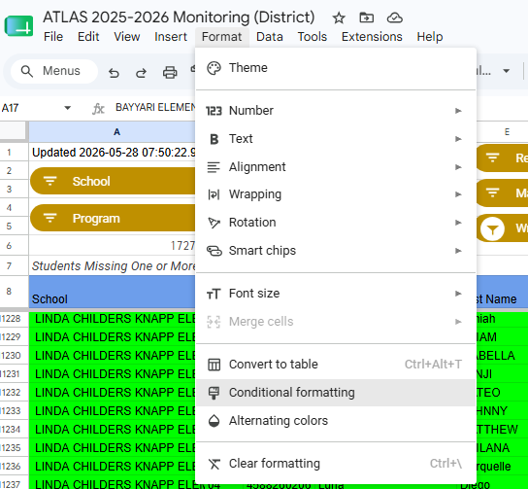
Conditional Formatting
Examples of Conditional formatting:
Tested=and($G9=0,not(isblank($G9)))
Res X = countif({"1","2","4","5"},$AM9)>0
DLM=countif({$L9,$O9,$R9,$U9,$X9,$AA9,$AD9},"DLM")>0
Notes:
The conditional formatting will take place in Google Sheets AFTER you export your data set from R.

Slide 24
Part 6: Final Product

Slide 25
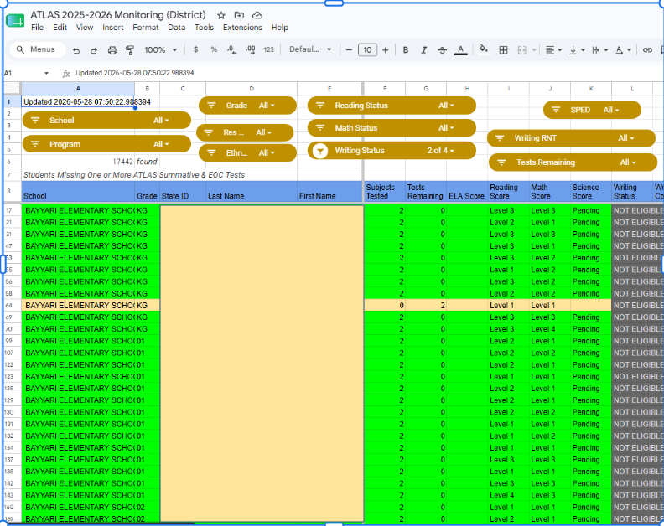
Notes:
Dashboard.

Slide 26
Why Slicers Matter
Functions
Narrow down options in a single field
Used in conjunction with another column as an “and” condition
Helpful when determining how many tests/domains a student has left to complete.
Helpful when monitoring subgroup completion
Notes:
Slicers.

Slide 27
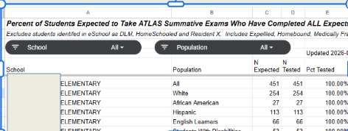
Monitoring Participation
Percent tested.
R Code
Notes:
Percent tested. Adding a few lines of code will allow you to calculate the percentages tested by subgroup to monitor those statistics throughout the testing window.

Slide 28
Next Steps
Distributing to Individual School Folders
foldername <- "Sample Status Sheets"
filename <- "Status Sheet"
# Create the folder
status_folder <- drive_create(foldername,type="folder")
# Walking through the school names in the merged data, will
# create a subfolder and a file for each one
for (school_name in unique(merged$School)) {
# See if there's a folder for the school inside the status folder
school_folder <- drive_ls(school_name,
path=status_folder,
type="folder")
if (nrow(school_folder)==0) { # Means the folder doesn't exist...
# Create the folder
school_folder <- drive_create(school_name,
path=status_folder,
type="folder")
}
Notes:
Future.

Slide 29
Distributing to Schools Cont.
# Look for a sheet inside the school folder
school_sheet <- drive_ls(filename,
path=school_folder,
type="spreadsheet")
if (nrow(school_sheet)==0) {# Means the sheet doesn't exist…
# Create the sheet
school_sheet <- drive_create(filename,
path=school_folder,
type="spreadsheet")
}
# Limit to the School
out <- merged |>
filter(School==school_name)
# Write the data to the first tab in the school sheet
write_sheet(data=out,ss=school_sheet,sheet=1)
}

Slide 30
Part 7: Why Test Coordinators Love It

Slide 31
Benefits
Hours saved manipulating spreadsheets
decreased chance of errors
Easier for me to compare schools
Every school is using the same dashboard
All leaders are viewing the same data
Focus shifts to scheduling students and completing testing.
Notes:
They don’t individually have to pull data sets
No “figuring” on their parts
Monitoring has just become easier.

Slide 32
Questions?
Notes:
Q&A

Slide 33
library(googlesheets4)
library(tidyverse)
gs4_auth("acrosby@sdale.org")
# Note: This will ****ALWYAS**** create a new Google sheet -- even if this is a # second sheet with same name...
#workbook<-gs4_create("Test Status 3-10 On Date")
# District level student export file from TIDE
students<-read_csv("C:/Users/acrosby/Downloads/StudentSearch_SPRINGDALE SCHOOL DISTRICT_29_Schools_20260528.csv",col_types=cols(.default='c'))
names(students)
students<-students |>
select(
School,
SSID,
`Last Name`,
`First Name`,
Grade,
SPED=`IDEA Indicator`,
`504 Status`,
ELL=`English Learner Status`,
RAELS=`Recently Arrived English Learner (RAEL)`,
`Alternate Portfolio`,
# `Non-Participation Code (K-3 only)`,
# `EOC Eligibility`,
`Text-To-Speech`
)
names(students)

Slide 34
# Prepping to filter to just 3-10
table(students$Grade)
# Filter to just those grades...
students<-students |> filter(Grade %in% c('03','04','05','06','07','08','09','10'))
table(students$Grade)
table(students$School)
# Get just the name part of the school w/o the DistID_LEA part
students<-students |>
mutate(
School=word(School,2,sep=' - '),
`Alternate Portfolio`=word(`Alternate Portfolio`,1,sep='-'),
RAELS=word(RAELS,1,sep='-'))
table(students$School)
# Getting info about Tests Given/In Progress
# Read in *A* pmt file. There will be PMT files separately for EOC, K-2,
# 3-10 subject area, ELPA, etc. No PMT file for DLM.
#
# Exported from tide for All Schools, All Tests, Any Status
pmt<-read_csv("c:\\users\\acrosby/downloads/PMTReportSearch_SPRINGDALE SCHOOL DISTRICT_29_Schools_20260422 (7).csv",col_types=cols(.default='c'))
pmt <- pmt |>
select(
SSID,
`Test`,
`Status`
)

Slide 35
names(pmt)
# You may need to modify for other things than 3-10 "standard" tests
pmt <- pmt |> mutate(Subject=word(Test,4))
table(pmt$Subject)
# Convert to a single line per student with 4 subject areas (Reading, Writing, Rithmatic and Stience)
wide_pmt <- pmt |>
pivot_wider(id_cols='SSID',names_from=Subject,values_from=Status)
head(wide_pmt)
# Merge the student data with the test status
merged <- students |>
left_join(wide_pmt,
by=c("SSID"="SSID")
)
head(merged)
glimpse(merged)
table(merged$Grade)
table(merged$`ELA-Reading`)
sheet_write(data=merged,ss=workbook,sheet="merged")
library(tidyverse)
library(googlesheets4)
library(googledrive)
gs4_auth("acrosby@sdale.org")
drive_auth("acrosby@sdale.org")

Slide 36
foldername <- "Sample Status Sheets"
filename <- "Status Sheet"
status_folder <- drive_find(foldername,type="folder")
if (nrow(status_folder)==0) { # Means the folder doesn't exist...
# Create the folder
status_folder <- drive_create(foldername,type="folder")
}
# Walking through the school names in the merged data, will
# create a subfolder and a file for each one
for (school_name in unique(merged$School)) {
# See if there's a folder for the school inside the status folder
school_folder <- drive_ls(school_name,
path=status_folder,
type="folder")
if (nrow(school_folder)==0) { # Means the folder doesn't exist...
# Create the folder
school_folder <- drive_create(school_name,
path=status_folder,
type="folder")
}
# Look for a sheet inside the school folder
school_sheet <- drive_ls(filename,
path=school_folder,
type="spreadsheet")
if (nrow(school_sheet)==0) { # Means the sheet doesn't exist...
# Create the sheet
school_sheet <- drive_create(filename,
path=school_folder,
type="spreadsheet")
}

Slide 37
# Limit to the School
out <- merged |>
filter(School==school_name)
# Write the data to the first tab in the school sheet
write_sheet(data=out,ss=school_sheet,sheet=1)
}
stop()
range_write(ss=workbook, # Points to the Google Sheet
data=pmt, # The data frame (tibble) to write
sheet='PMT', # Tab to write
range='TopLeftCell', # Location of the top left corner of the
# block, such as "A9","D35", etc.
reformat = FALSE, # FALSE means keep the existing formating, inc.
# conditional formatting rules,
col_names = FALSE # DO NOT write the names of the columnts, just
# the data. Lets you put "better" names or
# labels instead of your internal names
)

