Slide 1

Empowering At-Risk Youth through Innovative Education and Whole Child Healing
Path to Purpose:
Cindy L. Willis, Ed.S.
Superintendent
Arkansas Division of Youth Services

Slide 2
Presenter – Cindy L. Willis, Ed.S.
Teacher, Facilitator, Administrator
Public School in Oklahoma – English & Journalism
Traveling Teacher – CYS
Virtual Arkansas Facilitator
Virtual Arkansas Teacher
DYS Assistant Superintendent
DYS Superintendent
12 school years in the DYS school system

Slide 3
Who We Are!!!
We Commit To:
Identifying and serving students with disabilities
Improving individual academic achievement
Supporting progress toward state and local graduation requirements
Preparing students for post-secondary success
System Coordination
Aligned curriculum across all school sites
Consistent textbooks, technology, and instructional materials
Seamless academic continuity despite student movement
Protection against educational disruption due to placement changes
Teacher on Campus and Virtual Arkansas
All teachers meet “highly qualified” standards
School schedule mirrors traditional public schools
Focus on stability, professionalism, and instructional excellence
DYS Education System Mission
Our Mission
To provide high-quality education, aligned with Arkansas and national public education standards, that meets the unique needs of youth in the juvenile justice system.

Slide 4
Myth vs. Reality
Myth
Reality
Every student in DYS deserves to go to prison. If they are in DYS they did something REALLY BAD!!!
They don’t go to “real school.”
They don’t get help.
They are just going to be terrible when they get back.
Not every student in DYS deserves to be in prison or DYS.
We have 4-day school week and extra tutoring on Fridays.
They are helped by certified teachers that are dedicated to the DYS students on VA and at the facilities.
They learned better behaviors, coping mechanisms

Slide 5
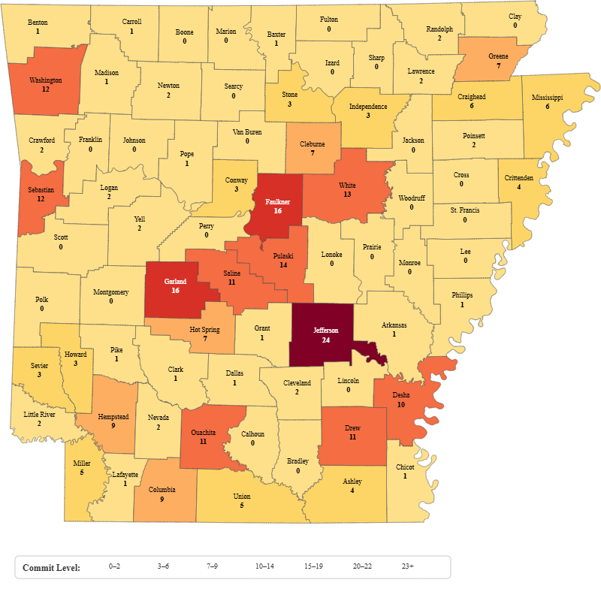
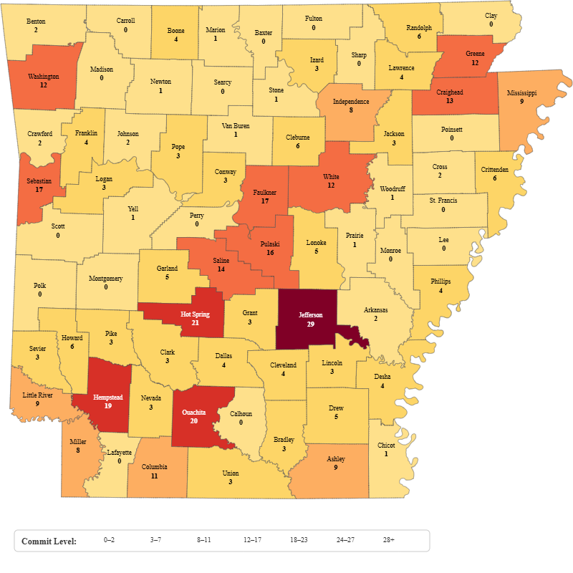
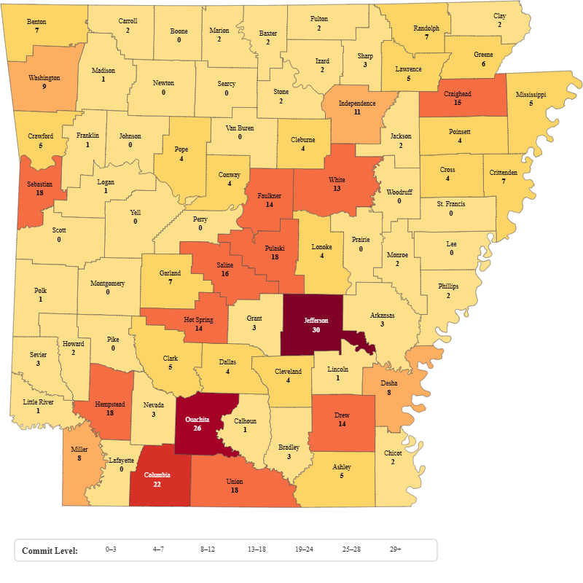
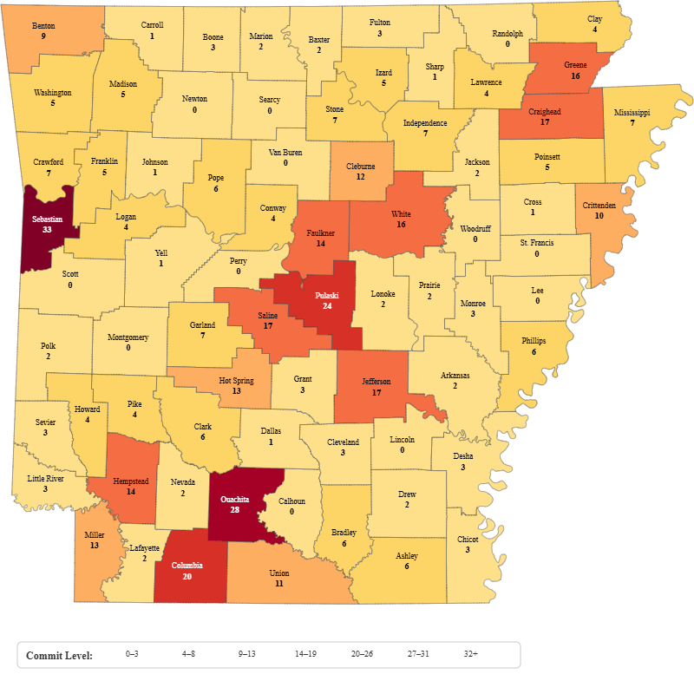
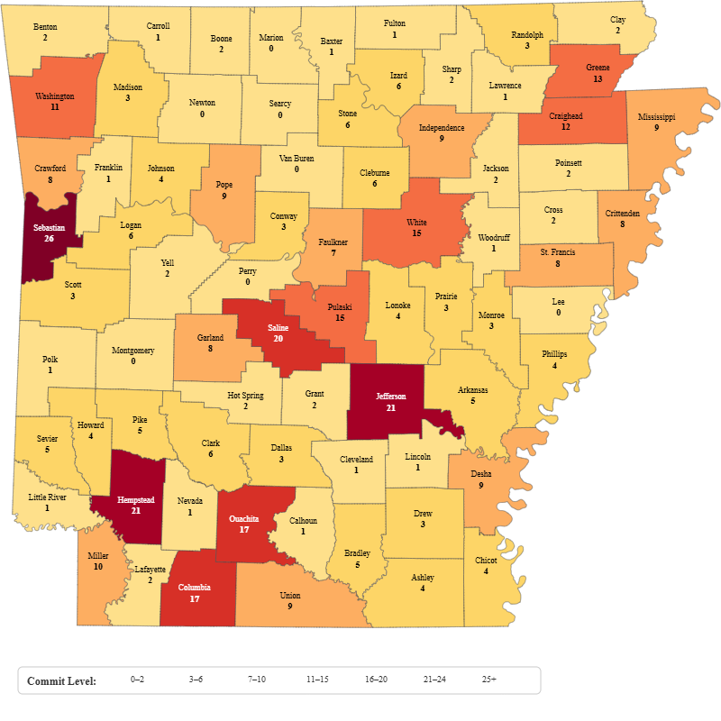
Youth Services Commitments
2021
2023
2022
2024
2025

Slide 6
DATA DROP
Facilities
Demographics
Alexander Juvenile Assessment and Treatment Center
Dermott Juvenile Treatment Center
Harrisburg Juvenile Treatment Center
Lewisville Juvenile Treatment Center
Mansfield Juvenile Treatment Center
Civilian Student Training Program
Vera Lloyd
The Cottages
Females – 53 in facilities
Males – 367 in facilities & stepdowns
Race Category | Count | Percentage
African American/Black | 132 | 63.77%
White | 108 | 52.17%
Other | 16 | 7.73%
Hispanic (all types) | 12 | 5.80%
American Indian | 5 | 2.42%

Slide 7
DATA DROP
Demographics
Demographics
✔️ Top 5 Counties by Frequency
Pulaski — 33 (9.57%)
Craighead — 20 (5.80%)
White — 18 (5.22%)
Sebastian — 15 (4.35%)
Columbia — 13 (3.77%)
Theft of Property
Battery – 2nd Degree
Battery – 3rd Degree
Breaking or Entering
Aggravated Assault

Slide 8

Behind the Scenes
How do we get students?
Treatment Team
Students have committed crimes and have been adjudicated by the court.
Students are now in the custody of the Division of Youth Services.
How do youth enter custody and the average duration of placement?
  Average length of stay is about 6 months.
  Can be as short as 3 months and longs as 2 years.
Mental Health
Medical
Education
Treatment
Aftercare
This is where we plan for high school/GED/graduate work.

Slide 9

Where do our students live before they get to DYS?
Home
  Parents, Grandparents, Other family members, Friend’s houses
Foster Homes
Residential Placements
Homeless
JDCs

Slide 10


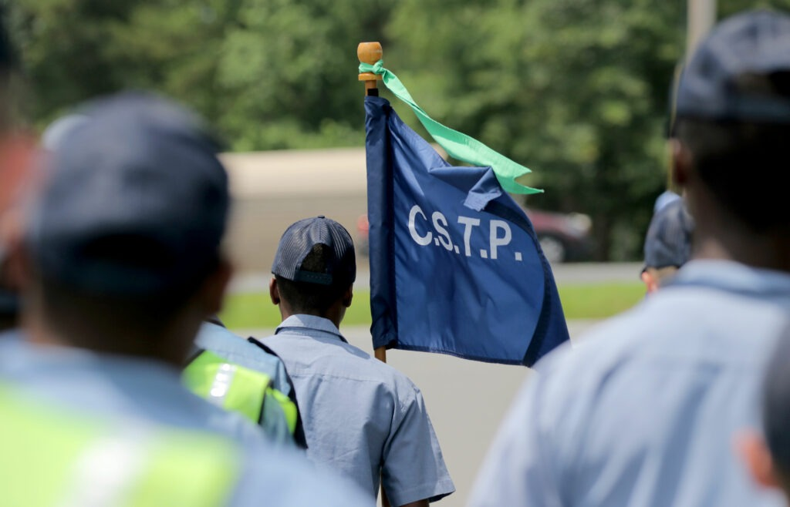








What does education look like at DYS?
Programs:
Rite of Passage
Civilian Student Training Program
Vera Lloyd
The Cottages
Partners:
Virtual Arkansas
Adult Education Centers
Arkansas River Coop
Edmentum
Orijin
Transfr

Slide 11



Cool Things We Do at DYS
Accelerated Learning
Graduate Students
Enroll, Enlist, Employ
Acceleration
Graduated over 30 students in SY 25-26 from high school.
Graduated 22 high school students this spring.
Graduated 36 GED Students from 8/2025 to 6/30/2026
We work to ensure that the students have the soft skills to be employed.
Access if they want to Enlist.
Information for Enrollment or actual Enrollment (Ask about our Arkansas Baptist Program)
We enrolled roughly 15 students that were in the 8th grade in English I for the summer. All passed but 1 with credit for acceleration.

Slide 12

GOALS
Treatment
  Work with therapist and case manager
  Improve behavior and relationships with family.
Education
  Credit Recovery
  Dyslexia Intervention
  Reading Skills Recovery
  Grade Level Instruction
  Classroom Etiquette
  Norms and Expectations
  High School/GED
  GRADUATION!!! ☺

Slide 13
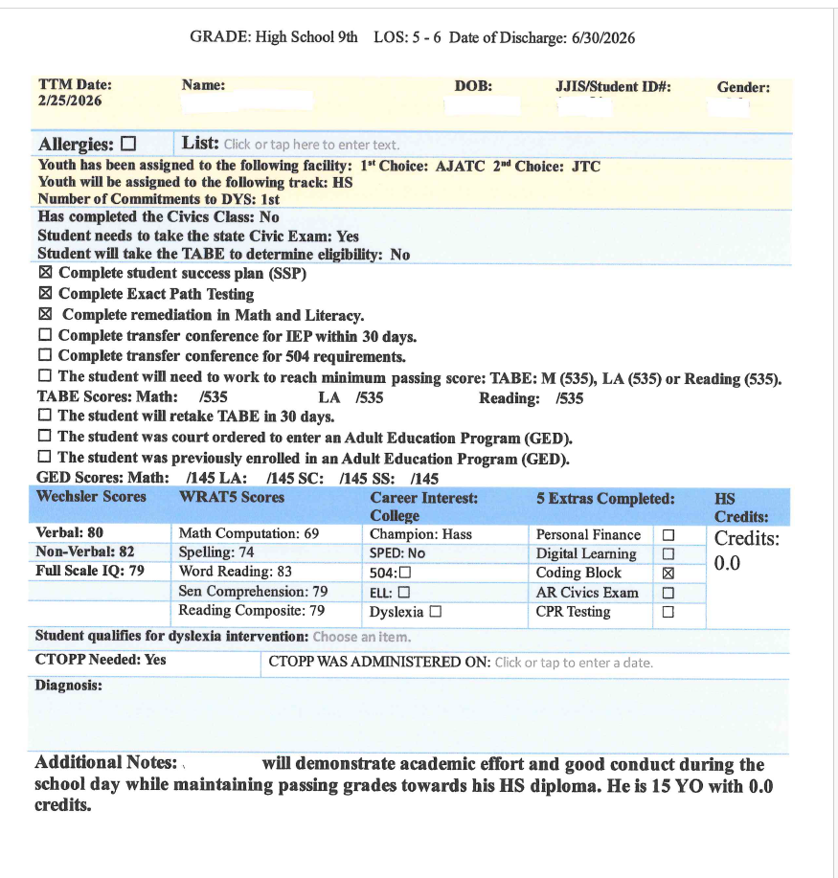
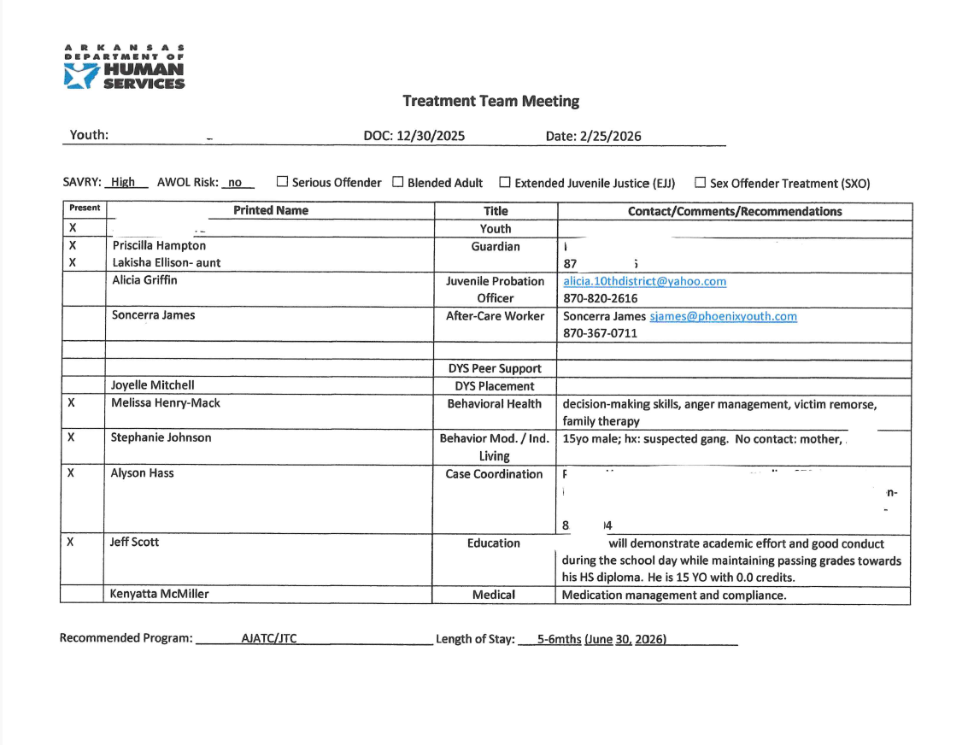
Treatment Plan

Slide 14
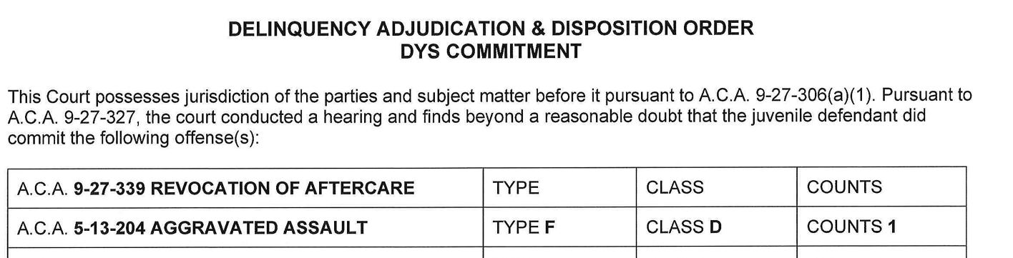
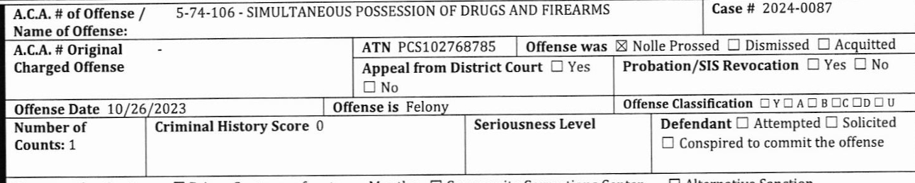
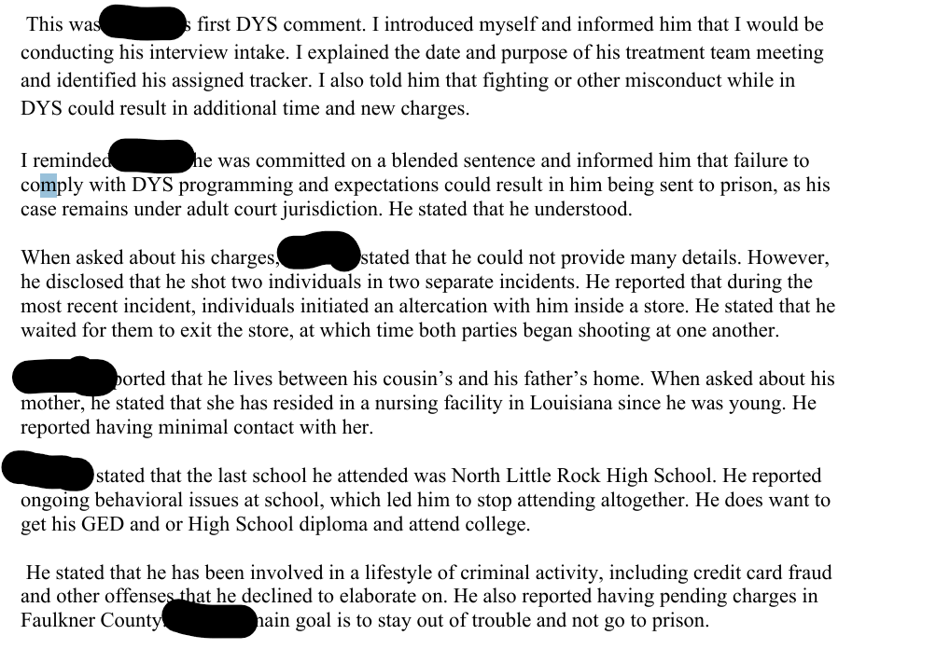
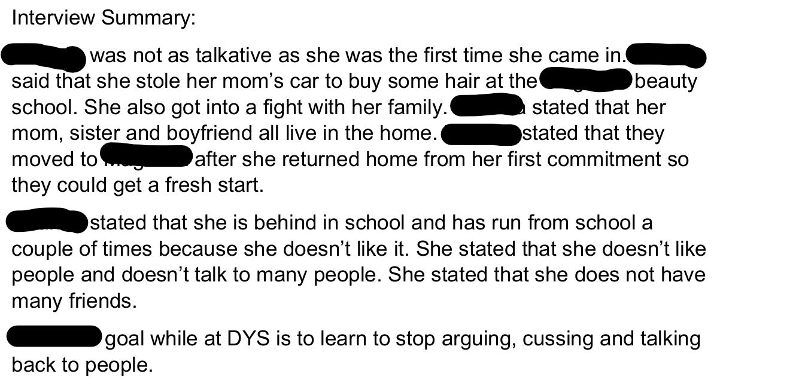
DYS Case Study
Student 1
Student 2
Female
Age 11
Male
Age 19/EJJ
Ages 11-21
All over Arkansas
All kinds of charges

Slide 15
What can I do to help at Public School?
Verbal Communication
Nonverbal Communication
Welcome the student back to class.
Ask the student about their grades. Many of our students make the honor roll while they are in DYS.
Show an interest in the student because they have just spent at least 6 months learning how to trust again.
Smile when that student walks back in your classroom.
Don’t shrug your shoulders or sigh
Think before you speak.
Remember this student has had therapy, education, and earned awards.

Slide 16



Slide 17
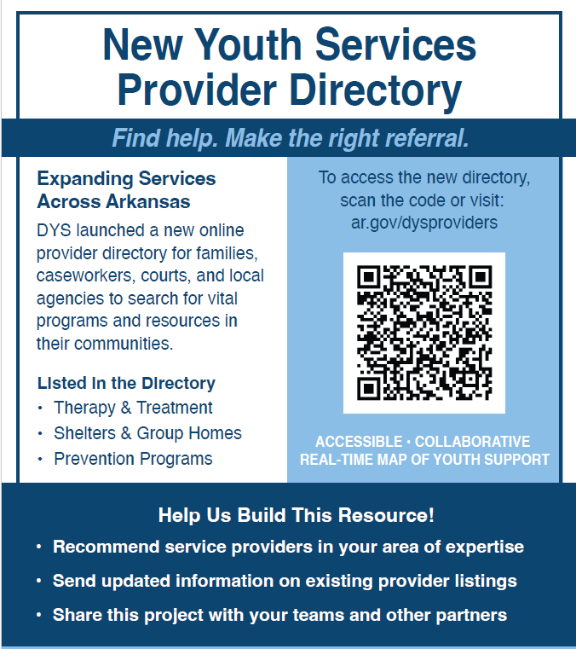

Community Resources and Prevention
Adrian Sanders
Social Services Administrator
Assistant Director – DYS Prevention
Office: (501) 534-4061
Cell: (501) 647-7496
700 S. Main St.
Little Rock, AR 72203
Adrian.Sanders@dhs.arkansas.gov

Slide 18

Cindy L. Willis, Ed.S.
Training Manager
Division of Youth Services/ Education Superintendent
P: 870-578-5886
C: 501-650-3982 cindy.willis@dhs.arkansas.gov
Please reach out and help us help you!!

