Slide 1
Leading District Improvement
Hope Worsham, Assistant Commissioner of Public School Accountability
Brooke McCain, Director of Monitoring and Accreditation
Notes:
Hope
“Today is about systems—not programs. High-performing districts do not rely on isolated initiatives—they build systems that produce consistent results across every school.”
“Our focus is not compliance—it is student outcomes. And ultimately, that means building the capacity of our people to deliver high-quality instruction every day.”

Slide 2

Is Your System Coherent?
Every system is
perfectly designed to
get the results it gets.
Mastering the 9 cells requires moving away from isolated initiatives and toward
coherent systems.
Every system is
perfectly designed to
get the results it gets.
Mastering the 9 cells requires moving away from isolated initiatives and toward
coherent systems.
Notes:
Hope
“Today is about systems—not programs. High-performing districts do not rely on isolated initiatives—they build systems that produce consistent results across every school.”
“Our focus is not compliance—it is student outcomes. And ultimately, that means building the capacity of our people to deliver high-quality instruction every day.”

Slide 3
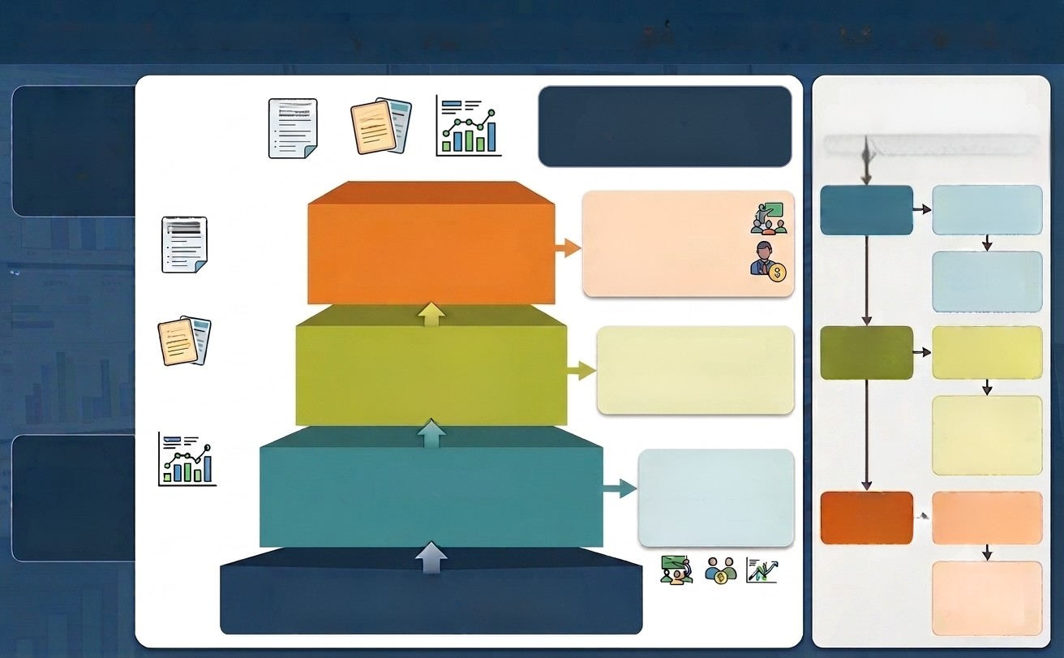
Arkansas’s Accountability System
Equal Weights for ELA, Math and Science
Focused on academic achievement, growth and opportunities.
STANDARDS
Growth of the
Lowest Quartile
Resource Deployment
and Supports
(Lowest Performers)
•Intensive Support Check
•Resource Allocation:
Title/1003 Dollars
ESOL Programs
Tutoring
• Instructional Facilitators
ALDs
Growth of All
Functionality of Tier 2 Interventions
(Targeted Supports)
  Presence & Function of Interventions
  Student Progress Monitoring
Data
  Standards Alignment Informed by ALDs
  Rigorous Data Review
  Balanced Assessment
Achievement
Effectiveness of Tier 1 Instruction
(All Students)
SUCCESS READY GRADUATE
Prepared Graduates

Slide 4
District/School Profile Based on Rating
High Achievement, High Growth
Low Achievement, High Growth
High Achievement, Low Growth
Low Achievement, Low Growth

Slide 5
Building Profiles
Description: This building demonstrates a highly coherent system where standard-aligned, high-rigor Tier 1 instruction is happening daily across all classrooms. Core instruction is strong, and robust tracking systems ensure that any small learning gaps are addressed immediately before they widen.
What District Leaders Should Look For / Next Steps: Verify Sustainability: Ensure that this high performance is consistent across all student subgroups, including the bottom quartile. Examine Replication Potential: Audit their collaborative team protocols and data-tracking systems to serve as a blueprint for underperforming schools in the district. Focus on Enrichment: Check if Tier 1 instruction includes extended learning opportunities or extension activities that continue to push top-performing students.
High Achievement, High Growth

Slide 6
Building Profiles
Description: This building demonstrates a highly coherent system where standard-aligned, high-rigor Tier 1 instruction is happening daily across all classrooms. Core instruction is strong, and robust tracking systems ensure that any small learning gaps are addressed immediately before they widen. | Description: This profile indicates that instruction is likely below grade level or severely misaligned across the board. Tier 1 core instruction lacks rigor, and the intervention systems (Tier 2 and Tier 3) are either disconnected from core standards or failing to track whether students are actually mastering prerequisite skills.
What District Leaders Should Look For / Next Steps: Verify Sustainability: Ensure that this high performance is consistent across all student subgroups, including the bottom quartile. Examine Replication Potential: Audit their collaborative team protocols and data-tracking systems to serve as a blueprint for underperforming schools in the district. Focus on Enrichment: Check if Tier 1 instruction includes extended learning opportunities or extension activities that continue to push top-performing students. | What District Leaders Should Look For / Next Steps: Audit Tier 1 Alignment: Conduct immediate walkthroughs to check if classroom activities and assessment practices are actually aligned to grade-level standards and Achievement Level Descriptors (ALDs). Review Curriculum Fidelity: Look for major gaps or inconsistent implementation of the curriculum from classroom to classroom. Rebuild Intervention Foundations: Investigate whether current interventions are scaffolded to help students reach grade-level expectations or if they are simply repeating low-level work.
High Achievement, High Growth
Low Achievement, Low Growth

Slide 7
Building Profiles
Description: While overall proficiency looks positive—often due to strong historical student baseline skills—students are not making meaningful progress over the school year. This typically indicates a lack of instructional urgency, low expectations for continuous growth, or weak Tier 2 intervention systems that fail to track live student progress.
What District Leaders Should Look For / Next Steps: Evaluate Rigor & Differentiated Instruction: Walk classrooms to determine if teachers are teaching to the ceiling or if instruction stalls once students hit basic "proficiency" targets. Check Live Progress Monitoring: Examine how the school tracks standard mastery dynamically rather than relying solely on end-of-year results. Review Tier 2 Interventions: Ensure that intervention systems are tightly aligned to core standards and actively driving growth for students who may be missing specific concepts.
High Achievement, Low Growth

Slide 8
Building Profiles
Description: While overall proficiency looks positive—often due to strong historical student baseline skills—students are not making meaningful progress over the school year. This typically indicates a lack of instructional urgency, low expectations for continuous growth, or weak Tier 2 intervention systems that fail to track live student progress. | Description: This profile shows that things are moving in the right direction. High growth indicates that effective Tier 2 and Tier 3 interventions are likely in place, or that Tier 1 practices are steadily improving. However, historical gaps or lingering inconsistencies in Tier 1 instructional rigor prevent these gains from translating into high overall proficiency yet.
What District Leaders Should Look For / Next Steps: Evaluate Rigor & Differentiated Instruction: Walk classrooms to determine if teachers are teaching to the ceiling or if instruction stalls once students hit basic "proficiency" targets. Check Live Progress Monitoring: Examine how the school tracks standard mastery dynamically rather than relying solely on end-of-year results. Review Tier 2 Interventions: Ensure that intervention systems are tightly aligned to core standards and actively driving growth for students who may be missing specific concepts. | What District Leaders Should Look For / Next Steps: Identify Tier 1 Gaps: Walk every classroom to pinpoint exactly where inconsistencies in grade-level rigor or instructional practices are occurring. Review Assessment Practices: Check if classroom assessments match the high expectations of state standards or if they lean toward lower-level tasks. Capitalize on Growth Drivers: Isolate what is working well in their collaborative teams or intervention blocks (especially within the bottom quartile) and anchor those successes into standard daily core instruction.
High Achievement, Low Growth
Low Achievement, High Growth

Slide 9
District Improvement Starts with the Right Questions
These three pillars provide the foundation for meaningful improvement.
CONDITIONS FOR LEARNING
Student Discipline
Classroom Management
School wide expectations
LEADERSHIP
CAPACITY
Developing Teacher Practice
Instructional Leadership and Feedback
Difficult Conversations
Progress Monitoring
GRADE-LEVEL INSTRUCTION
Curriculum and Instructional Alignment
Data and Decision-Making
Collaborative Team Effectiveness
Student Engagement
Notes:
Hope
8 critical areas - these are the things that rise to the top as areas to focus in to shift. If you are not having these data driven decisions and discussions, the issue will grow.

Slide 10

When discipline
breaks down,
instructional time is lost, engagement decreases,
and student achievement suffers.
System 1:
Creating Conditions for Learning
When discipline
breaks down,
instructional time is lost, engagement decreases,
and student achievement suffers.
Notes:
Hope

Slide 11
Discipline
Reflective Questions:
Are disruptions occurring that impact student learning?
What discipline data trends exist to indicate barriers to learning? (Locations, times of day, grade levels, etc.)
Scenario: Classroom Disruptions Are Impeding Instruction
A building principal is receiving frequent reports of classroom disruptions across several grade levels. Transitions are chaotic with minimal adult supervision. Teacher morale is declining, office referrals are increasing, and instructional time is being lost. While the principal is working hard to address individual incidents, the problem persists and is affecting student learning.
Practical Actions
Establish a school behavioral team to create consistent expectations and monitor progress.
Provide targeted staff training on classroom management, student engagement and self-regulation.
Establish discipline systems and clear roles and steps for escalation.
Analyze behavior data to identify patterns by classroom, grade level, location, and time of day.
Notes:
Staff Training - training staff on how to self-regulate
What are ideas you could raise to address the transitional chaos?? Give time to turn and talk.
These things should be addressed in the behavior matrix.

Slide 12

Schools improve when leadership extends beyond one person and becomes a shared responsibility across the organization.
System 2:
Leadership Capacity
Schools improve when leadership extends beyond one person and becomes a shared responsibility across the organization.
Notes:
Mark

Slide 13
Leadership Capacity
ARE MY LEADERS:
Equipped to lead effective data discussions, turn data into instructional next steps?
Providing feedback that improves teacher practice?
Equipped to address underperformance clearly and timely?
Scenario: Inconsistent Feedback and Accountability
A principal conducts classroom walkthroughs regularly but struggles to provide timely, actionable feedback. Teacher performance concerns linger for months without clear expectations, support, or accountability.
Practical Actions
Narrow the focus and communicate monthly look fors based on School Improvement goals.
Use tool that allows for immediate feedback.
Coach the principal on providing specific, actionable feedback tied to instructional expectations.
Establish consistent timelines for follow-up observations and support.
Monitor leadership actions to ensure concerns are addressed promptly and consistently.

Slide 14
What’s the Minimum?
Classroom → Building → District cycles across the school year
AugSepOctNovDecJanFebMarAprMayJunJul
Aug
Sep
Oct
Nov
Dec
Jan
Feb
Mar
Apr
May
Jun
Jul
ATLAS interim testing window
ATLAS interim testing window
CLASSROOM
DAILY — Teachers deliver instruction and reflect on student learning
DATA UP
Daily → Weekly
WEEKLY — Collaborative teams reflect on data; intervention tied to grade-level standards
Classroom (formative) evidence is reflected on continuously — far more often than the ATLAS interim windows below.
BUILDING
WEEKLY/BI-WEEKLY — Building leaders conduct classroom walkthroughs and give teachers feedback to improve practice
Weekly / Bi-Weekly
FEEDBACK DOWN
MONTHLY — Principals review walkthrough data trends to target where leadership attention is needed
DISTRICT
MONTHLY/QUARTERLY — District leaders review building-level data trends and progress-monitor toward district & building goals
Monthly / Quarterly
Feedback loop: district trend review → building focus & coaching → classroom practice → evidence rolls back up.
ATLAS interim window
recurring cycle check-in

Slide 15
What does a coherent system look like?
Classroom → Building → District cycles across the school year
AugSepOctNovDecJanFebMarAprMayJunJul
Aug
Sep
Oct
Nov
Dec
Jan
Feb
Mar
Apr
May
Jun
Jul
ATLAS interim testing window
ATLAS interim testing window
CLASSROOM
DAILY — Teachers deliver instruction and reflect on student learning
DATA UP
Daily → Weekly
WEEKLY — Collaborative teams reflect on data; intervention tied to grade-level standards
Classroom (formative) evidence is reflected on continuously — far more often than the ATLAS interim windows below.
BUILDING
WEEKLY/BI-WEEKLY — Building leaders conduct classroom walkthroughs and give teachers feedback to improve practice
Weekly / Bi-Weekly
FEEDBACK DOWN
MONTHLY — Principals review walkthrough data trends to target where leadership attention is needed
DISTRICT
MONTHLY/QUARTERLY — District leaders review building-level data trends and progress-monitor toward district & building goals
Monthly / Quarterly
Feedback loop: district trend review → building focus & coaching → classroom practice → evidence rolls back up.
ATLAS interim window
recurring cycle check-in

Slide 16
High-Quality Feedback
Observation → Impact → Next Step
Instead of simply identifying a problem, explain the effect on student learning and provide one concrete strategy the teacher can implement immediately.

Slide 17
Quality Feedback
Low-Quality Feedback:
Vague
Judgmental
Focuses on the teacher
Doesn’t explain why it matters
Doesn’t tell the teacher what to do next
High Quality Feedback
Evidence-based (“I noticed…”)
Connects to student learning
Specific and actionable
Focuses on one or two high-leverage next steps
Leaves the teacher knowing exactly what to try next

Slide 18
Feedback
Weak Feedback:
“You need to improve student engagement.”
Strong Feedback:
“During the 20-minute discussion, six students participated while the majority remained passive. To increase engagement, try having students discuss the question with a partner before calling on volunteers. This gives every student time to process and increases participation.”
The goal of feedback is not to prove you observed the lesson.
The goal is to improve the next lesson.

Slide 19
Let’s Practice
Pick one Low-Quality Feedback
Practice Rewording as High-Quality Feedback
Low-Quality | High-Quality
“Students weren’t engaged.”
“You need better classroom management.”
“Ask more higher-order questions.”
“Good job differentiating.”
“During independent practice, about half of the students finished early and began talking. Consider adding an extension task with higher-level application questions so early finishers remain cognitively engaged while you continue supporting other students.”
“Transitions took about four minutes because students weren’t sure what to do next. Try posting and practicing a consistent transition routine with a visual timer and clear directions before releasing students.”
“Most of today’s questions required students to recall facts. During tomorrow’s lesson, intentionally plan two or three ‘why’ or ‘how’ questions that require students to justify their thinking before you reveal the answer.”
“I noticed you provided sentence stems for students who needed language support while asking advanced learners to defend multiple solution strategies. Continue planning these supports ahead of time—they allowed more students to participate successfully.”
Notes:
One of the biggest shifts instructional leaders can make is moving from evaluative feedback (“what happened”) to actionable coaching feedback (“what to do next and why”). A useful framework is:
Observation → Impact → Next Step
Instead of simply identifying a problem, explain the effect on student learning and provide one concrete strategy the teacher can implement immediately.

Slide 20
Turn and Talk
How does your district ensure grade-level instruction happens daily?
System 3:
Grade-Level Instruction
Turn and Talk
How does your district know grade-level instruction happens daily?
Notes:
Brooke

Slide 21
Grade-Level Instruction
REFLECTIVE QUESTIONS:
Are standards, curriculum, and ALDs aligned across schools?
How are my leaders ensuring grade-level instruction happens daily in every classroom?
Scenario: Ensuring Grade-Level Learning for All
After receiving a district rating of a D, the central office staff gathers walkthrough data in all buildings. While most classrooms are teaching grade-level standards, rigor is consistently low, resulting in low achievement across the district.
Practical Actions
Review curriculum, standards, and ALD alignment across schools to ensure consistent expectations.
Conduct classroom walkthroughs with principals to monitor evidence of grade-level instruction.
Establish common look-fors that define high-quality, grade-level teaching.
Use instructional data and student work to verify that grade-level standards are taught daily.
Review principal coaching and feedback for instructional consistency.

Slide 22
Grade-Level Instruction
REFLECTIVE QUESTIONS:
Are my leaders equipped to guide teams to improve student outcomes?
Are team meetings focused on results, not compliance?
Scenario: Leading Teams Toward Results
A principal schedules regular collaborative and leadership team meetings, but discussions focus primarily on completing tasks, reviewing requirements, and sharing information. Little time is spent analyzing student outcomes or determining actions needed to improve results.
Practical Actions
Observe team meetings to evaluate the focus of discussions.
Coach leaders to use student outcome data to guide team decisions.
Establish meeting protocols centered on results, actions, and accountability.
Require clear next steps following each team discussion.
Monitor team outcomes to ensure meetings lead to improved student performance.

Slide 23
Improvement is not an accident. It is the result of clear goals, focused action, and sustained commitment.
How do I tie this all together?
Goals should serve as your North Star for action steps across the year.
Notes:
Matt

Slide 24
Scaffolded Goals
By [date], the [district, school, teacher] will increase [specific student outcome] as measured by [named assessment], from [use 2026 Atlas Summative as baseline data] to [target], resulting in approximately [number] additional students meeting expectations. Progress will be monitored using [interim assessments, CBMs, and HQIM-aligned measures] aligned to grade-level standards.
Goal Stem Structure
District Example: By May 2027, the percentage of students scoring proficient or advanced (Levels 3 and 4) in ELA on the ATLAS Summative Assessment will increase from 42% (420 of 1,000 students) to 50% (500 of 1,000 students), resulting in approximately
80 additional students demonstrating proficiency. Progress toward this goal will be monitored through weekly standards, curriculum, and ALD reviews; strategic instructional walkthroughs; timely feedback to teachers; and the use of walkthrough and student performance data to inform next instructional steps aligned to grade-level standards.

Slide 25
Scaffolded Goals
District Example: By May 2027, the percentage of students scoring proficient or advanced (Levels 3 and 4) in ELA on the ATLAS Summative Assessment will increase from 42% (420 of 1,000 students) to 50% (500 of 1,000 students), resulting in approximately 80 additional students demonstrating proficiency. Progress toward this goal will be monitored through weekly standards, curriculum, and ALD reviews; strategic instructional walkthroughs; timely feedback to teachers; and the use of walkthrough and student performance data to inform next instructional steps aligned to grade-level standards.
School Example: By May 2027, Arkansas High School will increase the percentage of students scoring proficient or advanced (Levels 3 and 4) in ELA on the ATLAS Summative Assessment from 38% (114 of 300 students) to 50% (150 of 300 students), resulting in approximately 36 additional students demonstrating proficiency. Progress toward this goal will be monitored through CTM data reviews, quarterly interim assessments, curriculum-based measures, student work analysis, instructional walkthroughs, and targeted feedback on instructional adjustments aligned to grade-level standards.
Teacher Example: By May 2027, Mrs. Smith’s Grade 2 classroom will increase the number of students meeting grade-level expectations in foundational literacy skills from 12 of 20 students (60%) to 18 of 20 students (90%), resulting in approximately 6 additional students demonstrating proficiency in decoding and encoding grade-level words. Progress will be monitored through curriculum-based measures (CBMs), student work analysis, benchmark assessments, and ongoing review of standards-aligned instructional data with ALD examples.

Slide 26

District Goals vs. Building Goals
District Level (The Satellite)
What must be true across every school to improve outcomes system-wide?
Building Level (The Microscope)
What do our students need, and what must teachers do differently tomorrow?
Building Shared Understanding of
System Coherence
Tier 1 Instruction
Setting District-Wide Priorities
and Expectations
Analyzing Standards, Curriculum, and ALDs
Identify Specific Learning Gaps
and Root Causes
Building Capacity in Collaborative Teams
Building Capacity in Building Leadership
Ensuring Student Practice with
Grade-Level Content
Progress Monitoring Building Expectations
and Timelines
Delivering Tier 2 and Tier 3 Supports
Notes:
Brooke go over the framing and then Mark will give specific examples of things Districts include in their Needs Assessment
Getting lost in the Needs Assessment versus what needs to be fixed tomorrow. “Right now, next month, and next year”

Slide 27
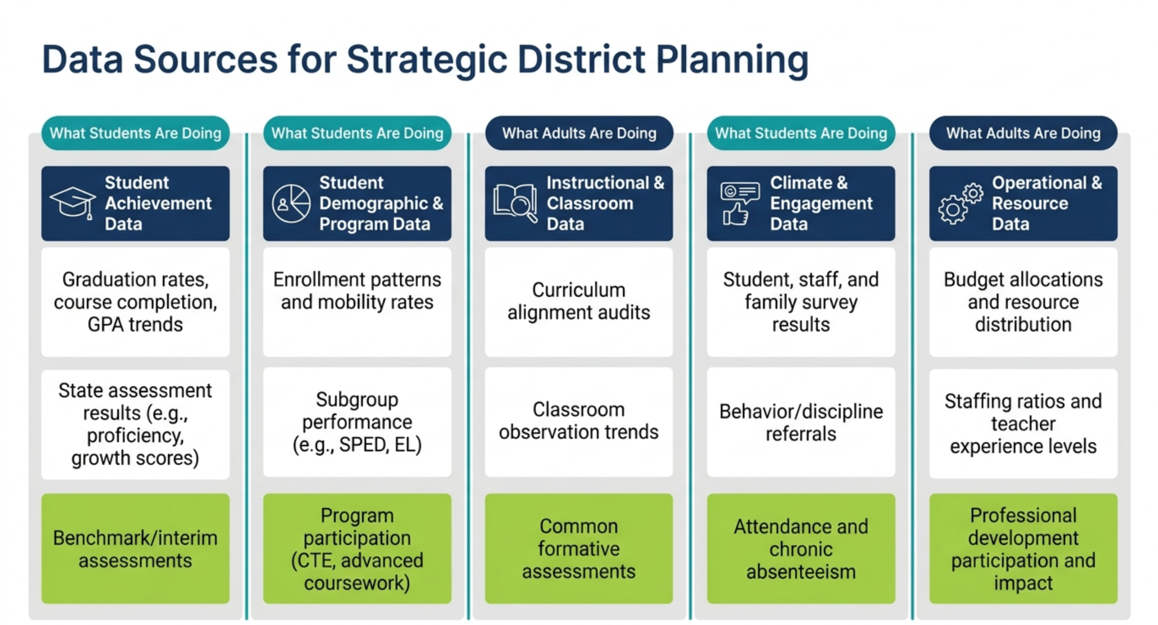
Start Where Learning Happens
Master Schedule Data
Being data rich can be overwhelming.
Graduation Rates and GPA Trends
Behavior and discipline referrals
Assessment Results
Interim Assessments
Participation Rates in Success Ready Pathways
Common Formative Assessments
Attendance and Chronic Absenteeism
Professional Development & Teacher Practice Impact
So, start in the classroom.
What are teachers doing?
What are students doing?
Ask students, what are you learning?
Notes:
Mark: Example of student engagement being low. What does student engagement mean? Asking a student, what are you doing today - what are you learning?

Slide 28
The Questions
We Ask
Determine the
Results
We Achieve
Effective district
leaders do more than monitor compliance.
They build
leadership capacity, remove barriers
to learning, and
create the conditions
for every student
to succeed.

Slide 29
Reflection Resource
Data and Decision-Making
Am I prioritizing data that drives meaningful decisions?
Are data conversations leading to clear instructional actions?
Leader Capacity for
Data Use
Are my leaders equipped to lead effective data discussions?
Can my leaders turn data into instructional next steps?
Curriculum and Instructional Alignment
Are standards, curriculum, and ALDs aligned across schools?
How are my leaders ensuring grade-level instruction happens daily in every classroom?
Collaborative Team Effectiveness
Are my leaders equipped to guide teams to improve student outcomes?
Are team meetings focused on results, not compliance?
Instructional Leadership and Feedback
Are my leaders providing feedback that improves teacher practice?
Is the feedback changing classroom instruction consistently?
Progress Monitoring
Are my leaders consistently monitoring progress toward goals?
Is progress reviewed, adjusted, and acted upon regularly?
Difficult Conversations
Are my leaders equipped to address underperformance clearly and timely?
Are expectations reinforced through consistent action?
Recognition and Culture
Are my leaders recognizing and celebrating effective practices?
Am I building a culture that reinforces success?

Slide 30
Thank You!

