Slide 1

Crisis Communications
A playbook in strategic, compassionate leadership
SPRINGDALE PUBLIC SCHOOLS

Slide 2

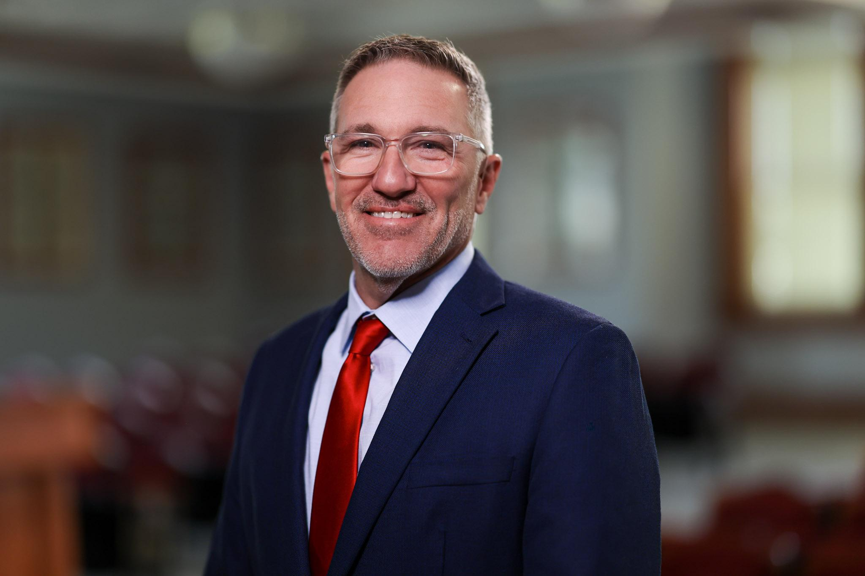

The Superintendent as Stabilizer
Shift to Adaptive Leadership
Leading through modern crises demands a distinct shift from operational manager to systemic stabilizer. This approach is characterized by your capacity to ground a frightened community in certainty.
By protecting academic continuity and building a baseline of structural and physiological reassurance, superintendents safeguard their schools from secondary organizational shock.

Slide 3









1. The Resilience Infrastructure
Networked Team
Modern Threats
The "Go-Kit"
Move away from strict, top-down workflows. Create an agile, cross-functional crisis network ready to operate with decentralized autonomy.
Evolve drills beyond simple fires. Prepare frameworks for ransomware lockouts, localized climate events, and social contagions.
Maintain pre-approved templates for lockdowns, bus accidents, data leaks, or sudden loss, keeping critical executive decisions simple under stress.
SPS EMERGENCY FRAMEWORK

Slide 4
2. Tactical Action: The First 48 Hours
Priority Focus | Primary Goal | Execution Strategy
 | Publish Verified Facts | Address occurrences immediately. If facts are scarce, say: "We are verifying reports and will provide an update by [Time]."
 | Middle-Out Approach | Alert the School Board and Principals first, then cascade directly to Staff and Parents before releasing details to the media.
 | Empathetic Sincerity | Exude absolute transparency. Cut sterile corporate speech and medical/technical jargon to keep human-centered trust intact.
SPS OPERATIONAL PROTOCOL

Slide 5

2. Decision-Making Under Pressure
Presence Over Perfection
The "Safety First" Filter
You do not require an immediate, perfectly polished solution to project stability. In moments of acute community distress, stakeholders require the visible, reassuring presence of a calm executive actively stewarding the district.
Apply a singular, unyielding filter to every choice during structural chaos. Assess every potential course of action by asking: "Does this choice maximize the physical and mental safety of our students and teachers right now?"
LEADERSHIP PLAYBOOK

Slide 6

3. Recovery: Establishing the New Normal
Restore Routines Rapidly
Familiar structures and predictable schedules serve as emotional anchors. Reopen school doors as soon as safely possible, even under modified schedules, to aid community processing.
Care for the Caregivers
Teachers carry student secondary trauma while processing their own. Deploy on-demand counseling services and establish dedicated teacher wellness lounges immediately.
No-Fault Post-Incident Audit
Once stability returns, execute a comprehensive district debrief. Document every performance bottleneck, identify friction in team responses, and update the Crisis Handbook.
DISTRICT HEALING & RENEWAL

Slide 7
4. Personal Leadership & Self-Care
Managing Stress from the Top
Superintendents cannot support their district from an exhausted core. Self-care is a tactical necessity, not an afterthought.
Seek Out Truth-Tellers
Cultivate a tight advisory cabinet of fellow superintendents who will offer unvarnished critique and objective guidance.
Lead from the Balcony
Regularly step out of immediate crisis logistics. Realign choices with long-term vision instead of reacting solely to immediate pressure.
SPS SUPERINTENDENT ADVISORY

Slide 8

Case Study:
The 6:00 PM Crisis
The Sunday Call
Sunday evening at 5:45 PM. A newly contracted teacher is arrested on double homicide charges during prep for New Teacher Orientation the next morning. You have 15 minutes before the story breaks on prime news.
How do you establish executive message command when your leadership cabinet is entirely decentralized?

Slide 9
Sunday Action: Rapid Escalation
1. The Virtual War Room
2. The 8-Minute Execution
The Thermostat Principle: With cabinet members isolated and stressed, your vocal control is your primary steering mechanism. Lower your speed and vocal volume deliberately to quiet operational noise and steer the group toward solutions.
Direct Command Posture: With legal and leadership only available via text, take direct ownership. Limit brainstorming entirely: "We have 8 minutes to issue a statement. We establish safety, clarify hire status, and direct support. No speculation."
SPS CRISIS TEAM PROTOCOLS

Slide 10
The Sunday Night Statement
Released exactly at 6:00 PM, the official statement targeted three unassailable truths to mitigate district-wide panic and prevent media misalignment:
Strategic Pillar | District Position | Verbatim Message Control
 | Zero Student Interaction | "This individual has not at any time come into contact with Springdale students."
 | Future Hire Only | Confirmed as a future orientation hire who had not yet initiated classroom duties.
 | Victim Support Focus | Offering sincere thoughts, prayers, and deep condolences to the affected families.
SPS COMMUNICATIONS OFFICE

Slide 11








Panel Takeaway: Voice in the Dark
Vocal Decibel Control
Short & Declarative
Monday Morning Save
Vocal speed is infectious. If the administrator matches the team's initial panic cadence, clarity dissolves. Speak at a slow, measured speed to regain operational control.
Do not organize collaborative focus groups in the acute phase of a crisis. Assign rapid, direct actions: "Find his start date," "Verify safety line," "Inform board."
Securing the news cycle Sunday night sheltered 170 incoming teachers. They arrived on campus to find a controlled system, bypassing media ambushes completely.

Slide 12
“
Clarity is a choice you make for your team when they are too overwhelmed to make it for themselves. On a Sunday night, via a cell phone, you don't need a boardroom to lead, you just need the courage to be the thermostat and set the temperature.
DR. JARED CLEVELAND, SUPERINTENDENT
SPRINGDALE PUBLIC SCHOOLS

