Slide 1

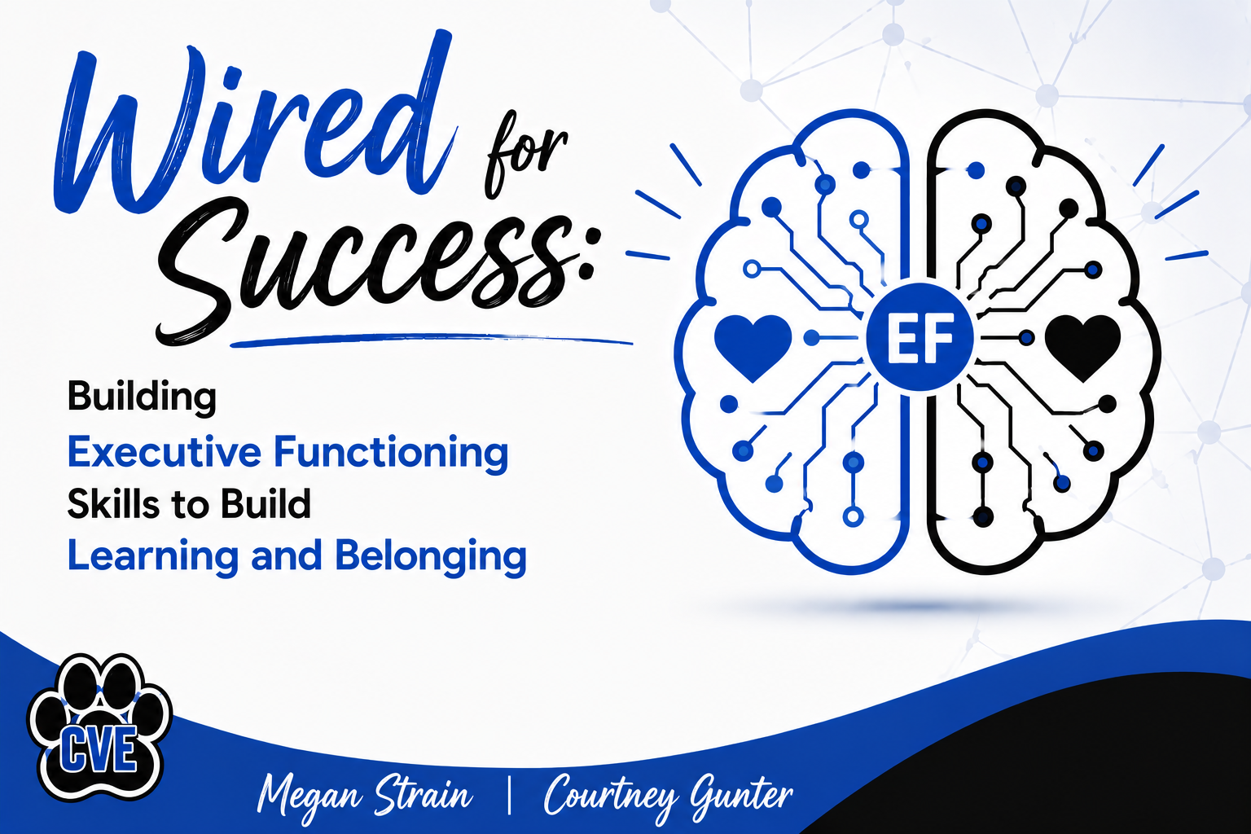

Slide 2

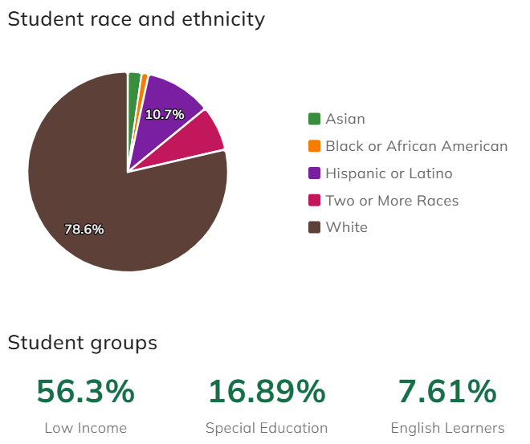
Russellville School District
Center Valley Elementary
  K-4 Building
  Approximately 360 students

Slide 3
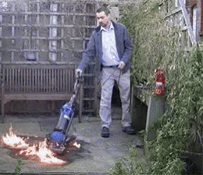
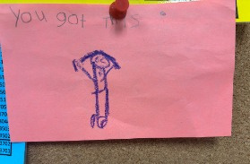
Reality Check?
  First-year principal, new counselor
  Increase in rural poverty (48%-64%)
  Increase in high-magnitude behaviors
  Systems were not sustainable

Slide 4

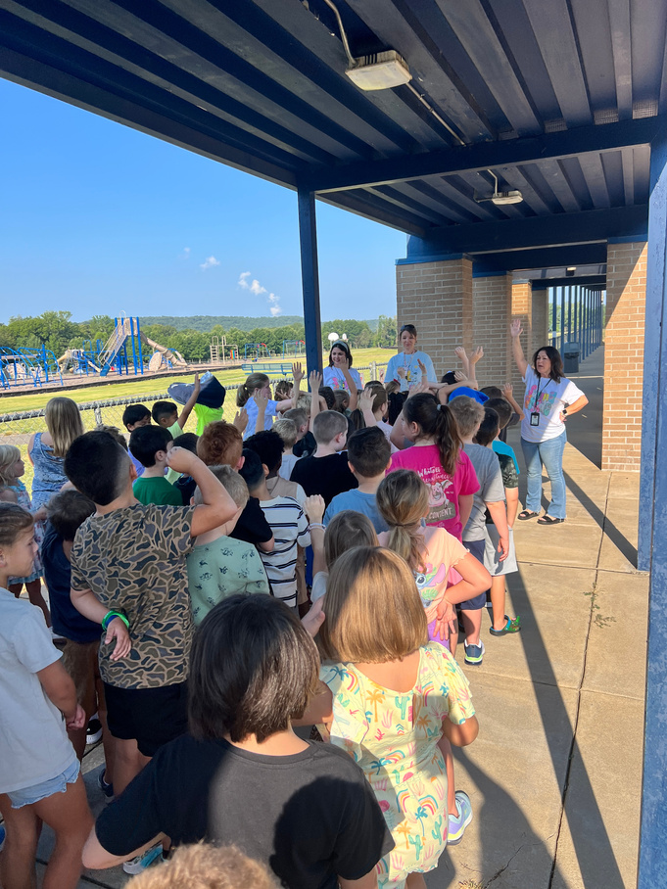
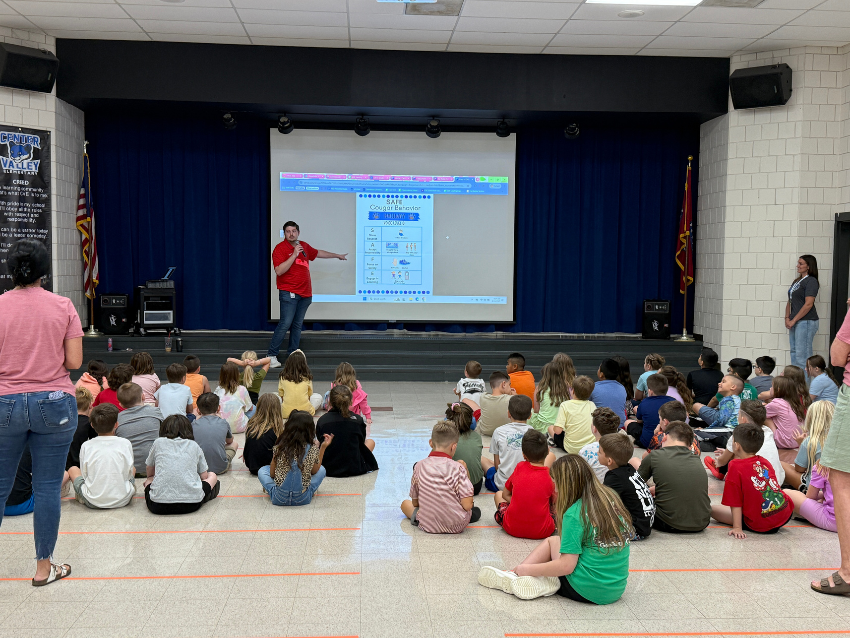
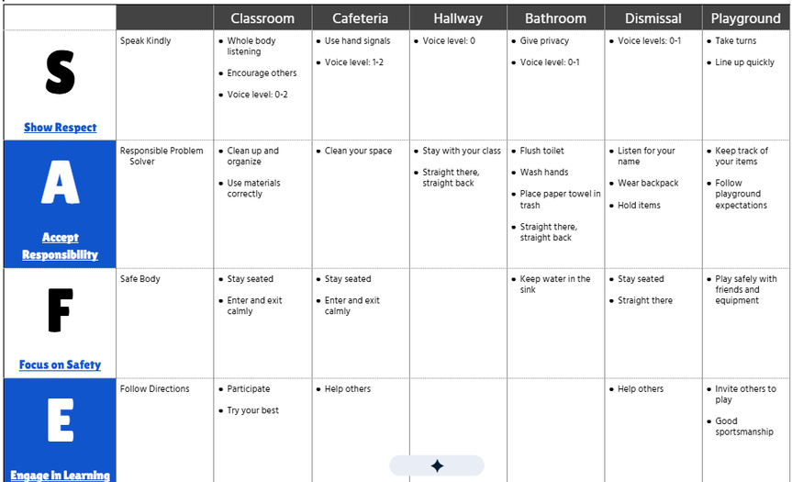
Tier 1: Universal Supports
  SAFE behavior matrix
  Behavior flowchart
  Major/Minors
  Lesson plans/sign-up for shared spaces
Common language - Is every adult in the building using it consistently?

Slide 5
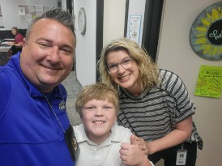
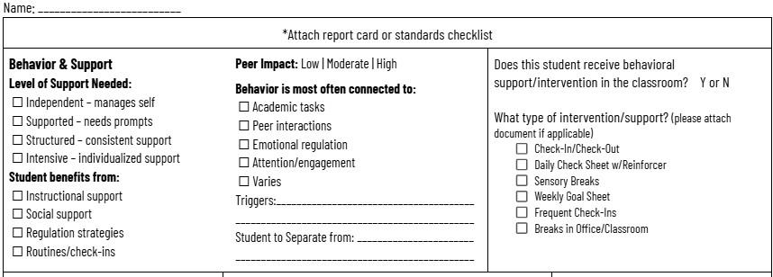
Tier 1: Universal Supports
Belonging + Prevention
  "Kids on my Heart"
  Student Placement Cards
  Class rosters viewed through a different lens

Slide 6
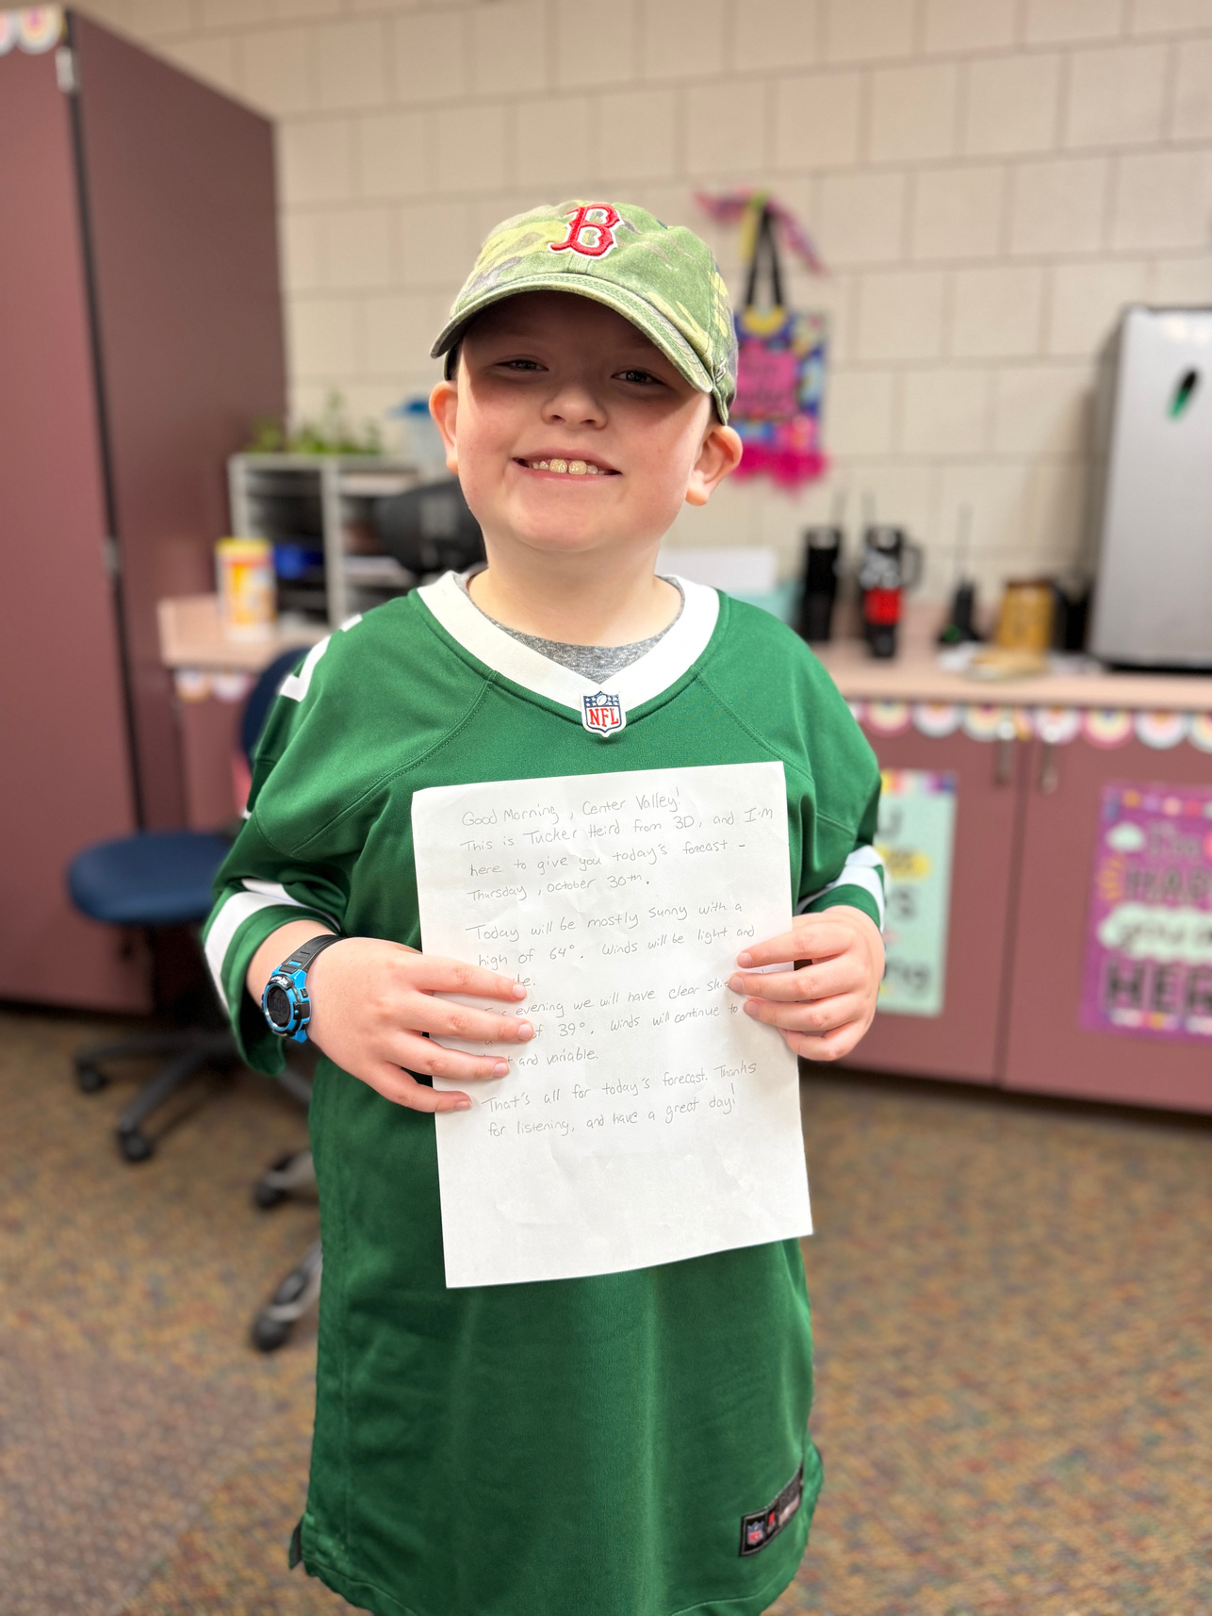

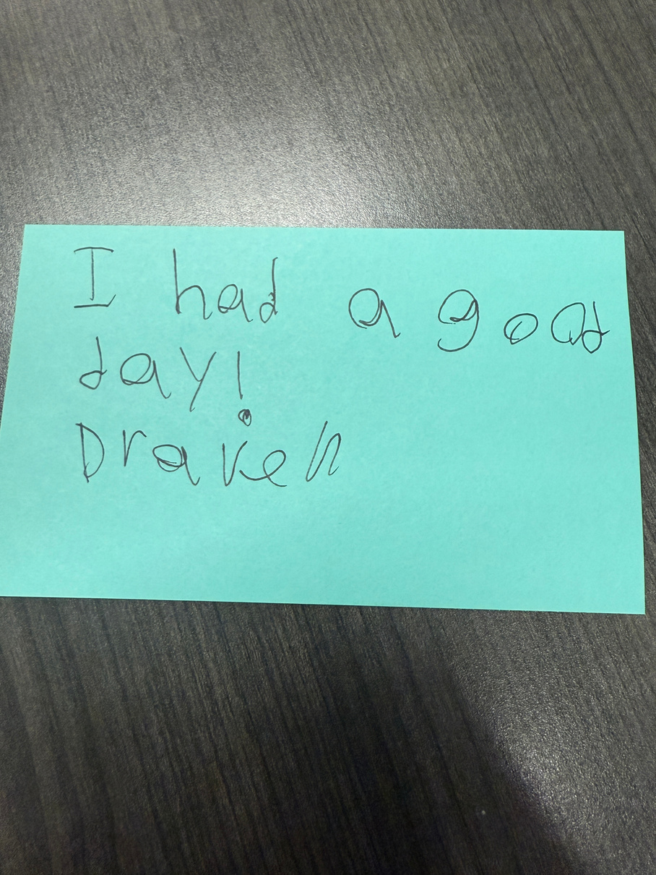
Tier 1: Collaborative Structures
Monthly KID Talks - Facilitated by: Counselor
  Team-based problem solving
  Immediate support for “hot spots”
  Principal + counselor attend to model, support, and provide accountability
  Not a “co-blaboration”
  KID Talk Template

Slide 7
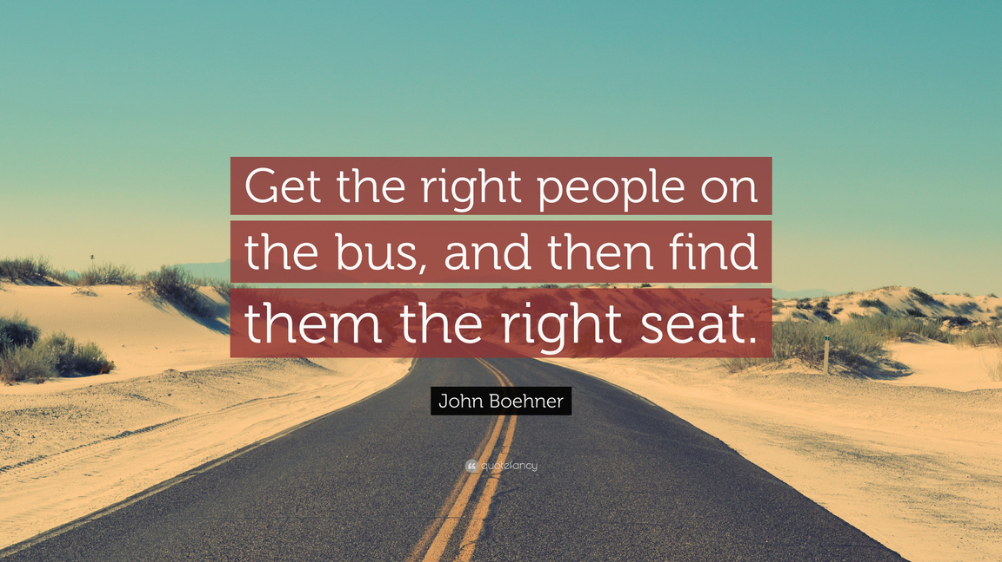
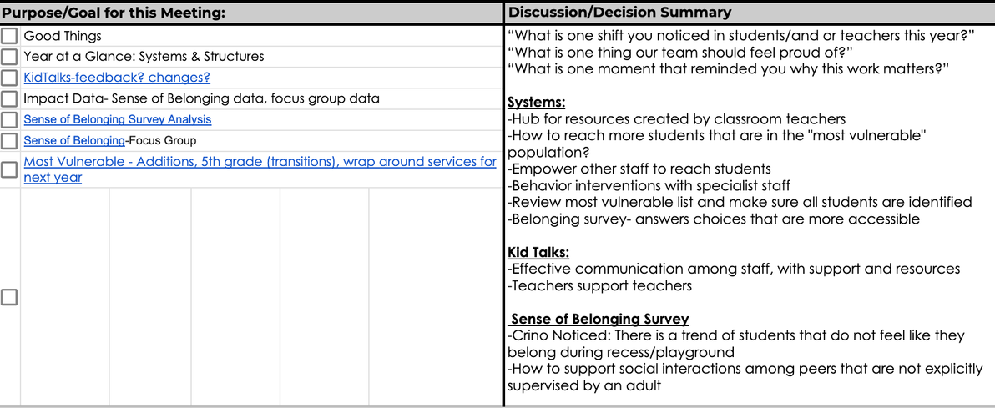
Behavior Team
Monthly meetings + semester half-day deep dives
  Team evolved as we learned our needs
Intentional Mix of Perspectives:
  Led by counselor
  Classroom Teachers, Specialists, Resource Teacher, SLP, Interventionist, Administrators

Slide 8

How many of you have students who CAN do the work…but don't?
Starts but doesn’t finish
Gives up quickly
Can’t begin a task
Constant Reminders

Slide 9


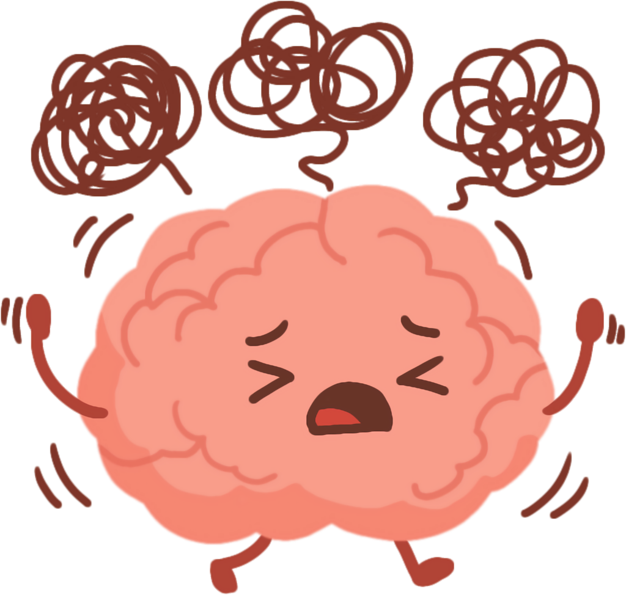
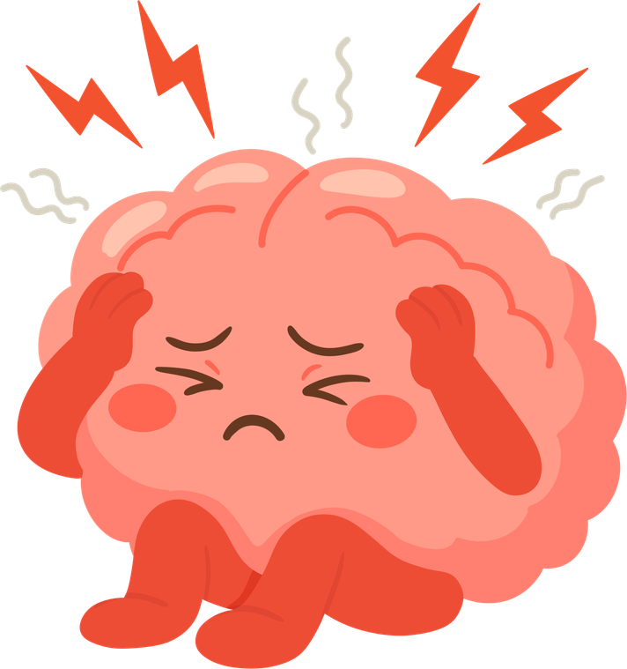
These often aren't motivation problems.
They're missing executive functioning skills.

Slide 10
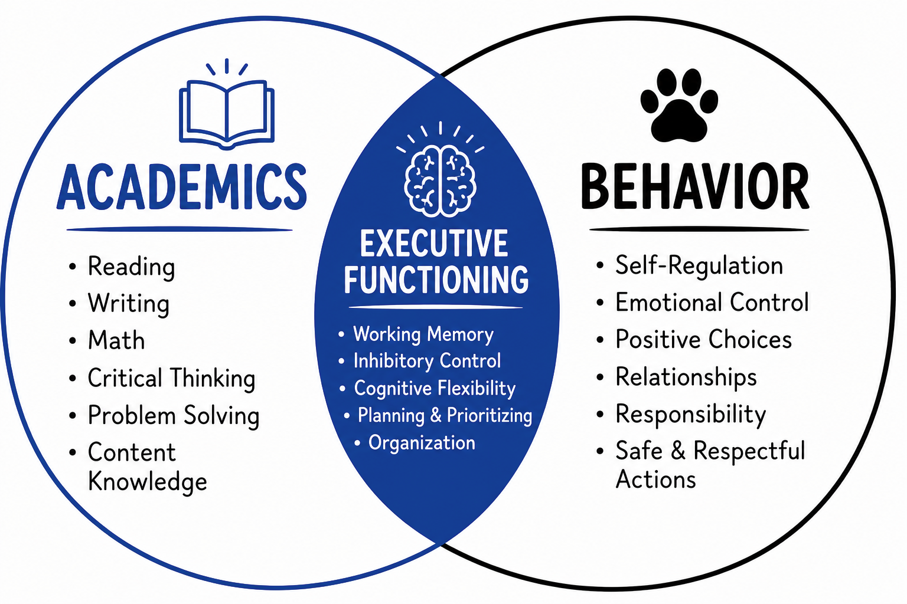
The more we learned about the brain, the more we realized we were solving the wrong problem.

Slide 11
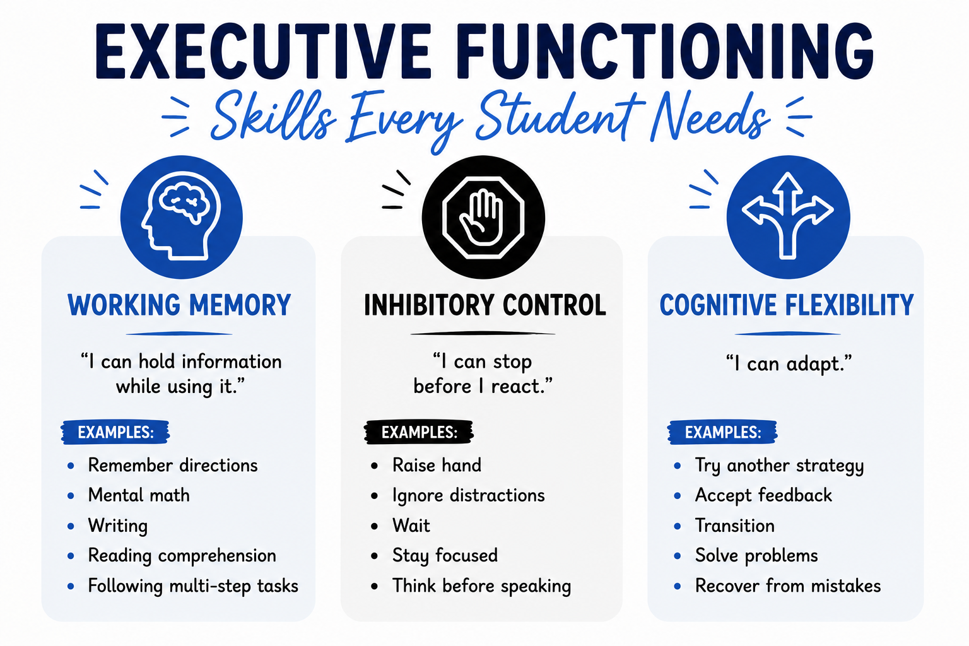
Notes:
Think about one student who struggles...
Is it motivation or....
working memory?
inhibitory control?
cognitive flexibility?

Slide 12
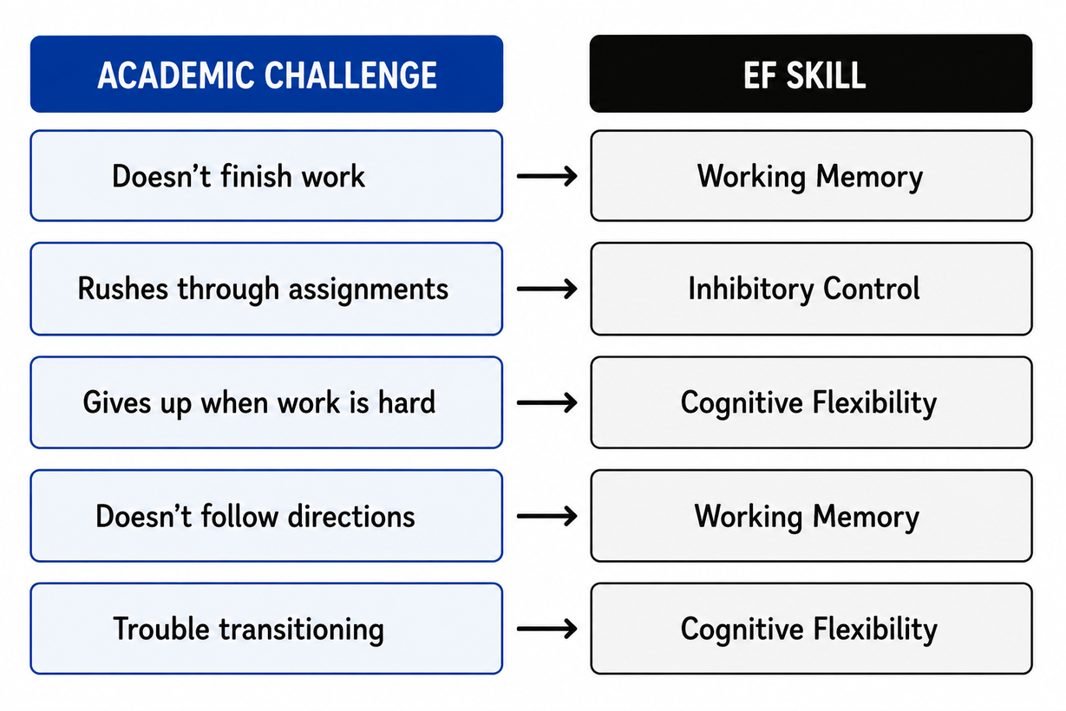
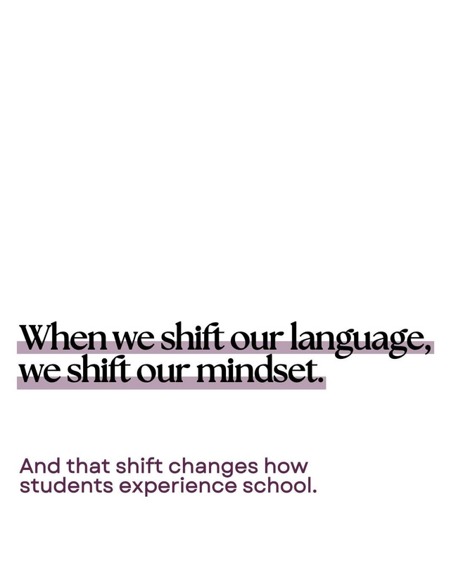
Instead of...
Why won't they?
Ask...
What is the missing skill?
Notes:
Working Memory activity??
Flash words or letters on the screen?

Slide 13
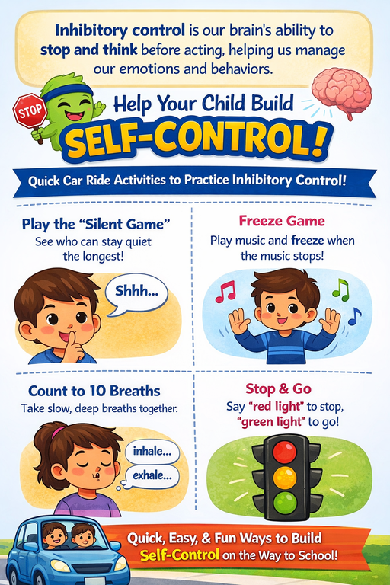
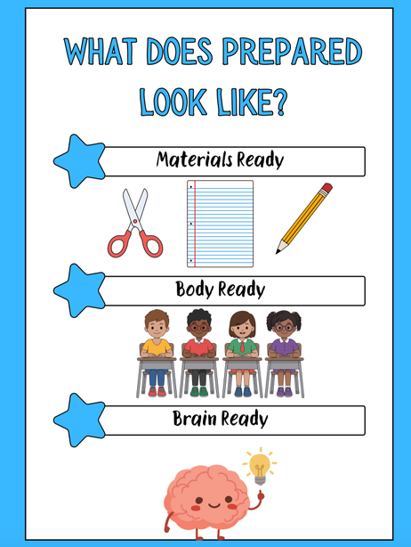
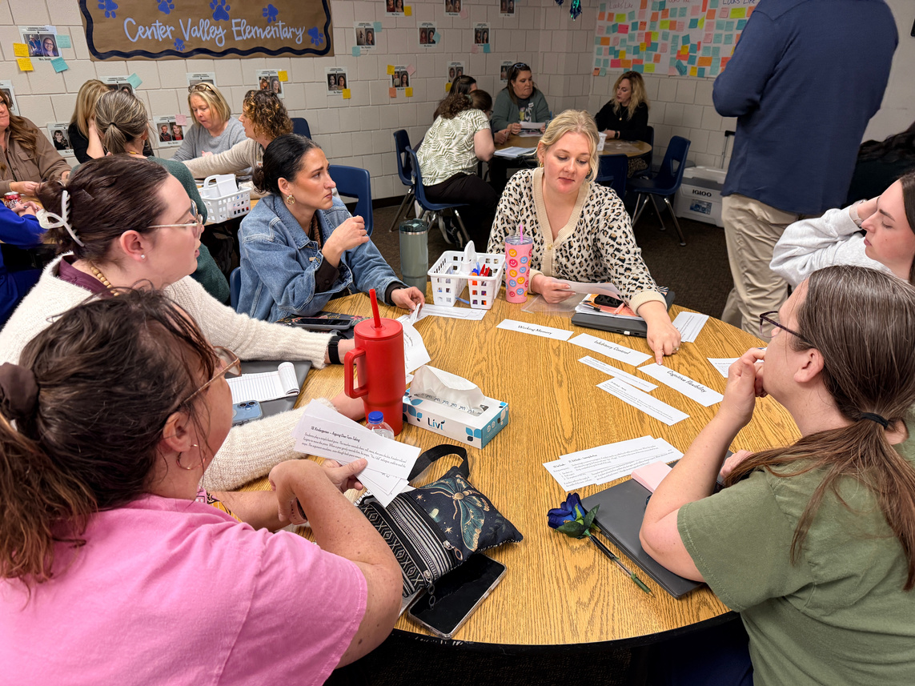
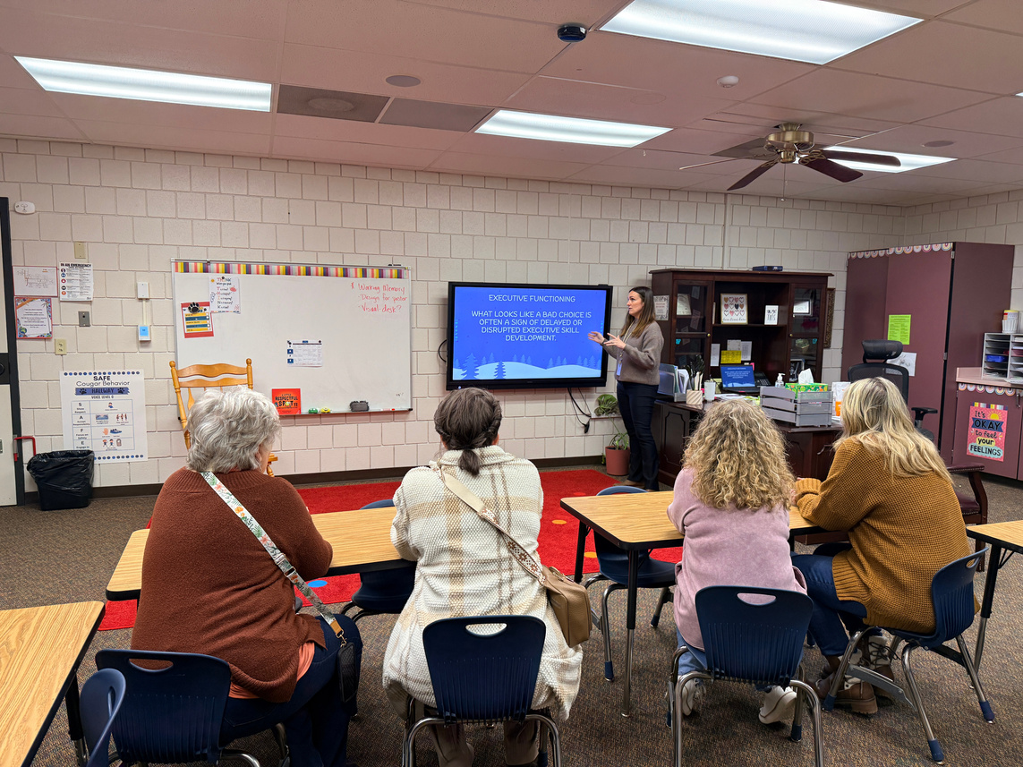
Tier 1: Executive Functioning
Executive Functioning Focus
  Weekly Skill Instruction:
    Working Memory, Inhibitory Control, & Cognitive Flexibility
Teacher Supports
  Weekly one-pager lesson
  Reinforcement strategies
  Posters and desk cards
  EF Report Card

Slide 14
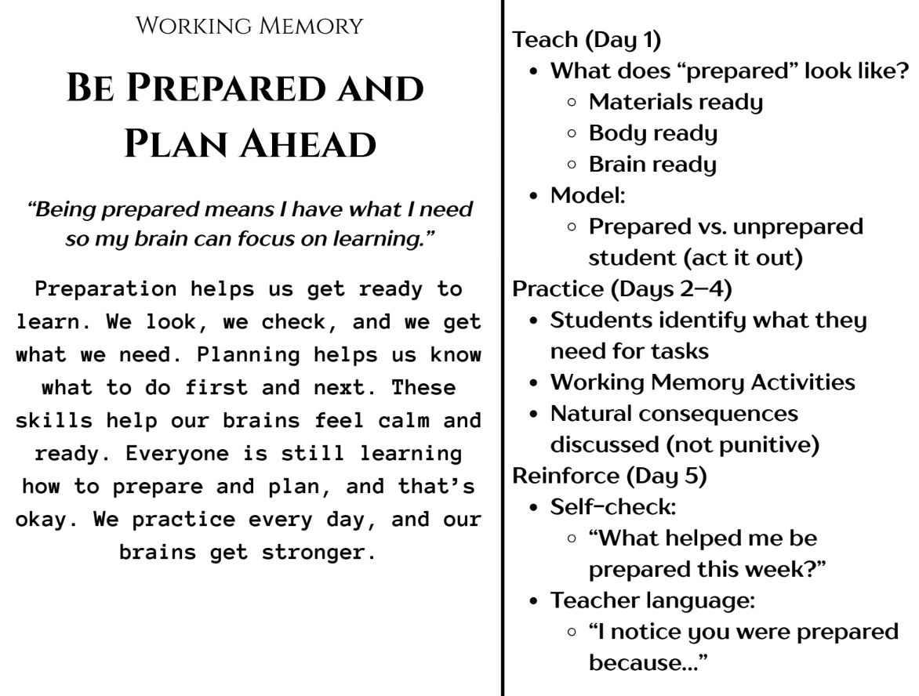

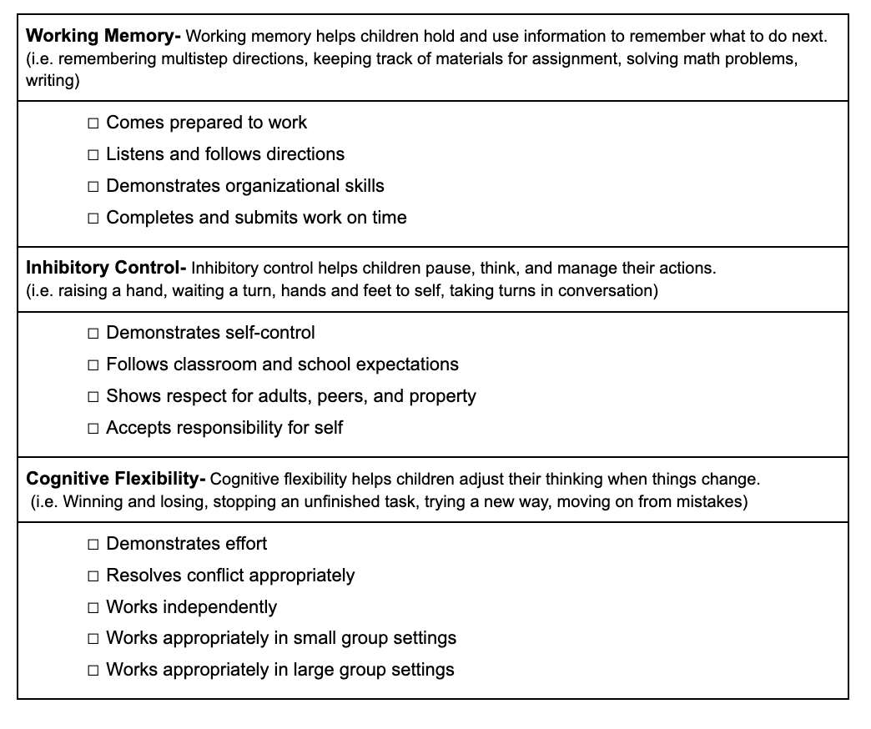
EF Report Card
EF Lesson

Slide 15
UPC LSA UAT

Slide 17
PLC USA ATU

Slide 19

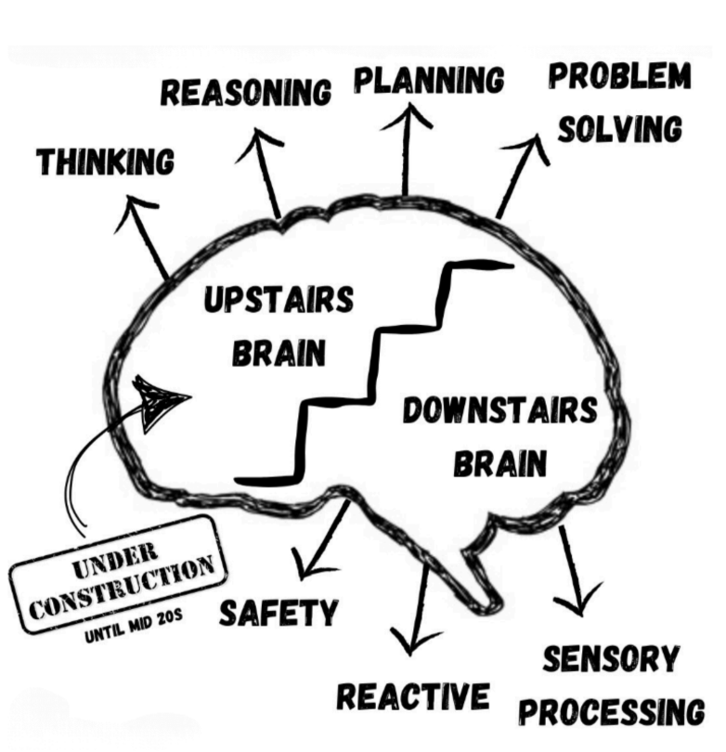
Brain States
Executive Functioning lives in the upstairs brain.
Compassion + Accountability

Slide 20
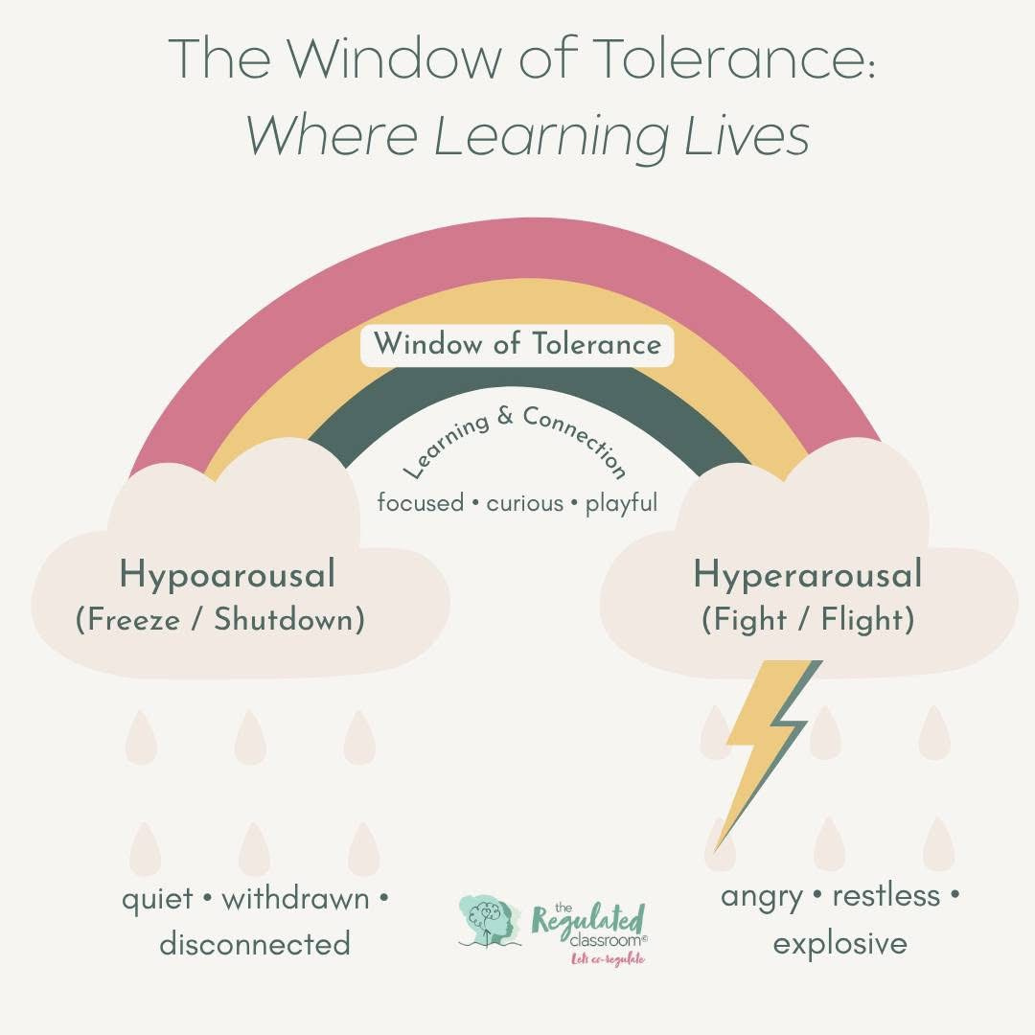
Students don't lose access to learning because they don't care.
They lose access because their brains move outside their window of tolerance.

Slide 21
When students leave their window, we often respond with more demands...when what they actually need is support getting back into a learning state.

Slide 22

Cognitive Load
Executive functioning helps students manage the load.
Change of routine
Poverty/Family Dynamics
Classroom Environment
Food insecurity
Anxiety
Lack of sleep

Slide 23
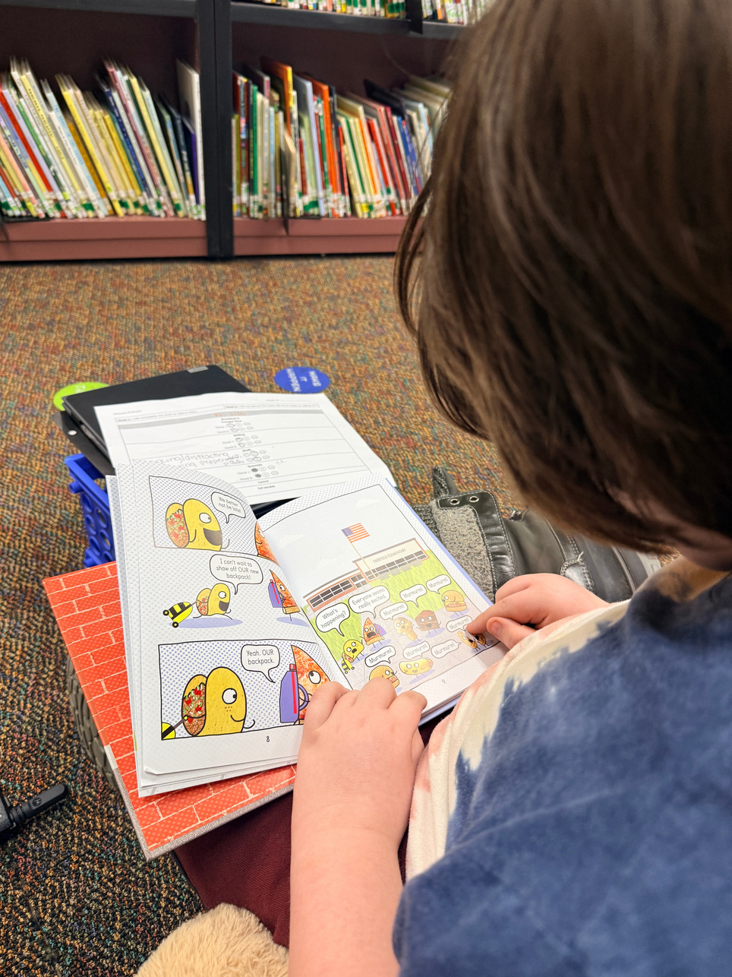
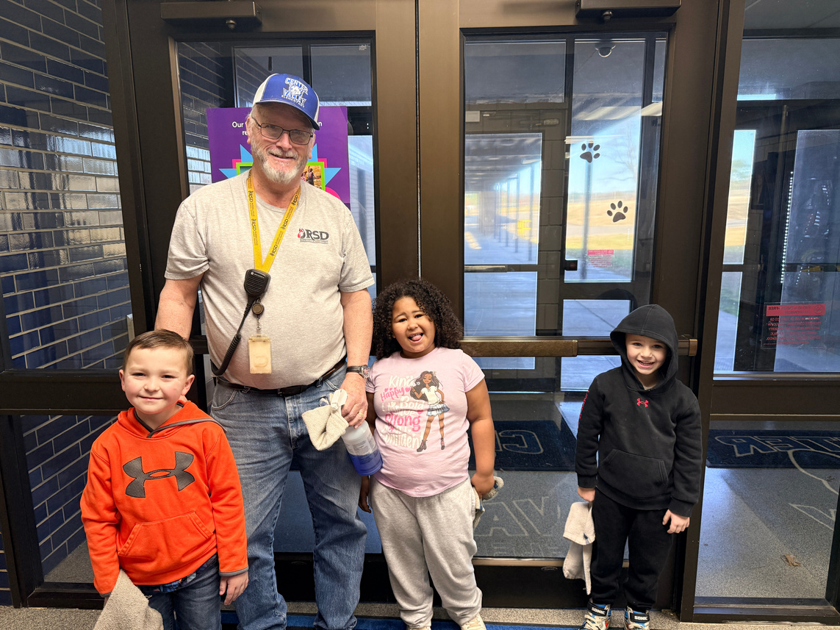
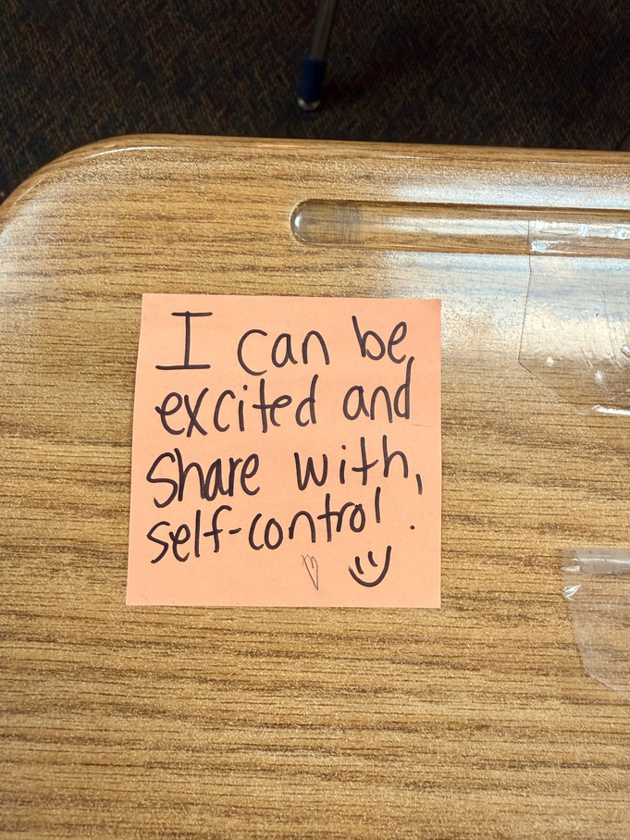
Tier 2 & 3: Intensive and Targeted Support
TIER 2: TARGETED - Strategic Interventions
Identified through KID Talks
  Check-In/Check-Out (CICO)
  Specific behavior goals & scheduled breaks
  Small groups with counselor
  Note Home System
TIER 3: INTENSIVE
Supporting Most Vulnerable Students
  Connect every student to a trusted adult (Principal, AP, SRO, Nurse, former teacher, interventionist, etc.)
  Data-driven decision making
  Bottom Quartile?

Slide 24
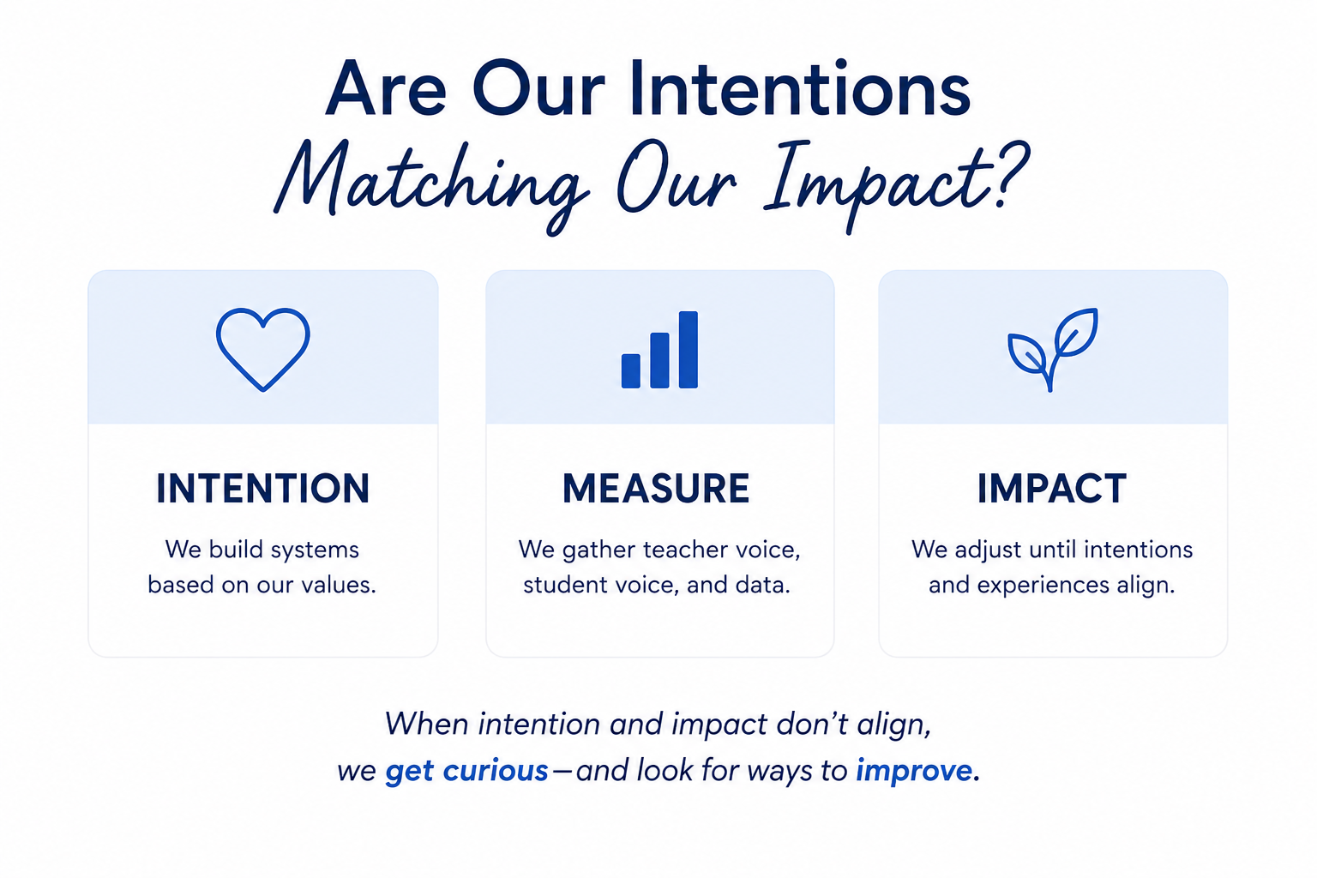

Slide 25

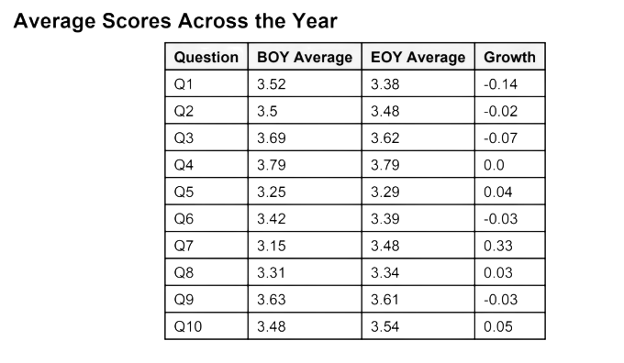
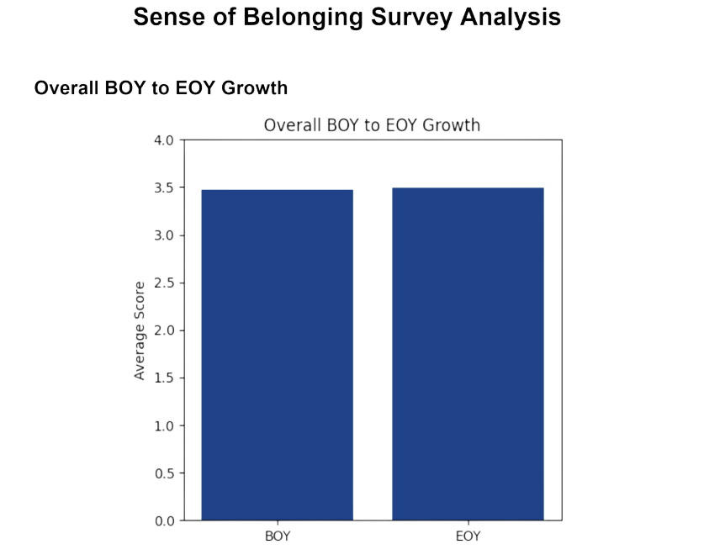
Sense of Belonging Data
Sense of Belonging Survey Questions
  My school is a place where people care about one another.
  I feel that I really belong in my school and classrooms.
  My teachers really care about me and are concerned when I am absent.
  My teachers help me understand what I need to learn and how to be successful in my studies.
  My school feels like a happy family.
  My classrooms feel like happy families.
  I feel like I am an important part of my classrooms.
  I feel like I am an important part of my school.
  My teachers encourage me to develop my interests and talents.
  I feel supported and respected in my school and classrooms.

Slide 26
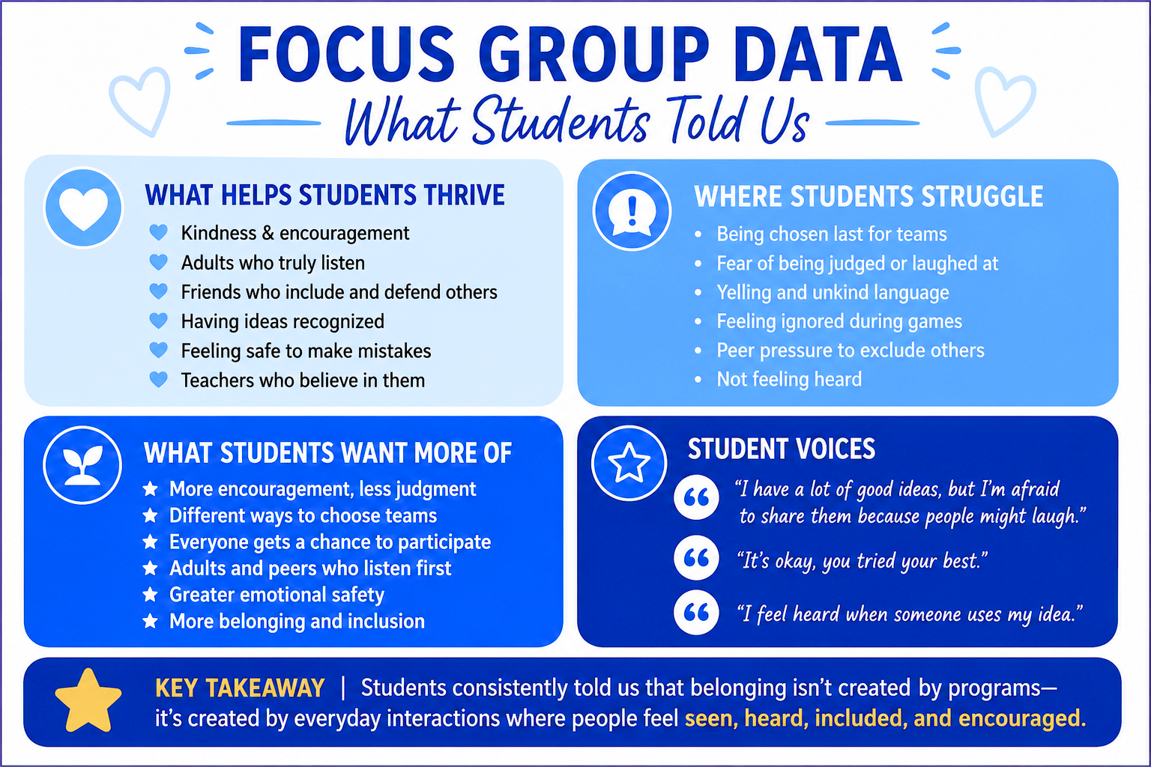
Focus Group Questions
  What helps you feel like you belong at school?
  What makes it harder to feel like you belong?
  When do you feel heard by others?
  What helps you feel safe to share your ideas?
  What do teachers do that makes you feel encouraged?
  What do other students do that helps you feel included?
  What happens when you don't feel included?
  How do you feel when you're chosen last for a team or activity?
  What could adults do differently to help students feel like they belong?
  What could students do differently to help everyone feel included?
  If you could change one thing about your school to help everyone feel they belong, what would it be?
  What do you wish adults understood about what it's like to be a student at school?
  Is there anything else you'd like us to know about belonging at school?

Slide 27
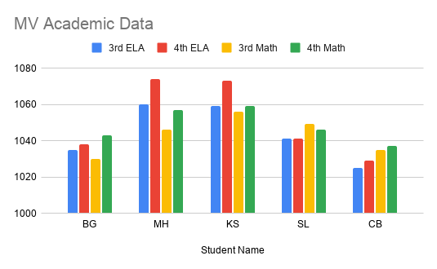
Most Vulnerable Data

Slide 28
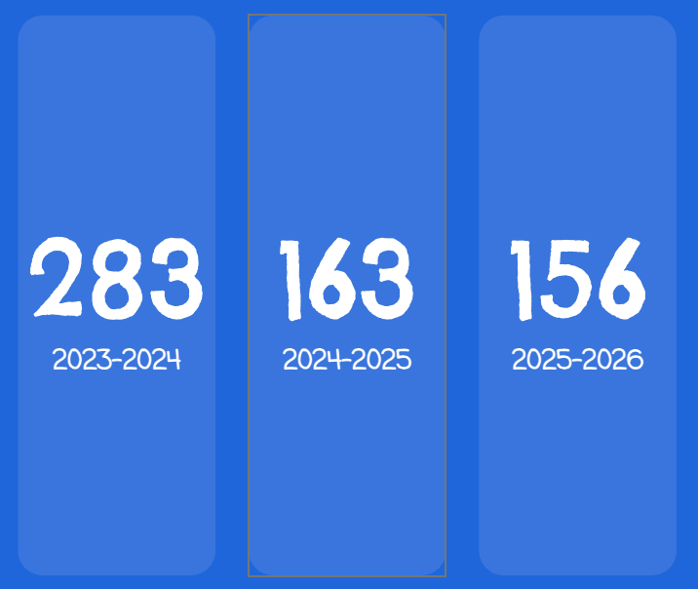
Behavior Data

Slide 29
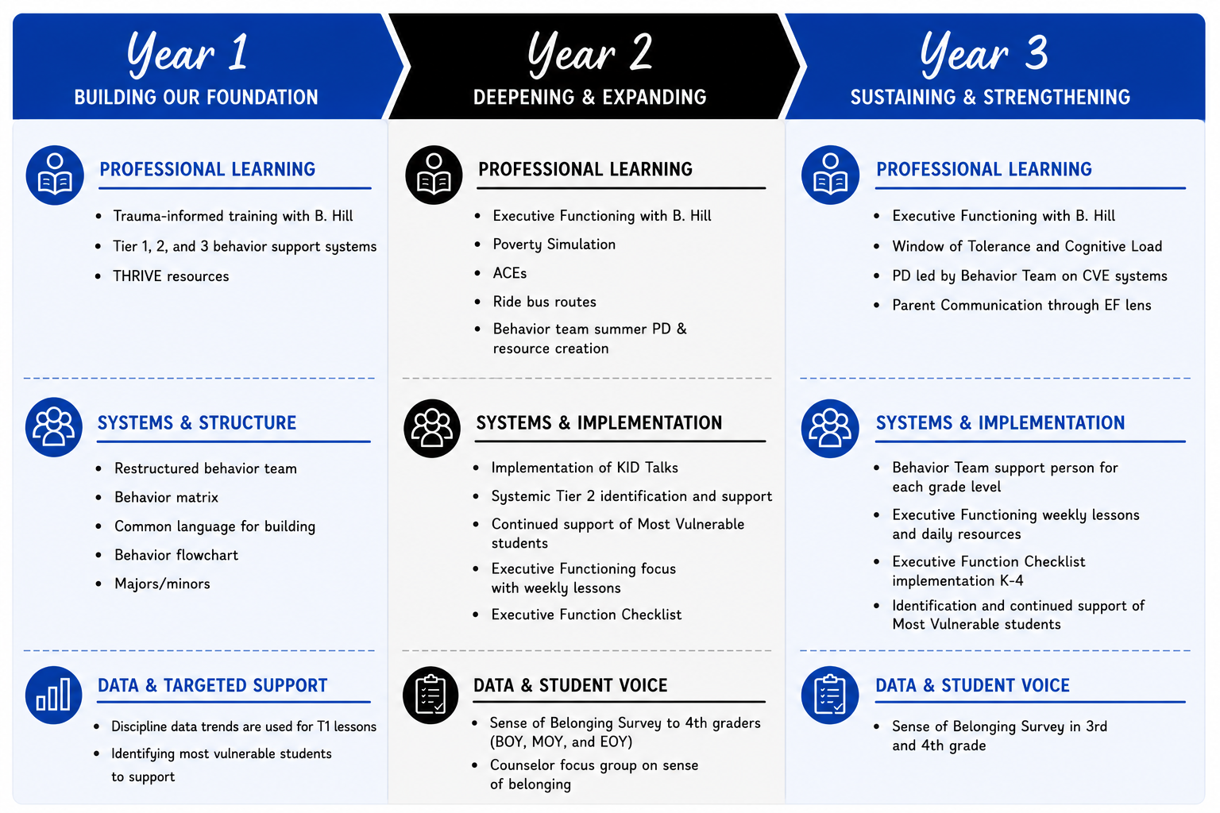

Slide 30

