Slide 1


D4
Ways
To De-Escalate and Navigate Conflict for EDUCATIONAL LEADERS
Presented By :
Stacy DeFoor,
Asst. Superintendent Sheridan Schools
Stephanie DeFoor,
Principal
Greenbrier Schools
July 28, 2026
Notes:
SKIT
FREEZE: (hold up pause sign)
Raise your hand if you've ever been in a conversation that sounded something like this.
Where did the conversation begin to fall apart?
Exactly. And the interesting thing is...the conflict wasn't really about the teacher anymore. It became about whether the parent felt heard.
That's why today's session isn't about how to deal with difficult people. It's about how to be the kind of leader people trust during difficult moments.

Slide 2

THE COFFEE SPILL
Notes:
Tell the story of The Coffee Spill.
What made the coffee spill?
Actually, the student didn't make the COFFEE spill. The cup was full of COFFEE. If it had been full of TEA, TEA would have spilled. Whatever is inside comes out when we're bumped.
Leadership is the same way.
Parents bump us, Staff members bump us, deadlines bump us, etc.
Conflict doesn't create what's inside us, it reveals it.
So what do we want to spill out of us when conflict inevitably bumps into us.

Slide 3

“
Today’s Outcome:
Conflict is inevitable. Escalation is optional.
“
By the end of this session, you will have practical strategies and conversation tools to de-escalate conflict while maintaining trust, professionalism, and a student-centered focus.
Practice it every day — the results will follow.
Notes:
Conflict is unavoidable in education. The goal isn't to avoid it--it's to navigate it effectively.
Think of it as a leadership opportunity.
Today we'll explore how educational leaders can intentionally RESPOND--not REACT--using D4 ways framework to build trust, preserve relationships, and keep the focus on what's best for students.

Slide 4


D4
Ways
OOR
DIFFUSE
EMOTION
FIRST
EMPATHIZE
and
LISTEN
FOCUS on
FACTS and SOLUTIONS
OPEN
OPPORTUNITIES
for RESOLUTION

Slide 5
D
TALKING POINTS
  Conflict is often more about emotions than the actual issue.
  When someone is angry or upset, their ability to think rationally decreases.
  Resist the urge to defend, justify, or explain right away.
  Your emotional regulation sets the tone for the entire interaction.
  Stay calm, and you become the thermostat, not the thermometer.
PRACTICAL STRATEGIES
  Lower your voice instead of raising it.
  Slow your rate of speech.
  Maintain open body language.
  Avoid interrupting.
  Allow pauses and silence.
DIFFUSE EMOTION FIRST
Which Response Diffuses?
Which response is more likely to de-escalate the situation?
Raise your hand for A or B
ENGAGE
Calm the emotion before addressing the issue.
When emotions run high, logic goes out the window.
“I can see you’re frustrated. Tell me more about your concerns”
“That’s not what happened.”
Notes:
Have you ever walked into a conversation angry and then calmed down simply because the other person stayed calm?
People cannot process solutions when they are emotionally flooded.
*read these after the "engage" activity:
Other phrases to use:
*I can see this is important to you.
*Thank you for sharing your concerns.
*Help me understand what happened from your perspective.

Slide 6
E
TALKING POINTS
  Empathy is not agreement.
  People want to feel heard before they are ready for solutions.
  Listening builds trust, even when you can’t give the outcome they want.
  Leaders listen to understand not to respond.
  Reflect back what you hear to show understanding.
PHRASES TO USE
  “What I’m hearing is...”
  “Tell me more about that.”
  “I understand why that would be frustrating.”
  “It sounds like your biggest concern is...”
EMPATHIZE
AND LISTEN
PARTNER PRACTICE
Turn to a partner and share a minor frustration you’ve experienced recently.
Partner’s job:
  Listen only.
  No advice. No fixing.
  Simply paraphrase what they heard.
How did it feel to be heard?
How hard was it not to jump in with solutions?
ENGAGE
People may not remember every solution you offer, but they will remember how you made them feel---heard.
Notes:
Often people need understanding before they are ready for solutions.
Ask clarifying questions
Educational leaders are in the relationship business. Strong relationships can withstand difficult conversations.
Think about a leader you respected. Did they always agree with you, or did they make you feel heard?

Slide 7
f
TALKING POINTS
  Focus on what is known, not on assumptions.
  Separate facts, feelings, and interpretations.
  Avoid assigning blame.
  Seek common ground and shared goals.
  Ask questions and gather information before making conclusions.
  The goal is not to win the argement--the goal is to solve the problem.
QUESTIONS TO GUIDE
THE CONVERSATION
  What do we know for certain?
  What information might we be missing?
  What outcome are we hoping to achieve?
  What do we both want for the student/team?
FOCUS ON
FACTS AND
SOLUTIONS
SCENARIO
Move the conversation from blame to problem-solving.
FACT OR FEELING?
  “The teacher does not care about my child.”
  “My child received three missing grades this week.”
  “The teacher didn’t even respond to my email for 3 whole days.”
  “This school doesn’t care about student safety.”
PARENT:
“My child is being targeted by that teacher.”
LEADER RESPONSE:
“I understand your concern. Let’s look at the
information we have and determine
what occurred.”
When we focus on facts and solutions, we reduce defensiveness and open the door to meaningful next steps.
Notes:
Once emotions are lowered and people feel heard, you can begin addressing the issue.
How many conflicts have you seen that were fueled more by assumptions than facts?

Slide 8
oor
TALKING POINTS
  People want hope that progress can be made.
  Even when you cannot give someone exactly what they want, you can often provide options.
  Collaboration increases buy-in and builds trust.
  Resolution is about preserving relationships while addressing the concern.
  The conversation isn’t over when the meeting ends--follow through matters.
PRACTICAL STRATEGIES
  Offer choices when appropriate.
  Create clear next steps.
  Establish timelines and expectations.
  Follow up and communicate progress.
OPEN
OPPORTUNITIES
FOR
RESOLUTION
Trust is built through follow-through.
The conversations we lead today impact the culture we build tomorrow.
Conflict should end with a path forward, not just an explanation of the problem.
PHRASES TO USE
REFLECTION
  “Here are some options we can consider.”
  “What would success look like from your perspective?”
  “Let’s work together on a solution.”
  “Here’s what you can expect from me moving forward.”
How often do we spend more time discussing the problem than discussing the solution?
Turn and Talk: Share an example where shifting to “what’s next“ changed the tone.

Slide 9


THE TWO PRINCIPALS STORY
Notes:
So think back to our original story about the coffee spill and remember, it's all about deciding what we want to spill out of us when conflict inevitably bumps into us.
Tell the Two Principals Story
What was different? It wasn't district policy, it wasn't experience, it wasn't who was right.
It was how the leader responded.
One reacted; one led.
That's what today's session has been about.

Slide 10
D4
Let’s
Review:
Ways
OOR
DIFFUSE
EMOTION
FIRST
EMPATHIZE
and
LISTEN
FOCUS on
FACTS and SOLUTIONS
OPEN
OPPORTUNITIES
for RESOLUTION
Notes:
So as you think about which conflict is most difficult for you--an angry parent, a frustrated staff member, a team conflict, or a student-related disagreement--remember D-4 Ways to de-escalate and navigate conflict.
D-calm the temperature
E-help people feel heard
F-move from emotion to problem-solving
OOR-create a path forward
LET AUDIENCE ROLE PLAY

Slide 11
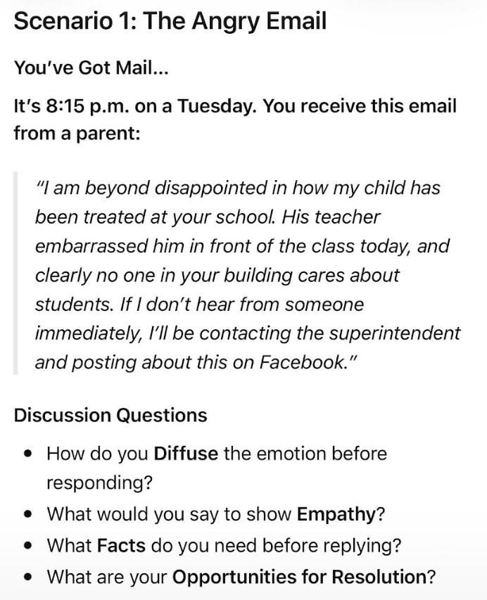
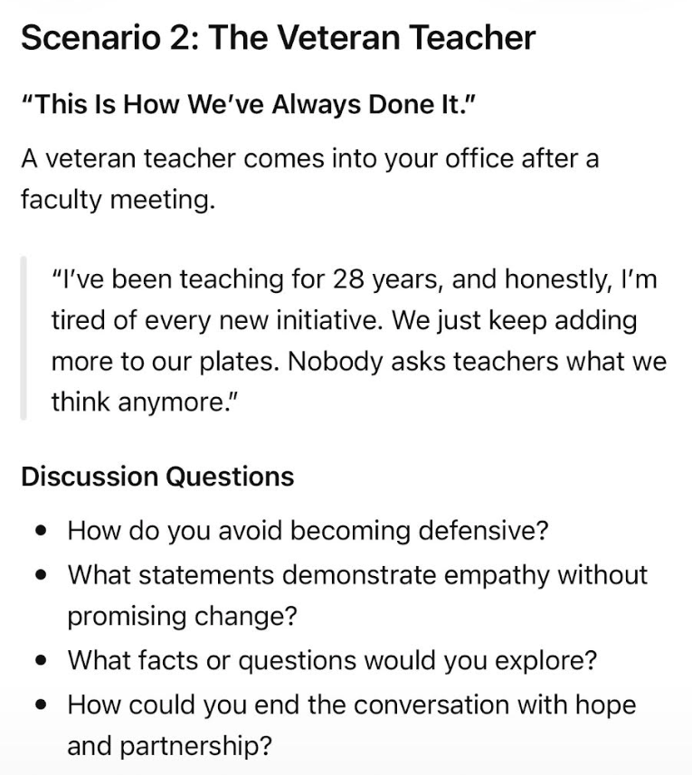

Slide 12
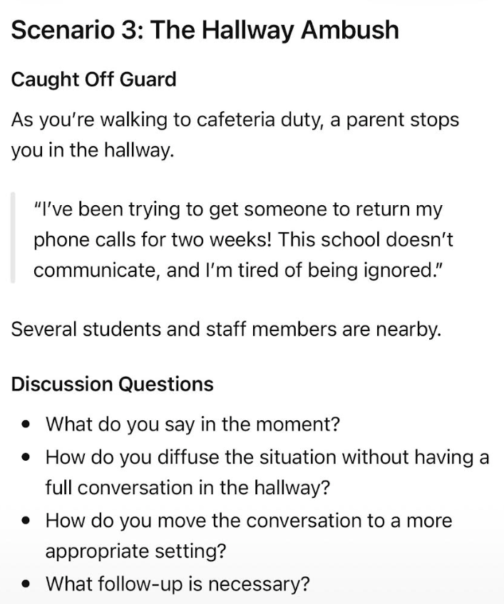
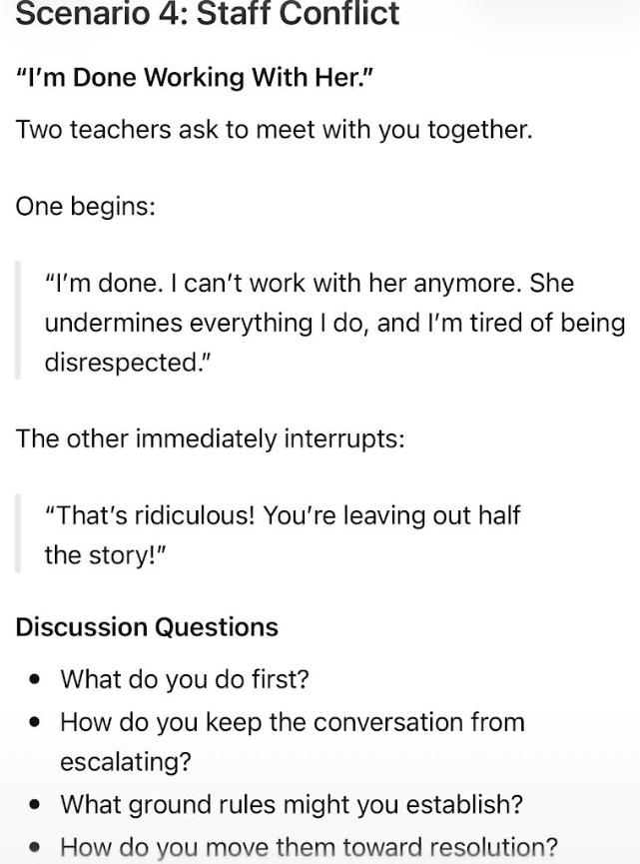

Slide 13
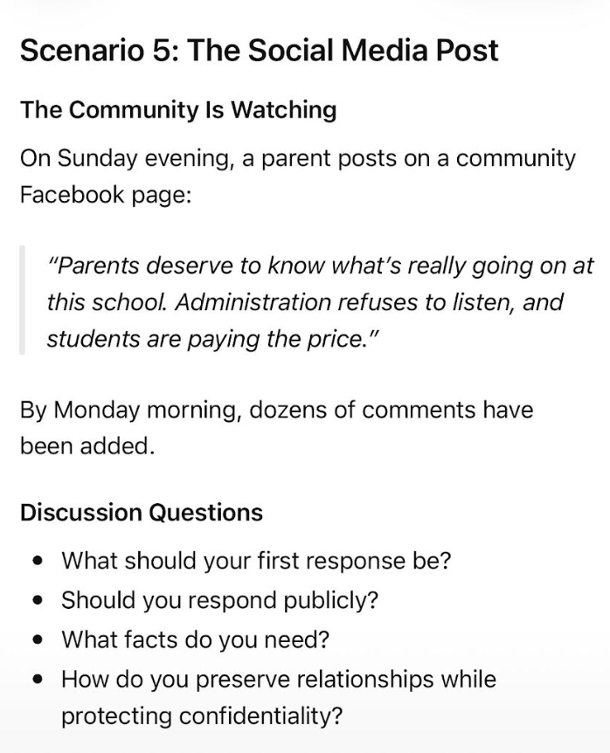

Slide 14

“Conflict doesn’t define leadership. How we respond to conflict does.”
Notes:
As educational leaders, conflict is not a sign that something is wrong. Conflict is evidence that people care deeply about students, staff and outcomes. Our role is not to avoid conflict, but to lead through it in a way that preserves relationships, builds trust and keeps the focus on what matters most--serving students.

Slide 15



stacydefoor@sheridanschools.org

