Slide 1


FROM DATA TO IMPACT
STAR CITY SCHOOL DISTRICT

Slide 2



2D’S & 1C
(COVID)
WHO WE ARE....
4A School with 70%+ poverty, Title I, CEP school
1
Only school in Lincoln County, 400+ sq miles
2
Purpose:
  Transparency across the district
  Vertical and horizontal alignment
  New teachers
  Consistency
3
Loose measurements
Notes:
Gina

Slide 3
Where We Were:
  One size fits all approach
  Checking off the boxes of planned lessons
  Instructional Resources
  Teaching vs Learning
1D & 2C
(2023)
Notes:
Whitney -
** quickly go through your slides to give more time for slides 8 and beyond.
A few years ago at Star City, teachers had a one size fits all approach to learning.
We were checking off the boxes of the lessons planned to teach.
We were focused on which instructional resources we liked best.
We were getting through the curriculum and teaching our hearts out but students were not growing.
Something had to change.

Slide 4
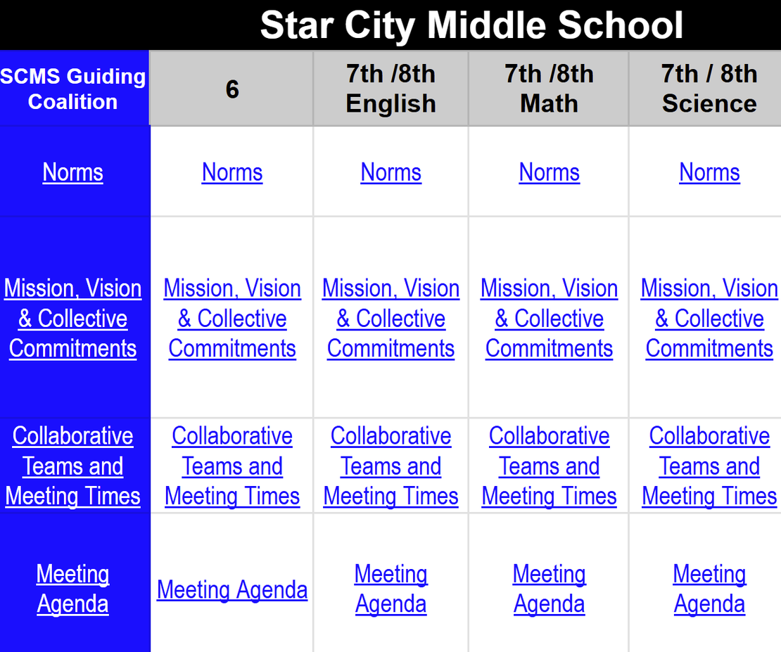
DISTRICT DASHBOARD
  Guiding Coalition
  Norms
  Mission, Vision, Collective Commitments
  Collaborative Teams and Meeting Times
  Meeting Agendas
Notes:
Whitney
The change took place district wide.
Our SCSD dashboard allowed for transparency across the district.
*Show the entire dashboard so that district wide is shown as well as essentials standards/YAG.
Guiding coalitions were formed on every campus with leaders wanting the best for the students in their buildings. These groups made up of at least one administrator, counselor, and teacher leaders for each grade or department.
All buildings developed PLCs and have designated meeting times. Each team created norms of how meetings will be ran and keep notes on an agenda.
Together each team created a mission, vision and collective commitments of how we will work towards the district's mission and vision.

Slide 5
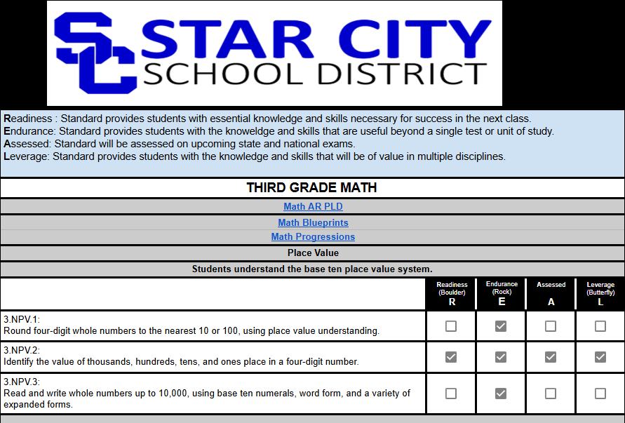
DASHBOARD INFORMATION
Notes:
Whitney
During collaborative team meetings, teachers were able to select standards that were essential for learning in their classrooms. We first used Solution Tree's, idea of boulders rocks and butterflies and then moved to the R.E.A.L. criteria.
Teachers asked themselves does the standard...
By having all of our essential standards being in one place, teachers across the district can work towards horizontal alignment even if they are not in the same building.

Slide 6
PRIOR YEARS
  Internal/ External support- PLC cohort/ TNTP
  2024-Hired 4 Specialists and created District Dashboard
  Shifted expectations to look at student data
2025- 2026 SY
  Assessments aligned to ATLAS (digital)
  Standards-based report cards K-3
  Tighter Pacing
  Accountability to driving instruction to the standard not the curriculum
  RTI
2C & 1B
(2024)
(2025)
Notes:
Heather
Began work in 2023
PLC & TNTP
4 specialists
District Dashboard
- shifted to student data
At the end of 23-24 school year, our simulated grades are 2 c's and 1 b.
What We Have Learned:
(not a perfect product yet, but we are growing)
- more time for teachers to work
-constantly reevaluating and rethinking what we can do to better use student data and help teachers hone their craft
-rethought what is essential
-teams need help!
- roles, checklists, deadlines
-how to use the standard to drive the instruction versus the curriculum driving our instruction

Slide 7
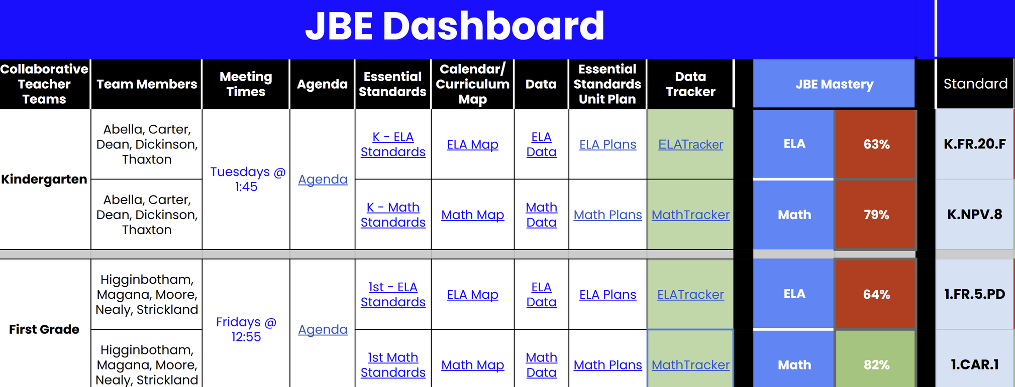
School Dashboard
Notes:
Jan- So how do we measure what matters? How do we monitor student by student, standard by standard?
Here at Star City School District we achieve this by administering 4 assessments to progress monitor students performance on each essential standard.
These assessments must assess the WHOLE standard.... they must have the same rigor and close in value points, and everyone must assess the same way. (ATLAS testing protocol) Also follow IEP's.
Teachers created assessments using various resources to ensure their assessments followed the guidelines, keeping in mind we are assessing what the standard says not what the curriculum says.
Here is an example of K geometry standard on shapes. The 4 assessments are linked at the top of each column with dates as to when they would administer them to the students. (This is where pacing will be very important)
After each assessment is given, very important decisions are made as to what the next steps are and how to respond to the students performance (such as whole group/small group/reassess-the color coding) Mrs. Thea will go into further details on this later in this presentation.

Slide 8
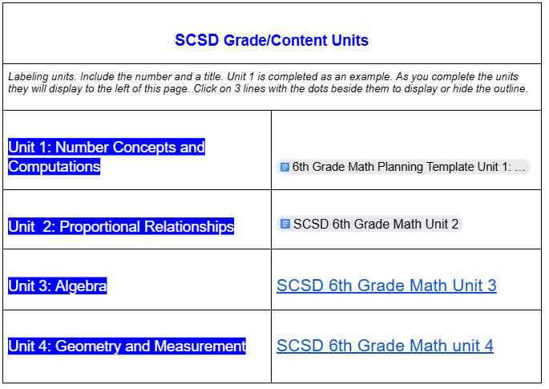
UNITS YEAR AT A GLANCE
Notes:
Jan- Besides working on assessments teachers also worked on a lot of planning for core instruction. This is the front page of each team's unit planning work. (the pattern for core instruction). Here they list the name of their units and have links to each unit plan.
Here is an example of 6th grade math.

Slide 9
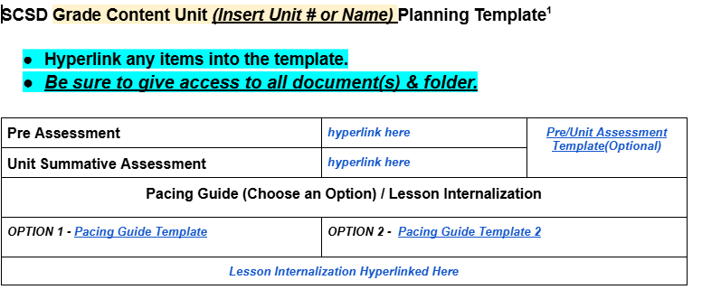
UNIT PLANNING TEMPLATE
Notes:
Jan
This is our district unit plan template. Teachers have linked each unit's preassessment, summative assessment, pacing guides, lesson internalization documents. Each essential standard broken down into concepts and skills and learning targets.

Slide 10
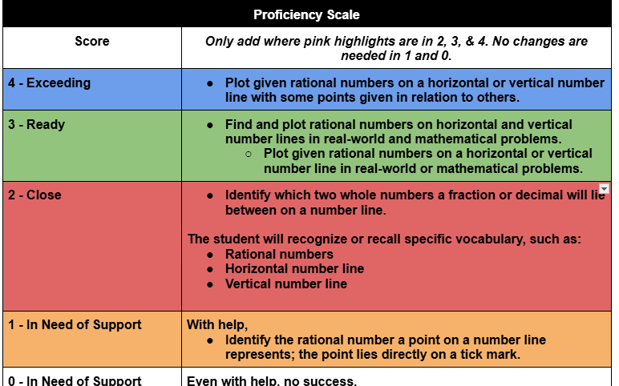
PROFICIENCY SCALES/PLDS
Notes:
Britnee
The Proficiency Scales is what drives our district assessments to ensure that the students are reaching proficiency in the essential standards. Those that are not is when we look at the next steps for RTI.
*Each essential standard has a proficiency scale written that is based off of the DESE PLDs. This helps to ensure that students are being assessed throughout the year like they will be assessed on the state exam.
Two demonstrates the skills needed to reach a three. Skills in the level two scale must be taught to reach the readiness in three. Skills in level two can be assessed formatively and summatively.

Slide 11
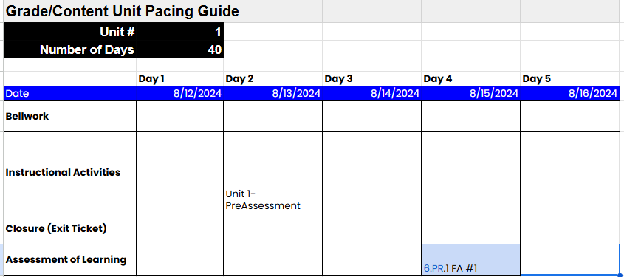
PACING GUIDE
Notes:
Britnee
These provide a clear process for teaching and learning for each unit.
These are used to help us make sure that everything is paced out and planned well throughout the year. By having everything in one place helps when we are meeting together to make sure that everyday is planned purposefully and that assessments are well paced out to give teachers time to re-teach and reassess if needed.
By having the actual activities that are going to be used linked on the pacing guide helps to demonstrate how students meet standard of readiness.
Purposeful lesson planning is the pattern-making and cutting process—you use the measurements (data) to design lessons that will fit the majority of your students just right, with enough room for growth.
Bellwork/Background Knowledge
Instructional Activities
Closure
Assessment/Check for Understanding/Clipboard
Color Code the District Assessments this color(Light blue 3)

Slide 12
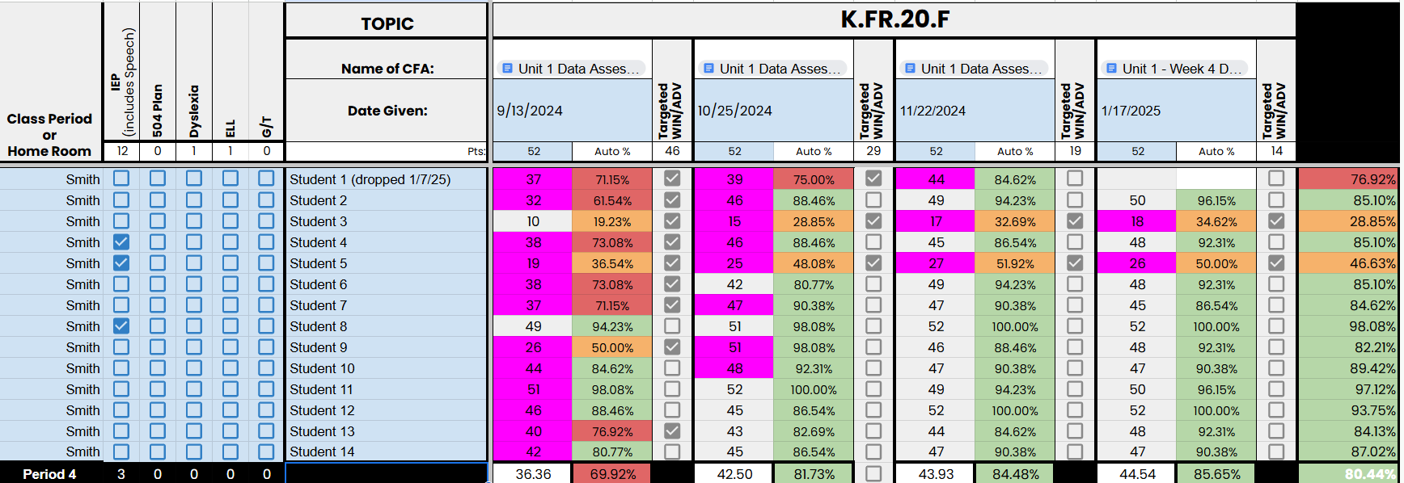


RTI/DATA TRACKER
Whole Group
Reteach
Small Group
Reteach
Notes:
Thea
****Add live link
Layers of intervention are like alterations and custom tailoring:
Tier 1 (core instruction) is the standard size—designed to fit most students well based on common measurements.
Tier 2 (targeted support) is the minor adjustment—taking in a seam or adding a hem to better fit students who need a bit more.
Tier 3 (intensive intervention) is custom tailoring—building a unique plan for students with more significant or specific needs.
Just as a tailor uses precise measurements to ensure every garment fits its wearer, teachers use student data to make sure every learner gets instruction that fits just right—no one-size-fits-all approach.
This is how we make this happen Talk about parts of Data Tracker Assessment:
-Made in Google Sheets
- Has multiple classes of one teacher or multiple classes for one grade level
-Walkthrough data tracker sample
Green = 80%
Red= 60-79%
Orange = 0-59%
Throughout the instructional process, you should be providing Tier 1 support for students who are not reaching mastery on class assessments. (80%)
-
After a district assessment is completed and classroom performance is below 70% the whole class re-teach should occur.
*Whole Class-Reteach
Have discussion on why students’ scores are dropping from assessment 1 to assessment 2.
Must use a different assessment.
Consider these things:
Types of assessments
Types of questions
Rigor
# of Questions
Testing whole standard vs part of standard
Same testing protocol being followed
Time of the day
After the reassessment has been given replace the original score with the reassessment score and change the cell to this color. (light red 3)
This displays your effort for growth and supports your artifact for merit pay.
If the district assessment is completed and the classroom performance is above 70% then the small-group re-teach should occur.
*Small Group-Reteach (Tier 2 Intervention)
The students who do not score at least 80% on the assessment need to be pulled for Tier 2 Intervention
Then re-assess after small group instruction has been given.
If a student does not perform at 80% after small-group and re-assessment, then consult with your content specialist.
We learned we had to give teachers a deadline. All data must be entered within 5 days of the given assessment.
Assessments must be paced well.
Have to have time to give the assessment and then to reteach.
If the class average is red/orange after the 3rd assessment, you must give the 4th assessment. If the class average is green after the 3rd assessment, you do not have to give the 4th assessment.

Slide 13
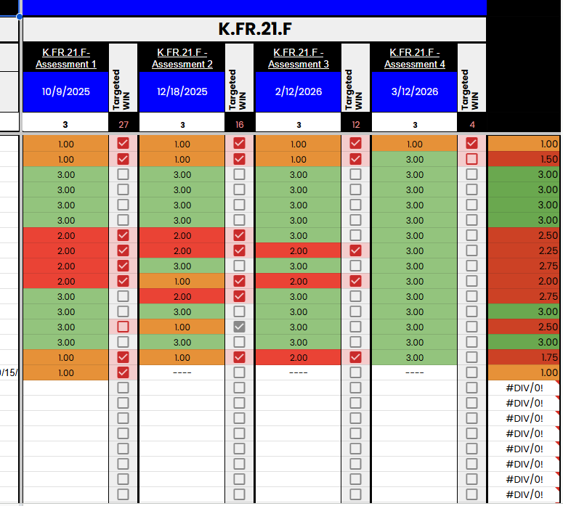
STANDARDS BASED REPORT CARD
Notes:
Thea
This is the document that we use to keep track of how each student performed on the pre-assessment and the final summative assessment.
Pre-Assessments:
Prior grade-level skills that lead to the essential standard.
Minimum of at least 2-weeks prior to the next unit.
Length- As many questions as it takes to gain the knowledge needed for the upcoming unit.
Assess at the same depth of knowledge of the prior skills.

Slide 14
WHERE WE ARE HEADED....
Next Steps:
1
Updating Unit Plans, Pacing
2
Assessment Alignment
3
Standards Based Grading
4
Incorporating Data Talks district wide
Notes:
Gina - UPDATE
Refined Unit Plans that meet our needs. Pacing Guide options, PLD updates,
Our concentration will be to hone in on the tasks with in the pacing and assessments within the classroom.
Continue to structure District Assessments to meet the needs in the classrooms. We want a fair and equitable opportunity for students with RTI in place.
Shifting to Standards Based in K-2 to move away from unbalanced 0-100 system and give feedback to parents on the standards.

Slide 15
QUESTIONS?
Notes:
Jan

Slide 16




THANK YOU!
866-446-3647
starcityschools.org
gina.richard@starcityschools.org
400 E. Arkansas, Star City, AR 71667

