Slide 1




Connected Communities:
Digital Citizenship Playbook:
Helping students make tech work for them
Notes:
Thank you so much for joining us today. Feel free during this webinar to jump in with questions in the chat and I’m happy to try and address them at the time or at the end. My name is Adam Brooks, and I have spent over a decade as a teacher, a special education facilitator, a college professor, and business consultant. Over the past 5 years alone,I’ve spoken to more than 32,000 students and trained over 62 nonprofit organizations, including 15,000 managers and educators.

Slide 2



“
“My central claim in this book is that these two trends—overprotection in the real world and underprotection in the virtual world—are the major reasons why children born after 1995 became the anxious generation.”
― Jonathan Haidt
The Anxious Generation: How the Great Rewiring of Childhood Is Causing an Epidemic of Mental Illness

Slide 3
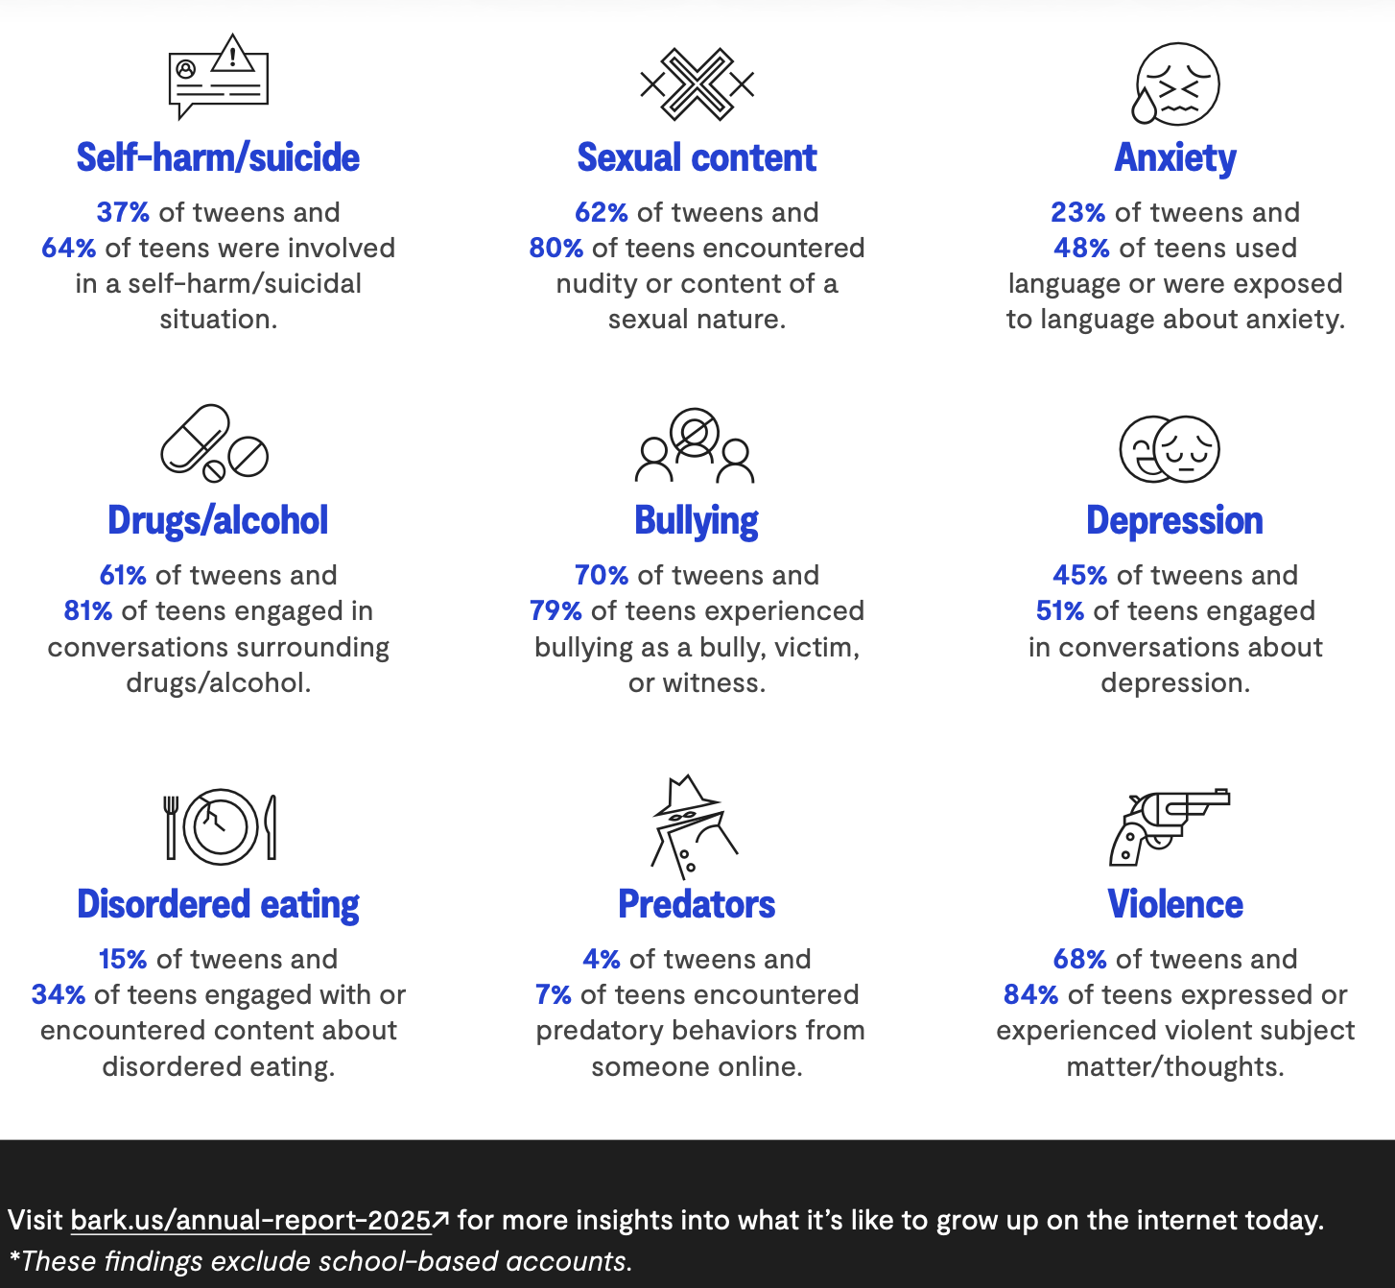



The reality for tweens & teens
According to Bark’s 2025 Annual report
70% of teens experienced bullying as a bully, victim or witness
48% of teens engaged
in conversations about anxiety
51% of teens engaged
in conversations about depression

Slide 4



Building a digital citizenship curriculum for today and tomorrow is our collective responsibility
Kids need more than protection — they need skills.
Digital spaces are
part of their education, relationships, and identity.
Critical thinking will drive success in a future shaped by AI
and evolving tech.

Slide 5
What we learned in 2025
→
Campaigns addressed cyberbullying, on-campus threats that started online, and more.
What worked: clear attention to urgency and instruction with more relevance to student lives.
Strong examples from schools that adapted to reflect current issues.
→
Digital citizenship weeks saw some excellent changes reflecting the needs of kids and the severity of the issues schools were seeing:
→

Slide 6
Moving beyond “don’t do that” to “here’s how to do it safely”
→
Using the internet for research? Teach students how to evaluate sources and identify misinformation.
Downloading and using apps? Help them recognize when apps ask for too much access or data.
Spending time on social media? Show them how to engage in a way that supports their well-being and safety.
→
Examples of modern digital citizenship curriculum themes that are proactive, not reactive:
→
These shifts reflect a move toward empowerment and discernment, not just restriction.

Slide 7

An important piece to the puzzle: Bring parents in
Most online activity happens after school hours.
Parents are often the first responders to digital crises.
Collaborate through workshops, guides, and ongoing communication.
The average American child has 2,000 photos online before age 2. By the tween and teen years, that number skyrockets.
Most families don’t fully understand how permanent online content can be.

Slide 8



Digital threats keep evolving
What worked yesterday isn’t enough today
Real stories show what’s at stake:
New apps emerge constantly, each with new risks and loopholes. Teens have constant smartphone access, even outside school hours

Slide 9
Where we go in 2026
→
Don’t just teach safety — build resilience.
Focus on AI and its threats.
Anticipate mental health crises and advocate for check-ins.
Go beyond etiquette — teach ethical tech use.
→
→
→

Slide 10



What we should be doing in the classroom
Teaching kids how to use AI responsibly
Modeling media balance
Checking in and providing strategies for students mental digital health

Slide 11

The hidden dangers of AI
Teach them to:
→
Recognize emotional manipulation AI can mimic friends, celebrities, and authority figures to influence behavior — often using flattery, urgency, or guilt to manipulate.
Understand data privacy risks Many AI tools collect and store what users type — which can include personal details, private thoughts, and even sensitive photos.
Spot the false sense of security AI can be helpful, but it’s not always accurate, ethical, or safe. Teach students to verify, question, and critically evaluate anything AI-generated.
It’s imperative to help students build digital instincts in an AI-powered world — even the smartest kids can be fooled by today’s AI tools.
→
→

Slide 12



The Deepfake dilemma
Deepfakes are no longer futuristic, and students are making them with tools gained from a quick social media search. Most students — especially teen boys — don’t grasp the lasting harm they can cause.
Kid sitting in front of
a computer screen (either front lit or haloed from the back or side)
Deepfakes are used to:
Cyberbully classmates
Spread fake, inappropriate pictures
Create unsuitable content to exploit teens
These incidents can lead to trauma, reputational harm, and in extreme cases, suicide

Slide 13

Preparing kids through culture changes, not just curriculum
Create an environment where kids can ask for help
A trusted adult is the most important safety tool — make it normal for students to ask for help.
Every student should know: Who can I go to at school if something happens online?
Train staff and parents to respond with care
Lead with empathy. Respond with calm and compassion — not punishment — to build trust.
Teach students what to do if they’re targeted or make a mistake
Integrate ethical tech use into lessons
Example: Sharing a deepfake can legally be distributing inappropriate pictures of children

Slide 14
Understanding social-emotional health in a digital world
Teach them to:
→
Build digital resilience
Help students recognize and manage the emotions that come from always being
online like comparison, rejection, and the pressure to perform.
Strengthen SEL in digital spaces
Apply core social-emotional learning (SEL) concepts — empathy, self-awareness, responsible decision-making —
to their online lives.
Acknowledge the 24/7 impact
“Likes,” comments, and DMs carry real emotional weight. Students need strategies to pause, reflect, and protect their mental health.
→
Today’s students don’t get a break from social dynamics — being online is 24/7 event.
→

Slide 15





What lasting digital citizenship
looks like
→
Start early — Younger students are already online. Don’t wait until middle school.
Build foundational skills early: empathy, online etiquette, and media balance.
Focus on conversation, not just compliance.
Give students space to ask questions, share experiences, and reflect.
Make it ongoing. Digital citizenship isn’t a week-long event, it’s a year-round need.
Peer-led lessons, family workshops, and cross-curricular connections all matter.
→
→
→
→
→

Slide 16


How Bark can help
Training
Bark offers a comprehensive approach to online safety, and we help schools, parents, and policymakers close critical gaps.
We’re a thought leader and partner in building a safer digital future for kids and vulnerable populations.
Tech

Slide 17


Get in touch
Adam Brooks
adamb@bark.us
602.510.7690

