Slide 1
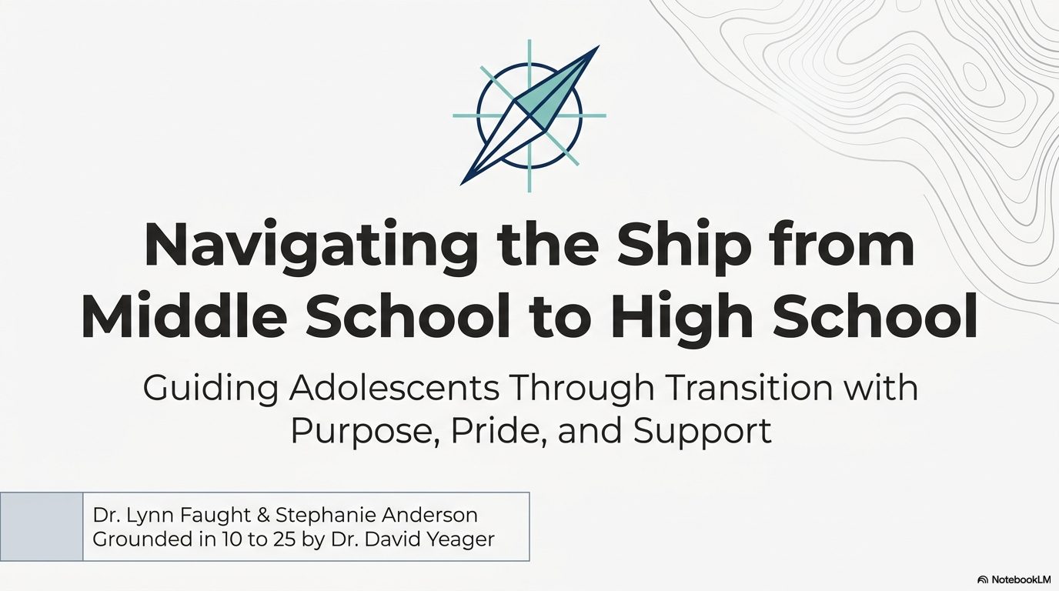

Slide 2


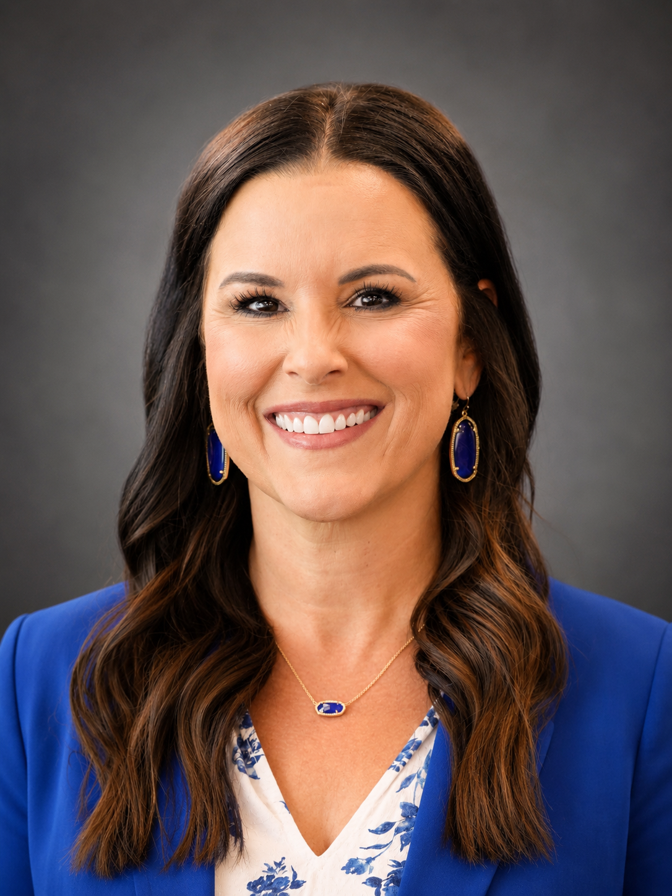
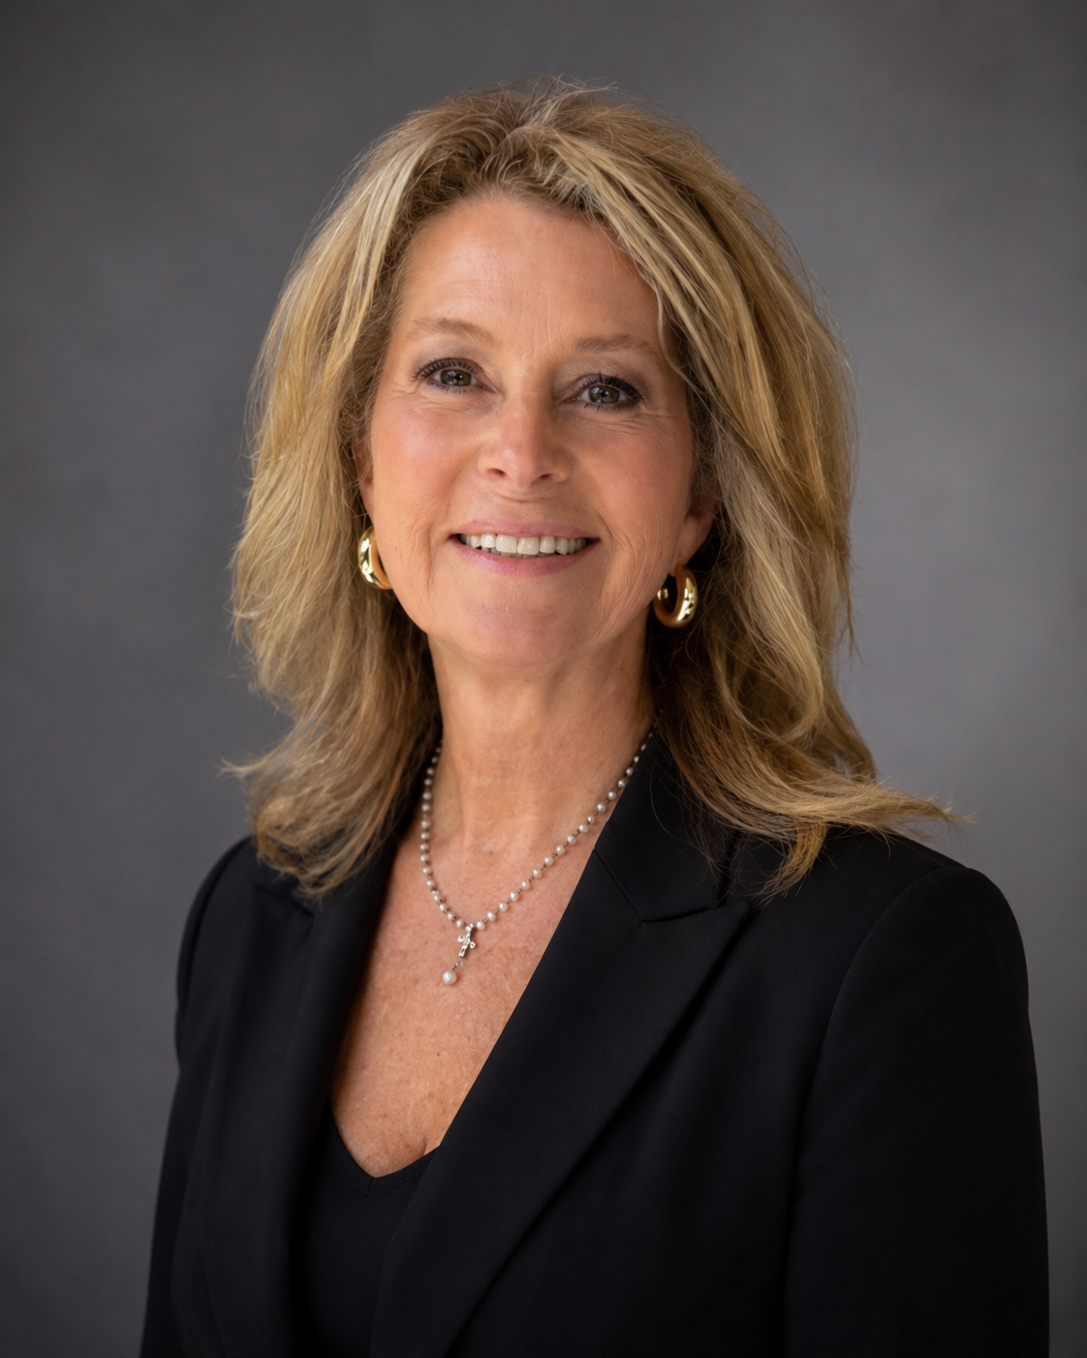
Who We Are
Lynn Faught
Stephanie Anderson
lynn.faught@fayar.net stephanie.anderson@fayar.net

Slide 3
Overarching theme:
To transform school culture, educators must master self-regulation to create safe environments (Conscious Discipline) while holding high academic standards paired with authentic respect (David Yeager: 10-25)—empowering students of all ages to manage their emotions and engage deeply in their learning.
Purpose in Schools & for Students
Conscious Discipline sets the foundation by teaching educators to regulate their own emotions first, creating a safe, connected school climate where students learn the social-emotional skills needed to stay calm and focus on learning.
10 to 25 builds on that foundation by guiding educators to adopt a mentor mindset—pairing high expectations with genuine respect—so adolescent students feel valued, motivated, and willing to take on hard challenges without fear of public embarrassment.

Slide 4
Who’s in the Room?
The "Two-Sided Business Card"
Everyone will share:
  Side A (The Official Title): What your email signature says you do.
  Side B (The Real Title): What you actually do in plain English or a fun 3-word summary (e.g., "Chief Fire Extinguisher" or "Adolescent Translator").
We are going to give you a bit to think of your “Real Title.” When we tell you, you will share with your shoulder partner. The person with the birthday the closest to today will go first.
1-2-4 Brainstorming Strategy

Slide 5
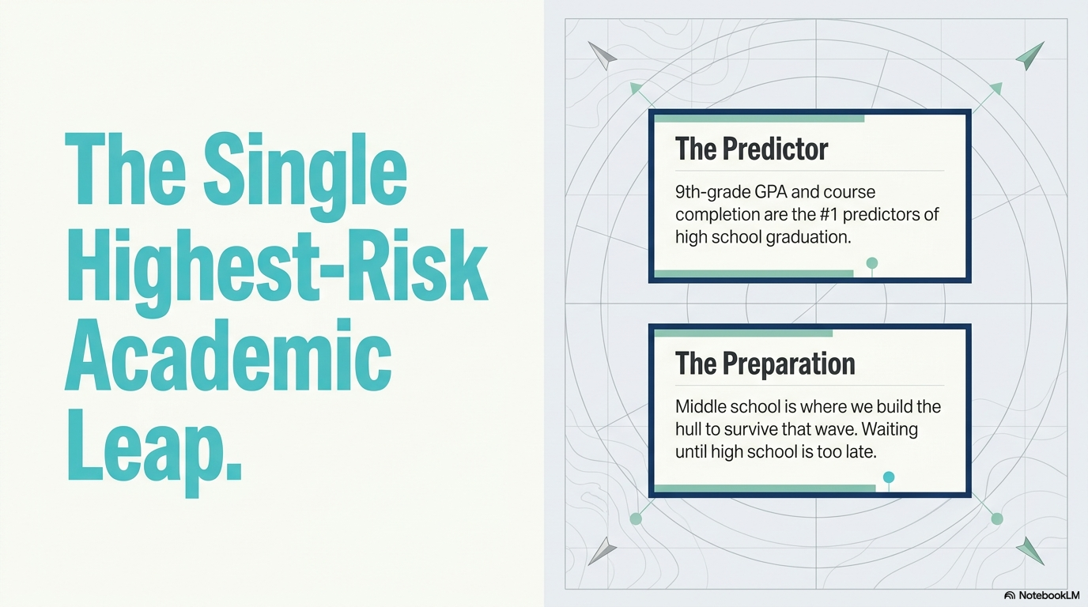

Slide 6
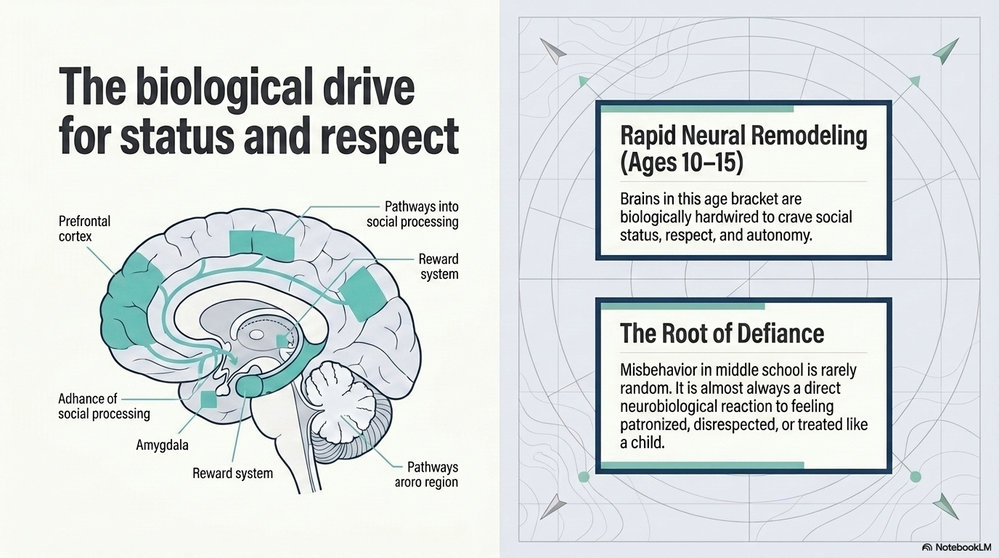

Slide 7
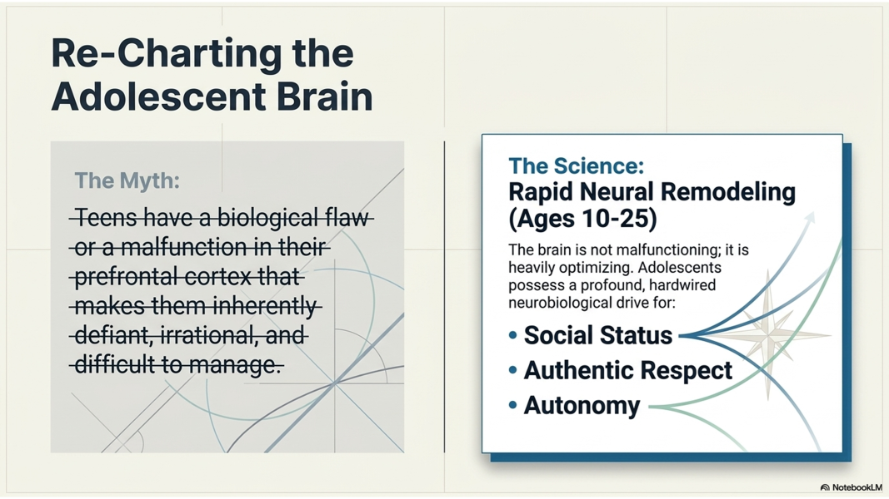
The Neurobiological Incompetence Model

Slide 8




What Type of Mindset Do You Have with Your Students?
The Enforcer
The Mentor
The Protector

Slide 9
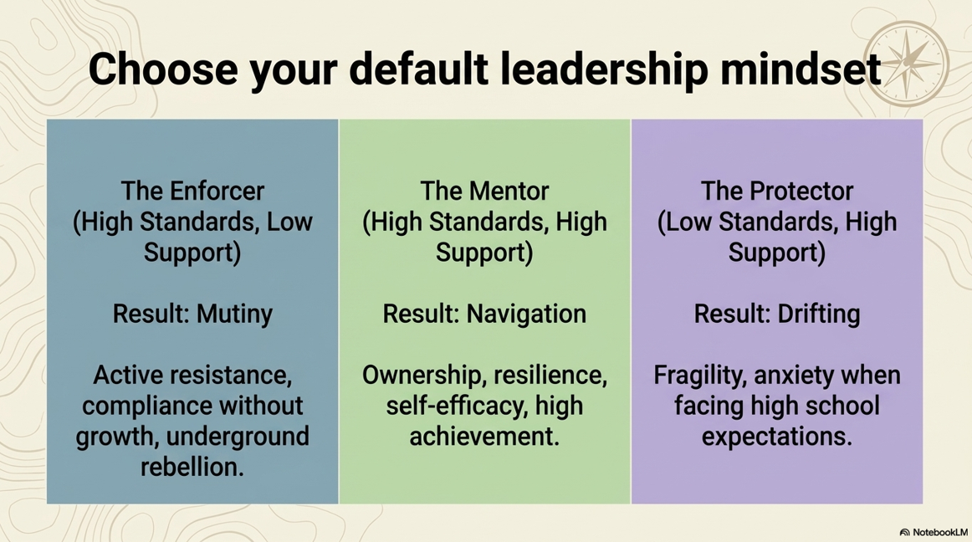

Slide 10
Think for a minute about your time as a teacher and as an administrator.
Which of these sounds like how you would describe your default mindset?
Why do you think that?
When the timer begins share with your shoulder partner.
Think/Pair/Share Activity
*The person with the longest hair will go first.
ACTIVITY / DISCUSSION

Slide 11
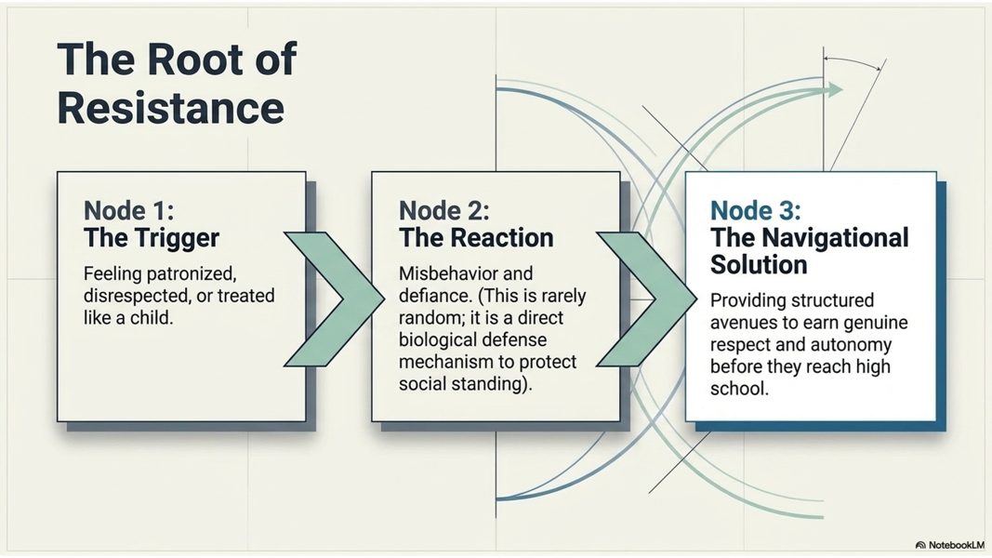

Slide 12
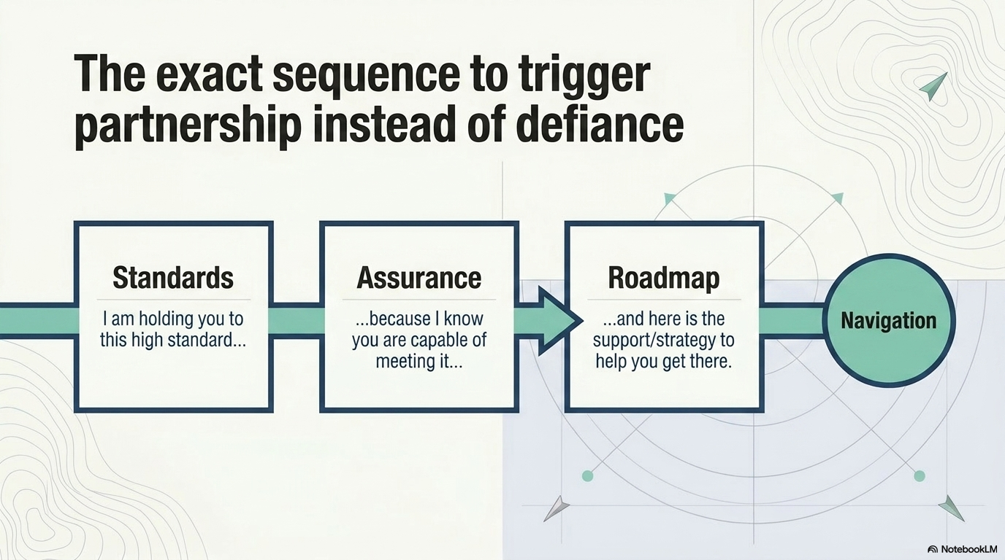

Slide 13
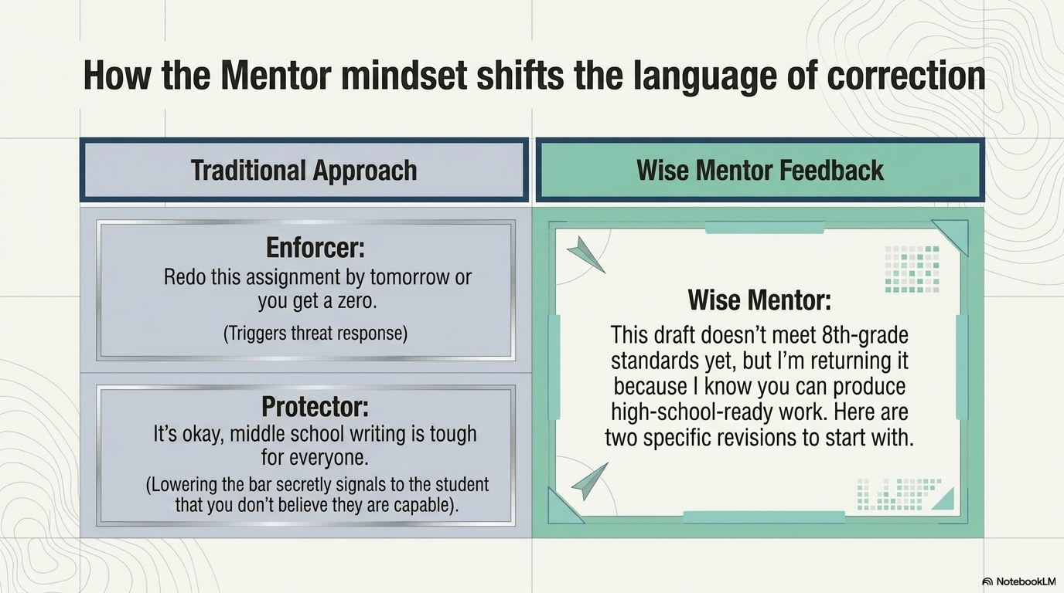

Slide 14
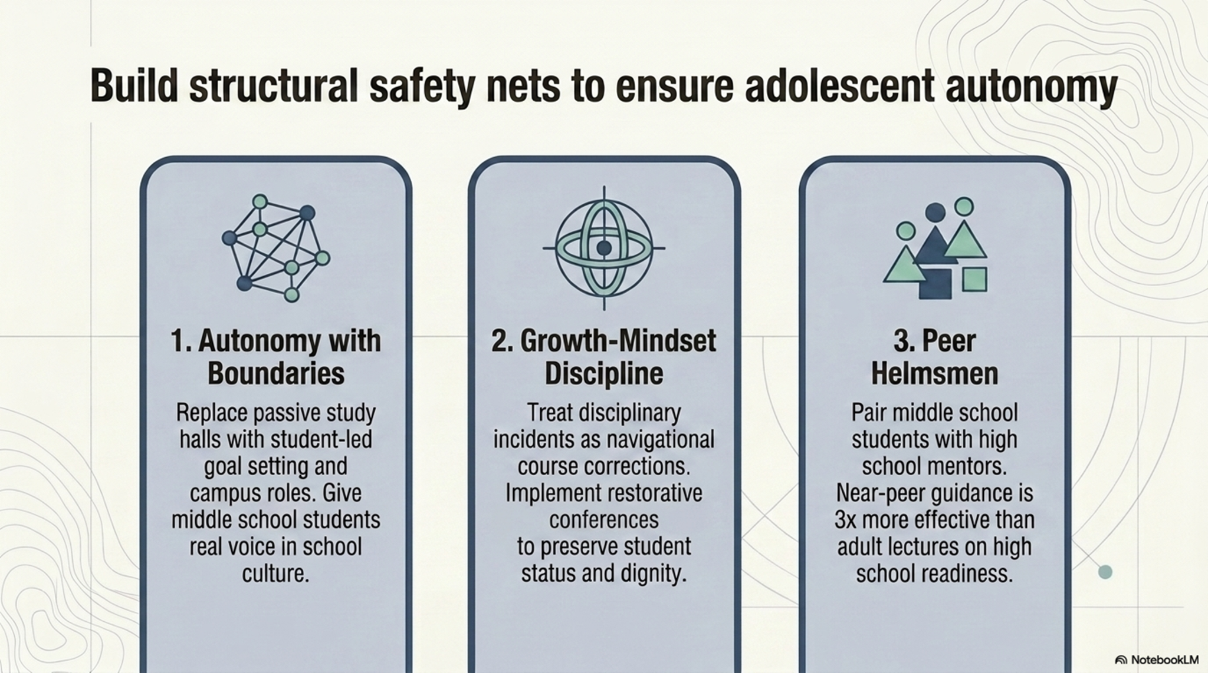

Slide 15
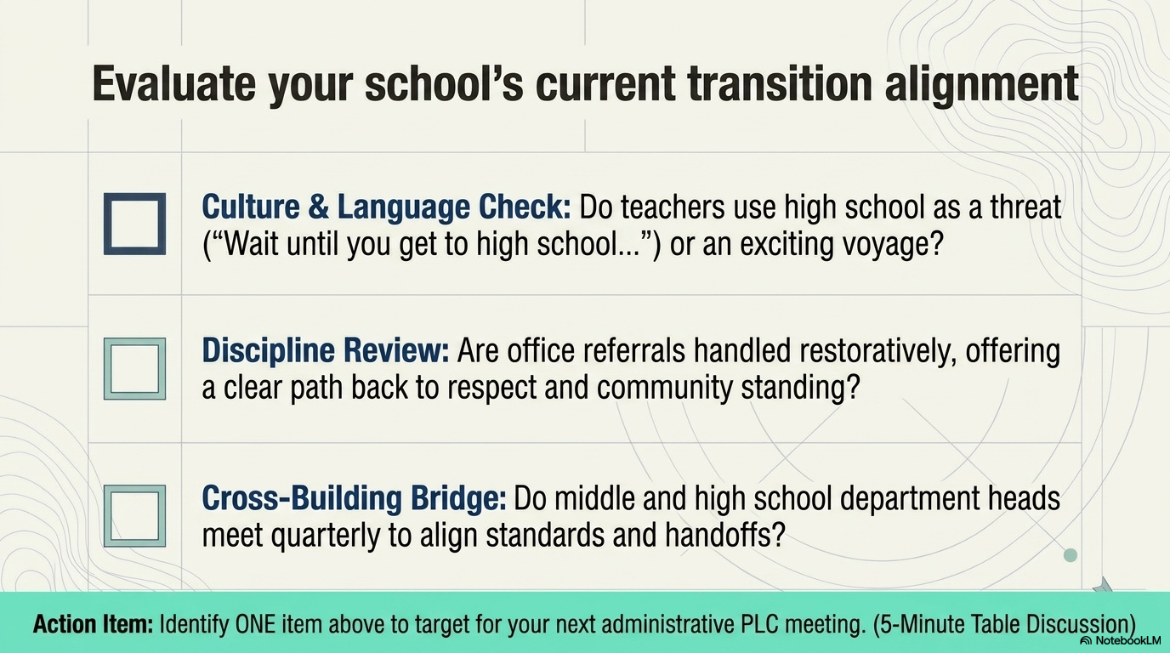

Slide 16
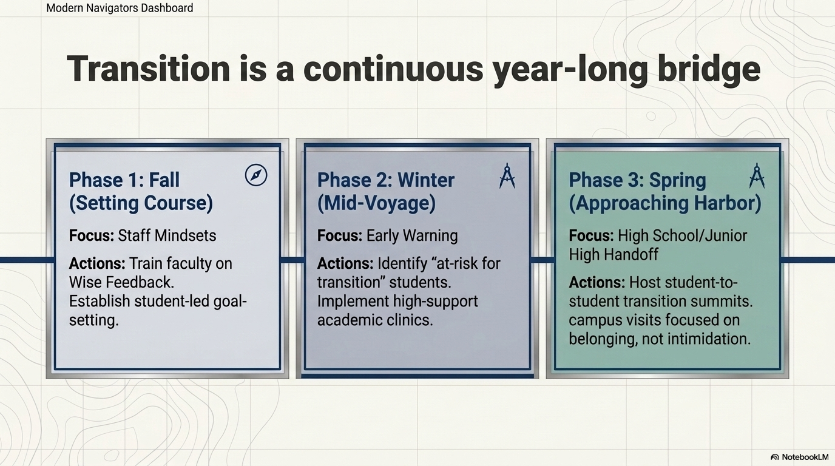

Slide 17
The Formula for Wise Feedback
To deliver feedback that young people actually trust and act on, use this
explicit transparency framework:
State the High Standard: Make it clear what excellence looks like and that you aren't lowering the bar.
Convey Personal Belief and Support: Explicitly state why you are giving the critique: "I'm giving you this feedback because I know you are capable of reaching this high standard, and I'm committed to helping you get there."
Provide Actionable Next Steps: Give concrete guidance on what to fix, keeping the focus entirely on growth and mastery rather than fixed traits or smarts.

Slide 18
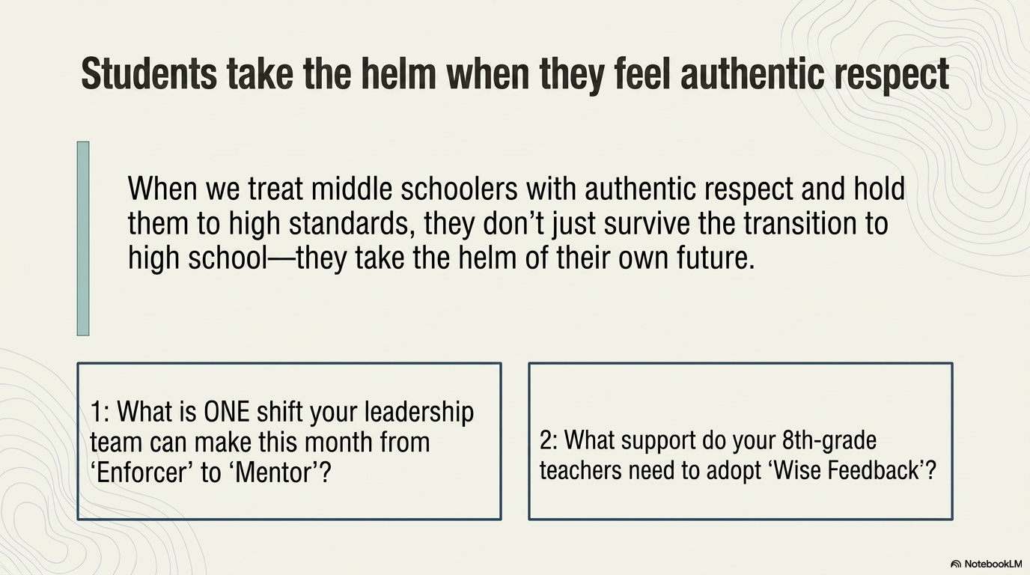
2. What supports do your teachers need to practice and provide “wise feedback” to their students?

Slide 19
Practical Strategies for Educators and Parents
Ditch the "Praise Sandwich": Traditional methods (praise, criticism, praise) often feel manipulative to youth ages 10 to 25. Instead, lead with your high expectations and your absolute belief in their potential to meet them.
Reframe Struggle as Part of Mastery: Explicitly tell students or children that encountering difficulty on a hard task is normal. Frame the struggle not as evidence that they lack capability, but as proof that they are engaging in real, high-level learning.
Ask Authentic Questions First: Before handing down evaluations, prompt them to evaluate their own work first. Ask: "What part of this draft feels strongest to you, and where do you think it still needs a push?" This honors their status, autonomy, and perspective.
Normalize Final-Stretch Reassurance: Young people experience intense self-doubt during high-stakes moments (like final exams, big projects, or performance milestones). Use repeated transparency statements right before these hurdles to remind them that your high standards are backed by total support.

Slide 20
YEAGER OUTLINES
5 CORE INSTRUCTIONAL & BEHAVIORAL PILLARS
TRANSPARENCY
QUESTIONING OVER LECTURING
REFRAMING STRESS
TAPPING INTO PURPOSE
PROTECTING STATUS AND BELONGING
FIVE CORE INSTRUCTIONAL & BEHAVIORAL PILLARS

Slide 21
TRANSPARENCY: EXPLAIN THE RATIONALE BEHIND SCHOOL RULES, ASSIGNMENTS AND POLICIES RATHER THAN RELYING ON “BECAUSE I SAID SO.” YOUNG PEOPLE RESPECT AUTHORITY WHEN THEY UNDERSTAND ITS PURPOSE.
QUESTIONING OVER LECTURING: USE BACK AND FORTH DIALOGUE TO GUIDE STUDENTS TOWARD SOLVING PROBLEMS THEMSELVES. ASKING THOUGHTFUL QUESTIONS HONORS THEIR AUTONOMY AND BUILDS DECISION-MAKING-SKILLS.

Slide 22
3. REFRAMING STRESS: TEACH STUDENTS THAT PHYSIOLOGICAL STRESS (SWEATY PALMS, RACING HEART) IS NORMAL MOBILIZATION OF ENERGY TO HELP THEM FACE A CHALLENGE, NOT A SIGN THEY ARE FAILING, OR INCAPABLE.
4. TAPPING INTO PURPOSE: MOTIVATE STUDENTS BY CONNECTING LEARNING AND BEHAVIOR TO PROSOCIAL GOALS - SKILLS THAT ALLOW THEM TO CONTRIBUTE TO COMMUNITIES OR MAKE AND IMPACT.
(FIELD TRIPS, SCHOOL VISITORS, COMMUNITY SERVICE)

Slide 23
5. PROTECTING STATUS AND BELONGING: AVOID PUBLIC REPRIMAND OR PUNITIVE TACTICS THAT TRIGGER SHAME. CREATE A CULTURE WHERE EVERY STUDENT FEELS VALUED PREVENTS DROPOUT, BEHAVIORAL ESCALATION, AND DISENGAGEMENT.
QUESTION:
HOW DOES THIS LOOK IN THE CLASSROOM?
WITH PARENTS?
IN YOUR OFFICE MEETING WITH STUDENTS?

Slide 24
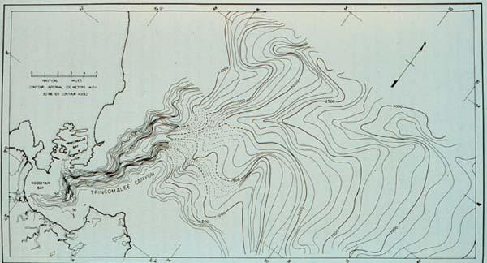
Middle schoolers are in a crucial stage of brain and identity development, and they thrive when we challenge them, respect them and believe in them. When we teach with high expectation and real encouragement, we don’t just manage behavior, we unlock growth.”
-AR Senator Denise Garner, retired RN Practitioner, specializing in Brain Development & Mental/Behavioral Sciences.

Slide 25
THANK YOU FOR NAVIGATING THE WATERS!
STEPHANIE ANDERSON, Ed.S: ASST. PRINCIPAL @ MCNAIR MIDDLE SCHOOL
CO-DIRECTOR OF ARKANSAS SCHOOLS TO WATCH
STEPHANIE.ANDERSON@FAYAR.NET
DR. LYNN FAUGHT:
PRINCIPAL @ MCNAIR MIDDLE SCHOOL
FAYETTEVILLE AR.
LYNN.FAUGHT@FAYAR.NET

