Slide 1
Leading Through Transformational Change: Building Systems, Culture, and Capacity
Arkansas ACTE 2026

Slide 2
Who do I have in the room today?
Notes:
🍐 This is a Pear Deck Poll Slide
🍐🍐 Your current options are: A: Teacher 3+ Years, B: Teacher 1-2 Years, C: Administrator, D: Support Staff Member

Slide 3
What would bring you the greatest value from today's session?
Notes:
🍐 This is a Pear Deck Poll Slide
🍐🍐 Your current options are: A: Community Buy In, B: Student Motivation, C: Culture Change, D: Practical Tools to Implement, E: Partnerships
🍐🍐 Students can select multiple responses.

Slide 4

Notes:
🍐 This is a Pear Deck Poll Slide
🍐🍐 Your current options are: A: Yes, B: No

Slide 5
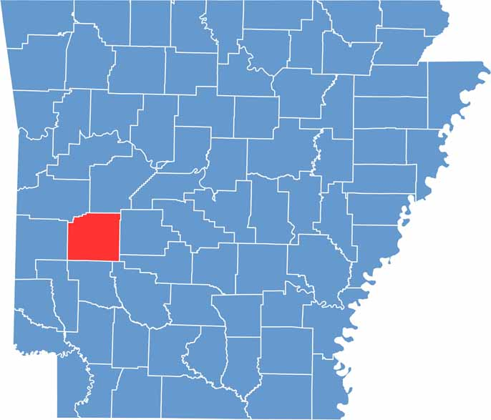

Slide 6
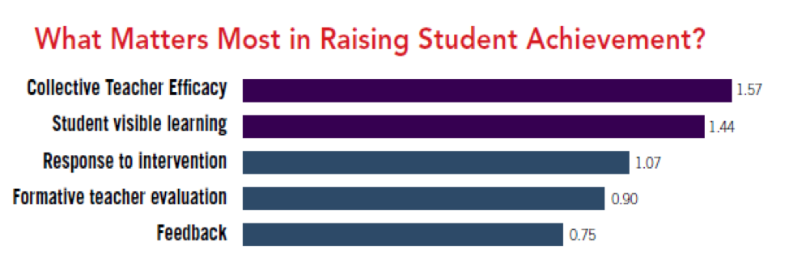
Notes:
🍐 This is a Pear Deck Text Slide

Slide 7

Notes:
What has been your favorite exposure experience thus far?
What has exposure done for your peers?

Slide 8
Goals for Caddo Academy
80% of Students will actively participate in a Club or Organization related to their Career/Interests.
Decrease Student Discipline Referrals by 6% each academic year of the Charter.
96% of Students will be led through a Career Action Plan by a cohort of Stakeholders including educators, family, and industry partners.
Increase Student Performance over the initial five years to meet or exceed the state average in Literacy, Math, and Science.
Improve the Graduation Rate to meet or exceed the State Average within five years.

Slide 9
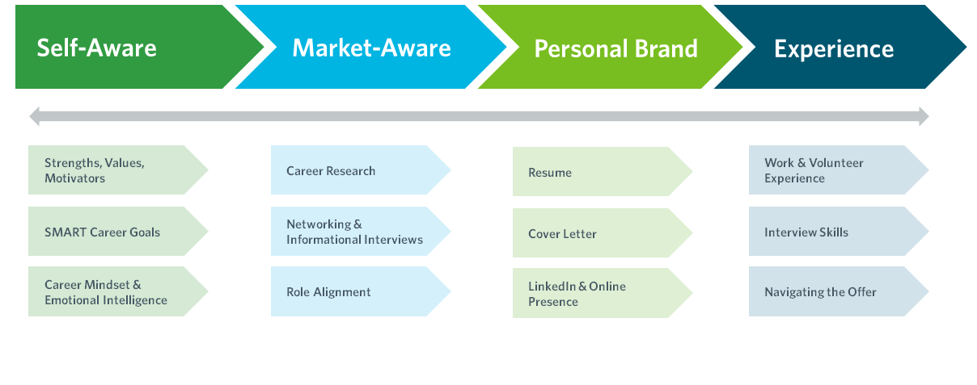
Academy Model-

Slide 10
Caddo Academy Theory of Action
Team | Theory of Action
School Leaders | If the school leader creates a systemic approach to culture, communication, and discipline and implements those systems with fidelity it will lead to a nurturing learning environment that supports the Personalized Learning work of the school.
Instructional Leadership Team | If the instructional leadership team actively engages their colleagues in the professional norms (pedagogy, technology, etc.) and leads the personalized learning work it will lead to increased capacity of leaders and teachers to lead.
7-12 Teachers | If teachers build authentic relationships with students, colleagues, and the community while committing to learning and trying personalized learning teaching methodologies it will lead to student success.

Slide 11

Caddo Academy
Justin Neel, Principal
jneel@caddohills.org
870-490-1222

