Slide 1


With Jennifer Holmes MSRT(R)(CT)
From Empty Classroom to Thriving Program
Building a Medical Class from Scratch

Slide 2

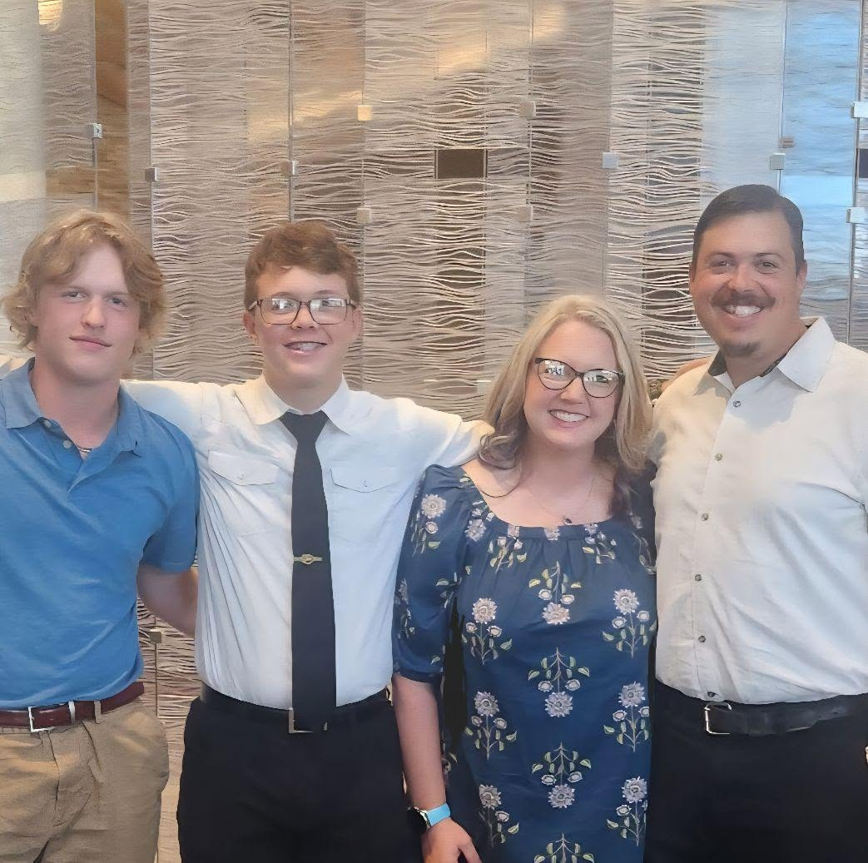
Let Me
Introduce Myself
I have been a radiologic technologist for the past 25 years. I still work PRN at our local hospital and pain clinic, helping cover vacations and fill in employment gaps when I can. I am starting my 5th year of teaching and am finally starting to get into the groove.
This past school year, I started working on my Master's in Education with 4 other teachers in my building. I am the wife of Zac, who is also a teacher, and two boys (Levi-19, and Kyle-16). When I am not at school, working on my own education, or running around chasing my family, you will find me taking a nap cause I am tired!

Slide 3
WHERE TO START
USING AI TO HELP
Goals for Today
INCLUDING COMMUNITY PARTNERS
BUILDING A HOSA CHAPTER
YOUR FIRST WEEK
QUESTIONS

Slide 4


Level 1
Level 2
Level 3
Introduction to Healthcare
What
Classes Do
Medical Terminology
I Teach?
Radiological Science
I have had a new class added every year. Each year, I have been told what I am teaching and then told to figure out what I want to do for curriculum.

Slide 5




Where do I start?
Find your AR Standards for the Course
Pick your curriculum
Make a Pacing Guide
This seems like something super simple to do, but when you have never heard of such a thing, it can be difficult, especially if it isn’t explained to you or where to find them.
Picking the correct curriculum seems daunting sometimes. Finding something that you will be working with the entire school year is important.
Figuring out how you will cover all of your standards to make sure they are all covered by the end of the year is important. A pacing guide helps.

Slide 6



Let AI Do the
Bulk of the Work
AI is one of the greatest things to help build a new class. Compared to 5 years ago, building this class has been so much easier. Let’s look at an example using two different platforms:
  ChatGPT
  Gemini

Slide 7

INCLUDING
COMMUNITY PARTNERS
Many of our classes are building future professionals who will work for our local hospitals and clinics. Finding ways to get students into those areas is a challenge, but not impossible.
Develop relationships with your local bosses early. Reach out to the PR person at the hospital/clinic and ask questions about working as a team.

Slide 8

WHAT
MIGHT
That Look Like
Attend open to the public events
Try to find out if the hospital/clinic is having a public event and find ways to attend it.
Ask them for donations for your HOSA group
Many hospitals/clinics will hand over money if you just ask.
Develop a partnered program where they get to use the facility.
I know these are rare, but you can’t do them if you don’t ask.
Ask the community to come into your classroom/school.
Whether it be to help in a project or just be a guest speaker, most are willing to help.
Look at a no as “not yet”
Just because a facility tells you no, it doesn’t mean it is no forever. As you build relationships and trust, facilities are more willing to work with you.

Slide 9



  See /Email/ Talk to Cathy Gunter
  Introduce HOSA the first week of school
  Find out when you can meet
  Elect officers ASAP
  Let the students lead the organization
  Actually teach the foundations of HOSA
Starting/Continuing HOSA
What all does that involve?

Slide 10
FIRST DAY/ FIRST WEEK
IDEAS
My 1st day presentation

Slide 11

MY GO-TO-
MUST- ALWAYS -DO-I-AM -SO -GLAD- I -DID THIS FOR MY CLASS
Documenting
Chapter Reflections
Documenting my days or weeks was job-saving sometimes.
You won’t remember what you did this year. Write a reflection to look back on for next year.

Slide 12
RESOURCES
Cathy’s Shared File
Academic Playbook
AR HOSA Website
National Consortium for Health Science Education

Slide 13



Questions?
Contact information:
Jennifer Holmes
Website:
My Classroom Page
E-mail:
jholmes@mhbombers.com

