Slide 1


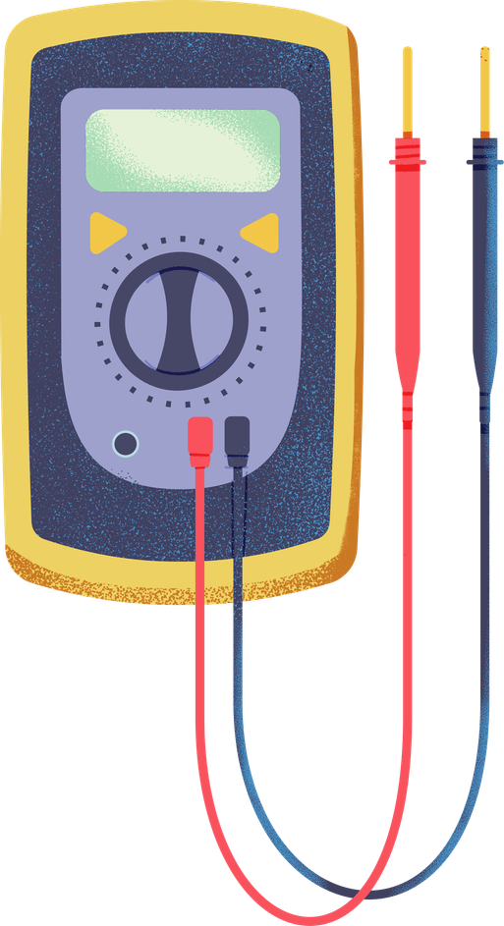
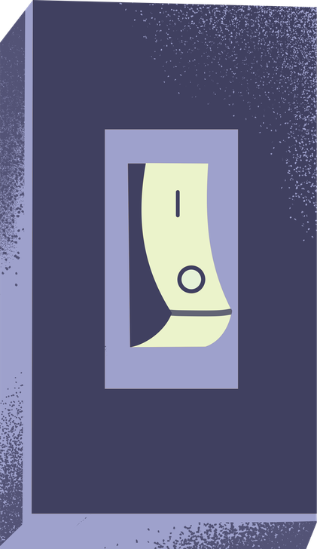


JENNIFER HOLMES MSRT(R)(CT)
PD POWERHOUSE:
THE BEST IDEAS I HAVE EVER STOLEN

Slide 2


TOPICS COVERED TODAY
  Success in the classroom
  Grouping students in ways that actually work
  Accommodation tracking
  Sub Planning
  You Should Buy That
  You Can’t Do That (Things That Will Get You Fired)

Slide 3

BUILDING A CULTURE OF
SUCCESS

Slide 4


Building a Culture of Success in Your Classroom
THINGS THAT WORK
Rules and Consequences-Set the rules and stick to them.
Decide early on, “What is the hill I will die on?”
Behavior Reflections (especially for lunch detention)

Slide 5
Building a Culture of success in Your Classroom
THINGS THAT WORK
Gain respect early (students are not your friends)
Document, Document, Document...all the different ways to document

Slide 6

GROUPING STUDENTS
In Ways That Actually Work

Slide 7

Wonderful Tools
Match Screen
Classroom Screen
Deck of Cards
Ideas from the Teachers in the Room

Slide 8


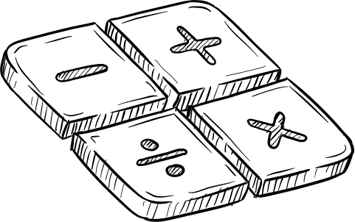
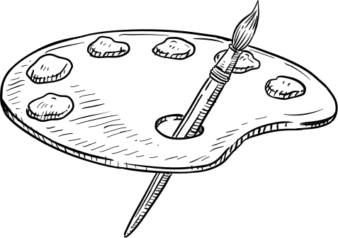



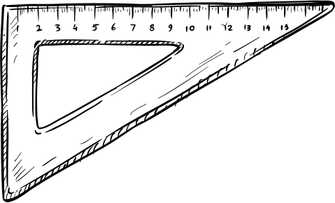
Accomodation
Tracking

Slide 9

Sub Plans
All the things you need to know

Slide 10








You Should Buy That
Really Great Teacher Things

Slide 11



YOU SHOULD BUY THAT LIST
Link to Master List
 | Classroom Decor
 | Chair Cover (full back) or (split back)
 | Ice maker
 | Tool Set
 | First Aid Kit
 | Hall passes (write your name/room number on them)
 | Light covers
 | Helpful Tools
 | Buzzers for Trivia Games
 | Sensory Stickers
 | Emotional support stickers
 | Meme grading stickers
 | The best staple remover in the world
 | Magnetic hooks (work to hang stuff from the ceiling)
 | Broom/dustpan
 | Helpful Tools
 | Step ladder
 | Magnetic Pockets
 | Colored Dry Erase Markers
 | Binder Clips Assorted Sizes
 | Mini Basketball Hoop
 | Gumba
 | 330 Second Dance Party
 | Teacher Attire
 | Teacher Bag #1
 | Teacher Bag #2
GUMBALL MACHINE

Slide 12



LET’S PLAY
Will This
Get You Fired?

Slide 13


QUESTION 2
You change a student’s grade because their parent is your friend?
With this get you fired?

Slide 14
Fired.
  Falsification of student records.
  Unethical conduct under the Arkansas Educator Code of Ethics.
  Abuse of a position of trust.
  Violation of district policies regarding grading and recordkeeping.

Slide 15

ANSWER THE QUESTION
YOU ACCEPT A $500 AMAZON GIFT CARD FOR TEACHER APPRECIATION WEEK. WILL THIS GET YOU FIRED?

Slide 16
THE ANSWER IS...
ARKANSAS'S EDUCATOR ETHICS CODE SPECIFICALLY WARNS AGAINST ACCEPTING GIFTS OR FAVORS THAT COULD IMPAIR OR APPEAR TO INFLUENCE PROFESSIONAL JUDGMENT.
ARKANSAS ETHICS COMMISSION RULES STATE THAT A PUBLIC SERVANT (WHICH GENERALLY INCLUDES PUBLIC SCHOOL EMPLOYEES) MAY ACCEPT AN ITEM GIVEN AS APPRECIATION FOR DOING THEIR JOB IF THE VALUE DOES NOT EXCEED $100.

Slide 17

The state defines a prohibited gift as anything over $100 given to reward past, present, or future official actions .
A $500 gift card easily exceeds this limit. Accepting it can lead to a Class A misdemeanor, which carries penalties of up to one year in jail, a $2,500 fine, and immediate grounds for termination by your school district.

Slide 18
MULTIPLE CHOICE
YOU HAVE CALLED SOMEONE TO WATCH YOUR CLASS TO LET YOU GO TO THE BATHROOM AND NOBODY SHOWS FOR 15 MINUTES AFTER YOU CALLED.
A. You just go to the bathroom but rush.
B. You pee/poop your pants.
C. Knock on the door to a neighboring class and ask them to listen for the class.
D. Don’t go.

Slide 19

MULTIPLE CHOICE
YOU HAVE CALLED SOMEONE TO WATCH YOUR CLASS TO LET YOU GO TO THE BATHROOM AND NOBODY SHOWS FOR 15 MINUTES AFTER YOU CALLED.
A. You just go to the bathroom but rush.
B. You pee/poop your pants.
BEST ANSWER
C. Knock on the door to a neighboring class and ask them to listen for the class.
D. Don’t go.

Slide 20





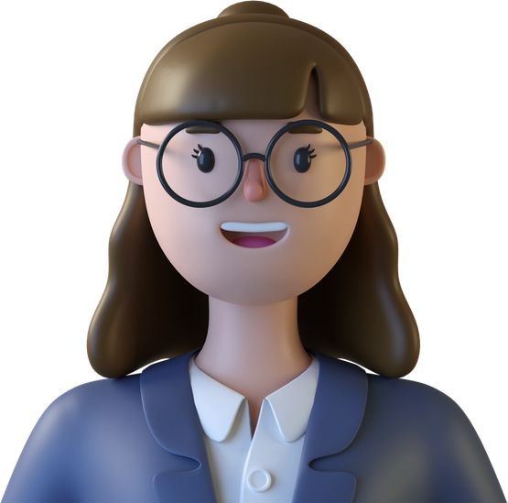


Answer the Question
You purchase a bunch of food and drinks and charge kids for the products so that you can buy more later on.
DONNA

Slide 21
Answer
Fired (if you ignore correction)
Not a good idea to do.
DONNA

Slide 22
Answer the Question
You are fired up on social media and post your extreme political views on your personal page. It gets a ton of responses because it goes against most of the public’s opinions.
DONNA

Slide 23
Answer
50/50 chance of getting fired.
DONNA

Slide 24
Answer the Question
You consistently hit “Reply All” when answering an email.
DONNA

Slide 25
Answer
Not fired, but will definitely annoy your coworkers when it isn’t necessary.
DONNA

Slide 26
Answer the Question
You are using your school-issued iPad for your Kindle app and you thoroughly enjoy the kinky romance novel genre. You have 8 different books downloaded onto that device.
DONNA

Slide 27
Answer
Possibly. Depends on your school's device use policy. In MHPS, it can get you fired.
DONNA

Slide 28





Scenario #1
30 seconds!
You need to pass out a ton of papers back to your students but will be out of town for PD. You leave a note for a trusted student to take care of this for you in your sub plans.
Will this get you fired?

Slide 29






Answer
+1 Point!
Yes! This is a blatant FERPA violation. (You should at least expect to be fired/written up .)

Slide 30

Other good information to have

Slide 31
Thank You For Attending
JENNIFER HOLMES MSRT(R)(CT)
-
JHOLMES@MHBOMBERS.COM

