Slide 1
Advocacy is in everyone’s job title
Alisha Hyslop
Chief Policy, Research & Content Officer
Association for Career and Technical Education
July 23, 2026

Slide 2
Defining Advocacy
Advocacy is the act of publicly supporting, recommending, or pleading in favor of a cause, policy, or group
Advocacy is the process of sharing knowledge to change and/or influence policies and practices.
Advocacy is a process, not a one-way or one-time activity

Slide 3
Advocacy
Advocacy requires an advocate – a person who speaks on behalf of a cause or proposal. Becoming an advocate is one of the most important things you can do to secure the future of CTE!
Notes:
To be an advocate means to speak on behalf of a cause or proposal, in this case, CTE.

Slide 4
Why is Advocacy Important?
Policymakers work for you!
You are an excellent resource!
You have the power to make change!
Notes:
Policymakers do not have one singular supervisor – we are their boss. Just as it is their responsibility to represent our needs in government, it is our responsibility to communicate our needs to them.

Slide 5
Advocacy Targets
Local Leaders
State Leaders
Federal Leaders
Superintendent
School Board
City Council Mayor
& More
State Delegates
State Senators
Governor
Dept of Ed
Dept of Labor
General Assembly
Senators
House Rep
President
Dept of Ed
Dept of Labor
Notes:
Advocacy is relevant at all levels of government, whether it’s to your local, state or federal leaders. At ACTE we primarily help you to advocate to your federal leaders. However, these many of these tools and tactics are useful for advocacy at any level.
Local leaders include:
Superintendent, School Board Member, City/County Supervisor or Council Member, Mayor or County Executive
State leaders include:
State Delegate, State Senator, Governor’s Office, Department of Education Officials, Department of Labor/Workforce Officials, Education Committee members in General Assembly
Federal leaders include:
Senators, House Representative, President, Department of Education/Labor Officials

Slide 6
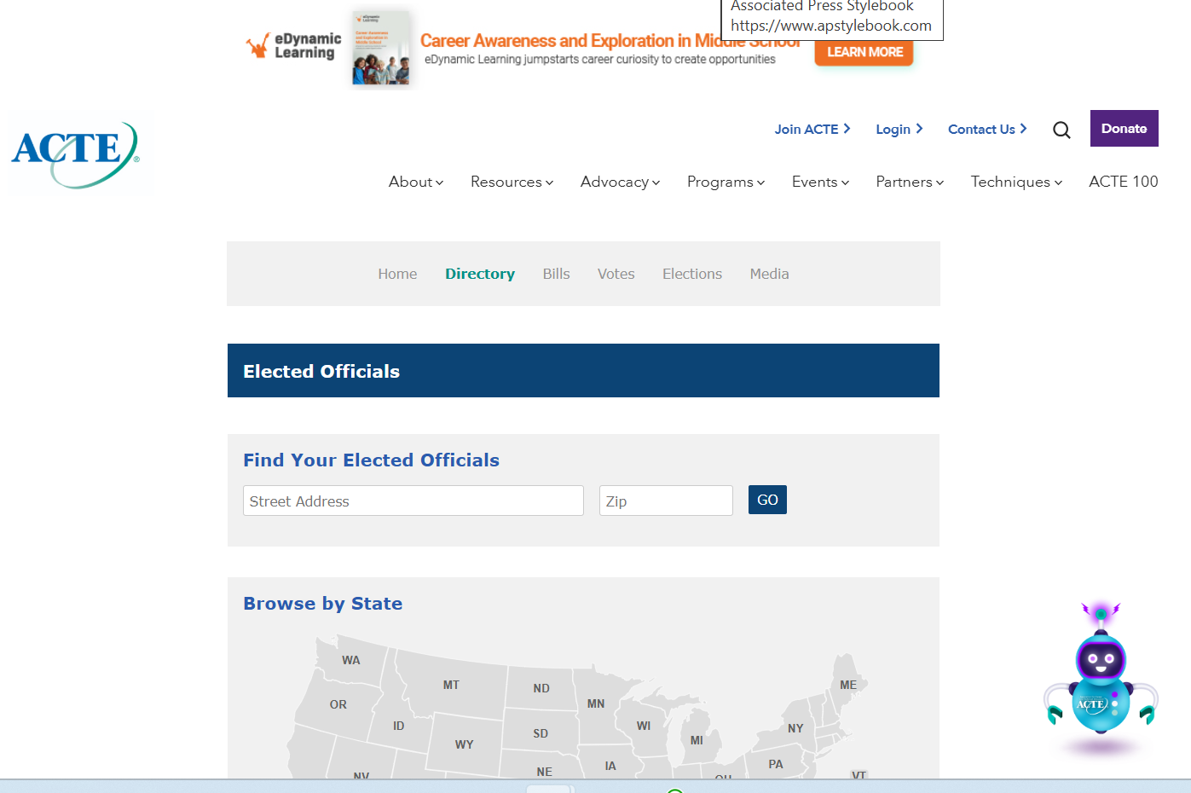

Slide 7
Approaches to Advocacy
Grassroots Advocacy
Grasstops Advocacy
Policy Advocacy
Digital Advocacy
Direct Action

Slide 8
Defining Lobbying
LOBBYING ACTIVITIES .—The term “lobbying activities” means lobbying contacts and efforts in support of such contacts, including preparation and planning activities, research and other background work that is intended, at the time it is performed, for use in contacts, and coordination with the lobbying activities of others.
LOBBYING CONTACT .—The term “lobbying contact” means any oral or written communication (including an electronic communication) to a covered executive branch official or a covered legislative branch official that is made on behalf of a client with regard to—
  the formulation, modification, or adoption of Federal legislation (including legislative proposals);
  the formulation, modification, or adoption of a Federal rule, regulation, Executive order, or any other program, policy, or position of the United States Government;
  the administration or execution of a Federal program or policy (including the negotiation, award, or administration of a Federal contract, grant, loan, permit, or license); or
  the nomination or confirmation of a person for a position subject to confirmation by the Senate.
Exceptions include mass communications; a request for a meeting, a request for the status of an action, or any other similar administrative request; testimony given before a committee, subcommittee, or task force of the Congress; information provided in writing in response to a request

Slide 9
Lobbying for 501(c)(3)'s
In general, no organization may qualify for section 501(c)(3) status if a substantial part of its activities is attempting to influence legislation (commonly known as lobbying). A 501(c)(3) organization may engage in some lobbying, but too much lobbying activity risks loss of tax-exempt status.
Legislation includes action by Congress, any state legislature, any local council, or similar governing body, with respect to acts, bills, resolutions, or similar items (such as legislative confirmation of appointive office), or by the public in referendum, ballot initiative, constitutional amendment, or similar procedure. It does not include actions by executive, judicial, or administrative bodies.
An organization will be regarded as attempting to influence legislation if it contacts, or urges the public to contact, members or employees of a legislative body for the purpose of proposing, supporting, or opposing legislation, or if the organization advocates the adoption or rejection of legislation.
Organizations may, however, involve themselves in issues of public policy without the activity being considered as lobbying. For example, organizations may conduct educational meetings, prepare and distribute educational materials, or otherwise consider public policy issues in an educational manner without jeopardizing their tax-exempt status.
https://www.irs.gov/charities-non-profits/lobbying

Slide 10
Advocacy Communication Methods
Written communications
Phone Calls
Meetings (including virtual and informal)
Social media
Traditional media

Slide 11
Local Partnerships
Potential Partners
Are interested in CTE
Can disseminate information to the community
Have experience with grassroots advocacy strategies
Notes:
Another great way to effectively utilize public forums is to use those platforms to meet others who are interested in your cause that have diverse resources to offer. For example, building partnerships with local businesses and industries, schools, PTA, public television stations and community organizations can help you gain access to different skills, networks, resources and audiences. Through these partnerships, you can also help to lift advocates' voices at events such as school board, PTA or community meetings.

Slide 12
Engage Your Local Network
Attend school board meetings
Attend PTA meetings
Use local news outlets to disseminate information (school newsletters or papers)
Identify yourself as a resource
Notes:
In addition to school events such as school board and PTA meetings, you can also disseminate information via your school's networks such as newsletters or newspapers. It's also a good idea to engage with your local school board officials to ensure they recognize you and/or your coalition as important stakeholders in their work.

Slide 13
Other Local Opportunities
Community forums
Media tours
Listening sessions
Candidate forums & debates
Candidate appearances at public events
Business/employer convenings
Notes:
Be sure to not engage in partisan activity when on the clock or representing your school!

Slide 14
Communicating with Policymakers
Keep it short
Be positive
Ask for a reply
Establish yourself as a resource
Use facts
Explain the personal narratives behind your interest
Thank them for their time and attention
Notes:
When writing to their offices, you can use our prewritten messages available in the Action Center, or write your own! Some ways to effectively communicate your message are…
Keep it short
Be positive
Ask for a reply
Establish yourself as a resource
Use facts
Explain the personal narratives behind your interest
Thank them for their time and attention

Slide 15
Key Messages
CTE engages students in education
CTE provides students with real-world skills
CTE helps students find their passion and provides options for college and career success
CTE prepares learners to meet the needs of the economy

Slide 16
Data and Storytelling
“Stories give life to data, and data gives authority to stories.”
- Wendy Newman

Slide 17
Storytelling Tips
Start with a Student
Share a real or relatable story. Who are they? What challenges did they face?
Show the Impact
How did your program help? Use one clear result or change.
Keep It Short
1–2 minutes max. Focus on emotion and outcome, not every detail.
Make It Local
Connect the story to your policymaker’s community or district.
End with a Call to Action
Ask for support. Be clear and direct: “This program works—please help us keep it going.”

Slide 18

Resources
CTE Policy Watch Blog
https://ctepolicywatch.acteonline.org/
Action Center
https://www.acteonline.org/take-action-congressweb-embed/#/
Advocacy Resources
https://www.acteonline.org/advocacy/advocacy-resources/
Notes:
We will send out some media after the presentation with link to the above resources, as well as the slides!

Slide 19
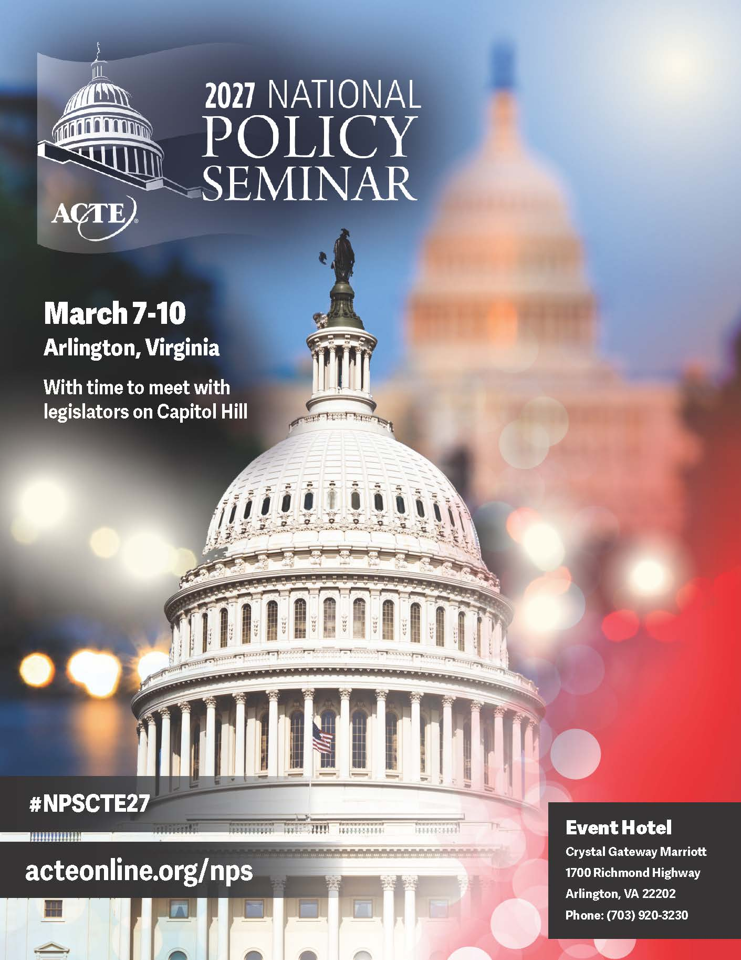
ACTE’s National Policy Seminar
Engage on key federal education policy priorities ​
Influence federal policies related to CTE advocacy, research and messaging​
Participate in Capitol Hill visits

Slide 20
Contact Info
Alisha Hyslop
ahyslop@acteonline.org
www.acteonline.org
@CTEPolicy

