Slide 1



From Classroom To Career: How Teamship Supports WBL
July 2026
Notes:
Colorado school districts are finding practical, scalable ways to expand high-quality career learning while advancing the Big Three and strengthening partnerships with local employers. This session explores how these efforts are helping districts build a more career-ready student population without overextending staff capacity.
Attendees will learn proven strategies for bridging the gap between classroom and career, including how programs like Teamship immerse students directly in real industry challenges. We'll examine how this work directly supports the Big Three and creates measurable value for districts, students, and employer partners alike.

Slide 2



The Colorado Moment: The Big Three
Quality Work Based Learning
College Credits
Industry Recognized Credentials
An authentic experience aligned to Colorado's WBL quality expectations, including labor market alignment and structured reflection.
Credit earned in high school that is aligned to a clear postsecondary pathway.
An in-demand credential that signals real skills to Colorado employers.
Today's focus: how districts can deliver the WBL leg of the Big Three at scale, without overextending staff.
College Board Teamship | From Classroom to Career
2
Notes:
Ground the room in the shared goal. CDE's strategic plan calls for 100 percent of Class of 2029 graduates to complete quality work based learning, college credit, or an industry recognized credential. Most districts have strong momentum on credit and credentials; WBL is where scale gets hard. Ask the room: which of the three is hardest for your district to deliver at scale? Expect WBL to be the common answer, which sets up the next slide.

Slide 3
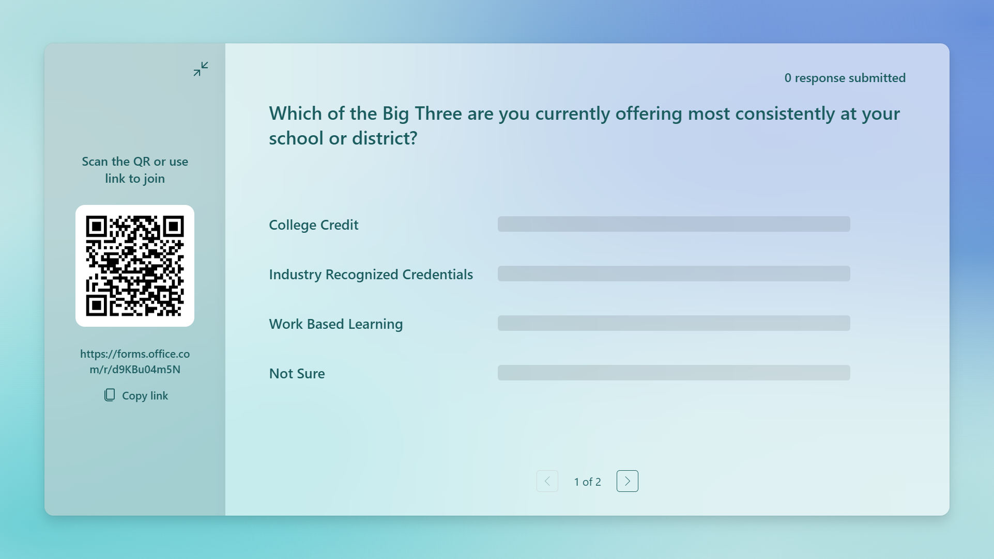
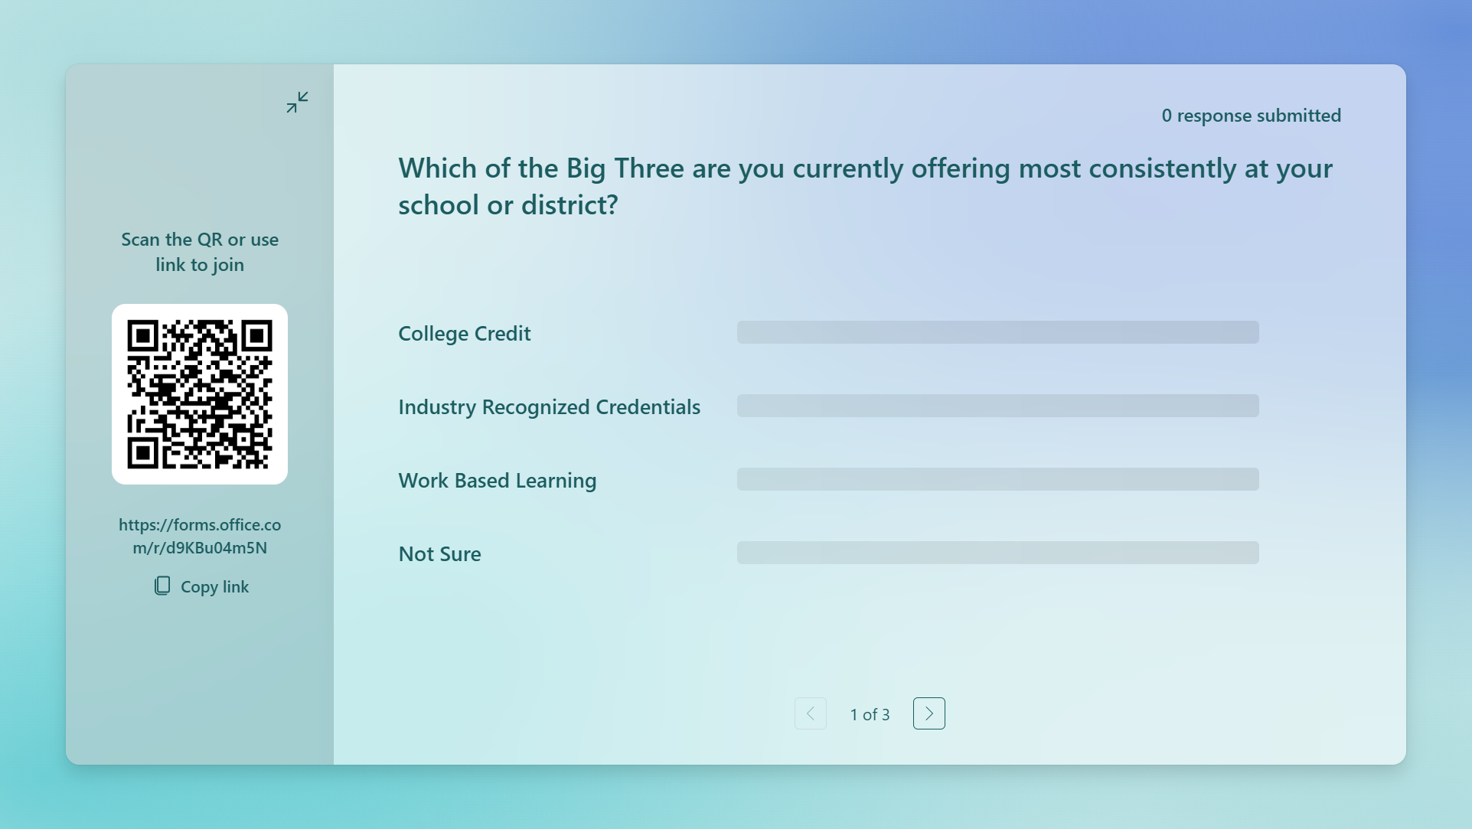

Slide 4




The District Challenge
Colorado educators at the PWR regional trainings named the same barriers again and again. Districts want quality WBL for every student, but the traditional model strains against real constraints.
Limited employer capacity
Transportation & scheduling
There are not enough traditional placements for every student who needs one.
Getting students to work sites conflicts with school schedules, especially in rural areas.
Access tied to networks
Staff bandwidth
Traditional internships favor students who already have social capital and connections.
Coordinating placements one student at a time overextends counselors and CTE staff.
The question is not whether to expand WBL. It is how to do it at scale.
College Board Teamship | From Classroom to Career
3
Notes:
Validate what educators already know. These four barriers came up repeatedly at the PWR regional trainings: employer capacity, transportation and scheduling, network dependent access, and staff bandwidth. Emphasize the last one, coordinating placements one student at a time is the hidden cost. Land the transition line: the question is not whether to expand WBL, it is how to do it at scale.

Slide 5
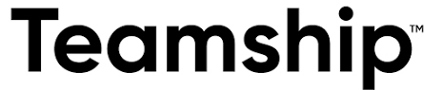
Bridging the Gap
Internship & Apprenticeships
Learning About Work
  Simulated, not authentic experiences
  Quality varies by provider
  Disconnected from student interests
  Minimal contact with employers
  No culminating moment
Real world problem solving.
Builds durable skills employers want.
Removes access barriers tied to social capital.
Guided coaching and structured support.
A capstone moment that builds real confidence.
Students often underprepared
Heavy burden on employers
Limited placement capacity
Access tied to existing networks
Hard to scale consistently

Slide 6


What is Teamship?
Teamship immerses small teams of students directly in real industry challenges, delivered through school, so every student gets a seat at the table.
Working across differences
Navigating uncertainty
Solving open ended problems
Delivering value through collaboration
Teams are intentionally built from varied backgrounds, strengths, and perspectives.
There is no answer key. Students learn to move forward without a script.
Real industry challenges rarely have one right answer, so students frame before they solve.
Teams pitch a proposal grounded in real insight directly to the business partner.
College Board Teamship | From Classroom to Career
4
Notes:
Introduce Teamship as the bridge. Key phrase: delivered through school. That single design choice removes the transportation, scheduling, and network barriers at once. Walk the four capacities briefly, they mirror what employers say durable skills look like in practice. Note this is real client work, not case studies or simulations.

Slide 7



How Teamship Works
Groups of three to four students collaborate over 60 hours to solve a meaningful, real-world problem for a business. No case studies, no hypotheticals.
1. Team
2. Launch
3. Solve
4. Pitch
Each team is intentionally designed to include different backgrounds, strengths, and perspectives.
Teams build skills, align on how they will work together, and interview their business partner.
With support from a certified coach, teams explore the root problem and design a proposal.
Students present live to the business partner and answer questions in real time.
College Board Teamship | From Classroom to Career
5
Notes:
Walk the model: Team, Launch, Solve, Pitch, roughly 25 to 40 hours total. Highlight two design details: teams are intentionally diverse because solving complex problems starts with seeing them from all sides, and a certified coach guides the process so students are never navigating alone. The live pitch is the accountability moment, students present directly to the business partner and take questions in real time.

Slide 8
How Teamship Advances the Big Three
Teamship maps directly to Colorado's expectations for quality work based learning.
COLORADO WBL QUALITY EXPECTATIONS
HOW TEAMSHIP DELIVERS
Authentic experience, not simulation
Students solve a real, unscripted problem for a real business, no case studies.
Labor market alignment
Problems come from real Colorado-relevant industries: operations, hiring, marketing, and growth.
Assessment and structured reflection
Coaching checkpoints and a culminating live pitch let students demonstrate learning.
Equitable access for all students
Delivered through school, removing the network, transportation, and placement barriers.
College Board Teamship | From Classroom to Career
6
Notes:
This is the alignment slide for district leaders. Left column is Colorado's WBL quality expectations under SB22-140; right column is how Teamship delivers each one. Spend the most time on the bottom row, equitable access, because delivered through school is what makes 100 percent goals plausible rather than aspirational. Invite questions about how districts document this alignment for reporting.

Slide 9


Built on the Mindsets of Modern Work
Teamship builds the mindsets students need to thrive in modern work, the durable skills employers say should be taught in high school.
Analytical
Design
Collective
Self-aware
Real problems are messy. Break them down before jumping to solutions.
All problems are human. Understand needs, motivations, and context with an orientation to action.
The best teams bring together different perspectives, not a single point of view.
Students own their growth, their habits, and how they show up on a team.
College Board Teamship | From Classroom to Career
7
Notes:
Connect mindsets to employer demand. Nearly all employers say durable skills like critical thinking and communication should be taught in high school. Analytical, Design, Collective, Self-aware are not soft add-ons, they are the operating system for the whole experience. Coaches are trained to coach on process rather than deliver content, which is also why this does not become one more curriculum for teachers to absorb.

Slide 10


What Makes Teamship Different
Full business partner services reduce burden on schools and employers.
Students work on real business problems with real impact.
Coach Institute certifies and supports educators.
Equitable Access
Traditional internship opportunities favor students with social capital and family connections. Teamship removes those barriers. Delivered through school, Teamship provides access for more students.
Rigorous Coaching
Traditional internships are often overseen by busy managers with little time, where students are left to figure things out alone. In Teamship, certified educators provide structured coaching to help student teams navigate challenges and build confidence.
Durable Skills
The workplace today rewards those who can adapt, collaborate, and solve ambiguous problems. Teamship mirrors that world, where there's no script, no single right answer, and success comes from learning how to coordinate with others to do hard things.
College Board Teamship | From Classroom to Career
22

Slide 11



What Students Take Away From Teamship
The student experience in Teamship builds real work credentials, durable growth, broader thinking, and impact that reaches beyond the classroom.
Real work experience that stands out
Growth that stays with you
A reimagined internship that goes beyond shadowing or simulations. Students push through the productive struggle of a hard problem and present ideas to real professionals.
In the AI age, making sense of complexity matters more than memorizing facts. Students practice breaking problems down, pushing through uncertainty, and bringing people together.
The kind of experience that stands out on college applications and in job interviews.
Practicing these mindsets builds confidence, competence, and the ability to make an impact.
Perspectives that expand how you think
Impact that goes beyond the classroom
Students work alongside teammates who approach problems, communicate, and decide differently, broadening their thinking and learning from one another.
Teams work with real businesses on real problems, improving employee training, redesigning an app, or shaping a startup's growth strategy.
They learn to listen more closely, challenge assumptions, and build ideas that go further.
The work is real, the stakes are real, and student ideas can create meaningful change.
College Board Teamship | From Classroom to Career

Slide 12
Measurable Value for Every Stakeholder
Teamship creates value districts, students, and employer partners can all see and measure.
10,000+
Students served through Teamship since 2017, delivered through school so access does not depend on networks
719
Businesses have offered real problems through Teamship, expanding employer engagement without district legwork
83%
Of business partners have implemented, or plan to implement, at least part of the student proposed solution
9.4
Average rating (out of 10) from business partners asked if they would recommend Teamship to another leader
College Board Teamship | From Classroom to Career
8
Notes:
Proof points. 10,000 plus students since 2017. 719 businesses have offered real problems. 83 percent of partners have implemented or plan to implement part of the student solution, that is the strongest line for employer skeptics, students produce work businesses actually use. 9.4 out of 10 partner recommendation score means the employer pipeline sustains itself. Pause here for questions on evidence.

Slide 13


Scale Without Overextending Staff
Teamship carries the heaviest lifts, partner recruitment, problem scoping, and coach development, so district staff can focus on students.
Business partnerships handled for you
Readiness & implementation support
Teamship maintains the employer network, secures partners, scopes problems, and manages relationships.
The Teamship team plans the implementation with you and supports coaches at any time after launch.
The Teamship Playbook
Ongoing professional development
Program planning resources, coaching slides and notes, and a video library of professional development.
Certified coaches get continuing development through recordings and live events, no district PD burden.
Employer commitment is under 5 hours, at no cost, with full onboarding, low lift for partners, high impact for students.
College Board Teamship | From Classroom to Career
9
Notes:
Address the staff capacity concern head on. Teamship carries the heaviest lifts: partner recruitment, problem scoping, the Playbook, and ongoing coach development. District staff focus on students, not logistics. For employer conversations: under 5 hours, no cost, full onboarding, and they walk away with usable ideas. Low lift for partners, high impact for students.

Slide 14


BUSINESS PARTNER COMMITMENT
Low-lift. High-impact for students.
Full onboarding and support are provided, and business walk away with a fresh perspective on a business problem they are facing.
Less than 5 hours of your time
Full support & onboarding
The full engagement fits inside a single workweek's spare hours.
Teamship prepares you for every touchpoint, no guesswork required.
3 facilitated student meetings
No cost to your organization
Every conversation is structured and guided by a certified coach.
There is no fee to participate as a business partner.
Scheduled well in advance
Fresh ideas & insights you can use
Dates are locked early so the commitment never surprises your calendar.
Student teams deliver proposals grounded in real research on your problem.
83% of partners implement or plan to implement student solutions 9.4 / 10 average partner recommendation rating
College Board Teamship | From Classroom to Career

Slide 15







Schools and Business Partners We Work With
Solving real business challenges while shaping the future workforce
Join the 700+ businesses big and small who have worked with students in the Teamship program.
Pose a Real Business Problem
Real-world problems are messy, complex, and open-ended. They are also opportunities for real-world learning and innovation.
Get Fresh Insights
See firsthand the fresh perspectives and innovative solutions student teams have to offer.
Join our growing network of businesses preparing the next generation of talent.
Provide Valuable Experience
Real-world collaboration is preparing tomorrow's workforce today. Your participation benefits the businesses at the heart of our communities.
BECOME A BUSINESS PARTNER ↗
23

Slide 16


Employer Engagement
U.S. Chamber
of Commerce
400+ Employer Endorsements and Counting!
AP Business with Personal Finance and AP Cybersecurity courses offer high school students the opportunity to earn credentials that validate professional skills and meet industry needs.
Addressing the Readiness Gap
Colorado Chamber
of Commerce
College Board is partnering with the U.S. Chamber of Commerce to bring additional employers to the table and partner with educators.
Workforce Development Initiative
College Board is working with local Colorado Chambers, Districts, Workforce Development Boards, and Career Focused Intermediaries to host employer engagement events.
National and state partners bringing employers to the table
College Board Teamship | From Classroom to Career
24

Slide 17

Pueblo School District 60 Spotlight
Marci Imes
Executive Director of Secondary and Career and Technical Education
SCHOOL DISTRICT
Supporting the Big 3
Launching Teamship in 2026
CollegeBoard
27

Slide 18
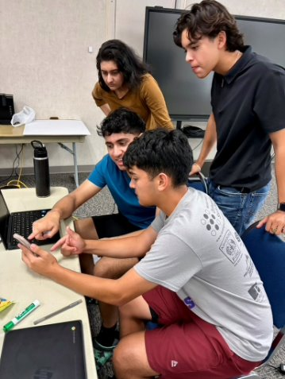
From classroom to career, for every student.
Teamship delivers the WBL leg of the Big Three, at scale and through school
Every student gets access, not just the well connected
Employers engage at low lift and see measurable value
District staff get structure, support, and a proven playbook
Let's talk about what a Teamship implementation could look like in your district.
Notes:
Close with the four takeaways, then open the conversation. Suggested ask: if your district is mapping its Big Three strategy for next year, let's talk about where Teamship fits. Offer to follow up with the alignment mapping from slide 6 and implementation timelines. Leave contact information verbally or in a handout.

Slide 19
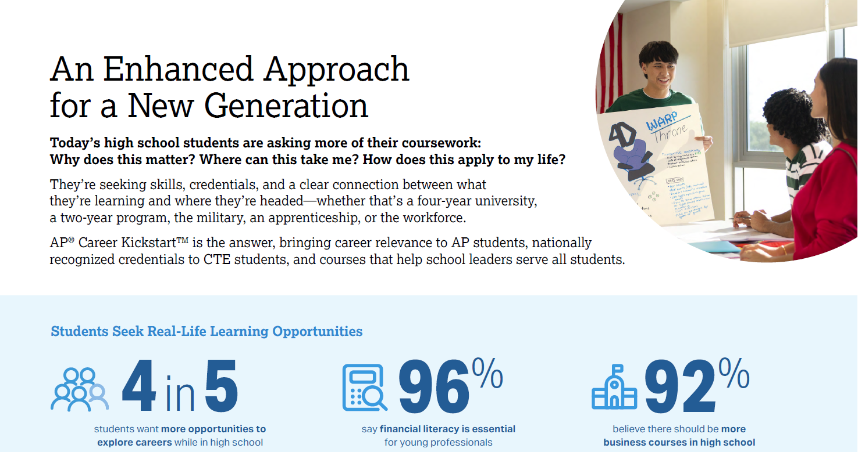
Notes:
Todays students are asking for more from their course work
students are disengaged and courses lack relevance
Coursework doesn’t adequately challenge them or allow them to showcase their best
-student want choice and agency
-hands on learning: experiments, simulations, demonstrations
Students seek real life learning opportunities
80% of students want more opportunities to explore careers
Almost every student felt that Financial literacy is important & want more business courses in their high school

Slide 20
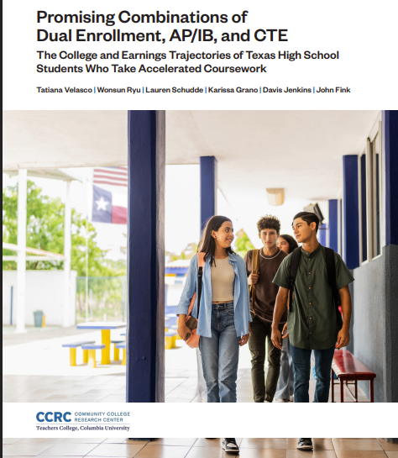
“Students who combine career-and-college-accelerated coursework … have stronger postsecondary attainment and sustained earnings gains by age 24 compared to students with a CTE-focus-only approach or no accelerated coursework.”
Source: https://ccrc.tc.columbia.edu/wp-content/uploads/2025/10/promising-combinations-dual-enrollment-ap-ib-cte-2.pdf

Slide 21
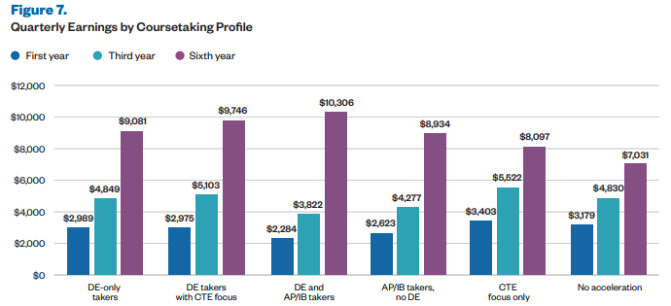
Leverage Point: Combining Advanced Coursework
Students with a CTE focus earn more than others in the first three years after high school, but after six years, students with DE, AP, and/or IB are the highest earners
Source: https://ccrc.tc.columbia.edu/wp-content/uploads/2025/10/promising-combinations-dual-enrollment-ap-ib-cte-2.pdf
Notes:
Short-term pathways matter—but long-term mobility is driven by rigorous academic access.
While early earnings may favor CTE, but long-term earnings favor AP/DE
Students combining AP + Dual Enrollment → strongest outcomes

Slide 22
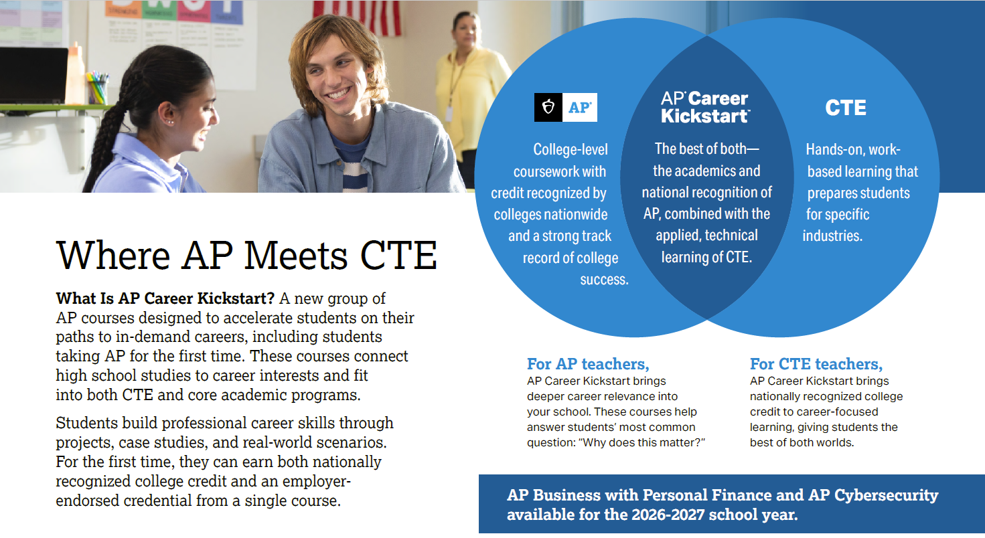
Notes:
AP Career Kickstart courses are designed to do more than just teach content—they build real career skills in four key ways:
They help students connect what they’re learning in school to their future college and career goals.
They focus on project-based learning, so students practice the kinds of tasks they’d face on the job.
The courses are aligned with college and industry standards, ensuring the skills are relevant and recognized.
And importantly, we’re partnering with employers to help validate and even score the exams—so students can earn both college credit and an employer-endorsed credential.
Bottom line: these courses deliver on what students are asking for—learning that means something and prepares them for what’s next.

Slide 23
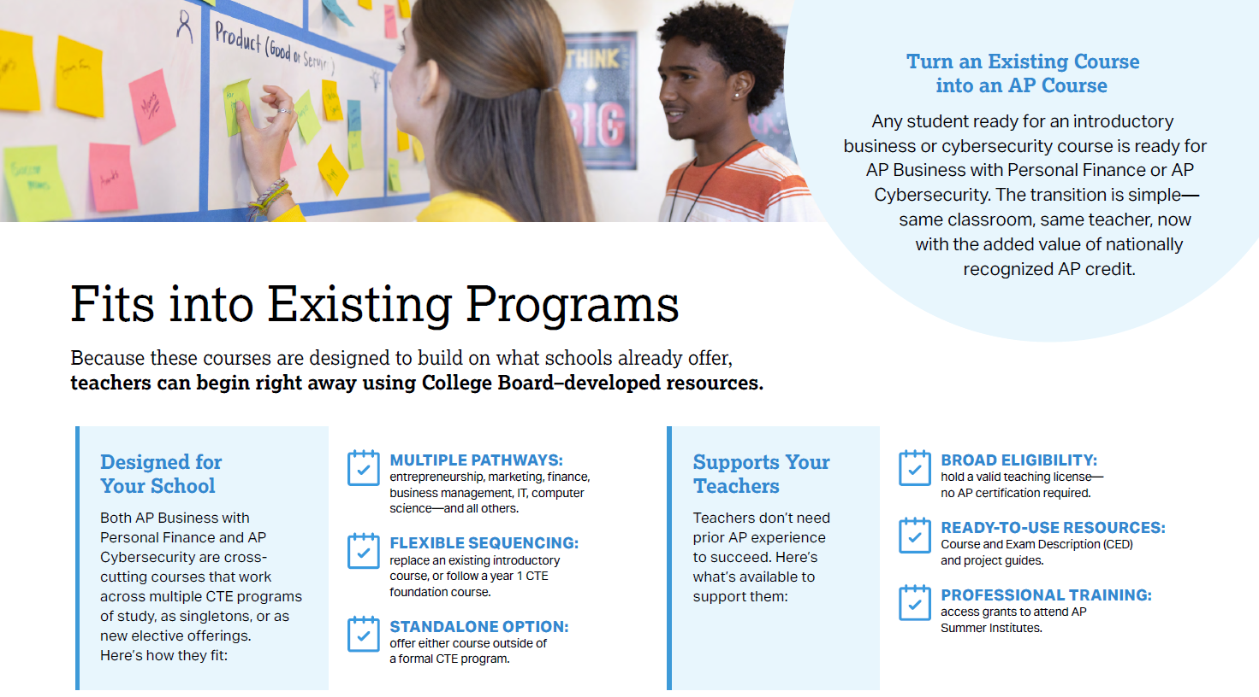
Notes:
Fits into what you already offer.
These courses build on existing business, marketing, finance, IT, and CTE pathways — no need to create a new program from scratch.
Simple transition to AP.
Schools can convert an existing introductory course into an AP course — same classroom, same teacher, now with nationally recognized AP credit.
Flexible implementation models.
Use it as a replacement course, a sequenced pathway option, or a standalone elective — giving schools scheduling and staffing flexibility.
No AP experience required for teachers.
Educators don’t need prior AP certification to begin, lowering barriers and accelerating launch timelines.
Ready-to-use College Board resources.
Course frameworks, exam descriptions, and project guides are provided — reducing prep burden and ensuring consistency and quality.
Professional development included.
Teachers gain access to AP Summer Institutes and training, building internal capacity and long-term program sustainability.

Slide 24
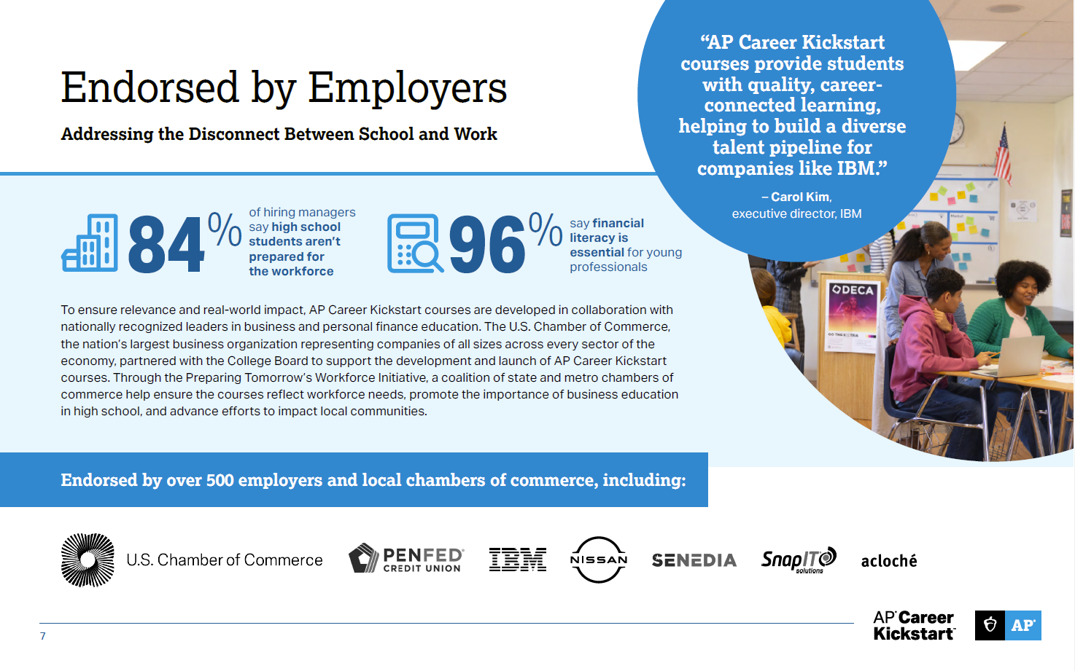
Notes:
There’s a clear workforce readiness gap.
84% of hiring managers say high school students aren’t prepared for the workforce, and 96% say financial literacy is essential — highlighting a major disconnect between school and career expectations.
AP Career Kickstart is built with employers, not just for students.
Courses are developed in collaboration with national leaders in business and personal finance, including the U.S. Chamber of Commerce, ensuring real-world relevance and career-connected learning.
Strong national employer endorsement signals credibility and demand.
More than 500 employers and local chambers of commerce — including IBM, Nissan, and PenFed — support AP Career Kickstart, reinforcing its role in building a diverse, career-ready talent pipeline.

Slide 25
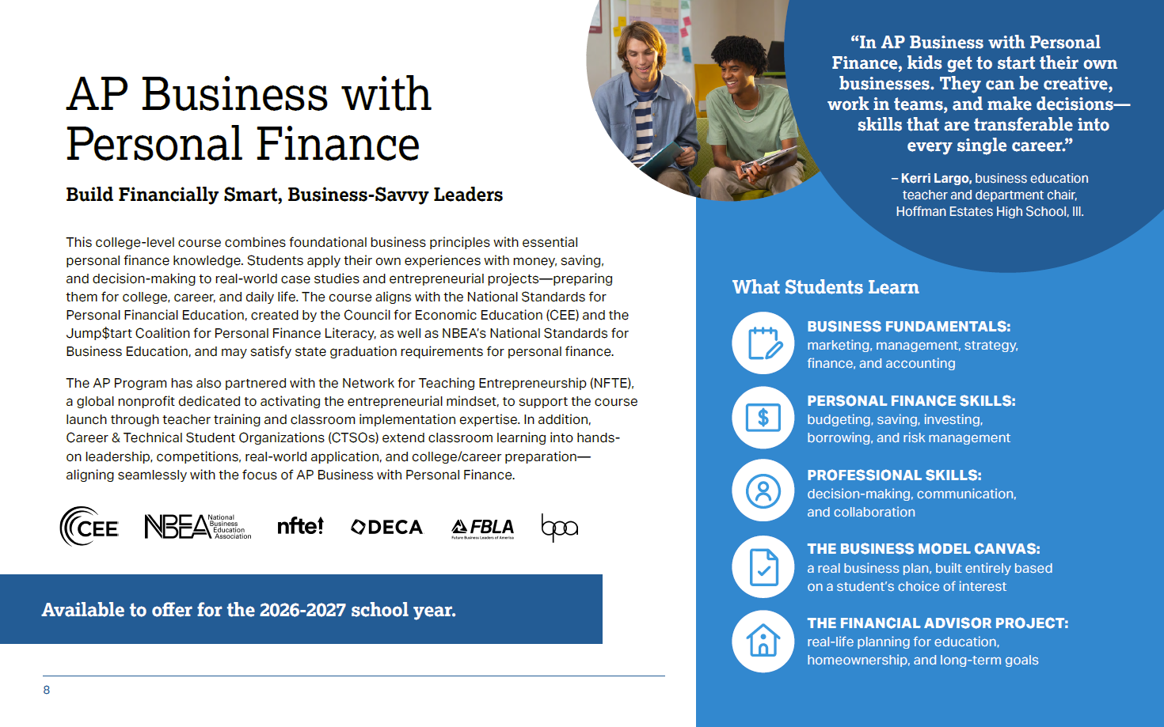
Notes:
Students learn business by doing.
Through project-based learning and the Business Canvas Project, students actively build and refine a real business idea — applying strategy, marketing, finance, and operations in an integrated way.
Personal finance strengthens business decision-making.
By connecting budgeting, saving, borrowing, and investing to business concepts, students see how financial literacy directly impacts entrepreneurial success.
Structured, comprehensive curriculum.
The course spans core business foundations — marketing, management, strategy, and finance — while embedding personal finance standards aligned to national benchmarks.
Real-world case studies drive application.
Students analyze authentic business scenarios, identify problems, apply core concepts, and make data-informed recommendations — mirroring real professional decision-making.
Capstone-level financial decision making.
In the Financial Advisor Project, students demonstrate mastery by creating financial plans tied to life goals, evaluating budgets, exploring careers, and making informed insurance and investment decisions.

Slide 26
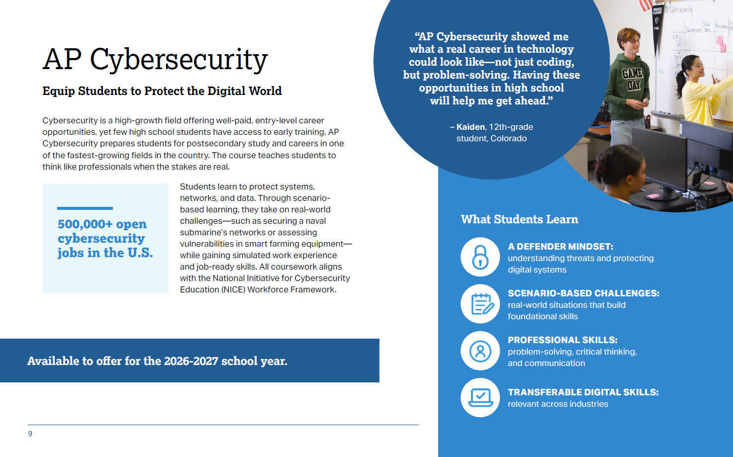
Notes:
Comprehensive, industry-aligned content.
Students build foundational and advanced cybersecurity knowledge — from social engineering and Wi-Fi threats to network defense, cryptography, and secure programming — reflecting the full security lifecycle.
Preparation for today’s and tomorrow’s threats.
The course addresses evolving risks like DDoS attacks, AI-based attacks, malware, and network vulnerabilities, ensuring students are prepared for a rapidly changing digital landscape.
Skill development that employers value.
Students strengthen communication, problem-solving, ethical reasoning, and technical analysis skills — competencies critical for both college success and cybersecurity careers.
Authentic, real-world scenarios.
Learners engage in hands-on, career-connected simulations such as vulnerability assessments, incident response planning, and securing high-risk environments.
Applied learning with professional relevance.
Through project-based tasks — like protecting air-gapped systems or securing naval communications — students practice applying technical knowledge in realistic, high-stakes contexts.

Slide 27
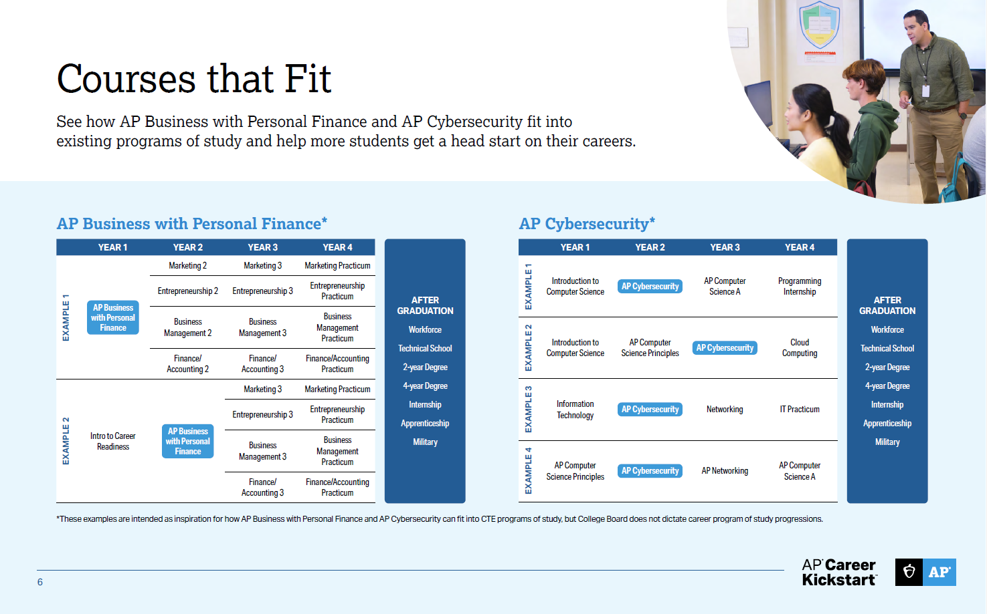
Notes:
Expand access to AP through CTE pathways.
By embedding AP Business with Personal Finance and AP Cybersecurity into existing programs of study, schools can reach students who may not have traditionally enrolled in AP — broadening participation without creating separate tracks.
Create earlier entry points to advanced coursework.
Students can take AP courses as early as Year 1 or Year 2, giving them earlier exposure to college-level expectations and building momentum toward continued AP success.
Connect high school learning to real postsecondary outcomes.
These courses align directly to workforce credentials, two- and four-year degrees, internships, and apprenticeships — helping students get a head start on both college credit and career pathways.

Slide 28
One Goal, Two Programs: Delivering the Big Three
Together, Teamship and Career Kickstart give districts a complete, scalable path to Colorado's Big Three.
TEAMSHIP
CAREER KICKSTART
CAREER KICKSTART
Quality Work Based Learning
College Credits
Industry Recognized Credentials
Teamship immerses student teams in real business problems, an authentic experience aligned to Colorado's WBL quality expectations, delivered through school.
Career Kickstart courses are built to college level standards, giving students the opportunity to earn credit aligned to a clear postsecondary pathway.
Career Kickstart pathways in fields like cybersecurity and business prepare students for in-demand credentials, backed by 400+ employer endorsements.
The wrap-up: one strategy, every student. Career Kickstart builds the credentials and credit; Teamship delivers the real world experience.
College Board Teamship & Career Kickstart | From Classroom to Career

Slide 29




CollegeBoard + Teamship
COWBL DIVISION
CACTE CareerTech Summit 2026 | Pueblo, CO
Evening Social on the Riverwalk
We're fixin' to gather for some top-tier mingling, mouth-watering grub, and a whole mess of fun. Here's the full rundown so you don't get left out in the cold!
THE DATE
THE TIME
THE PLACE
THE VIBE
Wednesday,
July 22, 2026
6:00 PM – 8:00 PM
Right when the sun starts dipping!
Angelo's Pizza
On the beautiful Pueblo Riverwalk
Where the heart of NYC
meets the soul of Pueblo, CO
Come hungry, leave connected. See you on the Riverwalk!

Slide 30

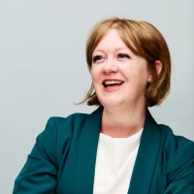
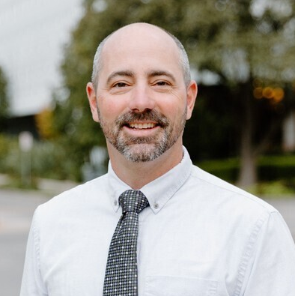
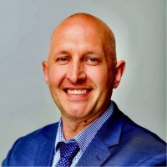
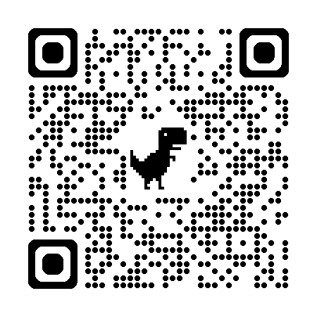
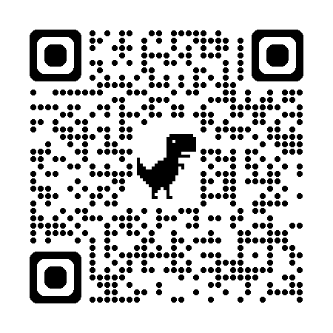
Thank You!
Chris Hughes
Director
chughes@collegeboard.org
970-623-1611
Noah Hurianek
Director
nhurianek@collegeboard.org
720-582-6735
Teamship
Career Kickstart

