Slide 1


The PIP Path
Transforming Your Life and Classroom

Slide 2

Question:
When was the last time you tried something that might fail?
Turn & talk (30–60 seconds)
Why is this question uncomfortable or is it?
Copyright 2026 The TAJL Group

Slide 3
Why this Matters:
The World Has Changed
• Jobs are evolving rapidly
• Creativity > compliance
• Problem-solvers are in demand
• Students need more than content knowledge
We’re not just preparing students for tests; we’re preparing them for life.
Copyright 2026 The TAJL Group

Slide 4
What is Entrepreneurial Thinking?
It’s NOT just starting a business
It IS:
Seeing opportunities in problems
Taking initiative
Creating value for others
Learning through action
A mindset, not a job title
Copyright 2026 The TAJL Group

Slide 5

Before we move on to the classroom….
Let’s focus on You!!!
Copyright 2026 The TAJL Group

Slide 6
Myth Busting!
Let’s Clear This Up…
❌ “I’m not a businessperson”
❌ “This doesn’t apply to my subject”
❌ “Students aren’t ready for this”
✅ This is about thinking, not business
✅ Works in ANY classroom
✅ Students are more ready than we think
Copyright 2026 The TAJL Group

Slide 7

The PIP Path
The PIP Model maintains that entrepreneurial success is a function of the synergistic interaction between passion, innovation, and perseverance.

Slide 8

Are you an Entrepreneur?
Copyright 2026 The TAJL Group

Slide 9

Simplify Life – Stop Overcomplicating it!
In my book, “Tennis Everyone! An Empowering Way to Improve Your Interactions with Others” the Simple Set, keeping it simple is essential in all aspects during game play. “Keeping it simple is really putting things into perspective. We tend to make a big deal about things as though it was the end of the world.” Do you question yourself frequently? Do you often ask yourself if should do this? Should I have done this? Are you a worrier? Often, we find ourselves creating self-inflicted fear or developing scenarios that keep us from facing uncertainty.
Copyright 2026 The TAJL Group

Slide 10

Let’s Reflect:
Think of examples of when you overcomplicated something in life or in career.
How did this affect you reaching your goal for that situation?
What impact did it have on your decision-making process?
How did it impact your relationships during that time?
Did it impact your career goals?
Reflect on how you would have done it differently and simplified the situation?
Share out with a partner and / or write this down!
Copyright 2026 The TAJL Group

Slide 11

Start Your Journey on the PIP Path
The PIP Model of Entrepreneurship is a framework proposing that Passion, Innovation, and Perseverance are the three essential, interacting drivers that sustain and guide successful entrepreneurial ventures, especially in uncertain and resource-constrained environments. According to this model:
Passion provides the emotional energy and commitment that fuels the entrepreneur’s vision and resilience.
Innovation drives the creation of novel solutions, business models, and processes that differentiate the venture and adapt to market needs.
Perseverance sustains consistent effort and adaptive problem-solving despite challenges, failures, and slow growth periods.
Copyright 2026 The TAJL Group

Slide 12

Applying it to Life - career!
How entrepreneurial thinking engaging the PIP Model enriches:
Personal growth
Career adaptability
Confidence and ownership
Mini activity:
“Identify a problem that has conflicted in your classroom, life, career, relationships and reframe it as an opportunity”
When doing this: Think about your passion, your ability to innovate and establishing perseverance.
Copyright 2026 The TAJL Group

Slide 13

Bringing it into the Classroom

Slide 14
PIP Framework in the Classroom
We can use this model and have students think like entrepreneurs and problem solvers instead of consumers of Information.
We are CTE, so we think like this already. Let's look at some classroom ideas.
Copyright 2026 The TAJL Group

Slide 15

PIP as a Lens for Learning
Instead of asking, “What did you learn?”
Passion: What part of this topic interests you most?
Innovation: How could this idea be improved, applied, or used differently?
Perseverance: What challenge did you encounter, and how did you work through it?
Can we shift from memorization to ownership and growth?
Copyright 2026 The TAJL Group

Slide 16

Establish a “Failure-to-Learning” Culture
For me, Perseverance can be the hardest component to teach.
What can ‘we’ do?
Celebrate productive mistakes. Admit our own!
Share stories of leaders, entrepreneurs and inventors who failed before finding success.
Recognize students for perseverance and not just achievement.
What can you think of? Discuss with a neighbor.
Possible classroom question, “What didn’t work, and what will you try next?”
Normalize resilience.
Copyright 2026 The TAJL Group

Slide 17

Assignments as Problem Solving Challenges
Take traditional projects and turn them into real-world problems.
You can assign a real-world problem or give them a choice – menu items.
Let students use a real-world problem they are passionate about and apply it to the project.
Other ideas?
Students use PIP to guide their solutions:
Identify the problem they are passionate about.
Develop innovative solutions.
Test, revise and ‘persist’ through setbacks and unforeseen challenges.
Copyright 2026 The TAJL Group

Slide 18
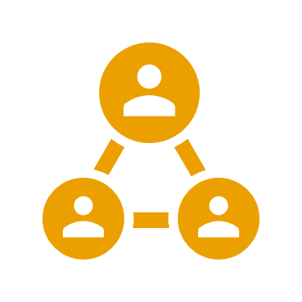
Include PIP in Group Projects
Assign roles to be connected to this mindset:
Passion Leader: Keeps the team connected to the purpose.
Innovation Leader: Generates new ideas.
Perseverance Leader: Helps the team overcome obstacles.
Can you think of a group project that you might try this with? Share out with your neighbor how it would look.
Copyright 2026 The TAJL Group

Slide 19

Some Classroom Questions:
"What are you passionate about in this situation?"
"What's an innovative approach?"
"How will you persevere through this challenge?”
Have fun with this mindset idea in your classroom. Remember who you are: Your Passion, Your Innovation and Your Perseverance. Find joy in what you do each day!
Copyright 2026 The TAJL Group

Slide 20
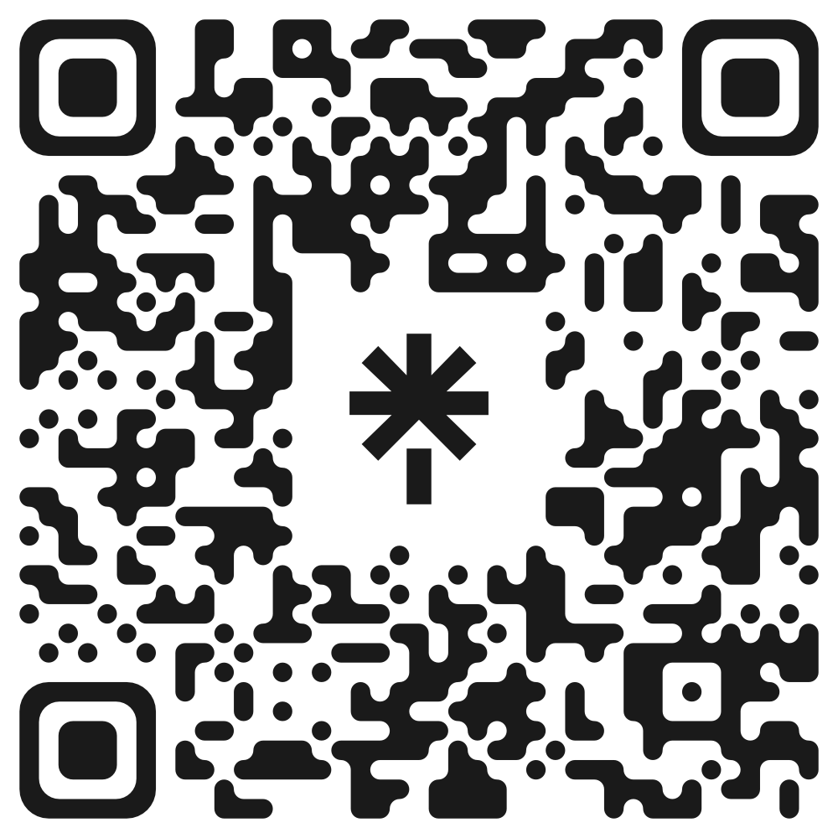
Questions? Contact Information.
LINK TO GOOGLE CLASSROOM
SCAN THIS QR CODE TO EXPLORE THE TAJL GROUP!
Email: vanessajimenez@thetajlgroup.com with specific questions or support.

