Slide 1
National ACTE Updates
Alisha Hyslop
Chief Policy, Research & Content Officer
Association for Career and Technical Education

Slide 2
ACTE celebrates 100 years as the largest national association of professionals dedicated to the advancement of CTE
Cultivating a culture of excellence & leadership in CTE for 100 years
Achieving CTE policy victories & strengthening legislative advocacy
Delivering robust professional learning & networking opportunities
Building a professional network that enhances member value

Slide 3
Centennial Activities
Microsite – https://www.acteonline.org/100
  Call for Artifacts
  Story Submission
Centennial merchandise
Trivia contest and artifact quiz
Timeline and history content
Digital assets
Upcoming documentary

Slide 4


You’re Invited
to a Once-in-a-Century
CTE Celebration!
Register by July 31 to secure
early bird rates!

Slide 5
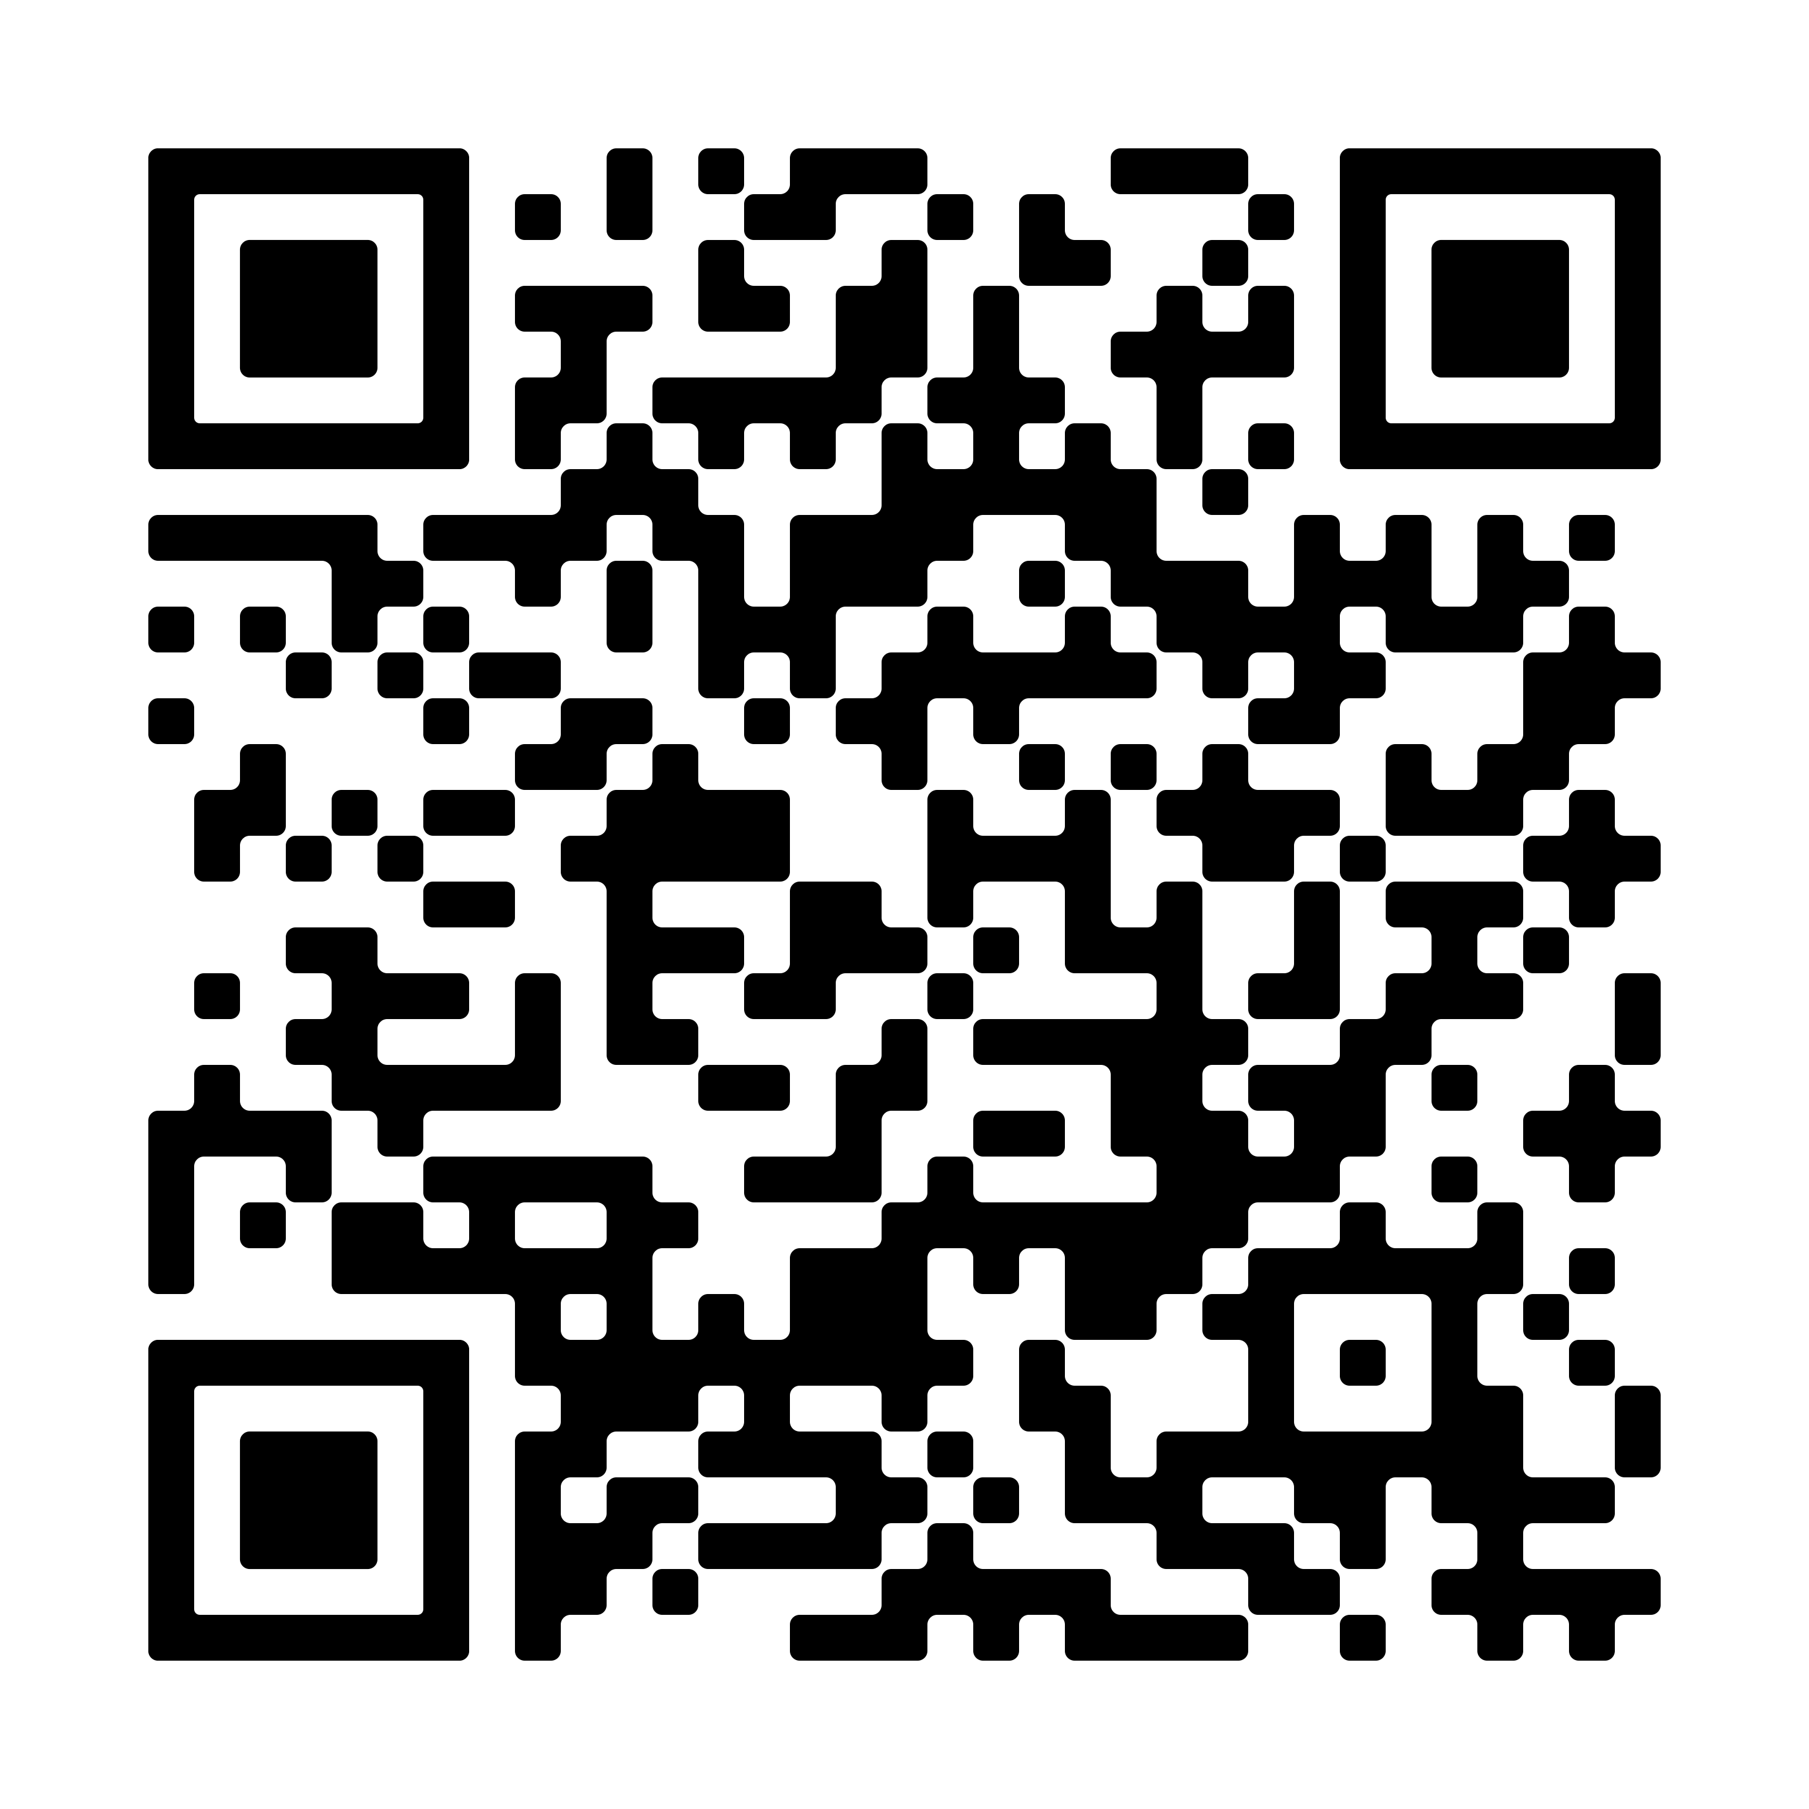
Get Involved with ACTE Member Benefits
Professional learning & networking opportunities
Leadership & recognition programs
High-quality CTE research, advocacy & awareness resources
CTE legislative alerts & updates
Annual subscription to Techniques magazine
ACTE event & ShopACTE member discounts
Member insurance program
Travel & entertainment discounts via MemberDeals
CTE news & updates
Voting privileges in national ACTE elections

Slide 6


Slide 7
Professional Development and Resources

Slide 8

Focused programming for postsecondary CTE professionals
Register by July 28 to secure early bird rates!

Slide 9

Focused programming for CTE administrators
Register now!

Slide 10
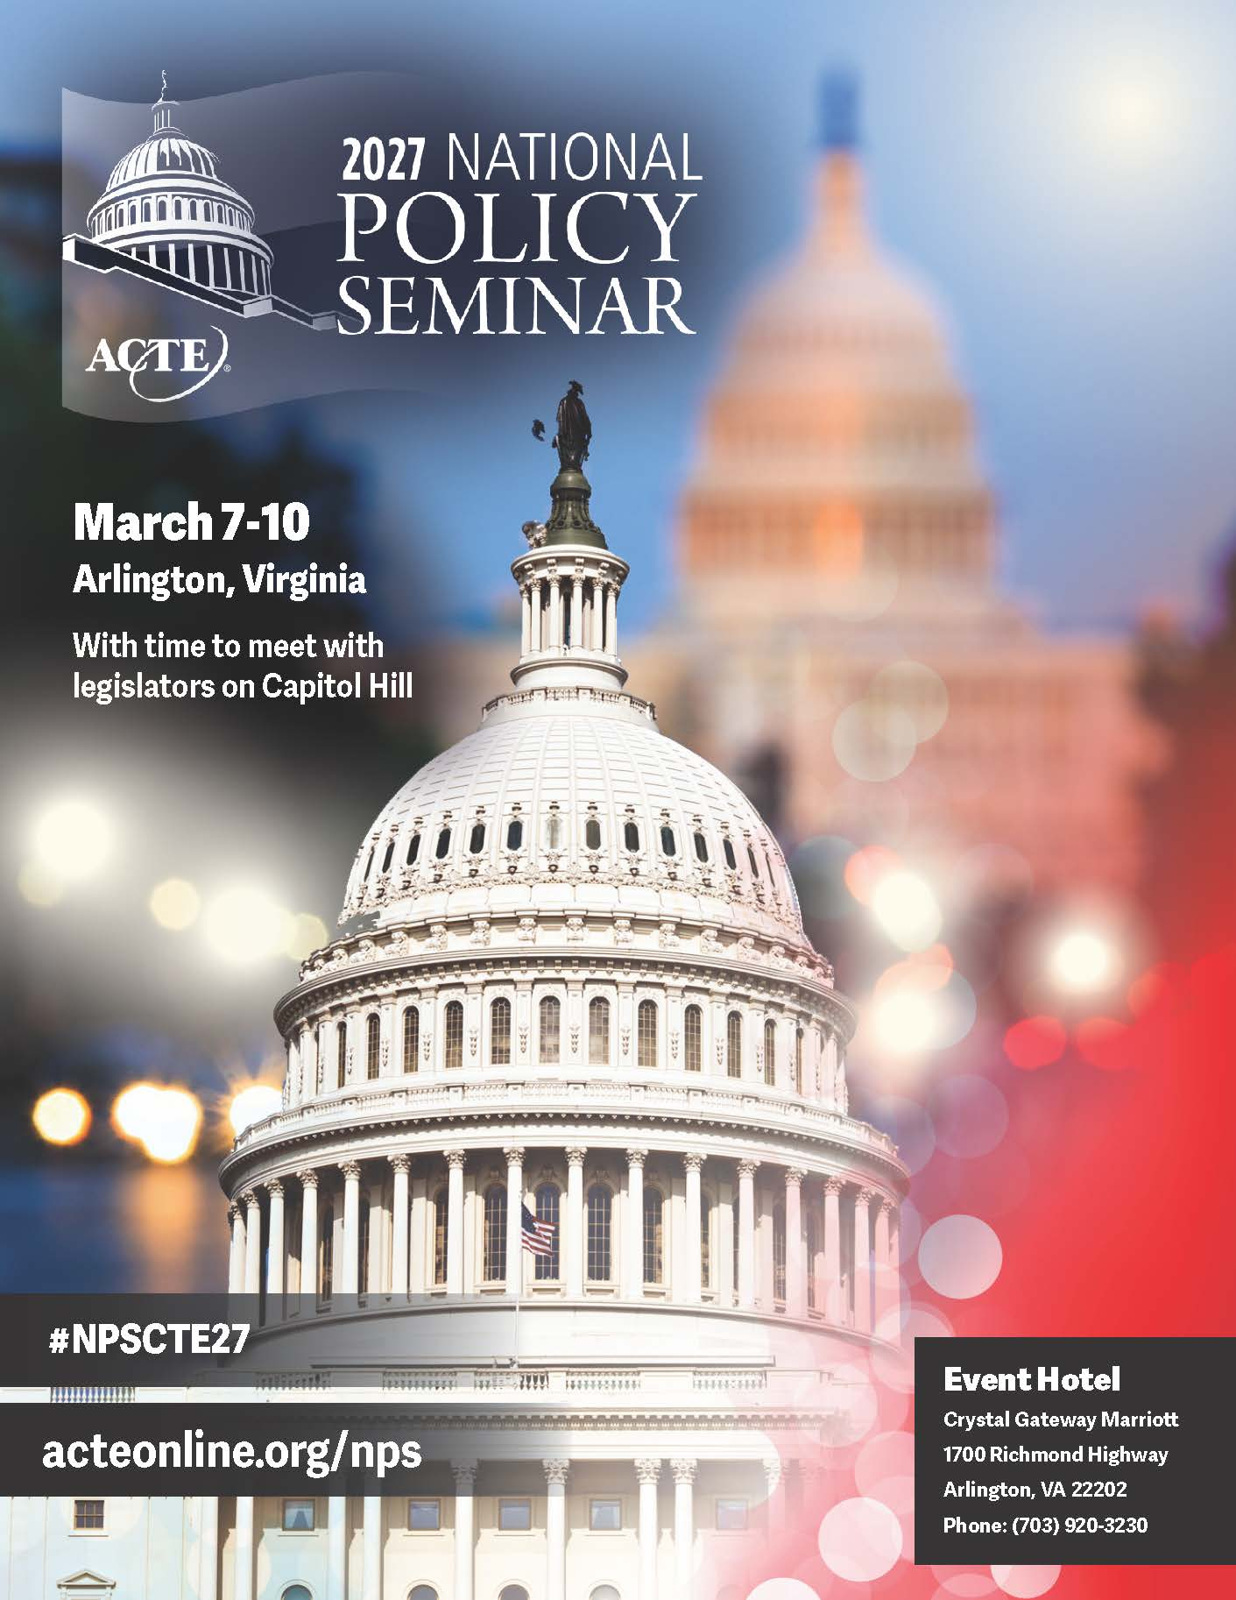
Engage on key federal policies related to CTE advocacy, research & messaging​
Save the date for 2027!

Slide 11

Focused programming for WBL professionals in secondary & postsecondary institutions
Save the date for 2027!

Slide 12
The ACTE Region Leadership Conferences
Region I 2027
April 7-9 New York, NY
Region II 2026
Sept. 9-11 Lexington, KY
Region III 2027
TBD
Region IV 2027
TBD
Region V 2027
April 7-9
Colorado Springs, CO

Slide 13
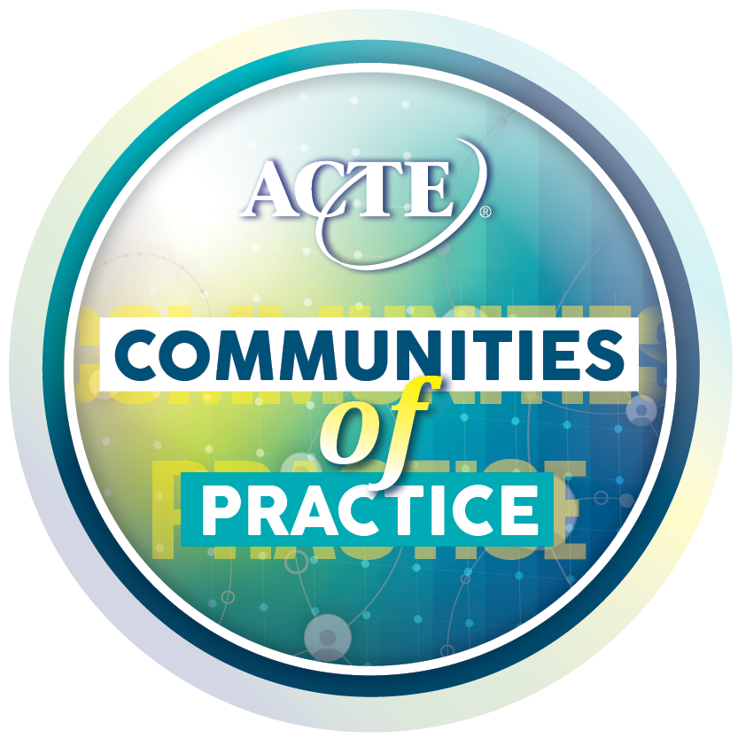


CTE Teacher Supporters
CTE Urban Education Alliance
Work-Based Learning
CTE Administrators
Rural CTE Educators
Black CTE Professionals
LGBTQ+ CTE Professionals
Women in CTE Leadership

Slide 14




CTE 101 Microsite for staff & partners new to CTE
CTE 101 for Counselors sponsored by Xello
CTE 101 for Administrators sponsored by Pearson

Slide 15
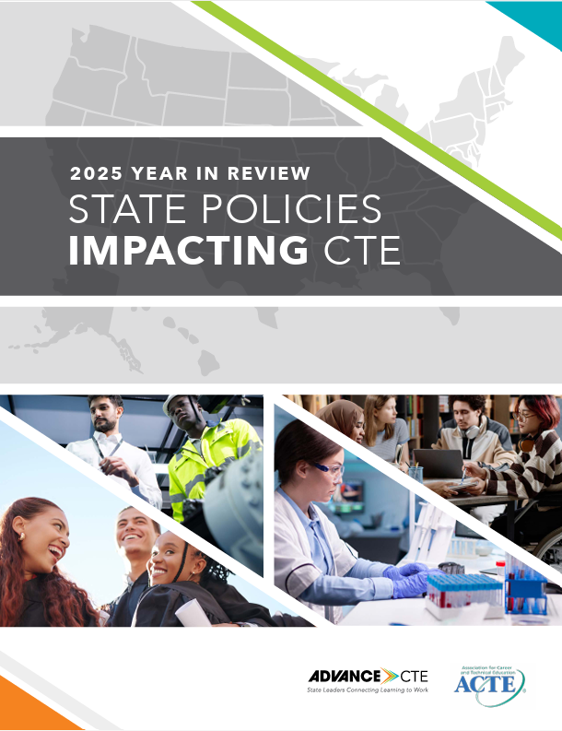
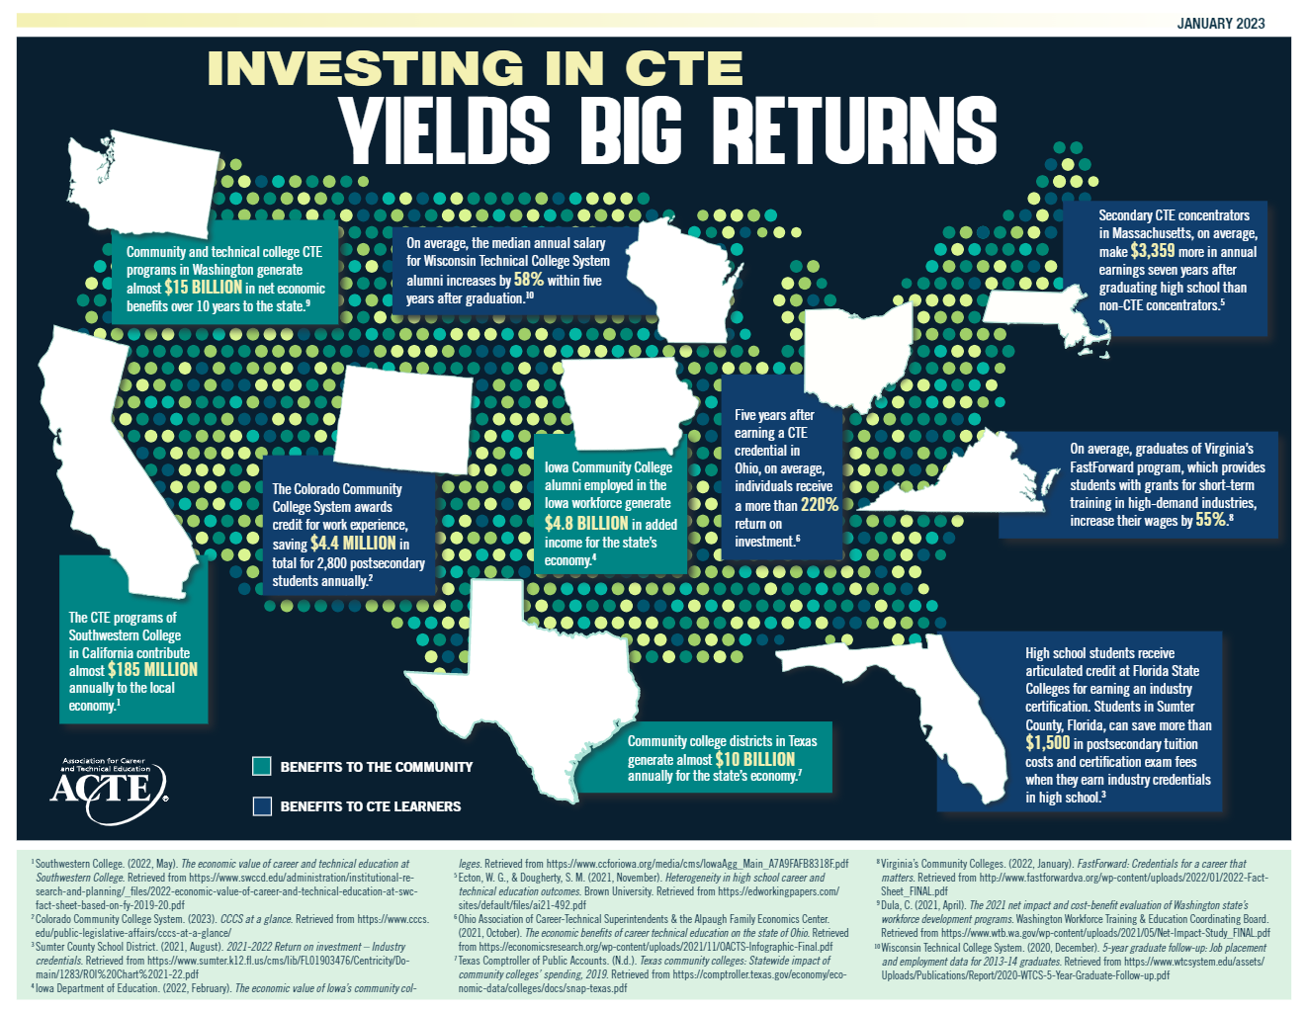
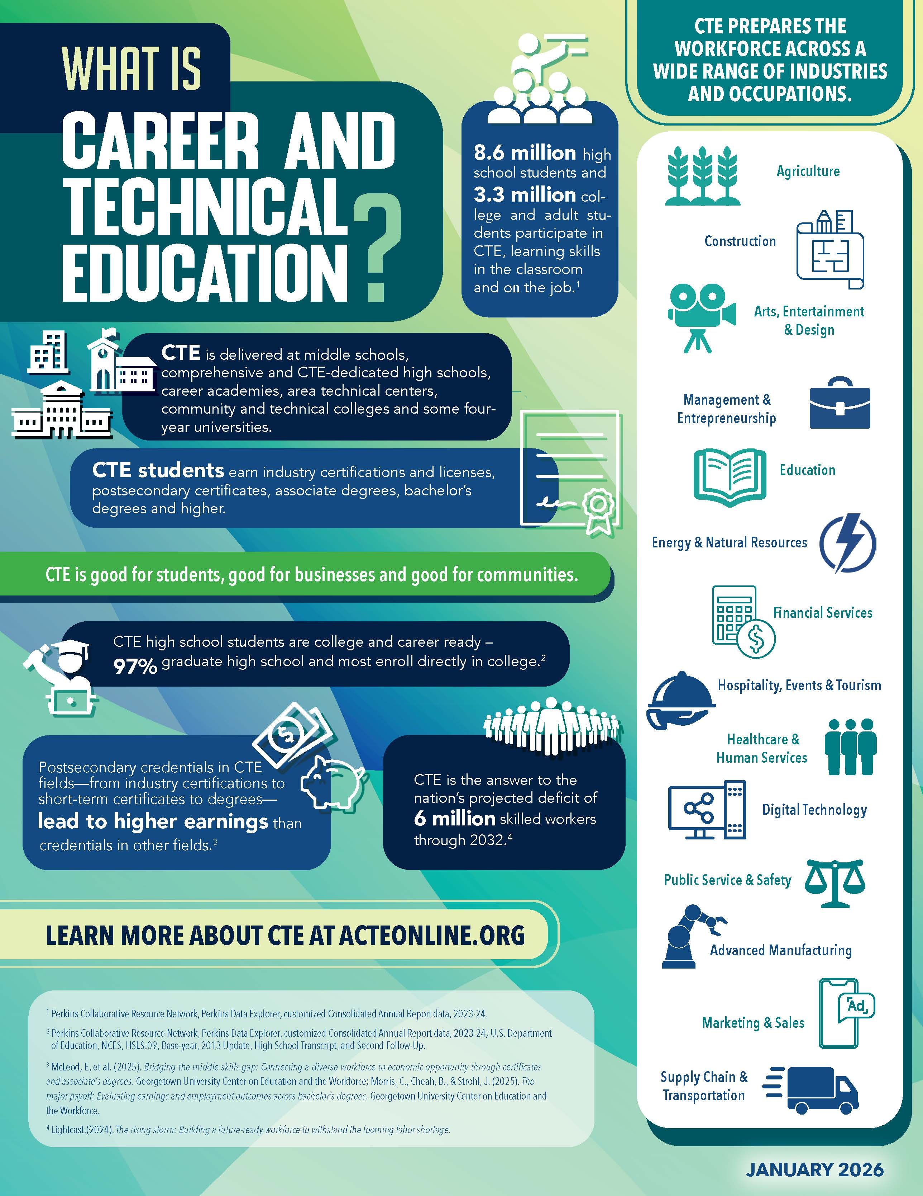
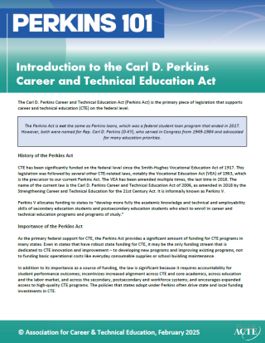
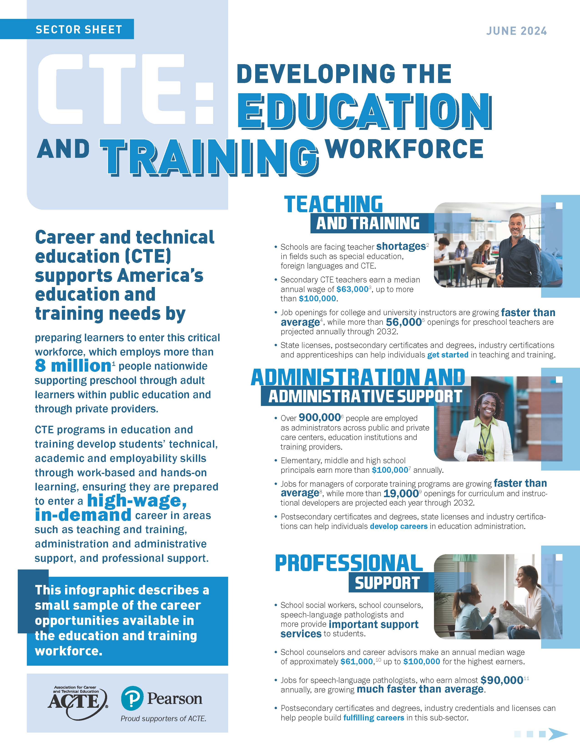

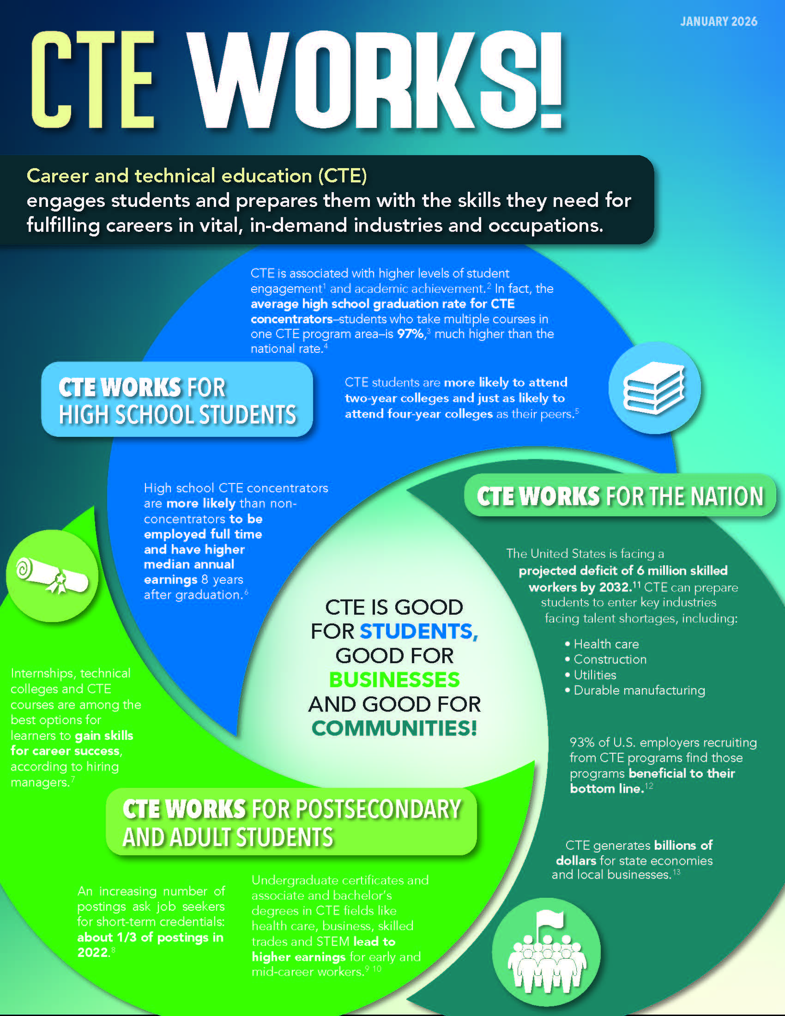
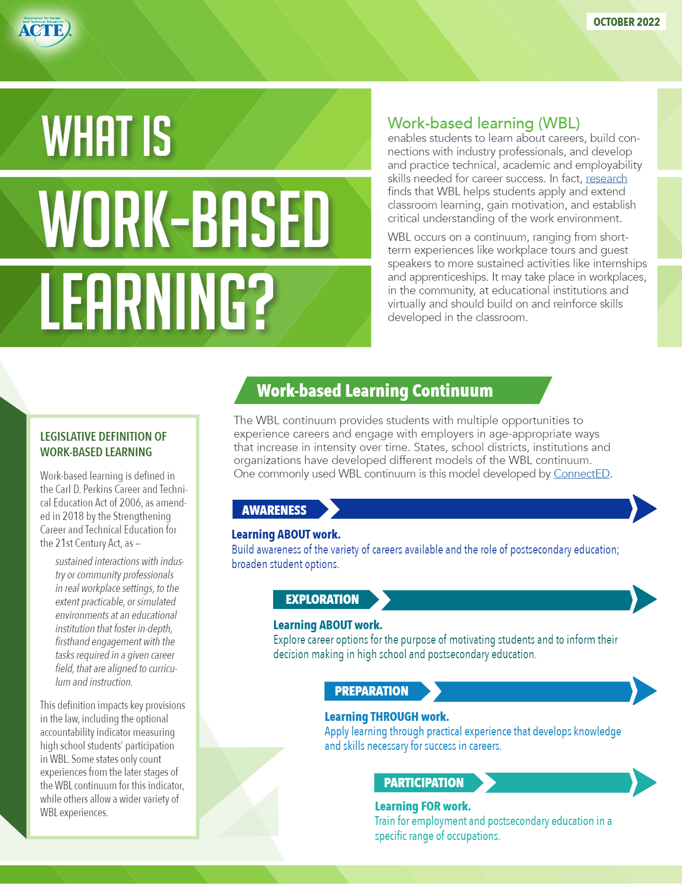
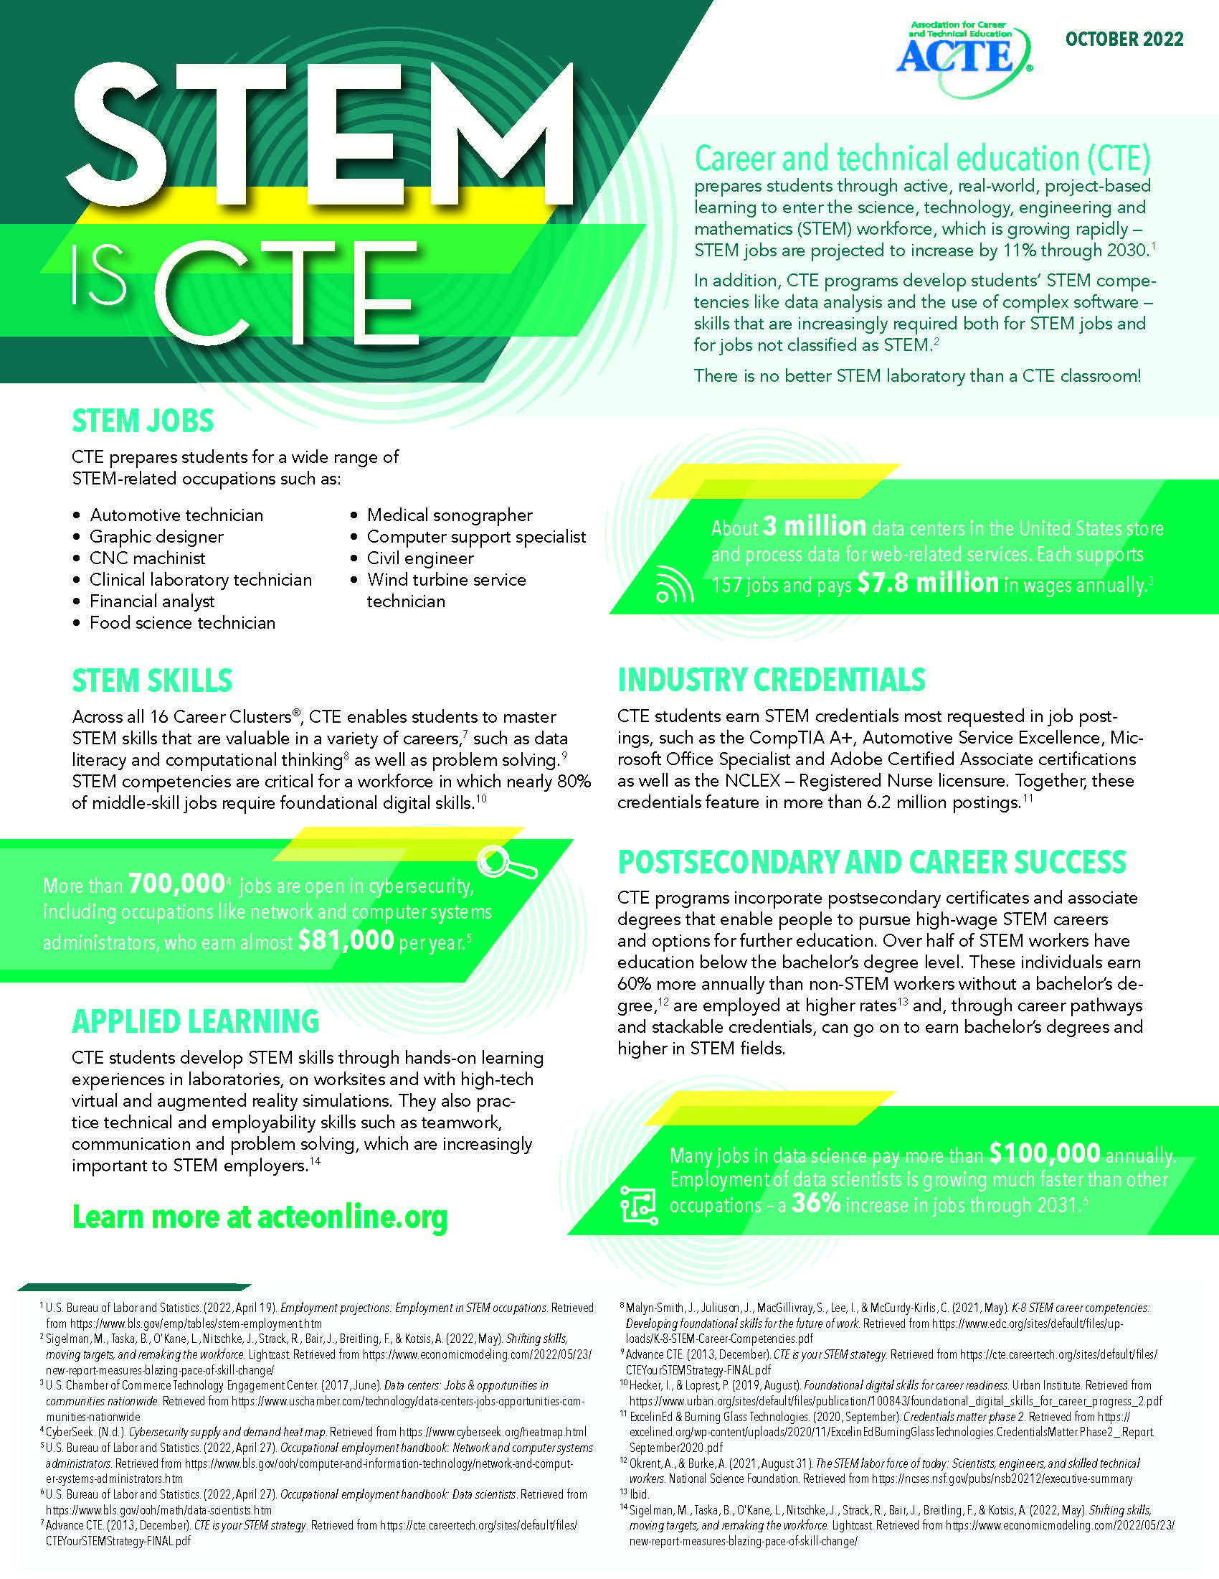
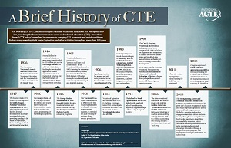
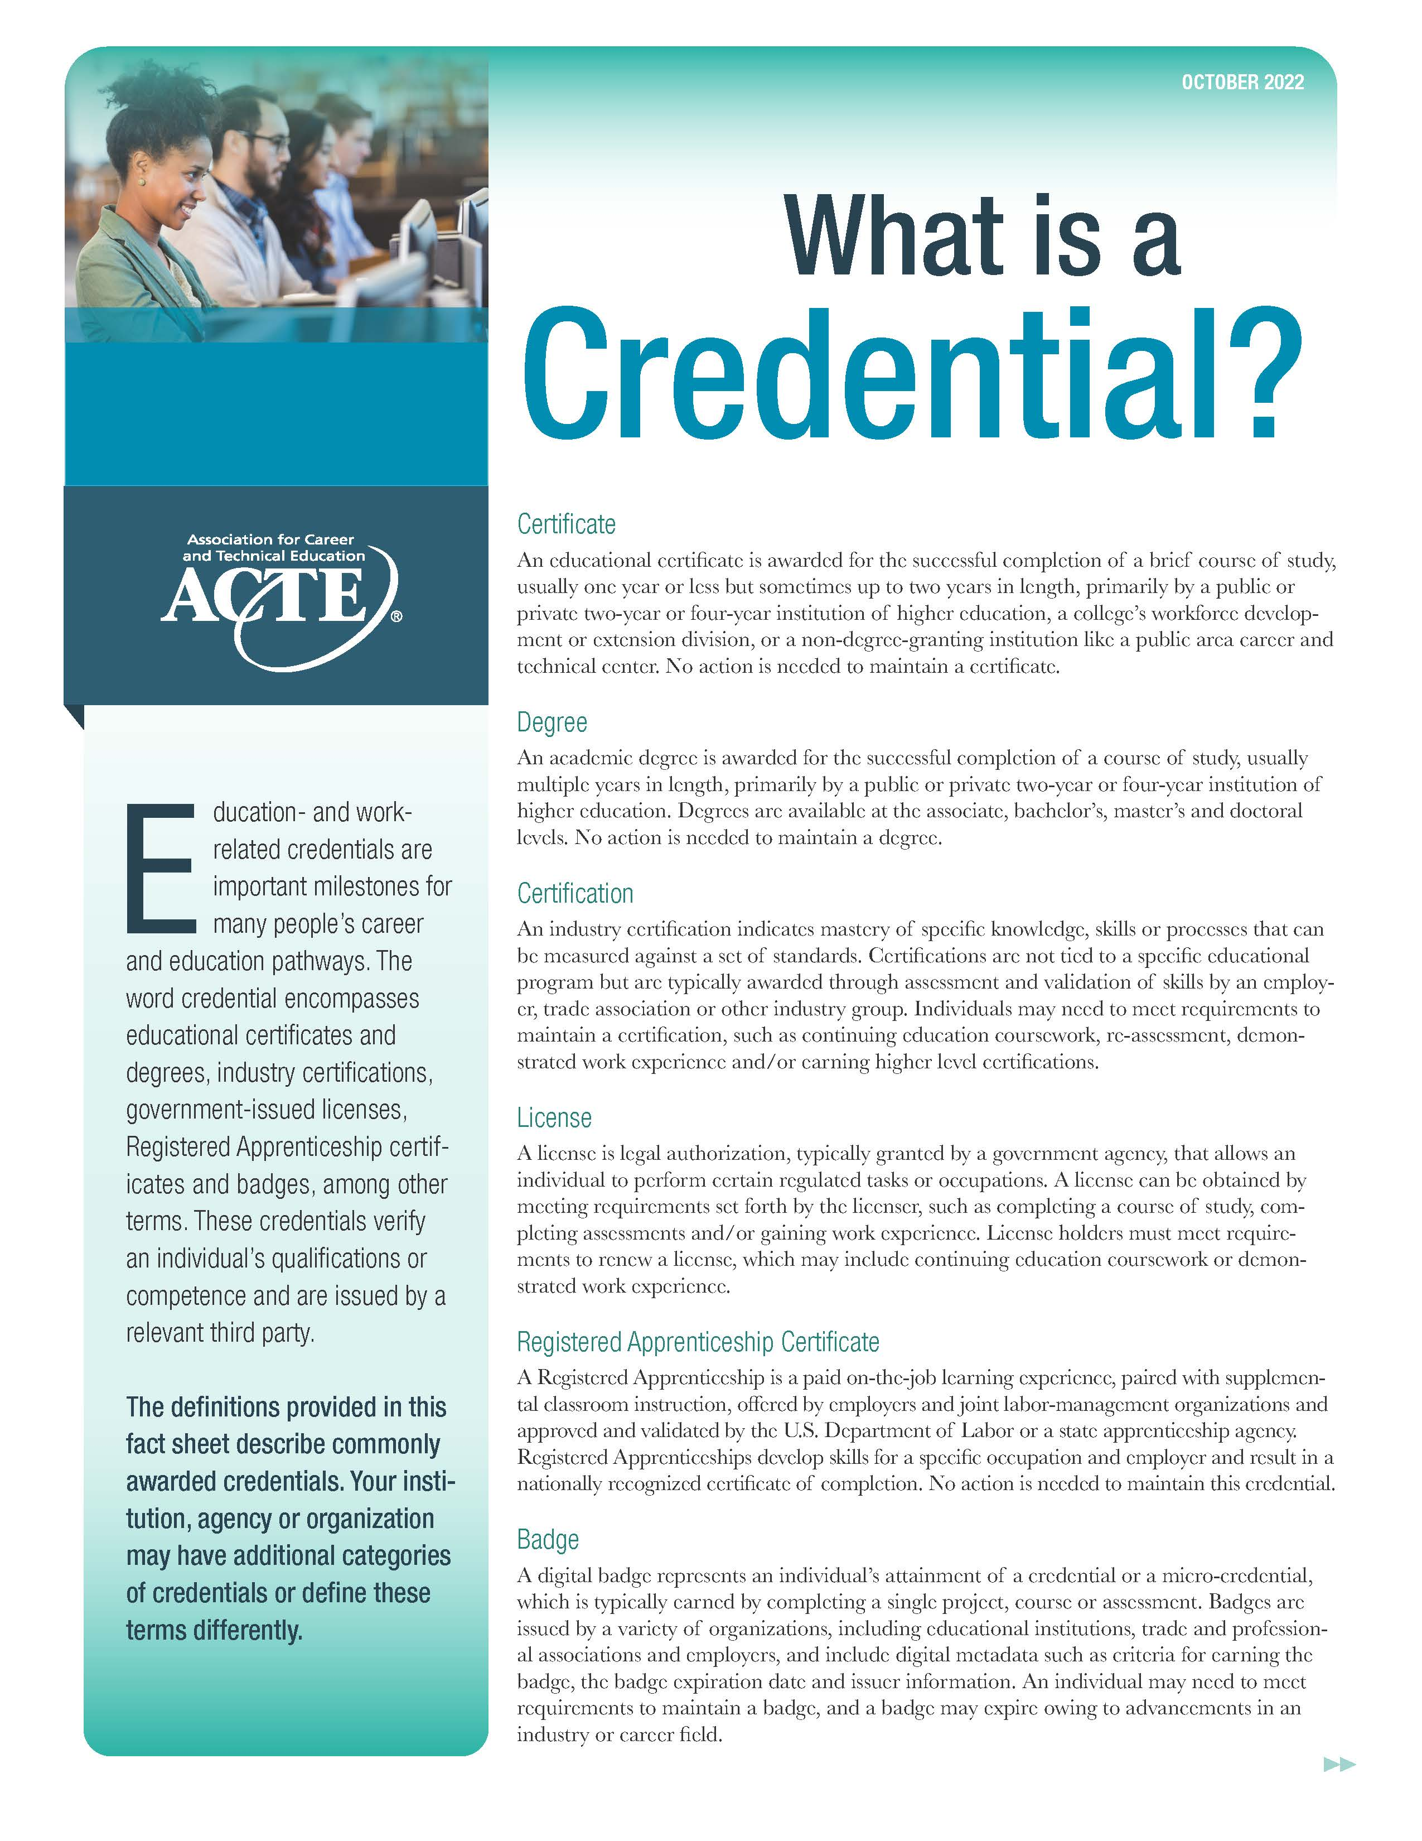
ACTE Resources Fact Sheets

Slide 16
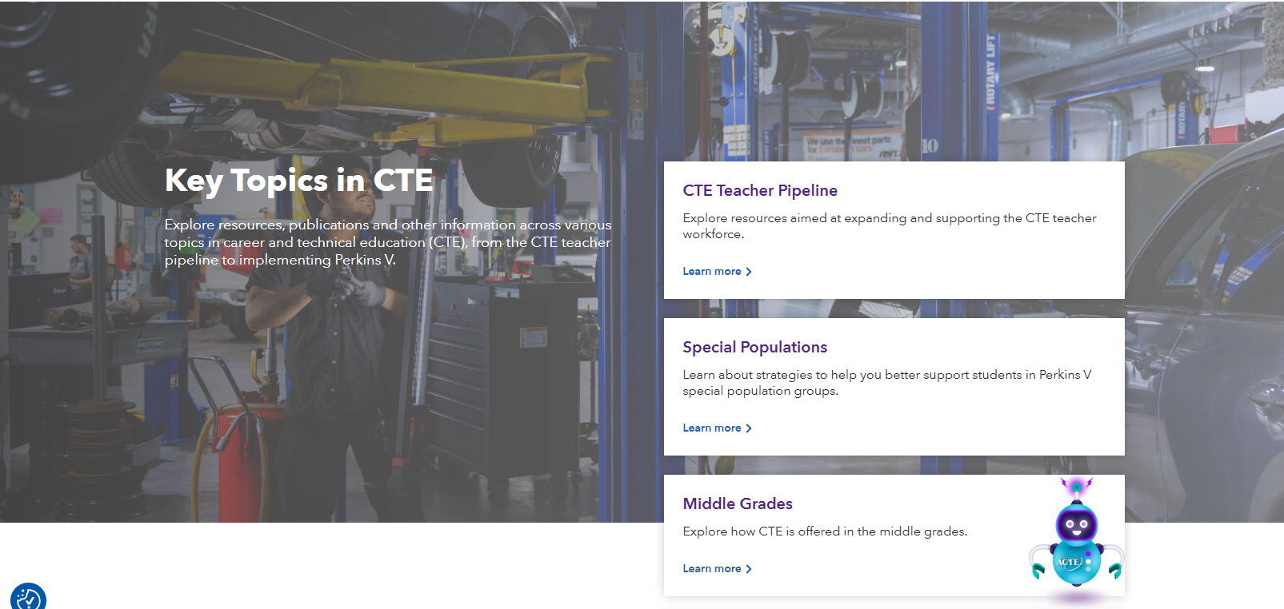

Slide 17
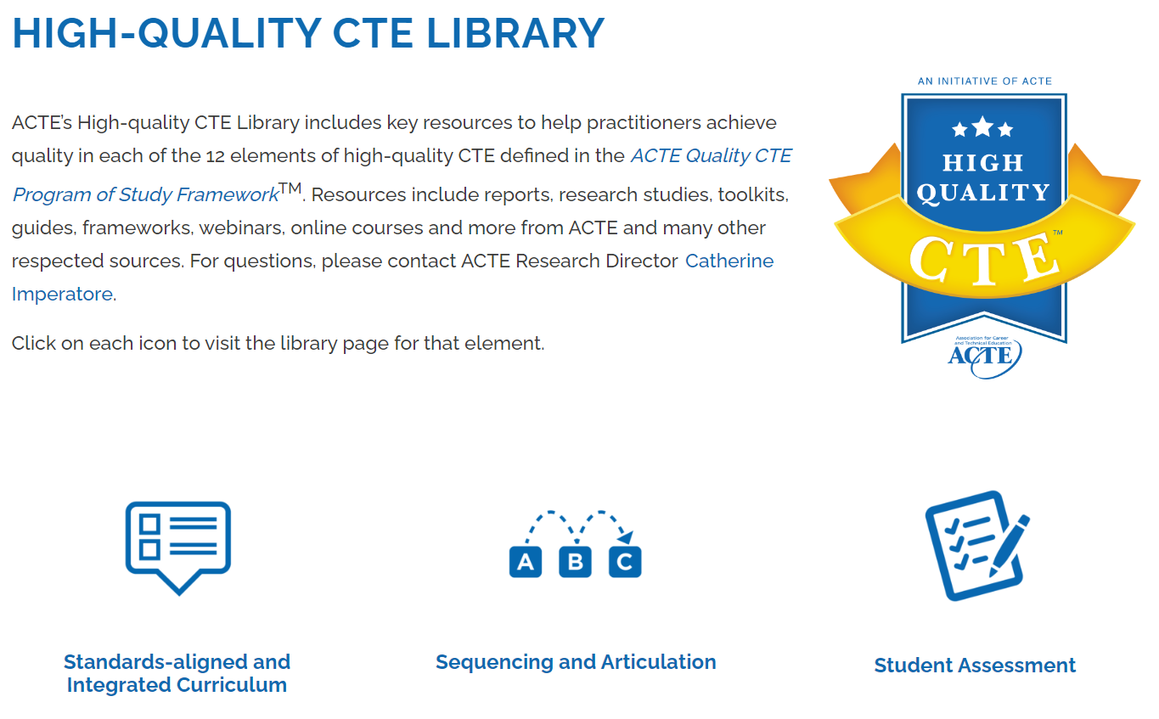
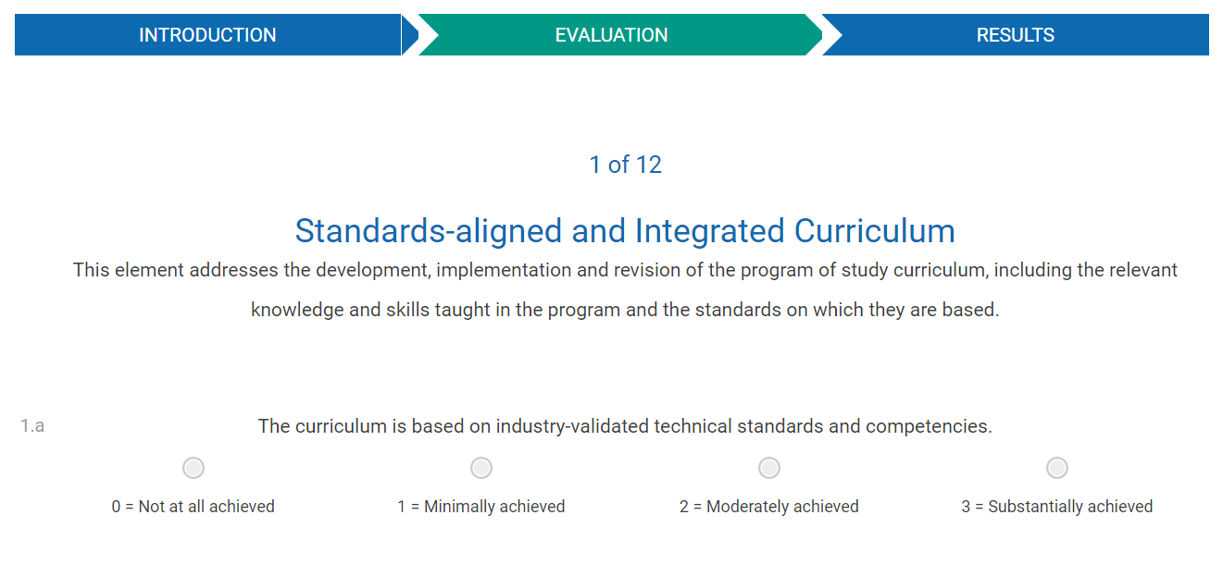

ACTE Quality CTE Program of Study Framework™
Online
self-evaluation
High-quality
CTE library

Slide 18


200+ self-paced online courses
50+ free CTE lessons & ACTE webinars
20+ free tutorials to enhance workplace skills
Free access to Career Ed Lounge & CareerPrepped

Slide 19
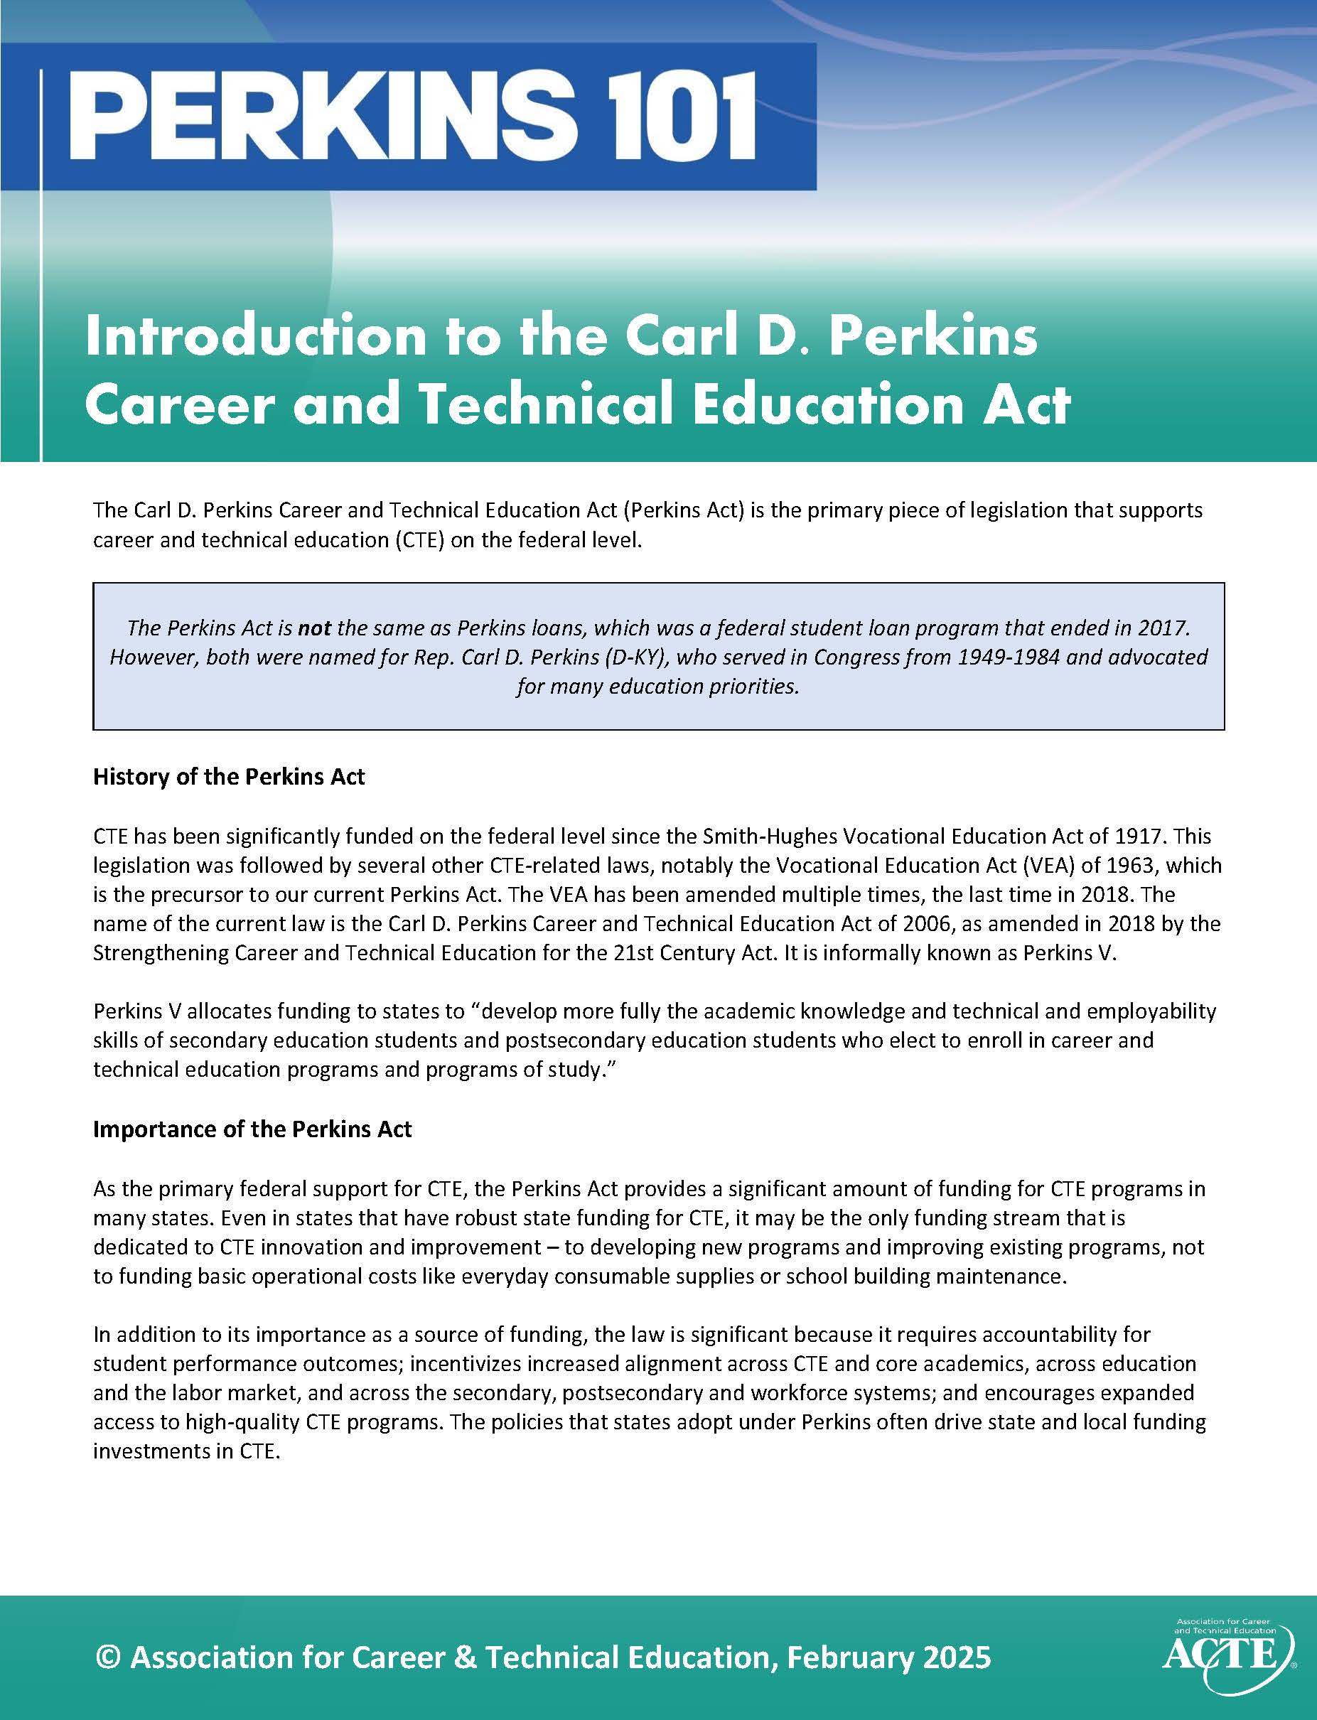
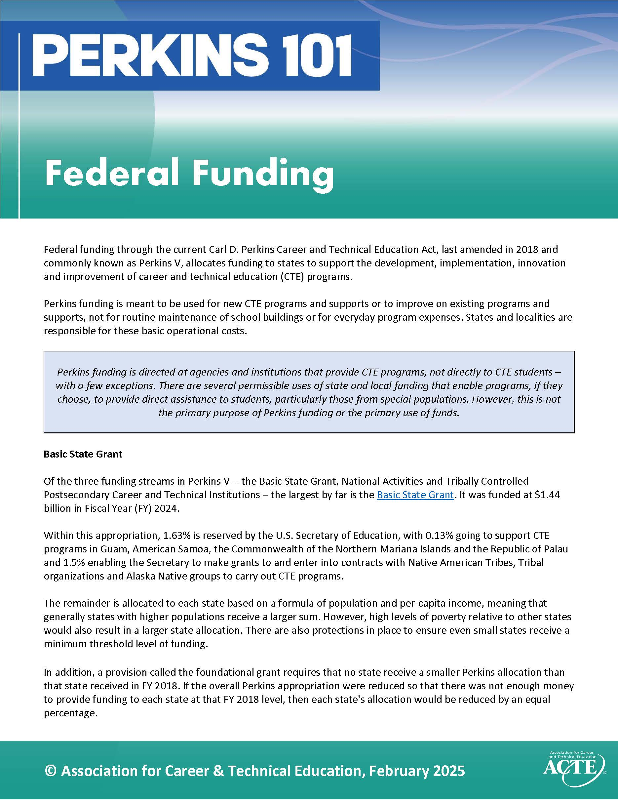
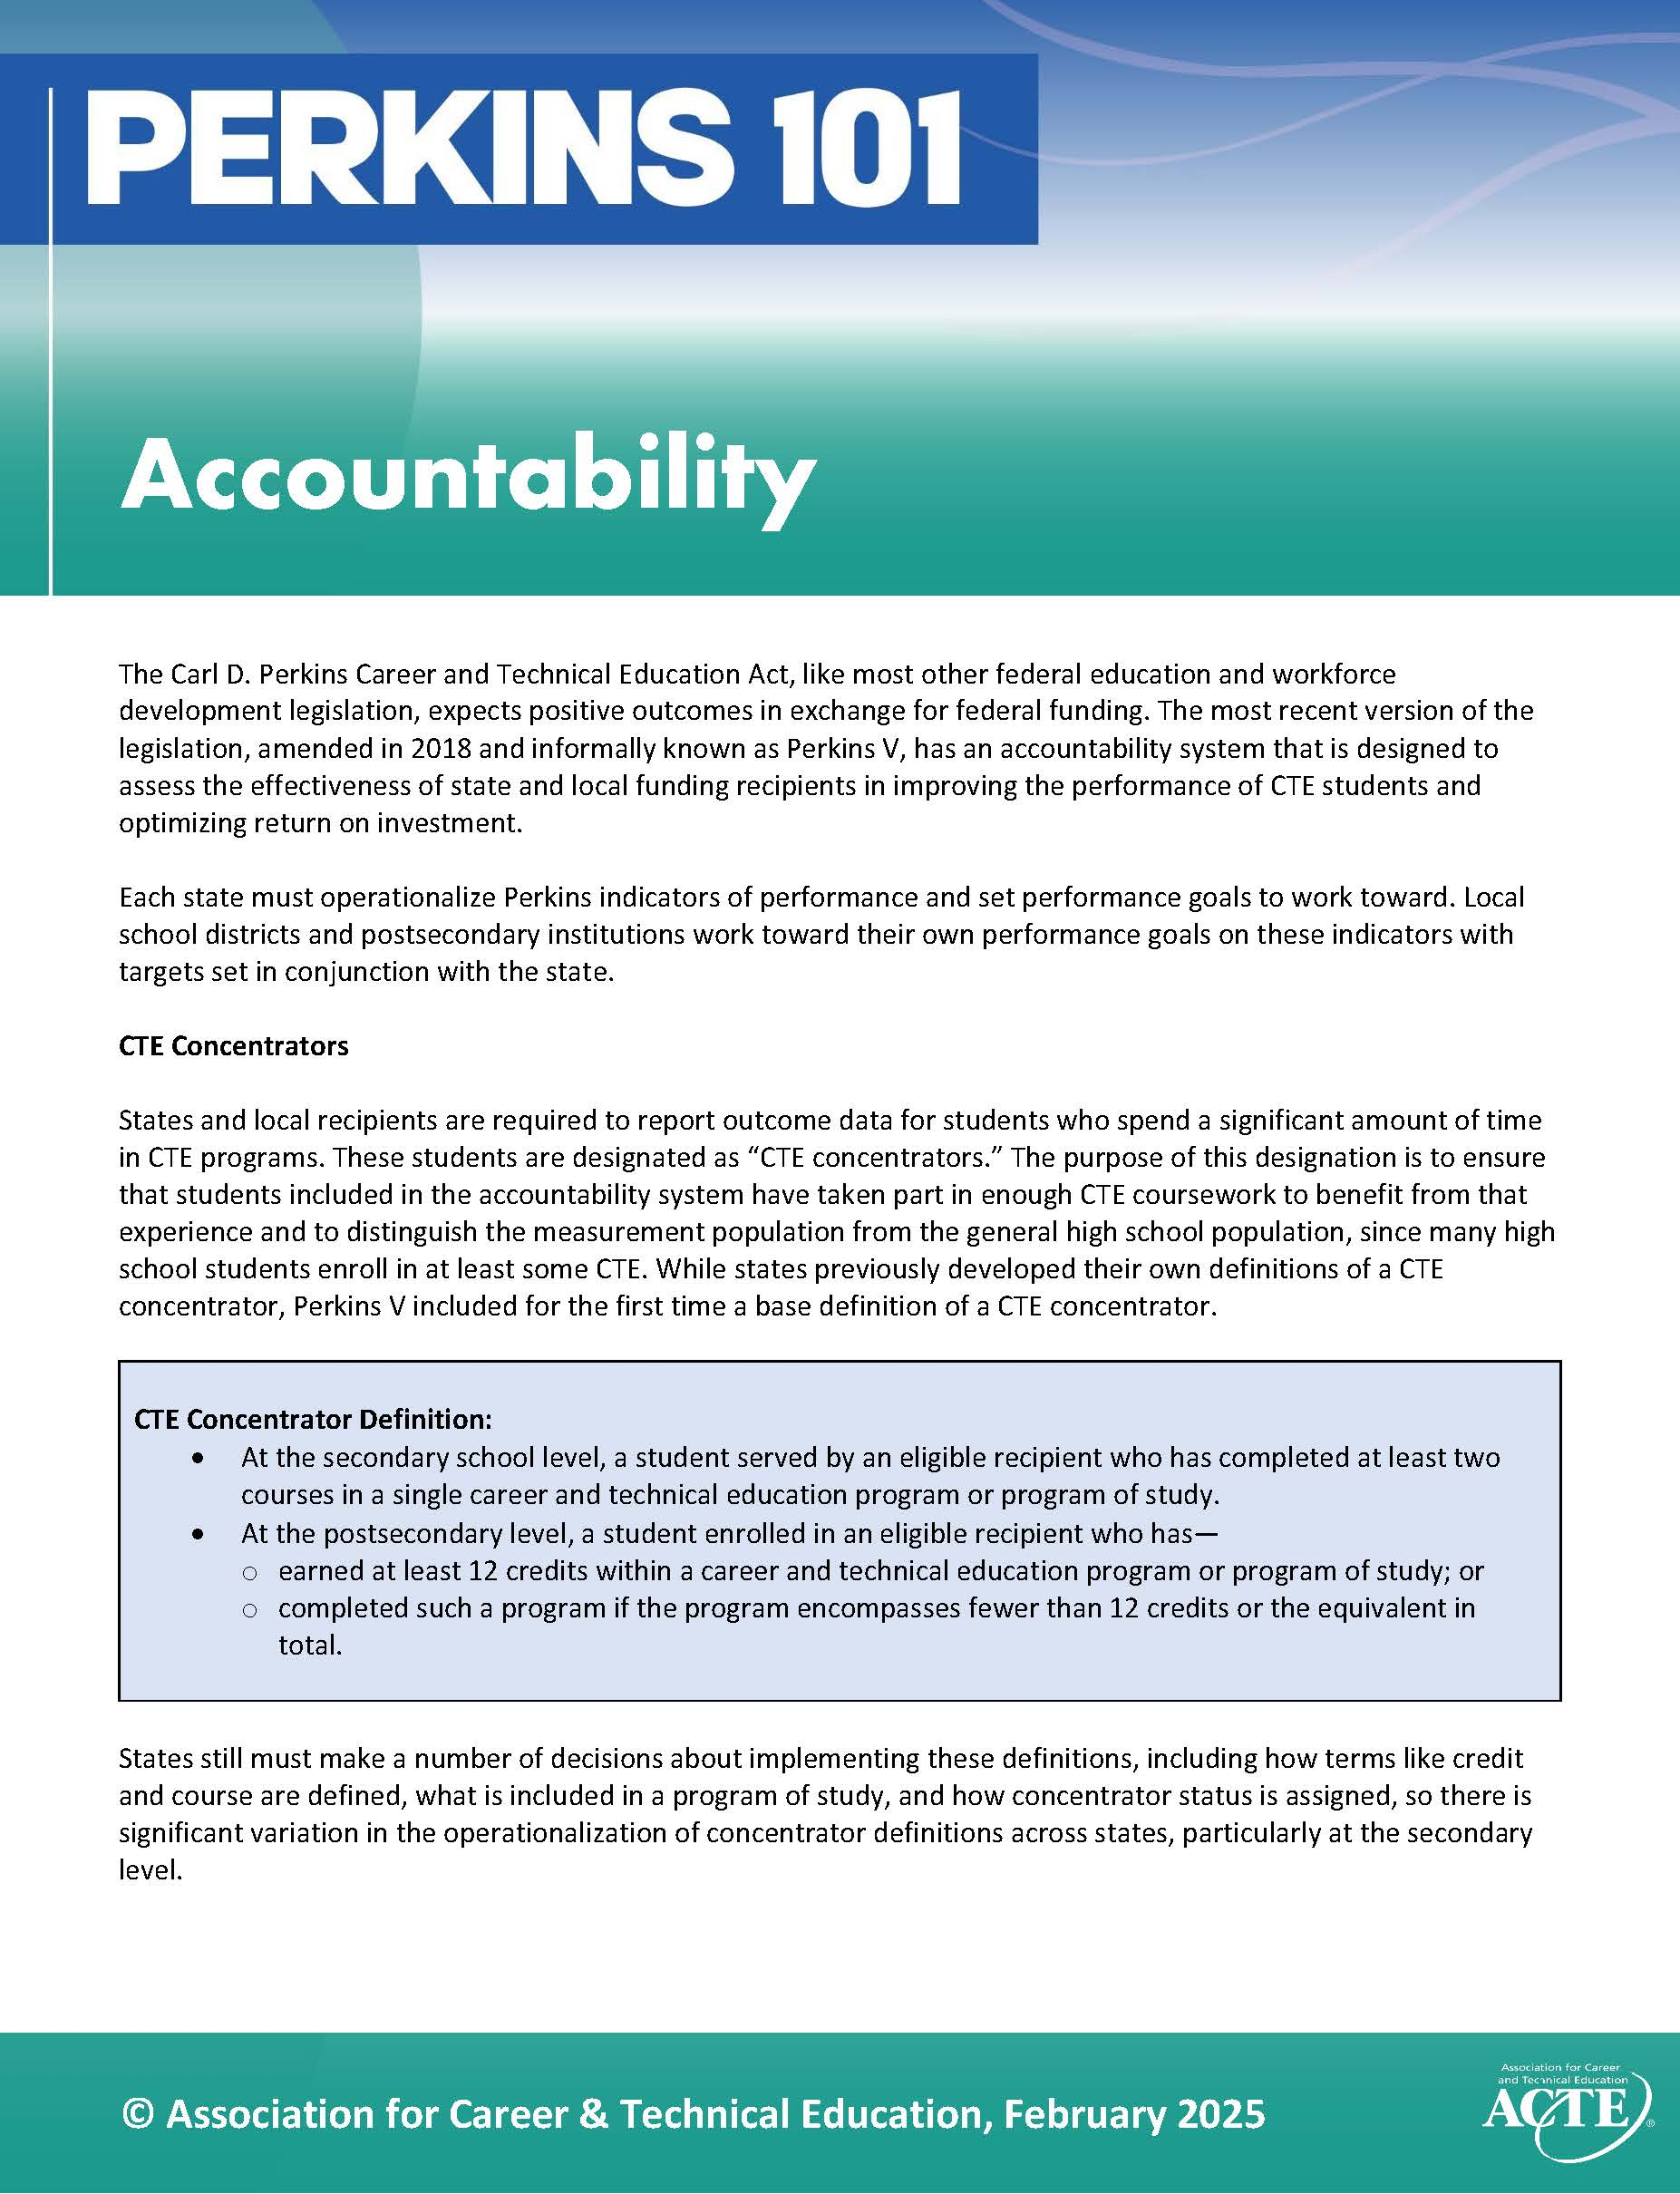
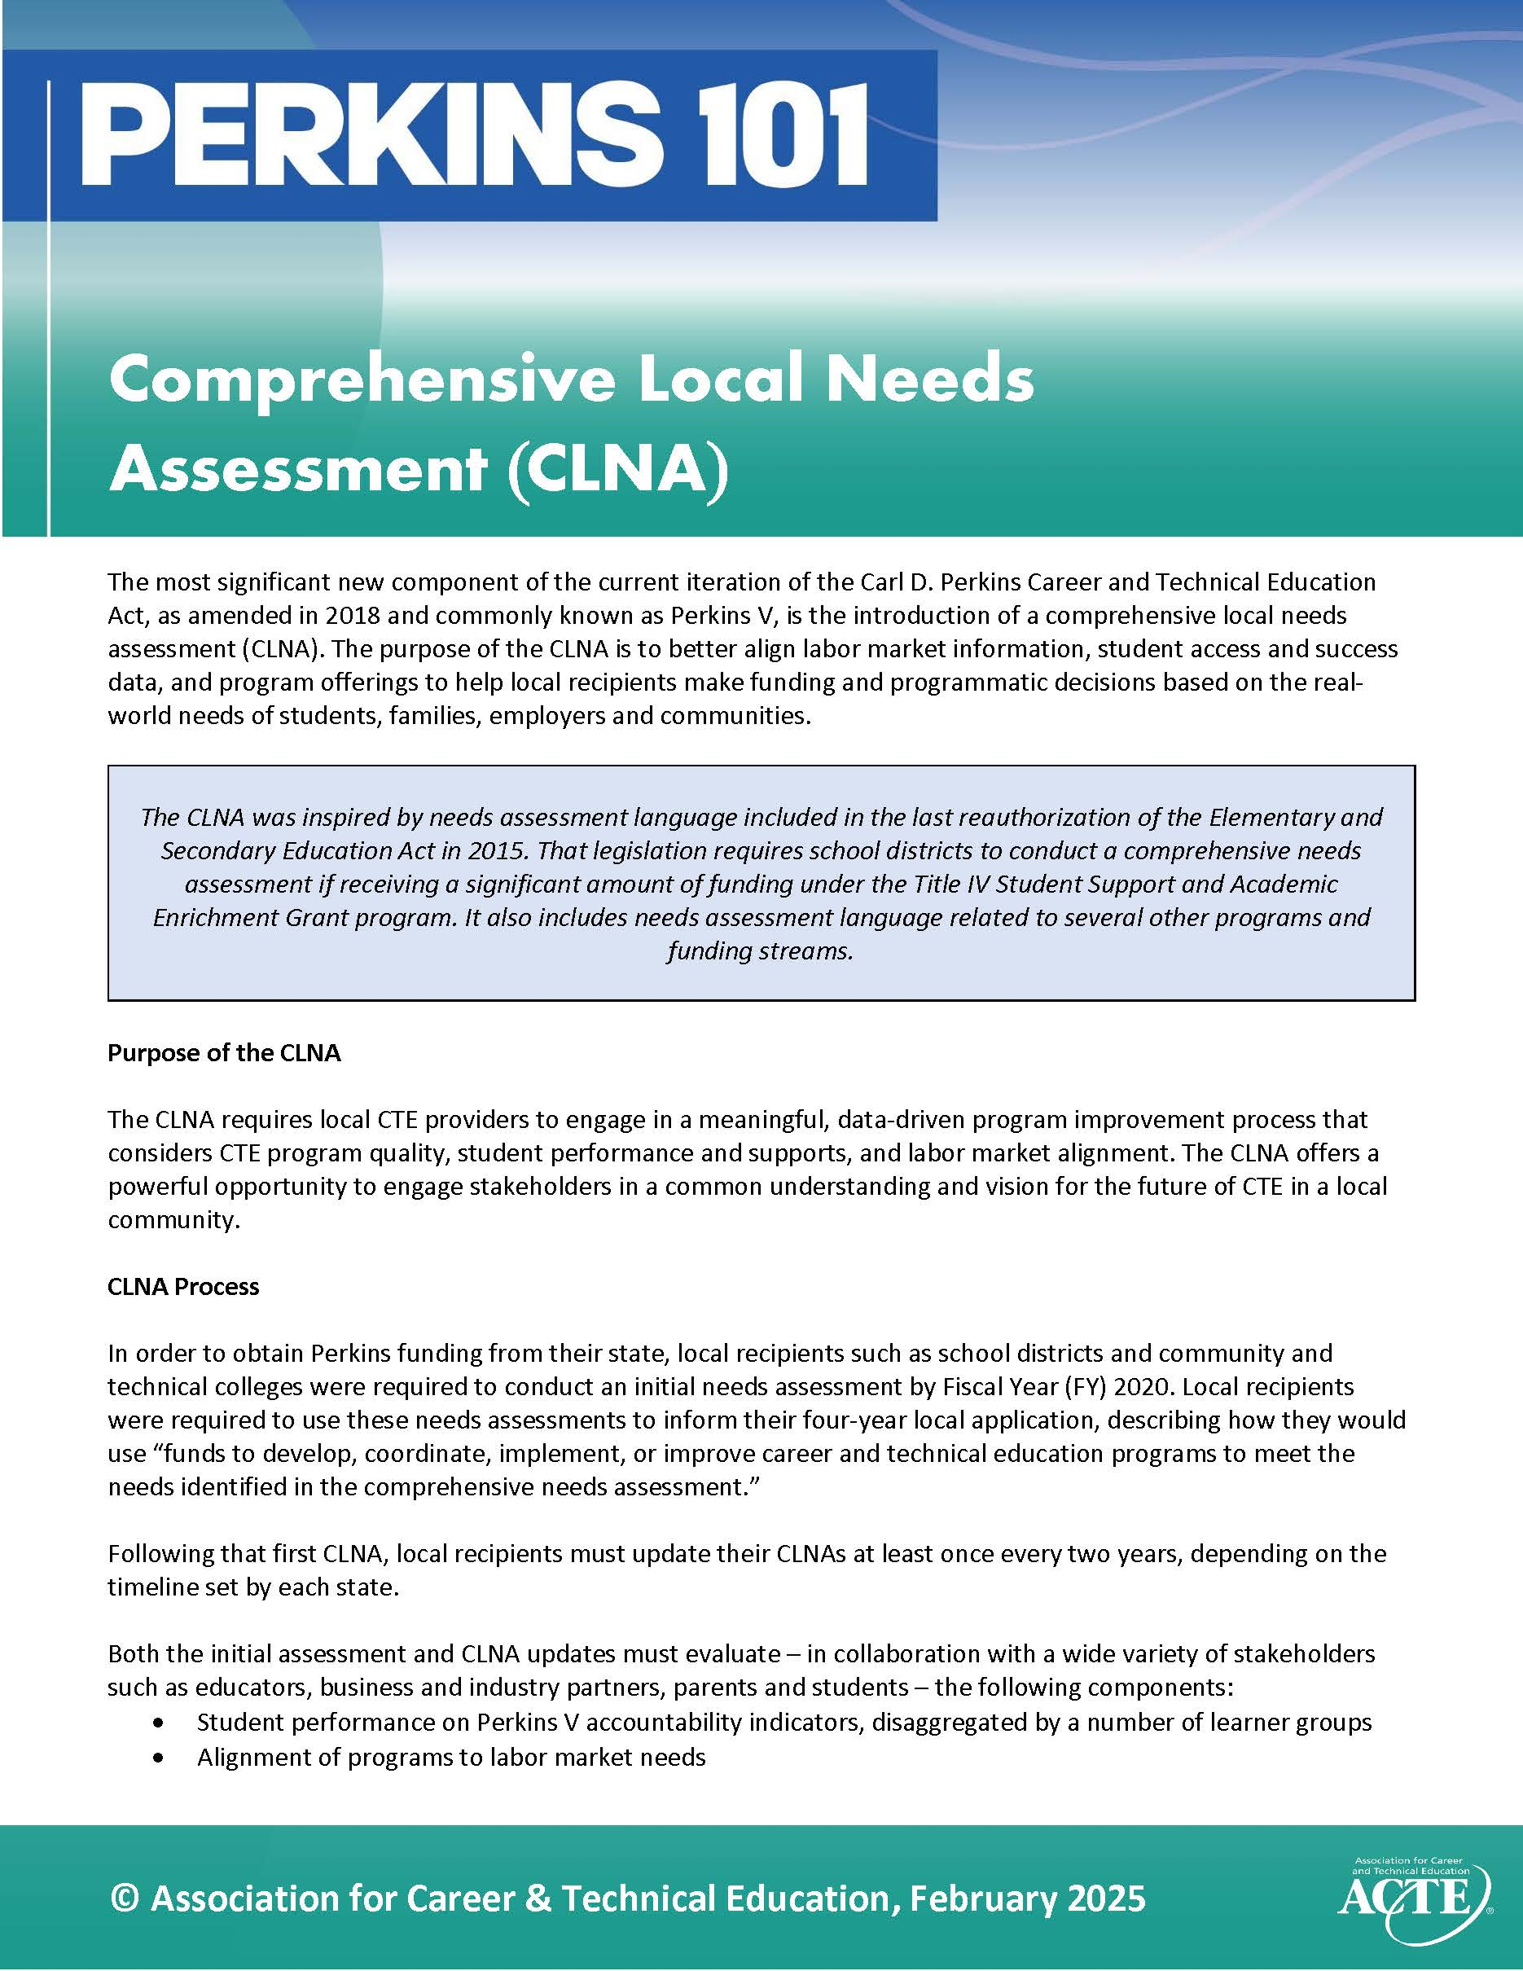


Perkins V Implementation Resources
ACTE’s Quality CTE Program of Study Framework Self-evaluation: A Tool for the Perkins V Comprehensive Local Needs Assessment
One-page & full-page summaries of the law
Perkins V Funding distribution chart

Slide 20
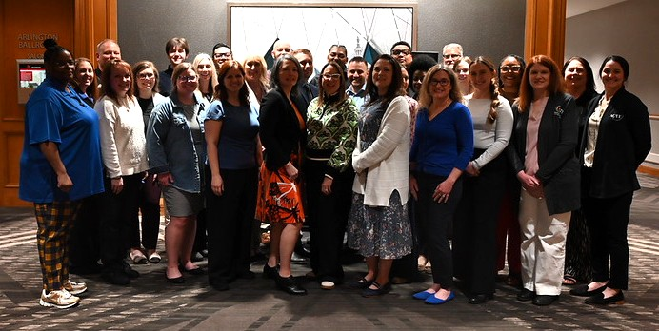
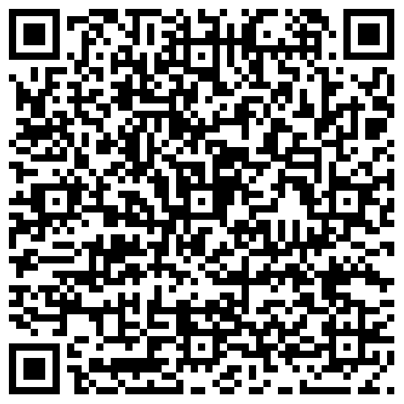
ACTE National Leadership
Fellowship Program
Applications Now Open
Through Sept. 15
One-year program runs January-December 2027 & Fellows receive:
$1,500 stipend
Complimentary registration to ACTE’s:
  CareerTech VISION 2026 & Centennial Celebration
  National Policy Seminar 2027
Apply now

Slide 21
Federal Policy Activities

Slide 22
ACTE’s Public Policy Work
CTE fact sheets & research
Direct lobbying & position development
Technical assistance
Online advocacy toolkit
Action Center
Coalition building
Resource development

Slide 23
Fiscal Year 2027 Appropriations
Lawmakers are working on FY 2027 funding bills
House introduced Labor-HHS-ED Appropriations bill in June
Proposes an $10 million increase to the Perkins State Grant
  Proposes broad cuts to other education and workforce development programs
The Senate has yet to release their bill but it is expected to be released in the coming weeks
Take Action: https://www.acteonline.org/take-action-congressweb-embed/#/
Notes:
Total ED Cut: $8 billion (10%)
Every Student Succeeds Act Title I Grants – $16.5 billion, a decrease of $1.9 billion
Pell Grant – $22.7 billion, an increase of $250 million and $7,445 for the maximum Pell Grant award, and increase of $50 (However, this increase is paid for by cutting subsidized student loans)
Total DOL Cut: $3.7 billion (27%)
Registered Apprenticeships – $290 million, an increase of $5 million
Strengthening Community College Training Grants – $75 million, an increase of $10 million
Completely eliminates funding for the WIOA Adult Training Program and WIOA Youth Job Training Program

Slide 24
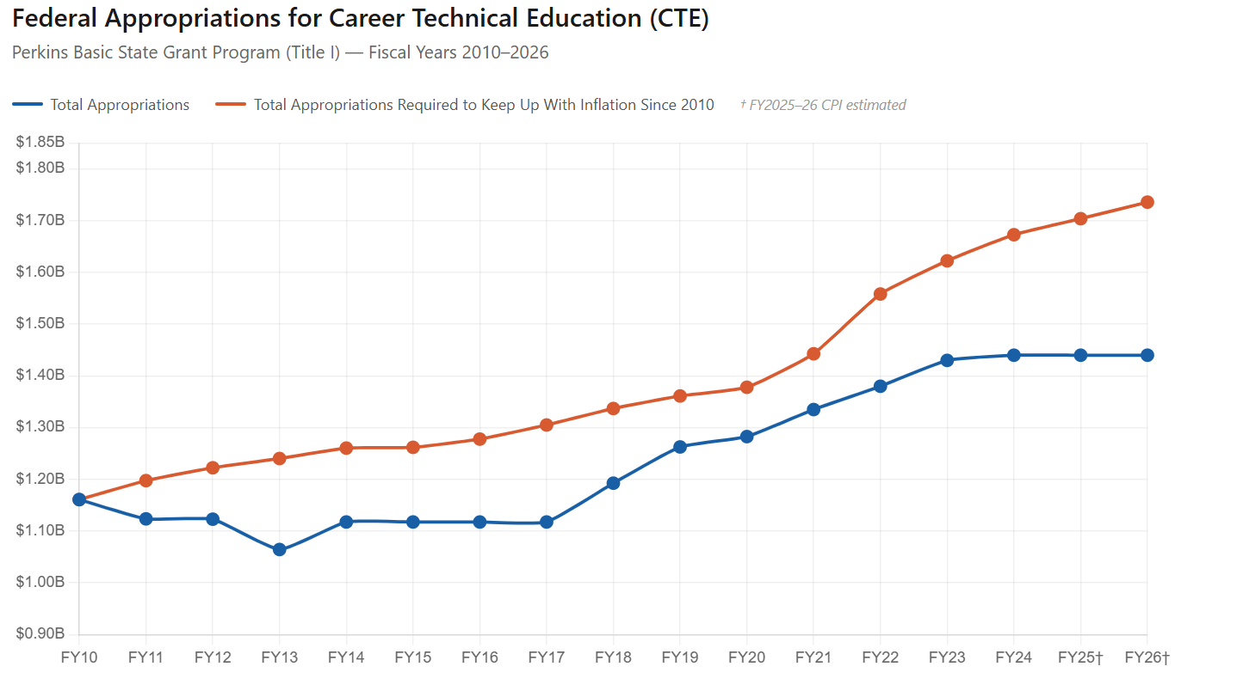
Notes:
This chart shows how Perkins funding has not kept pace with inflation. I use this chart to say that the receiving level funding for last three fiscal years is essentially a cut when accounting for inflation.

Slide 25
Workforce Pell
Expansion of prorated Pell Grant access to students enrolled in short-term programs between 150-599 clock hours (or equivalent credit) over a period of at least 8 but less than 15 week
The law went into effect July 1, 2026
  ED released final rules for implementation on May 18
The work necessary to truly adopt and scale WFP will take a long time, allowing states and ED to refine and evolve determinations based on early reporting or state feedback
Notes:
Statutory Requirements:​
Prepare students for high-skill, high-wage, or in-demand industry sectors as determined by the governor/state workforce board​
Meet the hiring requirements of employers​
Lead to a stackable or portable recognized postsecondary credential​
Leads to academic credit acceptable toward a higher-level credential​
Be in existence at least one year​
Have a 70% completion rate with 150% of normal time, a 70% job placement rate 180 days after completion, and meet earnings requirement compared to price​
Approved by the Secretary
Summary of ED Rules: https://www.acteonline.org/blog/cte-policy-watch/ed-releases-final-rule-on-workforce-pell/
Comment themes from joint ACTE-Advance CTE during the rulemaking process:​
Limit on ineligible institution/organization share of offering program to 25%​
Interplay of Workforce Pell and non-federal financial aid​
Interstate agreements​
Value added earnings/placement reporting – counting students that move into further education​
Interagency roles​
Data infrastructure improvements

Slide 26
Administration Activities
Department of Education has announced 14 interagency agreements (IAAs) with 6 other federal agencies to assume responsibility for a range of education programs
  Perkins was in the first IAA – announced last summer, with functions moved in the fall
  House Republicans have now introduced bills to codify
  Significant administrative and bureaucratic challenges during transition
New proposed changes to the uniform grant guidance
  Comment period closed July 13
  If proposed changes are not reversed, could impact use of federal funding for conferences, memberships, and several other activities
Other areas to watch: Apprenticeships, AI

Slide 27
Thank you for your support!
Association for Career and Technical Education®
1410 King Street, Alexandria, Virginia 22314
800-826-9972 | acteonline.org
ahyslop@acteonline.org

