Slide 1

WARM-UP
Reflection
★
A GREAT Experience
⚠
A NOT-SO-GREAT Experience
Think of a conference or workshop that was truly GREAT.
What do you remember most about it?
Why did it stand out?
Now think of one that felt NOT-SO-GREAT.
What do you remember about it?
Why did it fall short?
Hopefully, today we’ll help you plan events people remember as GREAT!

Slide 2
BUSINESS · MARKETING · ENTREPRENEURSHIP · FINANCE
Conference Planning
Made Easy
Tips & Tricks for Success
cobmef.org

Slide 3
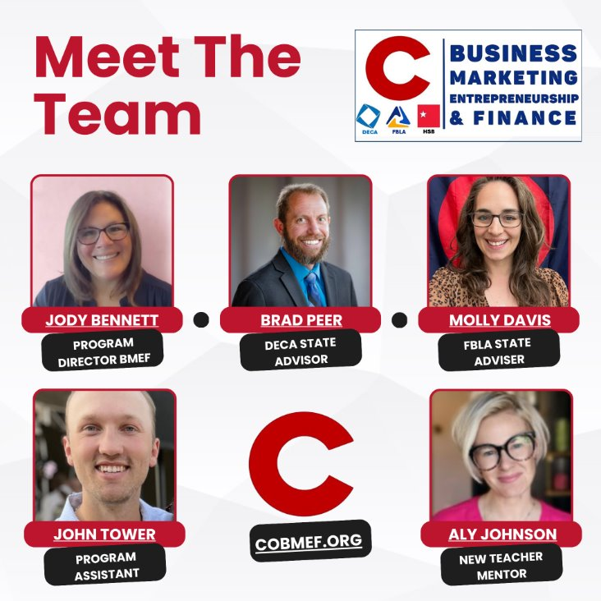
THE PEOPLE BEHIND THE PLANNING
Program Director · DECA State Advisor · FBLA State Adviser · Program Assistant · New Teacher Mentor

Slide 4

JODY BENNETT · PROGRAM DIRECTOR
What Makes Conferences Successful
✓
Preparation
Start early and write down every detail – even if you think you know it.
✓
Planning Systems
Use tools that keep every task on track.
✓
Communication
Understand who needs to know what – provide materials to help them.
✓
Flexibility
Stuff happens – don’t let that stuff take down the whole event.
Food… always food….

Slide 5

BRAD PEER · DECA STATE ADVISOR
Common Pitfalls
!
Poor Timelines
Deadlines slip when there’s no backward plan.
!
Unclear Roles
Nobody owns the task, so it falls through.
!
Vendor Issues
Miscommunication creates last-minute scrambles.
!
No Buffer Time
Every schedule needs room to breathe.

Slide 6

BRAD PEER · DECA STATE ADVISOR
Avoiding the Pitfalls
✓
Backward Planning
Start at the event date and work backward.
✓
Clear Ownership
Every task has one owner.
✓
Vendor Check-ins
Confirm details early and often.
✓
Run-of-Show
A plan-by-time keeps everyone aligned.

Slide 7
OPINIONS, EARNED THE HARD WAY
MOLLY DAVIS · FBLA STATE ADVISER
Conference Planning Hot Takes
1
Write down everything.
2
Delegate tasks.
Your future self will thank you.
You can’t do it all alone.
3
Think ahead to next year.
4
Don’t be indispensable.
Capture ideas while they’re fresh.
Build systems, not bottlenecks.

Slide 8
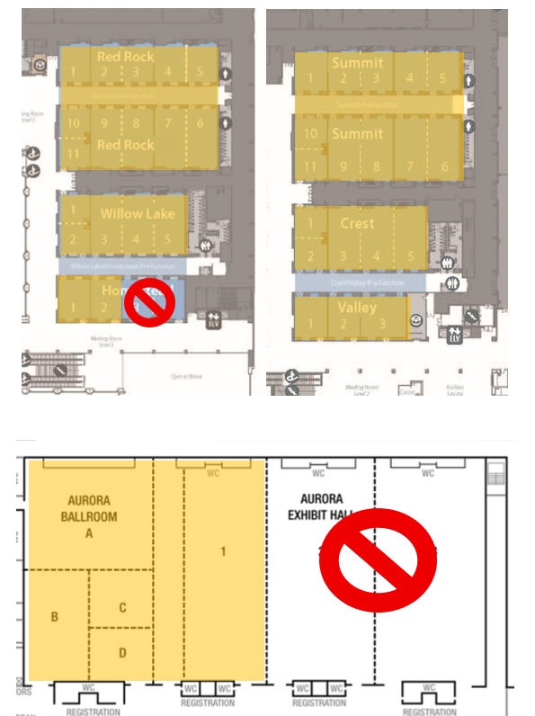
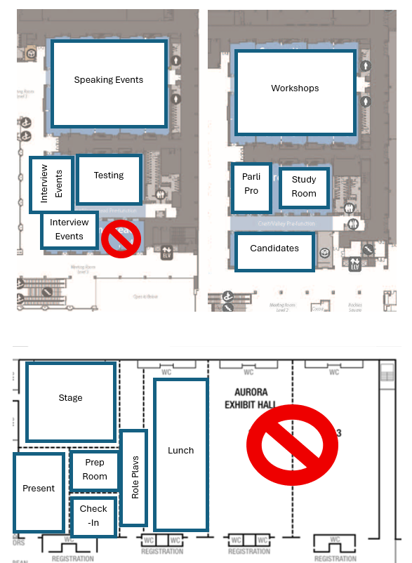
PHASE 1
Planning: 6–12 Months Out
1. 6–12 Months Out
2. 1–5 Months Out
3. Final Month & Onsite
Secure a facility, review your contract(s) and map out your spaces — before anything else.

Slide 9
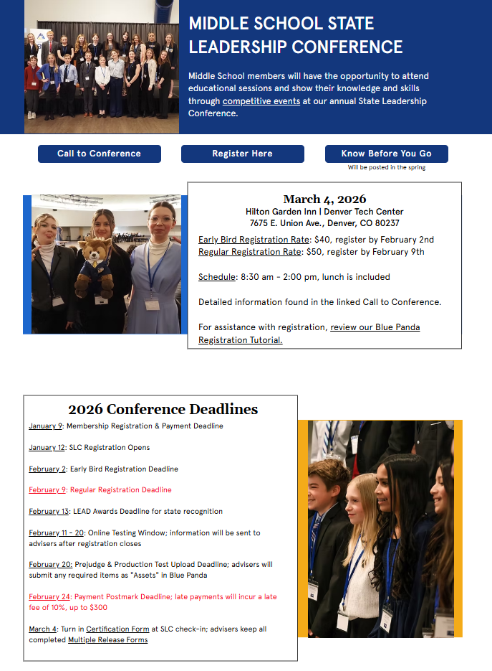
PHASE 1 · DETAILS
Planning: 6–12 Months Out
1. 6–12 Months Out
2. 1–5 Months Out
3. Final Month & Onsite
✓
Meet with venue staff
Onsite if possible.
✓
Make info accessible to ‘clients’
Registration guide + website.
✓
Inventory & order supplies
✓
Contract with vendors
Don’t forget to write EVERYTHING down.

Slide 10







TOOLS WE SWEAR BY
Write it down while in the thick of it...
Voice memos
Write it ALL down -
Reflect Later!
Google and/or Phone
  Keep
  Notes
  Sheet
  Doc
Notebook
Make sure to share with other leaders so they can write it all down too!
Large Post it in Office or HQ

Slide 11
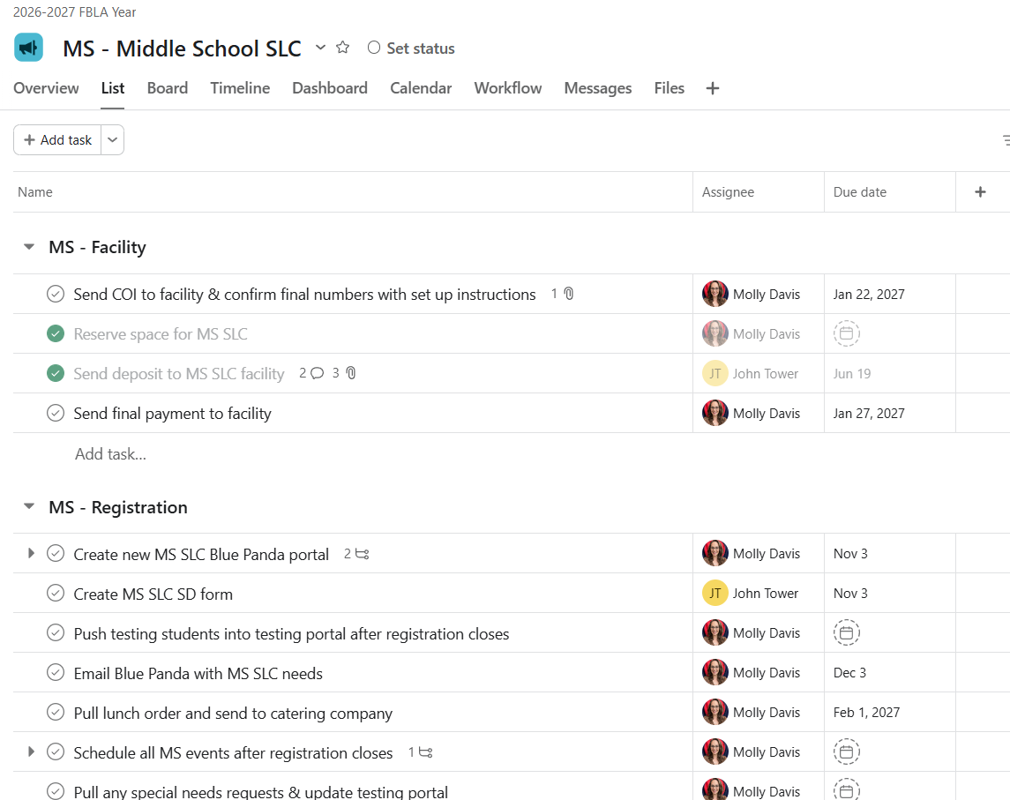
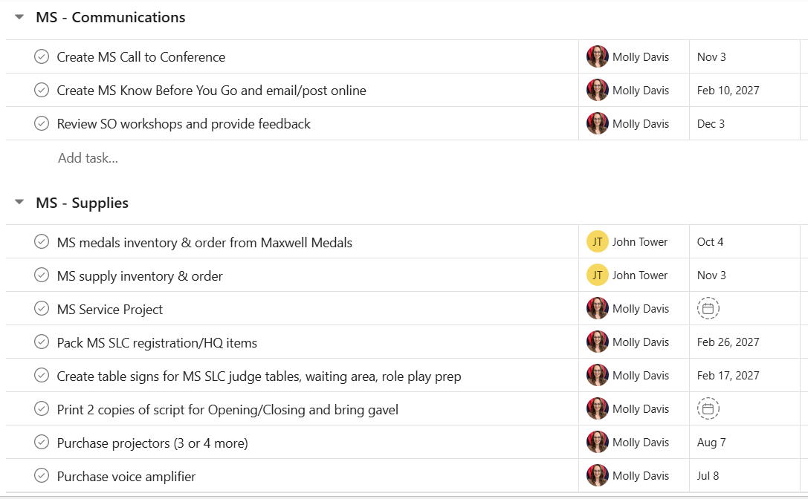
TOOLS WE SWEAR BY
A Quick Plug for Task Managers
Asana keeps every task, owner, and deadline visible in one place — no more sticky notes.

Slide 12
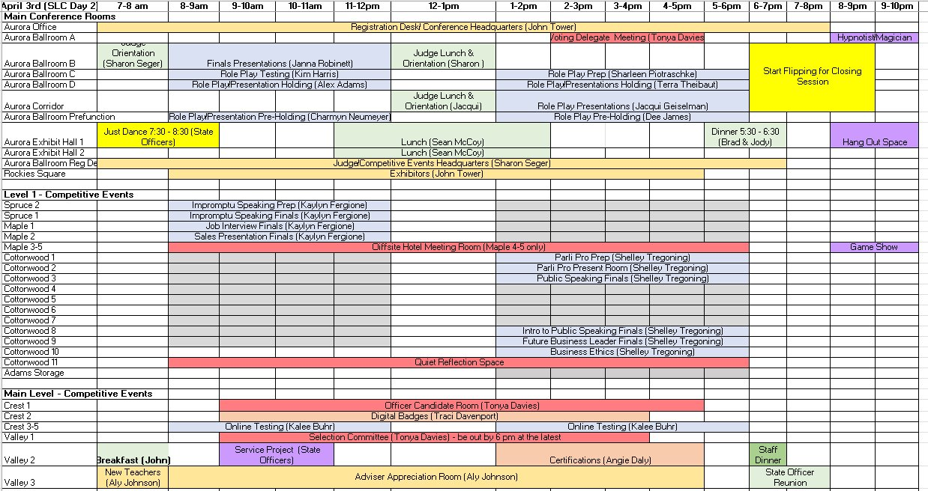
PHASE 2
Planning: 1–5 Months Out
1. 6–12 Months Out
2. 1–5 Months Out
3. Final Month & Onsite
✓
Communication is key
Stakeholders, venue staff, supporters, vendors.
✓
Print and organize
Get materials ready ahead of time.
Plan spaces in detail
✓
Finalize registration
Pull data as soon as it closes.

Slide 13
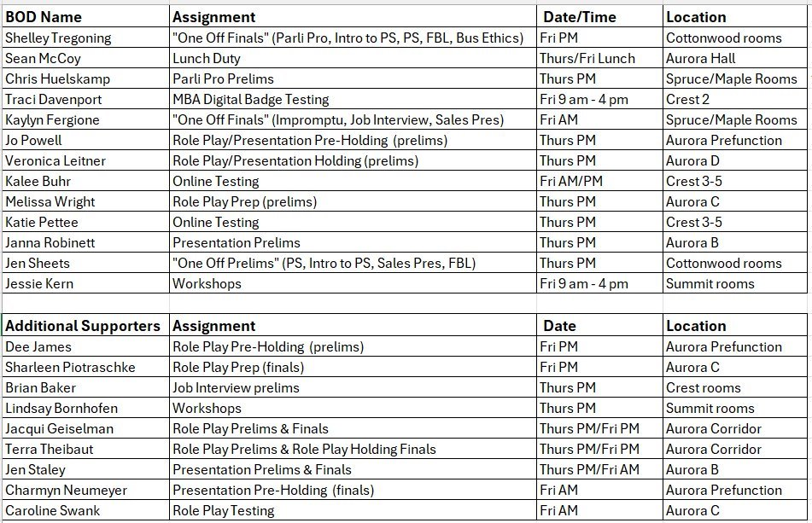
STAFFING
Conference Support Staff
Example 1: 4,000-person event
✓
Divide into zones
Assign Area Leads to each one.
✓
Keep in contact with Leads
✓
Be accessible if issues arise
✓
Take a breather
Example 2: 275-person event
Workshops: Tonya
Competitions room: Molly
Prep room: John
Floater: Jody
Before addressing “emergencies.”

Slide 14
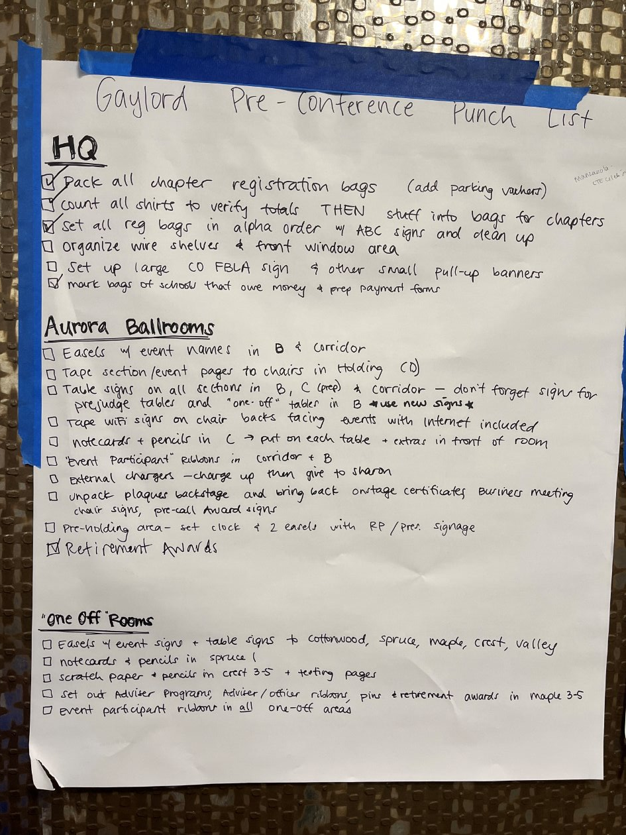
PHASE 3
Planning: Final Month & Onsite
1. 6–12 Months Out
2. 1–5 Months Out
3. Final Month & Onsite
FINAL WEEKS
ONSITE
• Organize! Pack extras & label boxes
• Punch list for prepping space
• Make info easily accessible
• Don’t overschedule yourself
  • Print + make a binder
• New idea? Write it down
  • Create a Google folder
• Have a thick skin
• Reminders to stakeholders

Slide 15
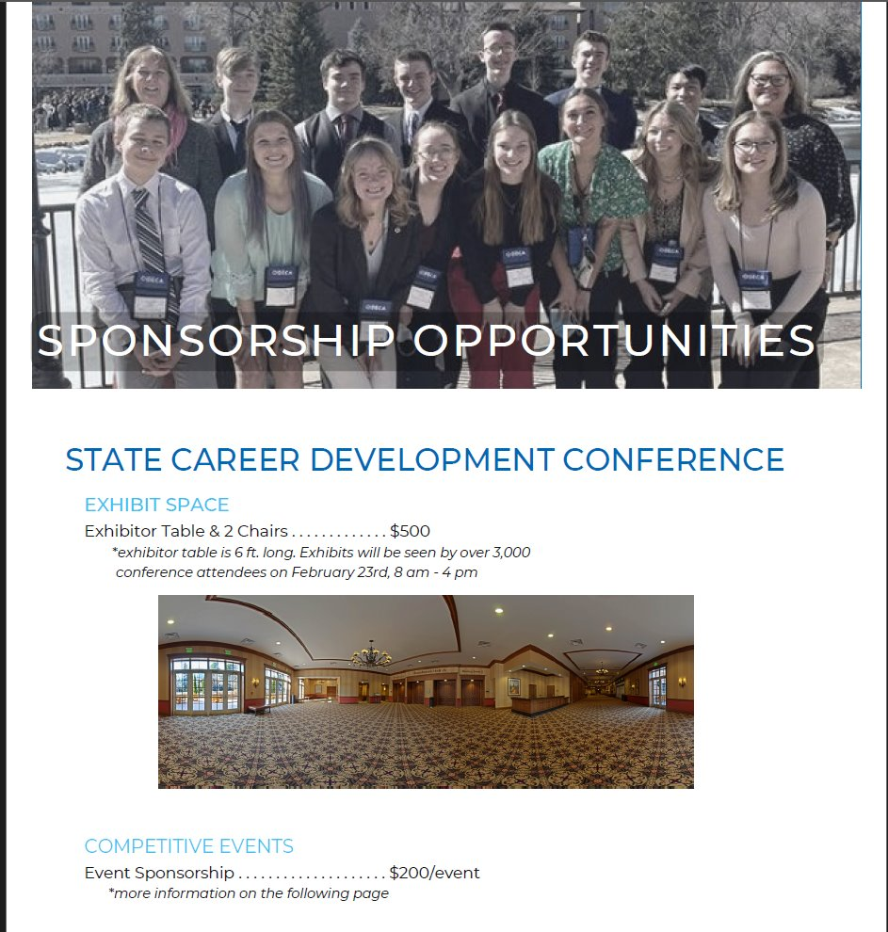
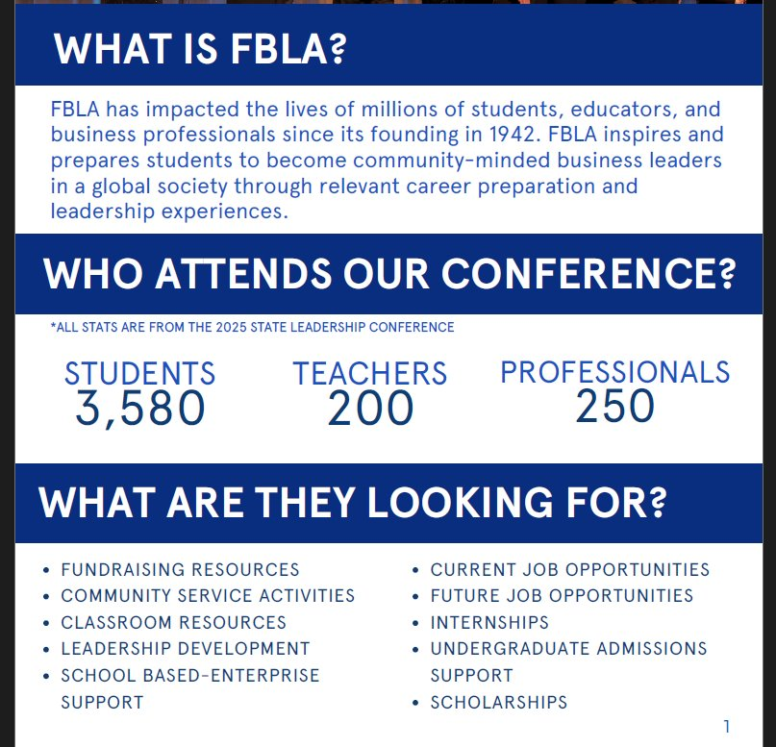
BRAD PEER · VENDOR RELATIONS
Sponsor/Presenter Coordination
BEFORE THE CONFERENCE
• Communicate early
  dates, times, pricing, venue location
• Include options
  Presenter, tabling, exhibits,
• Give a contact person for questions
• Use a platform (Google Docs, Jotform) to track submissions
• Send invoices with clear payment terms
DURING THE CONFERENCE
• Be available for questions
• Provide meal tickets / parking vouchers
• Troubleshoot issues — Wi-Fi is usually the big one
Thank You Notes

Slide 16

BRAD PEER · IN THE MOMENT
Managing Issues
1
Expect Issues
2
Stay Flexible
3
Communicate
4
Keep Moving
WHAT ATTENDEES SEE
Everything looks smooth.
BELOW THE SURFACE
• Phone / radio calls
• Room changes
• Missing judge/speaker/volunteer
• Speaker delay
• Technology issues
Issue
→
Assess
→
Decide
→
Communicate
→
Execute
→
Review Later
“The best conferences aren’t the ones without problems — they’re the ones where attendees never notice the problems.”

Slide 17

THE GUEST PERSPECTIVE
Attendee Experience
✓
Clear Signage
Walk the venue ahead of time.
✓
Smooth Flow
Organize materials beforehand; know the details.
✓
Positive Vibe
Good attitudes and smiling faces set the tone.
Emotions run high at our conferences and competitions —
a calm, steady voice of reason helps everyone.

Slide 18

THE NUMBERS BEHIND THE EVENT
While budget doesn’t directly translate to attendee experience, being aware of it is a key part of conference planning.
Leave enough room in the budget for the things that matter most to attendees — that’s what makes an event one to remember.

Slide 19
WRAPPING UP
Key Takeaways
1
2
3
4
Preparation
Systems
Roles
Confidence
Do the homework before day one.
Build repeatable processes.
Make ownership crystal clear.
Trust the plan you built.

Slide 20
Q & A
Questions
Share
Need Support?
Thank you for helping make every conference GREAT.
cobmef.org

Slide 21
Available Resources
Templates
(Docs, Sheets, Emails)
Job Descriptions
Budget Spreadsheets
Run-of-Show
Schedule Formats
Welcome Letters
Contact: Molly.Davis@cccs.edu Brad.Peer@cccs.edu Jody.Bennett@cccs.edu
cobmef.org

