Slide 1

Colorado’s 2030 Energy Goals:
What it means for your students
Sami Mooney, Business & Education Alignment Consultant
Megan Christensen, Climate Workforce Development Manager
Colorado Workforce Development Council (CWDC),
Colorado Energy Office (CEO)

Slide 2
Who are we?
Colorado Workforce Development Council’s Mission: Enhance and sustain a skills-based talent development network that meets the needs of employers, workers, job seekers, and learners for today and tomorrow.
Colorado Energy Office’s Mission: Reduce greenhouse gas emissions and consumer energy costs by advancing clean energy, energy efficiency and zero emission vehicles to benefit all Coloradans.
Together.. We are committed to building a strong, equitable climate workforce
Notes:
<2 - 2:05> and, to open it up a little - has anyone observed these values in action?

Slide 3
The Colorado Workforce Development Council (CWDC) is a Governor-appointed, public-private partnership with the purpose to advise, oversee, and integrate the work of the Colorado talent development network.
Notes:
The Colorado Workforce Development Council (CWDC) is a Governor-appointed, public-private partnership with the purpose to advise, oversee, and integrate the work of the Colorado talent development network.
The CWDC Office is the work unit that supports the Council in their work to enhance and sustain a skills-based talent development network

Slide 4
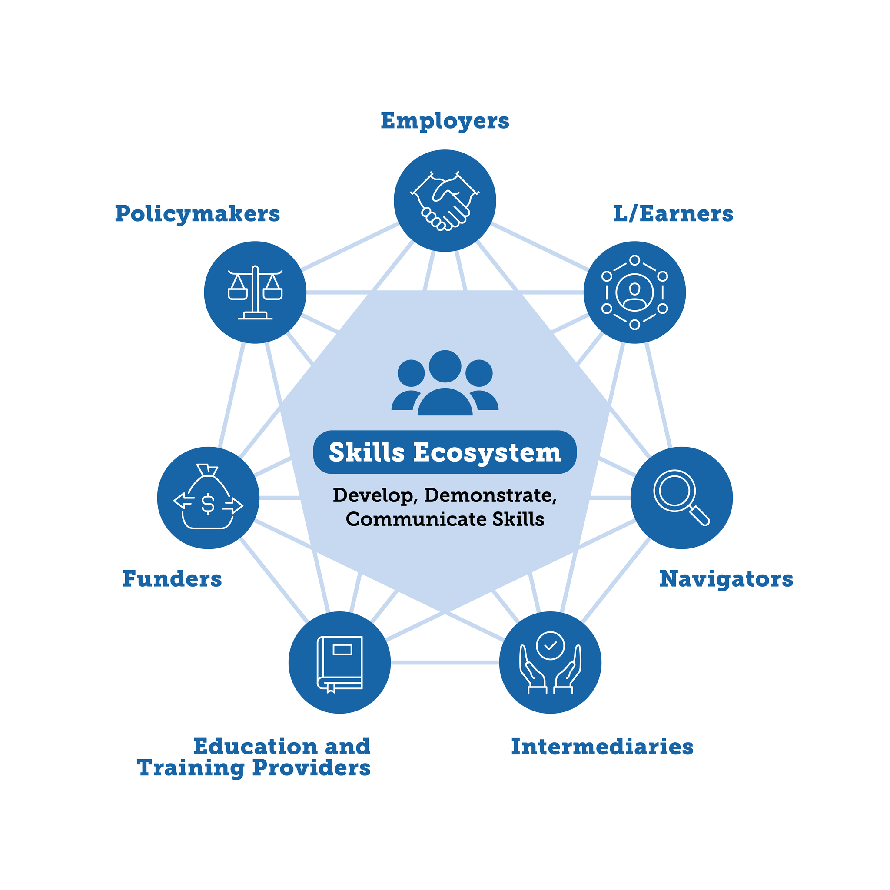
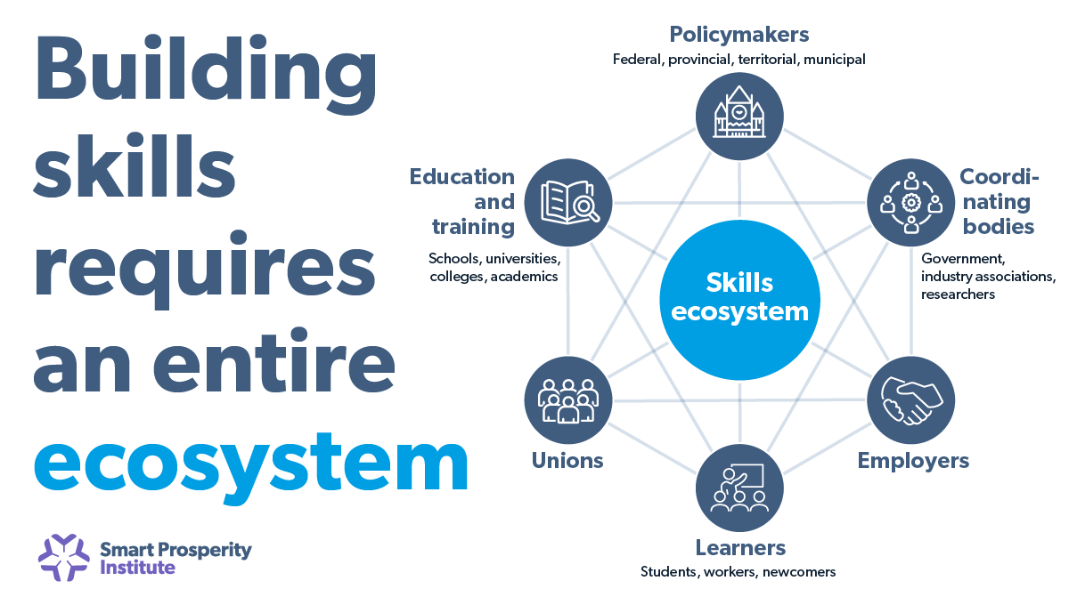

Slide 5
Agenda for the Session
Welcome & Intro to Climate Workforce Development
Climate Solution Sector Deep Dive: Building Efficiency & Electrification
  Integrating these solutions into your classroom
Other Climate Solution Sectors (summary)
  Integrating these solutions into your classroom
Pathways: Apprenticeships
Companion Pack: Feedback from Educators (Menti)
Q&A & Wrap-Up
Notes:
<2 - 2:05> and, to open it up a little - has anyone observed these values in action?

Slide 6
Where we’ve been
2021 2024 2025 2026
CO outlines 2050 Greenhouse Gas Pollution Reduction Roadmap (ie Climate Goals)
Colorado Energy Office (CEO) establishes workforce priorities and collaborates with CWDC
Colorado Climate Workforce Analysis & Plan Published
Climate Workforce Companion Pack for educators planned for this fall
2 Cohorts of Climate Jobs + The Skilled Trades Teacher Externships

Slide 7
Big Question for Today
How might we further integrate climate technology and climate solutions into the classroom?
Round Robin: What is something you are curious about?

Slide 8
The Energy Transition Requires a
Robust Climate Workforce
Colorado’s Climate Change Mitigation Goal = achieve net-zero greenhouse gas emissions by 2050. 50% by 2030.
That means we have a growing need for a young, skilled climate workforce … to the tune of ~13,000 additional or ‘upskilled’ skilled trades workers by 2030
We call these our “climate critical occupations”
“The limiting factors are going to be…whether we can build out, above all, the human capital that we need. I mean, the best estimate is it’s going to take at least a million more electricians in the U.S. If you know a young person who wants to do something that’s going to help the world and wants to make a good living at the same time, tell them to go become an electrician.” -Bill McKibben, November 15, 2022, New York Times.

Slide 9
Which means we need a lot more of…
Climate Action
Occupation
Heat Pump Installation and Maintenance
HVAC Tech, Plumber, Electrician
Development and Operation of New Battery Energy Storage Projects
Electrician, Battery Technicians
Geothermal Heating and Cooling
Plumbers and Pipefitters, HVAC Tech, Drillers
Electric Vehicle + Charging Infrastructure Maintenance
EV Auto Technicians + Charging Station Installer Techs
Development and Operation of Distributed & Utility-Scale Solar Photovoltaic Capacity
Solar Installers, Electricians, Construction Laborers
Development and Operation of New Wind Energy Projects
Wind Turbine Service Technicians, Construction Laborers, Engineers
Notes:
Where are the actual jobs?

Slide 10
Climate Solution Deep Dive: Building Decarbonization
Energy Efficiency (Use Less): Upgrading insulation, sealing air leaks, installing double-pane windows, upgrade to more efficient tech (LED light bulbs, Energy STAR appliances)
Electrification (Swap the Tech): Replacing appliances inside the building that burn fossil fuels with an all-electric alternative (gas furnace for heat pump, gas water heater for heat pump water heater, gas stove for induction stove)
Clean Energy (Change the Power Source): Powering those new electric appliances with renewable energy. This can happen locally (rooftop solar, community solar), and from your energy utility.
Tagline: "Maximize efficiency, electrify everything, and clean the grid.”

Slide 11
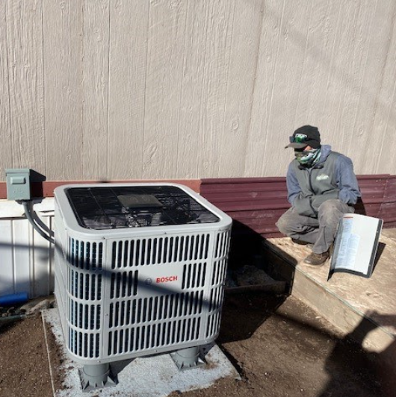
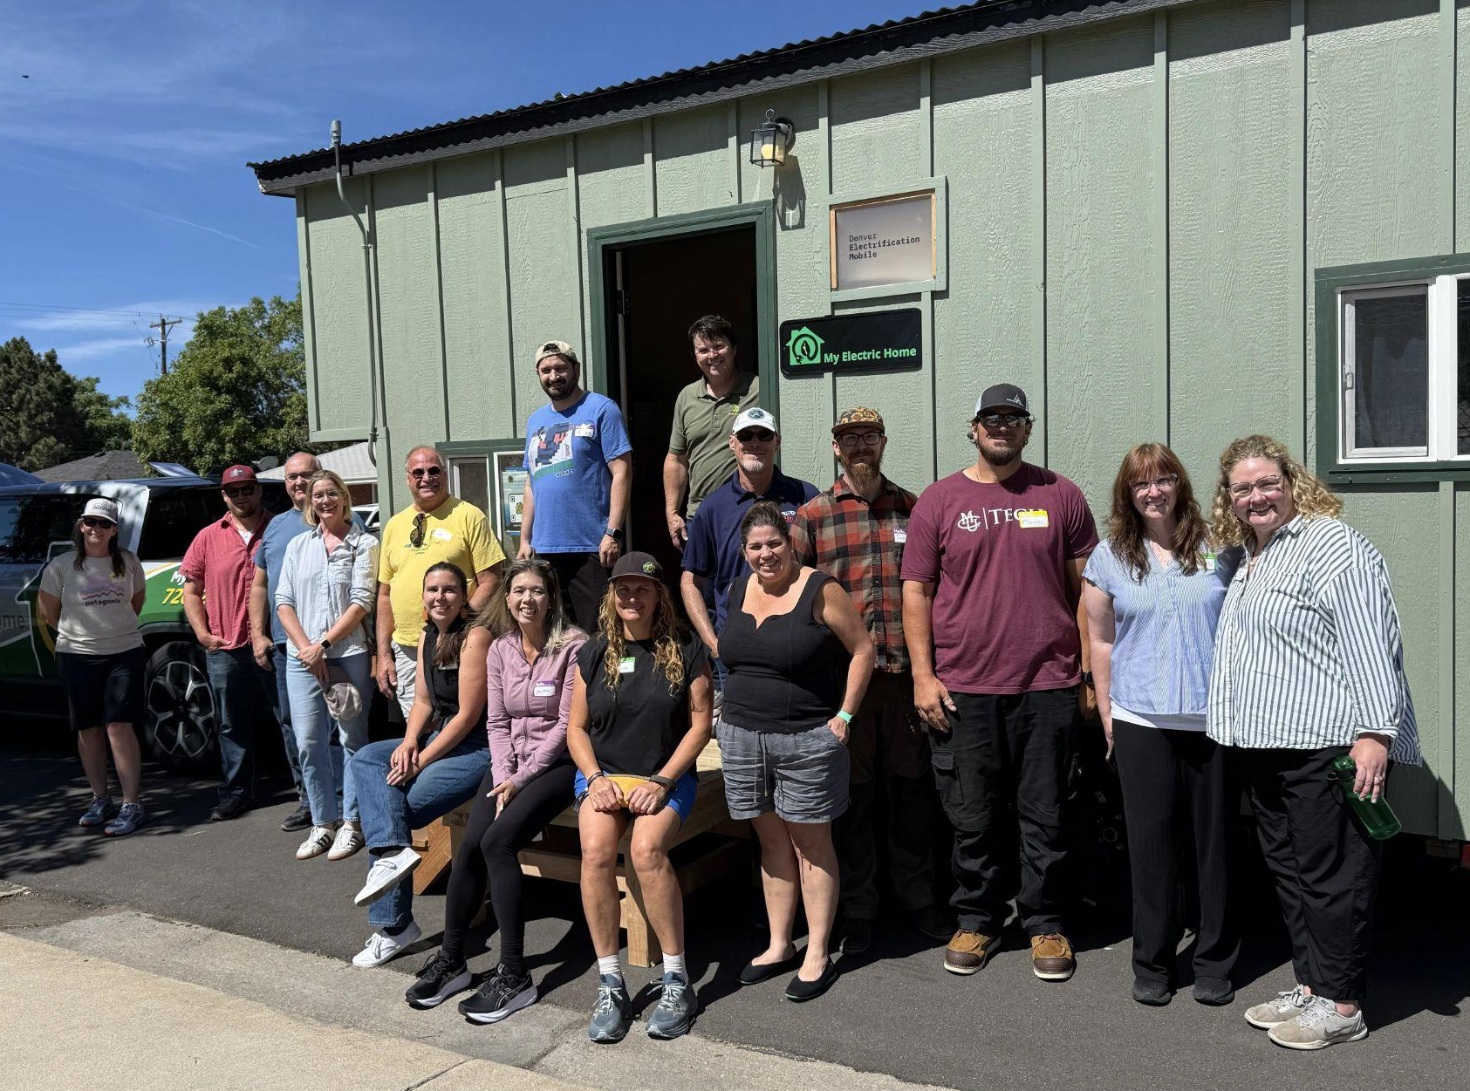
Example: Air Source Heat Pumps
& Water Heaters
Notes:
<2 - 2:05> and, to open it up a little - has anyone observed these values in action?

Slide 12
Efficiency & Electrification: Ideas for the Classroom
Make it relevant:
Heat Pump Installations in Colorado article
Clearview Distributors Market Insights
Rebate programs
Energy Star Appliances blog
Applications in the classroom:
What happens before you flip a switch
Students calculate energy use
Compare energy use before & after efficiency upgrades
Project DrawDown online tool, identify & research solutions (buildings sector)
School building efficiency project (ie do an energy audit, create a proposal)
Homeowner considerations looking into weatherization

Slide 13
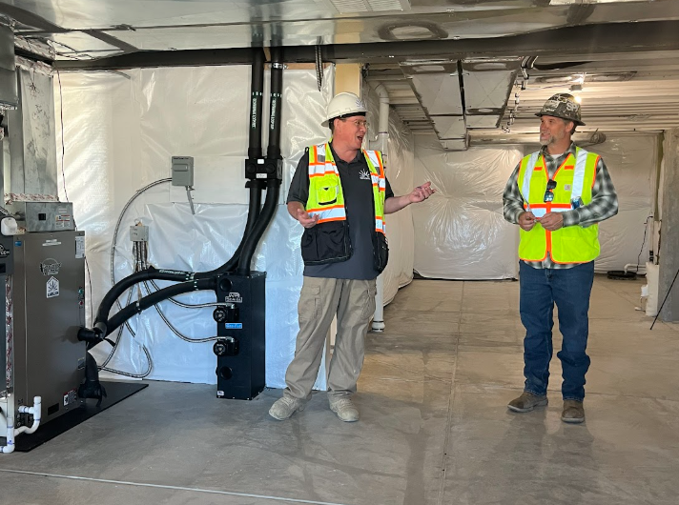
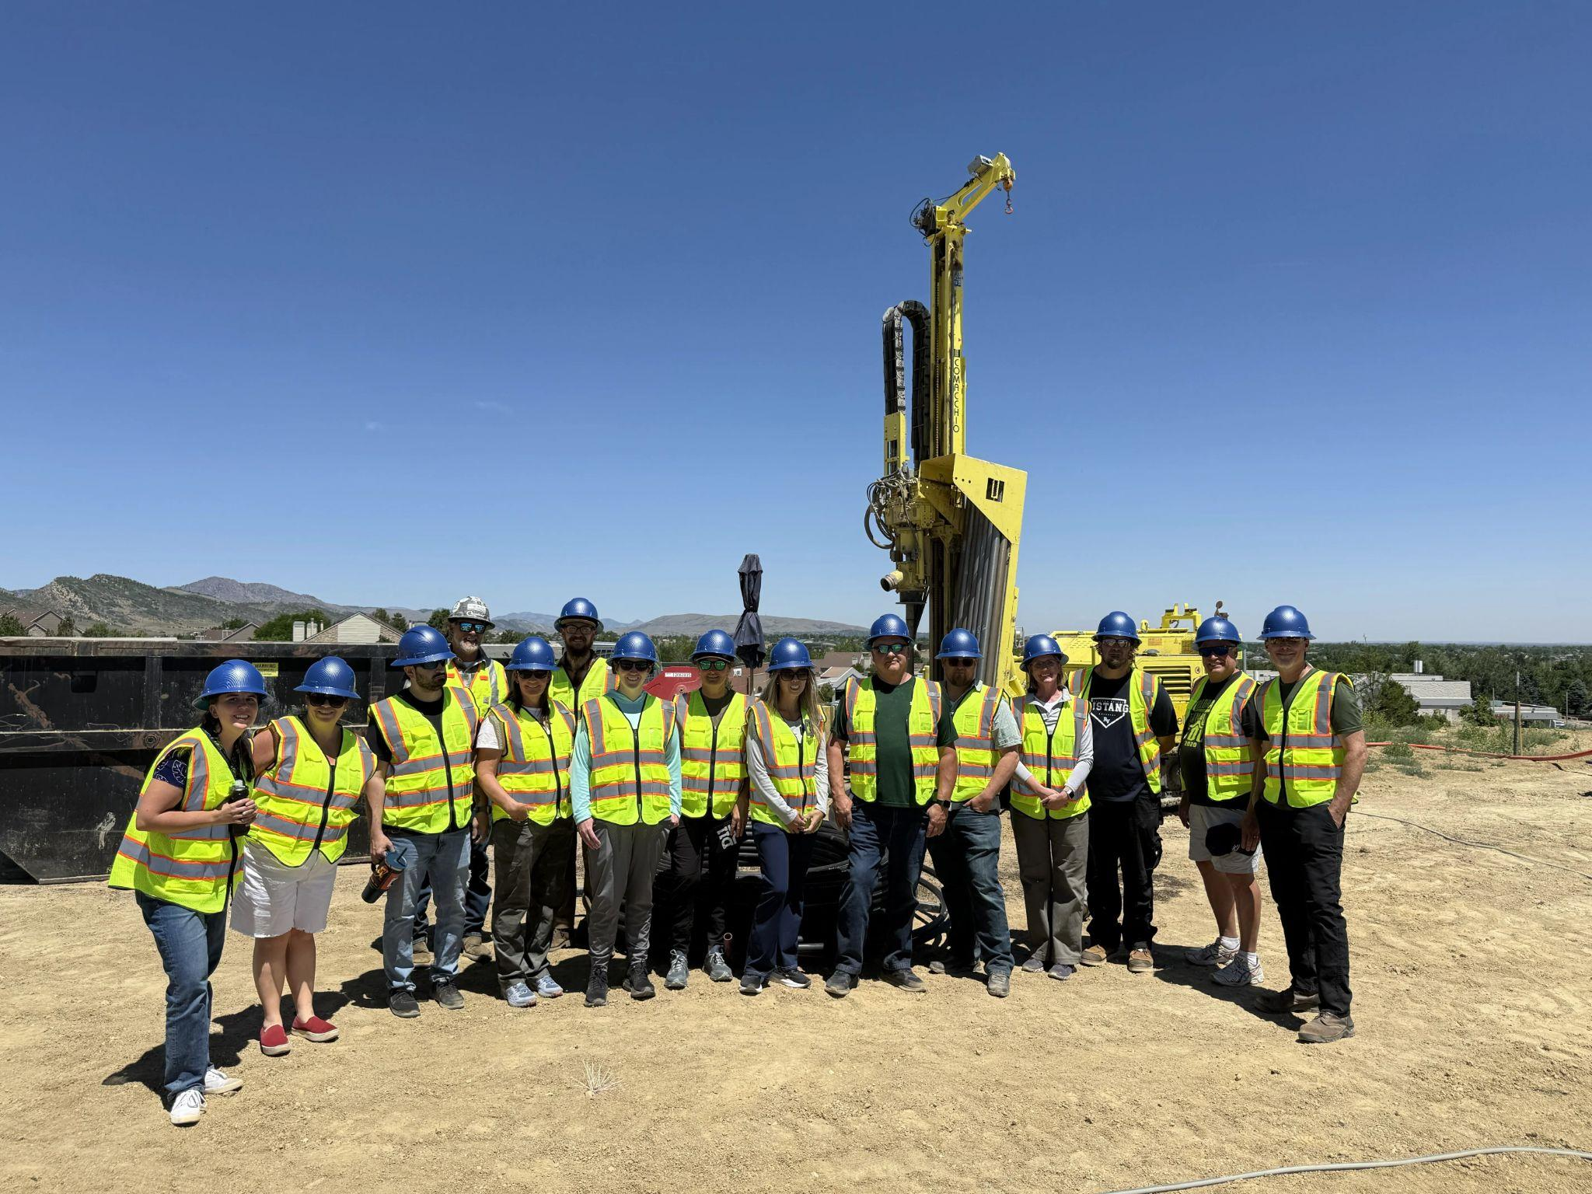
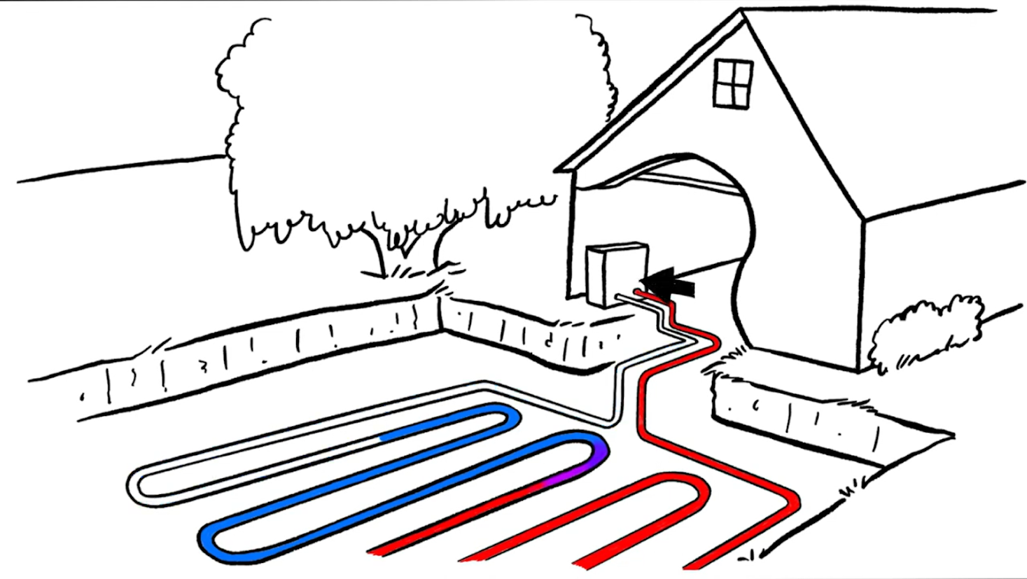
Example: Geothermal Heating
& Cooling (ground-source heat pump)
Notes:
<2 - 2:05> and, to open it up a little - has anyone observed these values in action?

Slide 14
Ideas for the Classroom
Make it relevant:
A renewables milestone for Colorado
Exploring Colorado’s untapped geothermal energy potential
Colorado Geological Survey: Geothermal
CO Geothermal site
Applications in the classroom:
Geothermal heating & cooling (shallow) vs power generation (deep)
What are geothermal heat pumps?
Assess why Colorado is uniquely positioned for geothermal power generation (and where)
Visit a drilling & installation site
Different jobs on a drilling & install site
Mapping Colorado geothermal installs /studies (starting map)
Notes:
<2 - 2:05> and, to open it up a little - has anyone observed these values in action?

Slide 15
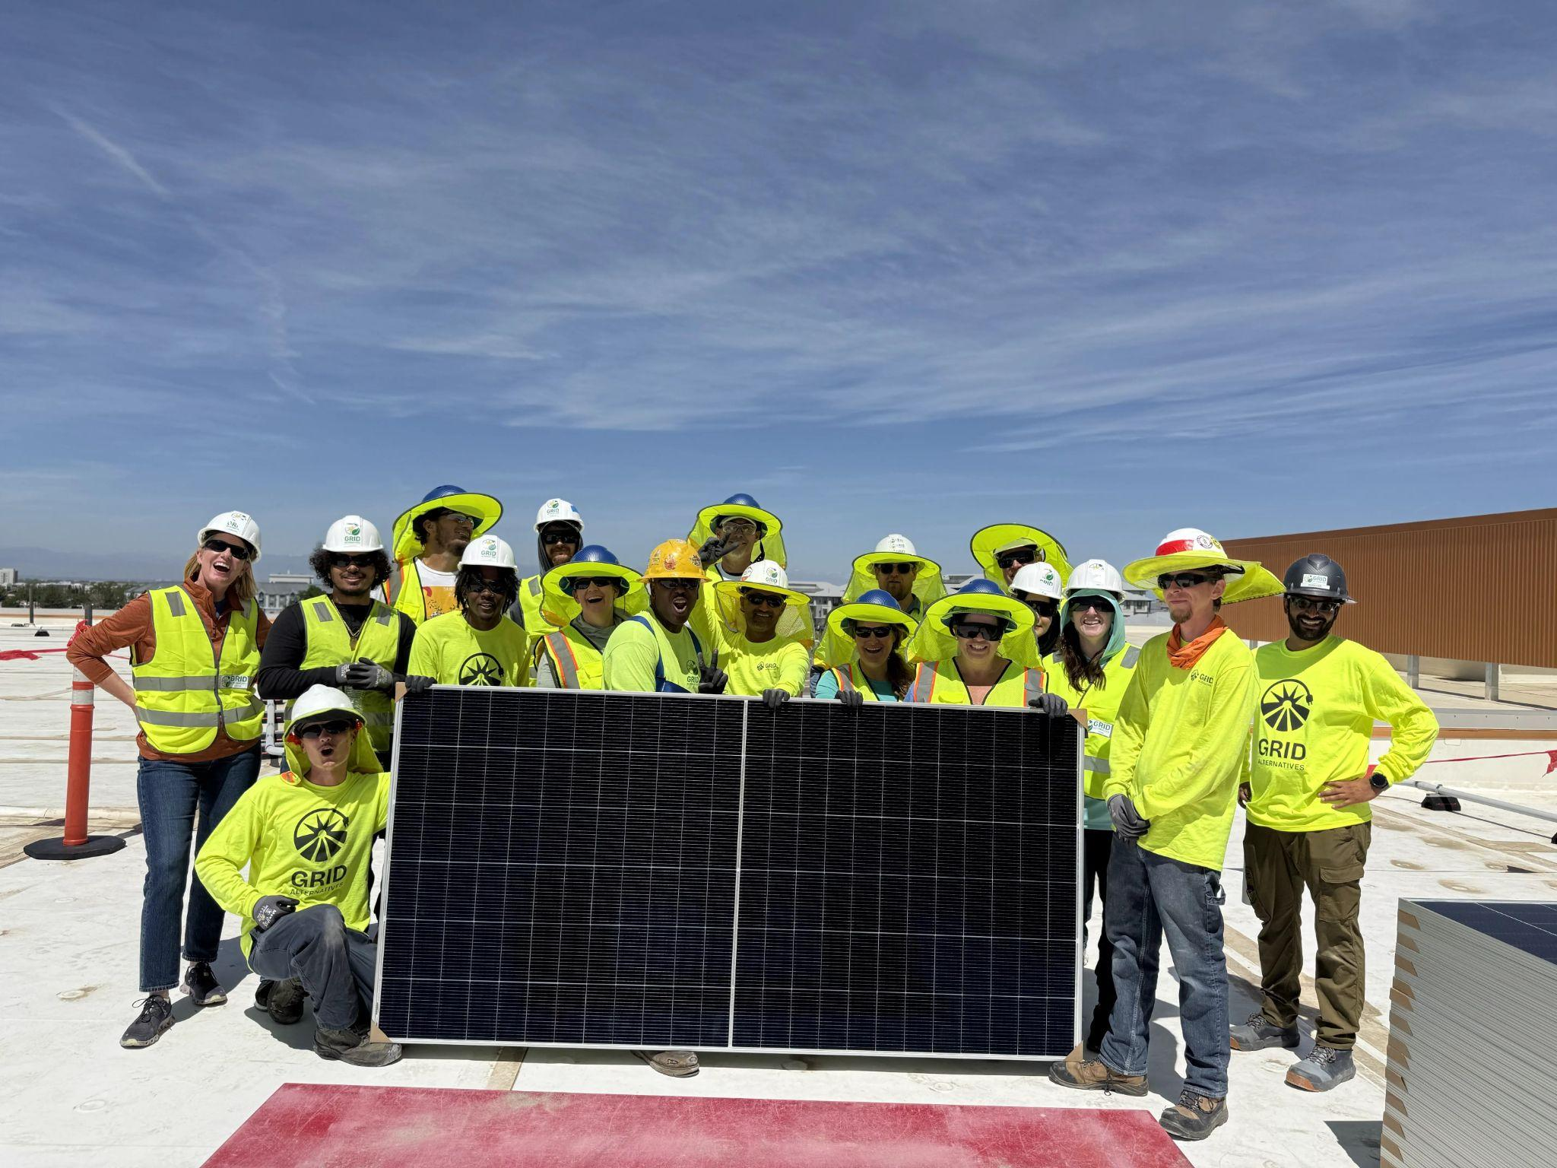
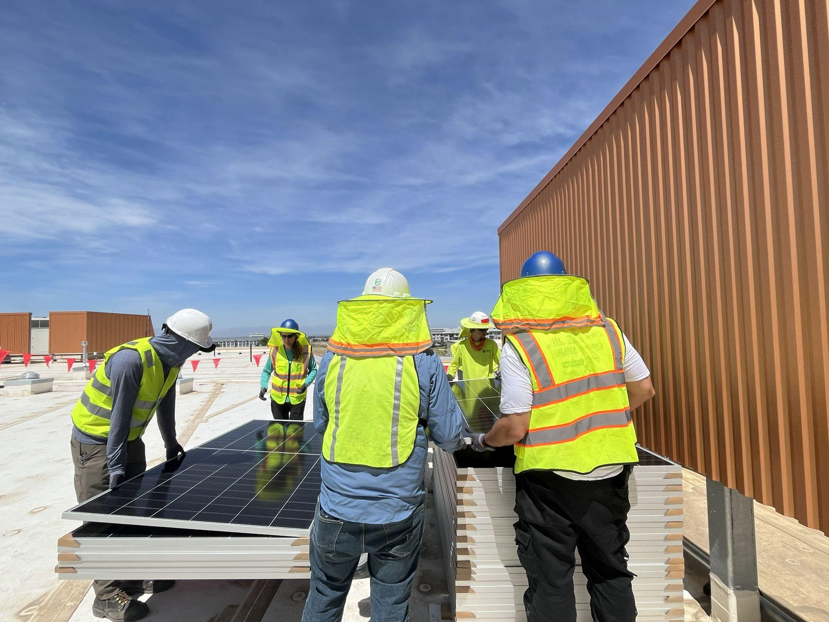
Example: Rooftop (Distributed)
Solar
Notes:
<2 - 2:05> and, to open it up a little - has anyone observed these values in action?

Slide 16
Ideas for the Classroom
Make it relevant:
What powers Colorado?
Colorado Frost Protection
New Colorado Law Plug In Solar
Wind Farms in CO
Applications in the classroom:
Solar WBL experience
Small scale solar install (shed, mini home)
Compare renewable energy use in Colorado to other sources
Math, engineering: research energy storage potential,
Notes:
<2 - 2:05> and, to open it up a little - has anyone observed these values in action?

Slide 17
Pause
What is…..
1 classroom experience,
1 WBL experience
or
1 credential related to this sector?

Slide 18
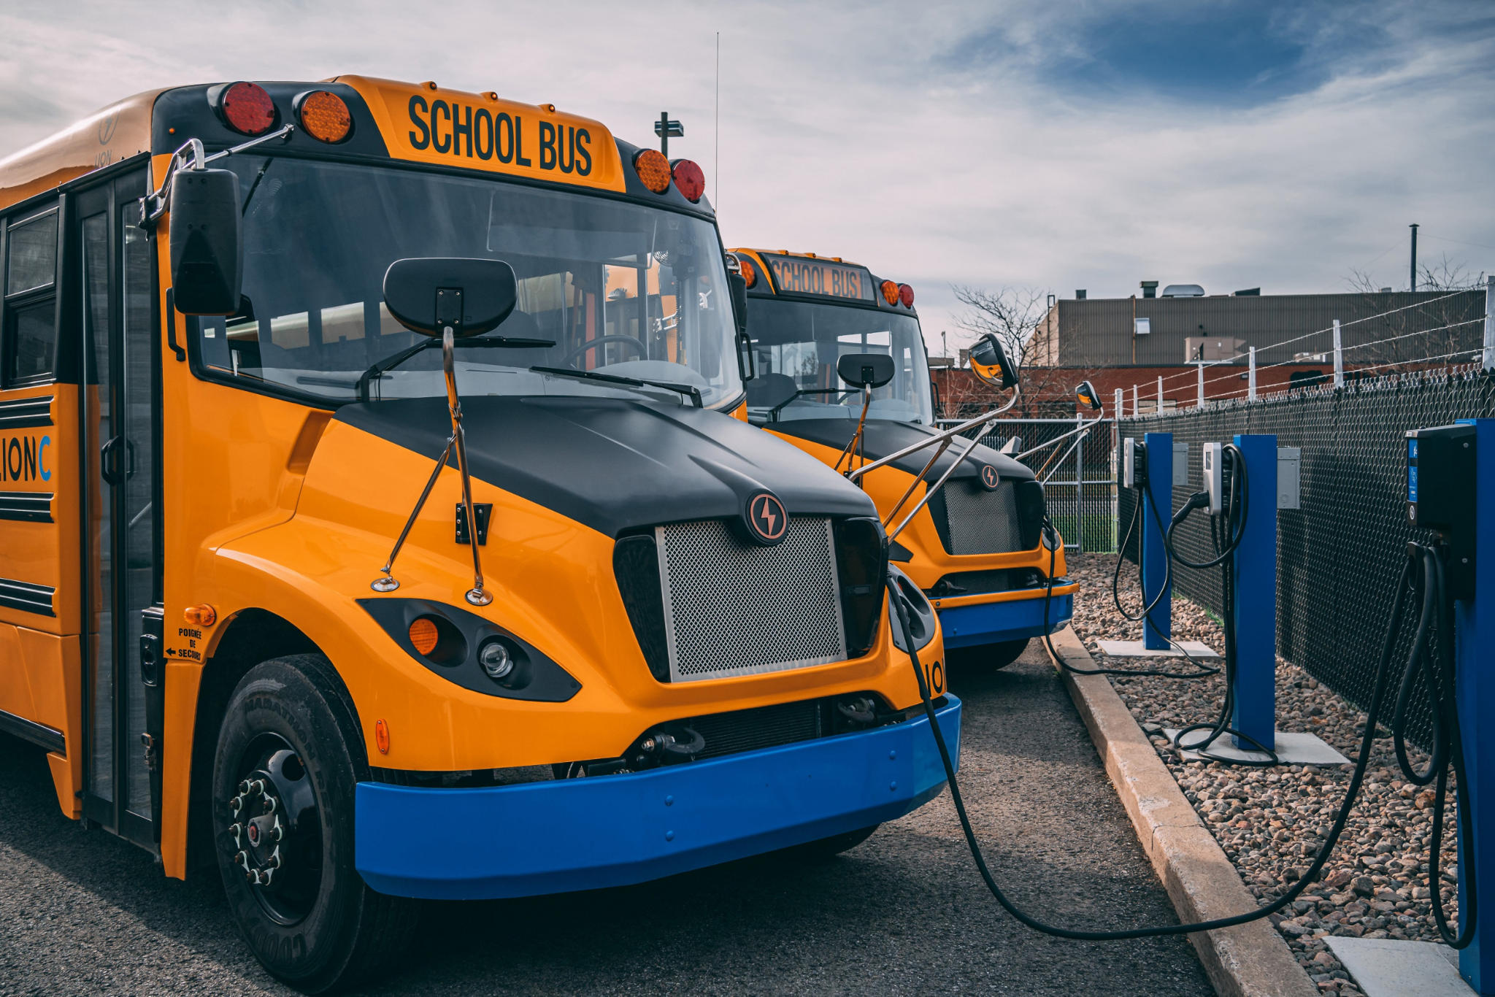
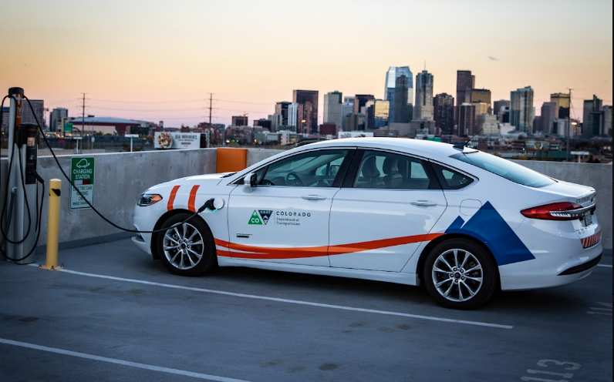
Other Climate Solutions Quick Blitz: Transportation
Source: Frontier Group
Source: Colorado Energy Office

Slide 19
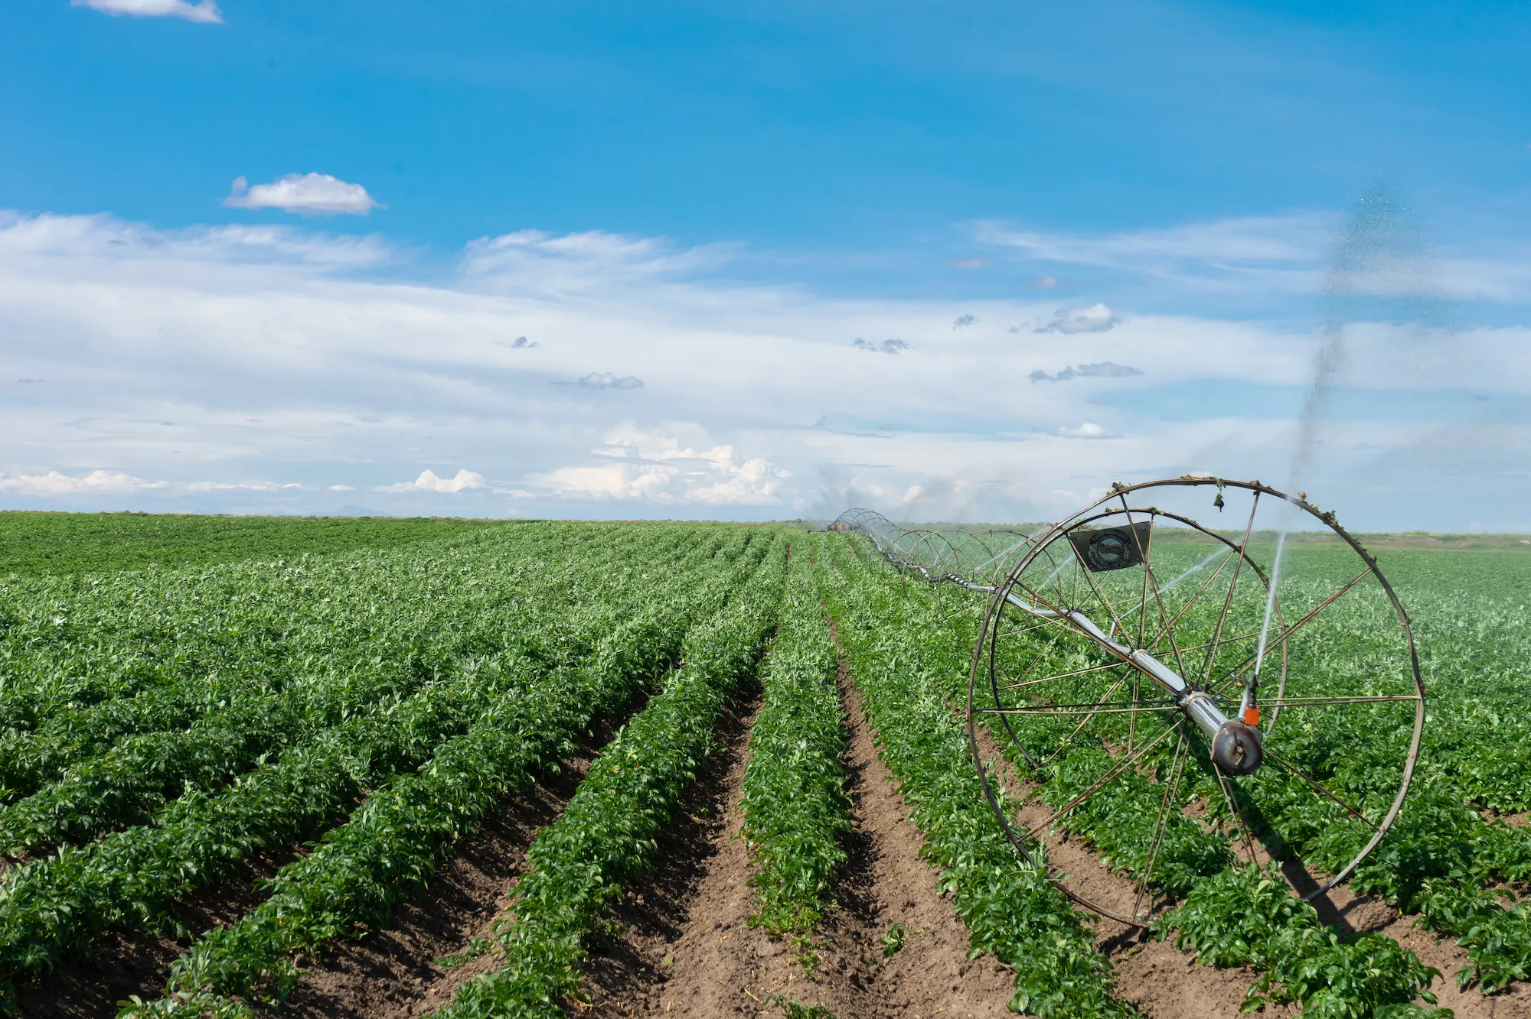
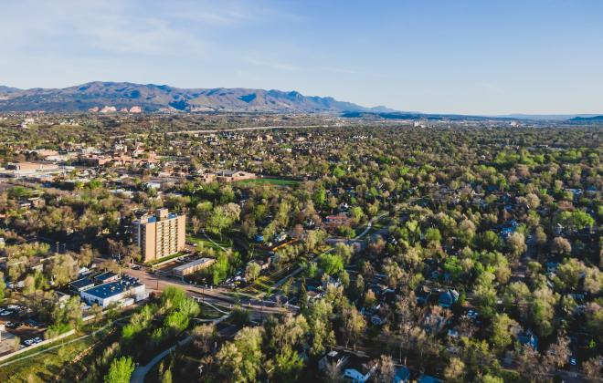
Other Climate Solutions Quick Blitz:
Agriculture & Natural Lands
Source: The Nature Conservancy Cool Green Blog
Source: Colorado Springs

Slide 20
Building Pathways for your Students

Slide 21
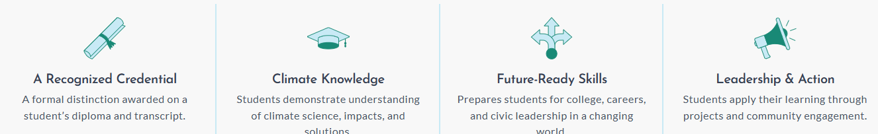
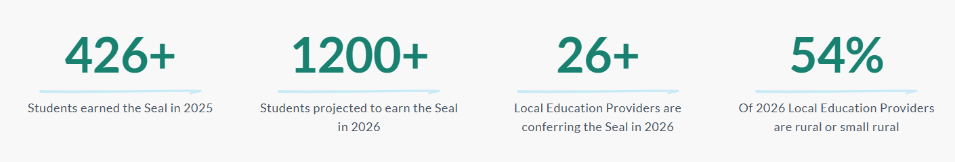
Seal of Climate Literacy
SB24-014

Slide 22
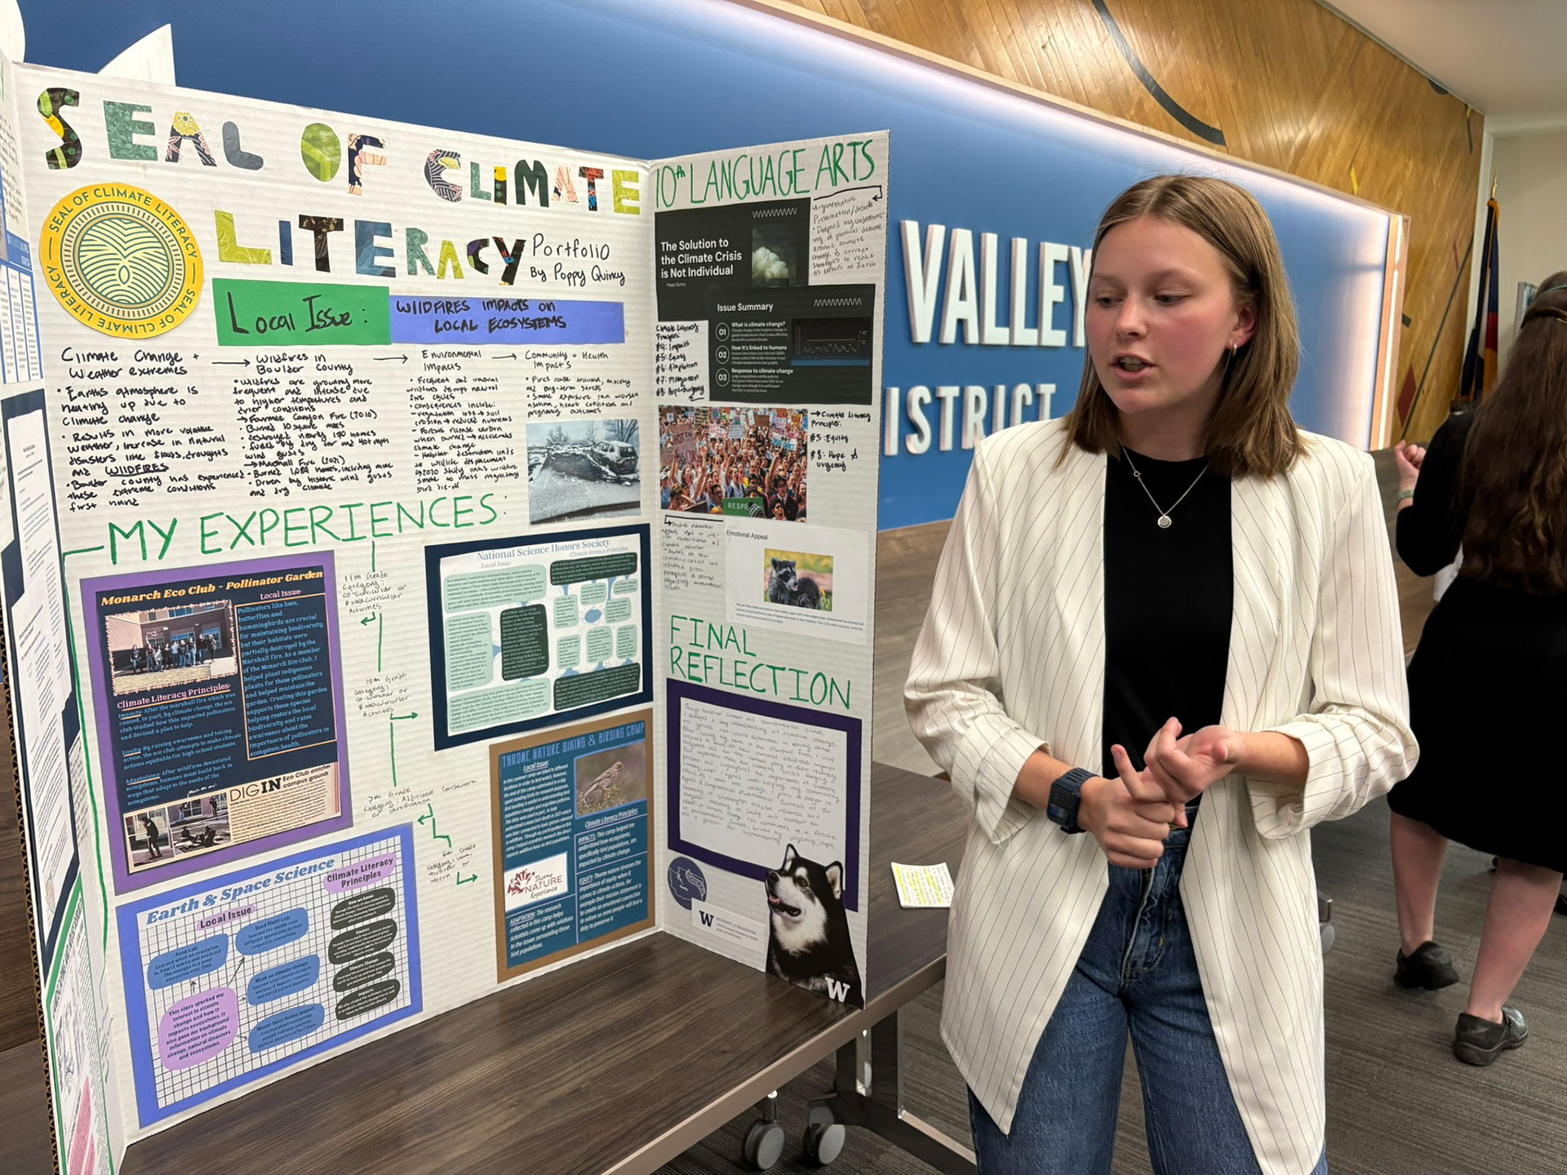
Climate Seal Resources
2025 Projects
Environmental monitoring and research
Sustainable agriculture and land stewardship
Waste reduction initiatives
Renewable energy solutions
Climate education and community outreach
Arts and media projects
Work-based learning and internships
Seal of Climate Literacy Website, student samples
CDE Implementation Webpage
Project Drawdown Tool

Slide 23
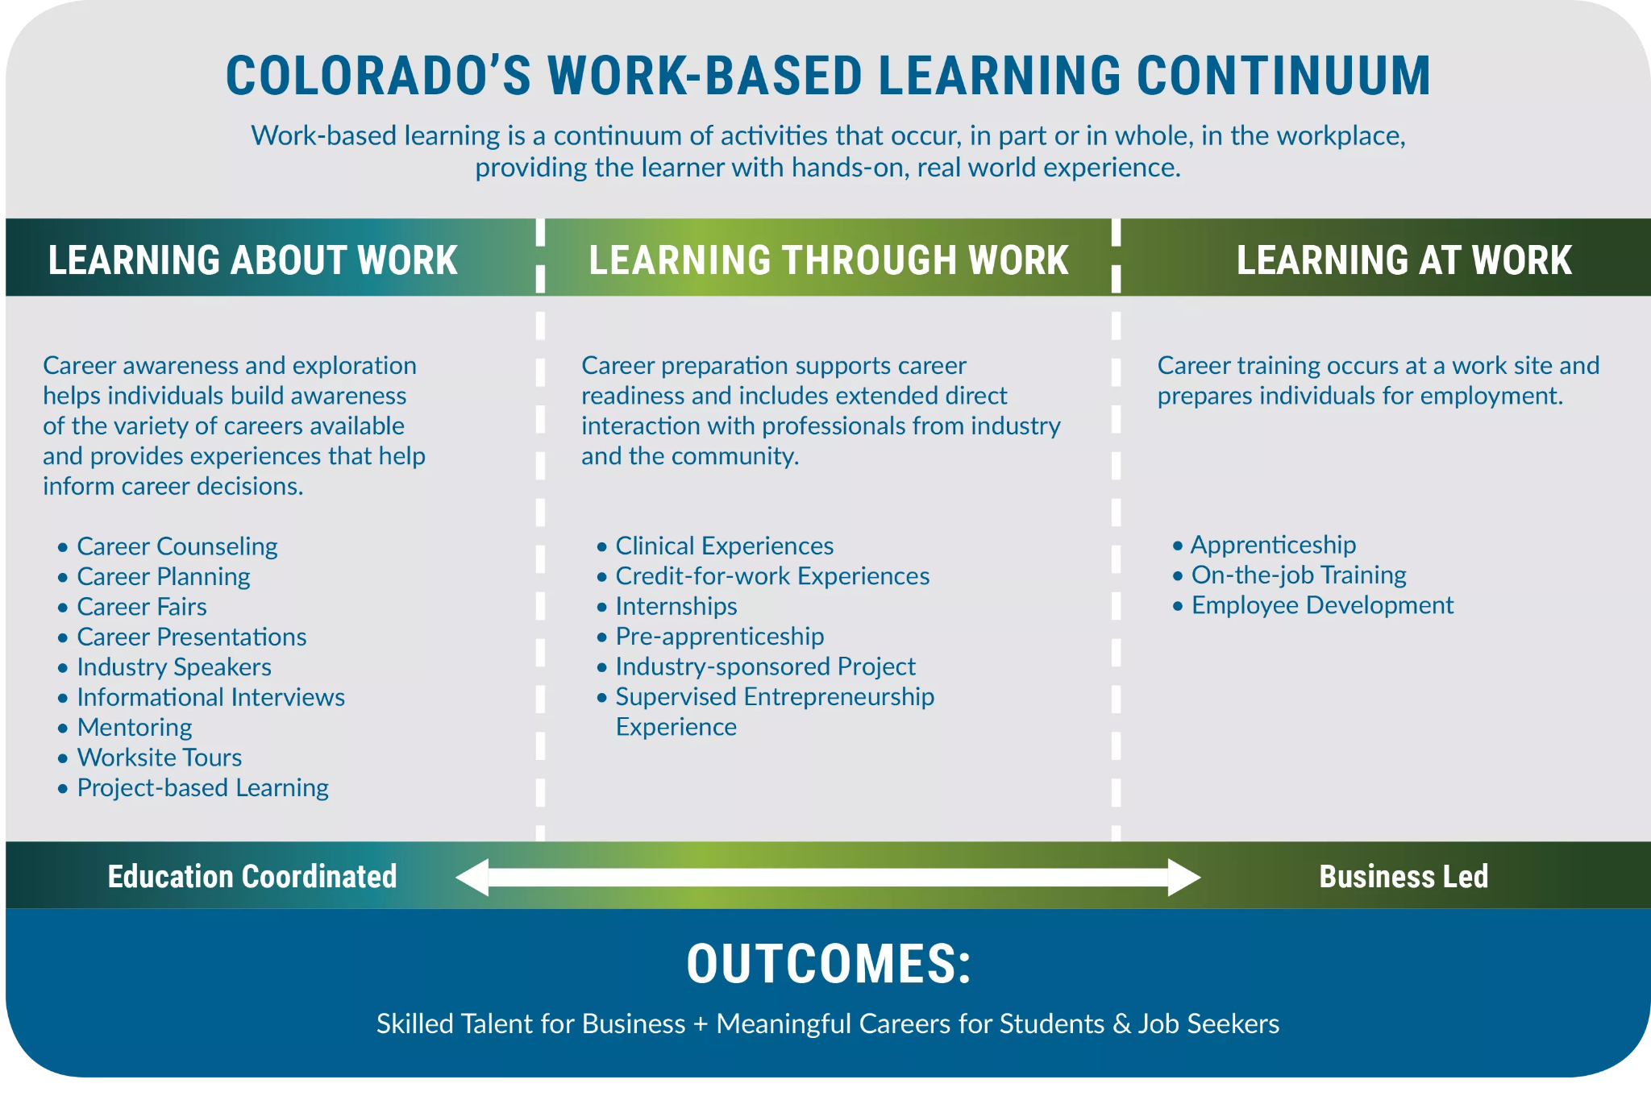

Slide 24
Quality Work-Based Learning
Learning About Work | Learning Through Work | Learning At Work
Field trip to local water treatment, recycling | Industry sponsored project - solving community issues | Host a registered apprenticeship fair
Climate speaker in core classes or CTE courses | Climate careers internship - policy, administration, research | Bring in registered apprenticeship speakers, current apprentices
Climate careers job fair or experiential learning activity | Climate careers internship- skilled trades | Obtain employment in the field
On campus PBL for sustainability | Industry sponsored project- school buildings/ landscaping
Notes:
https://careertech.org/wp-content/uploads/2024/10/Green_WF_Career_Clusters_Framework_10_2024.pdf
Learning at work

Slide 25
Quality Credentials
CDE List of Qualified Credentials (a non-exhaustive list)
Agriculture | Plant Science National Safe Tractor and Machinery Operation/OSHA 10 Agriculture, Food & Natural Resources
Construction | NCCER Core (inclusive of OSHA 10) + Electrical HBI Core (inclusive of OSHA 10) + Electrical, HVAC, Carpentry, Building Construction Technology, Plumbing Multi-Craft Core Curriculum (MC3) EPA Certification (Environmental Protection Agency) Exam (EPA 608)
Energy + Natural Resources | Natural Resources: Colorado River Watch Certification Wildland Firefighter type 2 (FFT2) Hydrology Technician 1
Transportation | ASE, Entry Level Maintenance and Light Repair ASE, Entry Level Automobile Service Technology

Slide 26
Mentimeter Time:
Feedback on the Draft of our Climate Workforce Educator Companion Pack

Slide 27
Resources

Slide 28
Green in CTE
CTE for Climate Jobs (report)
Seeing Green: CTE as a Catalyst for the Green Workforce (report)
2025 U.S. Energy & Employment Jobs Report (USEER) - National & Colorado Specific

Slide 29
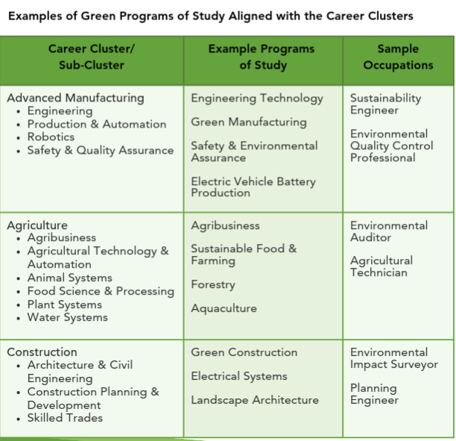
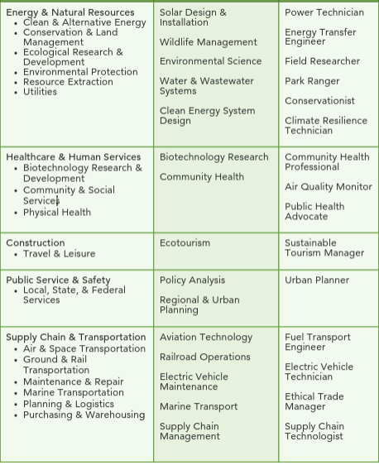
CTE + Climate Careers (CTE Clusters framework)
Notes:
https://careertech.org/wp-content/uploads/2024/10/Green_WF_Career_Clusters_Framework_10_2024.pdf
Sami- screen with Kelly, where are we going?

Slide 30
Additional Resources
Get into Energy: Explore Career Pathways in Energy Trades (flyers)
Heat Pump Training Toolkit (Colorado Energy Office)
Integrate climate careers education into your classes (Massachusetts free curriculum)
Career Dreamer from Google (if allowable, includes use of AI)
Work on Climate: Resources + community

Slide 31


Thank you!
Access this presentation here
email: megan.christensen@state.co.us
sami.mooney@state.co.us
websites: https://energyoffice.colorado.gov/
https://cwdc.colorado.gov/
Notes:
Specific needs

