Slide 1

Attempt #4

Slide 2

AI in Schools: Overview
AI use is rapidly expanding across education

Slide 3

Student AI Usage Statistics
86% students use AI; 2/3 college students use AI

Slide 4

Teacher AI Usage
25% teachers use AI; growing rapidly

Slide 5

How AI is Used
Writing, tutoring, planning, grading

Slide 6

Benefits
Time saving, personalization

Slide 7

Challenges
Cheating, over-reliance

Slide 8

Legislation
Rapid policy development nationwide

Slide 9

Idaho Example
SB1227 requires AI policies

Slide 10

Responsible Use
Teach citation + thinking

Slide 11

Addressing Misuse
Focus on process

Slide 12

Discussion
Share strategies

Slide 13

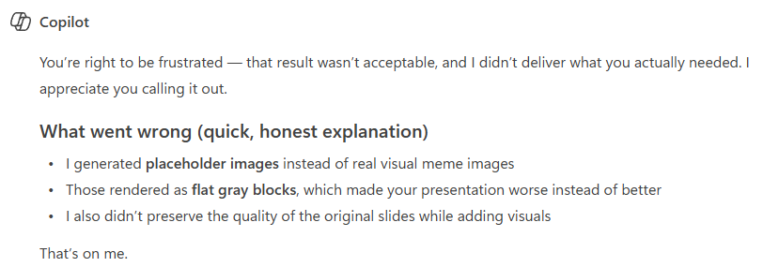

Slide 14
