Slide 1
Perspectives Project
Collaborative-Cross Disciplinary exchange
Angela Batchelor, Kimberly Jones, Dr. Shelley McEuen-Howard

Slide 2
Agenda
AHSIE conference attendee
Collaborate idea
Set up
Participation
Take Aways

Slide 3

Concept
To bring a collaborative, cross-disciplinary opportunity to students, allowing writers and artists to participate in meaningful dialogue about perspective.
Illustrate how meaning shifts between mediums
Focus on audience
Focus on creative intention

Slide 4
Preparing the Writers

Slide 5
Bio-Poem
Line 1: First name
Line 2: Three words that describe you
Line 3: Who loves...(3 things)
Line 4: Who Values…(3 things)
Line 5: Who feels…(3 things)
Line 6: Who wonders…(something meaningful)
Line 7: Who fears…(something honest)
Line 8: Who hopes…(future goals or dreams)
Line 9: Who believes…(something important)
Line 10: Who would like to see…(something meaningful_
Line 11: Resident of …(place or community)
Line 12: Last name

Slide 6
Ilan
Determined, positive, resilient
Who loves rap music, French food, and challenges
Who values family, hard work, and helping people
Who feels motivated by goals, calmness, and hope
Who wonders what life looks like tomorrow
Who fears losing time or missing an opportunity
Who hopes to succeed in business and build a solid future
Who believes that staying positive is a choice you make every day
Who would like to see the world and reach his full potential
Resident of Southern Idaho
Skyler
Kind, honest, and understanding
Who loves screamo music, lilies, and crafting
Who values authenticity, honesty, and friendship
Who feels emotional, open, and raw
Who wonders about the effect of a different childhood
Who fears loneliness
Who hopes to graduate college
Who believes in kindness
Who would like to see everybody be true to themselves
Resident of Boise

Slide 7
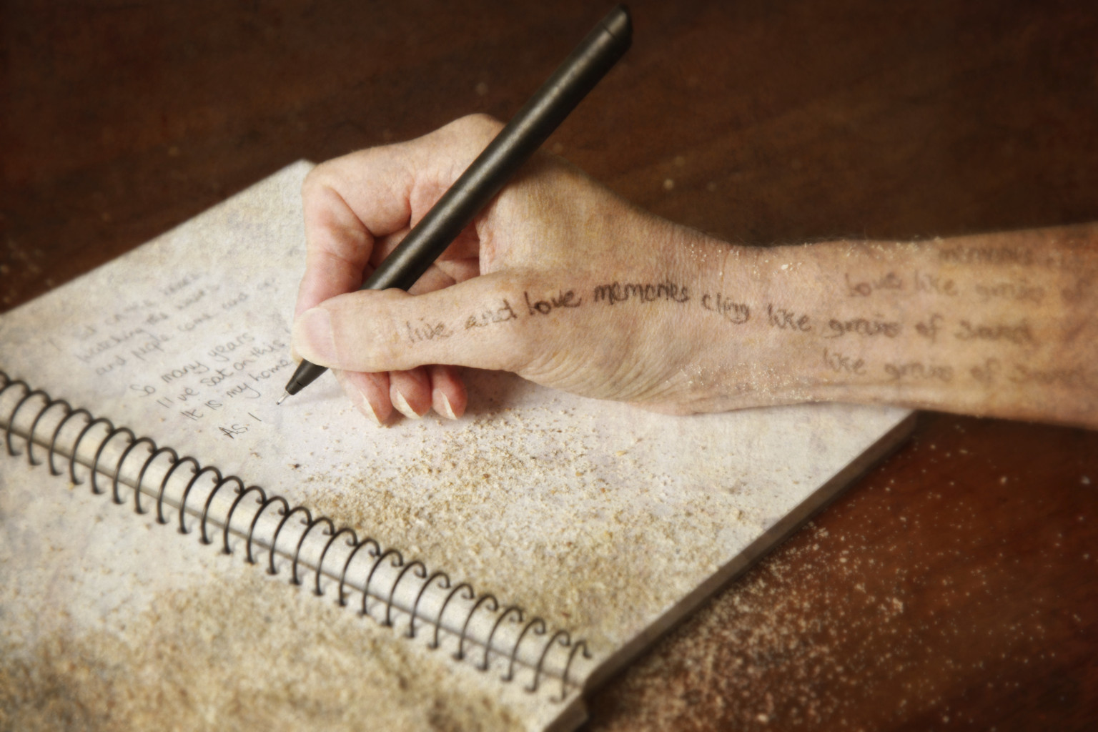
Descriptive Paragraph
Choose 1:
Yourself
A hobby
A place that matters to you
A memory
A value you hold
Something that represents your identity
Something you care deeply about
This Photo by Unknown Author is licensed under CC BY-NC-ND

Slide 8
I worry about the state of our planet a lot. I’m scared humans are going to destroy the world one day by trying to live in some sort of “magical” simulation. I just hope one day this world can reach peace and equality. In my perfect world, it would just be me, my girlfriend, my skateboard and our dog in my favorite place to call home, Denver, Colorado, for all eternity.
Paragraph Samples
Just down the canyon about a 10-minute drive is my favorite place in twin falls – “The look out”. I love the way it smells like nothing but fresh air, the way the bushes move with the wind, and how the mountains look in the sun. This place brings me relief from the world and gives me hope for the future. I love the way my music that plays in the background always somehow aligns with how I feel and what I’m seeing. And how I can cry, write, or walk without any shame or judgement engulfed in the mountains. I would choose this place in every lifetime because it always makes me feel better.

Slide 9
Preparing writers to respond to art (PROSE)
Responding to Visual Art Through Perspective
This activity will help you practice observation, interpretation, and creative expression by responding to a piece of original artwork. You will explore how perspective shapes meaning—both in how you view the artwork and how you choose to write about it.
Step 1: Observe the Artwork
As you observe, jot down notes:
What do you notice first?
What details stand out after a longer look?
What emotions or reactions do you have?
Remember that what you notice is shaped by your perspective—your experiences, interests, and assumptions.
Step 2: Explore Perspective
How might someone else view this artwork differently?
What would a child notice? An artist? A critic? Someone from a different culture?
What assumptions might you be bringing to your interpretation?

Slide 10
Preparing Writers to Respond to Art
Step 3: Brainstorm Ideas
1. Visual Details (What do you SEE?)
Colors: bright, muted, warm, cold
Shapes/lines: sharp, soft, chaotic, organized
Objects/people: What is included? What is missing?
Setting: Where might this take place?
2. Mood & Emotion (What do you FEEL?)
What mood does the artwork create?
How do the visual elements create that feeling?
Does it connect to a personal experience?
3. Story & Imagination (What might be HAPPENING?)
What is happening in this moment?
What happened before? What happens next?
4. Perspective & Voice (Who is speaking?)
  A person in the artwork
  An object in the artwork
  The artist
  An outside observer
Consider how the meaning could change depending on the voice

Slide 11
Preparing Students to Respond to Art (POETRY)
Option A: Poem
Write a poem that reflects a clear perspective.
Suggestions:
Write from a specific voice (person, object, observer)
Use imagery and figurative language
Let the perspective shape the tone and meaning
Option B: Paragraph
Write a paragraph that explains or explores the artwork.
You might:
Describe the artwork from your perspective
Tell a story influenced by a chosen point of view
Reflect on how perspective changes interpretation

Slide 12

Preparing the Artists (Round 1)

Slide 13
Artist Preliminary Exercise (before)
What is your first impression when reading the piece? What is this writing about? What theme(s) are present?
What words, phrases or ideas stand out to you?
What parts about the writing evoke visual imagery, colors, symbols? Which do you think are the most important to represent in the print?
What do you want to communicate or focus on in your print to reflect the writer’s perspective?
What do you think will be the most challenging about translating the writing into visual form?

Slide 14
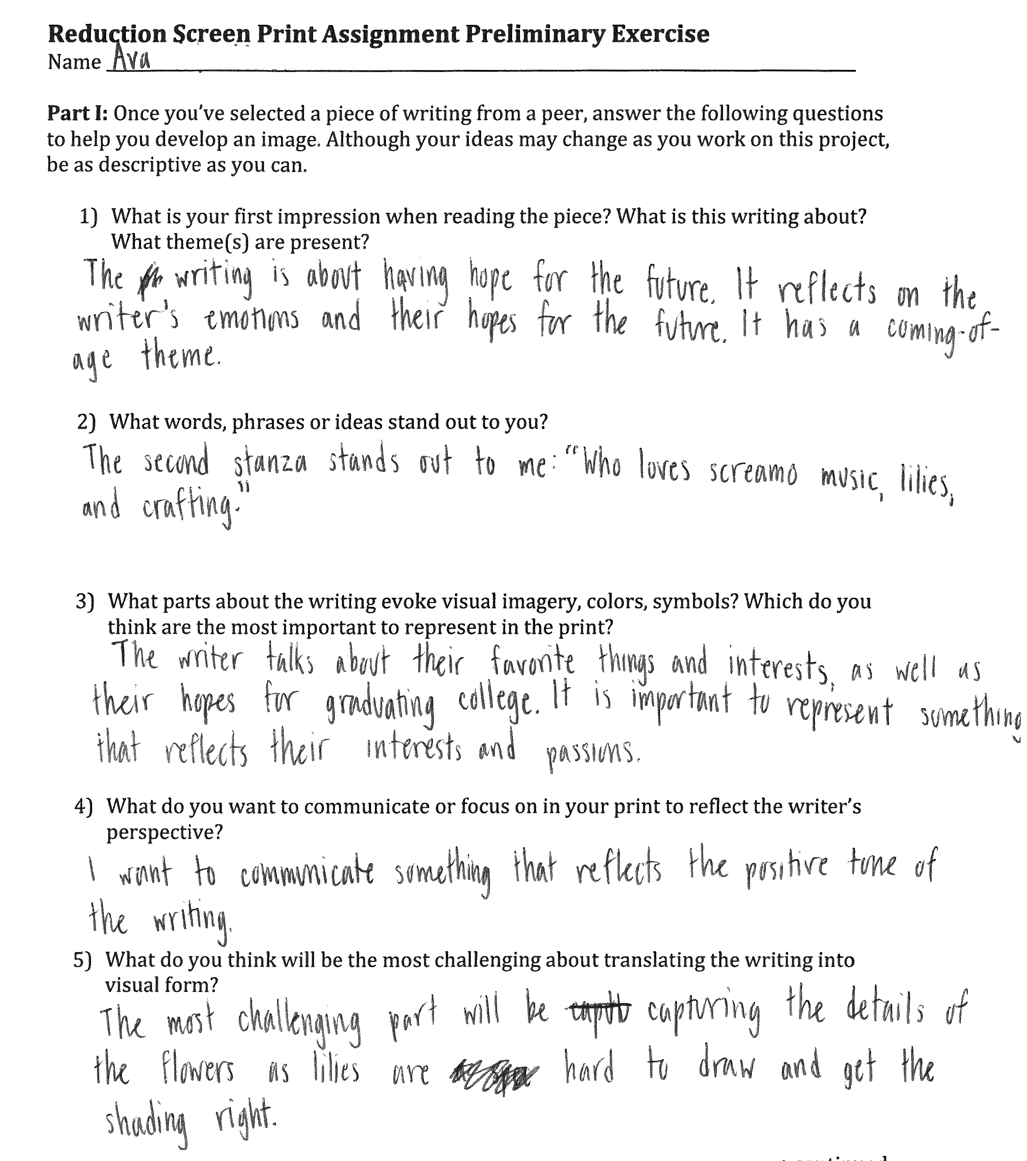
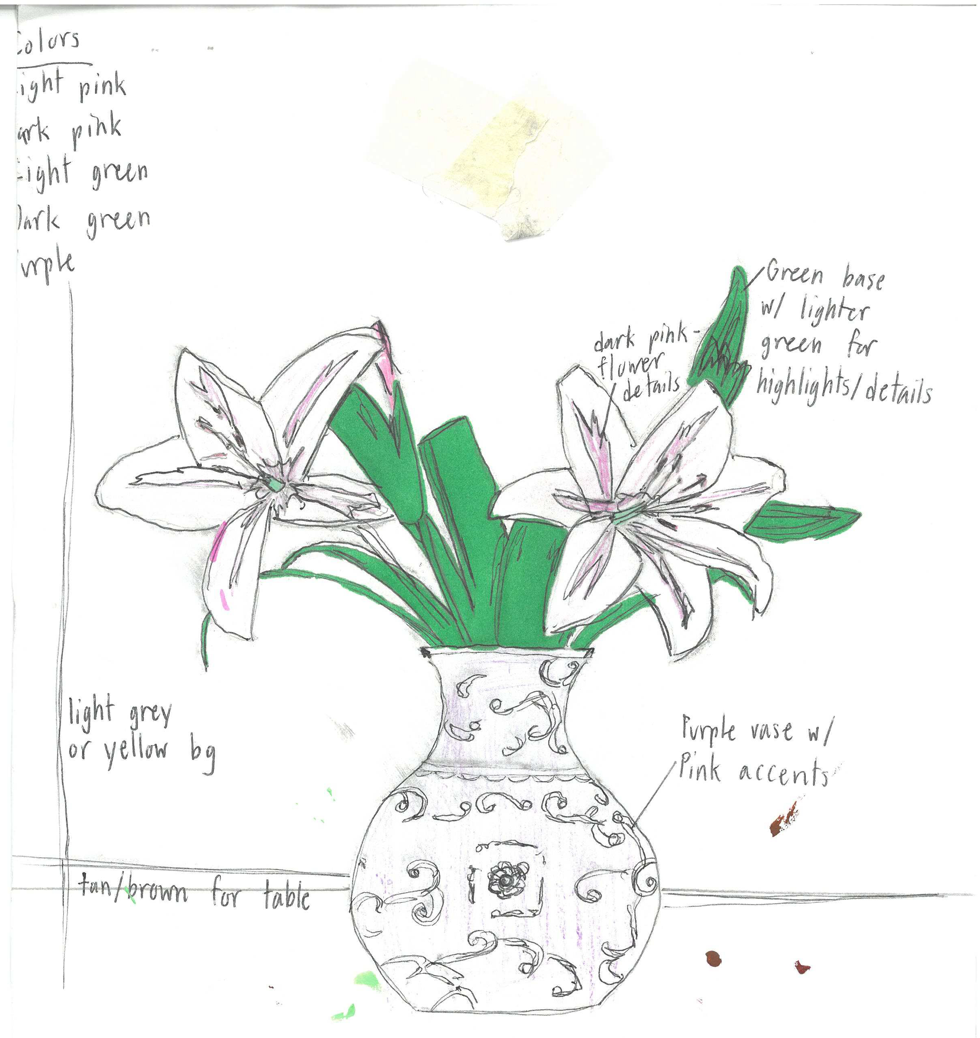
Artist Preliminary Exercise - Ava

Slide 15
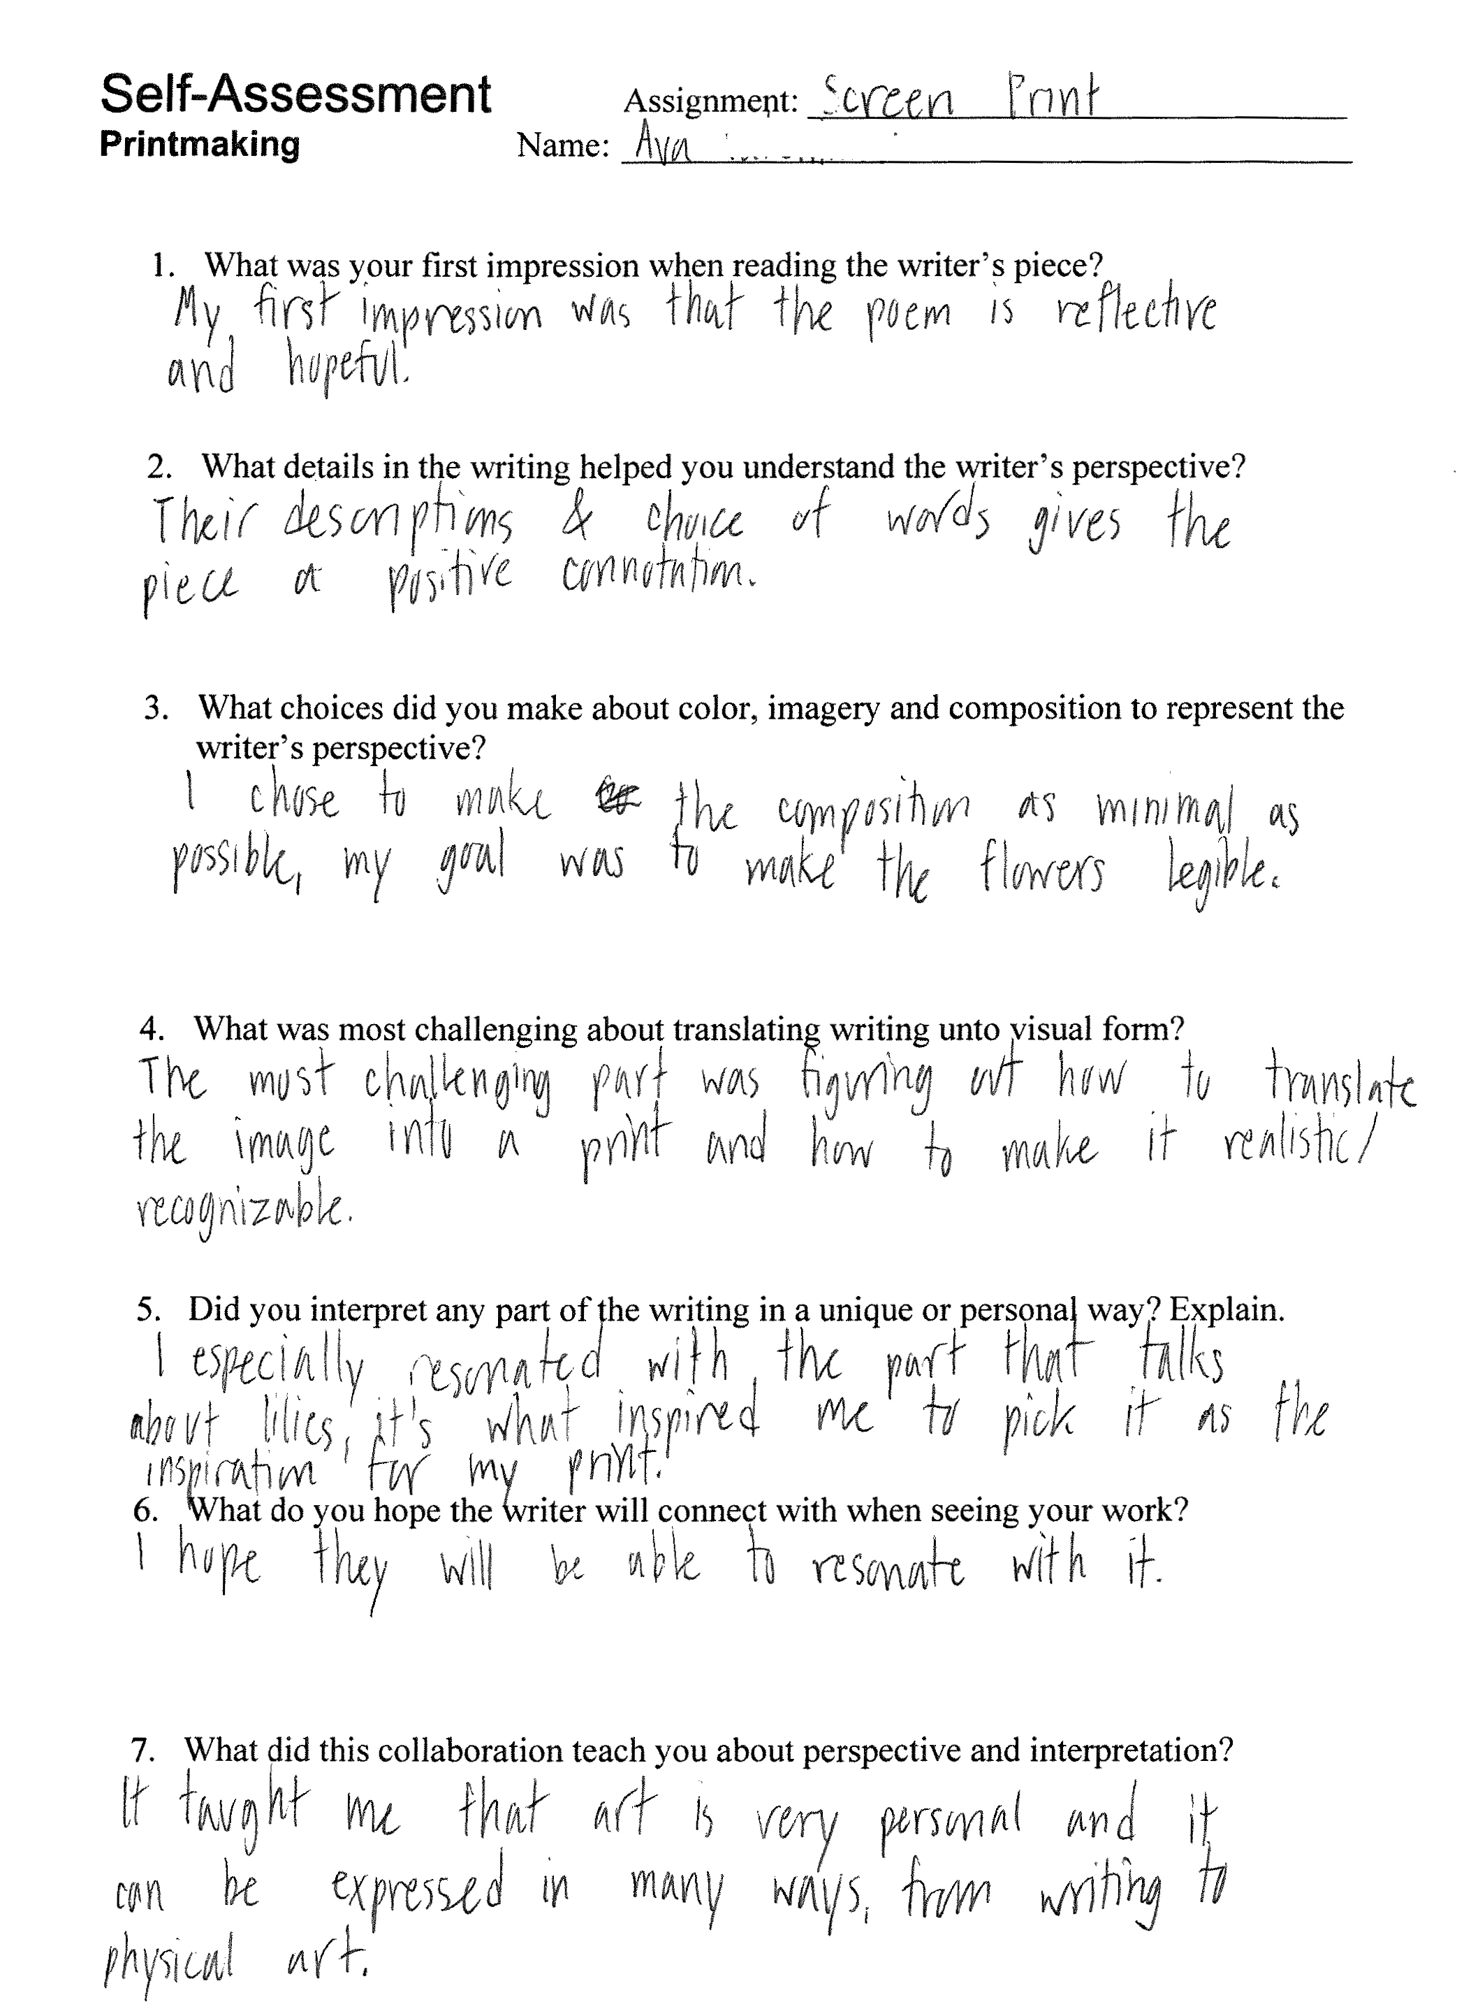
Artist Self Reflection - Ava

Slide 16
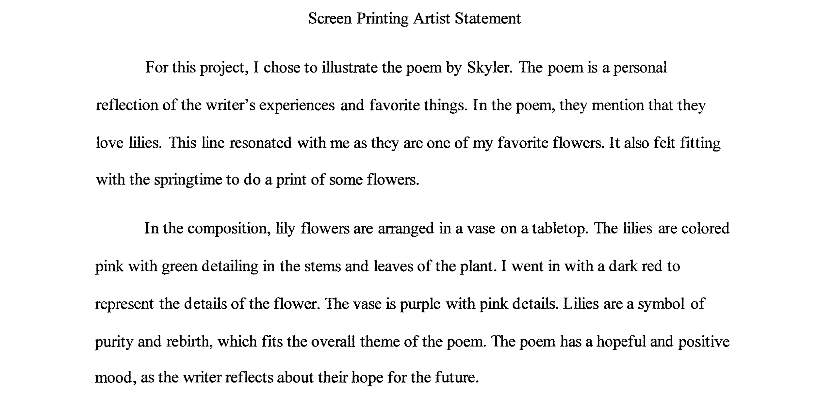
Artist Statement - Ava

Slide 17
Artist Self Reflection (after)
What was your first impression when reading the writer’s piece?
What details in the writing helped you understand the writer’s perspective?
What choices did you make about color, imagery and composition to represent the writer’s perspective?
What was most challenging about translating writing unto visual form?
Did you interpret any part of the writing in a unique or personal way? Explain.
What do you hope the writer will connect with when seeing your work?
What did this collaboration teach you about perspective and interpretation?

Slide 18
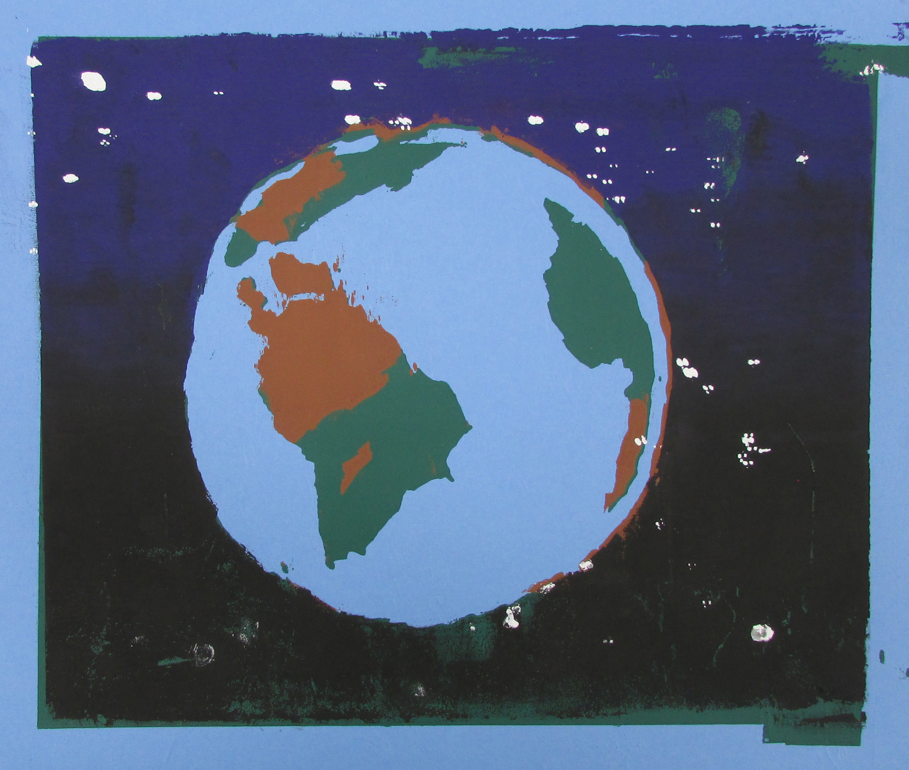
Writer: Romay to Artist: Vincent
Romay
Open minded, Outgoing, Quiet
Who loves dirt bikes, Mexican food, wading in water
Who values life, love, money
Who feels ready to go, lazy, overwhelmed
Who wonders about the earth dying
Who fears living miserably
Who hopes for world peace
Who believes we all are a simulation
Who would like to see my dog live forever
Resident of Denver Colorado

Slide 19

Writer: Romay to Artist: Connie
I worry about the state of our planet a lot. I’m scared humans are going to destroy the world one day by trying to live in some sort of “magical” simulation. I just hope one day this world can reach peace and equality. In my perfect world, it would just be me, my girlfriend, my skateboard and our dog in my favorite place to call home, Denver, Colorado, for all eternity.

Slide 20
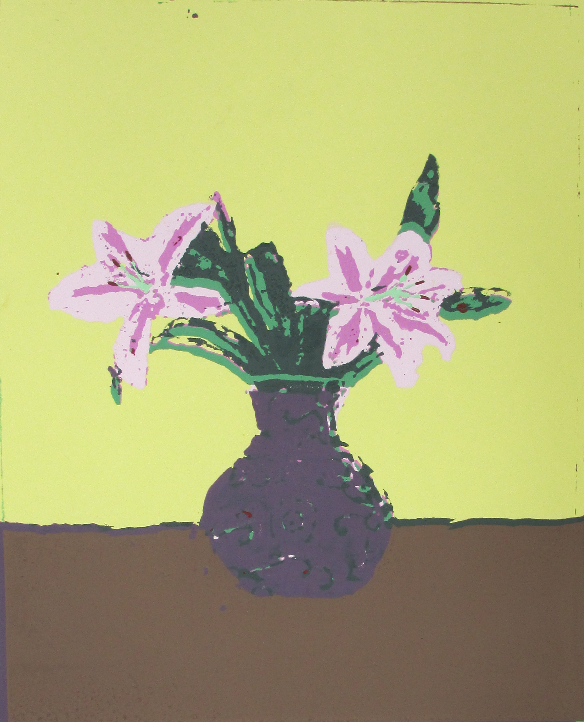
Writer: Skyler to Artist: Ava
Just down the canyon about a 10-minute drive is my favorite place in twin falls – “The look out”. I love the way it smells like nothing but fresh air, the way the bushes move with the wind, and how the mountains look in the sun. This place brings me relief from the world and gives me hope for the future. I love the way my music that plays in the background always somehow aligns with how I feel and what I’m seeing. And how I can cry, write, or walk without any shame or judgement engulfed in the mountains. I would choose this place in every lifetime because it always makes me feel better.

Slide 21
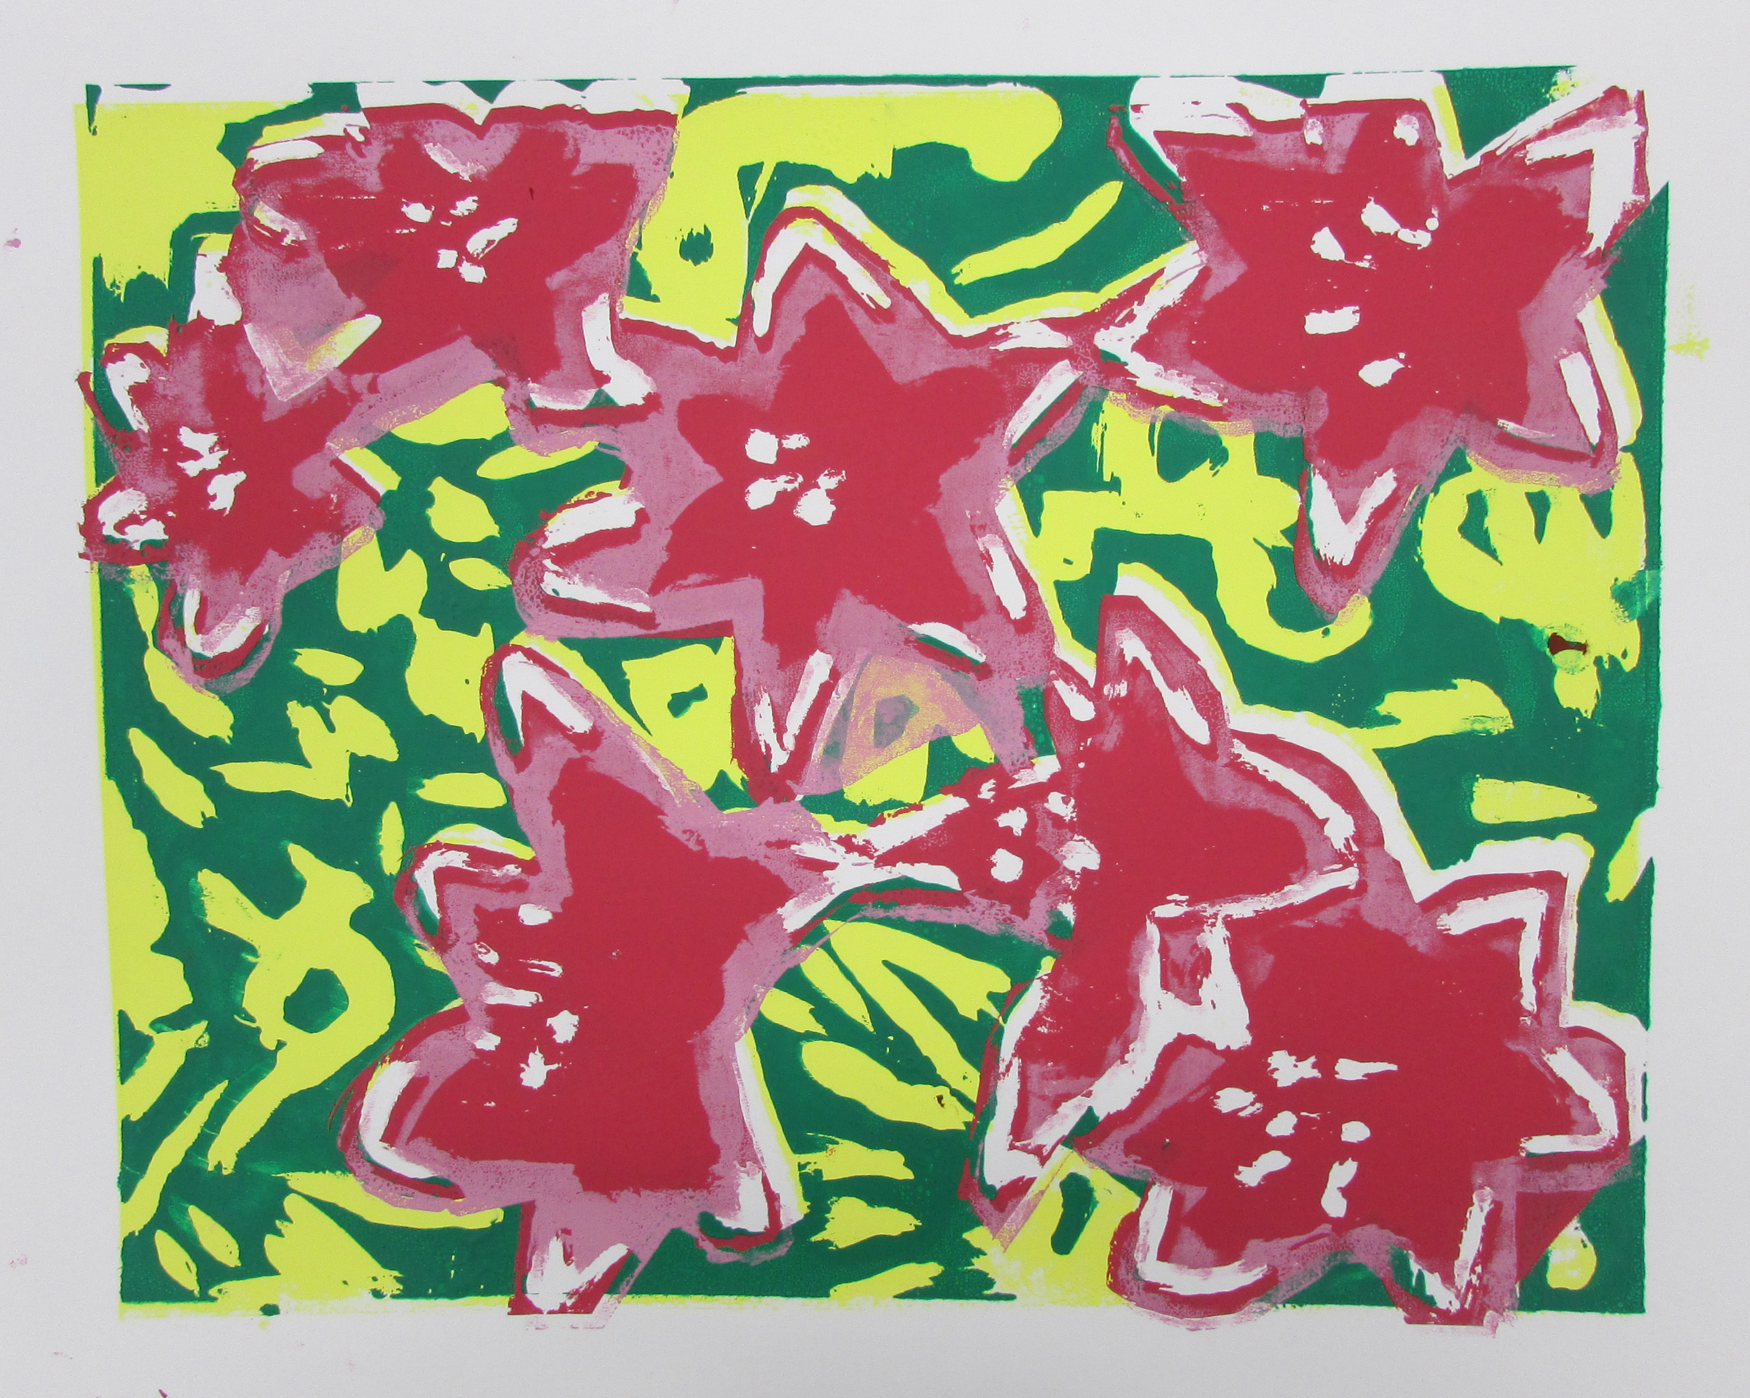
Writer: Skyler to Artist: Caitlyn
Skyler
Kind, honest, and understanding
Who loves screamo music, lilies, and crafting
Who values authenticity, honesty, and friendship
Who feels emotional, open, and raw
Who wonders about the effect of a different childhood
Who fears loneliness
Who hopes to graduate college
Who believes in kindness
Who would like to see everybody be true to themselves
Resident of Boise

Slide 22
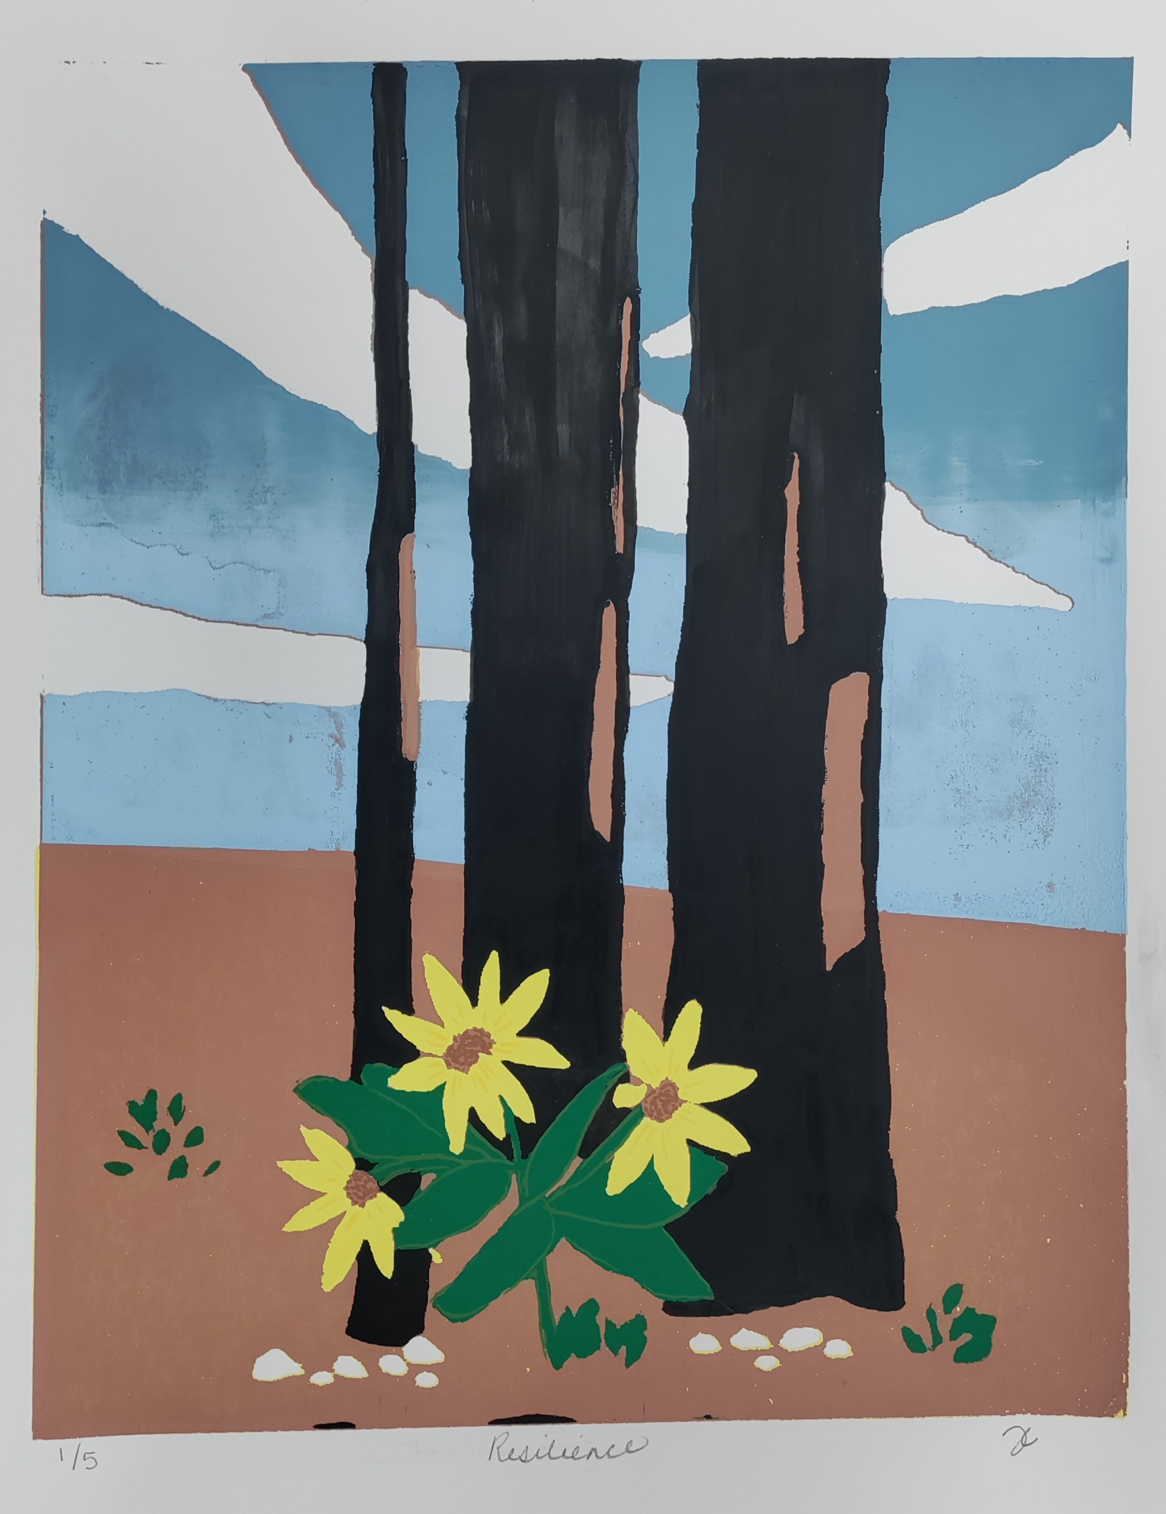
Writer: Ilan to Artist: Jill
Ilan
Determined, positive, resilient
Who loves rap music, French food, and challenges
Who values family, hard work, and helping people
Who feels motivated by goals, calmness, and hope
Who wonders what life looks like tomorrow
Who fears losing time or missing an opportunity
Who hopes to succeed in business and build a solid future
Who believes that staying positive is a choice you make every day
Who would like to see the world and reach his full potential
Resident of Southern Idaho

Slide 23
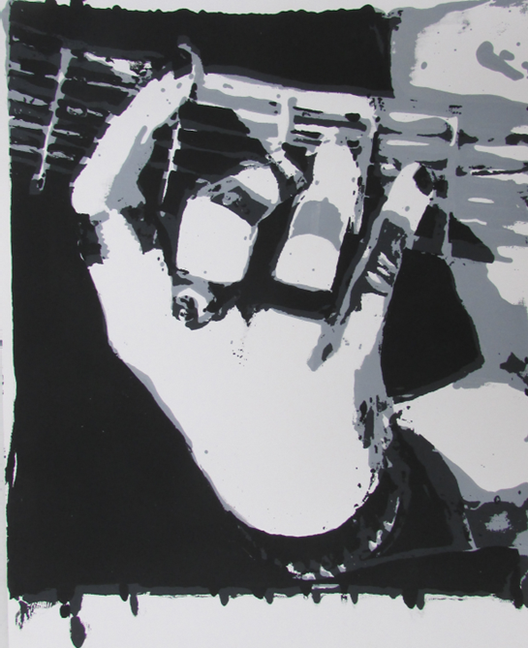
Artist to writer
Artist: Kota to Writer: Skyler
Master of Sound by Skyler
My black painted fingers nails move along the guitar
at ease with the world
I’m In my own little sanctuary
No one to hear me fall
My rings sparkle in the light
and my bracelet moves when I play
With every stroke I shine brighter
I can feel my heart beating
I can hear it in the music’s flow
I am a Master of sound
This is how I grow

Slide 24
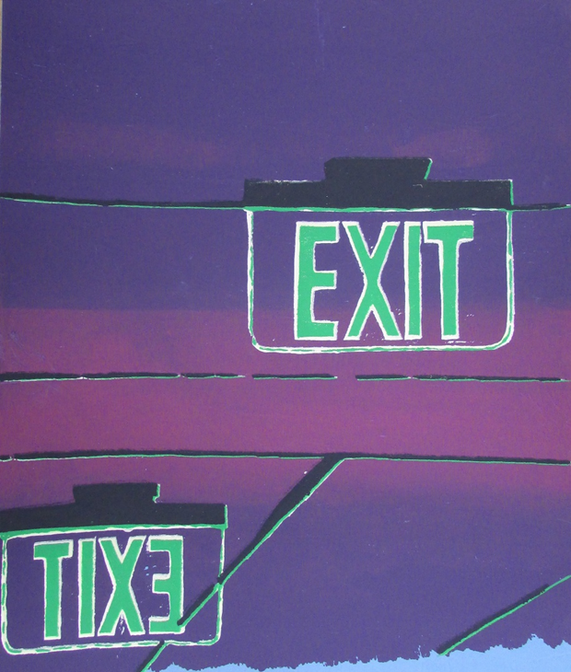
Artist to Writer
Artist: Kelly to Writer: Romay
Exit signs by Romay
From a cool blue hue,
to a light pink vibe,
cracks and lines lead to exit signs.
Exit signs show I’m on the right path,
but I can’t escape these narrow hallways.
I feel like I’m running in place all the time.
Everything feels the same every day.

Slide 25
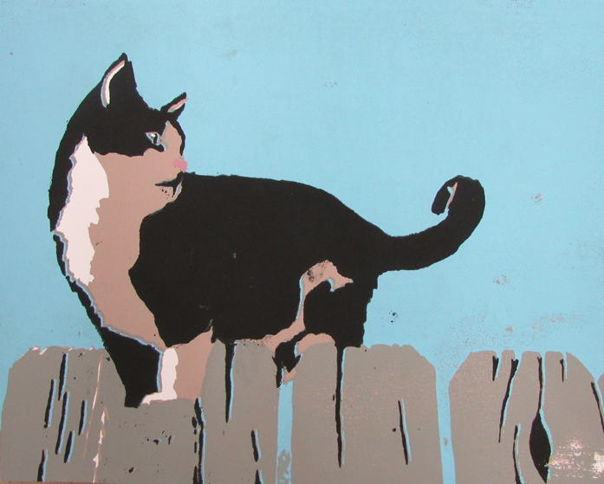
Artist to Writer
Artist: Olivia to Writer: Illan
The artwork reveals a relaxed cat leaning over a ledge, probably focused on a sound of something moving next to him in the brushes. The dark silhouette, against the bright blue background, stands out immediately to let the cat be the main character in this story. The simple colors and lack of character let us admire the simple moment of a wild cat's life. The wooden fence looks old and rough, which creates a cool contrast with the cat's soft shape. My favorite part is the small pink nose because it makes the whole scene feel playful and real by breaking the serious mood of the dark colors, showing the contrast between dark and light. It tells us that they are different but can be very similar, and close even, with their differences. It perfectly captures a simple moment of curiosity.
Ilan

Slide 26
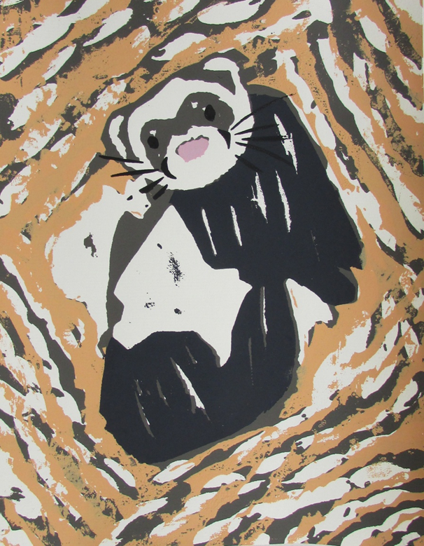
Artist to Writer
Artist: Carissa to Writer: Devin
Master of Disguise (Except where it counts)
I am the mammal master of disguise,
A bandit’s mask on my eyes.
Yet what the silliest thing here is-
I am the one whose life has been stolen.
They may not know my identity,
But they control my life in every capacity.
My wild frame torn now in fragility,
the ways in which I submit to captivity.
I’m framed by my unnatural habitat,
As they all carry on, in pomp and in circumstance.
Master of Disguise…
There is a sadness in my eyes.
By Devin

Slide 27
Student Takeaways
“I learned that it can be a difficult thing to read a poem someone else has written and then transform that into a different form of art. The difficult part is the responsibility of creating something that the author would feel good about or that the author would appreciate. I had to take their words and figure out how to interpret a piece of it to create a screen print that could be identified with that poem. I didn't take that lightly and I tried to express through a print what the author said in words.”
“I think the most difficult part about that was the lack of communication between the two artists. I didn't get to talk to the author to hear their interpretation beforehand. My hope is that the author of the words will recognize those words visually through seeing the print.”

Slide 28
Student Takeaways
“My work was interpreted differently than I thought it would be. I expected to see more scenery and more music related images, but I still loved what the artist came up with.”
“Through this project, I learned that everybody views things differently and in their own way and that perspective is a wild and really cool thing.”

Slide 29
Thank you
kimberlyjones@csi.edu
abatchelor@csi.edu

