Slide 1


Shaneece Green, MBA
Regional Coordinator - College Credit Plus
Columbus State Community College
Access
by
Design
Using Data to Expand Access to Opportunities for Underserved Students

Slide 2



Who Am I?
Professional Roles
  Regional Coordinator - College Credit Plus at
Columbus State Community College
  Former inaugural Diversity Initiatives Coordinator
  Founder of Sharks & Lilies, LLC
  Family Ambassador for the largest Ohio school district
Leadership & Impact
  Advocate for access based policies & practices
  Driver of meaningful social change
  Cultivator of community-centered partnerships & engagement
Shaneece Green, MBA

Slide 3









Who Are
YOU?

Slide 4







A Review of Research on:
Framing Access in Dual Enrollment
Lesson Outline
Conducting an Access Audit
Analyzing Data to Identify Gaps
Designing Targeted Supports
Building Actionable Plans with Metrics
Interactive Collaboration

Slide 5


Learning Goals
You will be equipped with information to identify access gaps in dual enrollment access and outcomes using structured data analysis
You will be equipped with information to analyze school/district-level trends to determine where targeted supports are most needed
You will be equipped with information to design data-informed interventions for underserved students and underperforming schools/districts
You will be equipped with information to develop an implementation plan with clear metrics for measuring impact and success

Slide 6

Introduction
Dual enrollment and early college were created to expand access to advanced coursework and postsecondary opportunities—especially for students historically underserved. Yet, participation data continues to show that these programs often serve students who are already on a college-bound path.
This collaborative workshop invites participants to examine a critical question:
How can data analytics be leveraged to identify root causes of underperformance in schools and inform targeted, high-impact interventions to best support student outcomes?

Slide 7


What is
OPPORTUNITY?
Opportunity refers to a favorable set of circumstances or conditions that allows an individual or group to pursue a goal, gain resources, or achieve desired outcomes.
Opportunity occurs when individuals or groups encounter circumstances that allow them to pursue goals, access resources, and achieve meaningful outcomes. Students need not only the existence of opportunity or resources but also the guidance, support, and fair conditions that enable them to fully benefit and succeed.

Slide 8


What is
ACCESS?
Access refers to the degree to which institutional structures, policies, and practices enable or constrain individuals’ ability to utilize available resources and opportunities.
Access is not just about whether resources or opportunities exist—it also reflects how institutional systems, policies, and practices shape who can actually benefit from them.
Notes:
Access is not just about whether resources or opportunities exist—it also reflects how institutional systems, policies, and practices shape who can actually benefit from them. Even when resources are technically available, barriers such as restrictive policies, inequitable distribution, or structural biases can limit individuals’ ability to use them effectively. Conversely, intentional structures and supportive practices can expand access, ensuring that all individuals have a fair chance to engage with and benefit from educational, social, or organizational opportunities.

Slide 9

PROVIDING ACCESS TO OPPORTUNITY
OPPORTUNITY
ACCESS
... is the DESTINATION
... acts as the BRIDGE
Notes:
Providing access to opportunity means creating the conditions and pathways that allow individuals to reach and benefit from valuable opportunities, resources, programs, and experiences. It requires both removing barriers and building supports that enable meaningful participation. In practice, this can include:
Eliminating systemic barriers – Adjusting policies, prerequisites, or eligibility criteria that prevent students from participating in programs like dual enrollment.
Providing information and guidance – Ensuring students and families are aware of available opportunities and understand how to engage with them.
Offering targeted supports – Tutoring, mentoring, advising, or financial assistance that equips students to take full advantage of the opportunity.
Ensuring equitable distribution – Designing programs and resources so historically underserved students have equal chances to participate.
Using data to inform decisions – Monitoring participation trends and outcomes to identify gaps, predict needs, and continuously improve access strategies.
In essence: access acts as the bridge, while opportunity is the destination—by thoughtfully creating pathways, support systems, and equitable policies, we ensure that reaching the “opportunity” is not just possible, but intentional.

Slide 10



COLLABORATION ACTIVITY
Step 1: Conduct an Access Audit
CONDITIONS
PATHWAYS
“What barriers prevent students from successfully accessing dual enrollment?”
“What supports or solutions could help overcome these barriers?”
Limited Awareness or Information
Outreach and Counseling Programs
Scheduling Conflicts
Flexible Scheduling and Online Courses
Academic Preparedness
Academic Support Services
Notes:
Conditions: Cultural or Social Barriers – Students may feel dual enrollment isn’t for “people like me” or face peer/family pressure.
Access Pathway: Mentorship and Peer Support – Pairing students with mentors who have completed dual enrollment to increase confidence and belonging.

Slide 11


WHY
Data?
Students come from various backgrounds, impacting the resources and opportunities they can access.
An example of equality in education would be allocating the same amount of funding for every school. With equity, funding would be based on each school’s needs, providing the resources that fit best.
Equity is also mindful of the individual student’s needs, considering learning disabilities and cultural differences. Programs that aim for equity can help provide teachers and students the resources needed for academic achievement.

Slide 12



STEP 2:
ANALYZE DATA
TO IDENTIFY GAPS

Slide 13
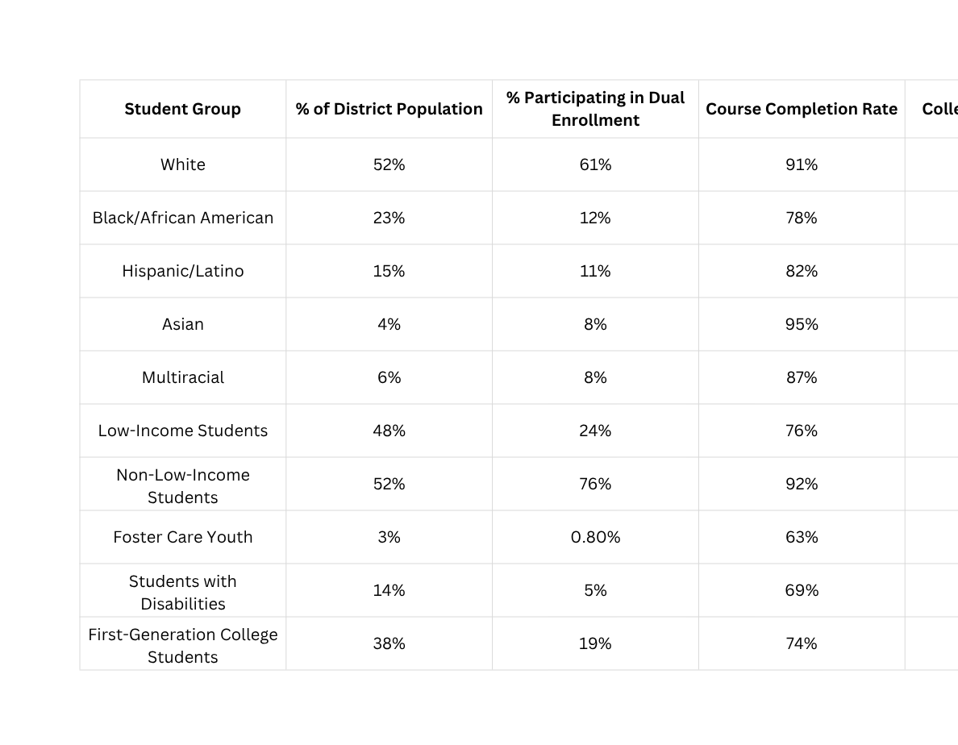

Sample Midwest School District Dual Enrollment Snapshot (Hypothetical Data)
District Enrollment: 4,000 High School Students

Slide 14
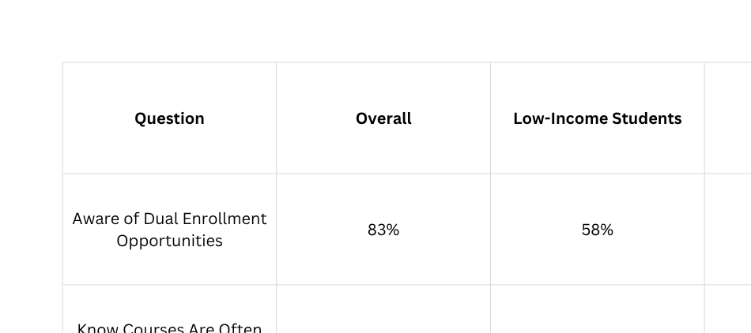


Sample student survey reveals(Hypothetical Data)
District Enrollment: 4,000 High School Students

Slide 15

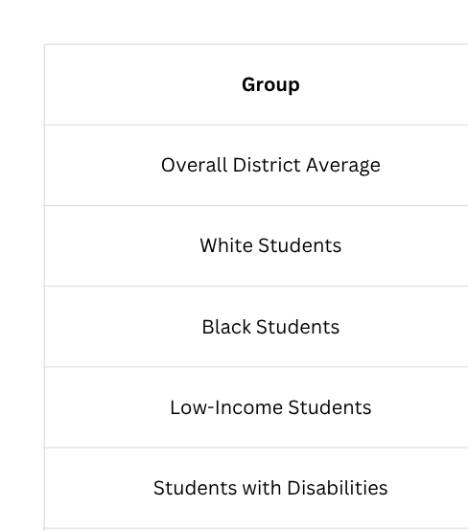
Sample Success gap (Hypothetical Data)
District Enrollment: 4,000 High School Students

Slide 16

Identifies Hidden Gaps
Importance of
Moves Beyond Assumptions
Improves Awareness Efforts
DATA
Students' Feel Supported and Respected
for Access
Higher Quality Programs and Outcomes
Data Drives Equitable Access and Success
Informs Action and Accountability

Slide 17


STEP 3:
DESIGNING
TARGETED SUPPORTS

Slide 18




Using Data to Expand Access
Target Supports Strategically - Identify Barriers Through Data + Voice
Identify Who Is Missing
Examine the Student Journey
Monitor and Adjust

Slide 19


STEP 4:
BUILDING ACTIONABLE PLANS WITH METRICS

Slide 20





BARRIER-TO-PATHWAY MAPPING STEPS
CONDUCT AN ACCESS AUDIT
ANALYZE DATA TO IDENTIFY GAPS
1
2
BUILDING ACTIONABLE PLANS WITH METRICS
DESIGNING TARGETED SUPPORTS
3
4

Slide 21

Conclusion
Using data to expand access to dual enrollment/early college helps identify who is being served well and who is being left out, particularly across awareness, access, and success. By examining patterns and gaps, schools can move from assumptions to evidence-based understanding of barriers such as eligibility requirements, scheduling conflicts, or limited outreach.
This information makes it possible to design targeted supports that directly address identified needs and improve equity. Ongoing use of data also ensures continuous improvement and accountability so that dual enrollment/ early college opportunities are not only available, but truly accessible and successful for all students.
Notes:
Key Takeaways
Data reveals who is being served—and who is being left out
Equity gaps in awareness, access, and success must be clearly identified
Understanding gaps helps move from assumptions to evidence-based action
Targeted supports are most effective when they are directly aligned to identified barriers
Continuous review of data ensures ongoing improvement and accountability
Big Idea
Expanding dual enrollment access requires more than opportunity—it requires intentional, data-informed action to ensure all students can participate and succeed.
Closing Reflection
What is one insight from the data that should shape future action?

Slide 22



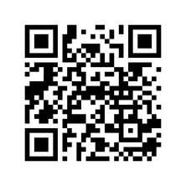
CLOSING REFLECTION
Answer the following question:
What is one insight from this collaborative session that will shape future action?
What is one action that can be taken immediately to improve access or outcomes for students?
Notes:
What Comes Next
Use data to identify one clear access or success gap in dual enrollment
Select one barrier that is contributing to that gap
Choose one targeted support that can be tested or implemented
Define how progress will be measured over time
Commit to Action
Small, focused steps lead to meaningful, equitable change in student opportunity and success.
Next Step Reflection
What is one action that can be taken immediately to improve access or outcomes for students?

Slide 23



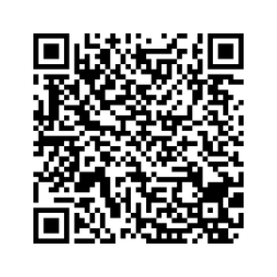
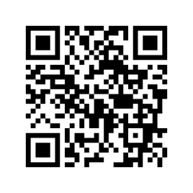
DELIVERABLES
  BARRIER-PATHWAY MAPPING TEMPLATE
  ACCESS BY DESIGN PRESENTATION
*PLEASE SELECT MAKE A COPY BEFORE EDITING

Slide 24




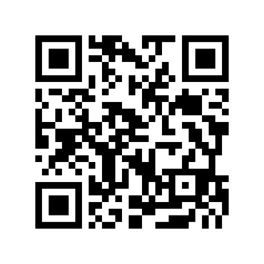
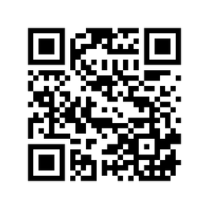
CONTACT ME
SHOP
  SHARKS & LILIES
  LINKED-IN

