Slide 1

Successfully Strengthening Partnerships:
Quincy’s Early College High School Opportunities & Post-Secondary Education Initiatives
RTI Summit, June 2026
Notes:
Meghan

Slide 2


Welcome and Introductions
Meghan C. Giovannoni Vice President, Quincy College
Student Success and Partnerships
Eli Stewart
Early College Transition Coach - Quincy High School
Dan Gould
Early College Transition Coach - North Quincy High School
Notes:
Meghan, Eli, and Dan

Slide 3

Quincy’s ECHS Pathway 2026 Promotional Video
Notes:
Meghan ~ Click Logo to Play Video

Slide 4


Quincy’s ECHS Pathway: Program Elements
Collaborative Initiative
ECHS Pillars
Academic Support
Non-Academic Support Services
ECHS Symposium
Study Blocks
College Visitations
Parent Advisory Team
Professional Development/ Training
Dual Enrollment Initiative
Summer Academy
ECHS Pathway Middle School Prep
Notes:
Dan

Slide 5
Quincy’s ECHS Pathway: Recruitment Strategy
Early High School Orientations
ECHS staff host engaging orientation sessions for students and families to introduce the Early College model, key benefits, and cost savings
Flyer Distribution
Clear, visually engaging materials shared in schools and community spaces; multilingual with QR codes for easy access
Parent Academies
Informational sessions specifically for parents/guardians
Email Outreach
Ongoing, targeted communication with students and families; highlighting benefits, course sequence, deadlines, and next steps.
Notes:
Dan

Slide 6
Quincy’s ECHS Pathway: Application Process
Applications open between February and March of the preceding academic year.
Students must submit a complete application to be considered.
Each student’s academic record and attendance history are reviewed.
In some cases, students may be required to attend a meeting (e.g., course scheduling or discussions regarding attendance or grades).
A formal email is sent to confirm acceptance.
The student’s schedule is finalized upon acceptance.
New students entering grades 9 –11 must attend the required ECHS orientation.
All students must complete the ECHS commitment form for the academic year.
K
Notes:
Dan

Slide 7
ECHS Program Overview ~ Enrollment Trends
2021-2022 enrollment ~ 149 students
2022-2023 enrollment ~ 204 students
2023-2024 enrollment ~ 240 students
2024-2025 ~ 304 students
  Grade 9 to ECHS Pathway
2025-2026 ~ 328 students
K
Notes:
Eli

Slide 8
Quincy’s ECHS Pathway 2025-2026 Enrollment
Combined High Schools |  |  | North Quincy High |  |  | Quincy High
Grade Level | # |  | Grade Level | # |  | Grade Level | #
9 | 74 |  | 9 | 37 |  | 9 | 37
10 | 85 |  | 10 | 36 |  | 10 | 45
11 | 78 |  | 11 | 47 |  | 11 | 35
12 | 91 |  | 12 | 44 |  | 12 | 47
Total | 328 |  | Total | 164 |  | Total | 164
Quincy’s ECHS Pathway Enrollment has doubled since 2021!
Notes:
Eli

Slide 9
Quincy’s ECHS Pathway 2026-2027,
Projected Enrollment
Combined High Schools |  |  | North Quincy High |  |  | Quincy High
Grade Level | # |  | Grade Level | # |  | Grade Level | #
9 | 74 |  | 9 | 37 |  | 9 | 37
10 | 85 |  | 10 | 36 |  | 10 | 45
11 | 78 |  | 11 | 47 |  | 11 | 35
12 | 91 |  | 12 | 44 |  | 12 | 47
Total |  |  | Total |  |  | Total
Quincy’s ECHS Pathway Enrollment has doubled since 2021!
Notes:
Eli

Slide 10
Quincy’s ECHS Pathway 2025-2026 Demographics
Race / Ethnicity
 | # of students
Asian | 108
Black/African American | 43
Caucasian | 117
Hispanic or Latino | 38
Multi-Race, Non-Hispanic | 13
Native American | 1
Pacific Island | 2
Fall 2025
Grade Level | # of students
9 | 74
10 | 85
11 | 78
12 | 91
TOTAL | 328
Special Populations
 | # of students
English Learner | 10
Special Education | 34
Low Income | 151
Notes:
Eli

Slide 11
Quincy’s ECHS Pathway 2025-2026 Demographics (continued)
Who are our students?
Low-income students
133 ECHS students are
also CTE students
151
104 ECHS students are
First Generation
Year 5 of State Designation
Notes:
Dan

Slide 12
Quincy’s ECHS Pathway Course Offerings, 2025-2026
Grade Level | Course Name | QC Credits
9 | Introduction to ECHS Pathway | 0
9 | Introduction to Computer Science | 3
10 | Introduction to Criminal Justice | 3
10 | Music Across Cultures | 3
Grade Level | Course Name | QC Credits
11 | Introduction to Environmental Science | 4
11 | United States History II | 3
12 | English Composition I | 3
12 | English Composition II | 3
12 | Statistics | 3
K
Notes:
Dan

Slide 13
Quincy’s ECHS Pathway: Class of 2026
93 ECHS ~ Class of 2026 Graduates
Number of Graduates | Post-Secondary Plans
16 | Degree-Seeking Quincy College Students
63 | Four-Year Institution
4 | Workforce / Trades
3 | United States Armed Forces
Notes:
~ Meghan~

Slide 14
Quincy’s ECHS Pathway Program
Cohort-based program in which students:
Earn college credits while in high school at no cost to the family
Receive support in and outside of the classroom to better prepare them for their transition to college
Graduate from high school with college credits, habits and skills needed to be successful in college and career
K
Notes:
Meghan

Slide 15


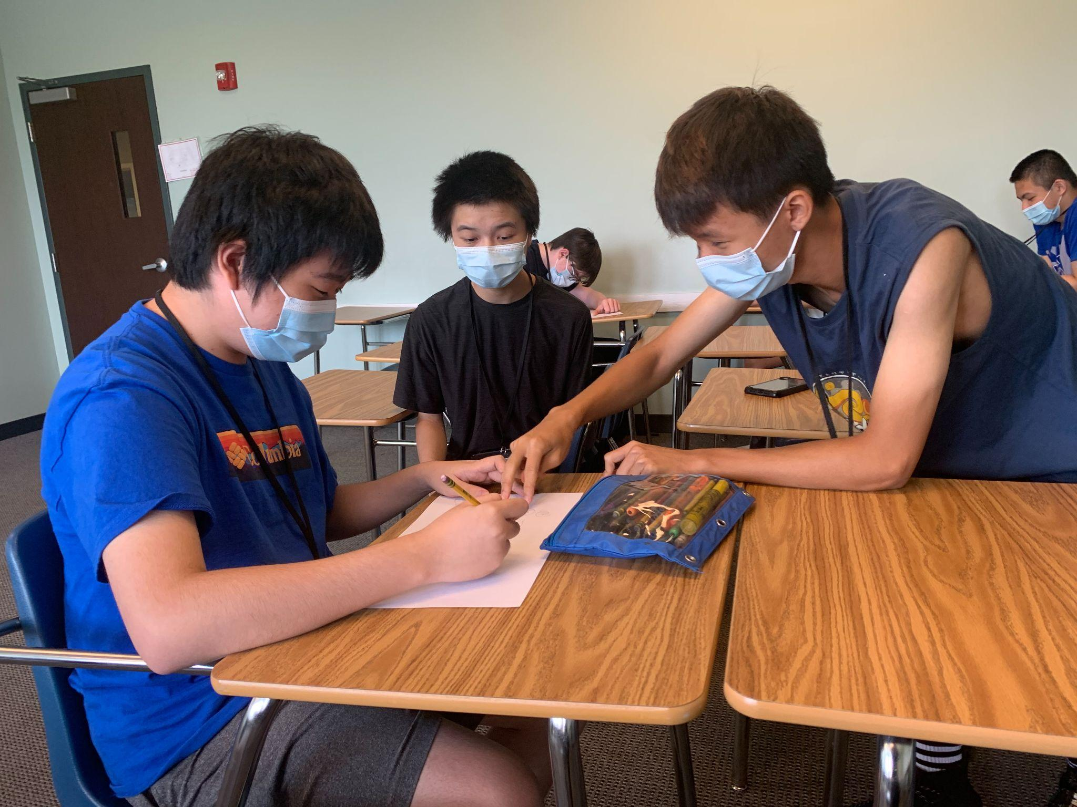
Quincy’s ECHS Pathway Program Support Services
Academic Opportunities
Academic Coaching
Study Skills and Organizational Strategies
Academic Advising and Learning Styles
K
Notes:
Eli

Slide 16

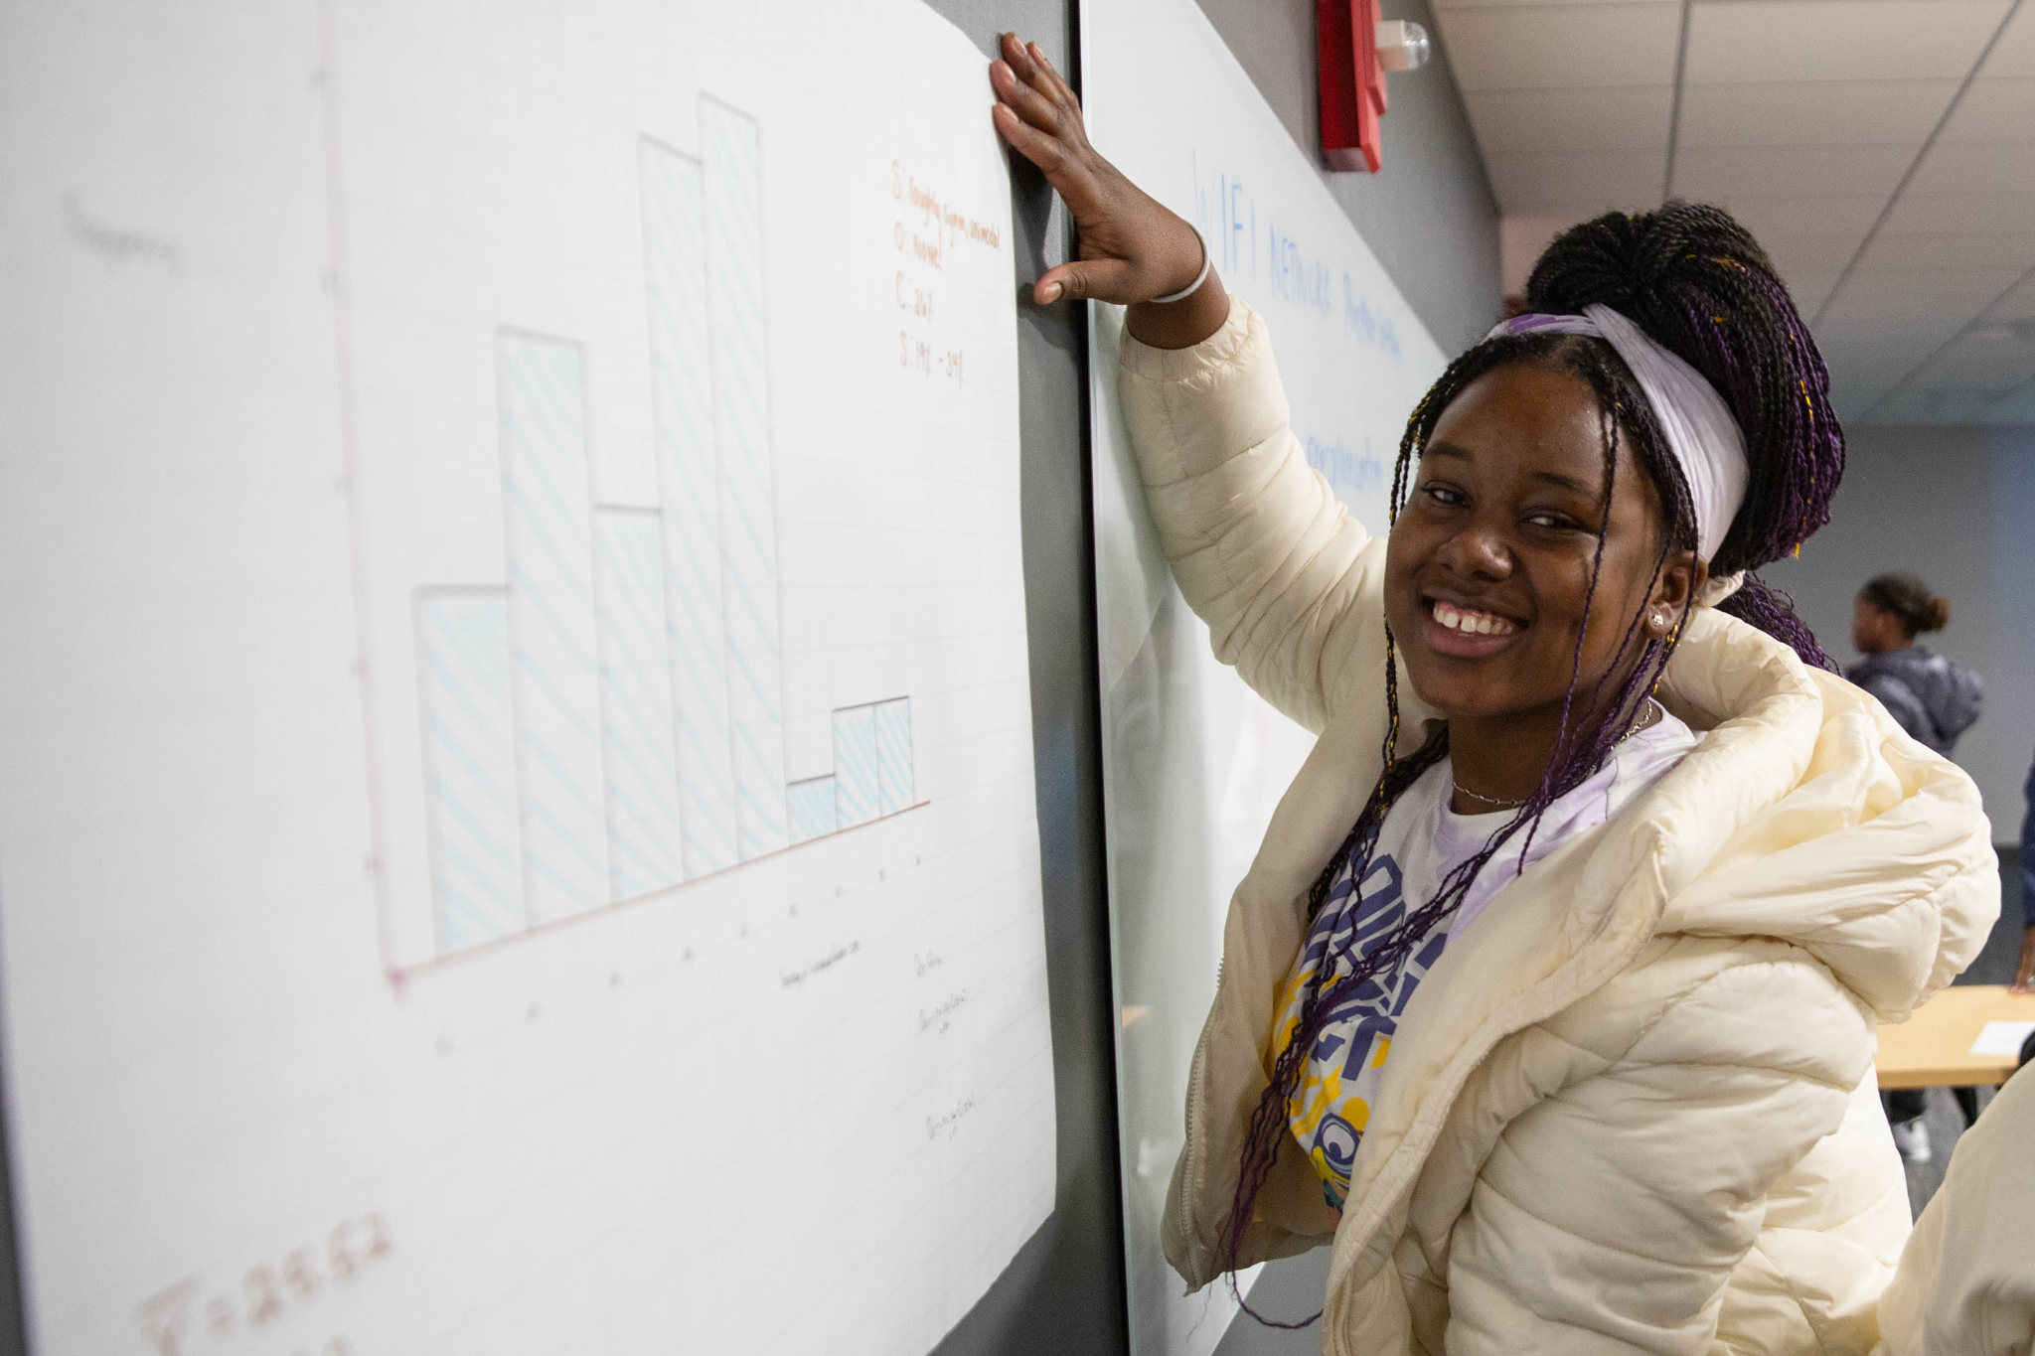
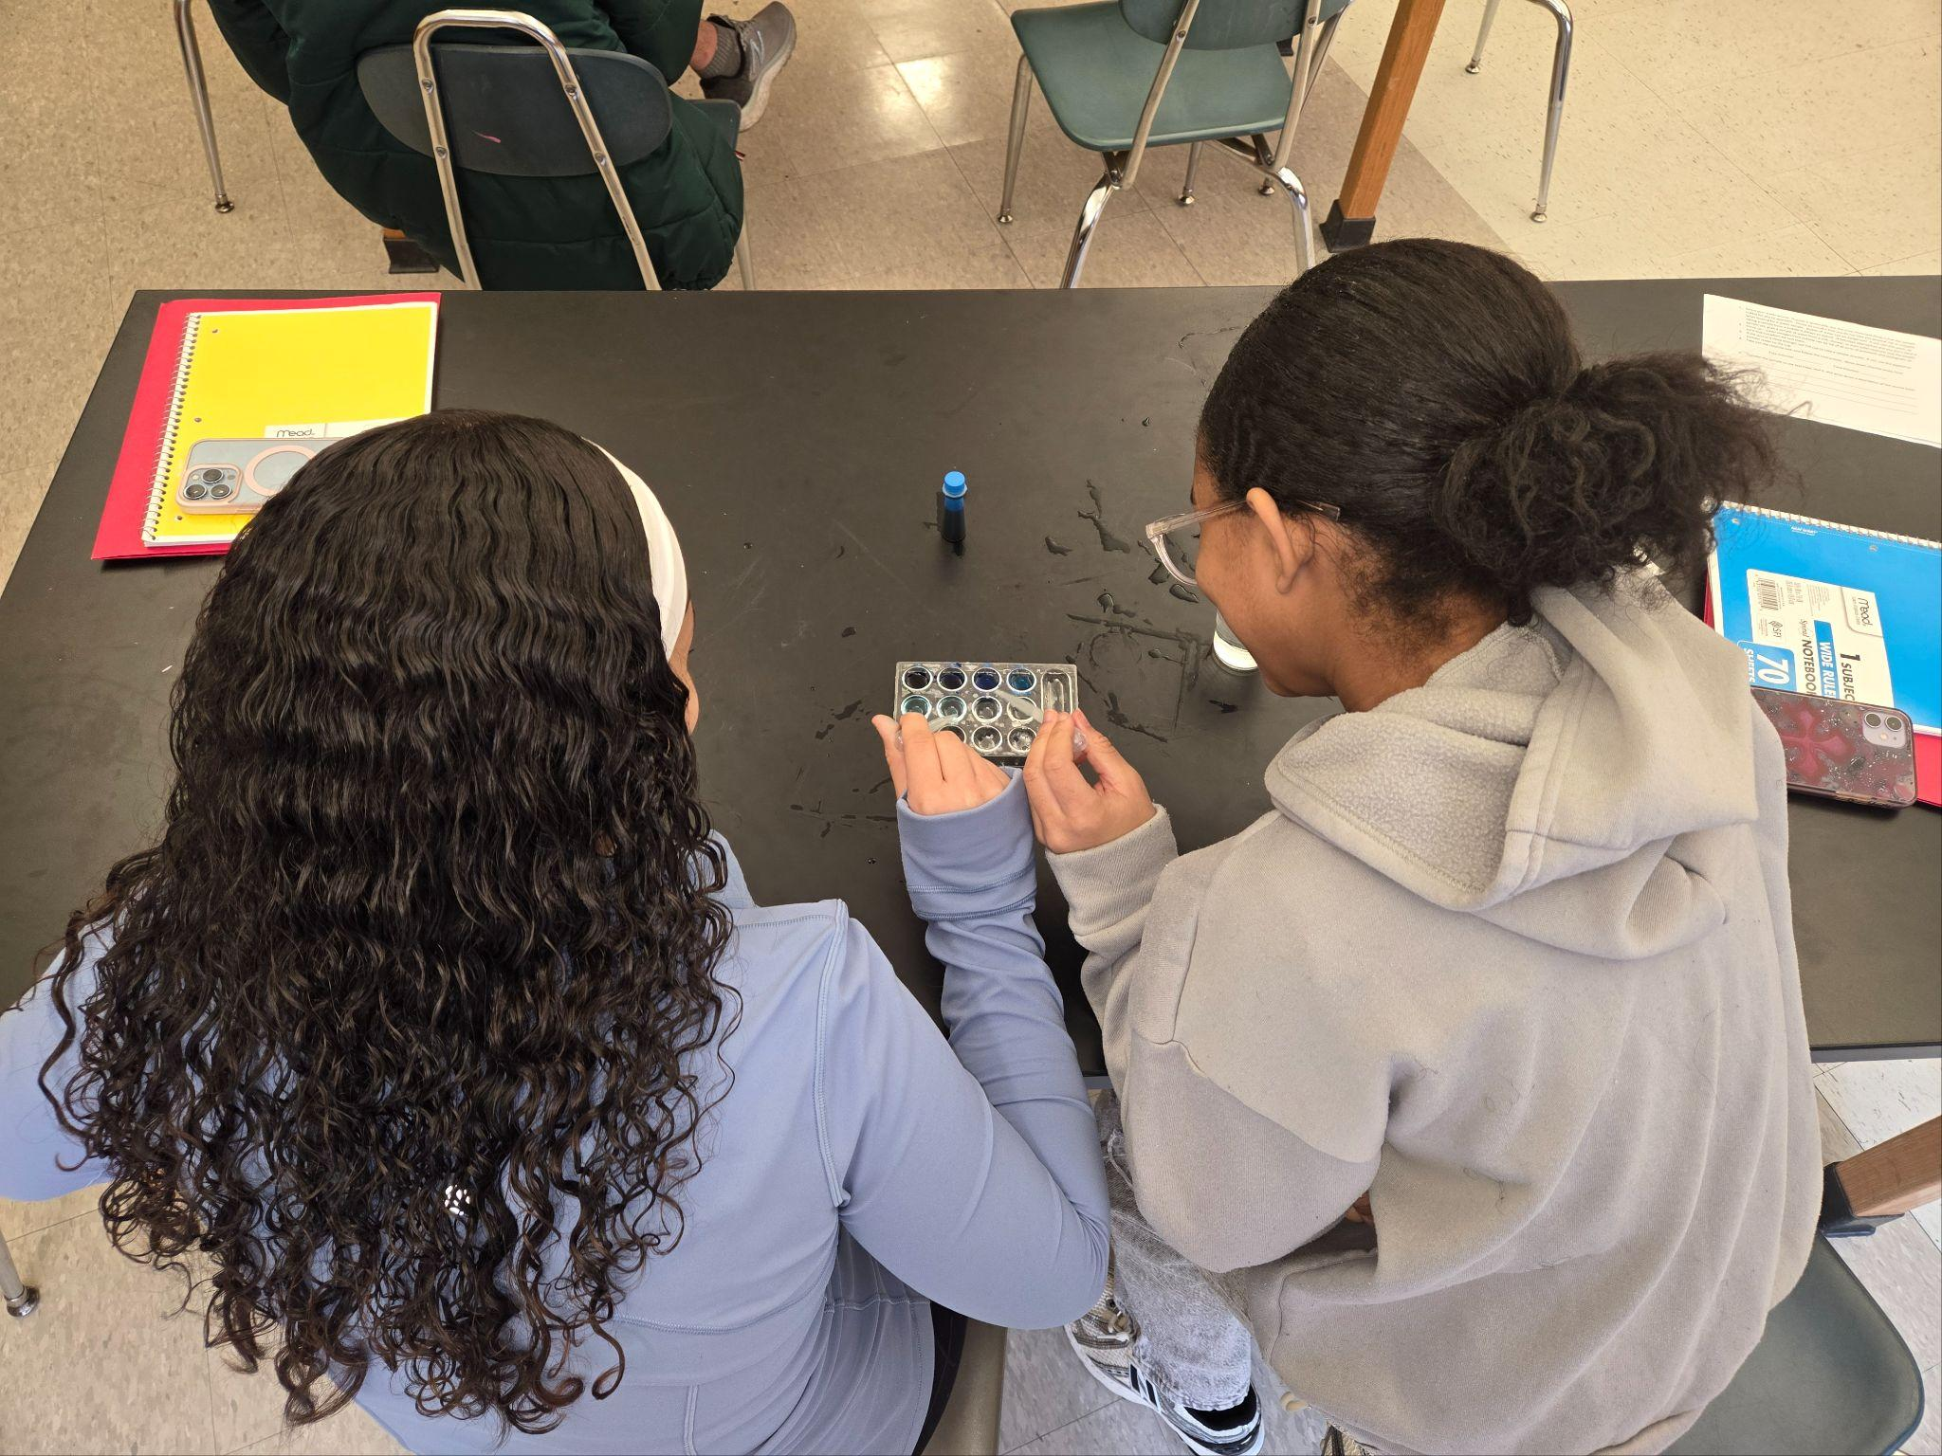
Non-Academic Support Services
ECHS Counselors
ECHS Transition Coaches
College and Career Planning
Student Orientations
Financial Aid Assistance
  FAFSA
  How to Pay for College
Social and Emotional Health and Wellness
Notes:
Eli

Slide 17
College Visitations
Purpose and Overview
College Classes
  English Composition 1 and 2
  Statistics
College and Career Readiness Workshops
  Model the Way with Your Resume
  Inspire a Shared Vision with Your Personal Brand
  Comprehensive Interview Skills
  Leading Up as Young Professionals
  How to Crush Your Interview
Notes:
Dan

Slide 18

Quincy’s Accelerated Associate Degree Program, 2025-2026
Currently offered to students in Grade 9
Earn an Associate Degree in Liberal Arts: General Studies from Quincy College
62 college credits earned while still in high school
No cost to students and families
Total enrollment - 38 students
  9th grade students = 24
  10th grade students = 14
Notes:
Dan

Slide 19
Quincy’s Accelerated Associate Degree Pathway: Application Process
Applications open between February and March of the preceding academic year.
Students must submit a complete application to be considered.
Each student’s academic record and attendance history are reviewed.
Interview with the student and parent/guardian mandatory
Conditional acceptance is sent out at the end of the summer
Half year grades and attendance is considered upon official acceptance in November of the academic year.
K
Notes:
Dan

Slide 20
Quincy’s ECHS Pathway: Dual Enrollment Initiative
Established foundation to create Quincy’s ECHS Pathway
Open to ECHS students
Students may take ONE free 3 or 4 credit course
Enrolled in an honors level course
Minimum unweighted GPA of 2.8
Students must earn a final grade of “C” or better to earn college credit
Save up to $1,000 through this opportunity
K
Notes:
Eli

Slide 21
Quincy’s ECHS Pathway: Summer Academy
Available to ECHS students: incoming Grades 10, 11, and 12, as well as graduating seniors
Variety of course offerings include: Public Speaking, Introduction to Computers, Foundations of Business, Website Design, Introduction to Programming, General Sociology, Precalculus, Introduction to Biotechnology, and Introduction to Forensic Science
Free Tuition, Fees, and Textbooks
182 students participated last summer
K
Notes:
Eli
Speak about Summer Academy & Dual Enrollment (Tim and Karen can chime in on DE)
Speak about how many credits can be earned

Slide 22
Quincy’s ECHS Pathway: Parent Advisory Team
Established Spring 2023.
Opportunity for current and prospective ECHS parents to connect, share program insight, assist in coordinating events, provide recommendations, and contribute to the ECHS and QPS community.
Seventeen parents currently participating
Four ECHS Parent Advisory Team Meetings per year
Offer a series of ECHS Parent Advisory Team events/initiatives:
  ECHS Student Orientation (August) ~ Parent Panel
  ECHS Workshop/Trainings:
K
Notes:
Eli

Slide 23
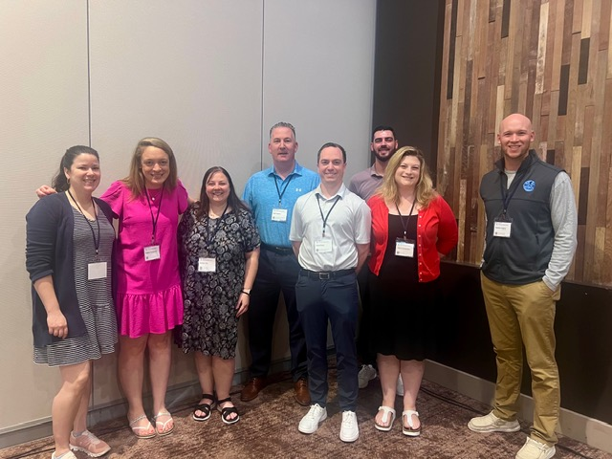
Quincy’s ECHS Pathway: Professional Development
QC Faculty Collaboration Initiative
Common Planning Time
Professional Day of Learning
ECHS Symposium Workshop
  Essential Practices for College and Career Instruction alongside Inquiry- Based Learning
Early College Professional Learning Series ~ MA DESE: Building Capacity for Rigorous Instruction and Enhanced Student Support
ECHS National Summit - Presenting June 2026
Statewide Presentations and Workshops
K
Notes:
Meghan
Speak about Summer Academy & Dual Enrollment (Tim and Karen can chime in on DE)
Speak about how many credits can be earned

Slide 24

Quincy’s 5th Annual ECHS Pathway Symposium
Opportunity to celebrate and reflect Quincy’s 5th year of ECHS Pathway.
Acknowledge and recognize Quincy’s ECHS Pathway partners and key stakeholders.
ECHS students had the opportunity to participate in a variety of interactive leadership workshops designed to support their college experience.
Students had the opportunity to meet ECHS Alumni.
ECHS Staff participated in professional development and training.
Notes:
Meghan
Vice Chair Hubley
Courtney Perdios
Kate Campbell
Guest speakers: Mayor Koch & Superintendent Mulvey; President DeCristofaro, DESE Commissioner Pedro Martinez, Speaker of the House Ron Mariano, Bob LePage of Exec Office of Education, Midori Morikawa, VP at State Street Foundation, Phylitia Jamerson, Exec Director of Early College High School (DESE), and three student presenters and student MC - Grade 12 ECHS students.

Slide 25

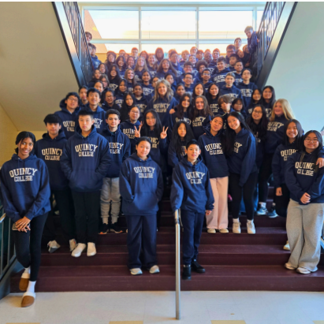

Quincy’s ECHS Pathway Prep Program, 2025-2026
5-Week, Saturday Morning Prep Program
214 students from Quincy’s 3-Middle Schools (SWMS, PWMS, CMS)
Broad Meadows Middle School (57)
  February 28-March 28
College and Career Readiness Sessions
  Critical Thinking
  Communications
  Leadership
  Statistics
  STEM
  College and Career Skills
  Community Service
South-West Middle School
Central Middle School
Point Webster Middle School
Notes:
Dan

Slide 26



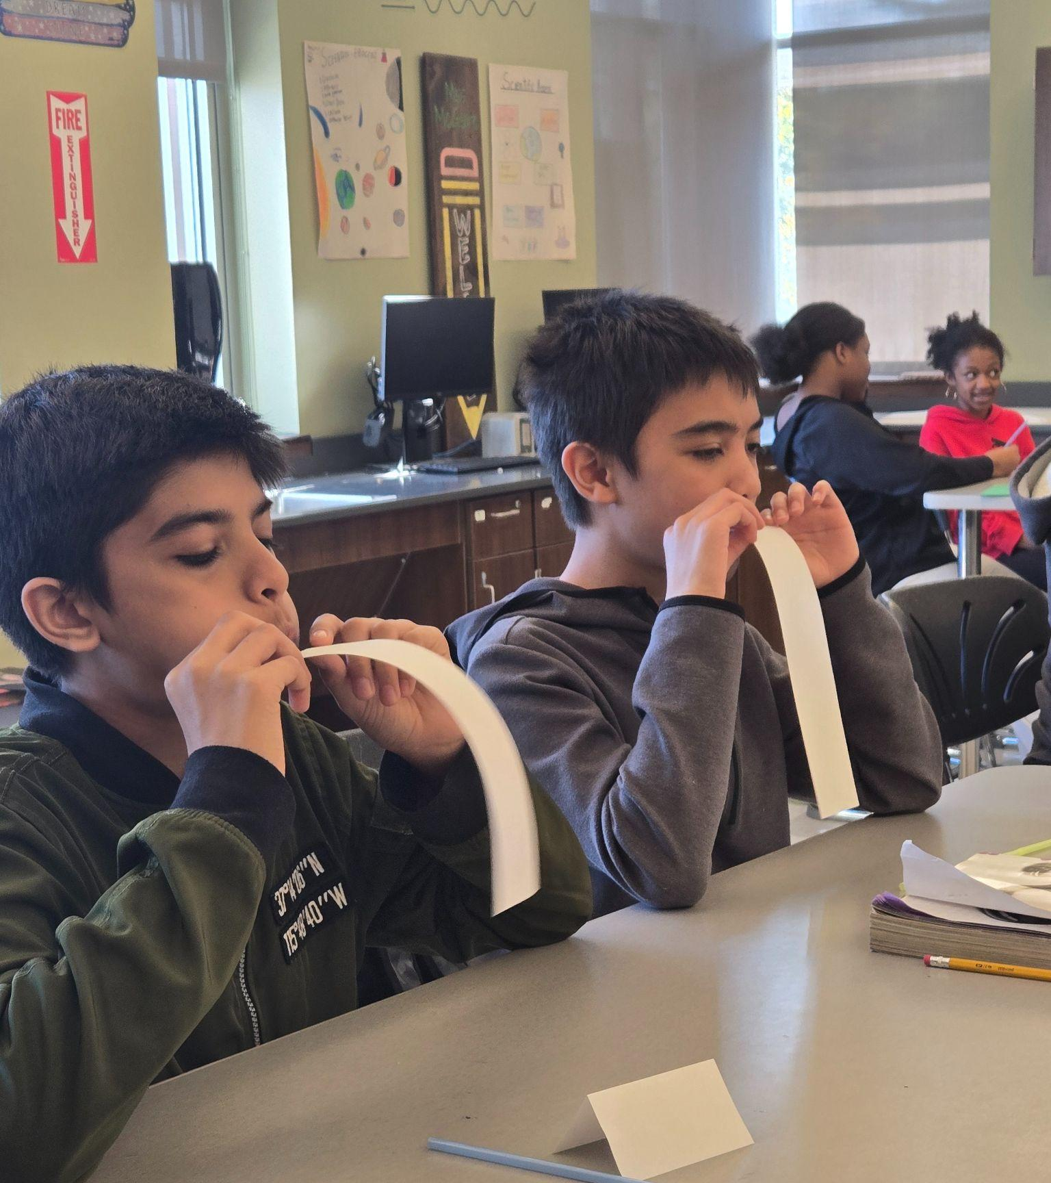
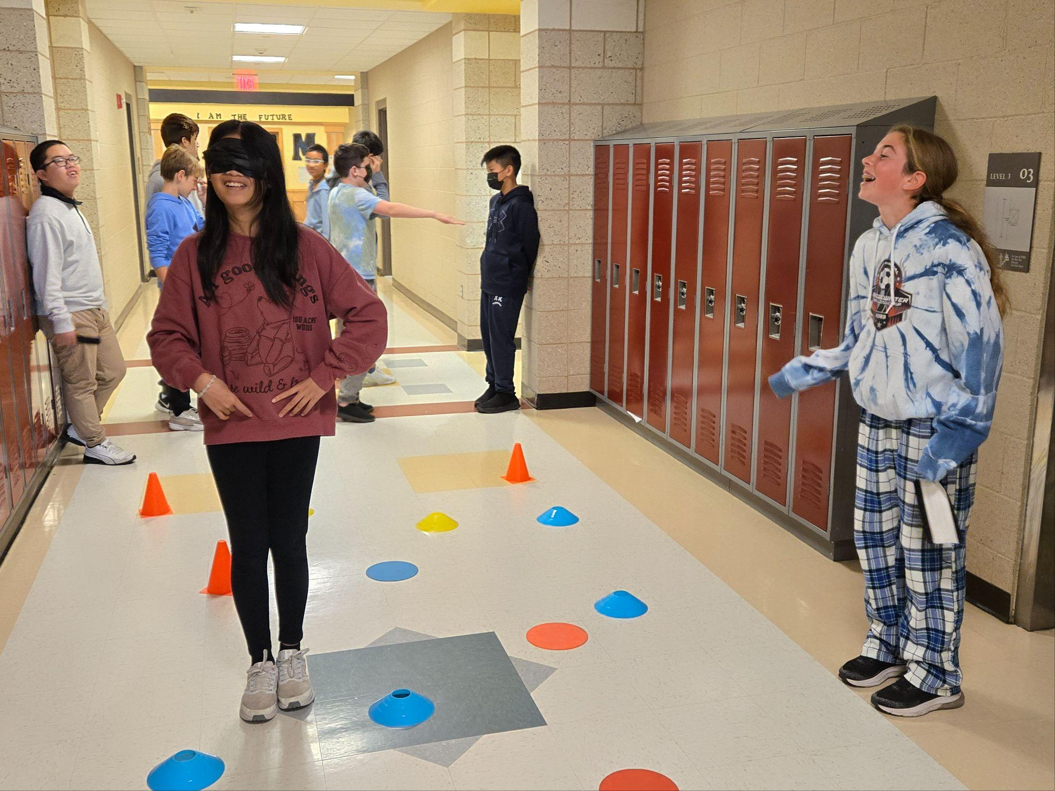
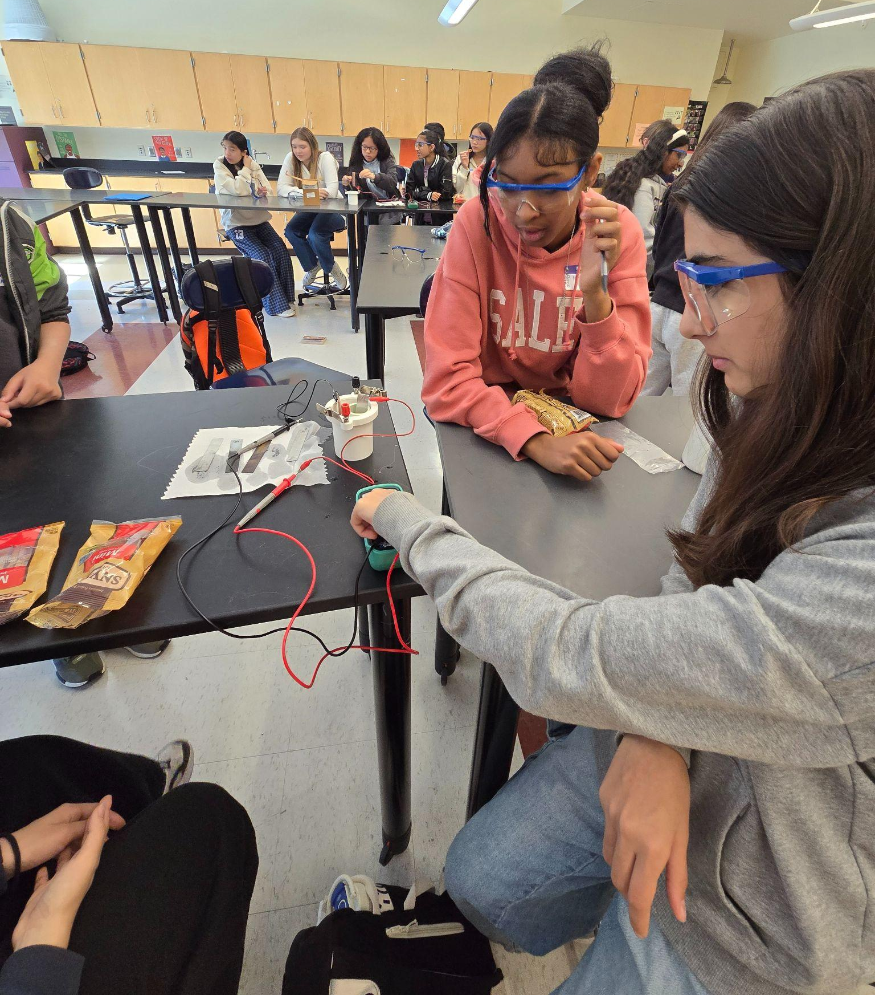
ECHS Middle School Prep Pathway
K
Notes:
Dan

Slide 27
Quincy’s Middle Schools: Middle School Prep Enrollment
QPS Middle Schools
South~West Middle School (24-25) ~ 68
Point Webster Middle School (24-25) ~ 48
Central Middle School (25-26) ~ 98
Broad Meadows Middle School (25-26) ~ 57
Atlantic Middle School (26-27)
Total: 271
Notes:
Dan

Slide 28
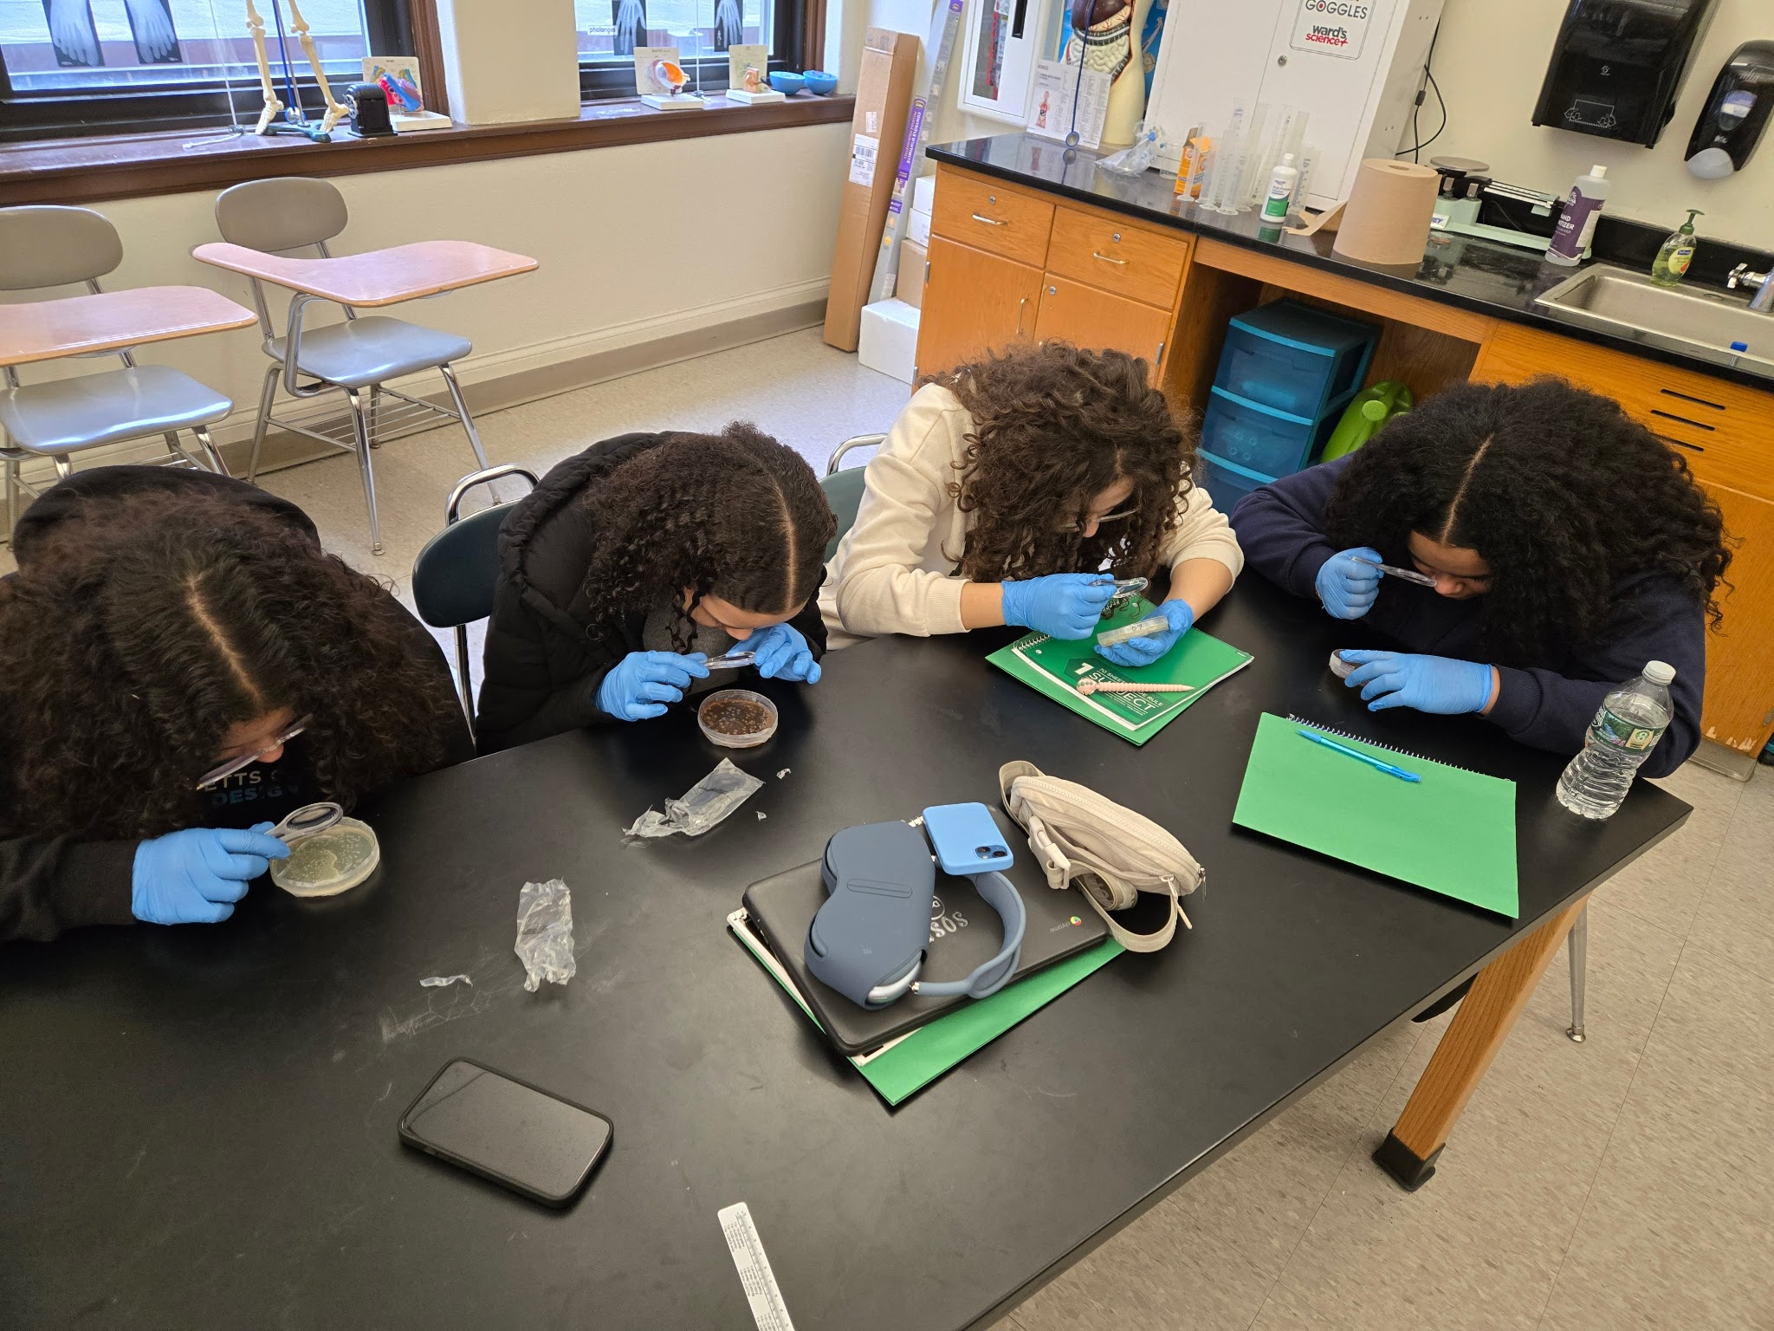
Quincy’s ECHS Pathway Resources and Materials
ECHS Pathway Newsletters (November 2025, March 2026)
Accelerated Promotional Flyer
Central Newsletter
Pathway Overview
2026 Symposium Brochure
Electronic versions of above are available upon request.
K
Notes:
Meghan
Review team will go over student applications and admit selected students into ECHS program

Slide 29


Questions and Answers
K
Notes:
Meghan

Slide 30
THANK YOU!!!
Notes:
Meghan, Dan, Eli

