Slide 1
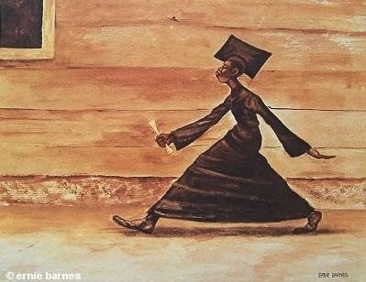

2026 ECN Network Conference: June 10, 2026
This session will share how Josephine Dobbs Clement ECHS has established and maintained a culture of excellence within its 20+ year history through the partnership of Durham Public Schools and North Carolina Central University.
Lori Bruce, Ed.D - Principal

Slide 2
ECN Session Objectives:
Provide a brief history of Josephine Dobbs Clement Early College High School
Provide a brief background / belief system / leadership lens and world view of Principal Bruce Fall 2021 - present
Share some of the intentional leadership decisions that have impacted the JDC ECHS school culture, parent and community partnerships, and consistent high performance
Allow time to ask questions and share other EC best practices among participants

Slide 3
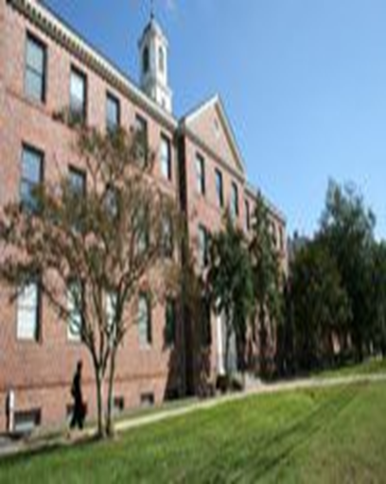
Josephine Dobbs Clement Early College High School
ECHS / Grades 9 - 12
Durham Public Schools
Accepting rising 9th graders only (typically receive nearly 400 applicants for 100 slots)
1801 Fayetteville Street, Durham NC 27707
On the Campus of North Carolina Central University
Principal: Lori Bruce, Ed.D
lori_bruce@dpsnc.net
Assistant Principal: Jamel Anderson-Ruff, M.Ed
jamel_anderson-ruff@dpsnc.net

Slide 4
Background & School Demographics
Grade | Student Enrollment 2025-2026 #
9th | 100
10th | 83
11th | 96
12th | 90
Totals | 369
African-American | 198
Hispanic | 123
White/Multi-racial/Other | 48
Background & Philosophy
NC Early College High Schools are part of NCDPI’s Cooperative and Innovative High School Network. We are small high schools from which students may leave with sufficient college credits to transition seamlessly into a four-year college or university. Early College High Schools have a special focus on students whose transition into postsecondary education may be more challenging: low-income, minority, English Language learners, and first-generation college-bound students. JD Clements ECHS began in the 2004-2005 school year as a partnership between Durham Public Schools and North Carolina Central University, including an NCCU appointed ECHS Liaison under the leadership of the Assistant Provost of Academic Affairs. Each year, we admit nearly 100 rising 9th grade students.
.
Mission Statement
The mission of the Josephine Dobbs Clement Early College High school is to expand learning opportunities for high school students, offer a rigorous, honors level curriculum that includes enrollment in college courses in grades 9 - 12 that potentially lead to earning two years of college credit while simultaneously completing their high school graduation requirements. Our unique program providing academic, emotional, and systematic supports that better ensure each student’s overall success in high school and their seamless transition into post secondary education.

Slide 5

Academic Achievement
2024 - 2025 Accolades
Exceeded Growth
#20 in the state of NC for academic growth in a school year
School Letter Grade “A”
100% Graduation Rate
US Department of Education Blue Ribbon School (2019)
2024-2025 Proficiency Composite Score: 94%
Math 1 - 85.7%
Math III - 98.9%
Biology - 89.7%
English II - 97.7%
NCDPI School/District Accountability Data:
https://public.tableau.com/views/NCDPIAccountabilityLandingPage/LandingPage?:showVizHome=no

Slide 6

DPS State Rankings – Academic Growth 23-24 / 24-25
One school was ranked in the top 20 of all schools for academic growth, while 3 schools were ranked in the top 100!
15 schools within DPS were in the top 20 percent of the state’s 2,590 schools for academic growth:
  J D Clement Early College HS – Ranked # 20 (10.39 Growth Index)
  City of Medicine Academy – Ranked # 44 (8.8 Growth Index)
  James E Shepard Middle – Ranked # 69 (7.68 Growth Index)
J D Clement Early College HS * | Oak Grove Elementary * | Lucas Middle
City of Medicine Academy * | Durham School of Technology * | Morehead Montessori
James E Shepard Middle * | C C Spaulding Elementary * | Mangum Elementary *
Lakewood Montessori Middle * | Rogers-Herr Middle *
Durham School of the Arts | Lyons Farm Elementary *
Burton Elementary | Holt Elementary
*Schools also in Top 20% in 2023-24
Notes:
Will be updated day of meeting 9/4

Slide 7
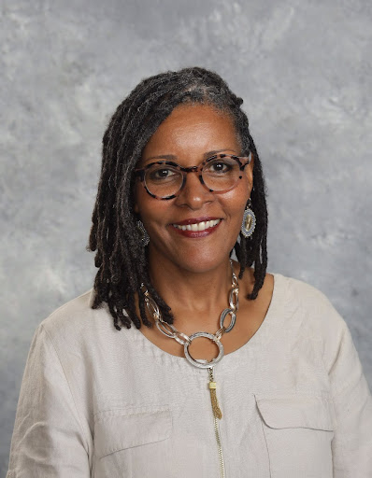
Lori Bruce, Ed.D - JDC ECHS Principal (since November 2021)
Grew up in Palmyra, VA outside of Charlottesville / Moved to North Carolina in 2002
Education: Graduated High School from Fluvanna County Schools,VA / BBA- Bachelors of Business Administration in Hospitality Mgnt. from James Madison University, VA / MEd - Masters of Education Administration from University of Virginia / Ed.D - Doctorate of Education Leadership from the University of North Carolina at Chapel Hill.
Mother of Durham Public Schools’ rising 6th and 8th grader
Previous Professional Education Experience: CTE Middle and High School Teacher in Fluvanna County and Charlottesville City Schools, Assistant Principal in Elementary, Middle, Alternative, and High School Settings in Charlottesville City Schools, Chapel Hill-Carrboro Schools, & Durham Public Schools, Central Office CTE Coordinator in Chapel Hill-Carrboro City Schools, Adjunct Professor for Masters of School Administration at UNC-Chapel Hill, NC Dept of Public Instruction Federal Programs Consultant, and Assistant Superintendent & Chief Excellence Officer in Ithaca City Schools, NY.
Dissertation Research: UNC-Chapel Hill 2007 “Perceptions, Motivations, and Achievement of African-American Students Enrolled in a Middle College High School” https://cdr.lib.unc.edu/concern/dissertations/9k41zf47f?locale=en
JDC ECHS School Community Goals 2025-2026: Lead, support, and collaborate with our students, faculty/staff, and families to provide a high quality, rigorous, and engaging educational experience attentive to the social and emotional developmental needs of adolescents that will provide the preparation and exposure to rich experiences that will increase the chances of our students thriving in their post-secondary educational experiences and the creation a choice filled and meaningful life aligned with their discovered interests and passions. Motto: Work Hard, Be Kind, Stay Humble

Slide 8
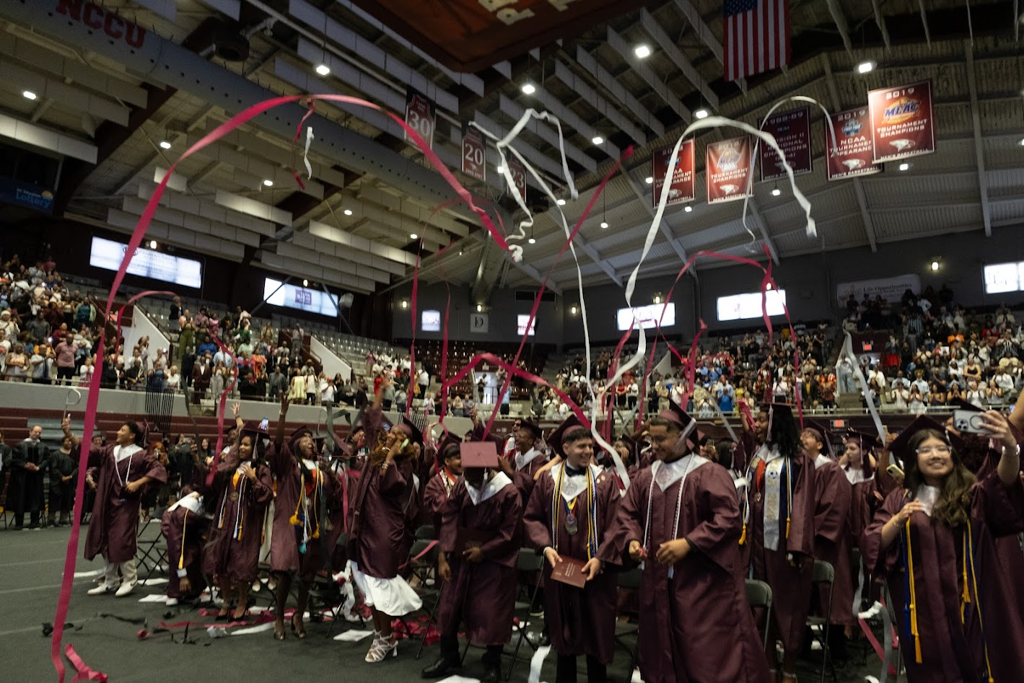
Proudest Moments as JDC Leader 2021 - present
Ability to Hire Quality Staff following Covid Challenges
Ability to maintain 100% graduation rate and high performance for NCDPI Accountability Model
State recognized growth index performance in addition to high performance (#7 23-24, #20 24-25)
Class of 2026 earned $7.6 Million in scholarships with acceptances in Ivy League Schools, HBCUs, NC UNC System Schools, and Private Colleges in and out of state
Rising PSAT/ACT scores that has allowed our students to gain merit based scholarships
Collaboration with JDC Alumni to celebrate 20th Anniversary and formation of an official JDC Alumni Association.
Ongoing MTSS Parent/Student Conferences with Admin and Counselor
Addition of Sophomore Seminar and Upperclassman Support
Effective Student Services Team working collaboratively with Admin and each other.
Shift in School Culture that expects more of students to take ownership of their education with school supports.
Preliminary Data 25-26 EOCs - more students scoring 4s and 5s vs. minimal proficiency/3.

Slide 9
Bruce Leadership Belief Systems about District Leadership:
Be very clear regarding your school systems’ intentions regarding how your Early College program fits within the goals of the district and expectations of the community.
  What is the main idea? End Game? Primary Goal? What are you being hired to do?
  Who is your target student population? What is the application/placement process?
  What happens when there is not a good fit between program/students?
How does district leadership support a healthy and productive relationship with your higher ed partnering institution?
  Are there existing relationships and common strategic goals among high level leadership? EC leaders should tap into and leverage common goals in a complex environment with frequent changes in leadership.
  How does your IHE see your EC program? Partner? Step-Child? Big Cousin/Little Cousin? Value Added? Nuisance?
How can your EC school access support from the district/community that your EC may not quality for through regular staff allotments?
Career and Technical Education, AIG, Social Worker/Mental Health, College Advising

Slide 10
Bruce School Leadership Belief Systems about Personnel and Hiring Quality Staff:
4. “The people make the party”: Leaders are in charge of the invite list - this cannot be outsourced.
  Do you have the right people on the bus to meet the goals of the school? To have a healthy/non-toxic school culture? Have you reached critical mass of quality faculty/staff to thrive?
  Educators are drawn to applying for jobs at smaller schools / appears to be an “easier” school - everyone is not ready to meet the standard.
  It is critical that professionals in small schools pull their weight, take pride in what they do, have high professional standards for themselves, and are motivated by the school’s collective success versus personal attention. Becoming an effective teammate is critical to a healthy school environment.
5. In order for teachers/support staff to become great at what they have been hired to do - leaders must remove distractions and provide consistency in what to expect each day/week within their school.
  Extra duties, comp time for school obligations outside of contract hours, school wide/faculty communication, appropriate pacing of school events that may disrupt teaching and learning, prioritizing college class attendance, minimal last minute planning that impact intentional lessons

Slide 11
Bruce School Leadership Belief Systems about Students:
6. Most students will rise to the expectation of their environment with consistent embedded supports.
  Quality educators know how to manage a classroom, inspire/motivate students, and gain authentic partnerships with parents.
  What is the infrastructure to guide student expectations? What district programs or policies support what is desired? (PBIS, Restorative Practices, Character Education?)
  Schools can optimize desirable student behavior and consistent good scholarship habits when students police/encourage each other.
  Address non-productive behaviors early and often - In the 25-26 school year, facilitated over 100 virtual parent meetings regarding academic standing & behavior
7. When you help students become owners of their own education / affirm discovery of career goals - they experience classroom instruction and support services differently. Actively teaching and allowing space for students to initiate seeking information to support their goals is a skill in an of itself…
State mandated career development plans, Xello resources, CFNC accounts/resources, visits from college representatives, free ACT/SAT prep resources, local college fairs, IHE speaker series/information sessions
Senior Picture Wall is inspiring to all JDC ECHS students each year

Slide 12
Bruce School Leadership Belief Systems about Parent Engagement:
8. Most parents want to support their high school student, but they are unsure of what is expected and how to engage appropriately that be will be different than engagement in elementary and middle school.
The goal is for school staff and caregivers to be authentic partners in shepherding the student through adolescence/high school.
  Communication with school staff, Access tools such as Infinite Campus/Canvas, awareness of what is happening at school and help their child to access opportunities, support good scholarship habits such as regular attendance and behavior.
It is important that parents understand what is expected as a K12 student vs. a college student.
  Communication with college professors (at JDC/NCCU - not allowed, must communicate through the college liaison/administrators, seminar teachers)
  EC/504 services in K12 vs. Higher Ed is different and students/families need help navigating
  More freedom/less supervision on a college campus requires maturity, trust, and consistent good decision making
Be explicit about the primary goals of high school
  Last opportunity to make mistakes with a safe place to land with guidance to recover
  Graduate on time, attention to GPA, class rank, enrolled in college classes in their intended field, develop a transcript and ACT score that is desirable to the applying college/university of their choice.
  Be eligible for college financial aid / eligible for scholarships (2.5 GPA)
  Develop the skills necessary to be independent and navigate any higher education institution

Slide 13
Bruce School Leadership Beliefs about Teaching and Learning:
The most impactful action towards high quality teaching and learning is hiring properly and offering specific support to staff as needed to meet their professional expectations effectively. School staff deserve candid communication about performance, its impact on school goals/school culture and your desire as leader to support them and make it work.
Instructional Time is Sacred: skipping class, walking the halls, teachers pulling students out of other teachers’ classes is not how we do things and will be addressed - there is a time and place for everything. Bell to bell instruction and student engagement is the standard.

Slide 14
Systematic Structures of JDC ECHS: Intentional Scheduling
All high school courses taught at the honors level (with the exception of Math, all students cycle through each JDC classroom teacher)
College course enrollment begins in the 9th grade - each year, students take more college classes, most juniors take 1 high school course each semester, most Seniors are exclusively taking all college courses
Collaboration with the IHE Liaison is critical to identifying college professors that may not be a good fit for early college students.
Attention to enrolled courses 4th block - Early Dismissal for Sports/Extracurriculars
6 High School graduation requirements are taken at NCCU: 2 world languages, Health and PE, 2 American History courses, NCCU Math 1100 = Math IV
4 90 minute block courses each semester, with a 30 minute intervention period each day
All EOC courses are taught in the Spring Semester
Seminar Courses scheduled each semester in the 9th and 10th grade to support success in high school and college courses (social/emotional well being, instructional interventions, character education lessons, ACT preparation, career planning, district assessments, etc…)
  Seminar teachers are certified teachers and expected to collaborate with counselor, content teachers, parents, administrators.
  Serve as the primary contact for MTSS Intervention Plans in Panorama
It is critical to have a quality school counselor to ensure all students on track, enrolled in the appropriate courses, collaborate effectively with the college liaison, and collaborate with MTSS Team/SIT/Administration to ensure structures of support are in place

Slide 15
Systematic Structures of JDC ECHS: Communication
Weekly/On-going Communication:
Students & Families: Weekly Sunday Message and Counselor Newsletter including a detailed updated calendar for the year
School Counselor and College Advisor REMIND Messages for each student and parent grade level
Teacher Canvas & REMIND messages
Principal/Counselor Parent & Student Meetings following MTSS letters regarding attendance, quarter grades, progress report grades, NCCU early warning grade reports, end of semester grades
Monthly Virtual PTSA & School Improvement Team Meetings
Annual / Semester Family Events: (mostly virtual)
Annual: Open House (Virtual and In Person)
Semester: Preparing for Priority Registration of College Classes
Semester: Meet the Teacher Night (approach to instruction, grading practices, goals for students)
Spring: Senior Family Meetings

Slide 16
Systematic Structures of JDC ECHS: School Counselor
Student Individual Meetings each semester - Transcript analysis & guidance
Schedule MTSS parent/student meetings with Principal
Social & Emotional Mental Health Support & Awareness
Honor Roll Celebrations each quarter
Collaboration with NCCU Liaison - enrollment of NCCU classes, aid with the transition from JDC to NCCU, NCCU speaker series for various NCCU Schools/Depts
Collaboration with Social Worker - student & family mental health services, UNC Mental Health First Aid Sessions
Collaboration with College Advisor: Scheduled College Representatives throughout the year, College Prep Workshops, FAFSA completion, Scholarship guidance and support
Collaboration with DPS Career Development Coordinator at JDC 1x per week: career development plans, internships, fellowships, job shadowing opportunities
Collaboration with DPS AIG Coordinator at JDC 1x per week: MTSS Intervention Plans, Governor’s School
All things Seniors: Recognition for scholarships & college acceptances, Senior Week, Senior Walk, College Decision Day
Plans end of year Awards Day

Slide 17
Systematic Structures of JDC ECHS: School Culture & Student Engagement
Weekly Student Clubs during intervention block
Student Government Association Monthly Activities - adjusted school schedule
Student Government Association Awards Day/End of Year Celebration events
Music Club Holiday Concert and Schoolwide Talent Show
Heritage Celebrations: Hispanic Heritage, African-American Heritage, Asian American and Pacific Islanders Heritage
Students are expected to step up and be leaders in planning SGA events with adult guidance and support
NCCU Homecoming: JDC students participate in the King/Queen Celebration, NCCU Parade, and Homecoming Week Celebrations/Greek Stroll
Grade Level Class Meetings each semester
National Honor Society Services: tutoring, support with new student orientation, school tours for interested families
NCCU Collaboration/Field Trips: Science Labs, Art Museum, Career Fairs, Expos
College Campus Field Trips
EF Tours International Trips Opportunities

Slide 18
Daily Schedule - ECHS 2025-2026
1st Period: 9:00 - 10:25 am
AAA Intervention/Enrichment : 10:30 - 11:00 am
(Monday - 1st period, Tuesday - 2nd/HR, Wednesday - 3rd, Thursday - Clubs, Friday - 4th period)
2nd Period: 11:05 am - 12:30 pm
3rd Period: 12:35 - 2:30 pm
4th Period: 2:35 - 4:00 pm

Slide 19
Student Club Opportunities at ECHS - AAA Block 1x/week
(clubs vary from year to year based on student interest/faculty sponsorship)
Yearbook
Crafts / Origami
Wealth Management / Personal Finance
Music
Literature
Film / Creative Writing
Science Olympiad
Science/STEM
Student Government Association
E-Sports
FBLA Future Business Leaders of America
Career & College
National Honor Society
Personal Finance Club
Games/Puzzles
LGBTQ & Allies
Latin X
Community Service
Math Study Hall / Academic Support
Health Sciences/STEM
We are Kings
We are Queens
Math Informatics Competition

Slide 20


Slide 21
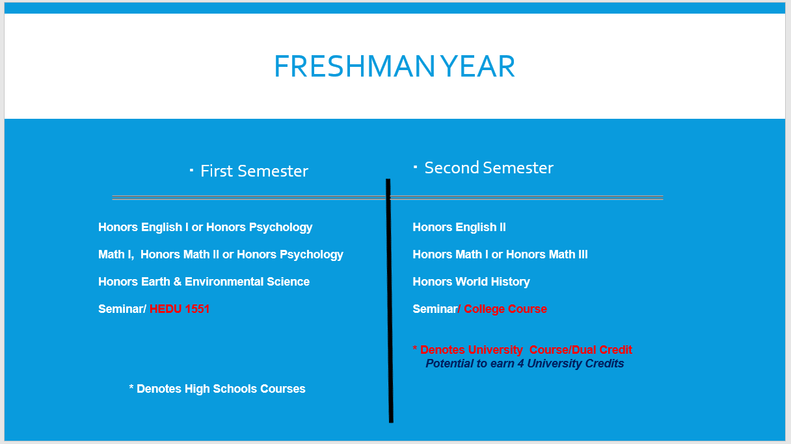

Slide 22
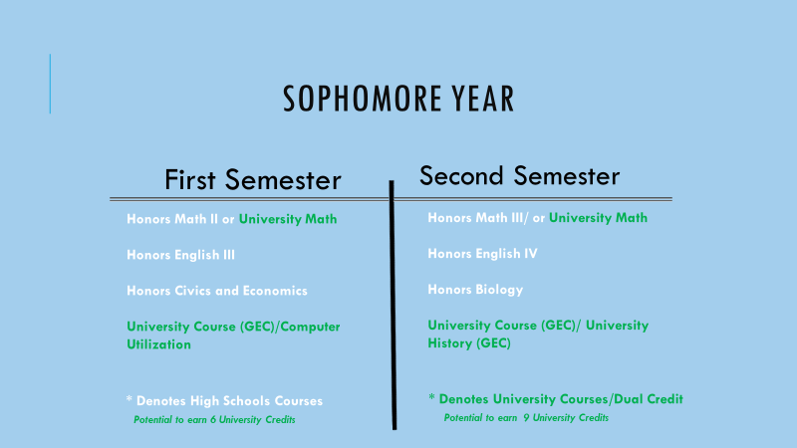

Slide 23
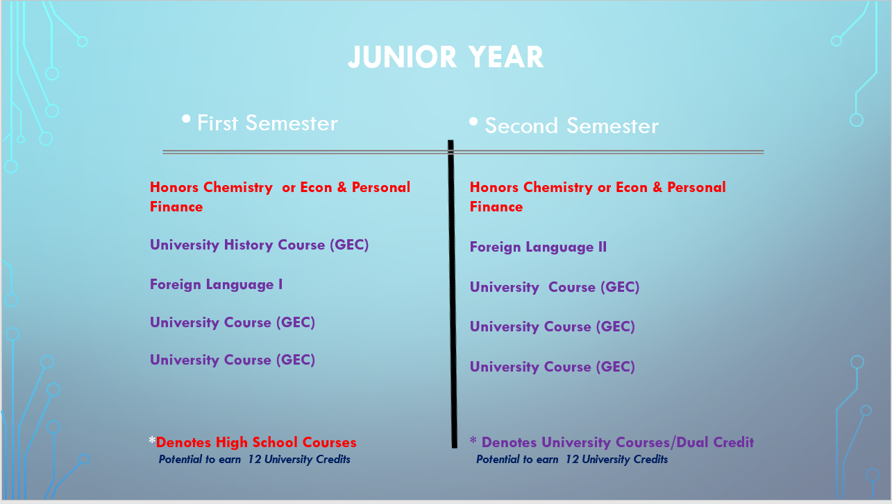

Slide 24
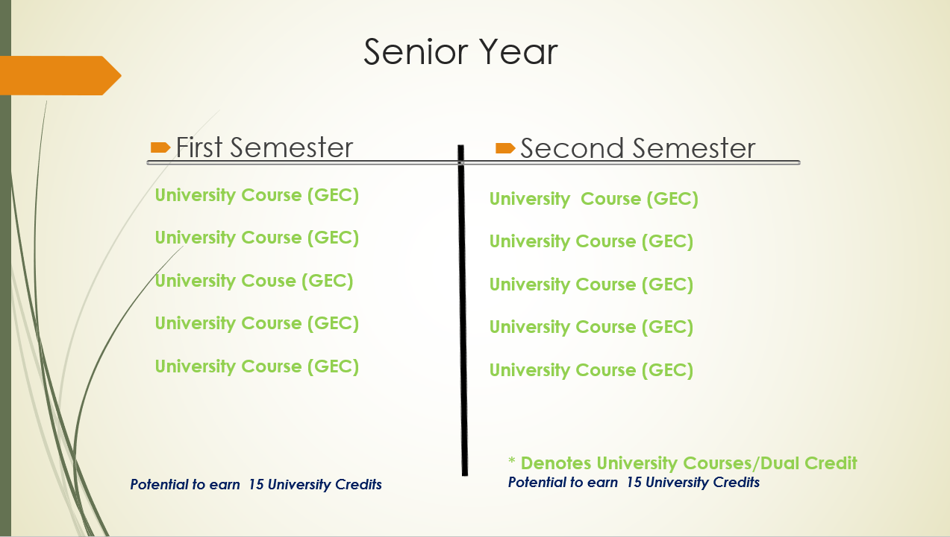

Slide 25
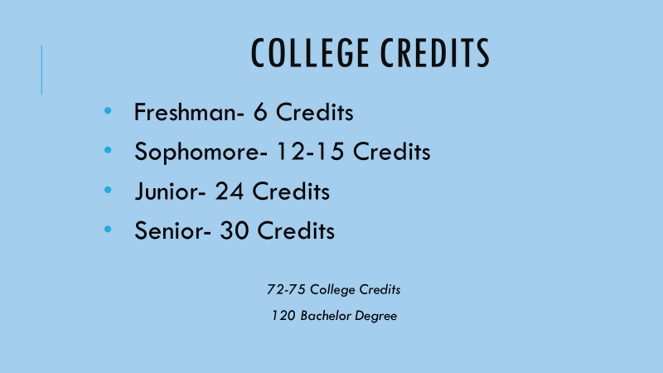
Optimal NCCU ECHS College Credits:

Slide 26
We welcome visitors to our school!
State Supt/Mo Green Visit to JDC ECHS March 2026:
CBS New Clip: https://youtu.be/OqOCc0ZkSC4?si=RGMlUHs-w57VJCU0
https://ncdpi.smugmug.com/2026-03-30-JD-Clements-Early-College-High/i-HzRMRMR/A
RTI ECN Network Schools & District Visitors
NCCU Higher Education Leader Referrals
Higher Education Leaders from Switzerland Visit 2024-2025 School Year

Slide 27
JDC ECHS Helpful Resources/Links:
2025-2026 Sunday Family Communication/Counselor Newsletters: https://docs.google.com/document/d/1RTg-024B3xsf2g_dVeOwnVY34XGTZ3_LSpGxogwi4vo/edit?tab=t.0
2025-2026 Faculty/Staff Directory at JDC ECHS: https://docs.google.com/document/d/1yScIaKUHbECkx_joqe6uVuch-DRijXhg_Dmf_cu5iPk/edit?usp=sharing
2025-2026 JDC ECHS Family Calendar: https://docs.google.com/spreadsheets/d/1R21mTq5nFn1BKv34LXXra1g4BcKJgvcvSdaz1lBna70/edit?usp=sharing
Student / Family Handbook 2025-2026: https://docs.google.com/document/d/18QsMMyCGly14Pm6gddHcsxw8goGR6kKs/edit?usp=sharing&ouid=101867352334123887854&rtpof=true&sd=true
August 2025 Virtual Open House Presentation: https://docs.google.com/presentation/d/1dlQULxcwCjWSGin_OblwWWc23MmDUMHMEUdEwyKsack/edit?usp=sharing
Welcome Virtual Meeting - April 2025 New Families/Students : https://docs.google.com/presentation/d/1YnQSmv0hvsPWs-QyGJ9VlEQpsp0qzUCRzzrSs3VGAts/edit?usp=sharing
Feb 2026 Virtual Preparing for NCCU Priority Registration Presentation for Fall 2026 Semester: https://docs.google.com/presentation/d/1t2Z44kz1DFYg68XxFkGY_qc1fntVdGDFAPfrQjqKasU/edit?usp=sharing
August 2025 Virtual Meet the Teacher Night: https://docs.google.com/presentation/d/1ppK2QikzumSeOgSADAy23i9eyjtvQqmW1GiITbVsM3o/edit?usp=sharing
October 2025 MTSS Letters to Families regarding academics/Attendance: https://docs.google.com/document/d/1vyKKieTyDDVbricOpKPNpaNZcUgT1j6U/edit?usp=sharing&ouid=101867352334123887854&rtpof=true&sd=true
DPS Magnet School Fair Presentation to Interested Families: https://docs.google.com/presentation/d/1RukjD0ZCoTuVvqXj_r_RDtecCVX7AfEZsc4f9uj6Y7c/edit?usp=sharing
2025

Slide 28
Bruce Leadership Final Thoughts:
Collaborate with SIT/Leadership Team on how your school will address academic dishonesty with AI/web-based tools. This was JDC’s top disciplinary offense in the 2025-2026 school year. We cannot teach students the skills that they need if they are taking short cuts…
The best public relations / advertising campaign is rooted in a quality product. Families/students that have good experiences with your school will spread the word without prompting. Be strategic about communication with middle school counselors and administrators.
There is a great deal of misinformation about dual enrollment/early colleges - types of students enrolled, assumptions about funding, hidden challenges - leaders must mitigate by managing up with higher leadership, managing down with school staff, and managing laterally with comprehensive high school leader colleagues to ensure accurate information is shared and communicate how EC programs are value added and not in competition with traditional high schools.
Our JDC ECHS goal is to attend to the skills and experiences that our students will need 10 years from graduation - good grades and obtaining a post secondary degree are not enough to succeed in life.
Find your tribe / support system with other educational leaders - this helps tremendously when navigating through uncertainty/chaotic times.
Principals/Asst. Principals/Leaders of Early Colleges must be visionaries and consistently seek out ways to expand opportunities for students and families though collaboration with district leaders, IHE partners, and the community. Be Bold and Courageous!

Slide 29
Leadership Matters:
Pink Panther Problem: Building Teams build Success!
https://youtu.be/Aa7RtTj8pWw?si=a5IzqvUoWulEFX1E

Slide 30
Thank you for your interest in our school!
JD Clement ECHS Website: https://www.dpsnc.net/domain/55
School Contacts:
Principal: Lori Bruce, Ed.D: lori_bruce@dpsnc.net
Asst. Principal: Jamel_Anderson-Ruff@dpsnc.net
Counselor: Lakisha_Bostick@dpsnc.net

