Slide 1
From Overload to Coherence
Driving Continuous Improvement with a Common Instructional Framework

Slide 2
Presenter
VANCE FISHBACK
Principal
Cabarrus Tech Early College
vance.Fishback@Cabarrus.k12.nc.us
(704)260-6750

Slide 3
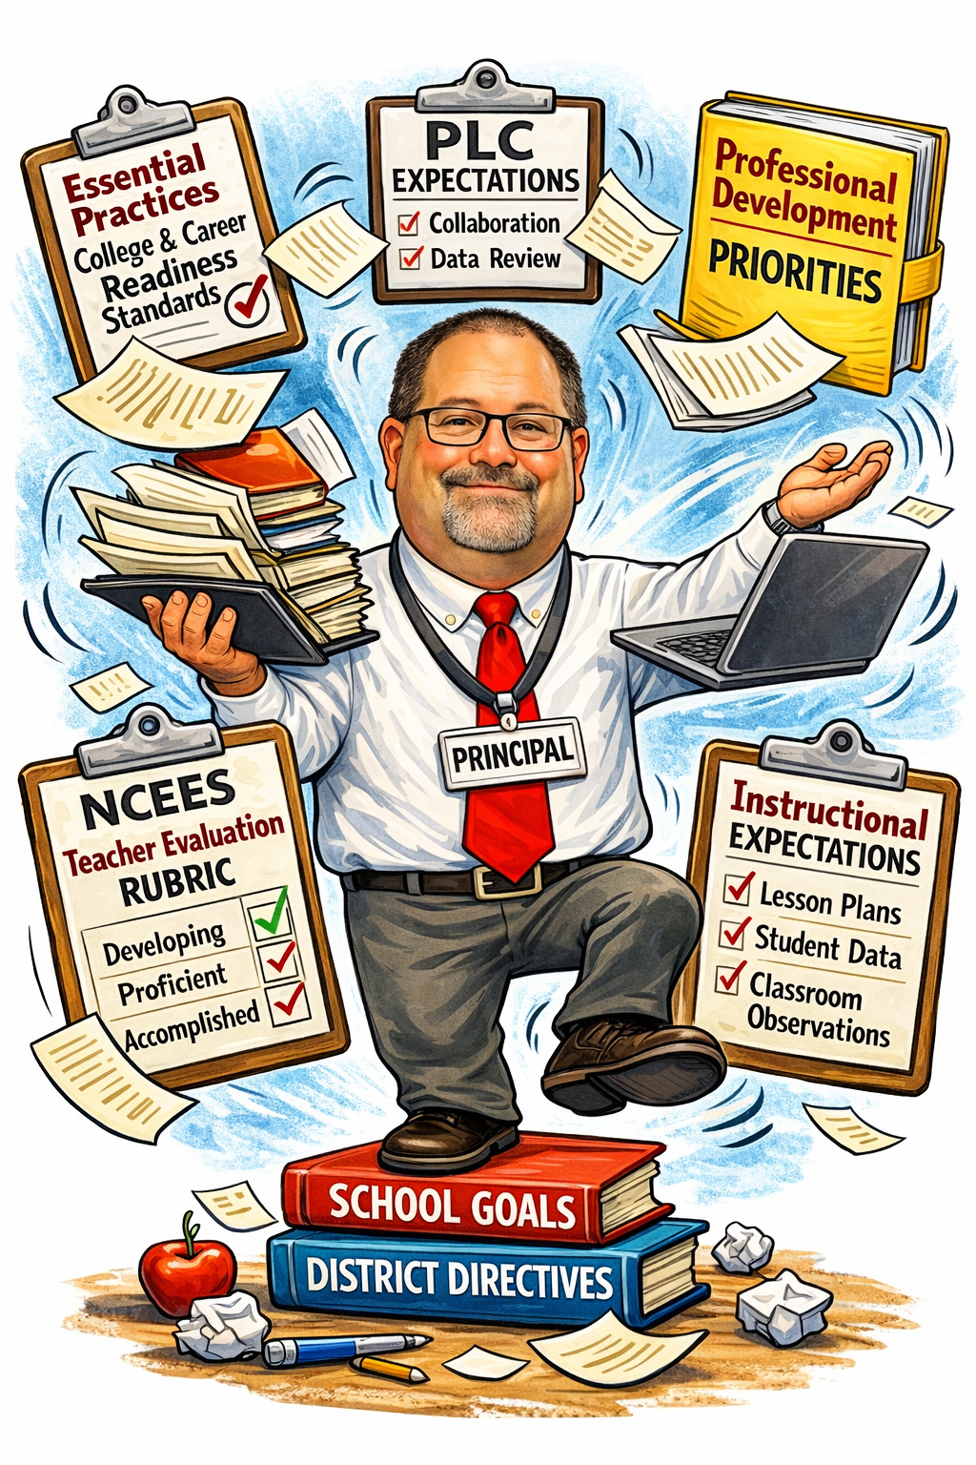
The Reality of Leading Instruction

Slide 4





The Leadership Challenge
Too Many Initiatives
Competing Documents
Complexity without Coherence
Teachers Navigating Multiple Expectations

Slide 5






What Teachers Navigate
Multiple Resources from different sources located in different places
Professional Development Priorities
PLC expectations
Multiple Evaluation Rubrics
District and School Level
Instructional Expectations

Slide 6
The Cost of Misalignment
Initiative Fatigue
Compliance Culture
Inconsistent Instructional Practice

Slide 7
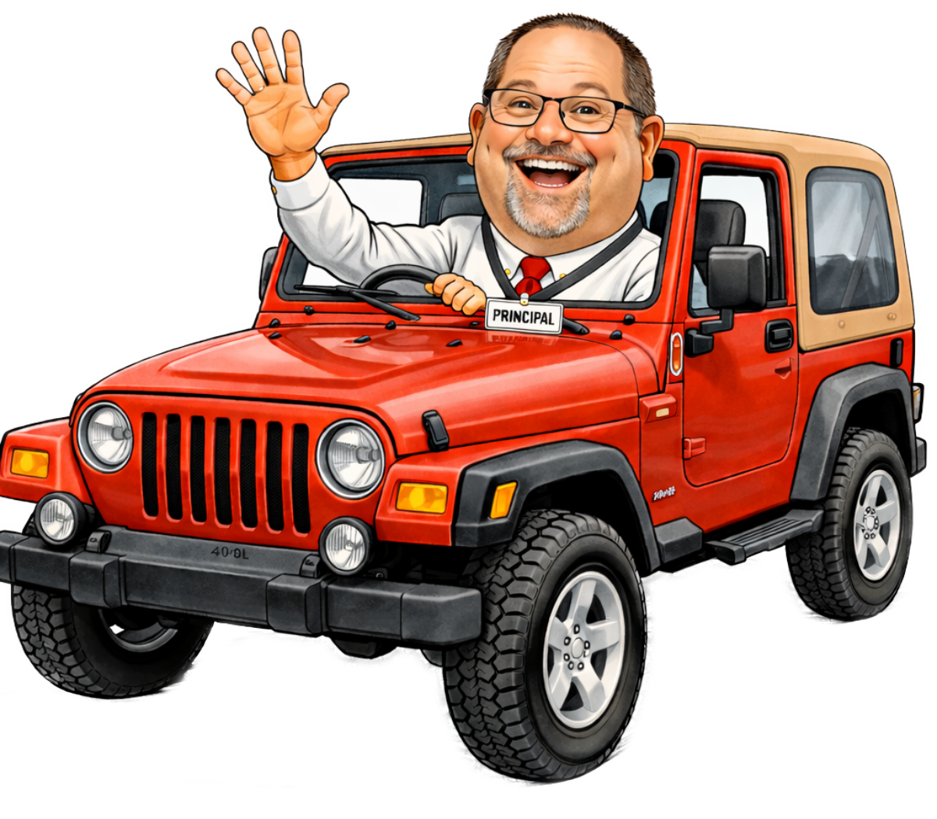
Our
Journey
2016
Expectations
Instructional Expectations from PD
2020
Resources
Consolidated all digital resources from past PD into the printed Great Big Book of Everything
2024
Framework
Added School Level Look-Fors to the NCEES Rubric
Support
Evaluation
2025
Began to examine the Framework in PLCs
2025
Developed the Framework that cross-walked Expectations, Resources, and Evaluations

Slide 8
From Fragmentation to Framework
Clearly Define Expectations
What do you want instruction to look like?

Slide 9
Instructional Expectations
Write down categories of expectations that deal with all facets of instruction?
Within those categories write down specific expectations to be defined.
Define the expectations

Slide 10
Categories for Expectations
General Course Design
Instructional
Pacing Guides
Unit/Lesson Plans
Grading Policy
Communication
Performance Based Objectives
Warm-Ups
Cognitive Interest Cues
Vocabulary
Metacognition
Read/Write/Speak/Think
Scaffolding/Differentiation
Assessments
Formative Feedback
21st Century Skills
Refocus Friday

Slide 11
Framework
Vocabulary Instruction – To be intentionally included in both the unit and lesson plans. Strategies should be used consistently in lessons and should include both academic and content vocabulary. When possible, use when annotating PBO’s.

Slide 12
Our
Journey
2016
Expectations
Instructional Expectations from PD
2020
Resources
Consolidated all digital resources from past PD into the printed Great Big Book of Everything
2024
Framework
Added School Level Look-Fors to the NCEES Rubric
Support
Evaluation
2025
Began to examine the Framework in PLCs
2025
Developed the Framework that cross-walked Expectations, Resources, and Evaluations

Slide 13
Resources
Great Big Book of Everything (GBBE)

Slide 14
Our
Journey
2016
Expectations
Instructional Expectations from PD
2020
Resources
Consolidated all digital resources from past PD into the printed Great Big Book of Everything
2024
Framework
Added School Level Look-Fors to the NCEES Rubric
Support
Evaluation
2025
Began to examine the Framework in PLCs
2025
Developed the Framework that cross-walked Expectations, Resources, and Evaluations

Slide 15
From Fragmentation to Framework
Crosswalk Expectations with Evaluations
Clearly Define Expectations
What do you want instruction to look like?
How will that expectation be evaluated?

Slide 16
Evaluation – NCEES
Standard III: Teachers know the content they teach
Teachers align their instruction with the North Carolina Standard Course of Study. In order to enhance the North Carolina Standard Course of Study, teachers investigate the content standards developed by professional organizations in their specialty area. They develop and apply strategies to make the curriculum rigorous and relevant for all students and provide a balanced curriculum that enhances literacy skills. Elementary teachers have explicit and thorough preparation in literacy instruction. Middle and high school teachers incorporate literacy instruction within the content area or discipline. Questions to Consider: • How do you make your curriculum rigorous? • How do you know your lessons are relevant to your students? • How do you ensure that students read and write daily? • What literacy skills do you integrate into your curriculum on a regular basis?
 | Developing | Proficient | Accomplished | Distinguished
State Descriptors | Demonstrates an awareness of the North Carolina Standard Course of Study and references it in the preparation of lesson plans. Secondary: Recognizes the importance of integrating literacy strategies within the content areas. | …and Understands the North Carolina Standard Course of Study, uses it in preparation of lesson plans, and applies strategies to make the curriculum rigorous and relevant. Secondary Incorporates a wide variety of literacy skills within content areas to enhance learning. | …and Develops and applies strategies based on the North Carolina Standard Course of Study and standards developed by professional organizations to make the curriculum balanced, rigorous and relevant. Secondary Evaluates and reflects upon the effectiveness of literacy instruction within content areas. | …and Assists colleagues in applying such strategies in their classrooms. Secondary Makes necessary changes to instructional practice to improve student learning.
Possible CECT Indicators | Daily learning objectives are related to the NCSCOS* Teacher’s lessons demonstrate the appropriate use of pacing guides.* | Pacing guide is developed and mapped to the current school calendar* Maintains current Unit & Lesson Plans Unit Plans reflect how the content goes beyond the standard level Performance Based Objectives (PBOs) are posted on the board and annotated daily* Incorporates vocabulary strategies into daily lessons* Lessons contain opportunities for students to read, write, speak, and think* Makes content relevant by incorporating real world or contemporary examples* Lessons contain strategies for disciplinary literacy | Performing all previous at a consistent level* Consistently refers back to PBO multiple times during the lesson* Consistently posts essential questions on the board and refers to it multiple times during the lesson* Lessons plans reflect a strategic incorporation of both academic and content specific vocabulary* Evaluates lessons for literacy instructional effectiveness | Serves as a model for this element* Leads PLC in work surrounding NCSCOS and literacy strategies*

Slide 17
From Fragmentation to Framework
Crosswalk Expectations with Expectations and Resources
Clearly Define Expectations
What do you want instruction to look like?
How will that expectation be evaluated?
Where can teachers find the resource for that expectation?

Slide 18
Resources
Great Big Book of Everything (GBBE)
New Classroom Instruction That Works (NCITW)
Essential Practices for CCR Instruction Annotated (EP)
New PD Handouts
New Articles

Slide 19
Our
Journey
2016
Expectations
Instructional Expectations from PD
2020
Resources
Consolidated all digital resources from past PD into the printed Great Big Book of Everything
2024
Framework
Added School Level Look-Fors to the NCEES Rubric
Support
Evaluation
2025
Began to examine the Framework in PLCs
2025
Developed the Framework that cross-walked Expectations, Resources, and Evaluations

Slide 20
From Fragmentation to Framework
Crosswalk Expectations with Expectations and Resources
Clearly Define Expectations
Create a Framework Document
Create a singular document that list the expectation, where to find the resource, and how it will be evaluated.
What do you want instruction to look like?
Where can teachers find the resource for that expectation?
How will that expectation be evaluated?

Slide 21
Framework
Vocabulary Instruction – To be intentionally included in both the unit and lesson plans. Strategies should be used consistently in lessons and should include both academic and content vocabulary. When possible, use when annotating PBO’s.
What is it:
GBBE – Close Reading pg. 28
NCITW Strategy 3 – Vocabulary Instruction pg. 40
How will it be measured:
CWT 2C – Student talk reflects discipline-specific habits of thinking and ways of communicating
NCEES 3A – Teachers align their instruction with the North Carolina Standard Course of Study

Slide 22
From Fragmentation to Framework
Crosswalk Expectations with Expectations and Resources
Clearly Define Expectations
Create a Framework Document
Develop Plan for Constant Improvement
Create a singular document that list the expectation, where to find the resource, and how it will be evaluated.
What do you want instruction to look like?
Where can teachers find the resource for that expectation?
How will that expectation be evaluated?
How will they receive initial training?

Slide 23
Our
Journey
2016
Expectations
Instructional Expectations from PD
2020
Resources
Consolidated all digital resources from past PD into the printed Great Big Book of Everything
2024
Framework
Added School Level Look-Fors to the NCEES Rubric
Support
Evaluation
2025
Began to examine the Framework in PLCs
2025
Developed the Framework that cross-walked Expectations, Resources, and Evaluations

Slide 24
From Fragmentation to Framework
Crosswalk Expectations with Expectations and Resources
Clearly Define Expectations
Create a Framework Document
Develop Plan for Constant Improvement
Create a singular document that list the expectation, where to find the resource, and how it will be evaluated.
What do you want instruction to look like?
Where can teachers find the resource for that expectation?
How will that expectation be evaluated?
How will they receive initial training?
How will you use it for continuous improvement?

Slide 25
Driving Professional Development
Framework anchors PD planning
PLCs focus on priority practices
Evaluation and PDP becomes growth-oriented

Slide 26

Continuous Improvement
Use walkthrough data & evaluation trends
Conversations from PLC meetings
Annual refinement

Slide 27
Framework
Read/Write/Speak/Think – Each student should read, write, speak, and think in each class, each day. Lessons will include discipline-specific skills.
What is it:
GBBE:
  Close Reading Strategies
  Learning Through Oracy
  Common Instructional Strategies (CIS)
Teaching Presentation Skills with Ignite
Disciplinary Literacy pdf
Disciplinary Literacy- A Shift That Makes Sense
NCITW Strategy 8 – Peer-Assisted Consolidation of Learning pg 77
NCITW pg 108 (Critical Thinking paragraph)
NCITW Strategy 12 - Cognitive Writing pg 111
NCITW Strategy 13 – Guided Investigations pg 117
NCITW Strategy 14 – Structured Problem Solving pg 123
How will it be measured:
CWT 2 –
NCEES 3A – Teachers align their instruction with the North Carolina Standard Course of Study
NCEES 4A – Teachers know the ways in which learning takes place, and they know the appropriate levels of intellectual, physical, social, and emotional development of their students
NCEES 4C – Teachers use a variety of instructional methods
NCEES 4E – Teachers help students develop critical-thinking and problem-solving skills
NCEES 4F – Teachers help students work in teams and develop leadership qualities

Slide 28
Refine Expectation
Break into Multiple Expectations
Align with
the Essential Practices for CCR Instruction
Essential Practices for CCR Instruction Walkthrough

Slide 29
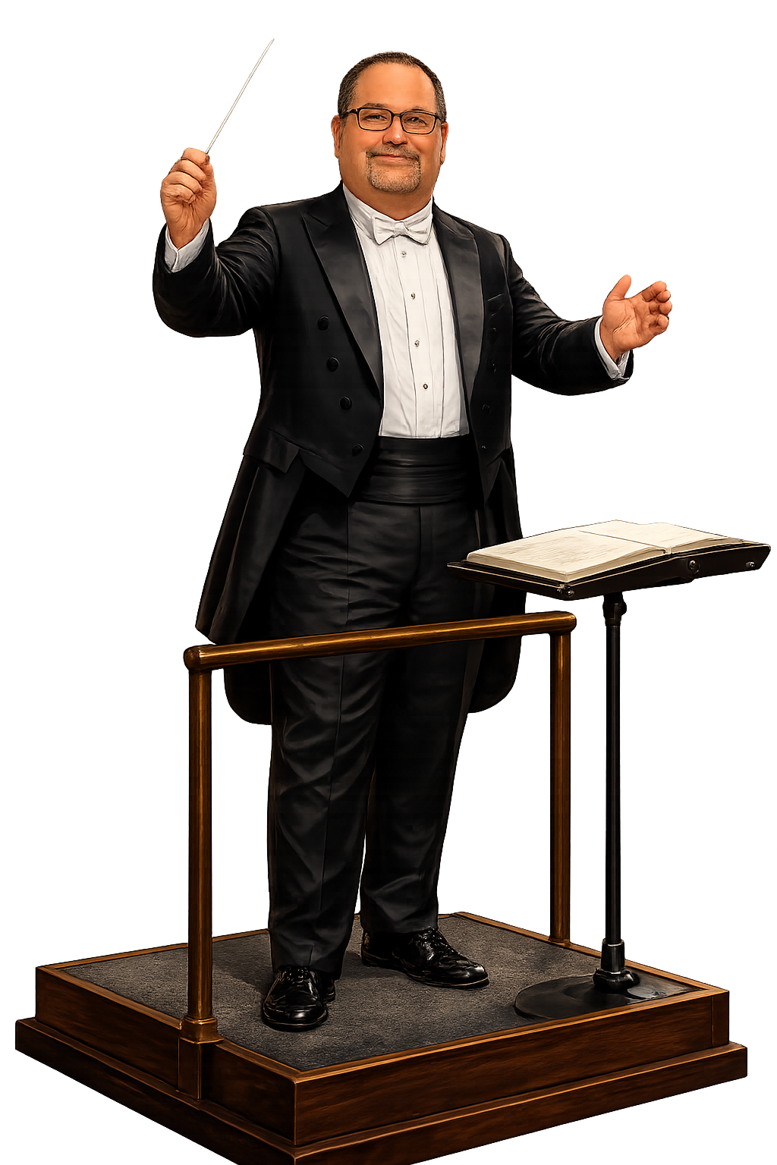
From Overload to Coherence

Slide 30
Thank
You
VANCE FISHBACK
Principal
Cabarrus Tech Early College
vance.Fishback@Cabarrus.k12.nc.us
(704)260-6750

