Slide 1
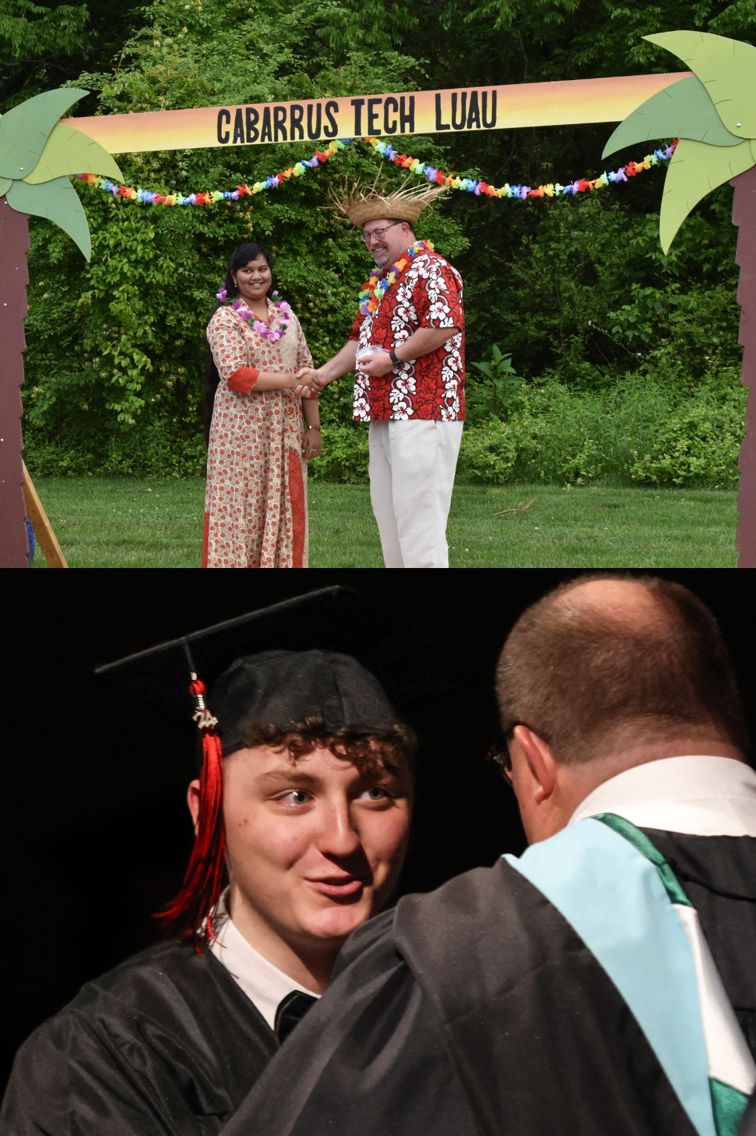
From First Hello to Final Goodbye
Building Student Belonging That Sticks

Slide 2
PRESENTERS
VANCE FISHBACK
Principal
Cabarrus Tech Early College
vance.Fishback@Cabarrus.k12.nc.us
(704)260-6750
STACEY DIAZ
School Counselor
Cabarrus Tech Early College
stacey.diaz@Cabarrus.k12.nc.us
(704)260-6750

Slide 3
In this Session
Look into what research says about Sense of Belonging
Examine how our Organizational structure, our Culture, & What and how we teach can be thoughtfully aligned over time to ensure students feel known, valued, and connected year after year
Explore strategies for introducing students to school culture prior to enrollment, establishing meaningful early connections, and maintaining intentional activities that reinforce belonging across all grade levels
Assess your own systems designed to create belonging

Slide 4
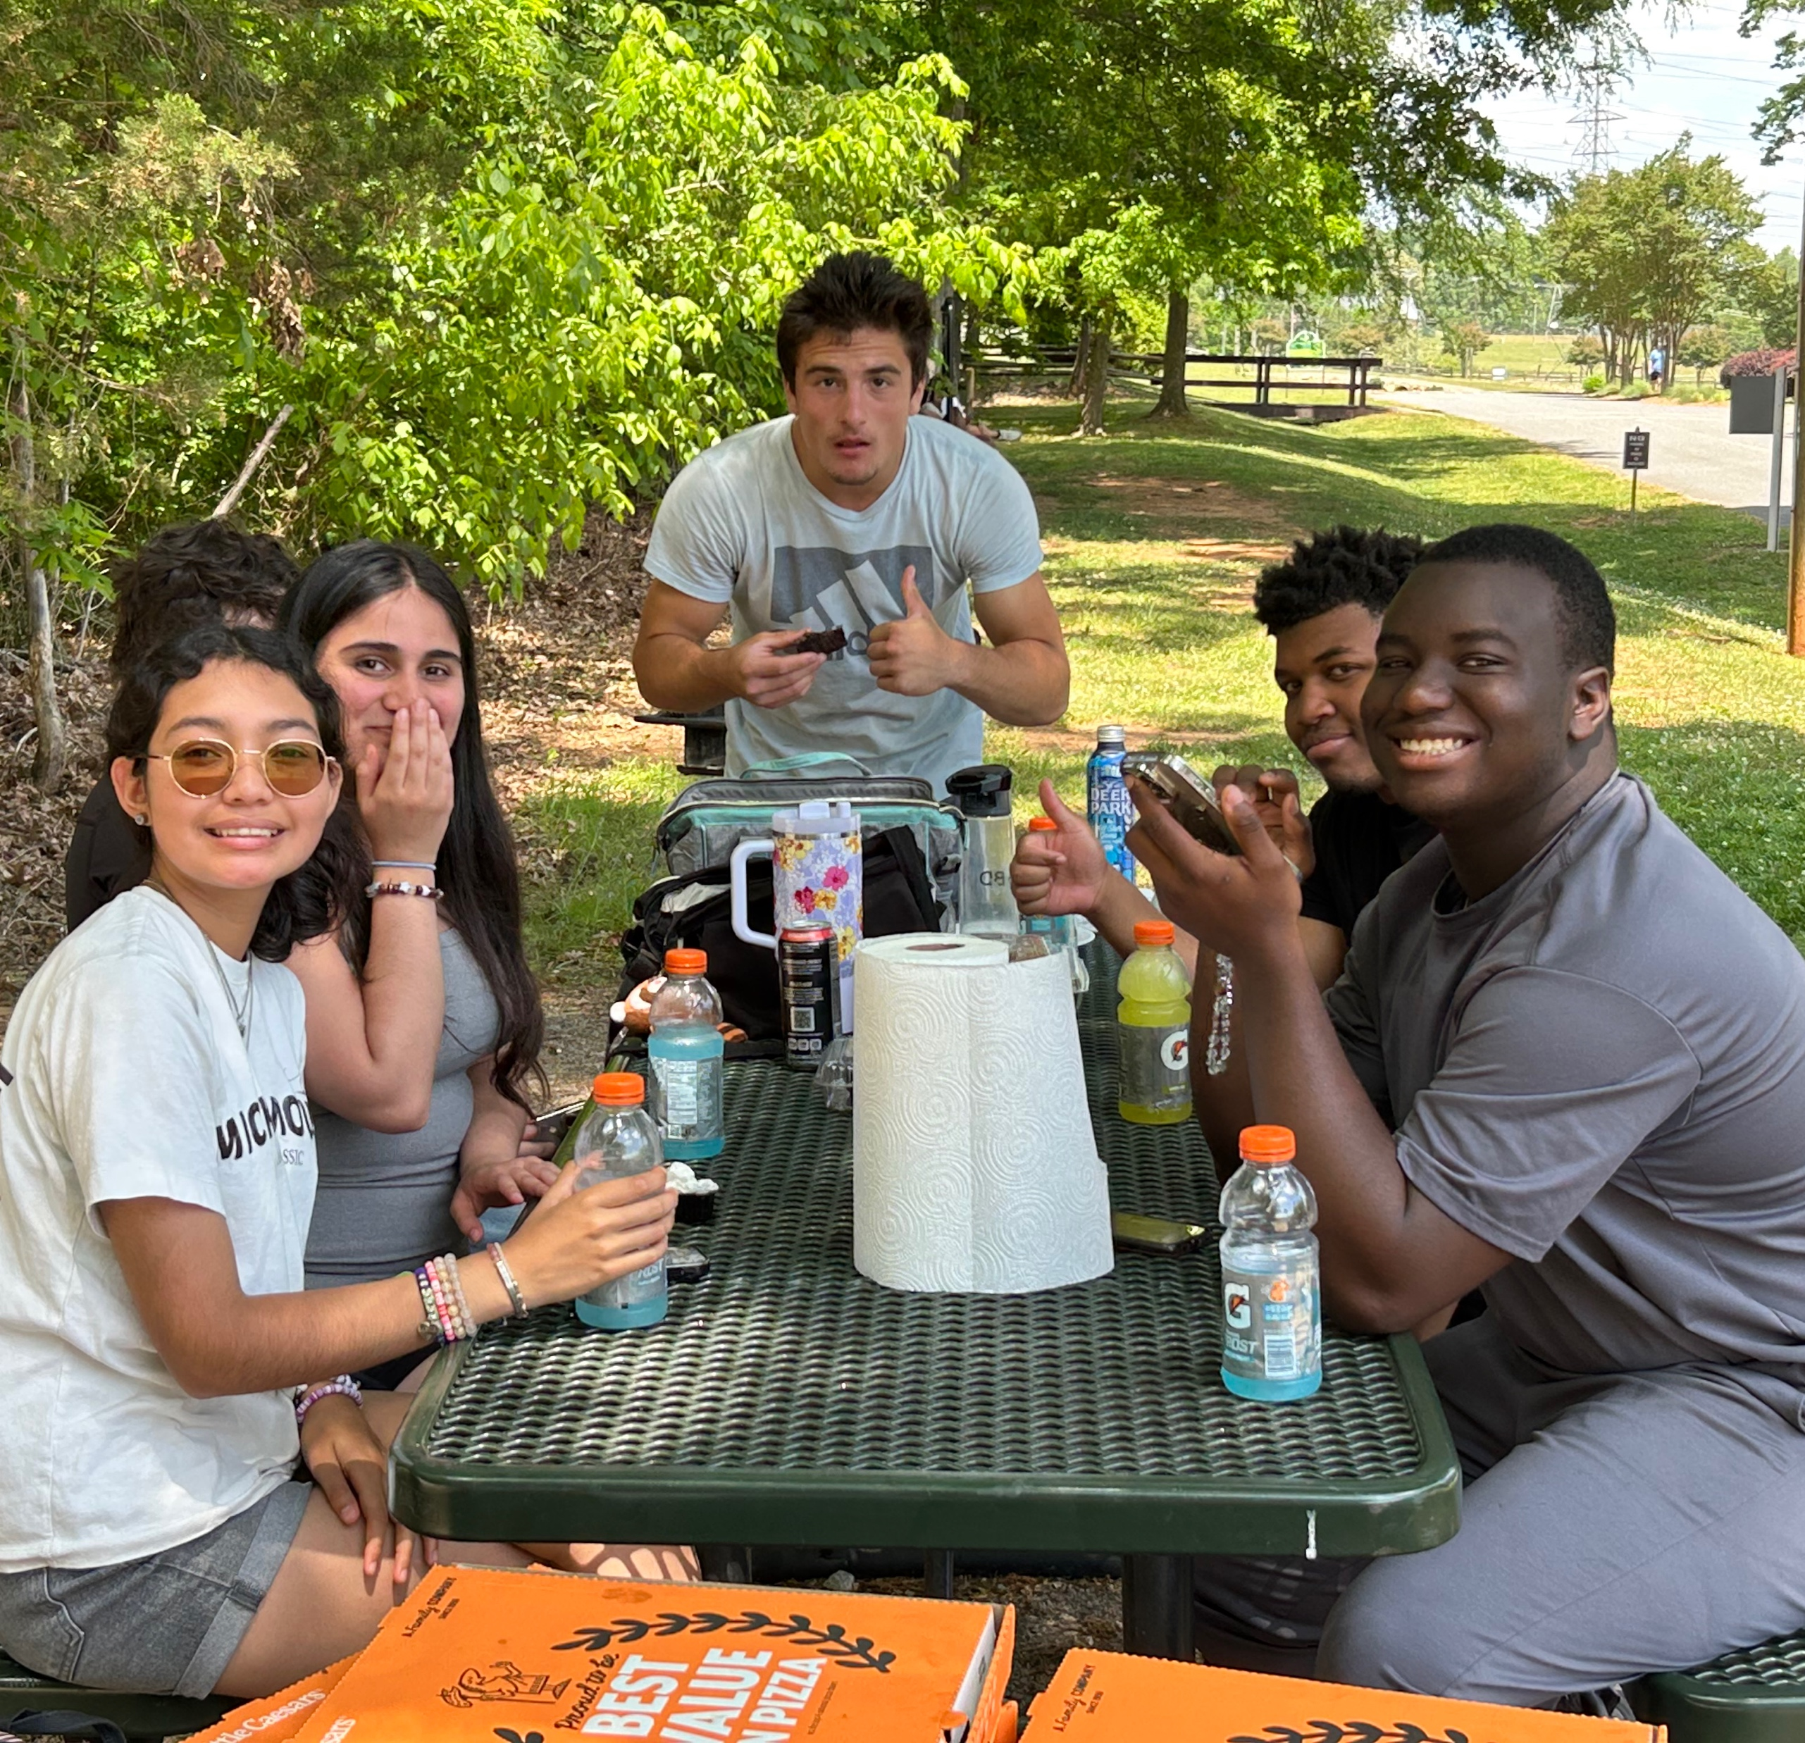
What!

Slide 5
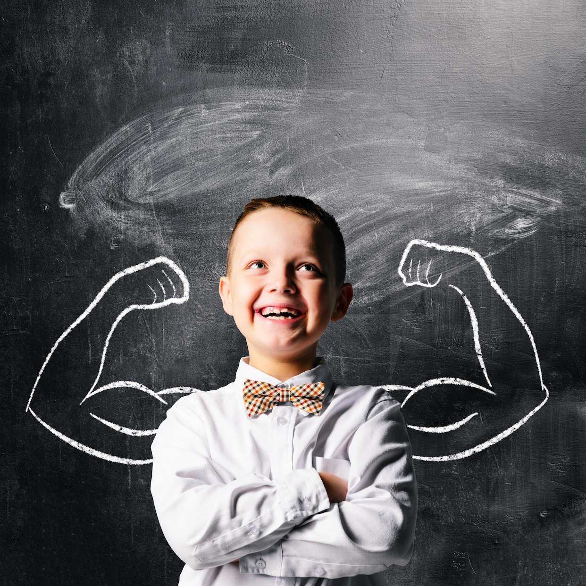
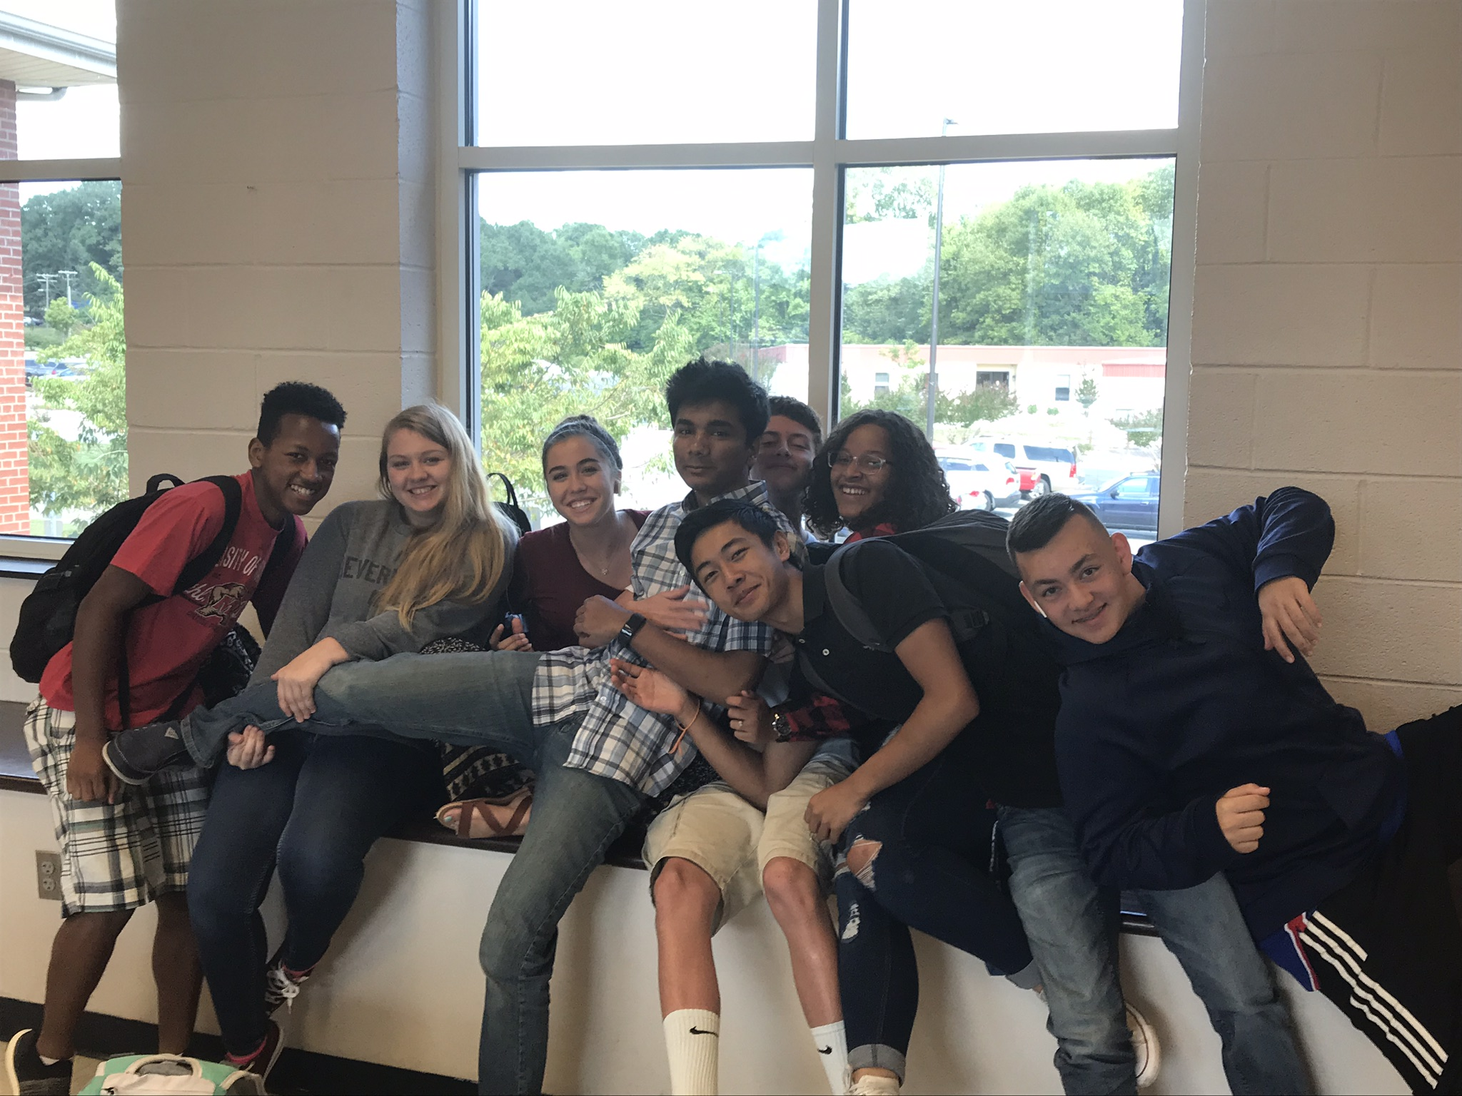
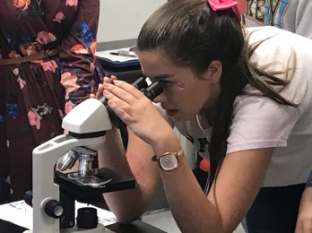
Areas of Belonging
Sense of
Self
Sense of Community
Sense of
Academic Efficacy
Who am I?
Do I fit in with others?
Can I do this work?

Slide 6

Self-concept
Self-efficacy
Self-esteem
Who do I think I am?
A student's perceptions of their traits, abilities, and roles
Can I succeed?
A student's belief in their ability to perform tasks and achieve goals.
Do I value myself?
Overall sense of self-worth and emotional evaluation
Sense
of Self

Slide 7
Membership
Feeling accepted and belonging to the group
Influence
Feeling heard and and that their voice has an impact
Sense
of Community
Integration and Fulfillment of Needs
Feeling the school meets their Social & Academic Needs
Shared Emotional Connection
Bonds formed during shared experiences

Slide 8
01
Mastery Experiences
02
Vicarious Experiences
Previous successes build confidence.
Watching peers succeed increases a student's own belief in their capability
Sense
of Academic Efficacy
03
Social Persuasion
04
Emotional & Physiological States
Encouragement and specific feedback from teachers, peers, and family.
Stress, anxiety, or confidence directly shape how students perceive their competence before and during academic tasks.

Slide 9
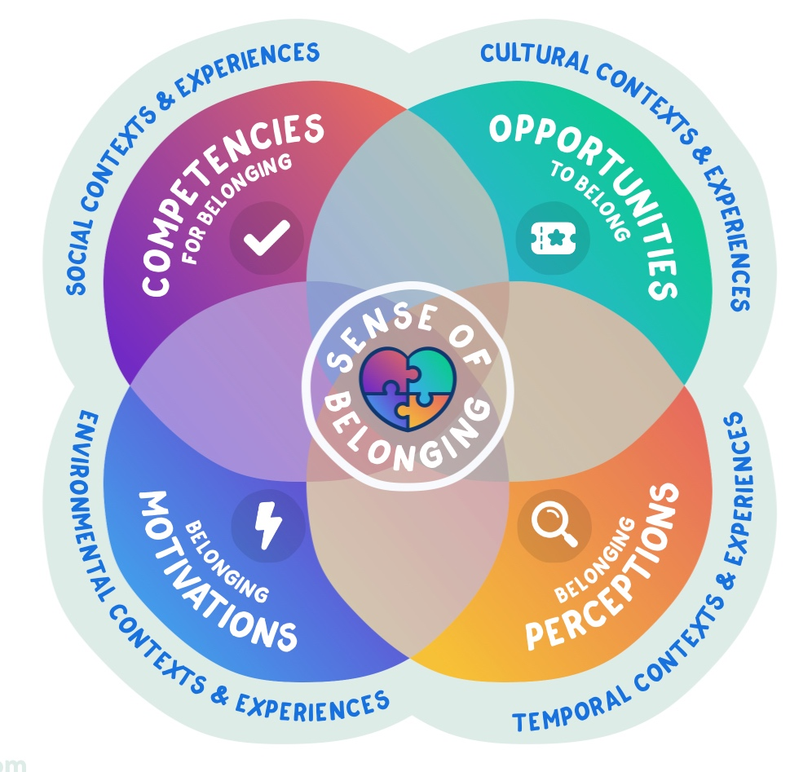
Allen’s Framework
Allen, Kelly-Ann, (2025), School Belonging: Evidence, Experts, and Everyday Gaps.

Slide 10
Putting It All Together
Sense of Self
Sense of Community
Academic Efficacy
Competencies
Does the student have the social-emotional skills for self-awareness and healthy identity?
Can the student navigate peer relationships, advocate for themselves, and collaborate?
Does the student have study skills, self-regulation, and goal-setting strategies?
Motivation
Is the student motivated to explore who they are and grow?
Does the student want to connect with peers and staff?
Does the student believe academic success is worth pursuing?
Opportunity
Is there space and support for identity exploration at this school?
Are there inclusive structures for all students to participate?
Does the student have access to challenging, meaningful work?
Perceptions
How does the student view their own value and potential?
Does the student believe they are accepted and included here?
Does the student believe they are capable of academic success?

Slide 11
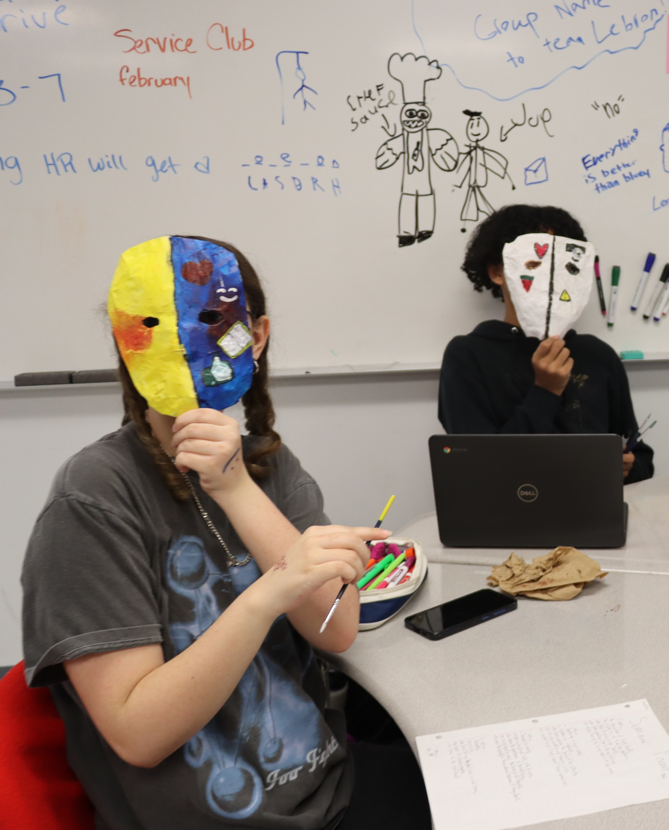
So What!

Slide 12
How Schools Build Belonging
Three school-level pillars that create the conditions for belonging to take root
Pillar 1
Pillar 2
Pillar 3
Systems & Structures
Traditions, Symbols & Celebrations
Skills, Knowledge & Pedagogy
Policies and procedures
Schedules that create time for advisory, mentoring, and community-building
Organized opportunities for every student to participate and lead
Data systems that track belonging, not just academic metrics
Cultural representations of the school in words and images
What we choose to celebrate — effort, growth, community, identity
Annual rites of passage that mark student milestones
Educator knowledge of identity development, efficacy, and community
Instructional practices that build academic confidence and voice
SEL curriculum woven into academic content
Staff skills for building relationships across differences

Slide 13
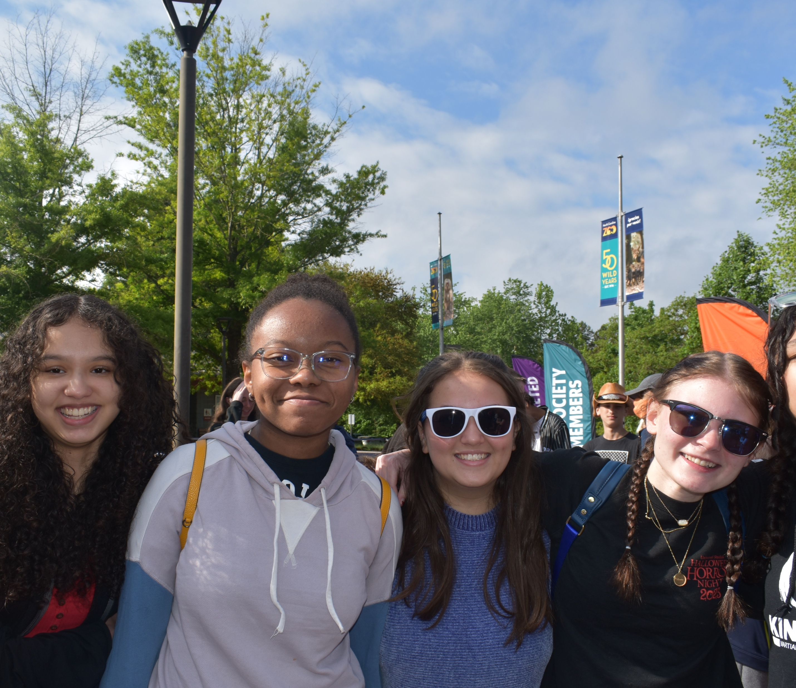
Now What!

Slide 14

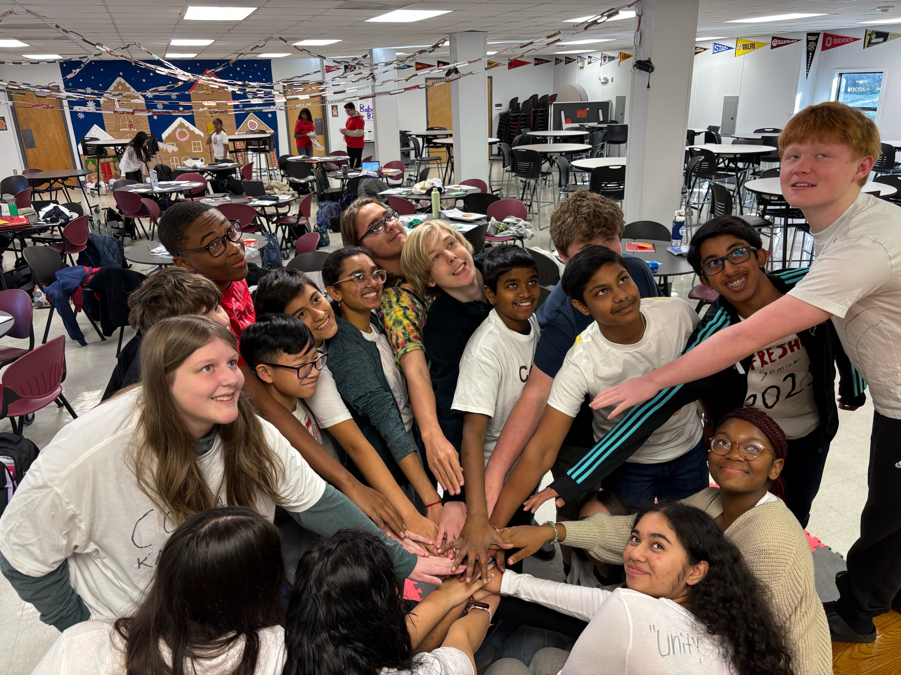
Building Belonging @
CABARRUS TECH

Slide 15




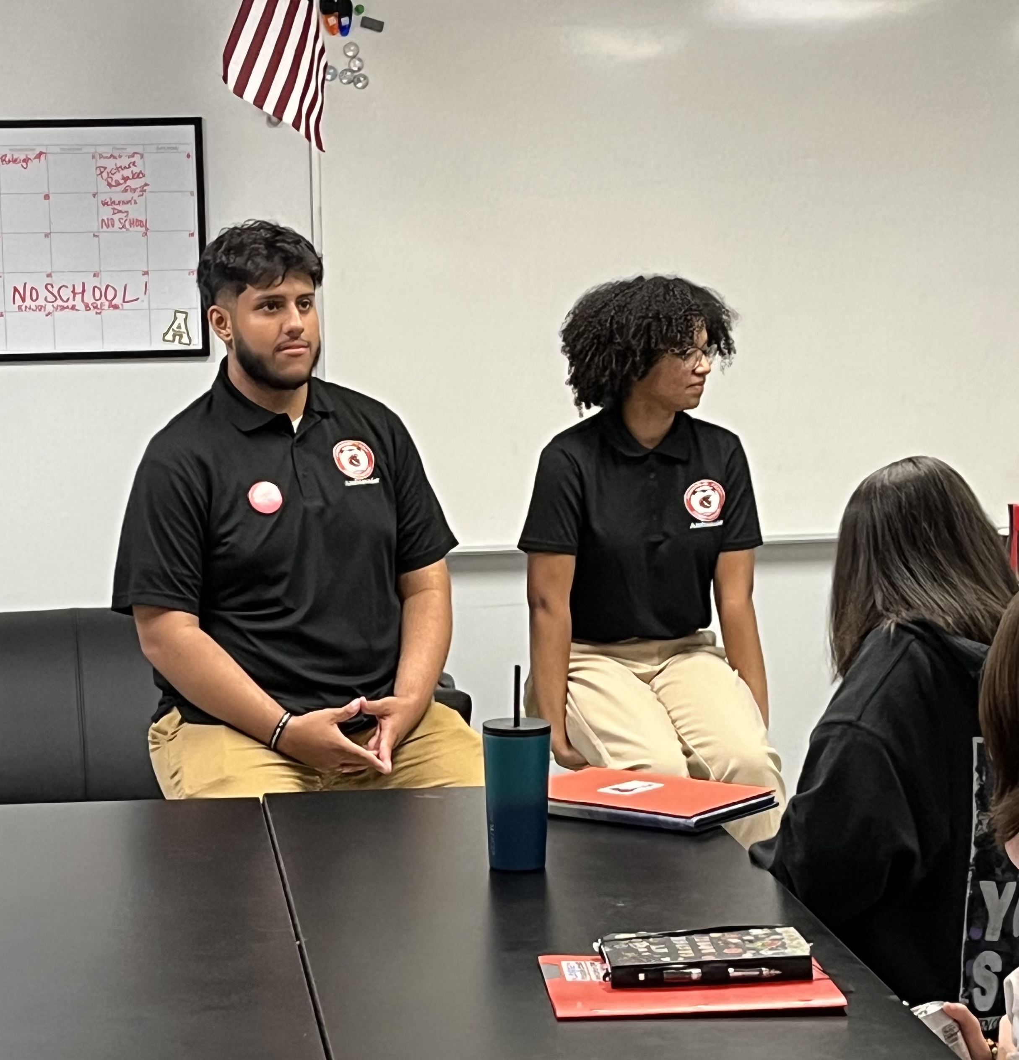
Recruiting
Materials
Presentations
How well do your materials represent all of your students?
Can future students see themselves in the student reps? How does your message reach parents and students?

Slide 16
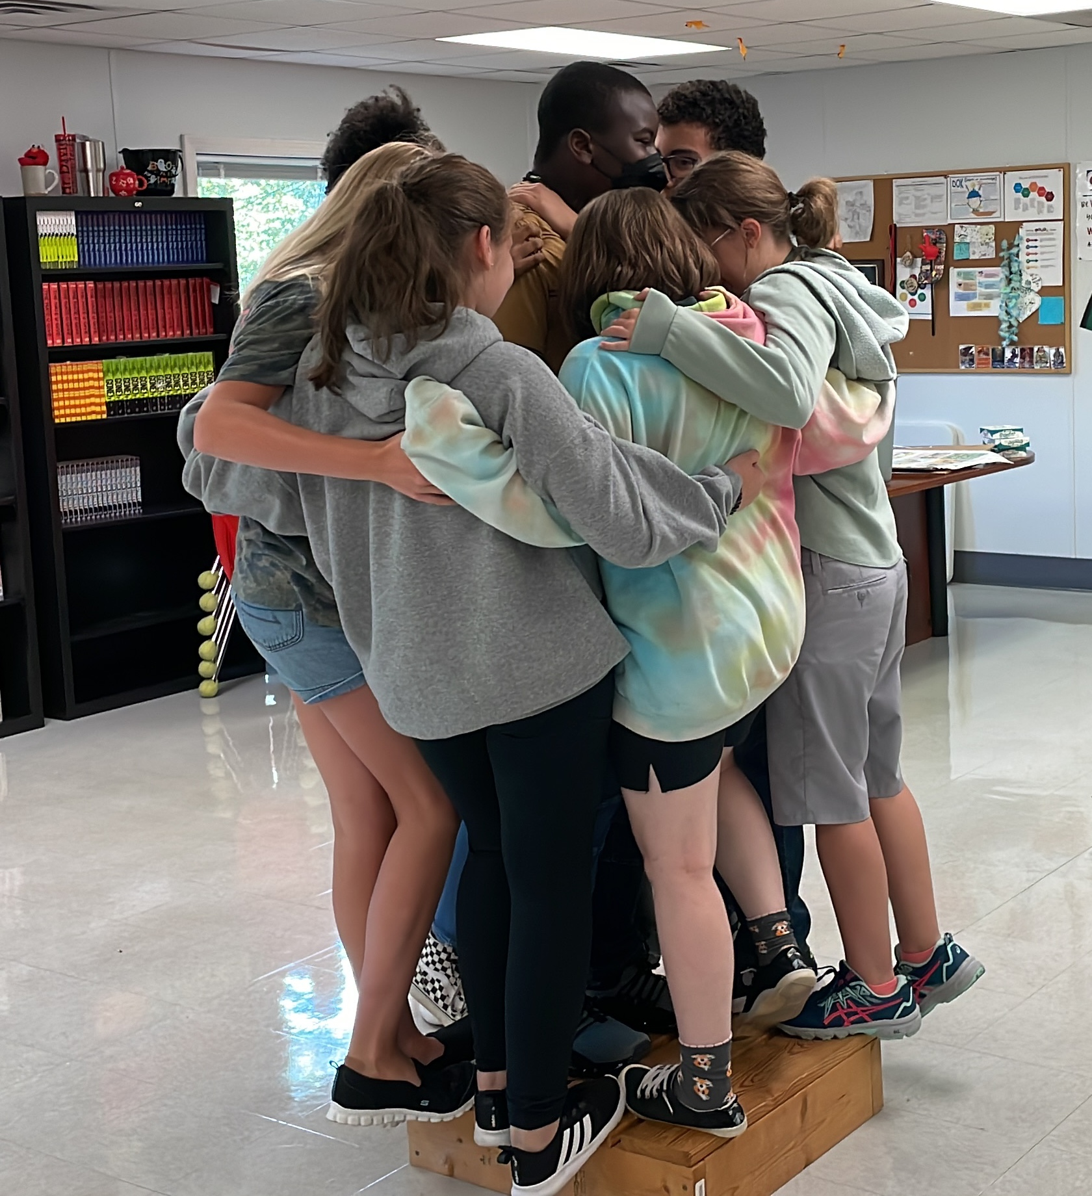
The Transition
3 Opportunities to Build Belonging Before They Start

Slide 17

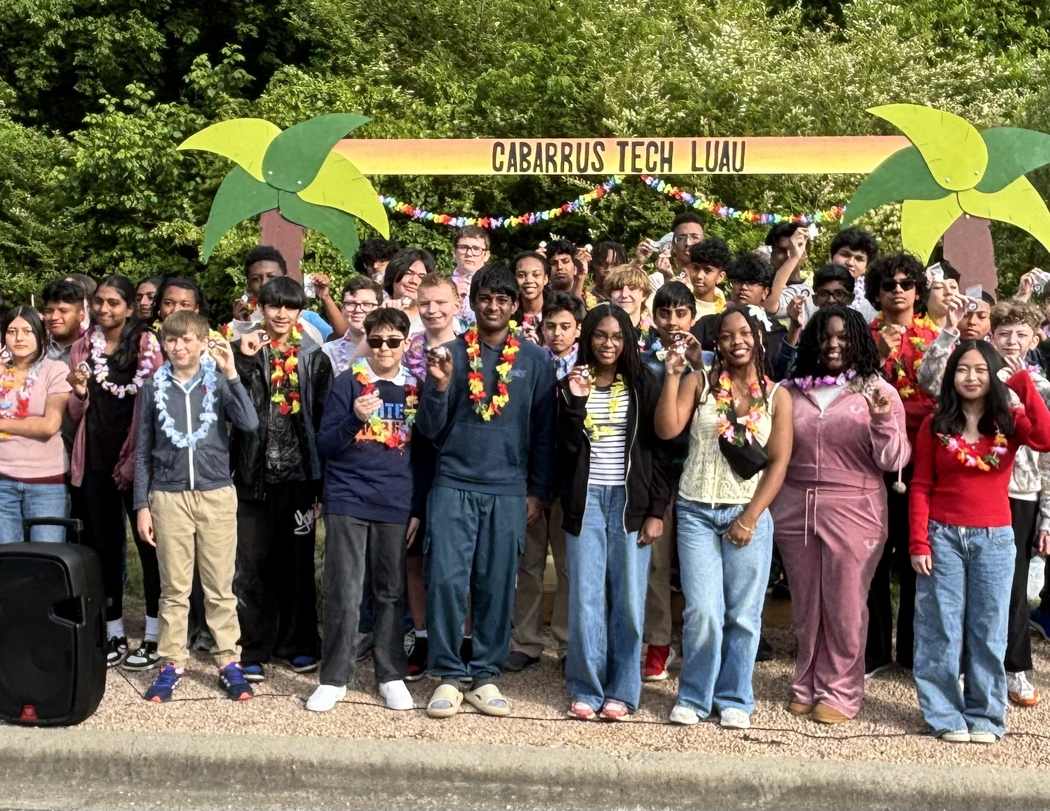


Building Belonging
Course Registration
Luau
Camp Discovery
Middle School Visits to Meet Selected Students
Our Induction Ceremony
Freshmen Transition Program

Slide 18
Luau
An evening of Food, Fun, and Fellowship
Our Induction Ceremony where we connect our newest Cobras to the Past, Present, & Future

Slide 19
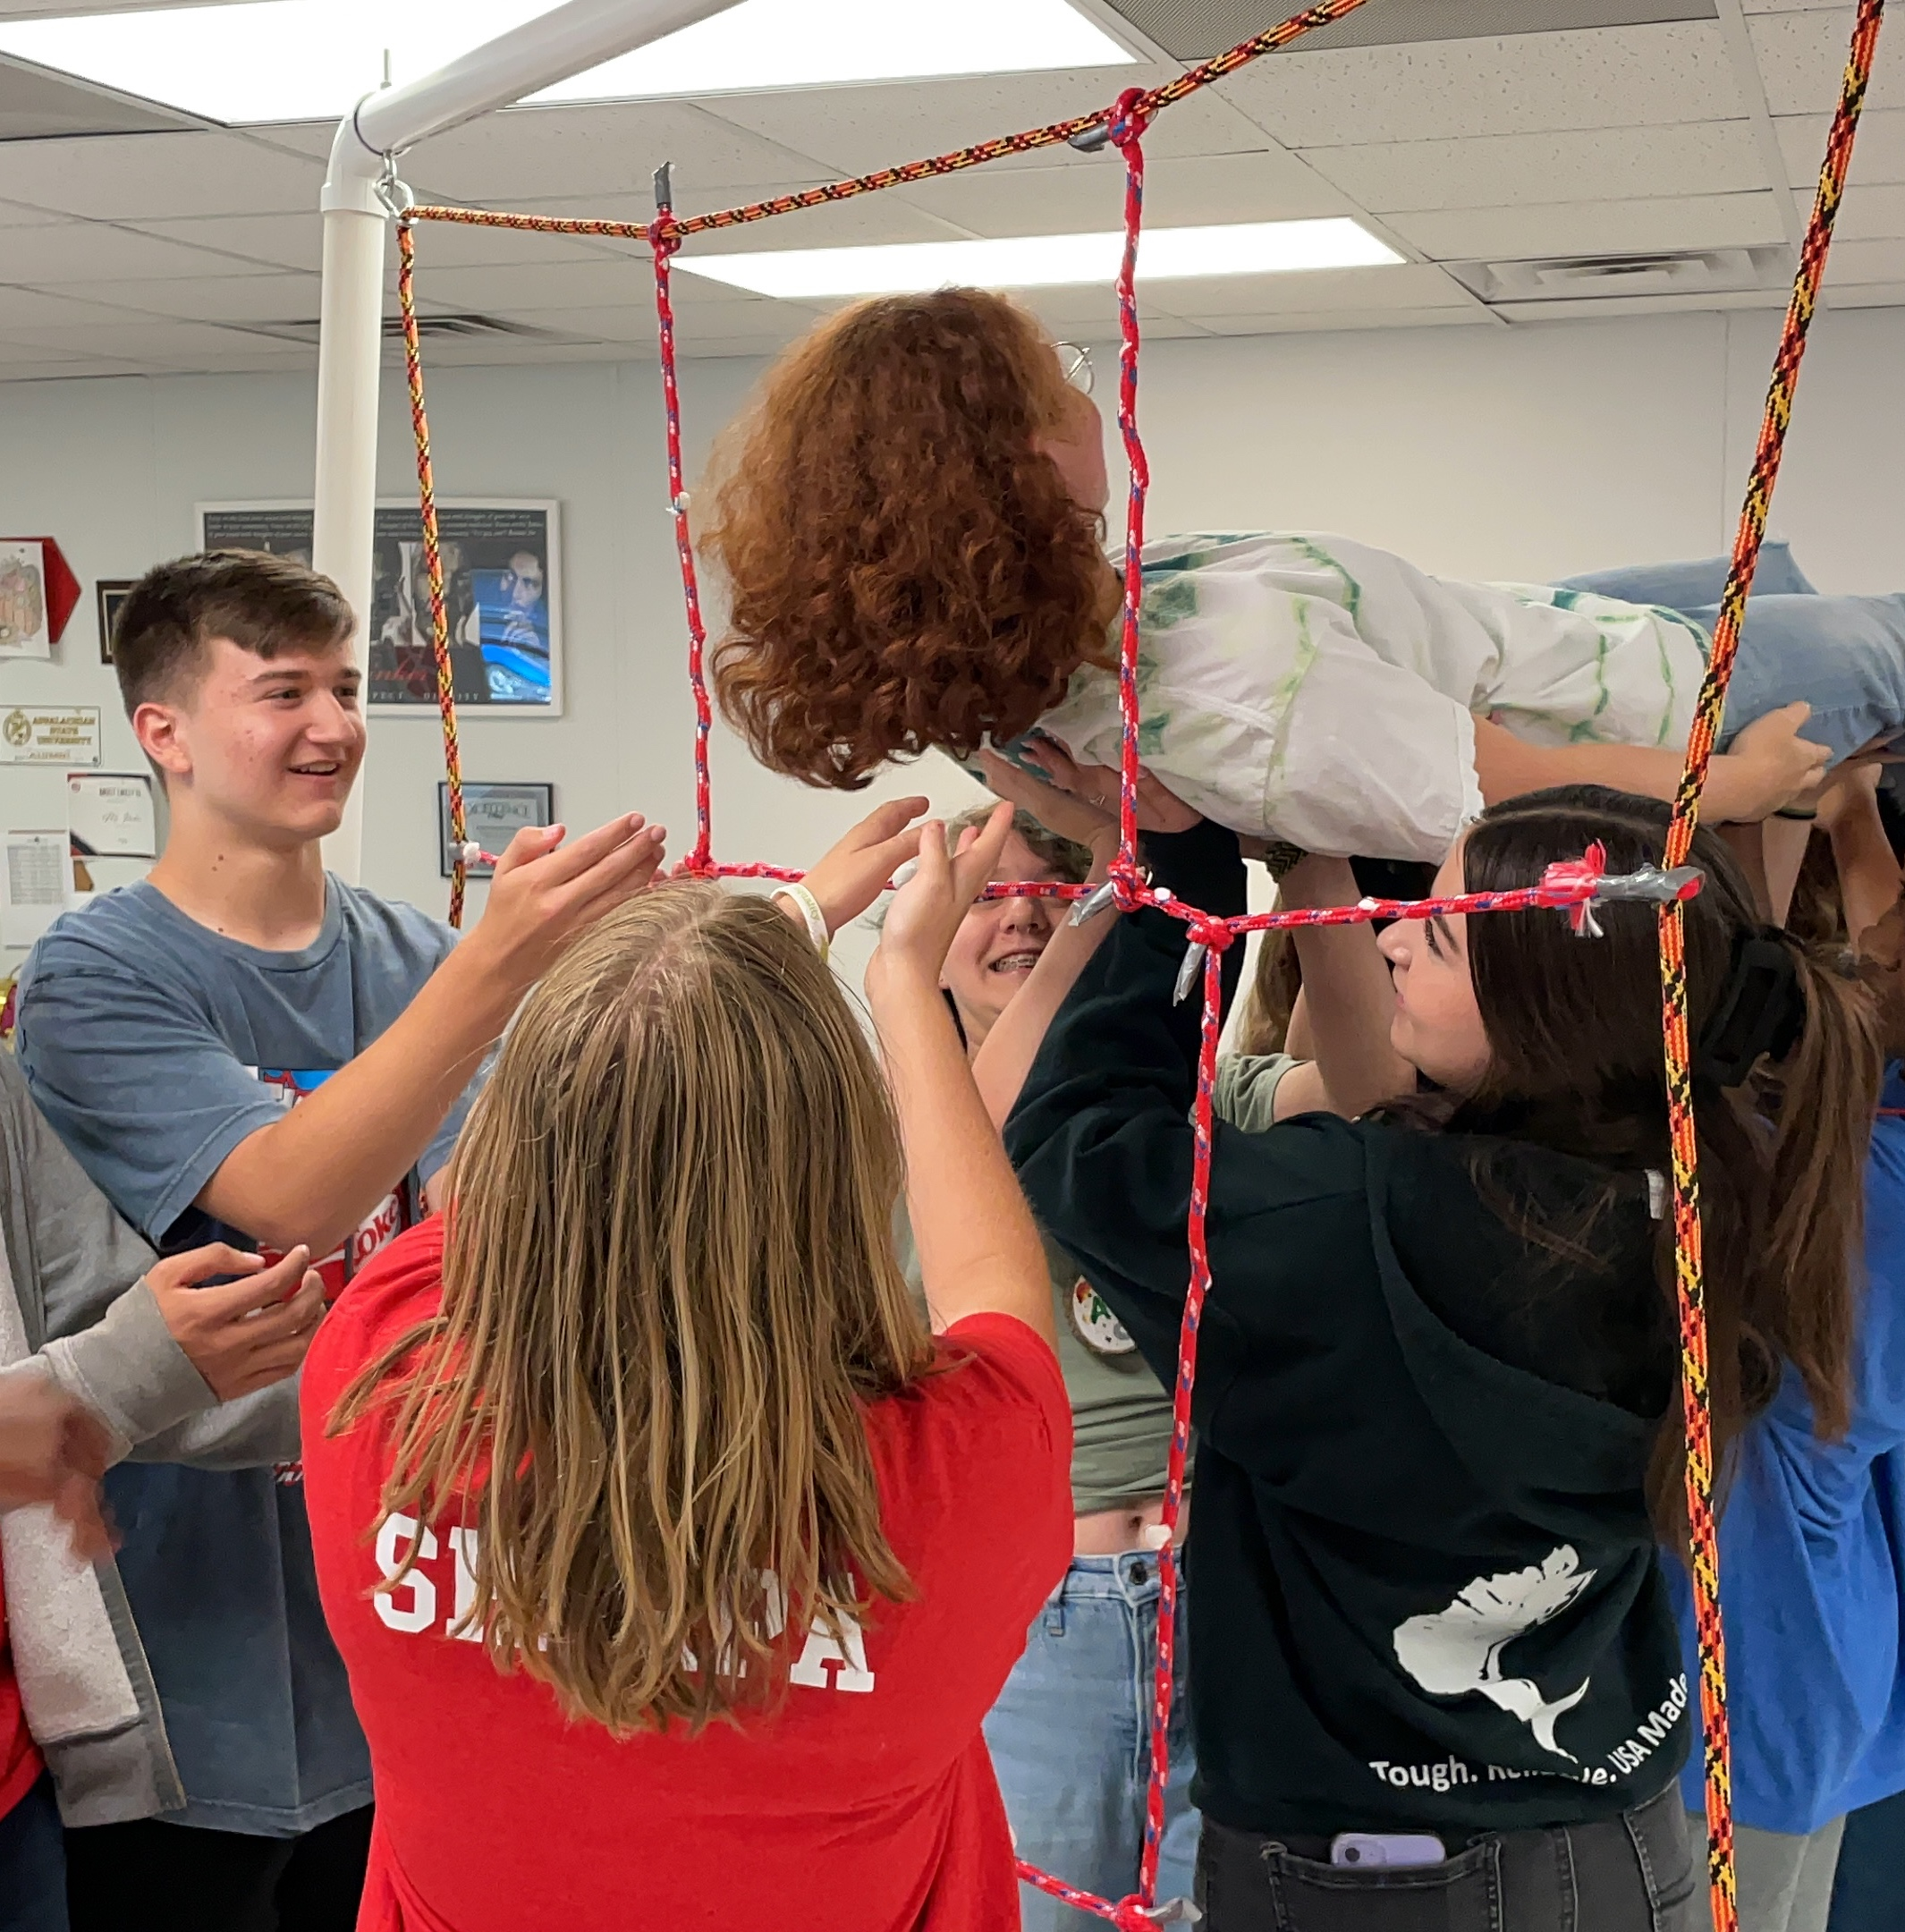


Camp Discovery
4 Full Days
Small and whole group activities designed to build trust, teamwork, and problem-solving.
Led by Upperclassmen (Sherpas)
Provides anchor experiences for how we learn and how they will take on challenges.
Energize the Soul
Jumpstart the Brain
Starts by building trust and must rely on each other to solve the challenges. All activities are debriefed using protocols.

Slide 20
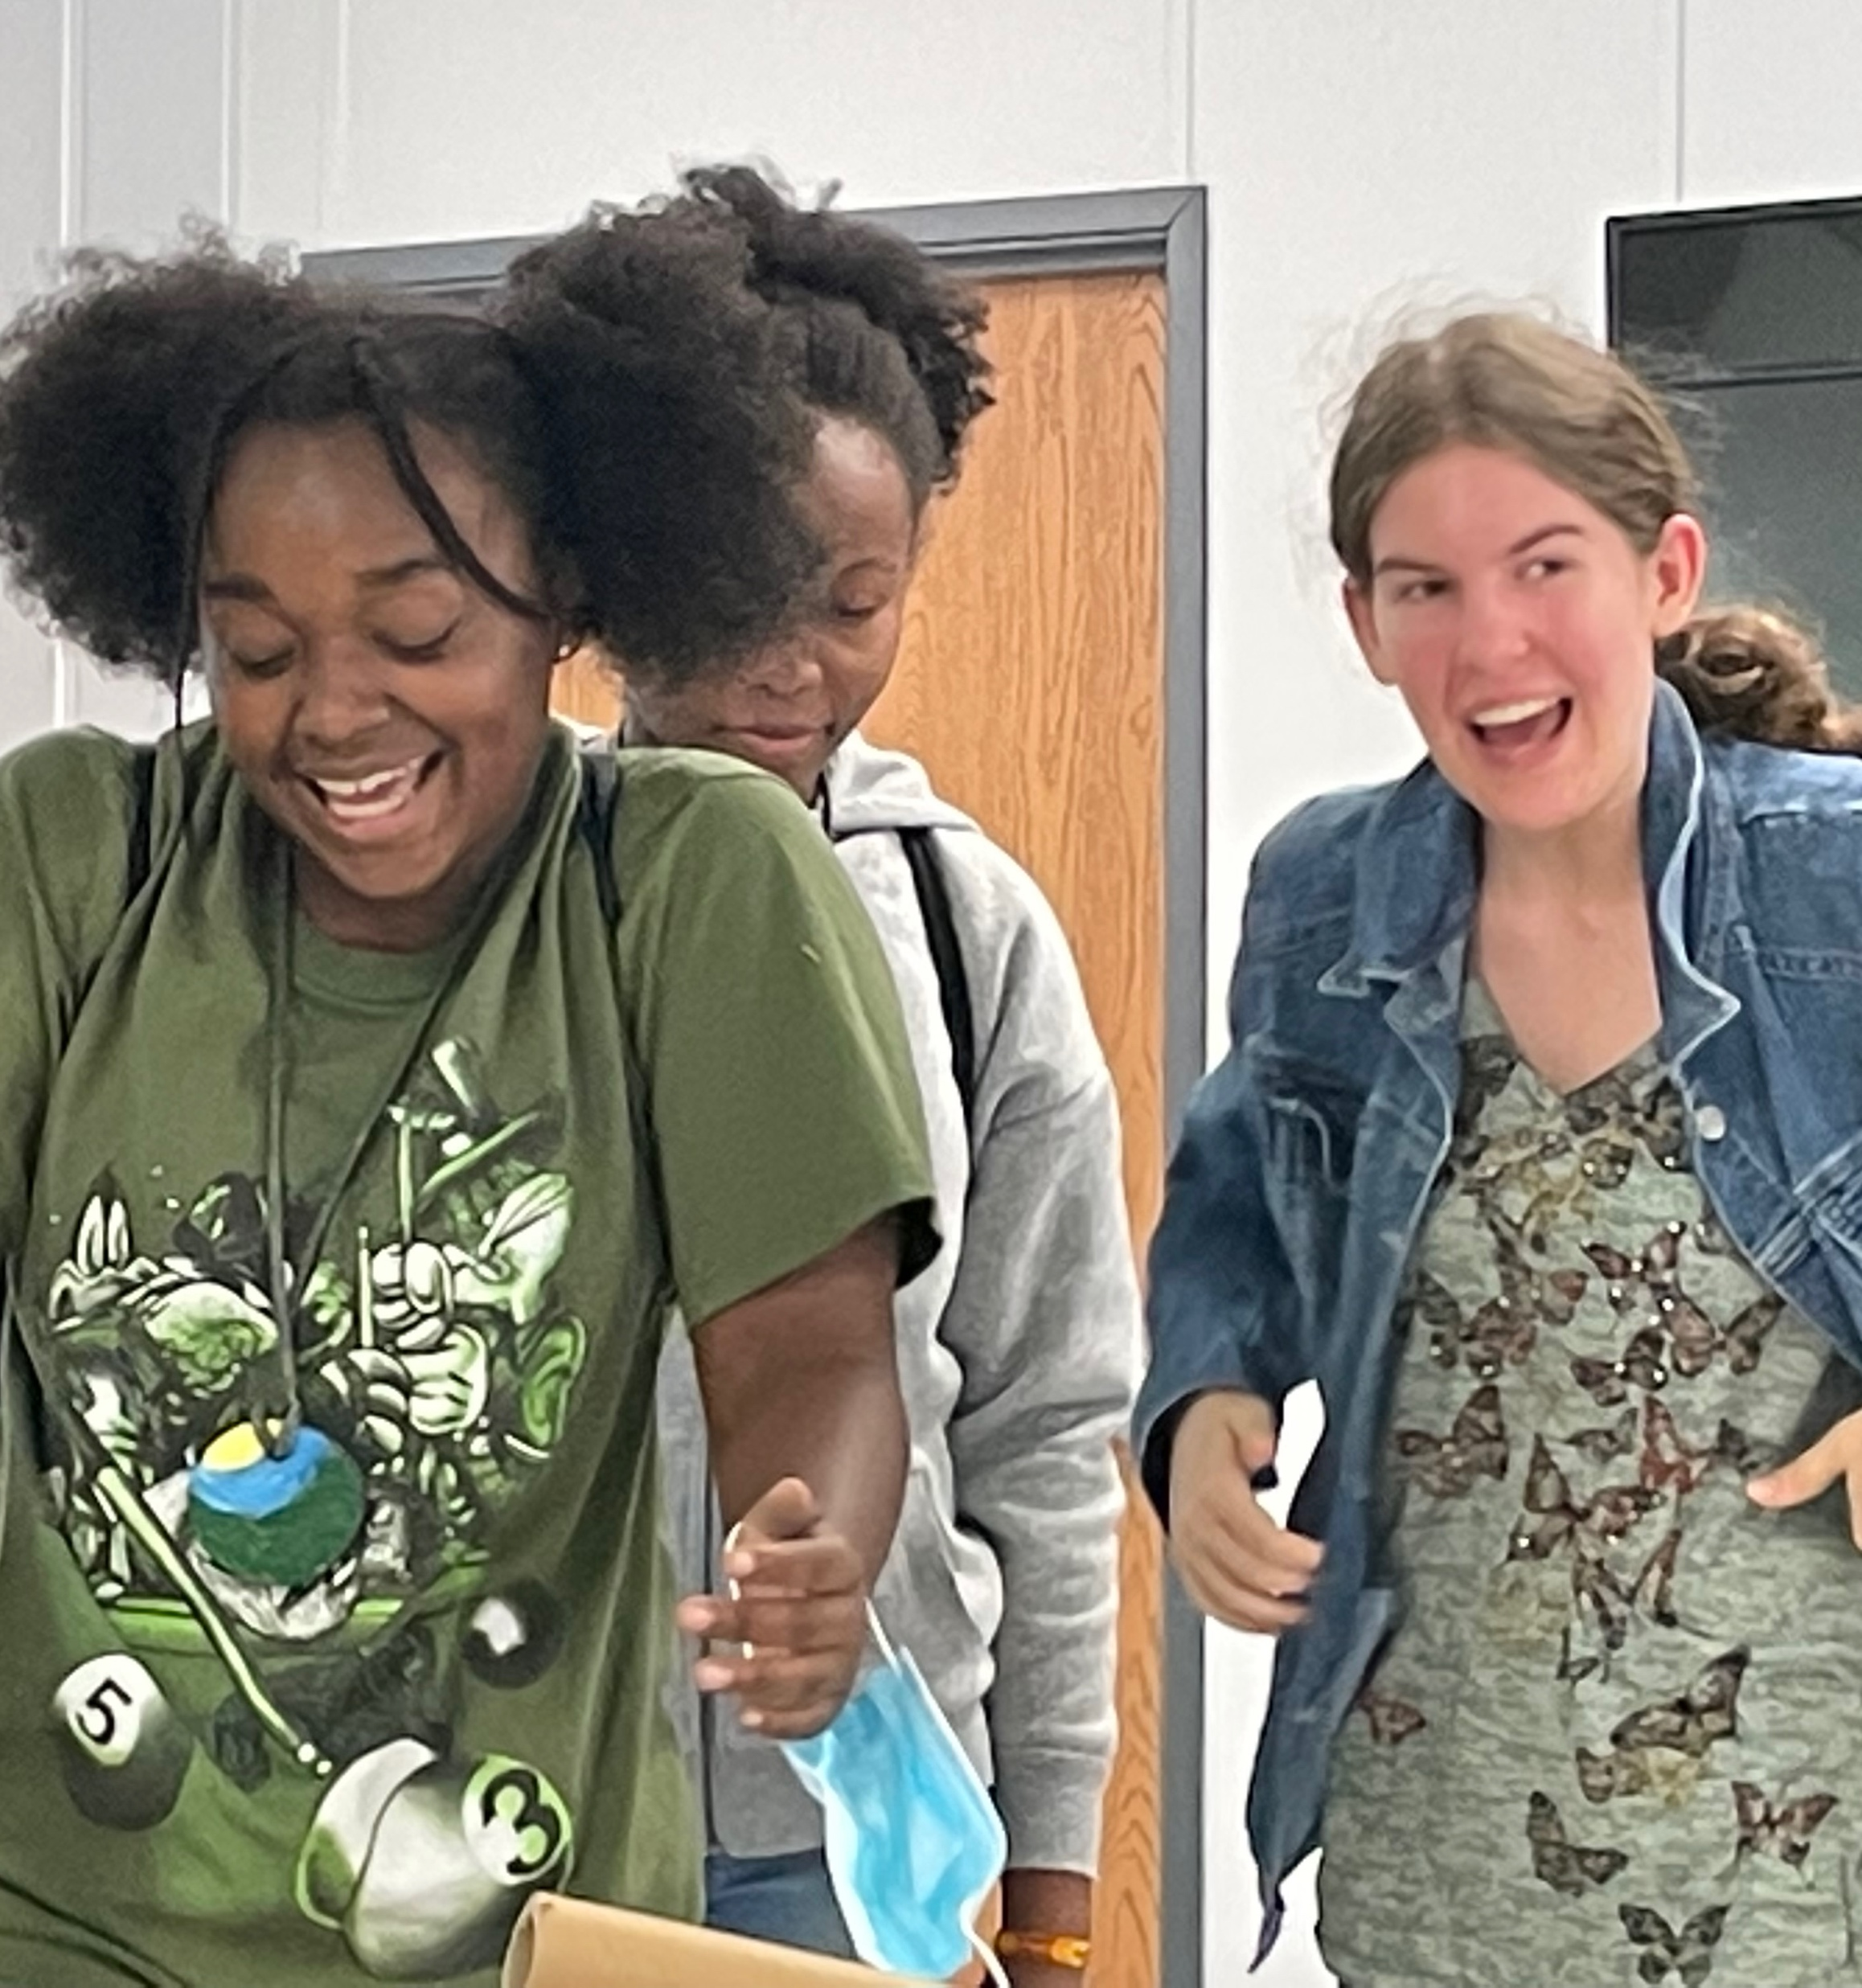
Traditions, Symbols & Celebrations
Rites of Passage, Images/Words, & What We Choose to Celebrate

Slide 21



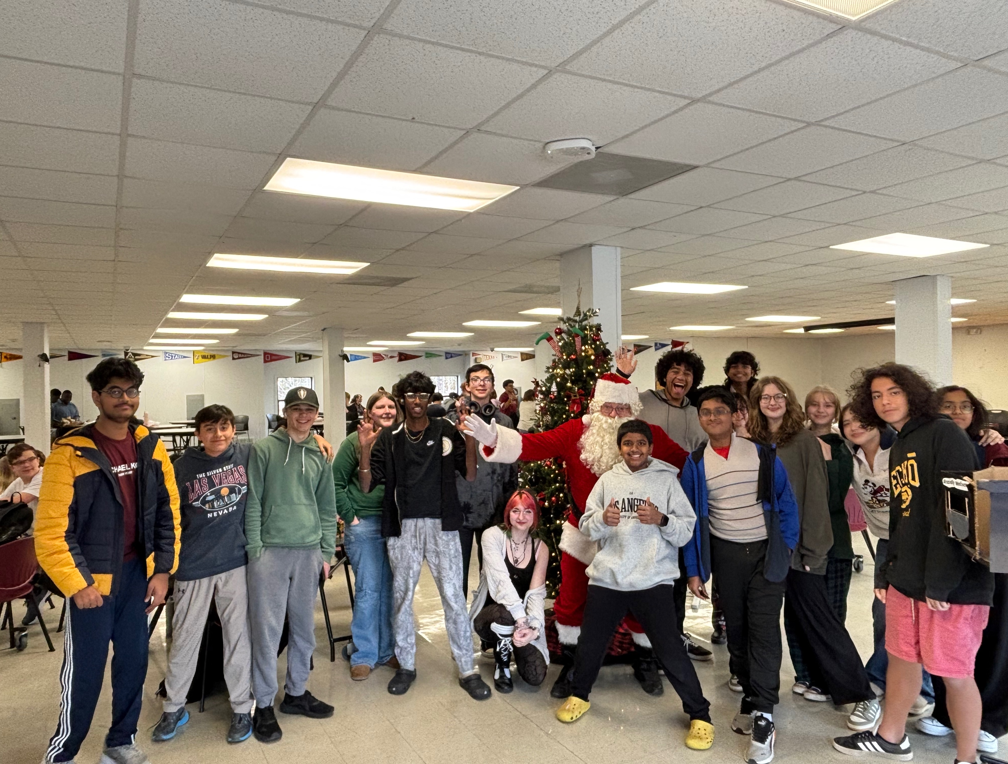


Traditions, Symbols & Celebrations
Your Why
Mission
Vision
Values
Themes

Slide 22
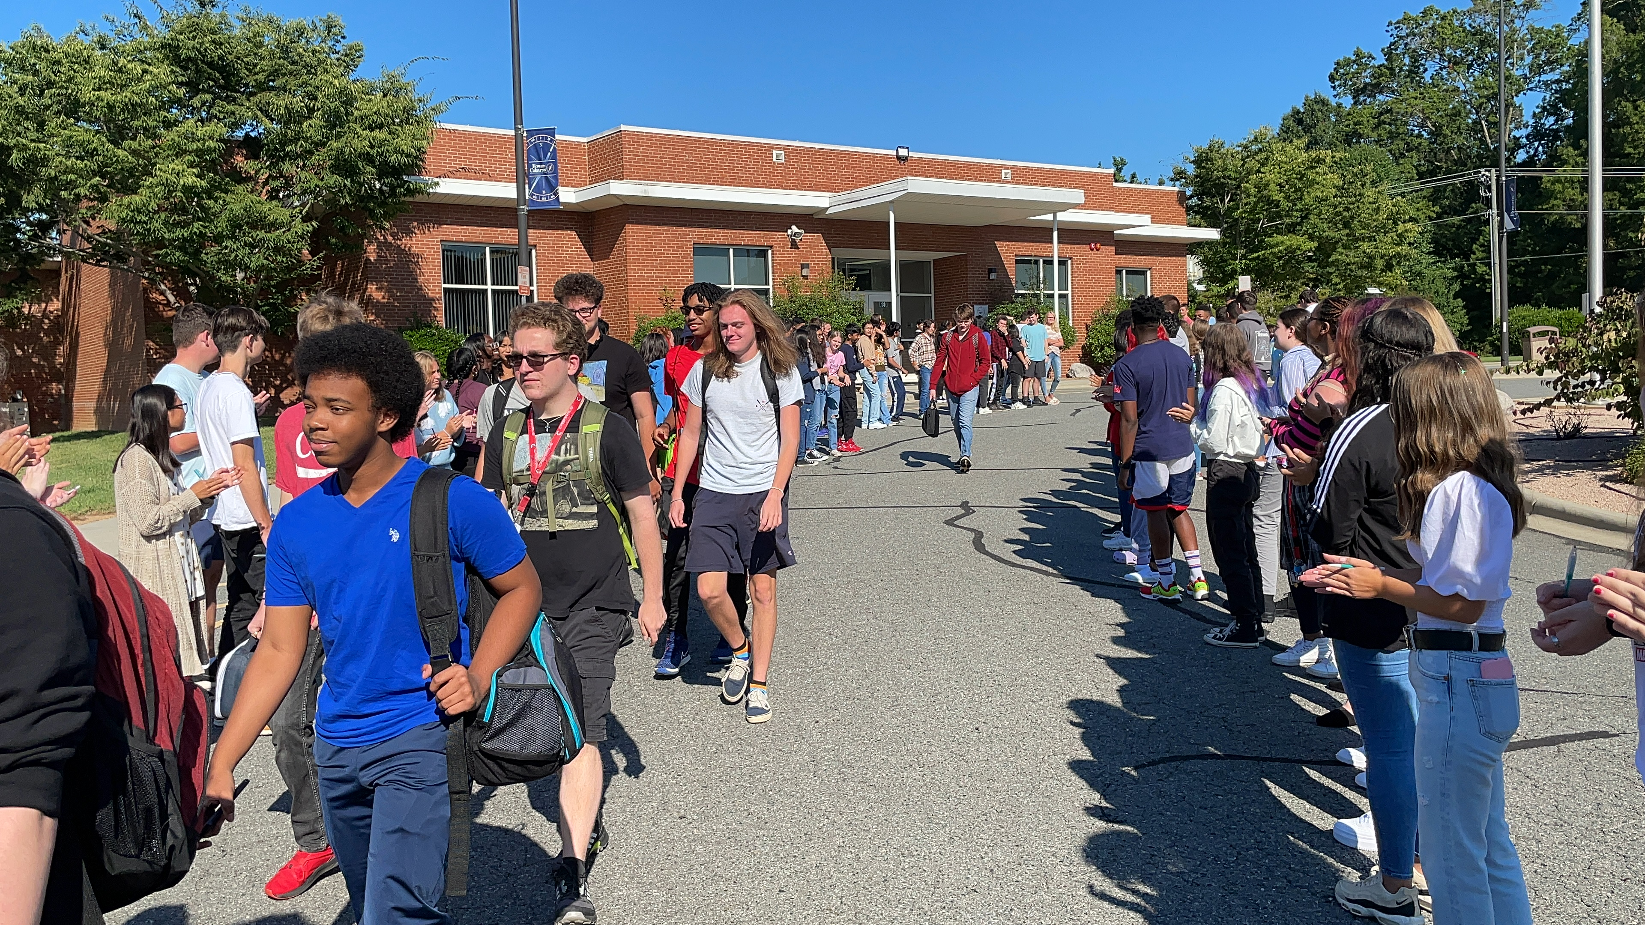
Student Walk In

Slide 23
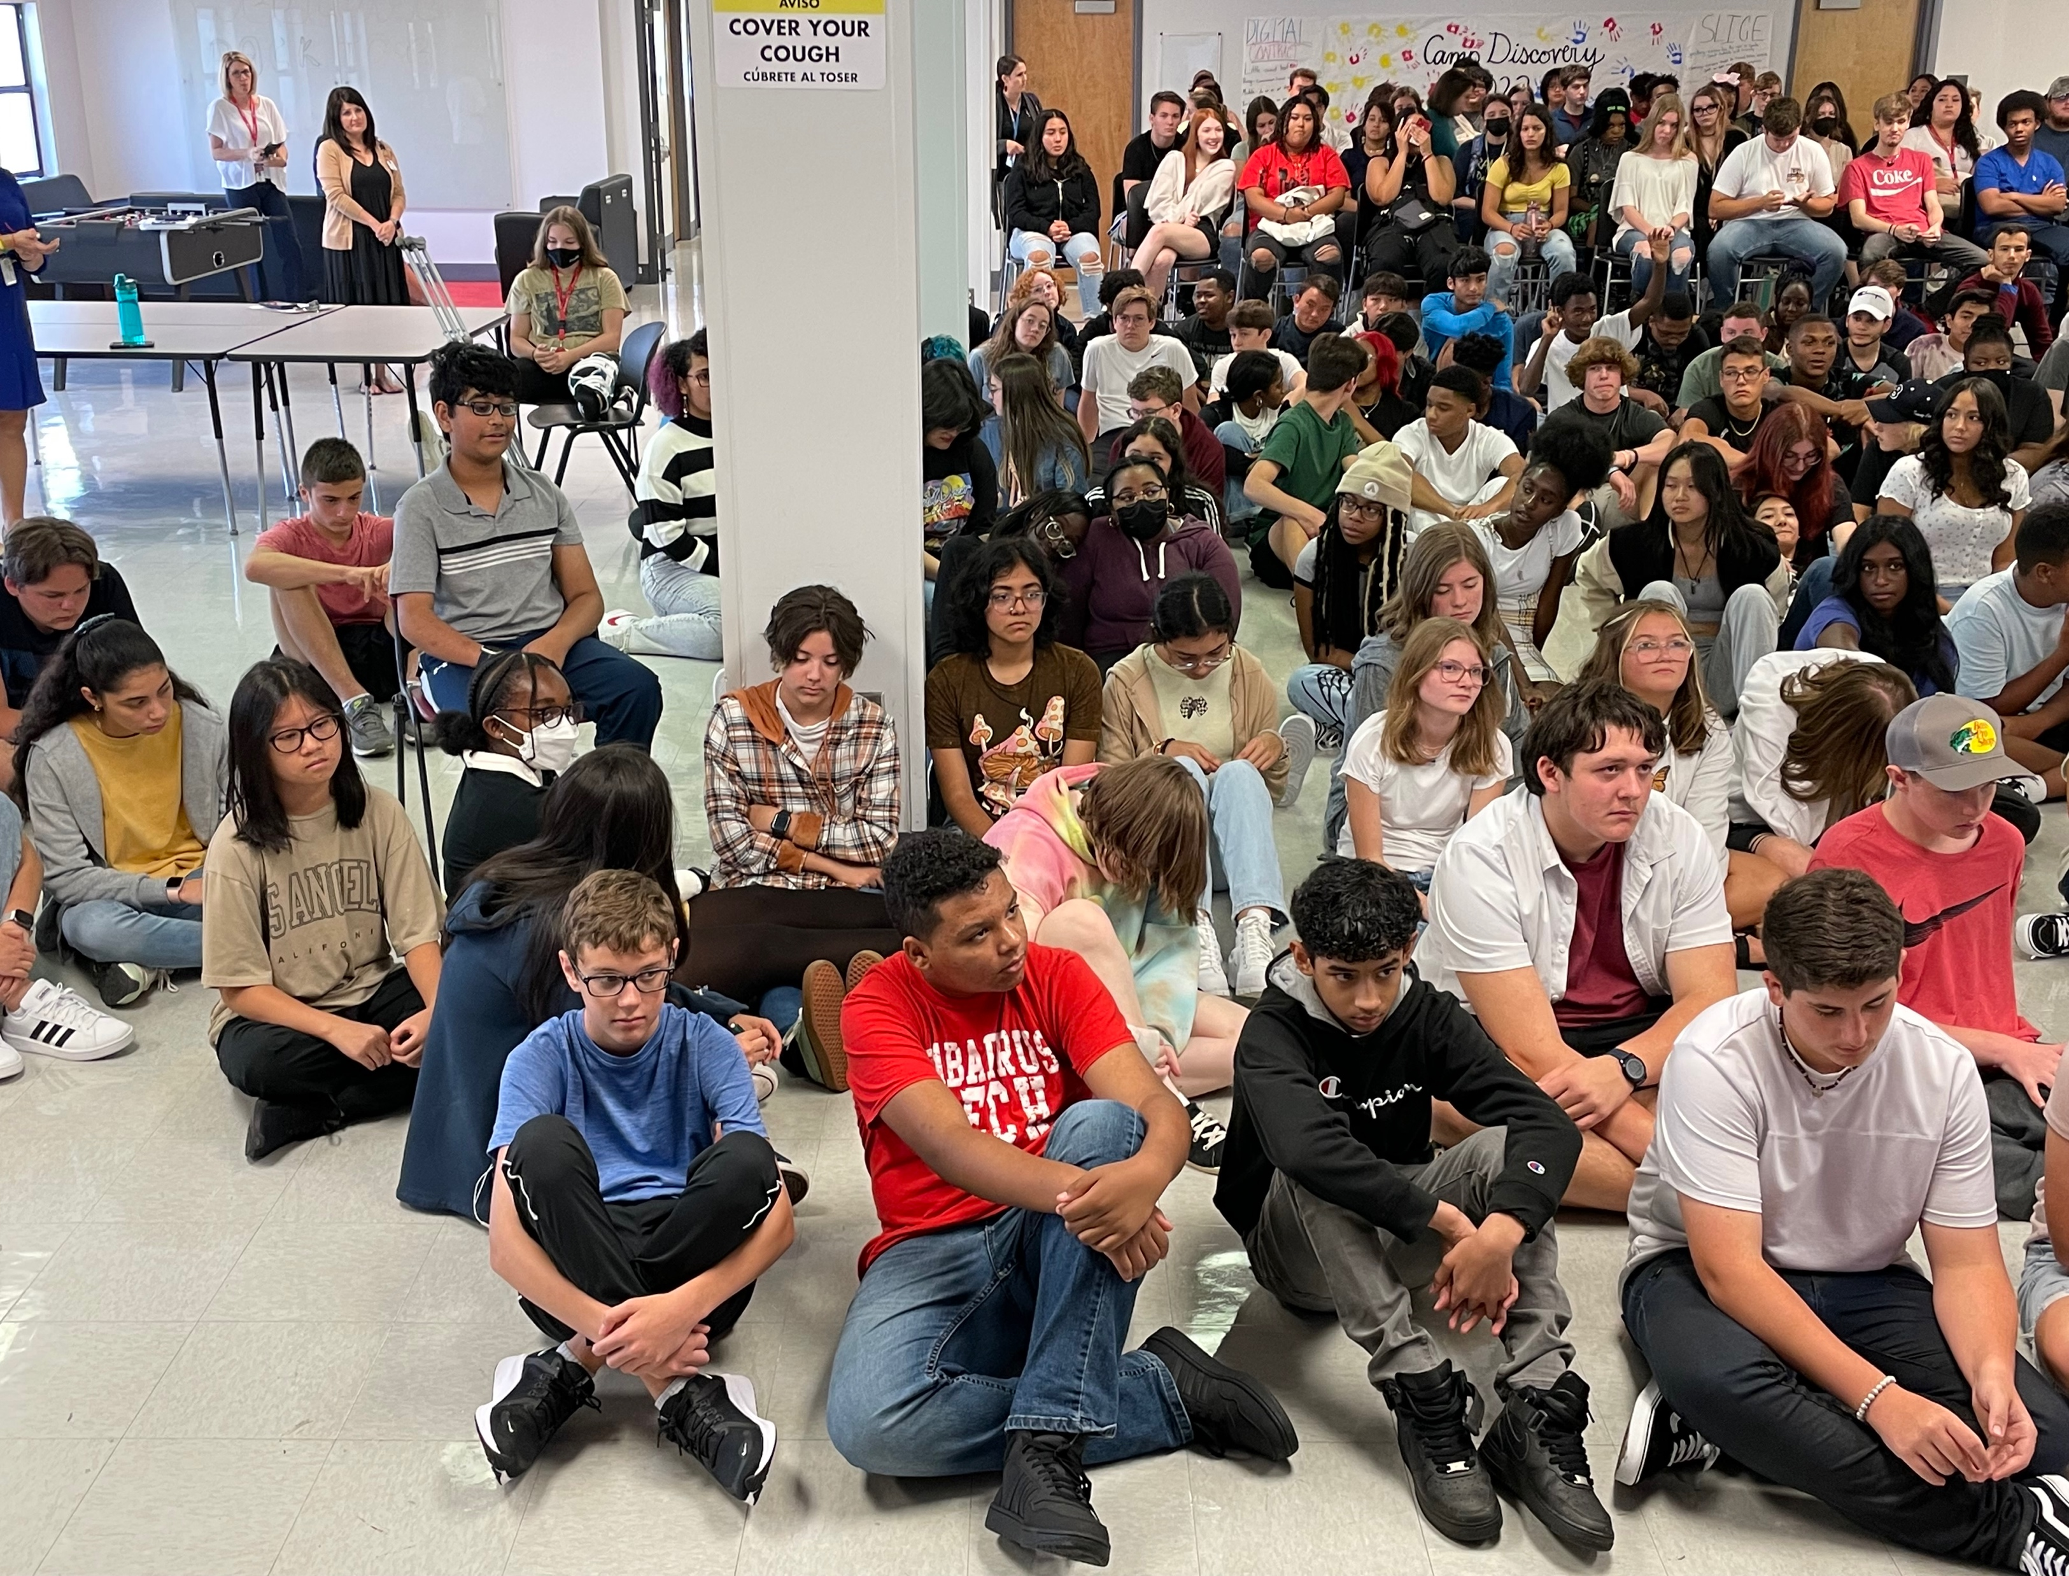
Full House
Classwork Spotlight
Cobras Who Care
Student Shout Outs
Teachers highlight student work from an assignment or project
Students nominate other students for doing something related to that month's character traits.
3 mins for random screened shoutouts
Student Birthdays

Slide 24

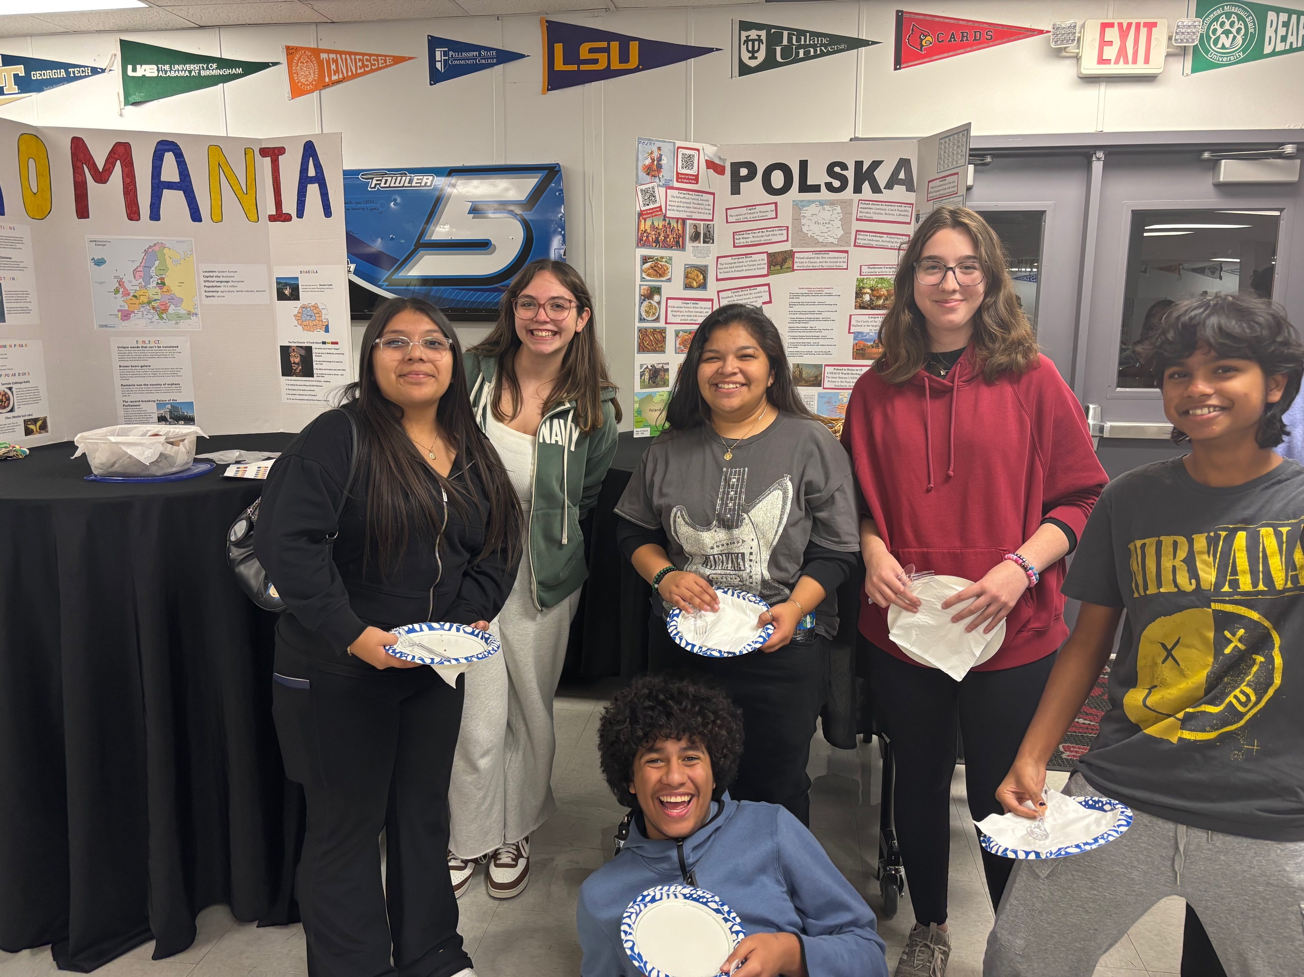
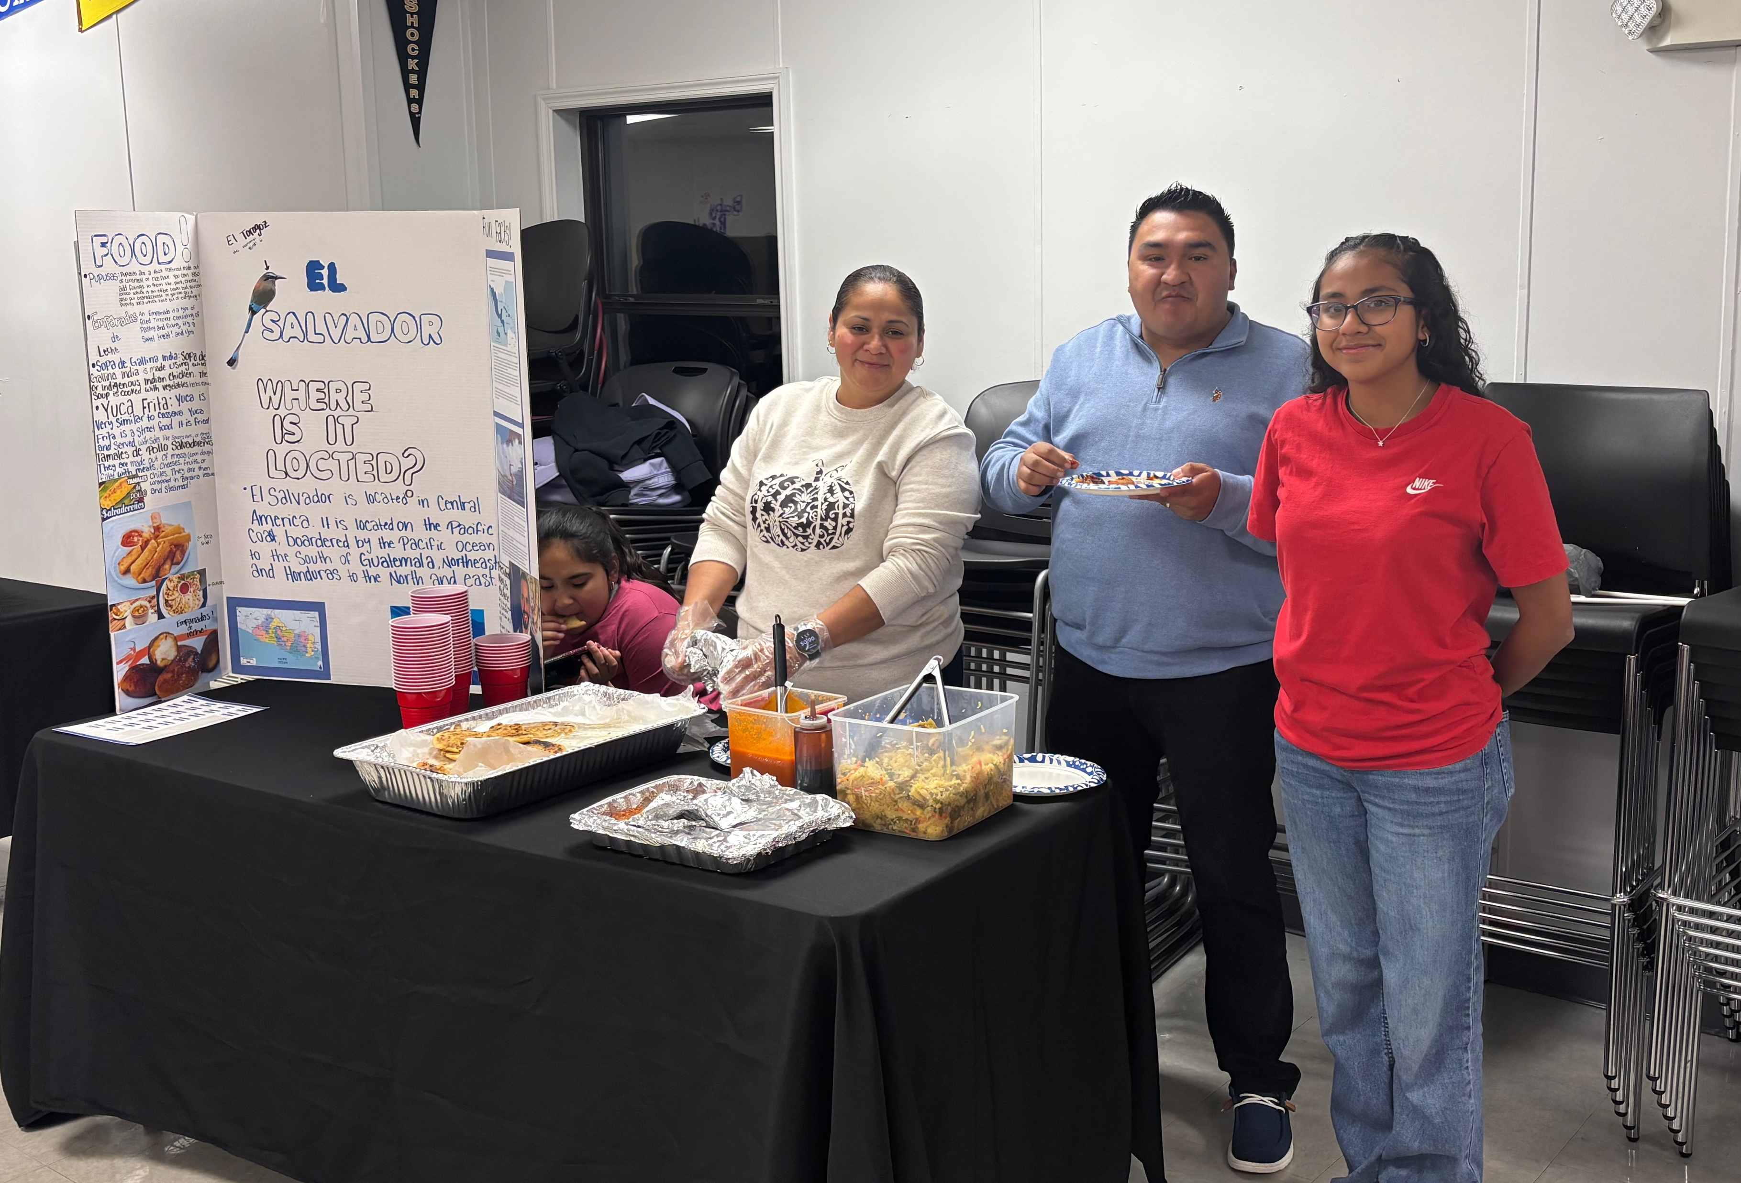
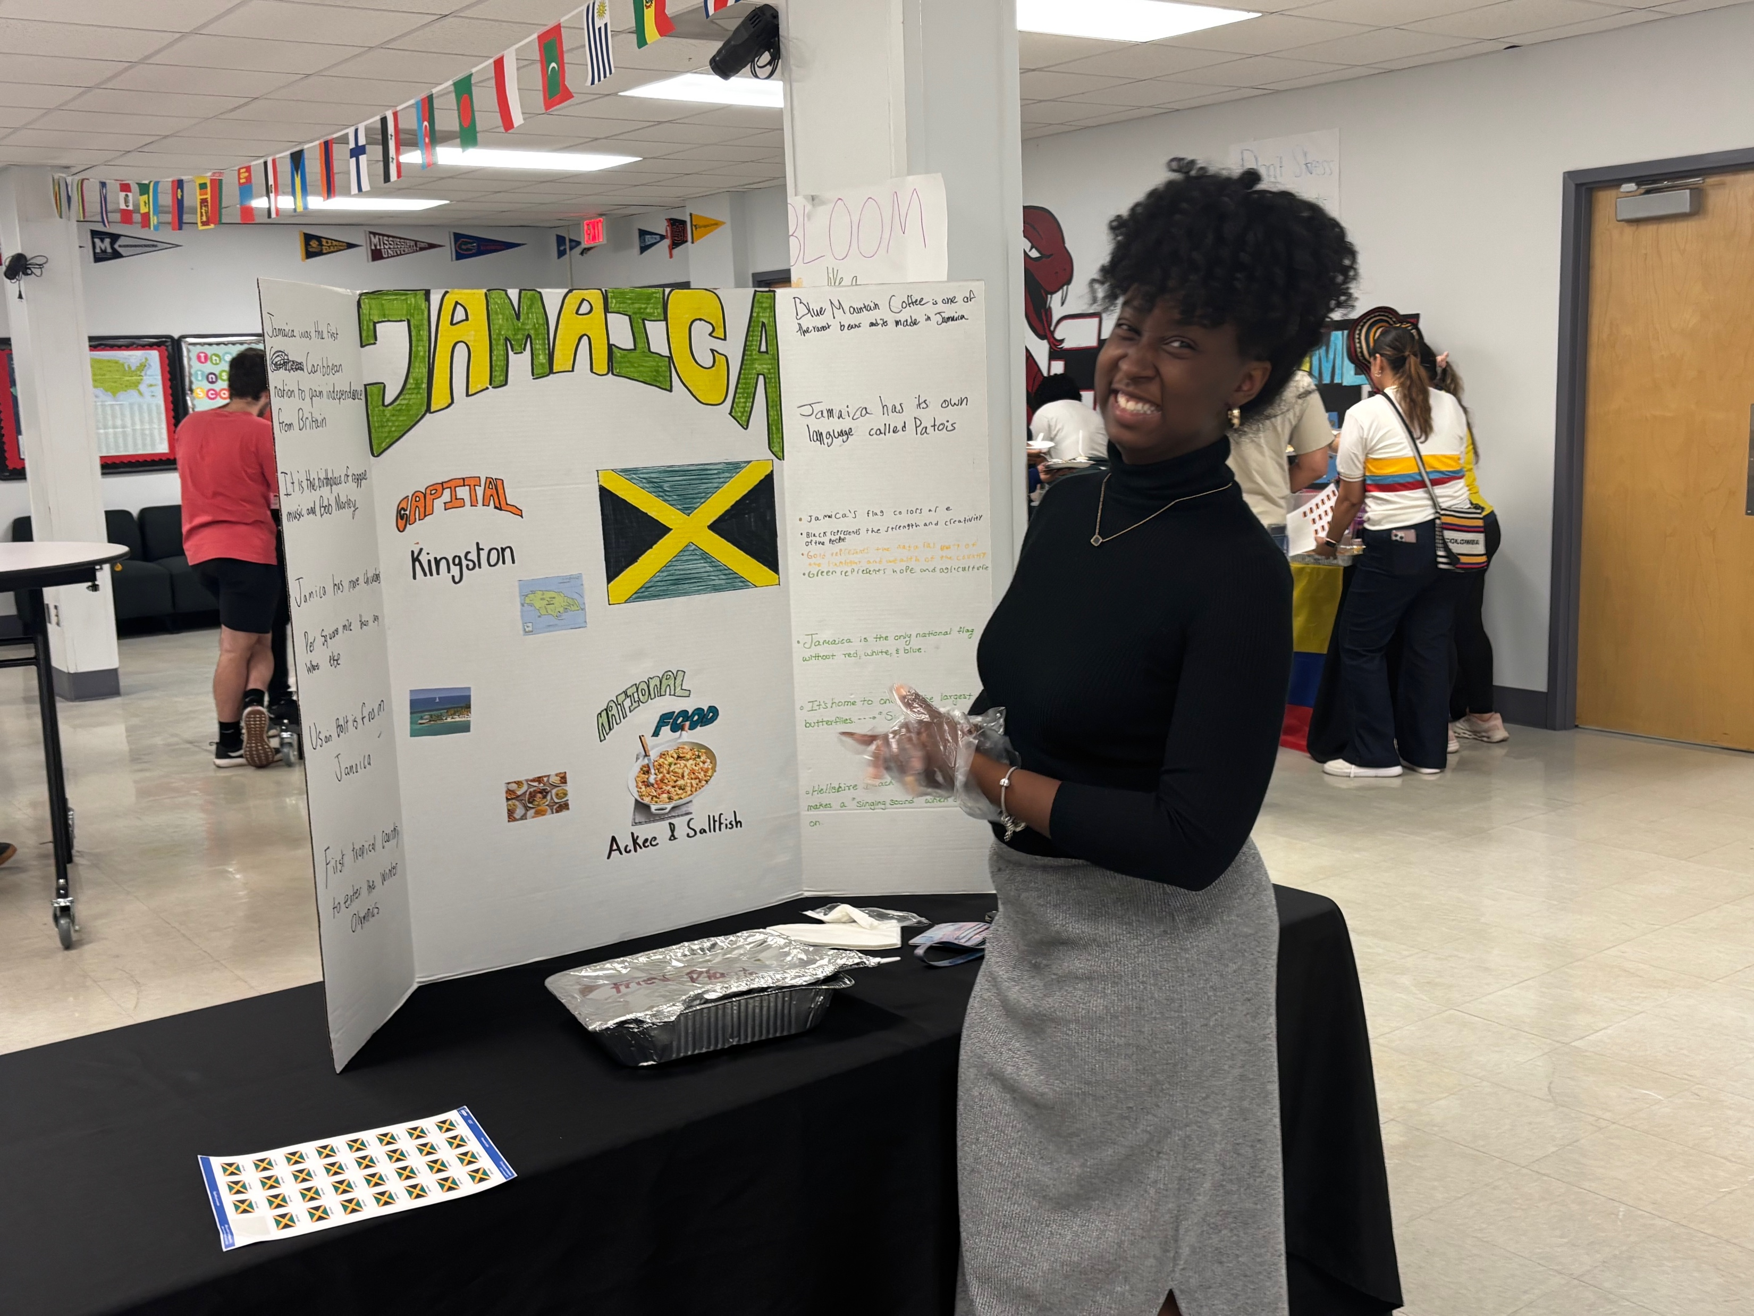
Feast of Nations

Slide 25
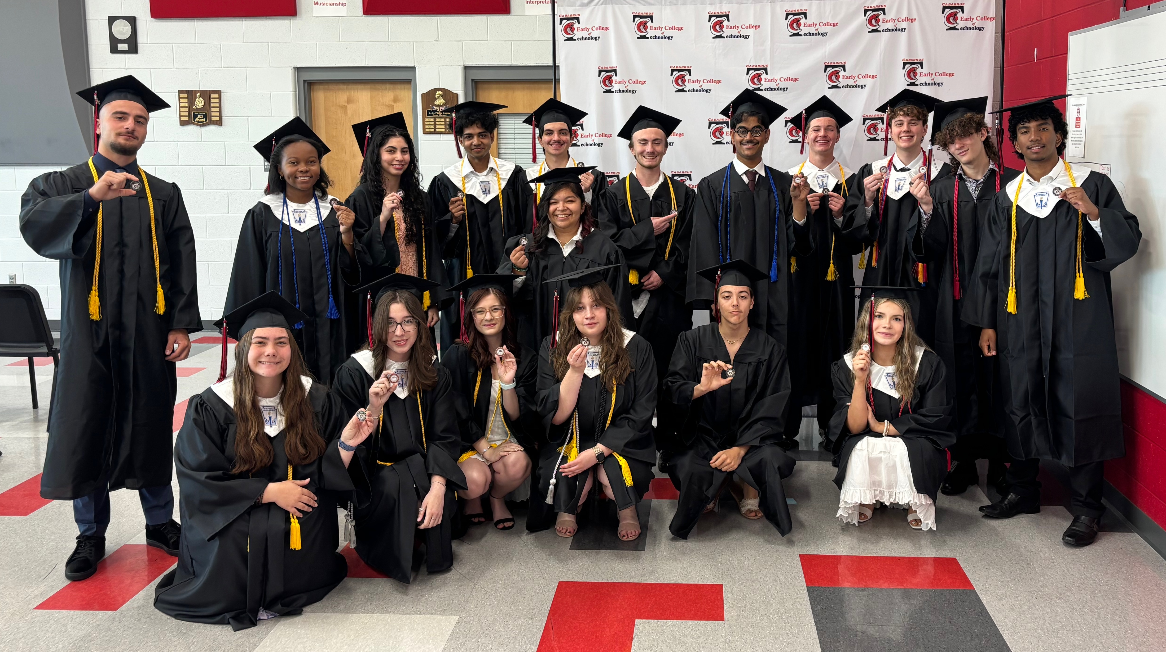
Graduation

Slide 26
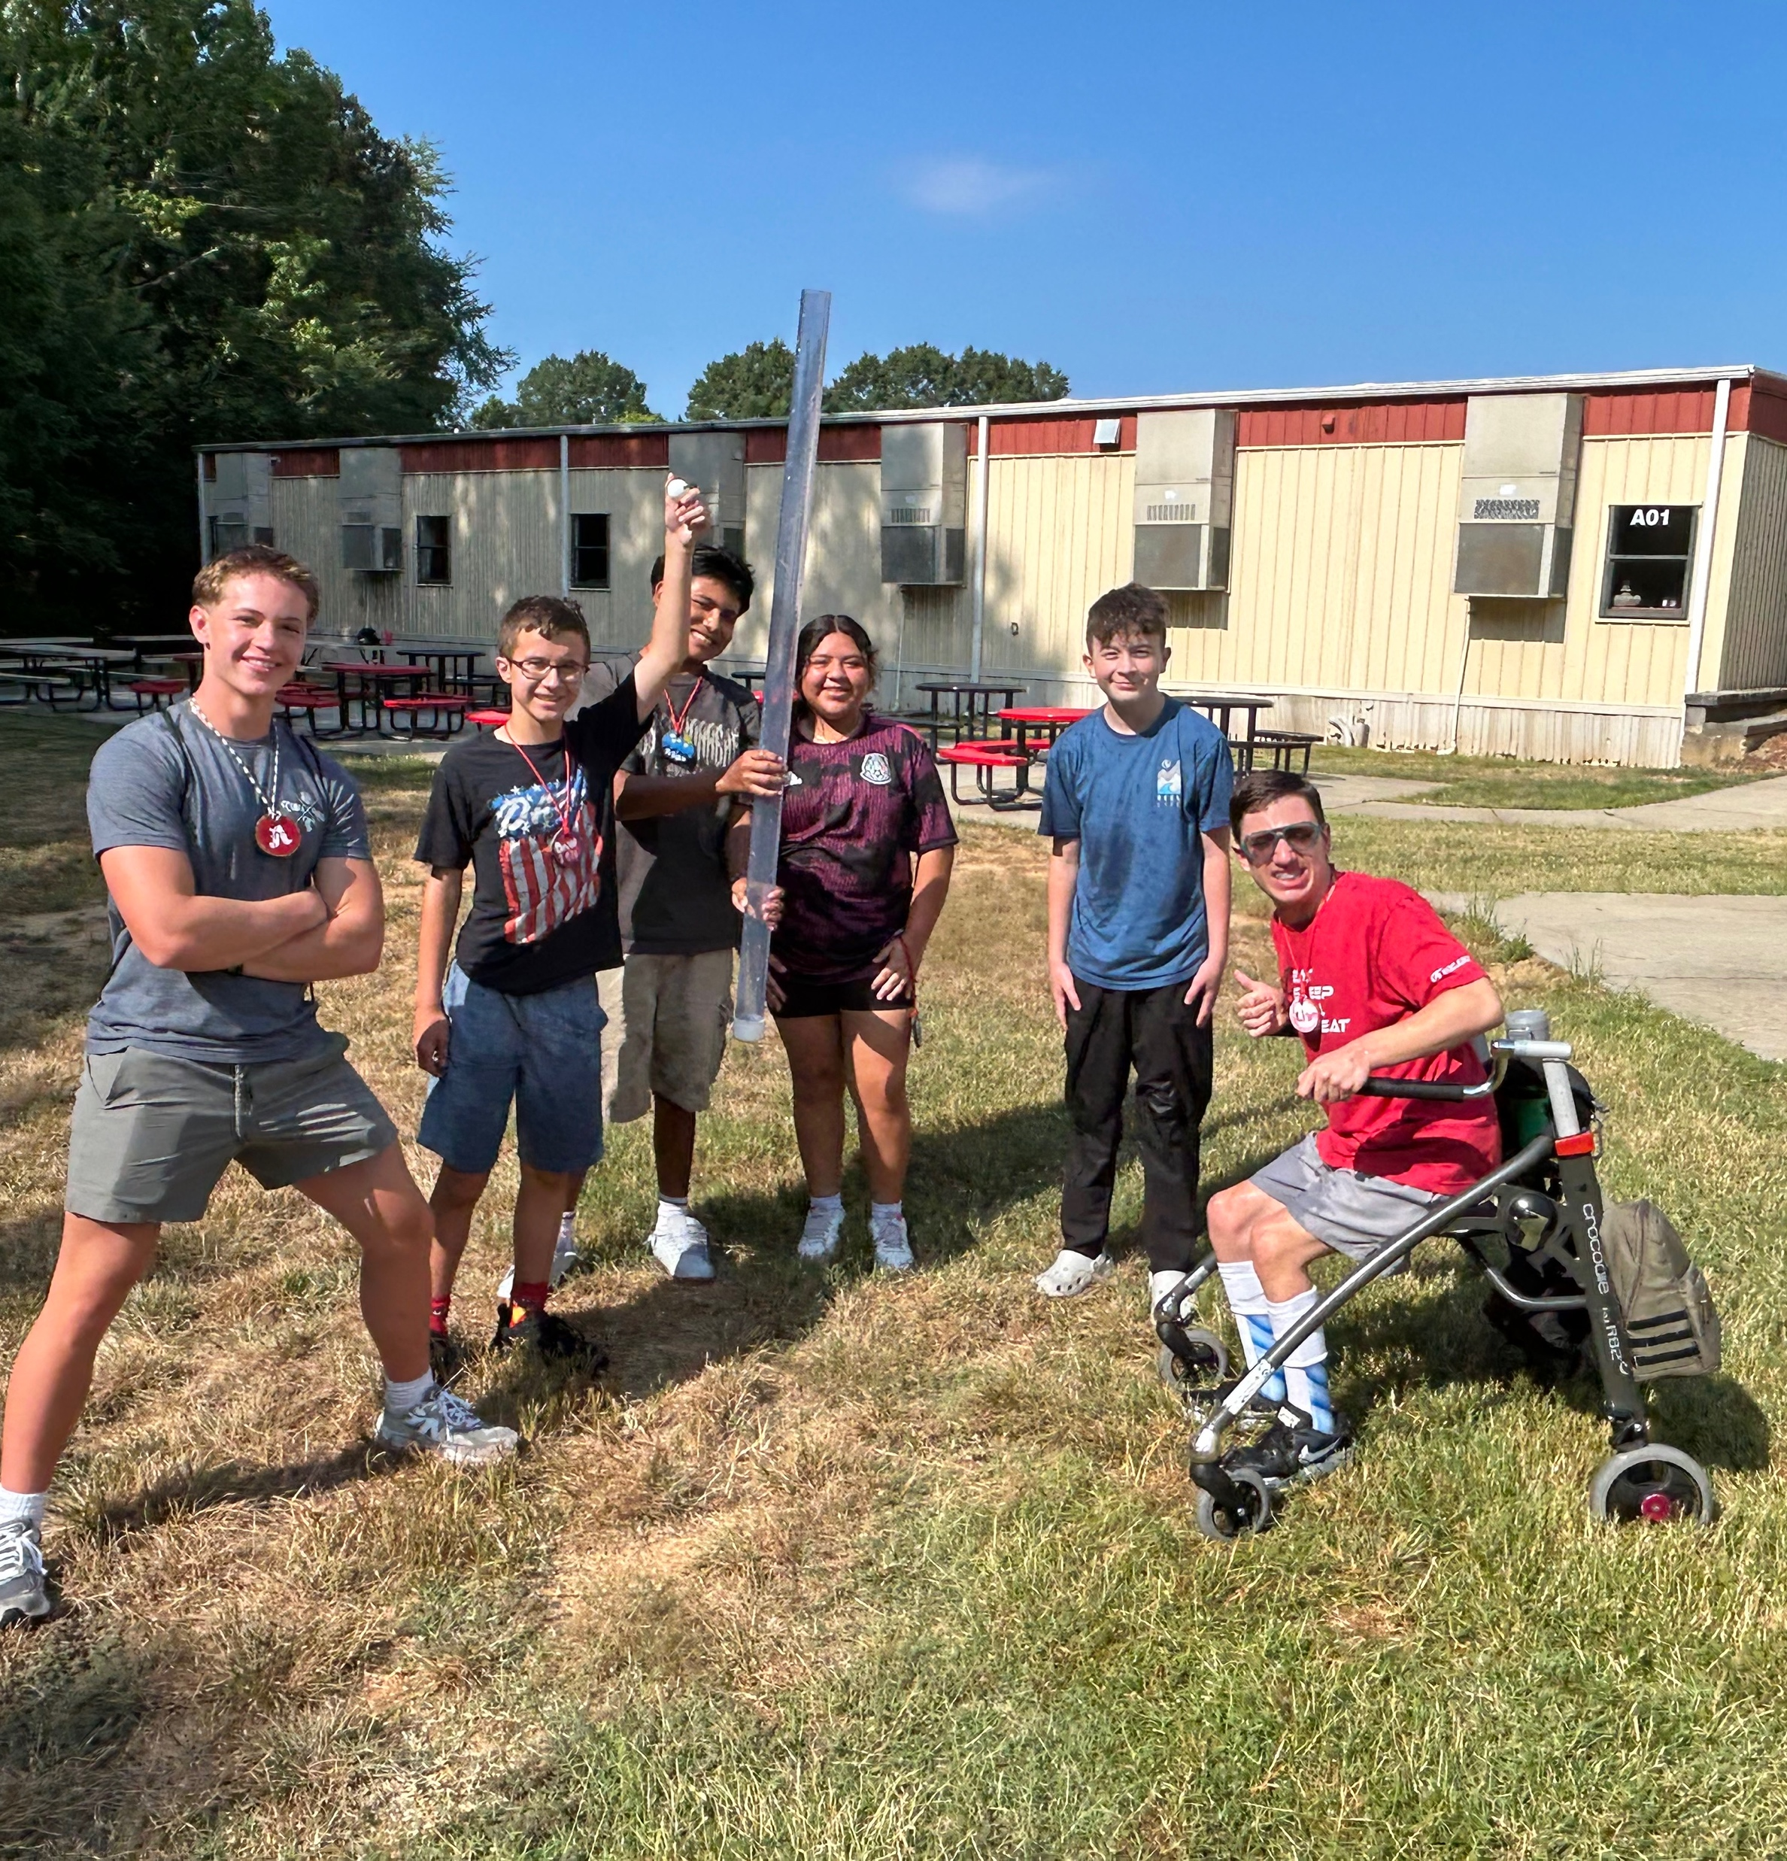
Structures, Policies, and Procedures

Slide 27
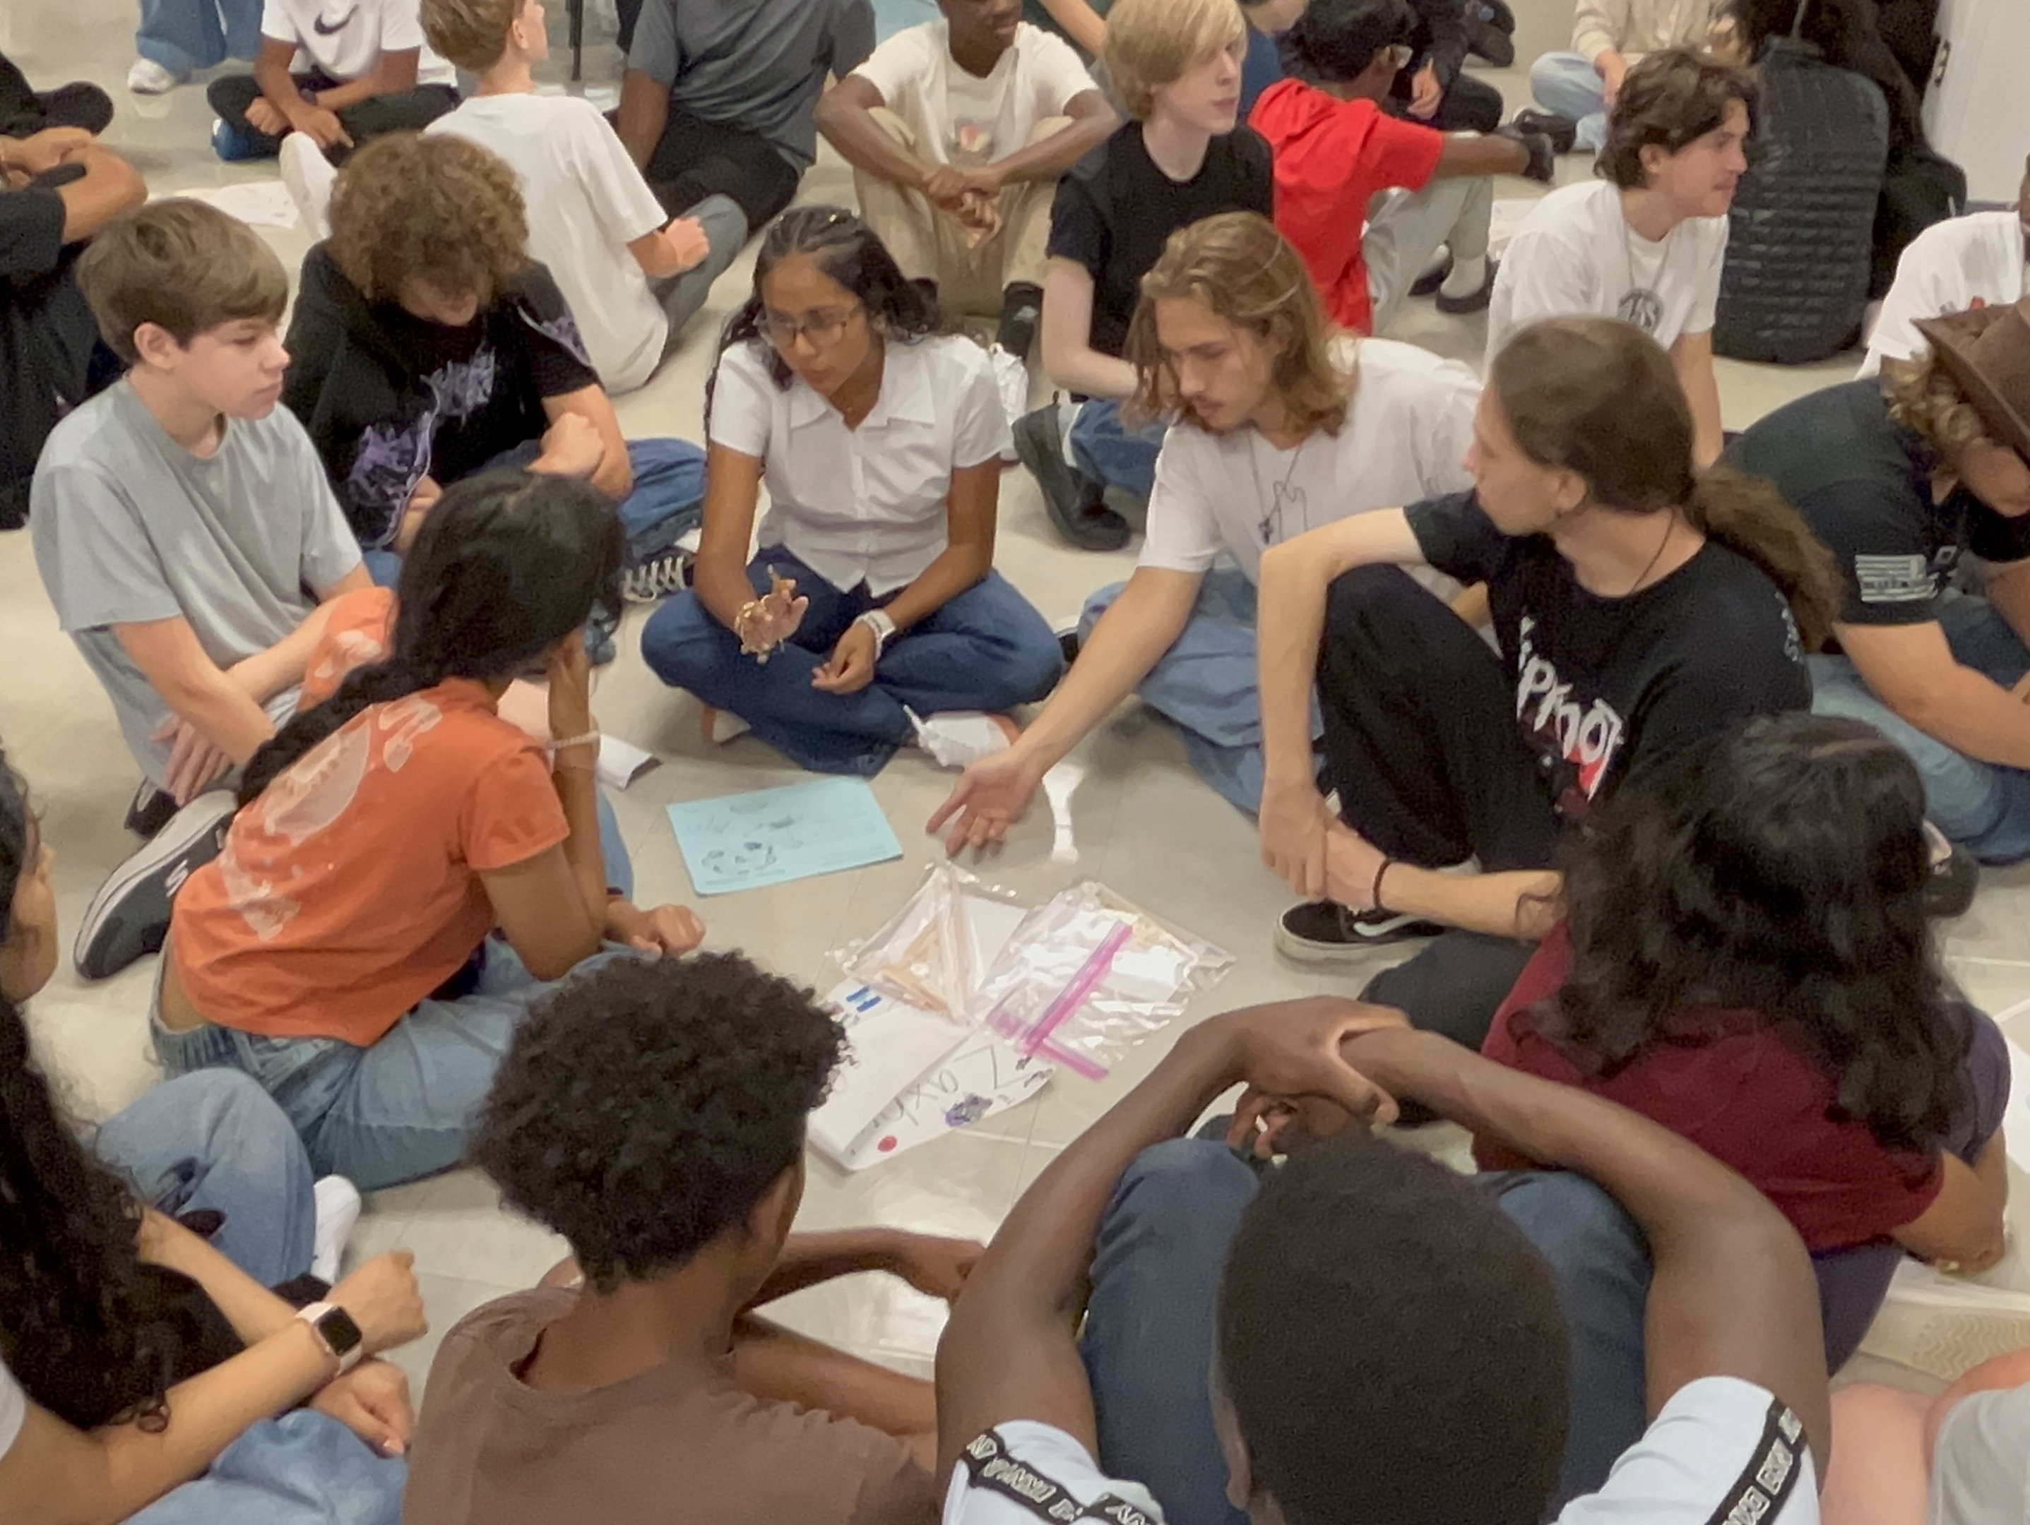
01
02
Cohort Scheduling
Connections Groups
03
04
Peer Mentors
Friday Seminars
Structures, Policies, Procedures
9th & 10th Grade
Learning Communities (LCs)
Small Groups of Multigrade Students that meet weekly for SEL Lessons
1½ Hour Block Each Friday
Whole School or Grade Level Activities

Slide 28
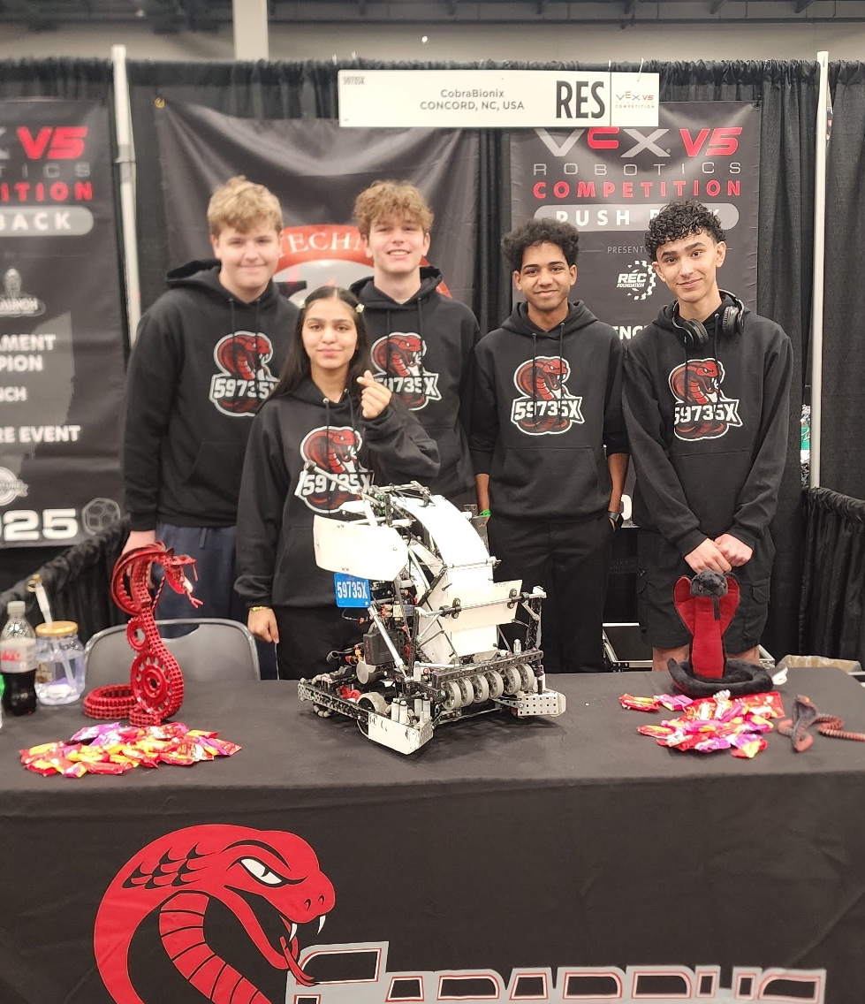
05
06
Clubs
Intramurals
07
08
Events
Extracurricular Teams
Structures, Policies, Procedures
1 Hr on Friday
Hold tournaments with other early colleges
A variety of activities to appeal to different groups of students
Teams that compete in
non-athletic events

Slide 29
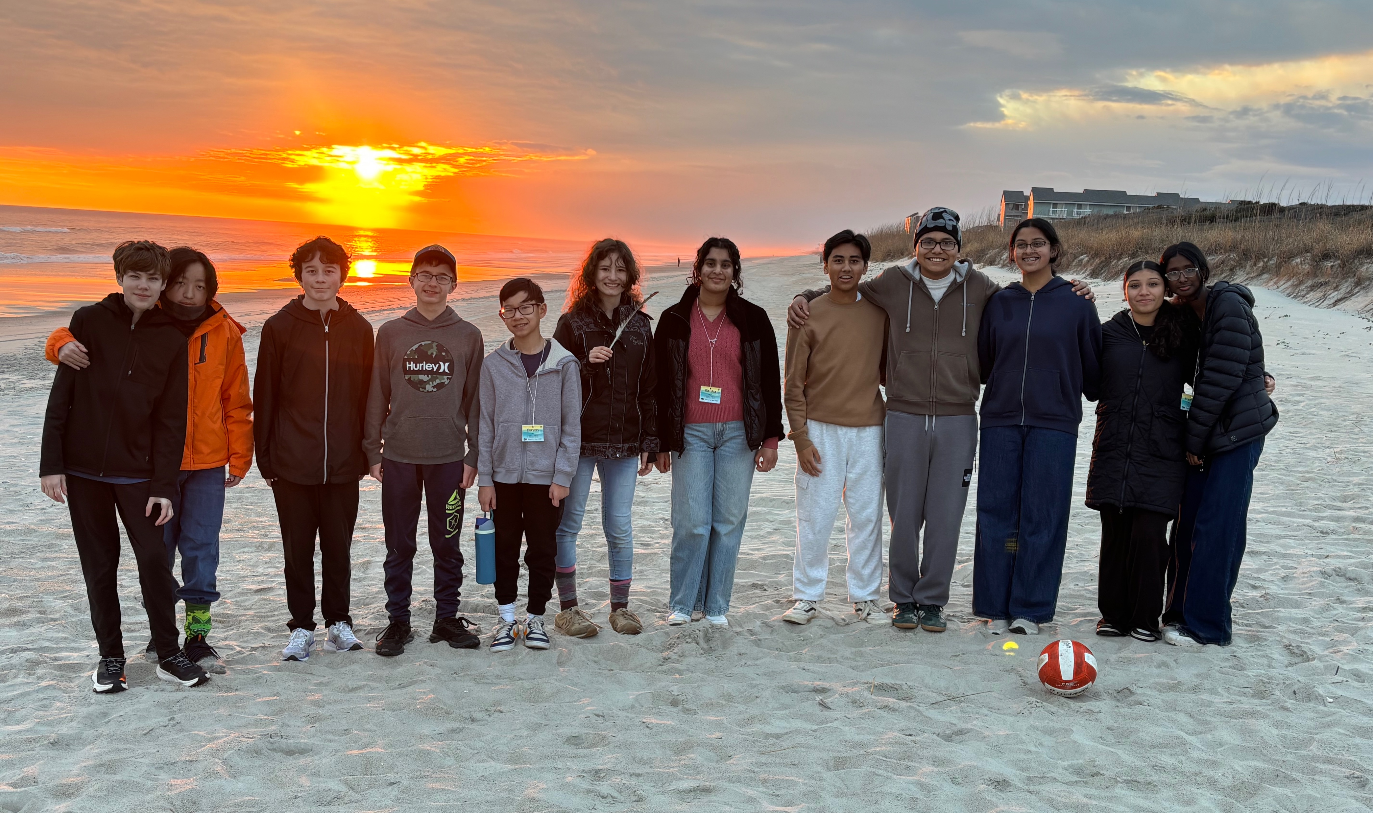
Structures, Policies, Procedures
Math I for All
Jrs All Day
Rules to Live By

Slide 30
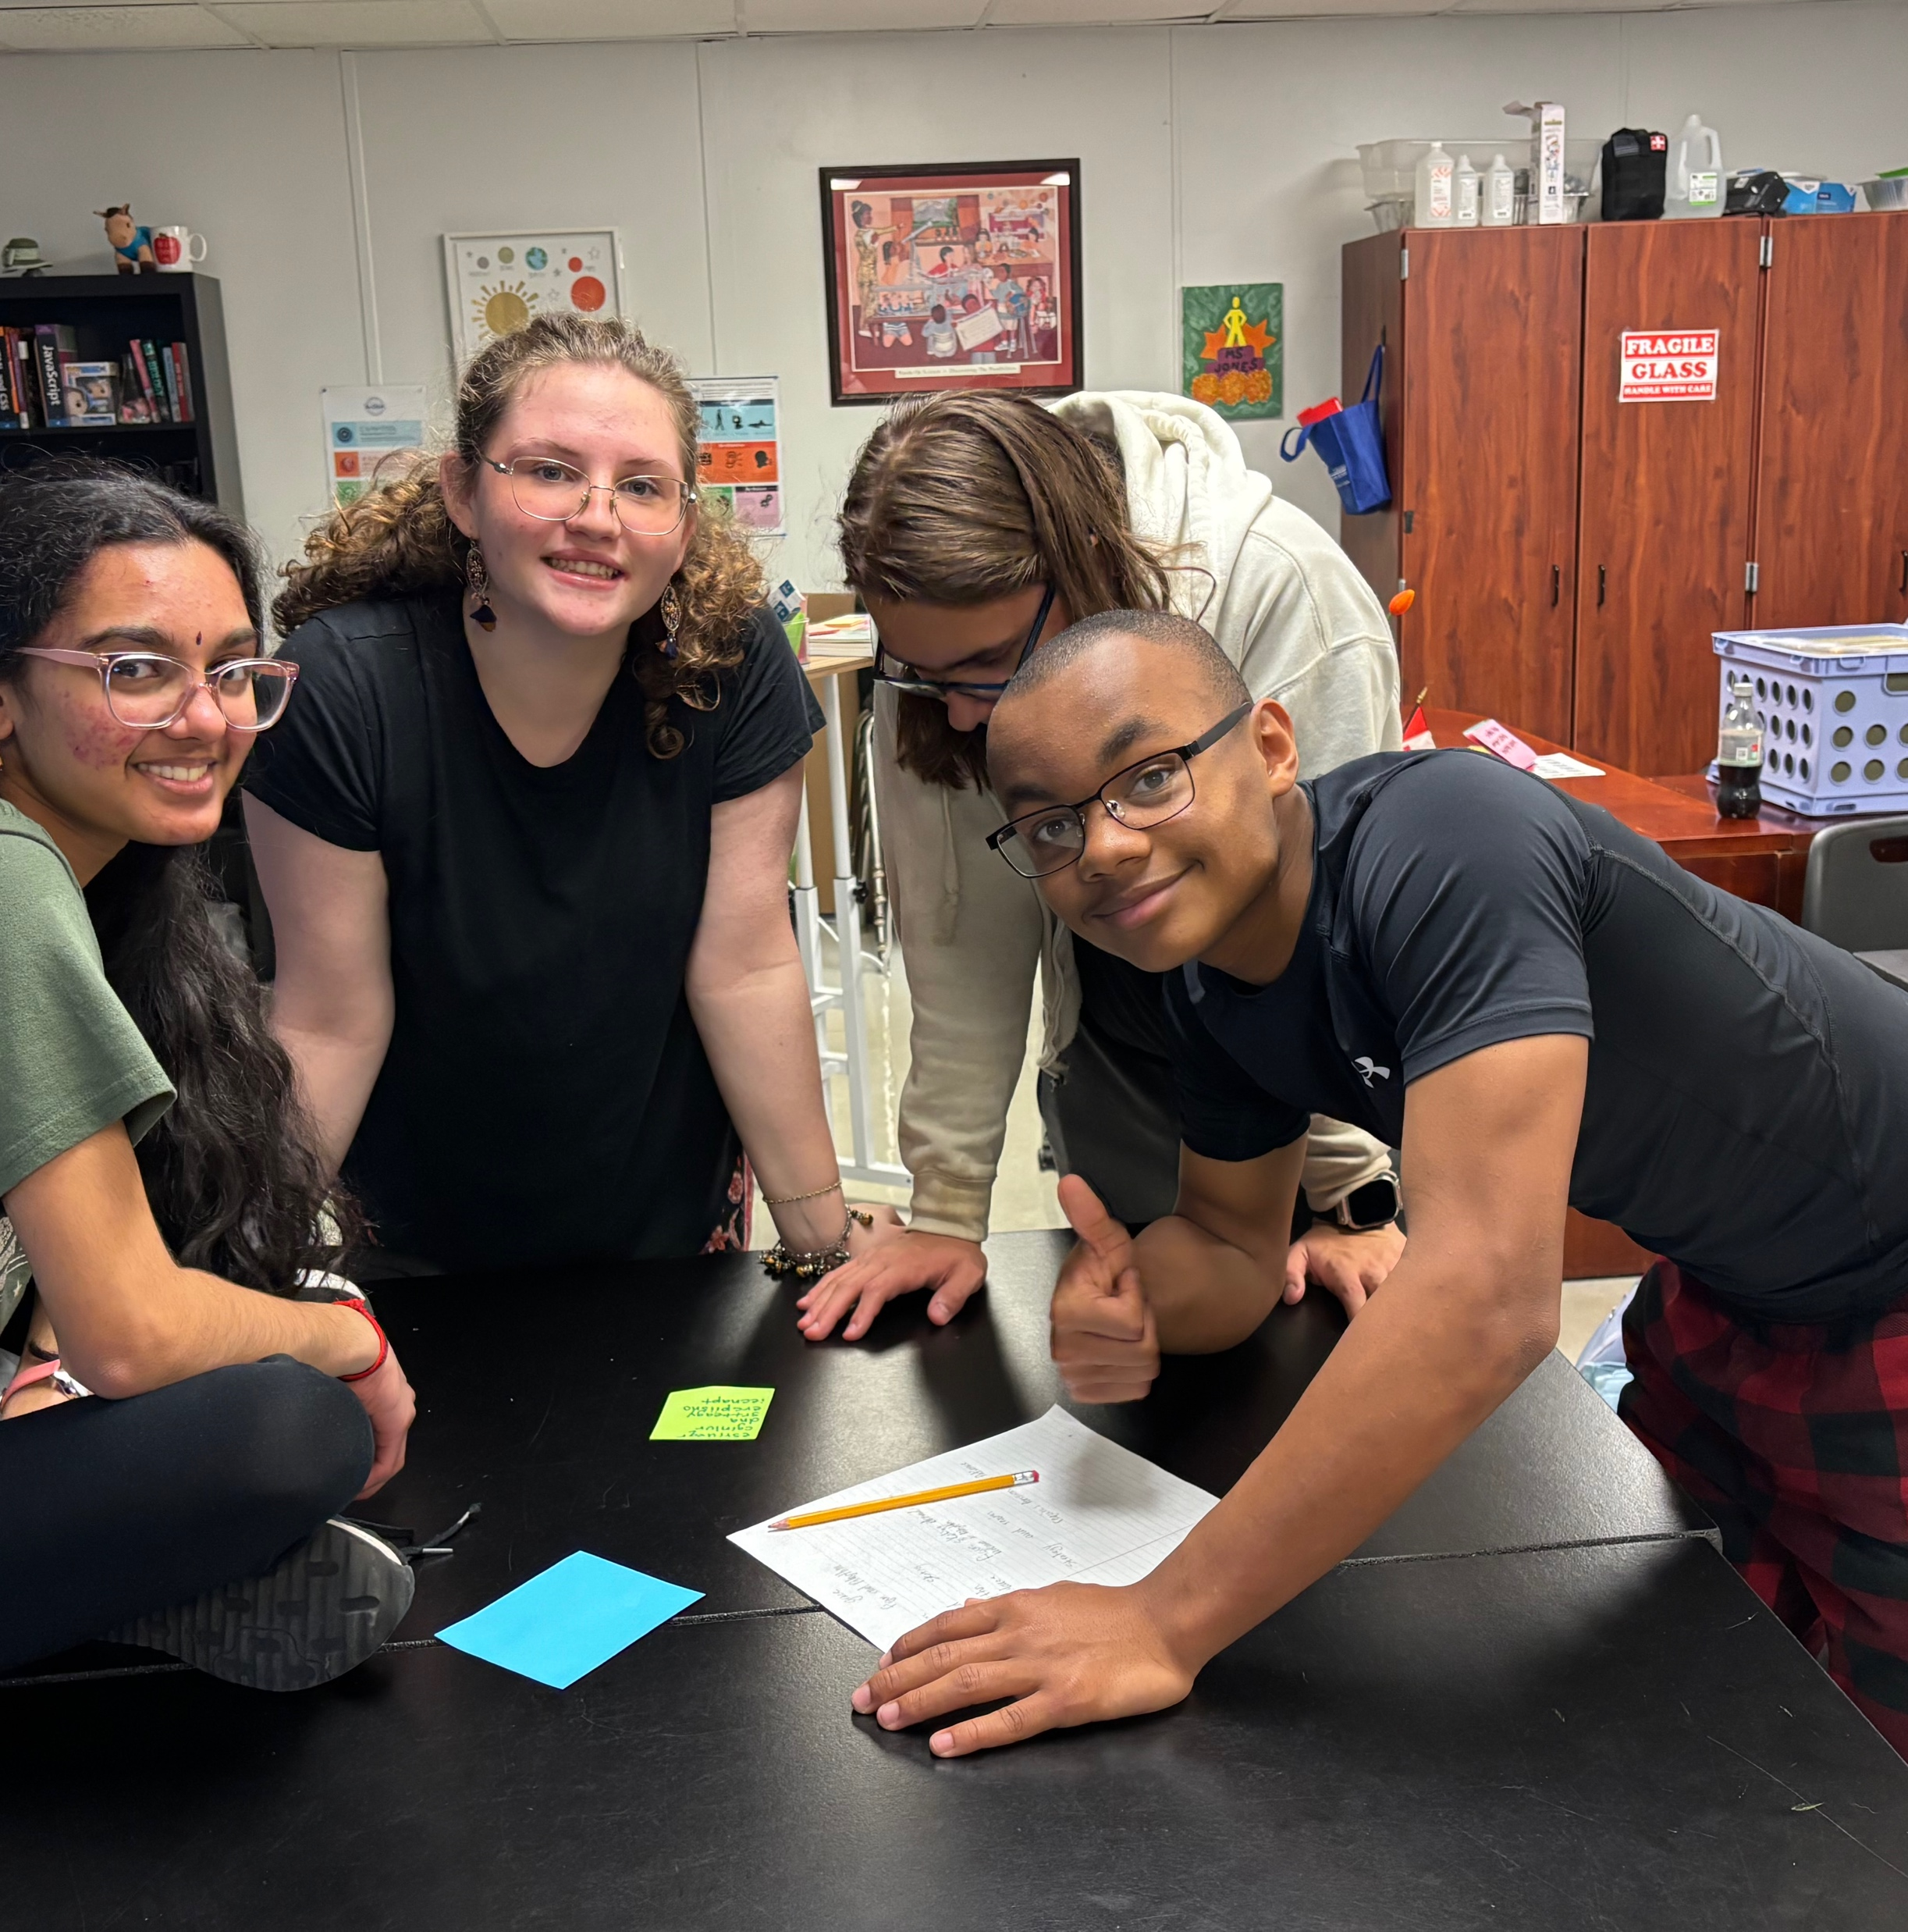
Skills, Knowledge & Pedagogy

Slide 31


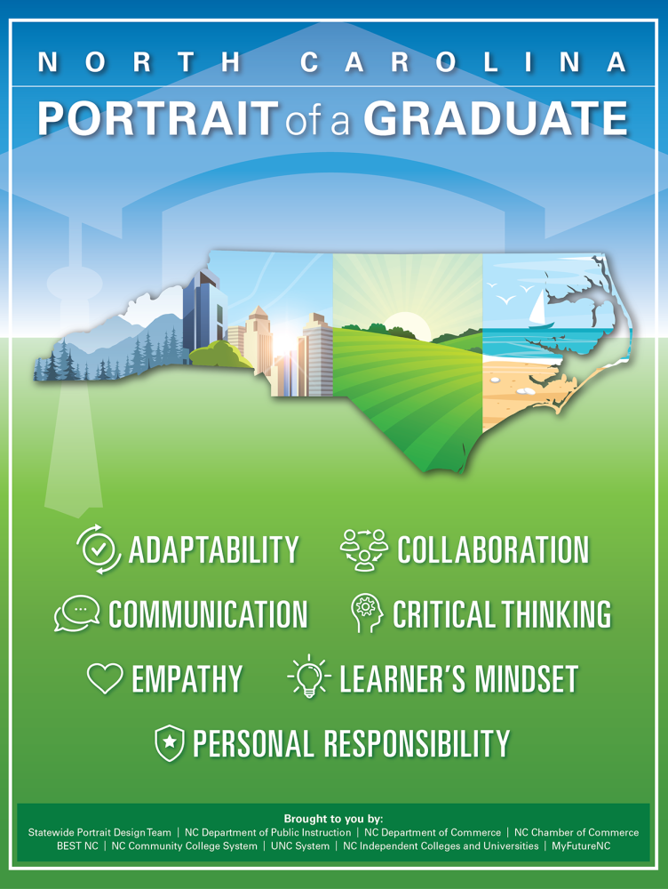
How You Teach Matters!
We use the NCSCOS to teach the skills needed for the 21st Century.

Slide 32
Seminar Class
9th Grade
11th Grade
10th Grade
12th Grade
Who Am I?
Who Do I Want to Be?
How Am I Going to Get There?
Where Am I going & How Do I present Myself?
What is My Role in Society?
Welcome to Adulting

Slide 33
Quick Recap
How will you?
Increase Students’ Sense of:
Self
Community
Academic Efficacy
By Addressing Their:
Competencies
Motivations
Opportunities
Perceptions
Through Your:
Systems & Structures
Skills, Knowledge & Pedagogy
Traditions, Symbols, and Celebrations

Slide 34
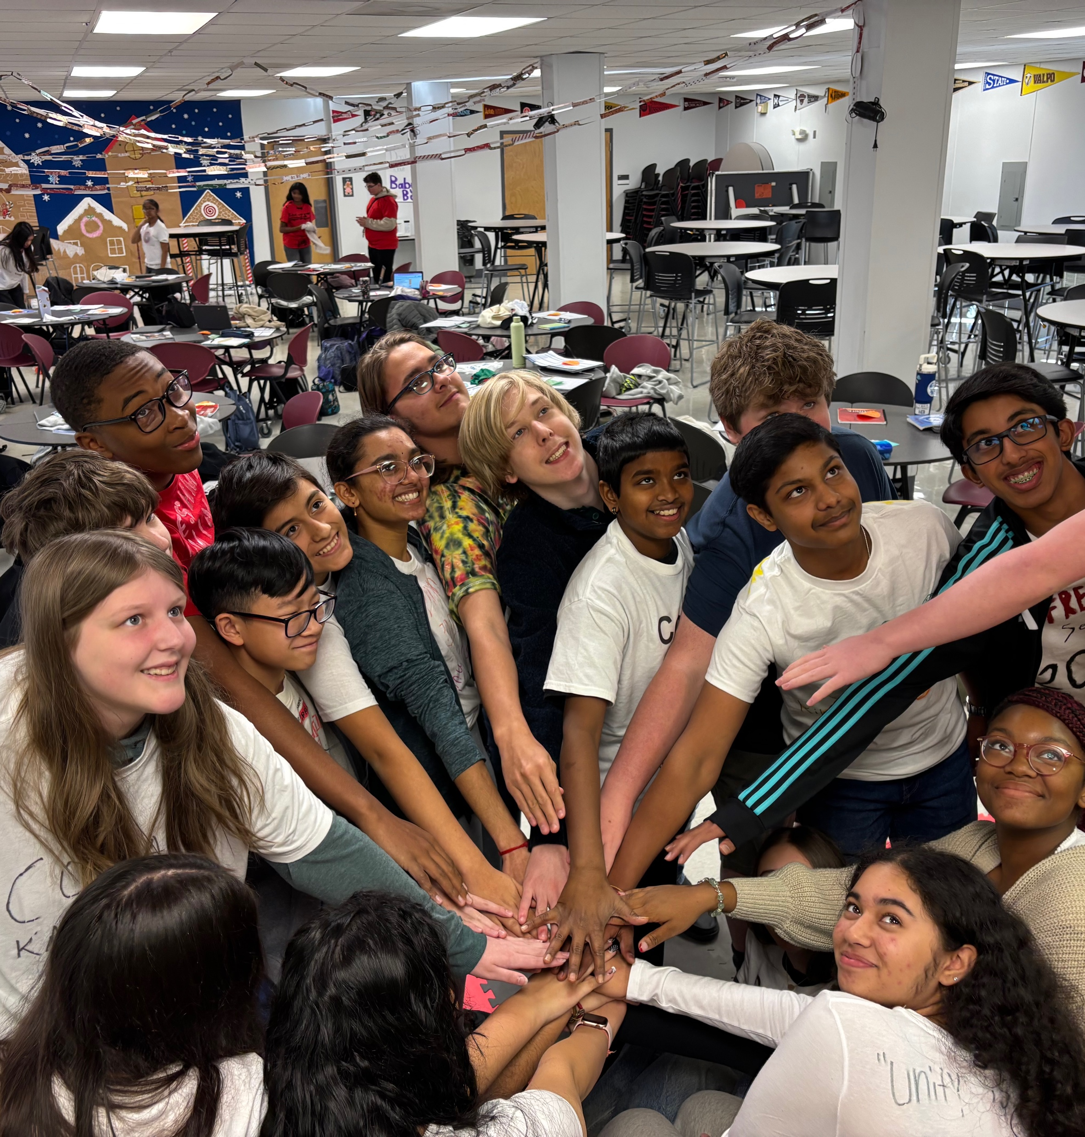
Thanks!
VANCE FISHBACK
Principal
Cabarrus Tech Early College
vance.Fishback@Cabarrus.k12.nc.us
(704)260-6750
STACEY DIAZ
School Counselor
Cabarrus Tech Early College
stacey.diaz@Cabarrus.k12.nc.us
(704)260-6750

Slide 35
Sense of Self
Erikson, Erik. (1968). Identity: Youth and crisis. New York, NY: W.W. Norton.
Marcia, James. (1966). Development and validation of ego-identity status. Journal of Personality and Social Psychology.
Rogers, Carl. (1951). Client-centered therapy: Its current practice, implications, and theory. Boston, MA: Houghton Mifflin.
Sense of Community
Goodenow, C. (1993). The psychological sense of school membership among adolescents. Psychology in the Schools.
McMillan, D. W., & Chavis, D. M. (1986). Sense of community: A definition and theory. Journal of Community Psychology.
Tinto, V. (1997). Classrooms as communities: Exploring the educational character of student persistence. Journal of Higher Education.
Academic Efficacy
Bandura, Albert. (1997). Self-efficacy: The exercise of control. New York, NY: W.H. Freeman.
Framework for School Belonging
Allen, Kelly-Ann, (2025), School Belonging: Evidence, Experts, and Everyday Gaps.
CITATIONS

