Slide 1
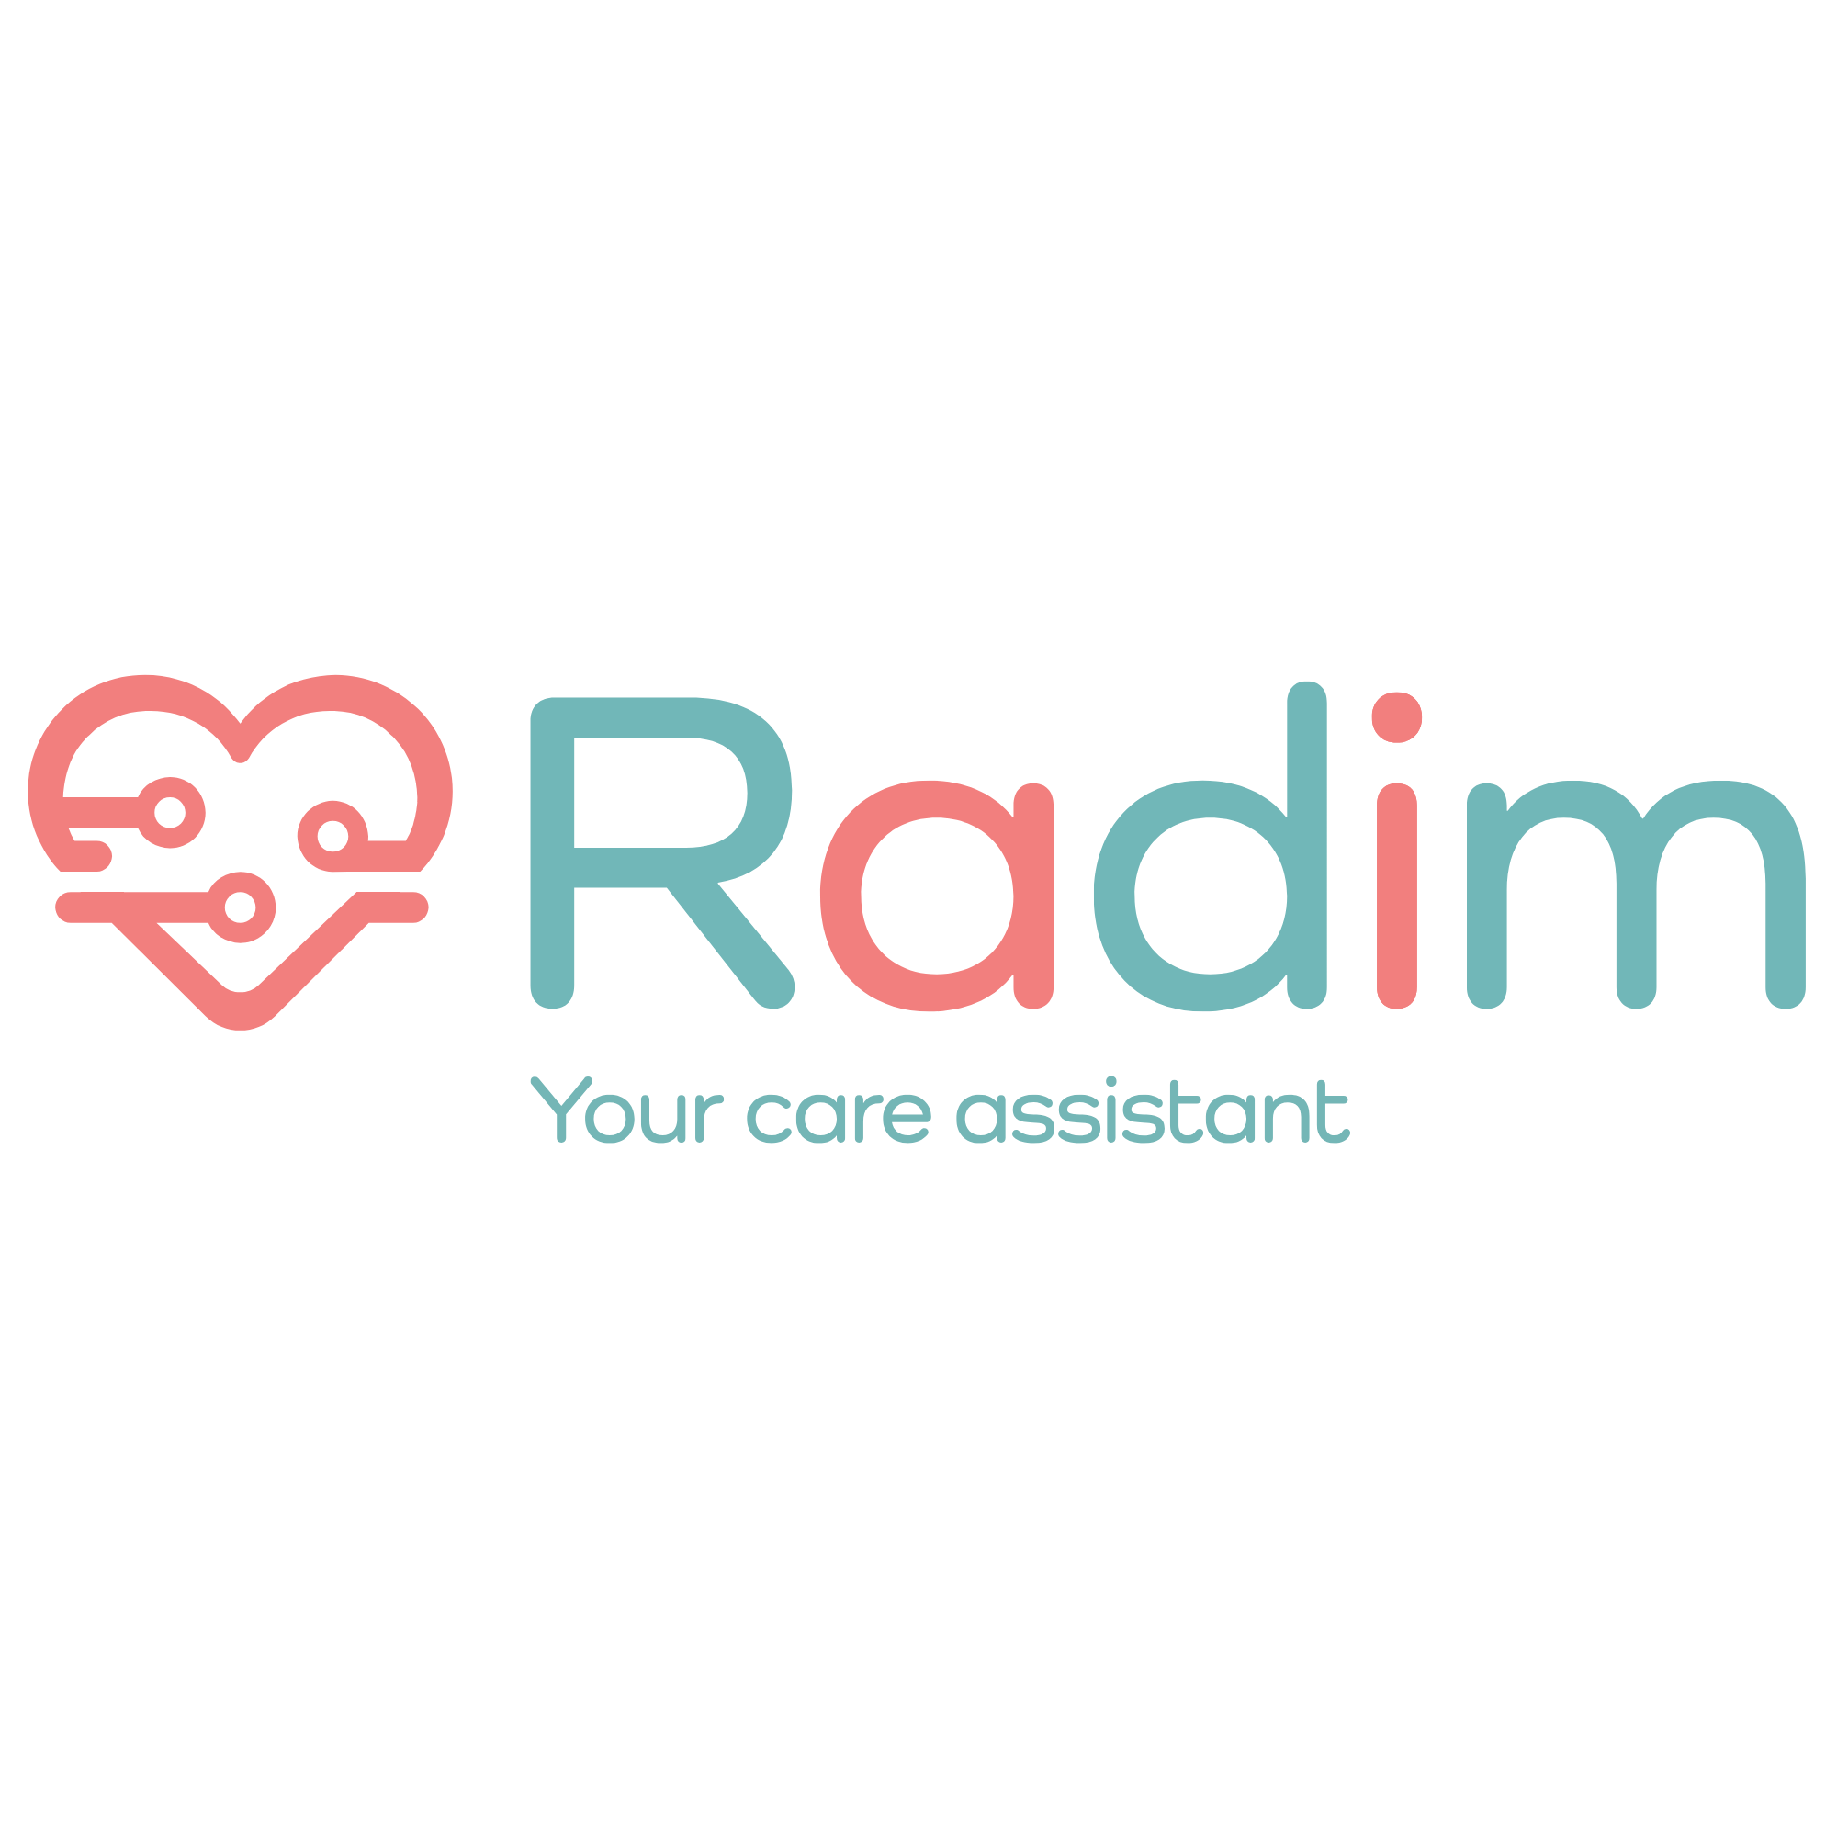

(eng)aging! 2026
Communities for All Generations · 9th International Conference on Aging and Technology
What If We Adapt
Technology
to People?
On restoring the dignity of people in retirement — and about Radim.
Michal Perna
Co-author
Founder and Architect · KOLIBRI / Radim Care
Petr Novák · CTU Prague · CIIRC
Prague · May 14–15, 2026 · radimcare.cz

Slide 2
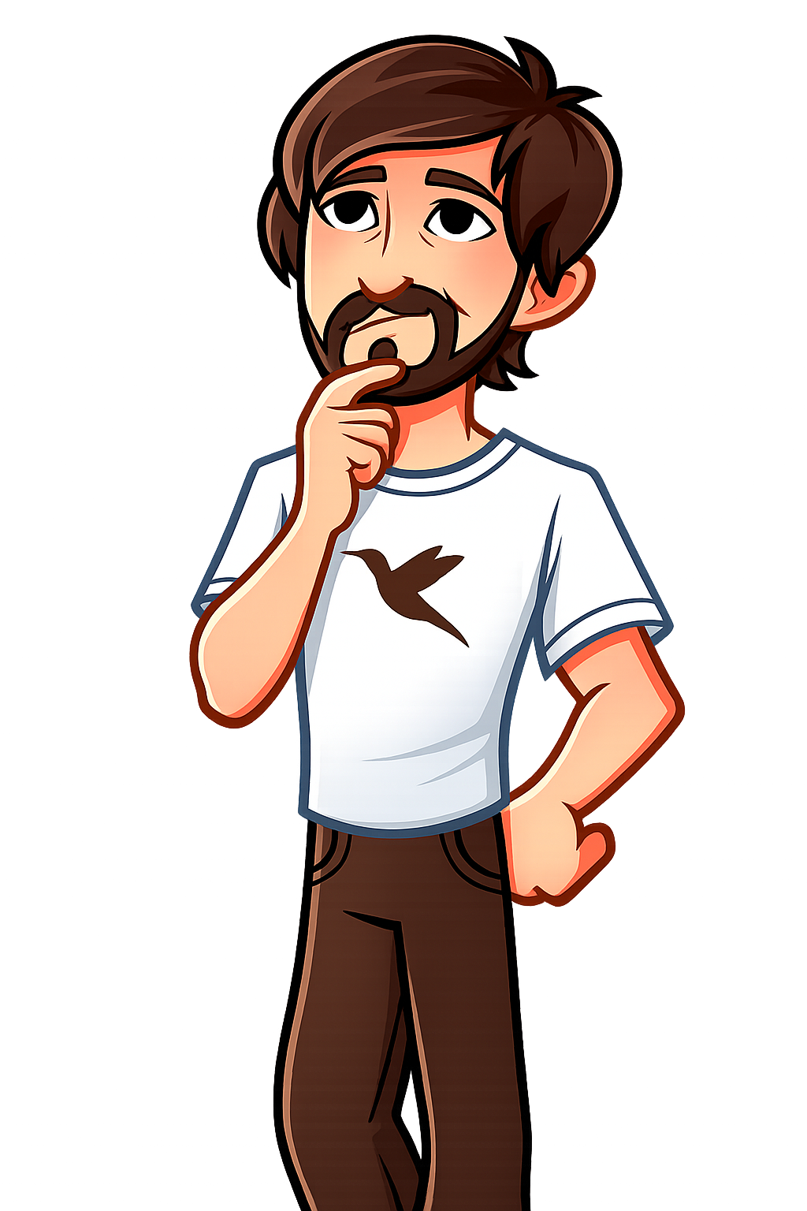








STRUCTURE · EIGHT QUESTIONS
If people will live longer than ever in history…
This talk asks eight questions.
How will family change?
How will community change?
How will care change?
What will everyday relationships look like?
What role will AI play in the Home?
How will we deal with loneliness?
How will we strengthen intergenerational connections?
How will we ensure human dignity?
Radim
(eng)aging! 2026 · Communities for All Generations
02 / 21

Slide 3
CAREGIVER · WHO BEARS THE BURDEN
Care rests on one person.
The caregiver bears the weight of daily care — often alone, without support or rest. Radim becomes their partner.
CAREGIVER'S REALITY
WHAT RADIM CHANGES
What they face every day:
How Radim helps:
Round-the-clock availability — care knows no working hours, the caregiver is on call 24/7
Burnout and isolation — loss of social life, career, and often health due to excessive burden
Lack of information — no overview of the senior's condition between doctor visits, decisions are made blindly
Fragmented communication — coordination with doctors, social workers, and family is chaotic, without shared context
Invisible work — society appreciates care verbally, but the caregiver has no status, reward, or systemic support
Takes over routine — medication, daily schedule, reminders, and monitoring run automatically, giving the caregiver breathing room
Alerts earlier — sensors detect changes in behavior and health before a crisis, allowing the caregiver to act proactively
Shares context — doctors, social workers, and family see the same data, coordination is no longer on one person's shoulders
Returns time — when Radim watches over, the caregiver can work, sleep, or rest without guilt
Doesn't replace the relationship — Radim handles routine, but the question "how are you?" remains human
The caregiver is not alone · Radim takes over routine and returns space for life · technology as a partner, not a replacement
Radim
(eng)aging! 2026 · Communities for All Generations
03 / 21

Slide 4
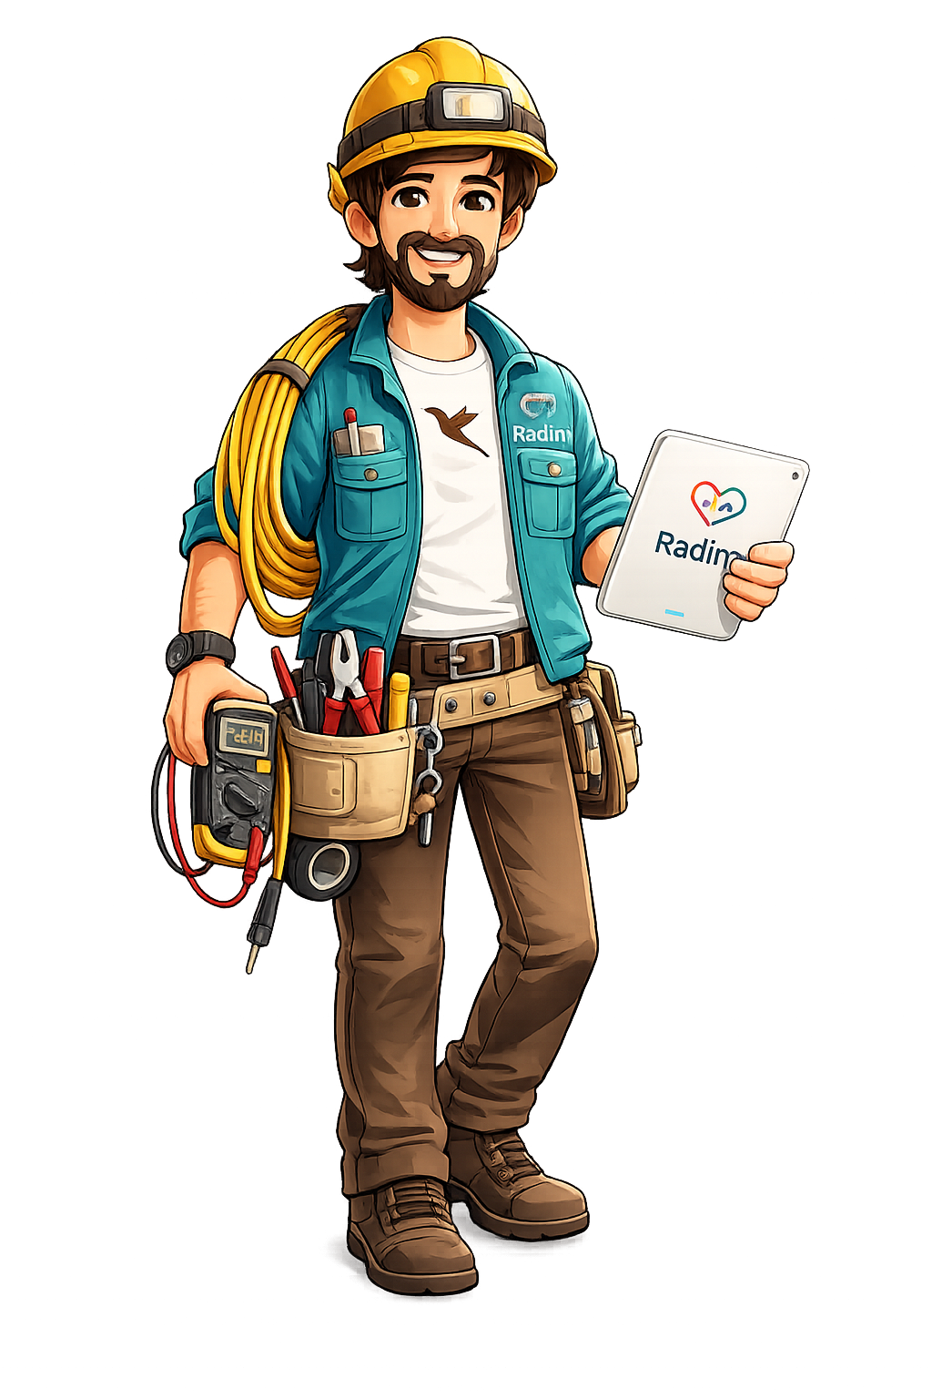
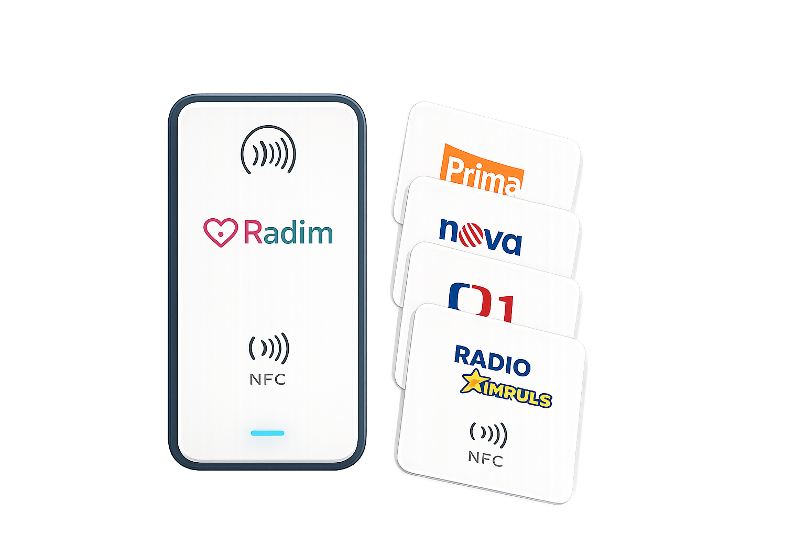
RADIM · ASSISTIVE CONTROL
Buttons + NFC Reader
when words aren't enough
⌂
Home Assistant
Local Storage
Buttons + NFC Reader
when words aren't enough
Four buttons for moments when speaking isn't possible. An NFC card brings up TV, favorite radio, or a video call with a grandchild — also works for children with special needs.
Mr. Radim Kafánek
Your Care Guide
Environmental control reduced to 4–5 large physical buttons. Radim adapts to the person — not the person to technology.
The system enables simple control of lights, TV, radio, video calls, or calling for help even during stress, tremors, or cognitive decline.
Possible extensions: pressure sensors, presence detection, NFC scenarios, and adaptive home automation.
Concept and assistive control development: Petr Novák · CTU Prague · CIIRC
Technology adapted to human rhythm · simplicity · dignity · safety
Radim
(eng)aging! 2026 · Communities for All Generations
04 / 21

Slide 5
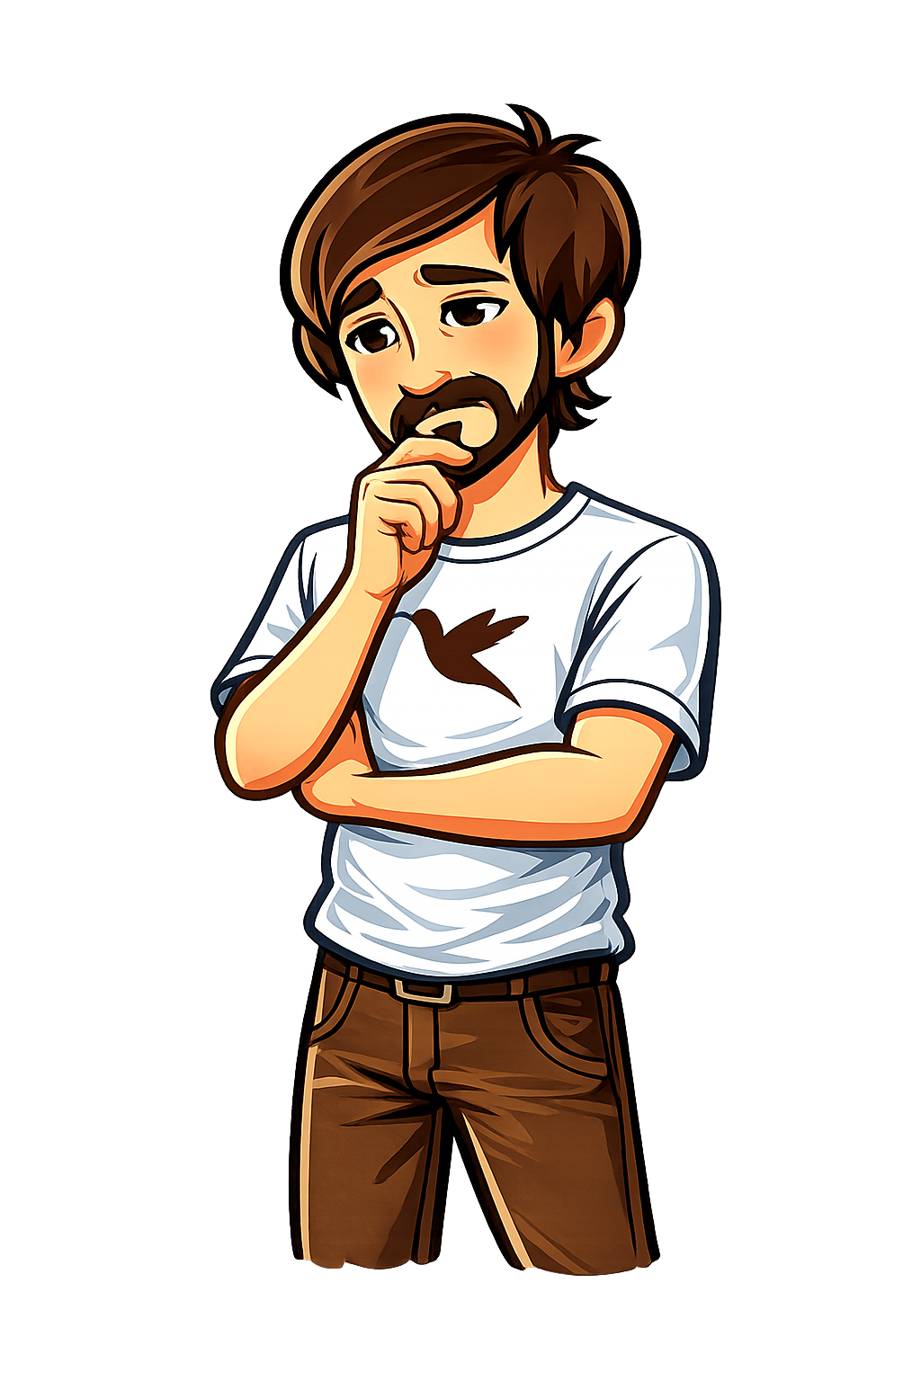

THREE TRUTHS · CONFERENCE CONTEXT
Technology in the senior's home.
What works?
Technology is no longer transforming just the economy.
It is changing the very infrastructure of human life.
Confucian China builds elder care on filial devotion. The African clan on shared living. Europe lost this — and must find it again.
Medicine extended our lives — now we must reinvent how to live them together.
Radim is not just an AI assistant.
It may be Europe's answer — infrastructure that brings the senior back into the game. As a contributor, not a recipient.
Radim
(eng)aging! 2026 · Communities for All Generations
05 / 21

Slide 6
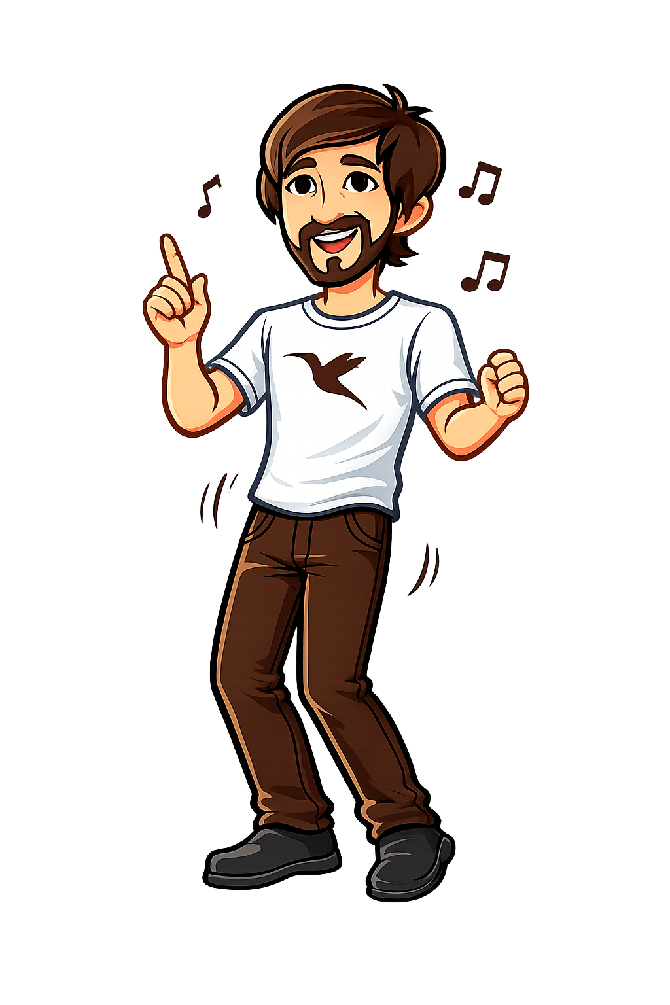



VISION · A BETTER WORLD WITH A NEW RHYTHM
A better world with a new rhythm.
Technology is no longer just changing the economy. It enters the home, relationships, memory — and how we live together.
Longevity
We live longer. Old age is no longer the final phase, but an active third of life. It needs its own rhythm.
AI in the Home
AI enters the home. It's not an app the senior must remember to open. It's an assistant that is simply there.
Dignity
The senior is not a burden. They are a person with experience that society needs — and for which they deserve reward.
Morning light · Radim is where you are.
Radim
(eng)aging! 2026 · Communities for All Generations
06 / 21

Slide 7
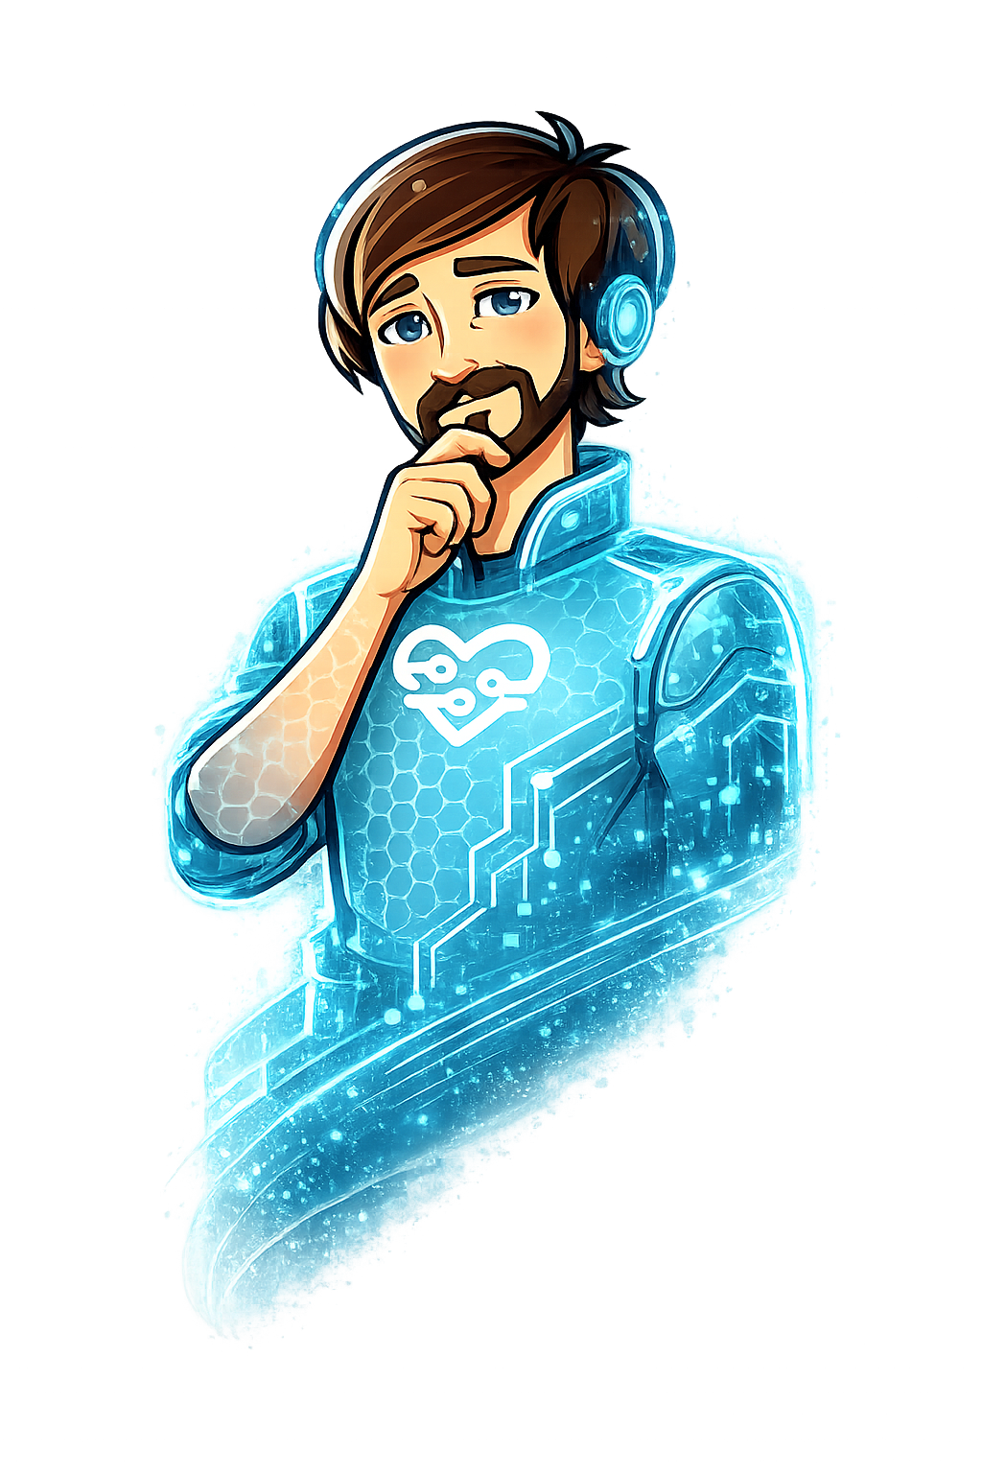
CONTEXT · CZECHIA AS A EUROPEAN PRECURSOR
The shift is already happening here.
133 seniors per 100 children — Czechia ages faster than the EU average. By 2050, nearly 29% will be over 65.
+50 %
2.2 mil.
Czechs aged 65+
21% of population · CSO 2024
280 thousand
growth of the 65+ cohort by 2050
seniors living alone
Eurostat — baseline scenario
concentration in regions and rural areas
It's not just about more seniors. It's about a transformation of relationships, care, and everyday social fabric.
Radim
(eng)aging! 2026 · Communities for All Generations
07 / 21

Slide 8
GLOBAL CONTEXT · WHY EUROPE NEEDS ITS OWN PATH
The senior in different cultures. Four continents, four roles.
Family bonds and the senior's standing differ fundamentally across cultures — and this perspective defines where Europe stands.
CHINA
AFRICA
AMERICA
EUROPE
Filial Devotion
Extended Family
Individualistic Market
Hybrid Model Under Pressure
FAMILY BONDS
FAMILY BONDS
FAMILY BONDS
FAMILY BONDS
The clan and community function as an extended family. The senior is a firm node in the social network, not a lonely individual.
Caring for parents is a moral and legal obligation enshrined in the civil code. Multigenerational cohabitation is the norm.
Senior residential communities and high geographic mobility weaken family bonds. Aging-in-place technology serves as a substitute for missing closeness.
The welfare state compensates for weakened family bonds and geographic fragmentation. The shape of care is formed by the historical memory of wars and political transformations.
SENIOR'S USEFULNESS
SENIOR'S USEFULNESS
SENIOR'S USEFULNESS
SENIOR'S USEFULNESS
Guardian of oral tradition, arbiter of disputes, memory of the clan. Usefulness remains a natural part of aging.
The senior represents clan authority and bearer of ritual continuity. Status is defined by hierarchy, not work performance.
The senior primarily acts as a service recipient. Care takes the form of a transaction, not a relationship, and the risk of social isolation is systemically high.
Aging is grounded in human rights and European regulation (AI Act, GDPR). Intergenerational solidarity is among the values enshrined in EU Treaties.
Europe's path stands on its own pillars: a human rights framework, regulation (AI Act, GDPR), and technologies that respect the senior's autonomy and dignity — not on inherited obligation, market, or extended family.
Radim
(eng)aging! 2026 · Communities for All Generations
08 / 21

Slide 9
CORE · WHAT IS RADIM
An assistive system for home care.
An input layer for situations where standard interfaces fail, and a broader care ecosystem behind it — Radim adapts to the senior and their environment, not the other way around.
INPUT LAYER
BROADER ASSISTANCE SYSTEM
In practice, Radim:
Beyond this layer:
enables control via alternative inputs — physical buttons, NFC cards, voice
monitors interaction between user and device, detects failed attempts, and responds
recognizes 7 types of dementia and tracks their gradual deterioration or improvement
saves energy at home — optimizes lights, heating, and appliances based on the senior's routine
adapts to the user — in pace, language, and controls based on abilities and habits
restores the senior's role and dignity — as a valued member of family and society
connects the user, family, caregivers, social workers, doctors, and specialists around one patient
runs a secure application with protection against fraud and social engineering
tracks interaction patterns over time and creates context for long-term support
adapts to region, language, and culture — from city to village, across Europe
protects its user — dignity, privacy, and safety
The input layer is subject to further development and pilot testing · the broader system connects the user, family and caregivers, doctors, social workers, and specialists.
Radim
(eng)aging! 2026 · Communities for All Generations
09 / 21

Slide 10
I + II · FAMILY AND COMMUNITY
What if the unit of care is not an individual,
but a household and a neighborhood?
Family
Community
geographically dispersed
weakened daily fabric
The shift. Adult children leave for work in Prague and Brno. Intergenerational contact changes from daily to weekly, from physical to screen-based.
Radim's role. Not a replacement for family — it's the technological floor on which they reconnect.
The shift. The neighbor who once brought soup now doesn't know she's ill. The community that kept the parish chronicle is now an administrative office.
Radim's role. Returns rhythm to the community — sharing memories, name days, and daily greetings.
Family and community are units of care — Radim adds a layer of context and easy connection.
Radim
(eng)aging! 2026 · Communities for All Generations
10 / 21

Slide 11


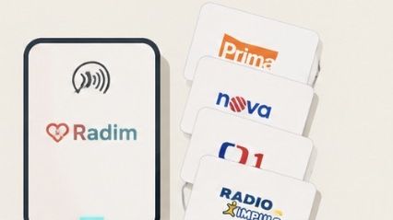
III · CARE
Technology has entered the home.
Care stops being a place you go to. It becomes infrastructure that is already there.
Voice
Mr. Radim Kafánek — an always-present voice assistant. No smartphone needed, hands-free.
Sensors
Buttons + NFC Reader
Motion, doors, water, smoke, temperature, CO₂, and energy consumption. Radim reads every signal in the home, with fall detection and customization for seniors' needs.
when words aren't enough
Four buttons for moments when speaking isn't possible. An NFC card brings up TV, favorite radio, or a video call with a grandchild — also works for children with special needs.
Central Hub
Home Assistant + Radim AI runs locally. Sensitive data stays at home, only anonymized signals go to the cloud.
Mr. Radim Kafánek
Your AI Care Assistant
Voice, hand, context · three layers of control for one person · from fall detection to calling for help
Radim
(eng)aging! 2026 · Communities for All Generations
11 / 21

Slide 12
V · PRINCIPLE
Two paths.
One extracts. The other builds.
EXTRACTIVE AI
INFRASTRUCTURE OF DIGNITY
Optimization for engagement.
Slow when needed.
—
Subject. The senior as a market segment that produces data.
—
Subject. The senior as an active member of community and memory.
—
Value. Accumulates at the platform.
—
Value. Returns contractually — 70 / 20 / 5 / 5.
—
Trust. Replaced by user dependency.
—
Trust. Built into the design — slowness, memory, respect.
—
Pace. Slowness is a flaw to be eliminated.
—
Pace. AI steps back when unsure. It defers to the elder.
Radim builds the second path.
Radim
(eng)aging! 2026 · Communities for All Generations
12 / 21

Slide 13




IV + VI · ECOSYSTEM
Loneliness won't be solved by a device.
An ecosystem will.
Community
Six layers around the senior — and Radim, which holds them together.
Dignified aging doesn't come from a single app or device. It emerges where family, community, care, support, state, and market connect around the senior — and strengthen each other.
The senior and family form the core of the relationship. Community keeps the daily rhythm, doctors treat, social services bridge crises, caregivers assist in daily life, and authorities guarantee rights. Markets are not just where value flows — a farmers' stand, pharmacy, neighborhood shop, or café are meeting places, where the senior remains part of everyday life.
Radim doesn't replace these layers. It holds them in a single interface the senior understands — and gives everyone else the context to act sooner and more precisely.
Authorities
Doctors
Senior
+ Family
RADIM
Social
Markets
Caregivers
Radim
(eng)aging! 2026 · Communities for All Generations
13 / 21

Slide 14
CORE · RADIM AND DIGNITY
Six things that change Radim the experience of retirement with Radim.
Dignity is not just a word for a presentation. It lives in every detail of how Radim treats a person.
1
Remembers you.
2
Doesn't rush.
3
Doesn't lie.
Your name, life story, favorite song, grandchildren's names. Every greeting by name, every conversation builds on the previous one — care that doesn't forget people and records life stories.
Response rhythm adapts to the senior, not the screen. When needed, the device waits. Slowness is a feature, not a flaw.
No fake emotions. When Radim isn't sure, it says so. Dignity means not talking to a person like a child.
4
Respects boundaries.
5
Doesn't take over the relationship.
6
Returns value back.
Recording only with consent. An audit log the senior has the right to review. A 24-hour cooling-off period before any significant action.
Family makes the relationship, Radim handles routine. Medication, check-ups, daily rhythm — but the question "how are you?" remains human.
70% of revenue is contractually returned to the population the system serves. The senior is not a data source — they are the recipient of value they helped create.
Radim
(eng)aging! 2026 · Communities for All Generations
14 / 21

Slide 15




VII · MODEL
A senior who "works" again.
From home. With dignity, without risk, safely!
Radim turns a senior's experience and opinion into value — and restores their place in society.
1
Work from Home
2
Anonymous Data
3
Value Returned
At their own pace. Conversations, surveys, and opinions. The senior responds when and how they want — Radim adapts the work to their energy.
Under their control. Responses are aggregated and anonymized. Third parties receive them only with consent. The senior sees who asks and why.
For them and for the municipality. Retail, manufacturers, political parties, and research pay for insight. The fee is split between the senior, municipality, and Radim — contractually and transparently.
Why do we pay for 25-year-olds' data — and not for the experience of those who have lived a full life?
Radim
(eng)aging! 2026 · Communities for All Generations
15 / 21

Slide 16
ECONOMICS · RETIREMENT AS A CREATIVE PHASE
The senior creates. The community pays. Value returns.
A value flow built on usefulness — not on sympathy.
1. CREATES
2. CONNECTS
3. RETURNS VALUE
Senior
Radim
Senior + Family
active role, not passive
→
fairness · transparency
→
three return channels
—
Life story and memories
—
Anonymizes data, contractually protects
—
Fee to the senior's account — monthly
—
Craft and profession mentorship
—
Shows who asks and why
—
Part goes to the municipality and local services
—
Local history and community memory
—
Audit log open to the senior
—
Better product offerings for seniors
—
Participation in polls and decisions
—
Consent at every step — including withdrawal
—
Political decisions with the voice of elders
—
Product and service reviews
—
Fair price based on insight value
—
Research and science with real experience
Retirement stops being a cost item. It becomes a resource.
Radim
(eng)aging! 2026 · Communities for All Generations
16 / 21

Slide 17
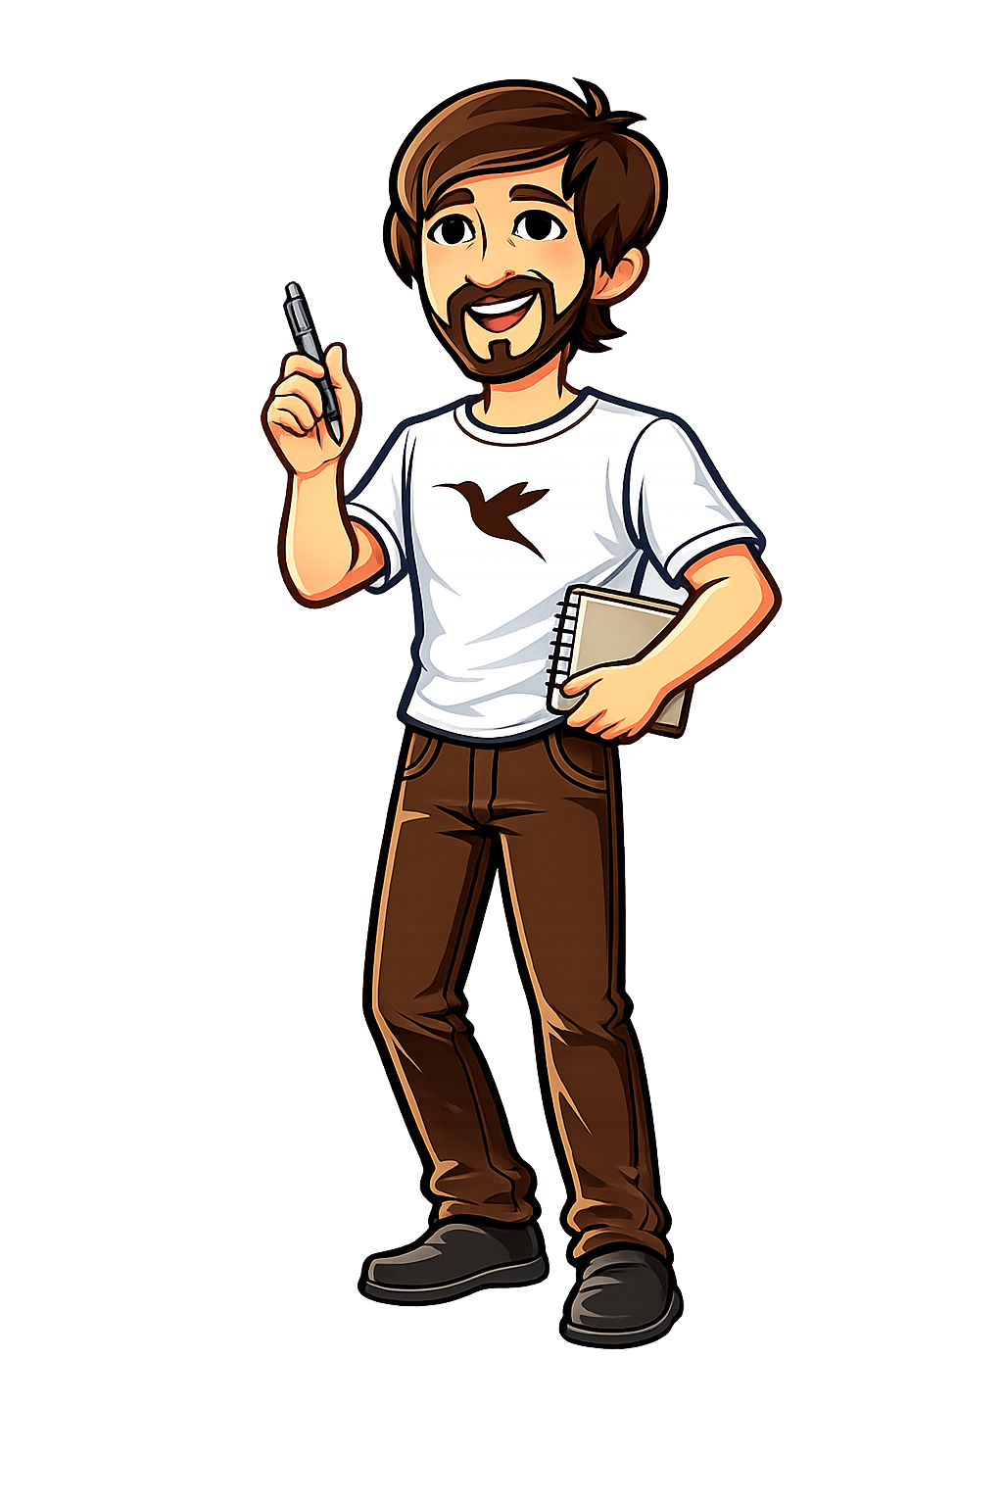



VIII · DIGNITY
What are we building on?
More than two years of daily contact — not a questionnaire.
2+ YEARS
IN THE SAME BUILDING
PERSONAL
Café in a senior residence
Parkinson Center
Caring for a person with Huntington's
Prague — Háje
specialized facility
long-term family care
Daily encounters with dozens of residents showed how human contact is missing in care. Seniors don't need more services — they need someone to remember them.
Direct experience with progressive neurological diseases. Ritual, slowness, and predictability are not comfort — they are necessities. Medications given on time are a matter of dignity, not just health.
Two years of daily care for a loved one with Huntington's disease showed where technology helps — reminders, context, calm response — and where it can never replace another person's presence.
Dignity means being seen.
Slowness is a feature, not a flaw.
Technology complements. It doesn't replace.
Radim
(eng)aging! 2026 · Communities for All Generations
17 / 21

Slide 18
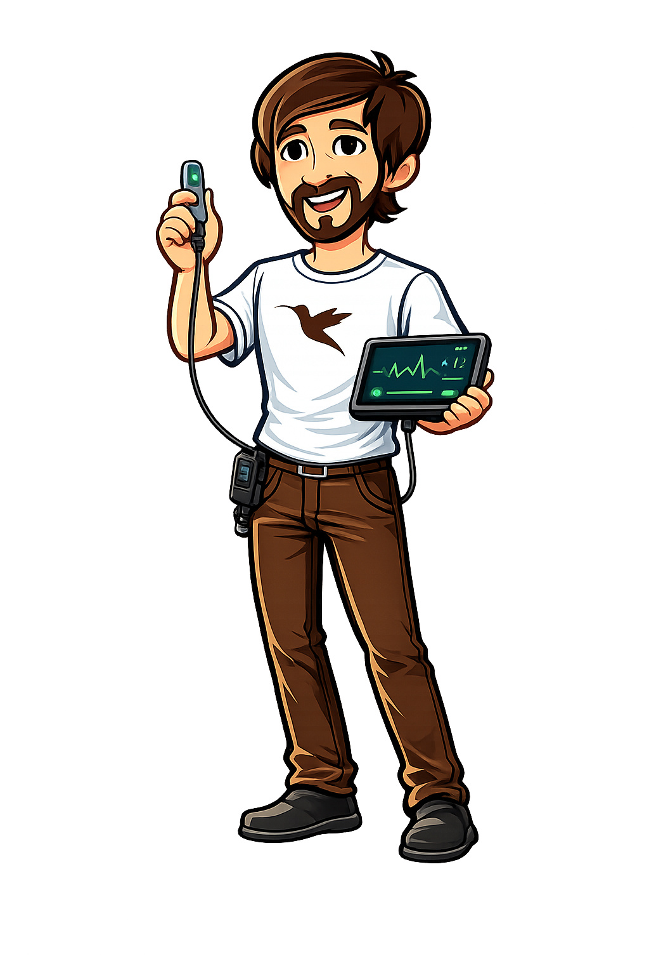
PILOT · 2026–2027
What we will actually measure.
Modest, data-backed milestones. If results don't support continuation, we'll say so publicly and adjust the plan.
PILOT DESIGN
PARTNERS
PARTICIPANTS
First 300 households in the first year. Seniors 70+ and their families in Prague, Brno.
COLLABORATION
Petr Novák · CTU, CIIRC
Applied AI and social robotics
IN NEGOTIATION
Život 90
Duration
Start June 2026. 12 months of active operation, quarterly evaluation with mixed methodology.
Contact network and methodology for working with seniors
POTENTIAL PARTNER
Post Bellum
Collecting and preserving personal stories
WHAT WE MEASURE
We track daily rhythm and capture micro-changes that a doctor can't see during a brief visit. From these, we calculate whether the senior is improving or declining — day by day.
WE ARE REACHING OUT TO
Target Institutions
Research, retail (Albert, Tesco), multinational companies, banks, regions, and municipalities
WHAT WILL COME OF IT
An open annual impact report, an anonymized dataset, and a methodology for deploying Radim in ordinary households.
Honest limitation: impact claims are hypotheses to be tested, not measured results. One year of solo development. Production scale is unverified.
Radim
(eng)aging! 2026 · Communities for All Generations
18 / 21

Slide 19
POSITIONING · WHAT WE LEARN FROM, WHERE WE DIFFER
Related systems and academic context.
We build on European research, learn from American AI companions, and differ in our value-return model.
RELATED SYSTEMS
SELECTED SOURCES
ElliQ
Intuition Robotics · IL / USA
WHO (2021)
Decade of Healthy Ageing: Plan of Action 2021–2030. World Health Organization.
Commercially available only in the US (subscription). English only. No value return to the senior.
WHO Europe & AGE Platform Europe
Age-friendly environments in Europe: A handbook of domains for policy action.
StoryWorth
USA
Eurostat (2024)
Email prompts to share memories. No AI, no compensation, no connection to archives.
Population structure indicators — Czechia. European Statistical Office.
CSO (2024)
Remento
USA
Demographic Handbook 2024. Czech Statistical Office.
Coghlan, Waycott, Lazar & Barbosa Neves (2021)
Audio reminiscence with family delivery. No legacy agreement, no value return.
Dignity, Autonomy, and Style of Company: Dimensions Older Adults Consider for Robot Companions. Proceedings of the ACM HCI, 5(CSCW1).
NYSOFA & Intuition Robotics (2023)
HereAfter AI
USA
ElliQ pilot data — 95% loneliness reduction among 800+ participants. New York State Office for the Aging.
Voice clone after the senior's death. No compensation for the living person.
European Union (2024)
Regulation (EU) 2024/1689 — Artificial Intelligence Act. Risk-based regulation framework.
Our distinctive approach: cultural localization beyond translation, contractual value return instead of subscription, the Legacy Module as an ecosystem, not a standalone service.
Radim
(eng)aging! 2026 · Communities for All Generations
19 / 21

Slide 20





LEGACY · WHAT WE LEAVE BEHIND
The senior returns to the system!
Earning from home through their experience and opinion. It restores their role — and the dignity that comes with one's own work.
1
I · WORK
Earns from home
2
II · DATA
Anonymous insight
3
III · DIGNITY
A full-fledged role
Short conversations, surveys, voting, and everyday behavior. At a pace that suits them — and for a fee.
Responses are aggregated, anonymized, and sold to third parties where there is demand.
Not a passive care recipient. A contributor whose experience has value — and the community knows it.
4
Who pays for insight
5
How the fee is split
6
Control stays with the senior
Retail (Albert, Tesco), manufacturers for seniors, regions and municipalities, political parties, research and universities.
70% to the senior monthly. Part to the municipality for local services. The rest to Radim for operations and further development.
Consent at every step, right to withdraw. Audit log open — the senior sees who asked and how much they got back.
The senior is no longer someone we take care of. They are someone who contributes.
That is Radim's legacy: a new economic role for a generation the market currently views as a cost.
Radim
(eng)aging! 2026 · Communities for All Generations
20 / 21

Slide 21

(eng)aging! 2026
CONCLUSION · CHANGING DIGNITY
Old age is not a burden.
Old age has value — let's restore dignity, usefulness, and a role of their own to European aging.
Connecting Europe makes sense. But for whom are we building it?
Despite its political correctness, Europe has grown cold toward seniors. Thanks to medicine, seniors live longer — but in oblivion, loneliness, and sorrow.
In wealthier circles, they are travelers enjoying their free time — not watching grandchildren. Families no longer live together.
We must change this — with infrastructure, not rhetoric.
Thank you for your attention.
Special thanks to:
Ing. Denisa Vinařská · Petr Novák · prof. Štěpánková (CTU) · Háje Senior Residence
Michal Perna · kafanek@kafanek.com · app.radimcare.cz

