Slide 1


WELCOME!
INDIANA CTO CLINIC 2026
Sign up to enter to win a door prize!
SCAN TO SIGN UP

Slide 2
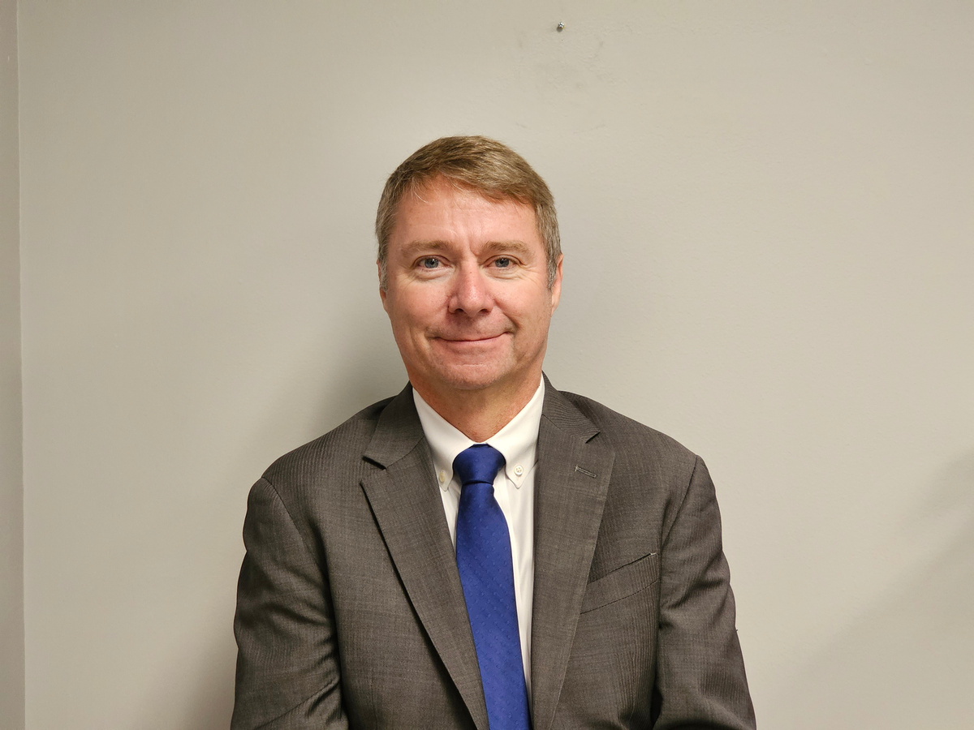
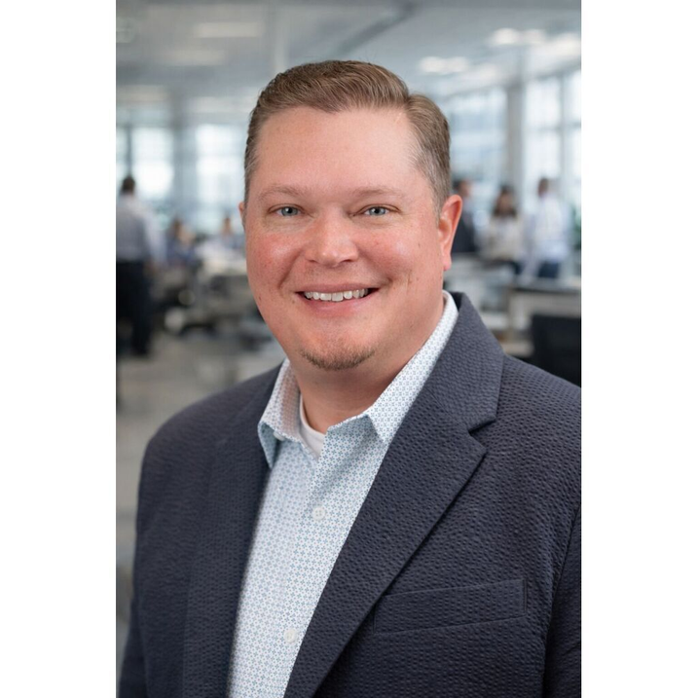
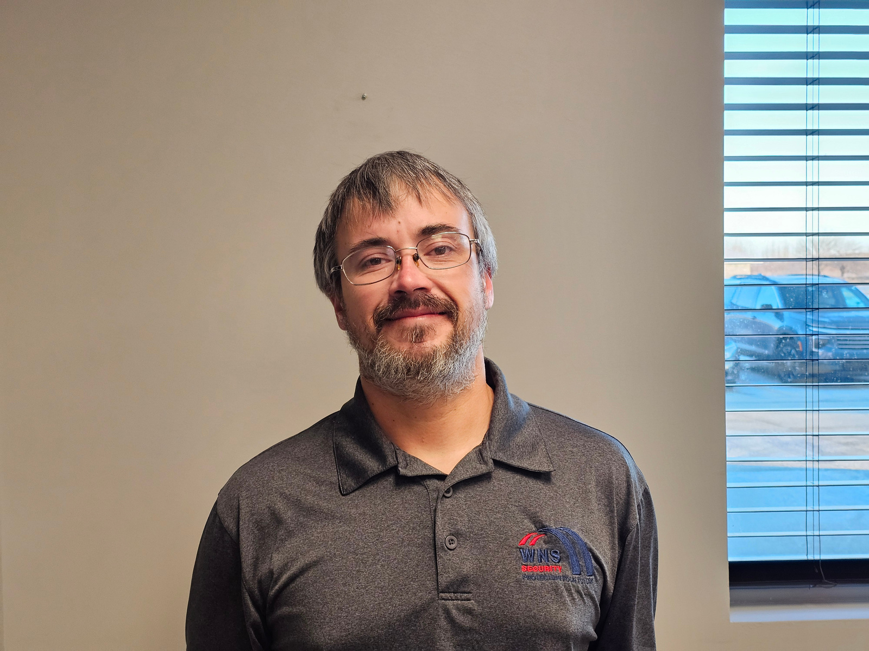
MEET YOUR
PRESENTERS
Dave Hadley
President
WNS Security
Jamie Ramos
Director of Technology
Carroll Consolidated School Corporation
Kyle McKinley
Project Manager
WNS Security

Slide 3


School leaders are expected to do more with less.
Limited budgets
Aging equipment
THE REALITY
SCHOOLS FACE
Failing systems

Slide 4
A SOLUTION?
YOUR SECURITY GRAND PLAN
A strategic roadmap for improving school security over time based on risk, budget, and priorities.

Slide 5

THE 4-STEP GRAND PLAN FRAMEWORK
1
2
Audit: Know what you have
Build: Define where you want to go
3
4
Plan: Prioritize investments over time
Reassess: Review and adjust annually

Slide 6
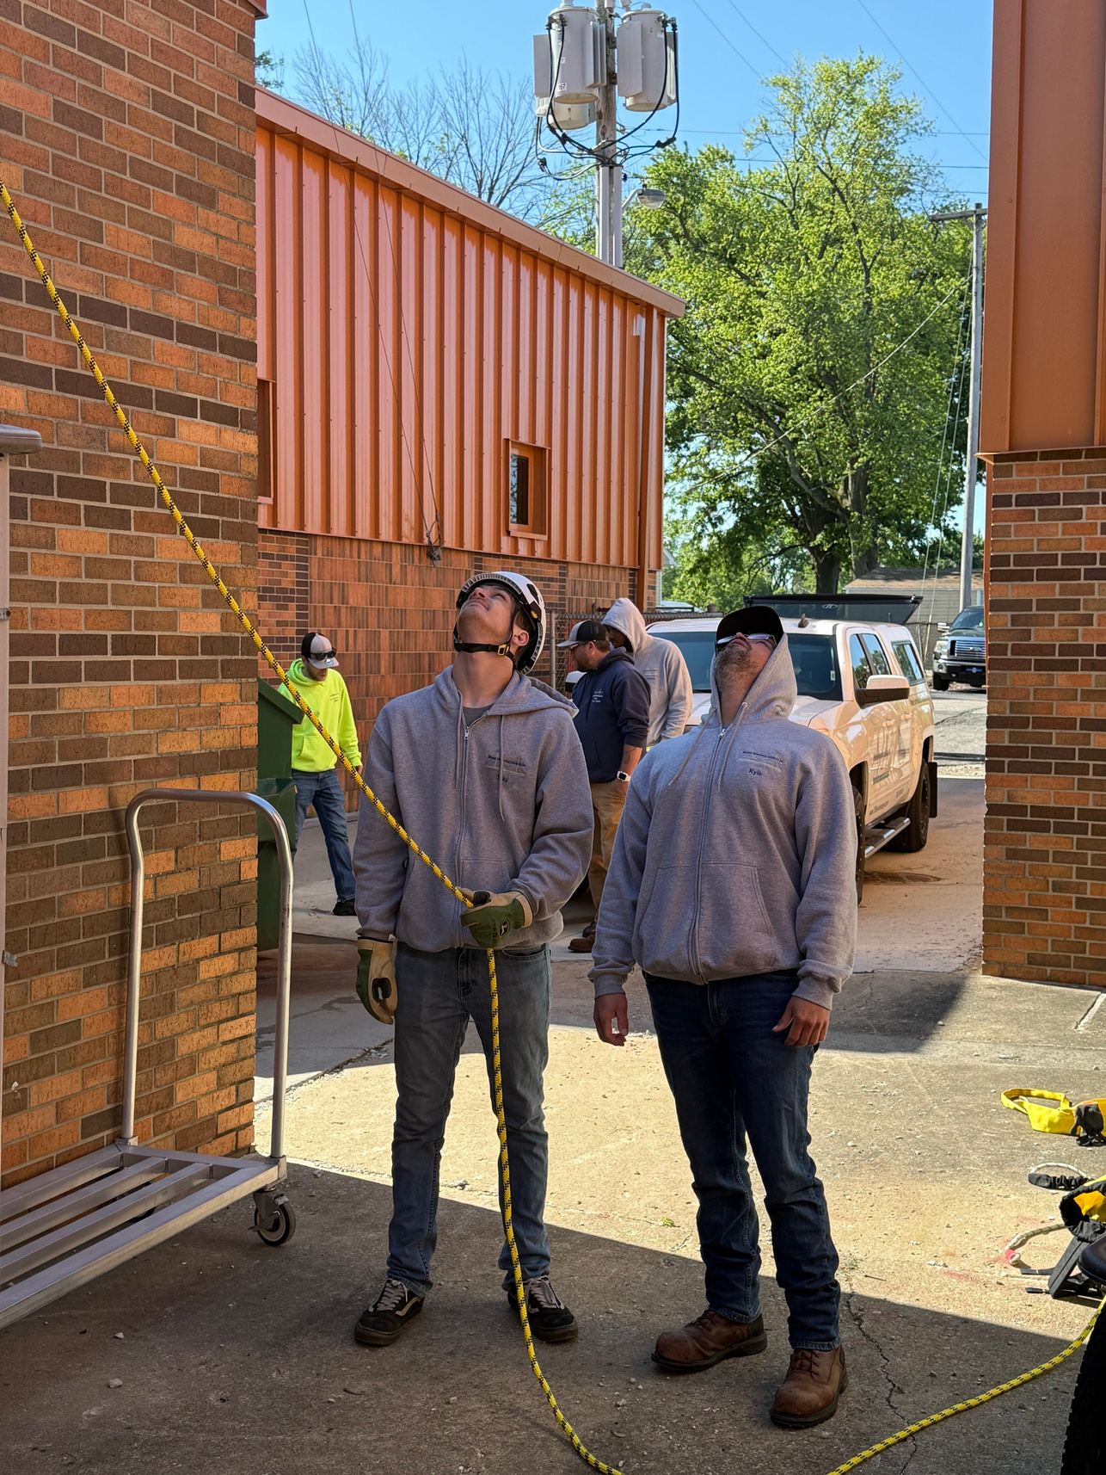
GRAND PLAN
IN PRACTICE
Let's look at how the GRAND PLAN has worked for Jamie Ramos at Carroll Consolidated School Corporation to address the school's unique needs, budget, and timeline.
Let's Talk
What challenges are you facing with school security planning? How can we help you get started?

Slide 7
(765) 588-0119
Request your free evaluation
Scan QR code to get started
THANK YOU!
The door prize winner is…

