Slide 1
Emerging Technology Education Initiatives
AdvanceKentucky
Beyond the Buzz: Implementing AI with Purpose Across a District
KACTE Annual Conference • Wednesday, July 22, 2026 • 8:00 AM • Louisville, KY
Monique M. Rice | Director, Emerging Technology Education Initiatives (ETEI)
Notes:
0:00–1:00 — Welcome the room; note this is the 8:00 AM Wednesday slot, so bring energy and keep the opening brisk. Introduce yourself and AdvanceKentucky/ETEI in one breath. Hook: “Every one of your CTE programs is training students for jobs that increasingly expect AI fluency on day one — this session is about how AdvanceKentucky helps you get your faculty ready for that, at no cost to your district.” Preview that there's a sign-up moment at the end for anyone who wants to pilot this.

Slide 2
TODAY'S SESSION
Agenda
01
Why AI Literacy, Why Now
02
Inside the AI Literacy & Readiness Program
03
Pilot Spotlight: Barbourville City Schools
04
Bringing AILRP to Your Program
1
AdvanceKentucky | ETEI
Notes:
1:00–2:00 — Set expectations: this is a working session, not just a pitch. Mention there's an interest form at their tables for anyone who wants to explore piloting AILRP — no pressure, just an easy way to start the conversation. Q&A held to the end, but feel free to flag questions along the way.

Slide 3
ABOUT US
AdvanceKentucky & ETEI
AdvanceKentucky is an initiative of the Kentucky Science and Technology Corporation (KSTC), working with districts statewide to grow STEM enrollment and success.
College Readiness Program
Access to Algebra
ETEI
AP course support and access statewide
Building strong math foundations early
Computer science, AI, and emerging tech — formerly Computer Science Initiatives
ETEI's current portfolio: CS+Additive Manufacturing, CS+Engineering, the Code.org Regional Partner Professional Learning Program — and now, the AI Literacy & Readiness Program (AILRP).
2
AdvanceKentucky | ETEI
Notes:
2:00–4:00 — Quick orientation for anyone unfamiliar with AdvanceKentucky. Note that CS+Additive Manufacturing and CS+Engineering already live inside CTE-adjacent pathways — AILRP is a natural next step for programs already working with ETEI, not a brand-new relationship.

Slide 4
THE LANDSCAPE
The AI Skills Gap Is Already Here
86% vs 24%
7×
62%
28%
Use AI at work, but only 24% feel equipped
Growth in jobs requiring AI fluency (2023–2025)
Average wage premium for AI skills
Employers seeking AI-capable early-career talent
Sources: Skillsoft Workforce Readiness Report (AI Edition, 2025–26); NACE Job Outlook 2026; Gloat AI Skills Demand Report 2026
3
AdvanceKentucky | ETEI
Notes:
4:00–7:00 (3 min) — This is the hook. Let the room sit with the 86/24 gap — adoption has outrun readiness everywhere, including in the workforce your CTE completers are entering. Don't rush this slide; it's the reason the rest of the session matters.

Slide 5
THE LANDSCAPE
CTE Is Where Workforce Readiness Meets the Classroom
Employers are already asking whether graduates can use AI tools on day one — not just whether they know what AI is
AI tools are showing up first in exactly the fields CTE teaches: engineering, manufacturing, IT, health sciences, business
Differentiation tools help every student in mixed-skill CTE classrooms — from first-year exploratory courses to advanced pathways
Kentucky's KETS Master Plan principle — AI supports professional judgment, it doesn't replace it — is a natural fit for CTE's hands-on, judgment-based instruction
4
AdvanceKentucky | ETEI
Notes:
7:00–10:00 (3 min) — Land the thesis: CTE isn't a downstream audience for AI literacy, it's the frontline. Invite a quick show of hands — who's already fielding questions from advisory boards or employer partners about AI skills?

Slide 6
SECTION 01
Introducing the AI Literacy & Readiness Program
A partnership between AdvanceKentucky and Kentucky school districts
5
Notes:
10:00–10:30 — Quick verbal transition: “So what does AdvanceKentucky actually offer to help close that gap? This is AILRP.”

Slide 7
AILRP OVERVIEW
What Is AILRP?
A one-year partnership between AdvanceKentucky and a Kentucky school district or program, built to:
Build educator AI readiness
Integrate AI into instruction
Strengthen literacy through AI-enabled strategies
Guide school-based AI goals and policy
At no cost to the district. AdvanceKentucky covers workshop registration fees and delivers all training, coaching, and data analysis.
6
AdvanceKentucky | ETEI
Notes:
10:30–12:30 (2 min) — Keep this simple and concrete. The “no cost” line is important — say it out loud, don't just let it sit on the slide.

Slide 8
AILRP OVERVIEW
Six Goals, One Year
Increase Educator AI Readiness
Integrate AI Into Instruction
Strengthen Literacy Through AI
Measured by pre/post assessments
Teachers build AI-integrated lessons
Feedback, scaffolding, differentiation
Build School-Based AI Leadership
Develop AI Policy & Guidance
Evaluate Program Impact
Cross-role teams set goals via SCRIPT
Districts draft use, privacy, instructional policy
AdvanceKentucky delivers a summary report
7
AdvanceKentucky | ETEI
Notes:
12:30–15:30 (3 min) — Walk the grid left to right, top to bottom, briefly. Don't read every word — call out that goal #5 (policy) is often what districts underestimate the value of until they're in it.

Slide 9
AILRP OVERVIEW
What Your District Gains — At No Cost
Two-day SCRIPT strategic planning workshop for your leadership team
Introduction to AI faculty workshops, with registration fees covered
Classroom coaching and instructional support all year
Specialized AI professional development tracks
Pre/post data analysis and a summary impact report
8
AdvanceKentucky | ETEI
Notes:
15:30–18:30 (3 min) — This is the value slide — slow down here. Emphasize “coaching all year,” not just a one-day event; that's what distinguishes this from a typical PD workshop.

Slide 10
AILRP OVERVIEW
What Your District Brings
Staff participation in scheduled workshops and PD
A team roster and participation in the SCRIPT workshop
Classroom access for coaching and observation visits
Support for AI-integrated instructional strategies
Participation in data collection; staff travel costs
9
AdvanceKentucky | ETEI
Notes:
18:30–20:30 (2 min) — Be upfront: this is a real commitment, but manageable — no curriculum overhaul, no budget line beyond travel. Frame it as “show up and participate,” not “build something new.”

Slide 11
AILRP OVERVIEW
The Fine Print — In Plain Language
Duration
Cost
Data Privacy
One full academic year, from signature through the end of the school year — renewable by mutual agreement.
No cost to the district. AdvanceKentucky covers workshop registration fees and delivers all training and analysis.
Both parties comply with FERPA and Kentucky data privacy law. No PII is stored without district approval.
10
AdvanceKentucky | ETEI
Notes:
20:30–22:30 (2 min) — CTE admins will ask about cost and data privacy first — get ahead of both questions here.

Slide 12
AILRP OVERVIEW
It Starts With SCRIPT
A two-day strategic planning workshop where a cross-role leadership team — administrators, teachers, counselors — sets your school's own AI goals before any faculty training begins.
1
2
3
4
Assemble a cross-role team
Set school-based AI goals
Draft policy priorities
Everything after builds on this
This is the same SCRIPT process ETEI already uses for CSforAll planning — familiar territory for programs that have worked with us before.
11
AdvanceKentucky | ETEI
Notes:
22:30–24:30 (2 min) — If anyone in the room has done CSforAll SCRIPT planning with ETEI before, call it out — this reuses that same muscle.

Slide 13
AILRP OVERVIEW
A Shared Vocabulary: TeachAI's Seven Principles
Purpose
Compliance
Knowledge
Balance
Integrity
Agency
Evaluation
What learning goal does this serve?
Does this respect FERPA & policy?
Do adults understand the tool first?
What's gained — and what's lost?
What does academic honesty look like?
What human judgment stays in the loop?
How will we know if this helped?
Used table-by-table in the AILRP faculty workshop, with a real classroom scenario tied to each principle — not a lecture.
12
AdvanceKentucky | ETEI
Notes:
24:30–27:30 (3 min) — Highlight Compliance and Agency specifically — those map most directly to what CTE admins worry about (student data, human judgment in grading/placement decisions).

Slide 14
AILRP OVERVIEW
Built on Kentucky's Own Guidance
KDE guidance
Districts set their own policy on tools like ChatGPT; staff should never enter personal or confidential student/staff data into open public AI tools.
KETS Master Plan
“Humans in the loop” — AI should support professional judgment, not replace it.
FERPA & KY law
Both parties comply throughout the partnership; no PII stored without district approval.
13
AdvanceKentucky | ETEI
Notes:
27:30–29:30 (2 min) — This slide exists to reassure administrators specifically — nothing about AILRP asks a district to override its own policy authority or KDE guidance.

Slide 15
SECTION 02
Pilot Spotlight: Barbourville City Schools
A preview of AdvanceKentucky's flagship AILRP pilot
14
Notes:
29:30–30:00 — Transition: “Let me walk you through our first AILRP pilot partnership, launching later this summer.”

Slide 16
PILOT SPOTLIGHT
Our First AILRP Pilot
Barbourville City Schools completed the two-day SCRIPT strategic planning workshop, and its one-day, all-faculty Introduction to AI workshop (6.5 hours) is scheduled for July 31, 2026, under their AILRP Letter of Agreement.
Classroom coaching and instructional support will begin right after, continuing through the rest of the school year.
This pilot is just getting underway — the faculty workshop hasn't happened yet. Today's story is about what's planned, not results already in hand.
15
AdvanceKentucky | ETEI
Notes:
30:00–32:00 (2 min) — Be candid about the stage this pilot is at: the SCRIPT workshop is done, but the faculty workshop is still ahead of us (July 31). Frame this honestly as a launching pilot, not a finished case study — nothing here should sound like a result that's already in.

Slide 17
PILOT SPOTLIGHT
Inside the Faculty Workshop
Planned for July 31, 2026
Welcome & SCRIPT Tie-In
30 min
AI Foundations: TeachAI + KY Guardrails
70 min
Tool Demos: Engage & Create
70 min
Guided Lesson Development Lab
90 min
Share-Out & Policy Input Workshop
50 min
Closing Commitments & Exit Ticket
10 min
16
AdvanceKentucky | ETEI
Notes:
32:00–35:00 (3 min) — This is the planned agenda for July 31, not a recap — say so plainly. Walk the flow quickly — note the shape: foundations in the morning, hands-on practice at midday, turning it into a real lesson and policy input by afternoon. Every teacher will leave with something they built themselves.

Slide 18
PILOT SPOTLIGHT
Tools Teachers Will Use
MagicSchool AI
Diffit
Brisk Teaching
All-in-one planning, rubrics, differentiation, and parent communication. Free-forever tier for individual teachers.
Turns any text into reading-level-adjusted versions (grades 1–12), plus vocabulary and translations.
Browser-based AI feedback layered directly into tools teachers already use, like Google Docs.
All three offer free tiers for individual teachers — a low barrier for faculty to try before committing further.
17
AdvanceKentucky | ETEI
Notes:
35:00–38:00 (3 min) — These are the tools planned for the July 31 workshop. If time allows, mention the Appendix B/tool one-pager teachers will get, and that pricing/features shift quickly so this list is a starting point, not a permanent recommendation.

Slide 19
PILOT SPOTLIGHT
What to Expect From This Pilot
Every teacher will leave the July 31 workshop with a lesson they can use the following week — not a hypothetical
The policy input session is designed to surface real, specific questions for the SCRIPT team to act on
Classroom coaching visits begin right after, building directly on workshop momentum
Full pre/post readiness data and the impact report will follow at the end of the school year
18
AdvanceKentucky | ETEI
Notes:
38:00–40:00 (2 min) — Be clear this is the plan, not a report — the workshop is still ahead of us on July 31. Framing it as “here's what it's designed to deliver” keeps you honest about timeline while still showing the room what to expect.

Slide 20
SECTION 03
Bring AILRP to Your CTE Program
We're recruiting districts for the 2026–27 school year
19
Notes:
40:00–40:30 — Transition: “So how do you actually get started?”

Slide 21
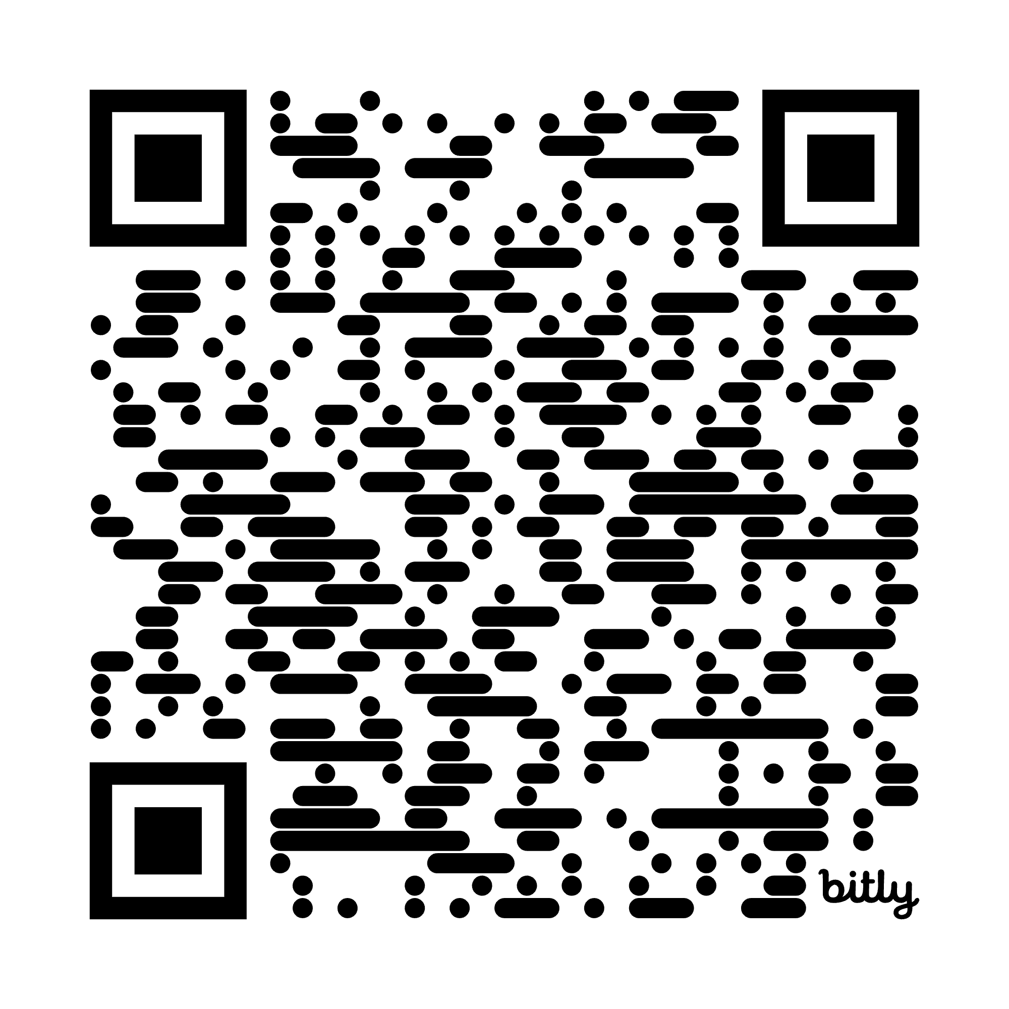
GET STARTED
How to Get Started
Reach out — talk to Monique today, or fill out the interest form
1
Sign a Letter of Agreement outlining both parties' commitments
2
Assemble your cross-role SCRIPT team
3
Complete the two-day SCRIPT workshop and set your school's AI goals
4
Launch your faculty Introduction to AI workshop — a full year of coaching follows
5
20
AdvanceKentucky | ETEI
Notes:
42:00–44:00 (2 min) — Step 1 is deliberately low-friction — the interest form is not a commitment to the full program, just a way to start a conversation.

Slide 22
GET STARTED
Why This Fits Your CTE Program
Connects directly to your workforce-readiness mission — the exact gap employers are naming
No-cost professional development for faculty who are already stretched thin
Pairs naturally with existing ETEI pathways — CS+Additive Manufacturing, CS+Engineering
Positions your program, and your students, ahead of the AI-skills curve employers are hiring for
21
AdvanceKentucky | ETEI
Notes:
44:00–46:00 (2 min) — This is the synthesis slide — tie the workforce stats from slide 4 back to the concrete program on offer.

Slide 23
We're recruiting additional districts and CTE programs to pilot AILRP for the 2026–27 school year.
Fill out the interest form — no commitment required to start the conversation. Or email mrice@kstc.com.
22
Notes:
46:00–48:00 (2 min) — This is the recruitment ask. Physically point to the interest forms on the tables. Keep the ask low-pressure — “no deadline today, just a way to start talking.” Mention you'll follow up with everyone who fills one out within a week.

Slide 24
Thank You
Monique M. Rice, Director, ETEI, AdvanceKentucky
mrice@kstc.com
AdvanceKentucky.com | AI Literacy & Readiness Program
bit.ly/AILRPinterestform
23
Notes:
48:00–50:00 (2 min) — Open the floor for questions. If time is short, offer to take remaining questions at your conference table.

