Slide 1
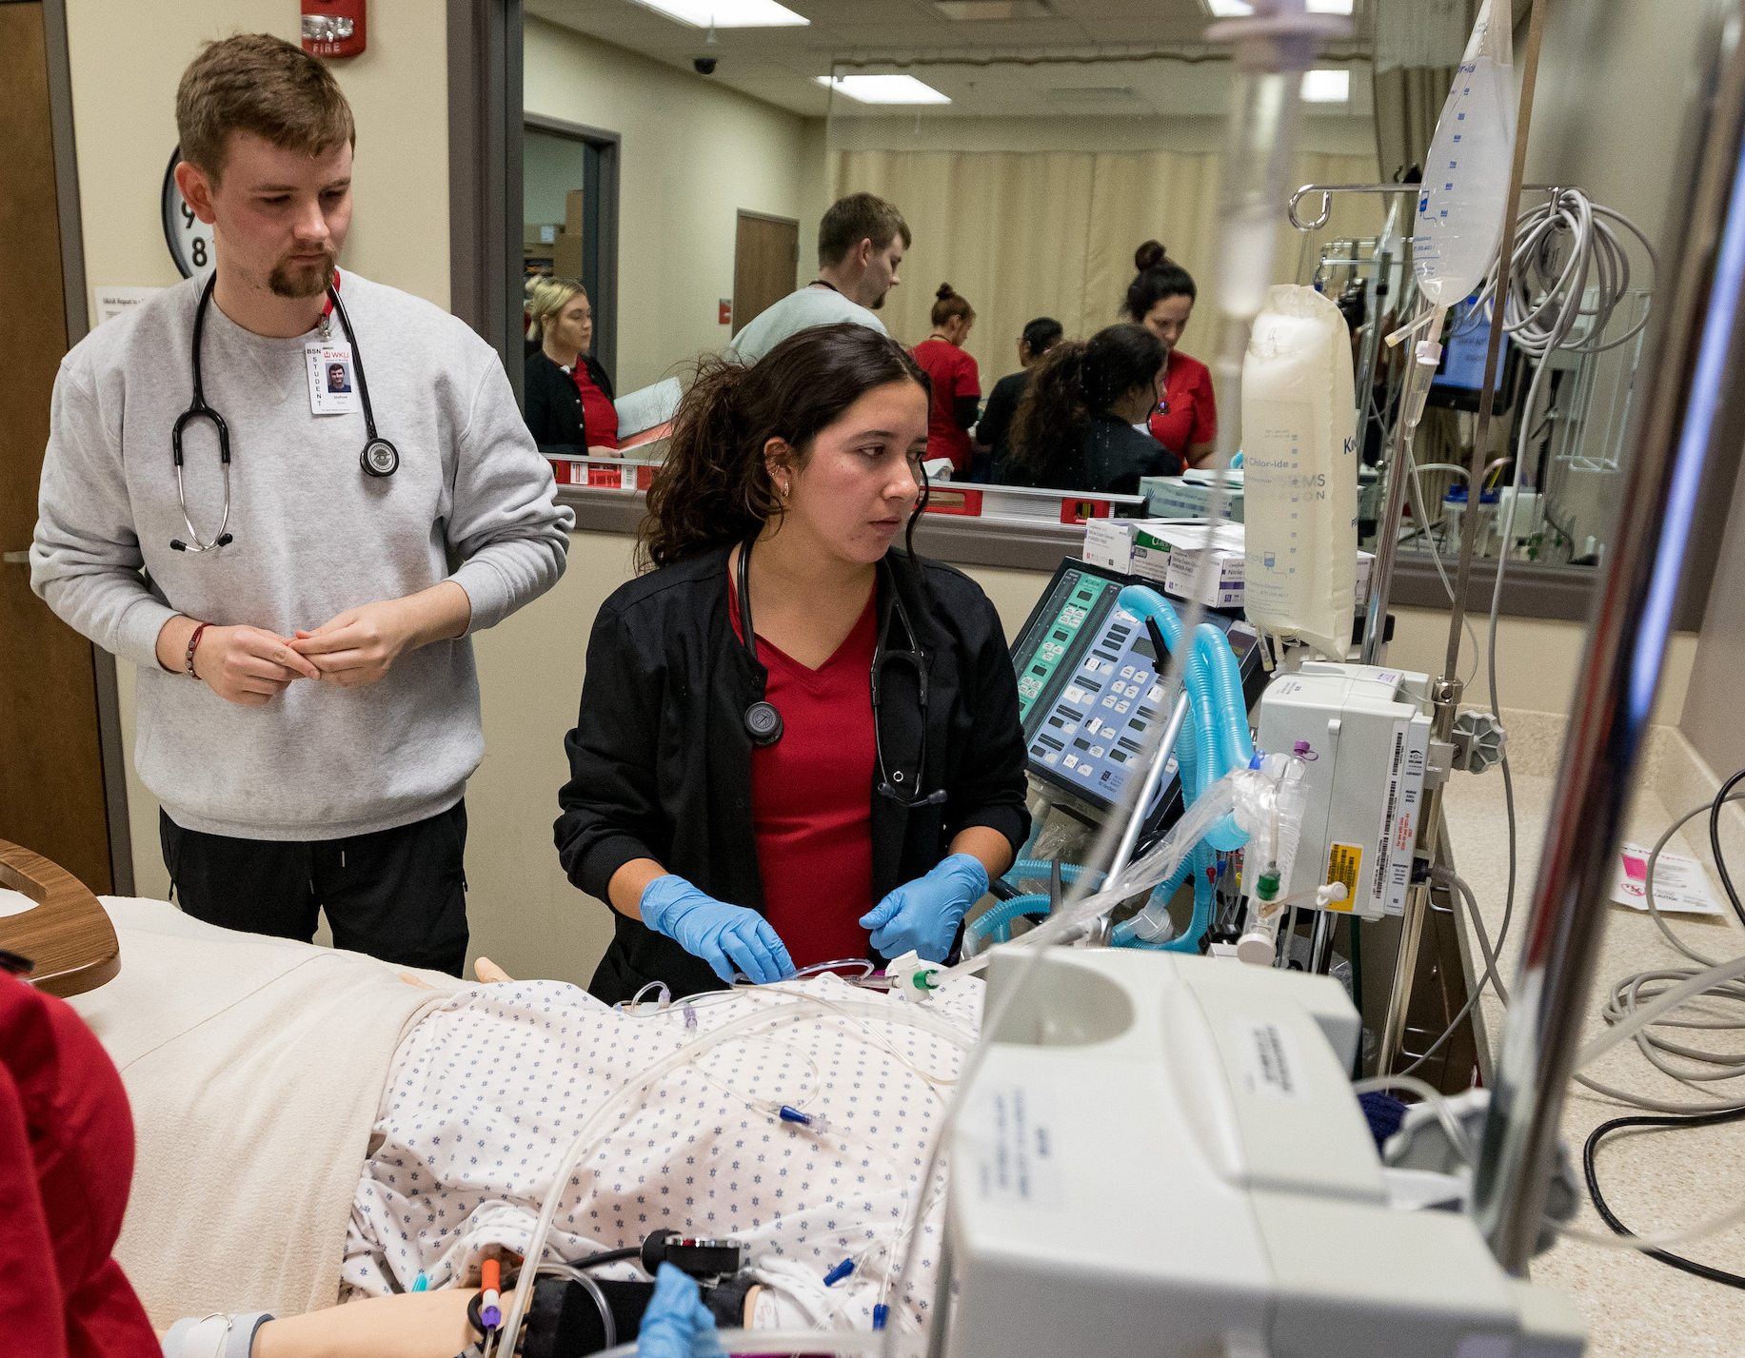
Simulation without the stress: best practices for teaching, Not grading in cte healthcare programs by: dr. Tracy Jenkins, CNE & dr. Kim Pharris, CHSE
Notes:
Professional Development Faculty:
Dr. Tracy Jenkins, DNP, RN, CNE, The Impact Center for Leadership and Innovation
Dr. Kim Pharris, DNP, RN, CHSE, Western Kentucky University, Pedagogical Assistant Professor
2026

Slide 2

Learning outcomes
Learners will understand there are INACSL and SSH standards for best practices in simulation and how to access them.
Learners will realize how simulation can bridge the gap between class and real-life practice.
Learners will recognize the importance of planning appropriate simulations based on each course need.
Learners will understand how to use Pre-briefing/ Simulation/Debriefing materials for simulation.
Learners will understand how to facilitate a simulation without interruptions.
Learners will identify free or low-cost simulation resources appropriate for secondary and postsecondary healthcare programs.

Slide 3
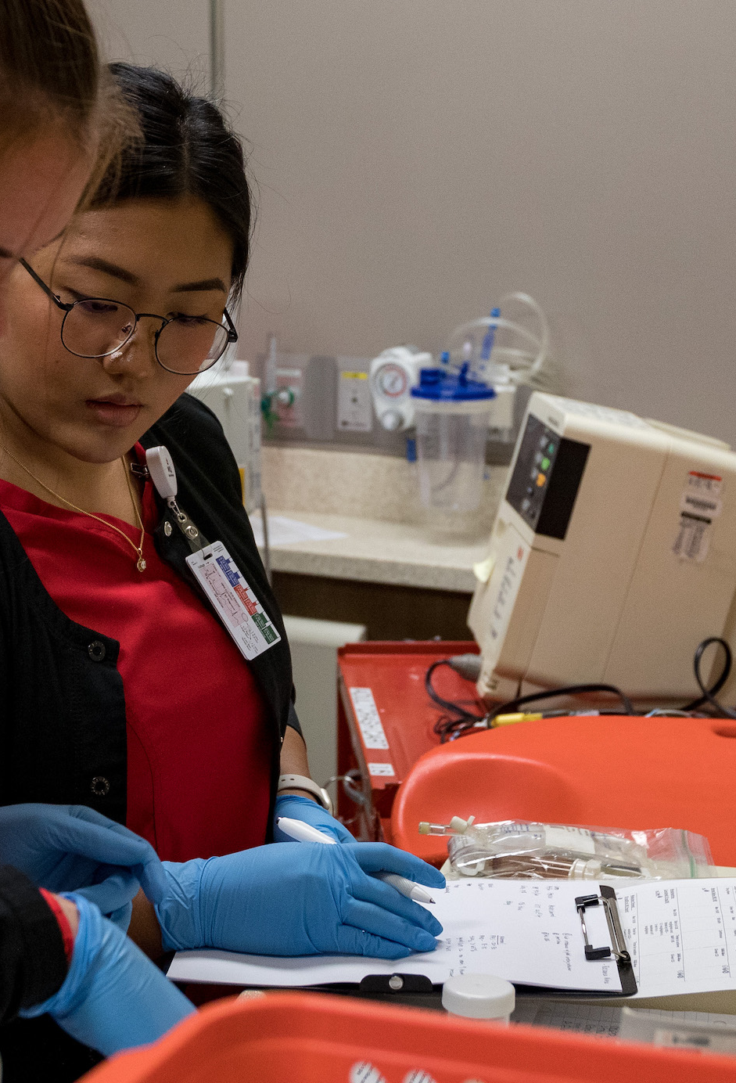
Why Simulation?
Simulation allows students to practice clinical and decision-making skills in a realistic, yet safe & controlled environment.
This approach boosts their self-esteem and confidence, making it easier to bridge the gap between theoretical knowledge and real-world practice.
Simulation does NOT require: High-fidelity manikins, Dedicated sim labs, or Large budgets
Examples CTE teachers can use tomorrow: Role-play with peers, Task trainers (BP cuffs, glucometers, injection pads)Standardized patients (students, retirees, drama clubs)Tabletop case simulations
Notes:
Citation:
Koukourikos, K., Tsaloglidou, A., Kourkouta, L., Papathanasiou, I. V., Iliadis, C., Fratzana, A., & Panagiotou, A. (2021). Simulation in Clinical Nursing Education. Acta informatica medica : AIM : journal of the Society for Medical Informatics of Bosnia & Herzegovina : casopis Drustva za medicinsku informatiku BiH, 29(1), 15–20. https://doi.org/10.5455/aim.2021.29.15-20

Slide 4

Professional Development → Train teachers before running scenarios Prebriefing → Student prep work / expectations Debriefing → Guided reflection, not grading Operations → Scheduling, supplies, volunteers
Notes:
Website: https://www.inacsl.org/healthcare-simulation-standards

Slide 5
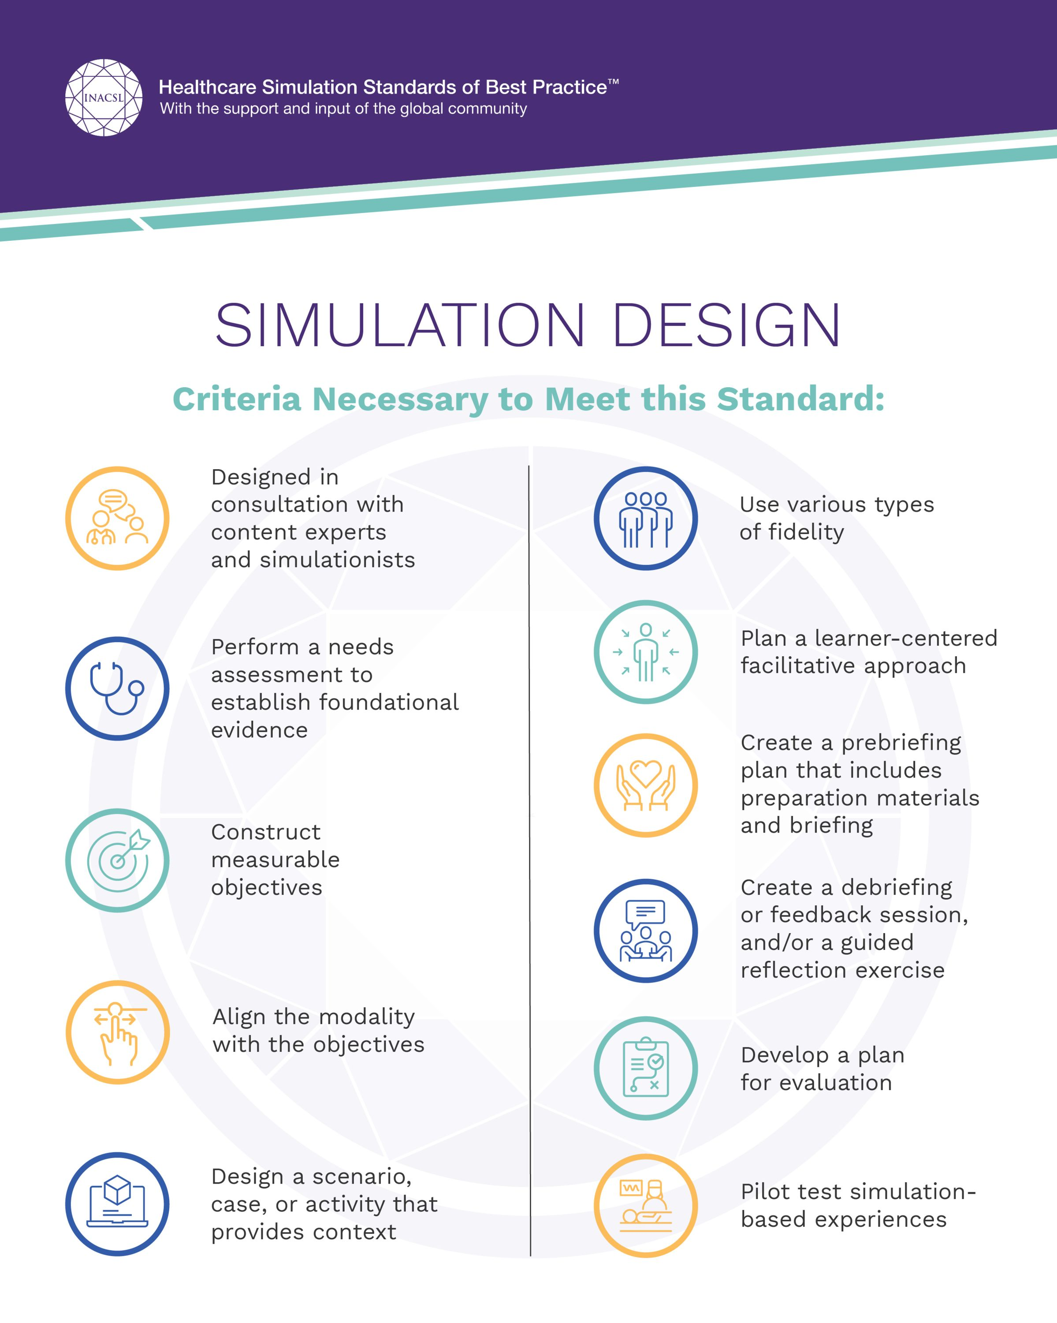
Designing the appropriate simulation for your course. Ask Yourself: what do your learners need to know for your course?

Slide 6
Simulation Cycle: Works at any level for Any simulation experience
PREBRIEFING
01
SIMULATION
02
DEBRIEFING & REFLECTION
Notes:
3 phases of simulation

Slide 7
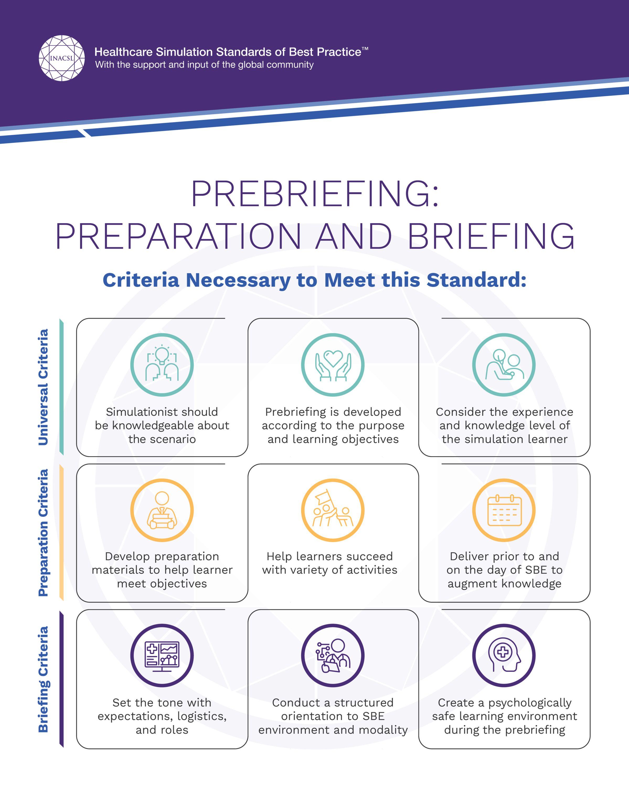
Prebriefing standards
Set Objectives for the simulation.
Prebriefing ensures that simulation learners are prepared for the educational content and are aware of the ground rules for the simulation-based experience.
This could be assigned readings, videos, skills review, case students, pretest or quiz, medication cards, short didactic lesson.
Encourage students to be BRAVE during the simulation, step outside their comfort zone.
Teacher can make the Prebriefing assignment their “Ticket to Ride” the simulation experience. If not done, they observe
Notes:
Full INACSL article: https://www.nursingsimulation.org/article/S1876-1399(21)00095-5/fulltext

Slide 8
Pre- Briefing examples for Simulation
CNA/Pre-Nursing
Review of Vital Signs
Hand Hygiene Video
Communication with Patients Video
EMS
Scene safety discussion
Allied Health
Scope-of-Practice Discussion
Medication mistake videos

Slide 9
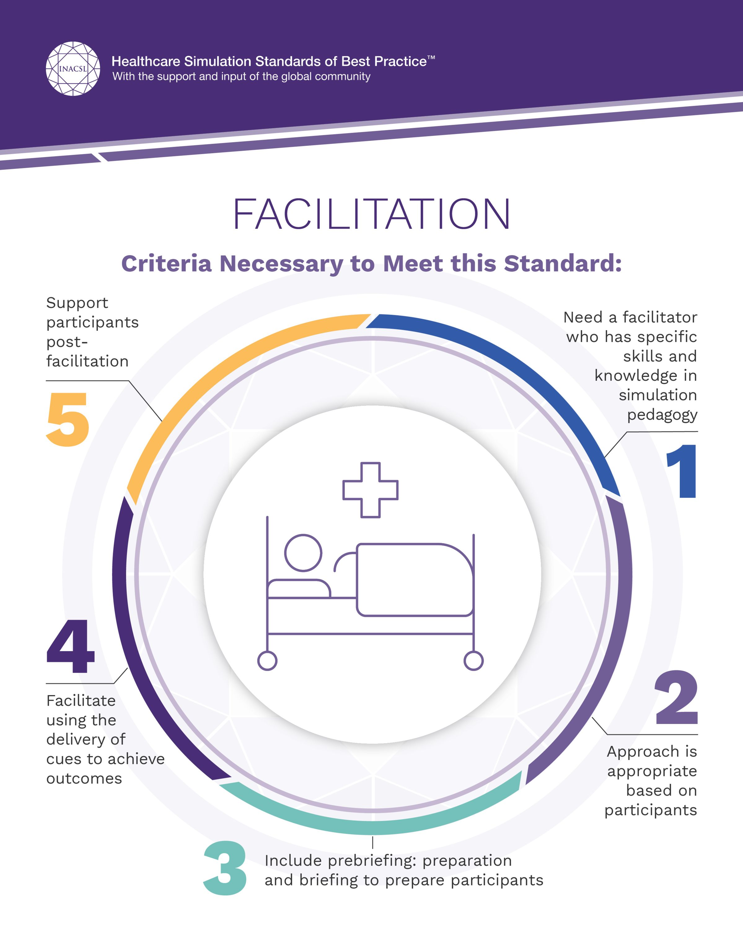
Simulation
Introduce Scenario: Present the simulation scenario to participants.
Role Play and Execute: Participants engage in the scenario, performing their roles. Those Observing also participate using the SOF.
Faculty as Facilitators: Faculty guide and support without direct interference.
Maintain Flow - No Interruptions, Allow the simulation to proceed without interruptions for corrections, but observe the TIME LIMITS.
Simulations should not be graded.
Notes:
As educators we want to stop students when they are going down the wrong path, but that is not active learning. Allow the simulation to come to its conclusion, then during debriefing the students can share where they got stuck and what they should have done. DO NOT INTERRUPT the simulation to teach/help/explain. Observing the time limits for simulations (usually 15-20 minutes) even if the students did not hit the goals. Debriefing will usually connect the dots for them and give them the “Ah ha” moment.

Slide 10
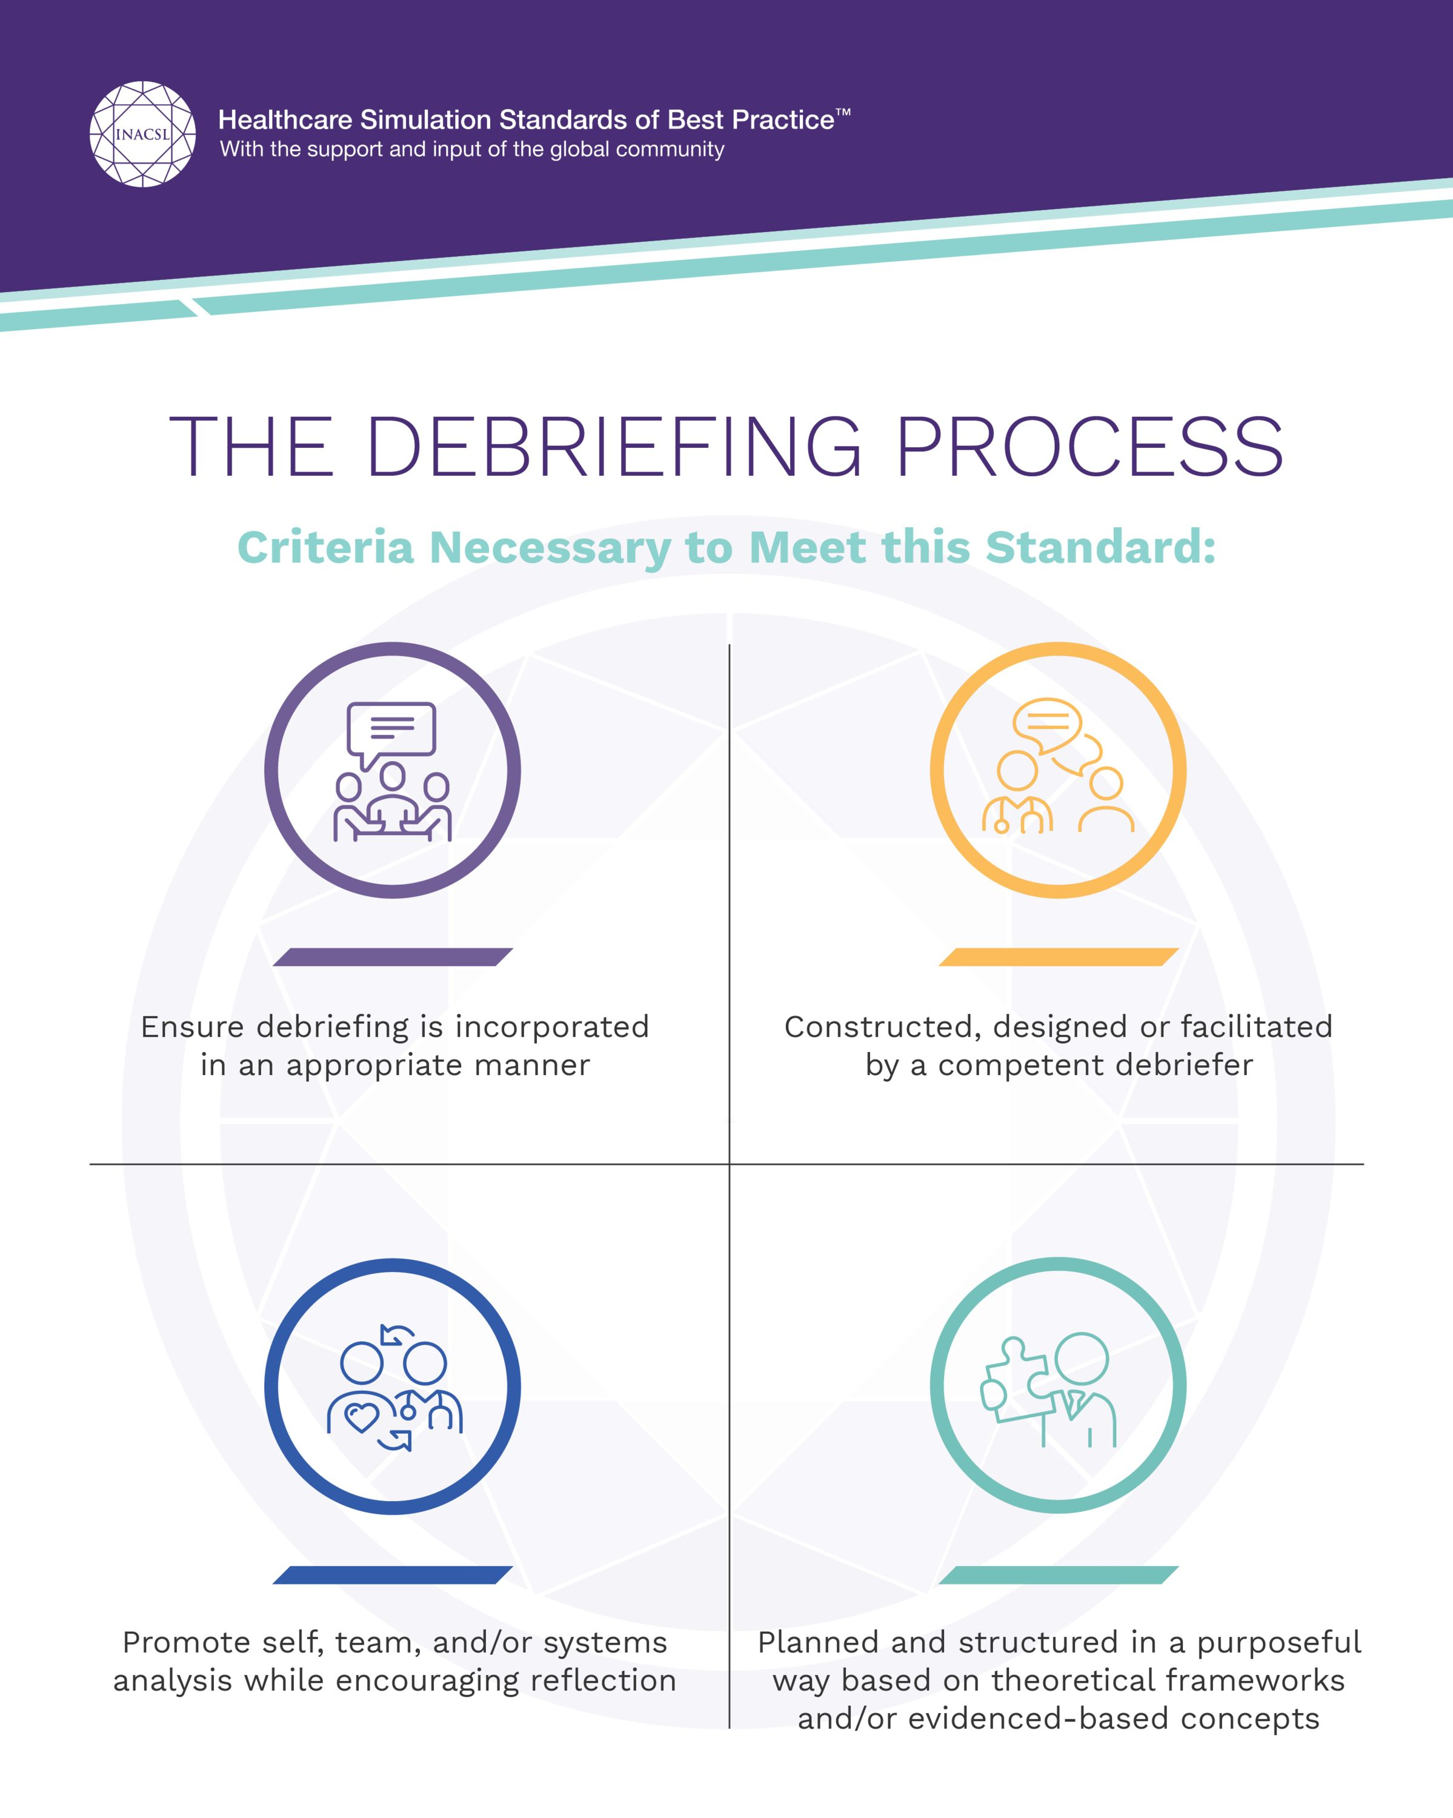
debriefing
FACILITATE, DO NOT LECTURE
LET THE LEARNERS SHARE WHAT THEY DID RIGHT AND WHAT CAN BE IMPROVED UPON FOR NEXT TIME.
ASK HOW THE LEARNERS ARE FEELING
Guide them through the simulation process and LET THEM TALK. As teacher’s this is difficult, but necessary for learning.
Notes:
Teaching, it’s what we do, but in simulation it’s best practice to let the learners speak, they will correct each other given time or may ask the facilitator a question, then it is ok to answer. Keep it short and sweet.

Slide 11

debriefing
Reflect on Experience: Encourage participants to reflect on their actions and decisions.
Discuss Performance: Analyze the performance of the participants.
Identify Learning Points: Highlight key learning points and areas for improvement.
Feedback and Improvement: Provide constructive feedback and discuss ways to improve. Ask what do you wish you had done differently? Or How will this change your future practice?
Notes:
Debriefing should be led by the LEARNERS and not the facilitator. If they get stuck, you can cue them as to what they need to discuss.

Slide 12
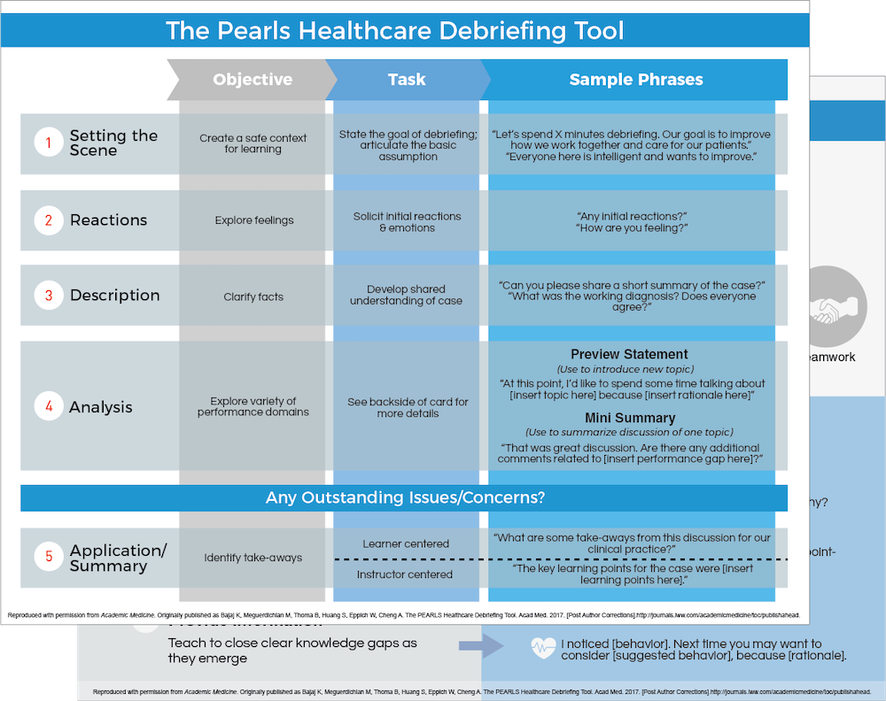
PEARLS: DEBRIEFING Promoting Excellence and reflective learning in simulation
A conceptual framework debriefing structure and script to be used for focused debriefing.
A link to this is at the end of this presentation.

Slide 13
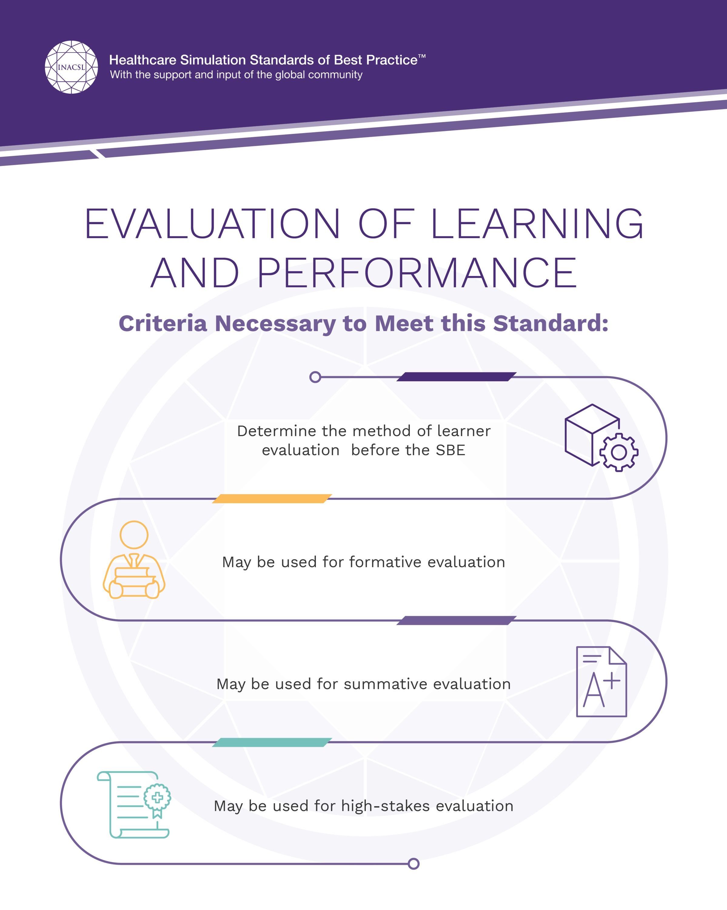
HOW DO I WANT TO USE THIS SIMULATION FOR MY COURSE?
SHOULD THIS BE A FORMATIVE SIMULATION?
SHOULD THIS BE A SUMMATIVE SIMULATION?
HOW DO I EVALUATE THE LEARNER?
BEST PRACTICE STATES SIMULATION LEARNERS SHOULD NOT BE GRADED FOR SIMULATIONS.
Notes:
Simulation is a learning strategy, not a testing method. Grading performance in simulation undermines its purpose and conflicts with best-practice standards.
Key reasons:
Psychological safety: When grades are attached, students prioritize “not failing” over clinical reasoning, risk-taking, and learning from mistakes.
Simulation ≠ reality: Time compression, incomplete data, manikin limitations, and faculty prompts make simulation an artificial environment that cannot reliably measure competence.
Inconsistent conditions: Variation in roles, team dynamics, cues, and equipment reduces fairness and reliability for summative grading.
Evidence-based standards: INACSL explicitly discourages summative grading of simulation performance because it threatens validity and learner trust.
Simulation is where students are allowed to fail safely so they can succeed in real patient care.

Slide 14
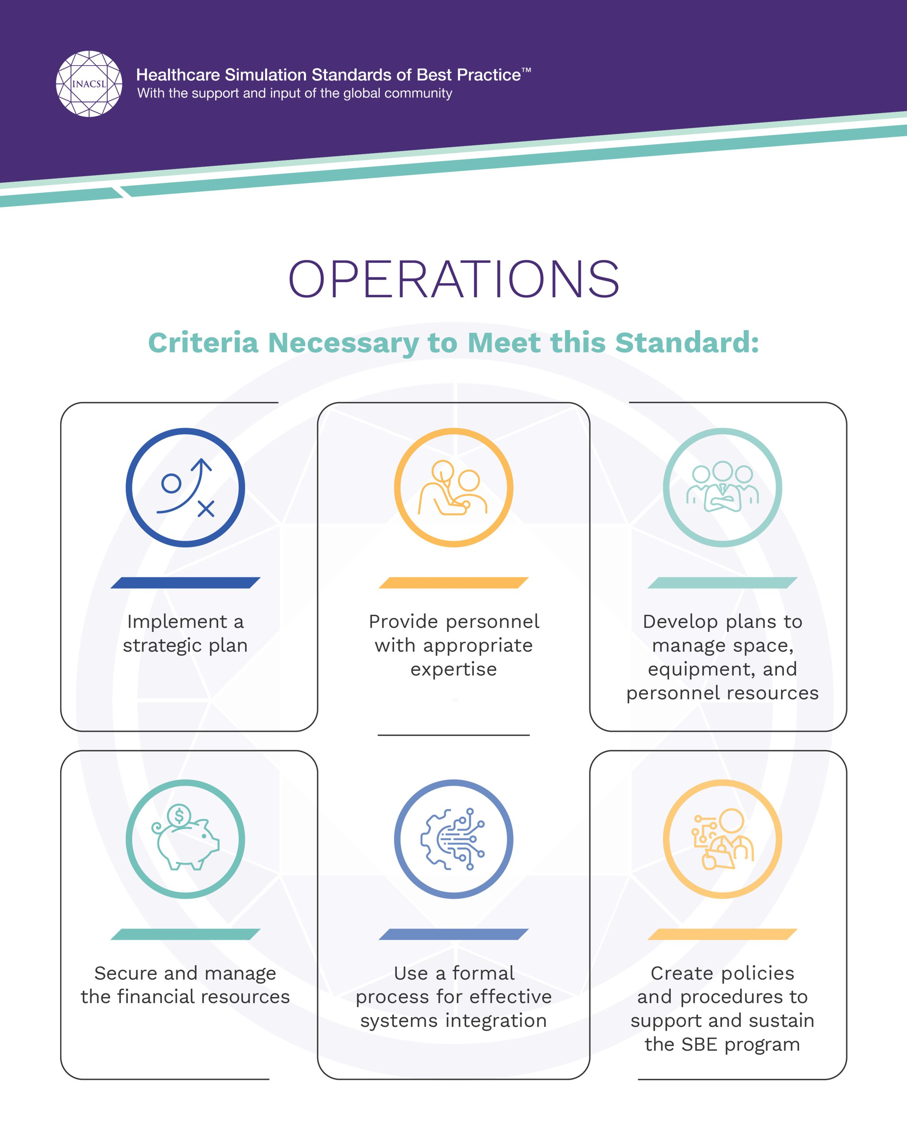
OPERATIONS
Simulation teachers and staff (if available) assist in the day-to-day simulation operations.
The use high fidelity and low fidelity manikins as well as task trainers (hands, arms, etc.) can be used in simulation.
Collaboration with retired healthcare nurses, EMS, MNAs, or your drama class/club.
It’s important to plan yearly meetings to set standards for your simulations. And create a simulation calendar for staff and students.

Slide 15
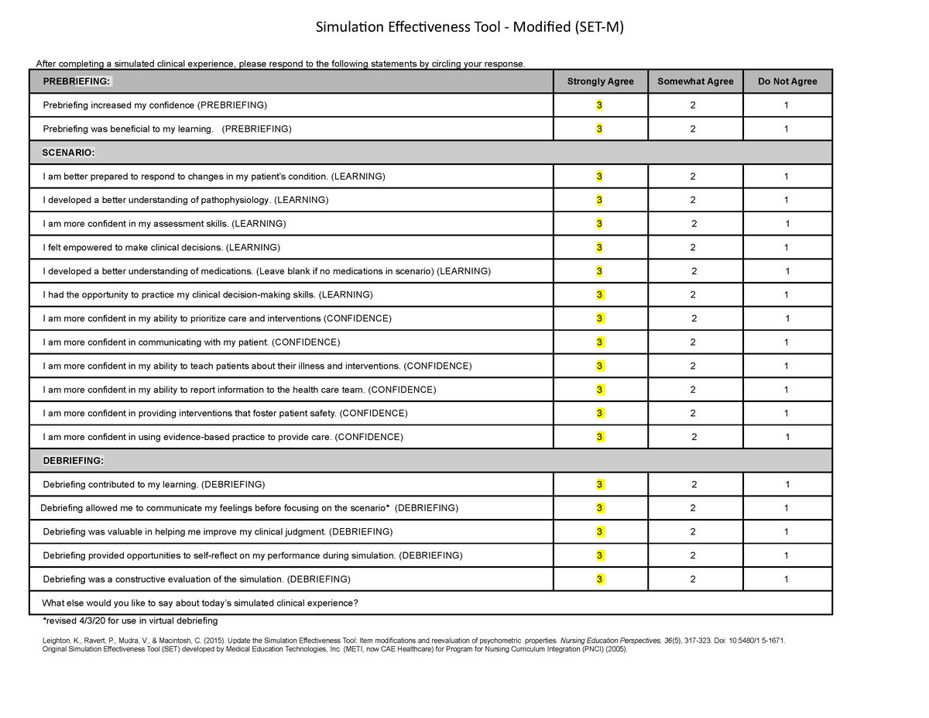
SET-M Tool for Evaluation of Sims
“The SET-M is designed for evaluation of clinical simulation scenarios. Leighton, Ravert, Mudra, and Macintosh (2015) updated the SET to incorporate simulation standards of best practices and updated terminology.
The researchers determined the tool required updating to capture the desired outcomes – learner’s perceptions of how well their learning needs in the simulation environment were being met. “ Link at end of presentation.
Notes:
Website: https://www.healthysimulation.com/tools/evaluating-healthcare-simulation/simulation-effectiveness-tool-modified-set-m/

Slide 16
Let’s practice:
Each table will do:
One Learning Objective
One Prebriefing Assignment
One Scenario
One Reflection from the scenario

Slide 17
Free resources for CTE educators:
Healthy Simulation Resources: https://www.healthysimulation.com/
The National League of Nursing (NLN) has templates available for writing simulations. See link: https://www.nln.org/docs/default-source/uploadedfiles/professional-development-programs/sirc/simulation-design-template-2023.docx?sfvrsn=d26a60d_13
NLN SIRC has HOMEGROWN Solutions website also has lots of FREE ideas for simulation and is a repository for ideas from all over the US of sim ideas. Here is the link: https://www.nln.org/education/education/sirc/sirc/sirc
FREE resources from Healthy Simulation. Here is the link for the SET-M: https://www.healthysimulation.com/tools/evaluating-healthcare-simulation/simulation-effectiveness-tool-modified-set-m/#aioseo-downloadable-files-for-set-m
Here is the link for the structured observer form (SOF): https://www.nln.org/docs/default-source/uploadedfiles/professional-development-programs/sirc/structured-simulation-observer-form.pdf?sfvrsn=2ad292f3_3
Reach out to hospitals/education departments for supplies that have expired and they must throw out.
Drama Clubs and retired nurses/EMTs to act as the patient or family member.

Slide 18
What questions can we answer?
Link to Survey:
Nurses may receive 1.0 CE for this presentation.

