Slide 1
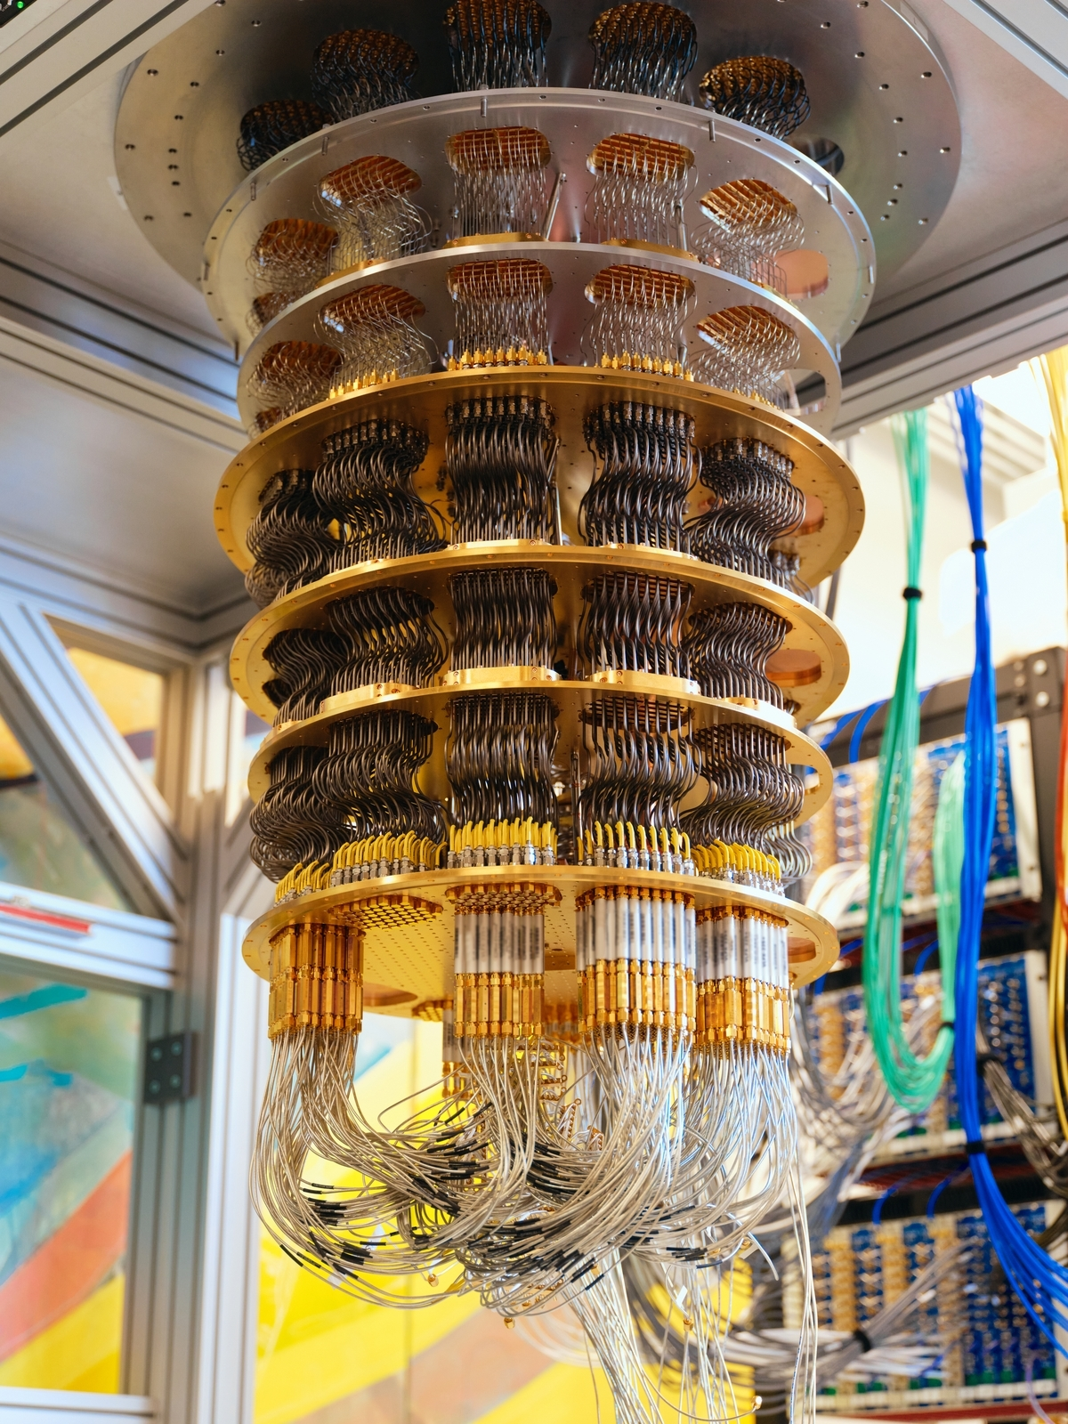

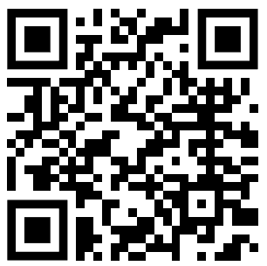
Quantum Computing (QC) for All
Dr. Nabeel Alzahrani
Ph.D. in Computer Science
Faculty, School of Computer Science & Engineering
Co-founder, Artificial Intelligence, Quantum Computing, Fusion Energy, and Semiconductors (AQFS) Research and Training Lab

Slide 2

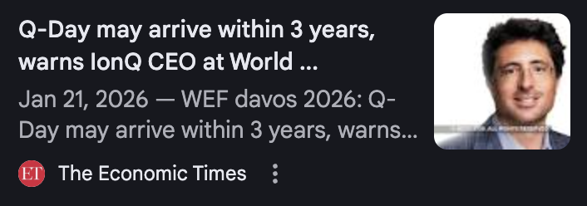
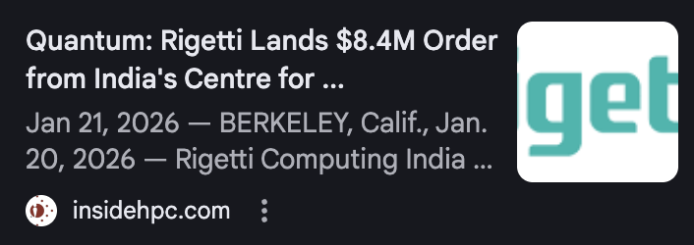
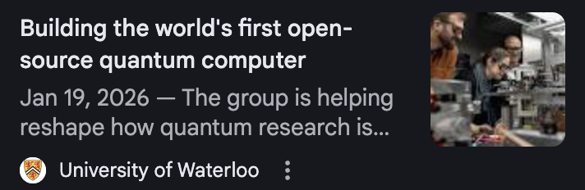
Quantum Computing (QC) in the News
2025 was the UN’s International Year of Quantum Science & Technology
  Celebrating 100 years of quantum science leading to discoveries like the laser, MRI, and the transistor
“Q‑Day” Could Arrive 2030–2040
  Quantum computers may one day break current encryption
Rigetti Ships 108‑Qubit Quantum Computer (QC) to India
  QC are being built and used globally
Open-Source QC in Development
  Anyone can experiment with quantum computing worldwide

Slide 3
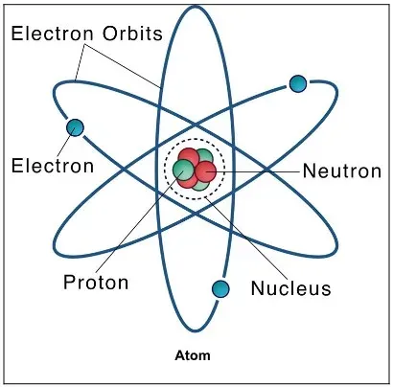
What Is Quantum?
Quantum = how subatomic particles behave
  Electrons
  Neutrons
  Protons
  Photons
Subatomic particles behave in strange ways compared to everyday objects
  Superposition
  Entanglement
  Tunneling
  Teleportation
Quantum physics / mechanics explains these strange behaviors
  Rules behind superposition, entanglement, tunneling and teleportation
Subatomic Particles

Slide 4
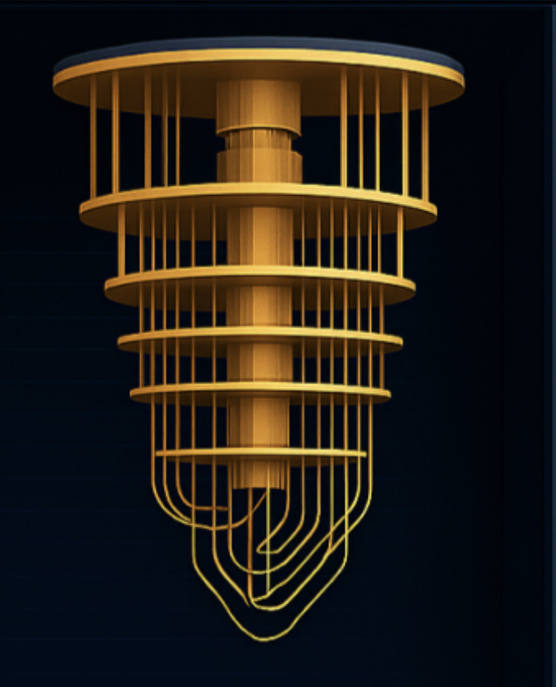
New Breakthrough in Computing
Not faster computing
  Fundamentally new kind of computing
Built to solve problems classical computers (normal computers) cannot
Powered by the laws of the quantum physics
Practical quantum computers started around 2020 (~5 years ago)
  Research began in the 1980s (~45 years ago)

Slide 5
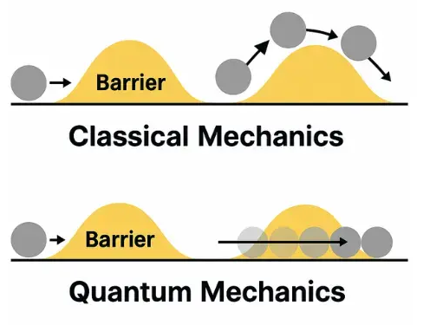
Why Quantum Computing Matters
Nature is quantum
  Atoms
  Molecules
  Energy
Classical computers (CC) struggle to model nature accurately
  Number of possible states grows exponentially with atoms
  Electron tunneling: Transistors are now so small that electrons can tunnel through them
Quantum computers follow nature’s rules
  Built on quantum mechanics
Quantum Tunneling

Slide 6
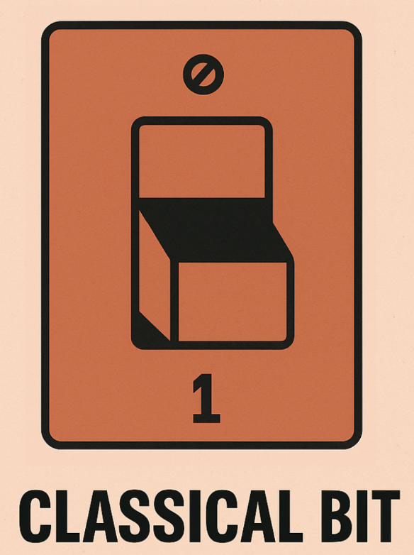
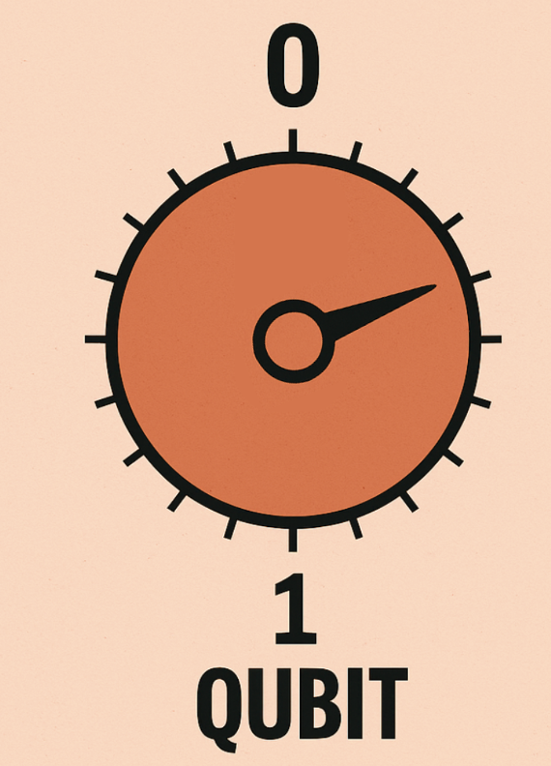
From Classical to Quantum
Classical Binary Digit (Bit)
  Bit = 0 or 1
  Like a light switch (off or on)
Quantum Bit (Qubit)
  Qubit = 0 and 1 simultaneously (superposition)
  Like a dimmer switch (can be partly off and on)
Measurement
  Before measurement: qubit exists in a combination of 0 and 1 (superposition)
  After measurement: qubit behaves like a classical bit (0 or 1)

Slide 7
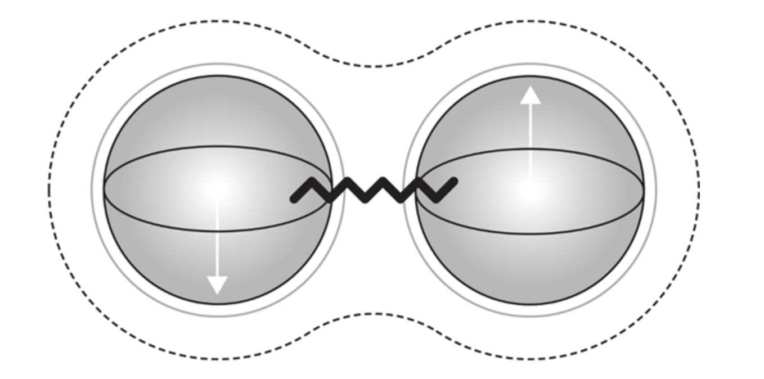
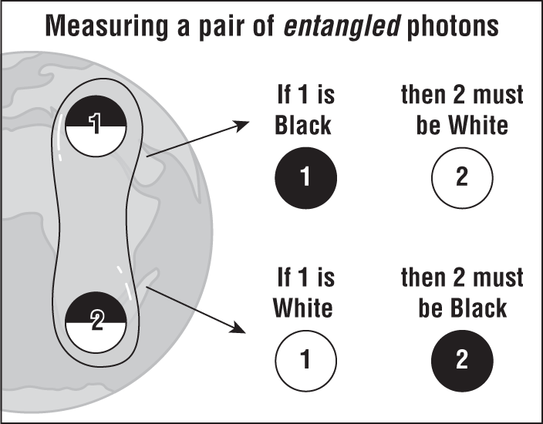
Entanglement: Quantum Connection
Two qubits or more can share a single quantum state (entanglement)
  Neither qubit has a definite value until measured
Measuring one instantly reveals the other
  The other qubit will show the correlated state (0 or 1)
Distance does not weaken this correlation
  The link works even if qubits are across the universe

Slide 8
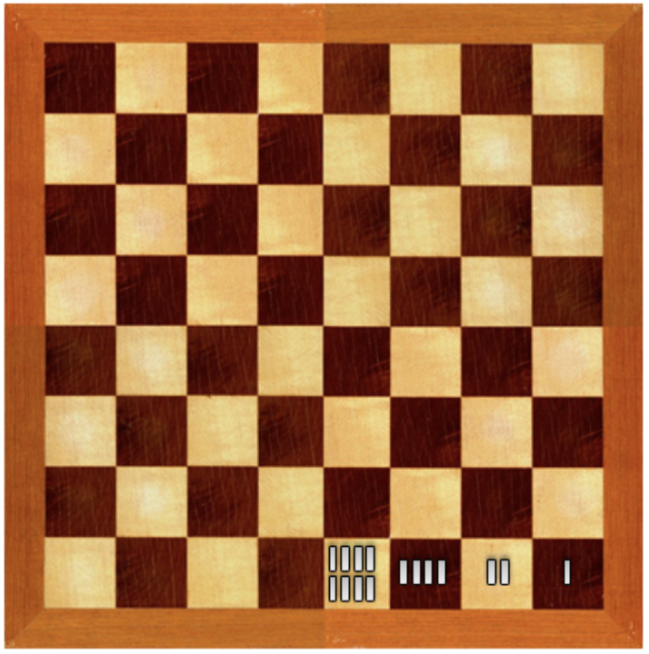
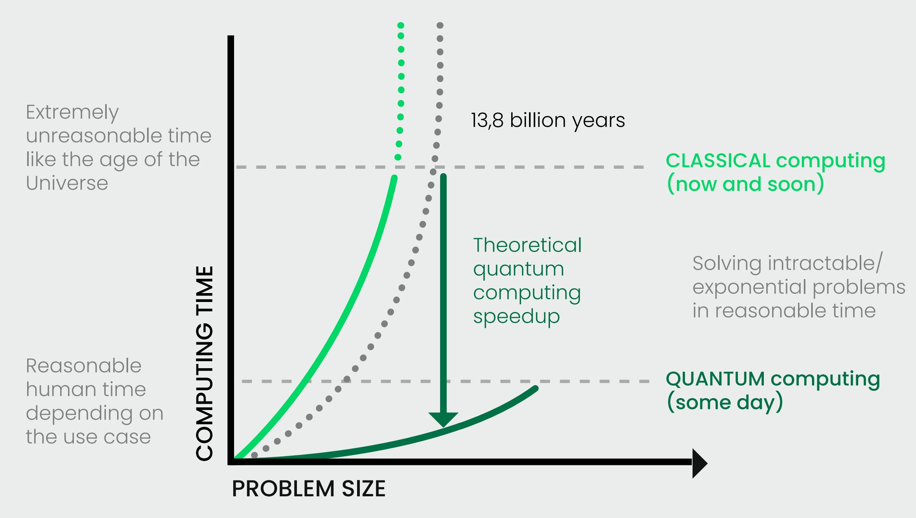
Exponential & Parallel Power
Exponential
  Each added qubit doubles computational states
Parallel
  Quantum computers explore many states at once
65 qubits
  More states than grains of sand on Earth
300 qubits
  More states than atoms in the observable universe
Natural Solar Panel: Chlorophyll (135 atoms)
  Problem size: 2¹³⁵ states
  CC: 100K universe lifetimes
  QC: 20 min
  Plants (natural quantum processor): Energy transfer (not simulate) in trillionths of a second

Slide 9
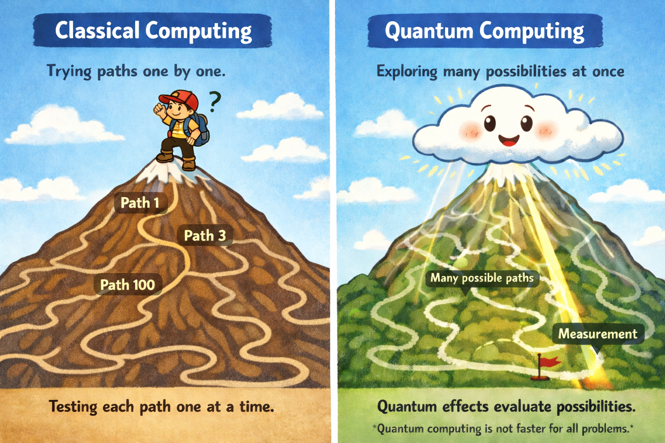
CC vs QC: Different Ways to Solve Problems
Notes:
The mountain represents the problem, the cloud represents a quantum computer, and the brightest yellow path represents a good solution.
The cloud covers all possible paths at the same time, meaning it represents all possible solutions at once.
The cloud sends waves along all paths, and as these waves interact, some paths become brighter while others become dimmer.
By repeating this process, good paths become more likely and stand out more than the bad paths.
When we examine, or measure, the quantum computer, we see one path — the brightest one, which has the highest probability of being a good solution — and we take it as the result.
Designing how these waves are sent so that good solutions stand out and unlikely ones fade away is the heart of quantum computing algorithm design, and this is where computer scientists play a central role.

Slide 10
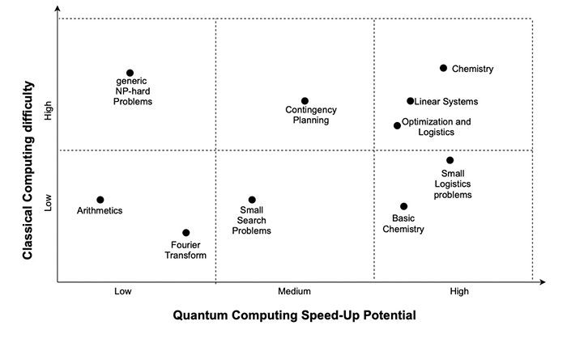
Where Quantum Shines
Chemical & material simulations
  Molecules, reactions, new materials
Massive optimization
  Logistics, finance, scheduling
Select machine learning tasks
  Quantum clustering, pattern recognition
Advanced cryptography
  Quantum key distribution, code breaking
Not for: Everyday computing
  Games, email, browsing

Slide 11
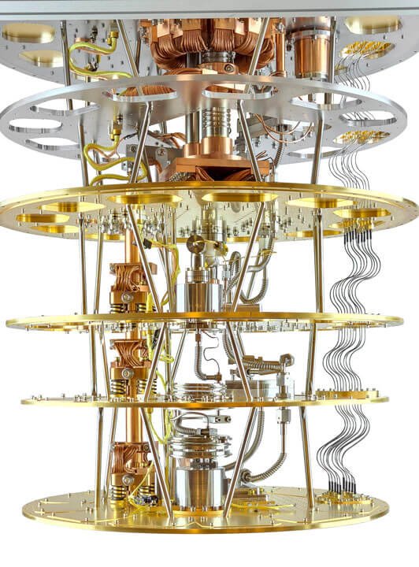
Quantum Hardware Reality
Quantum states are extremely fragile
Must be protected from heat, noise, vibration
Requirements:
  Temp: –459.66°F (colder than the universe)
  Ultra-high vacuum
  Extreme isolation
Solution: Physical vs. Logical Qubits
  Physical qubits: Actual hardware qubits, vulnerable to noise
  Logical qubits: Built from many physical qubits for error correction

Slide 12
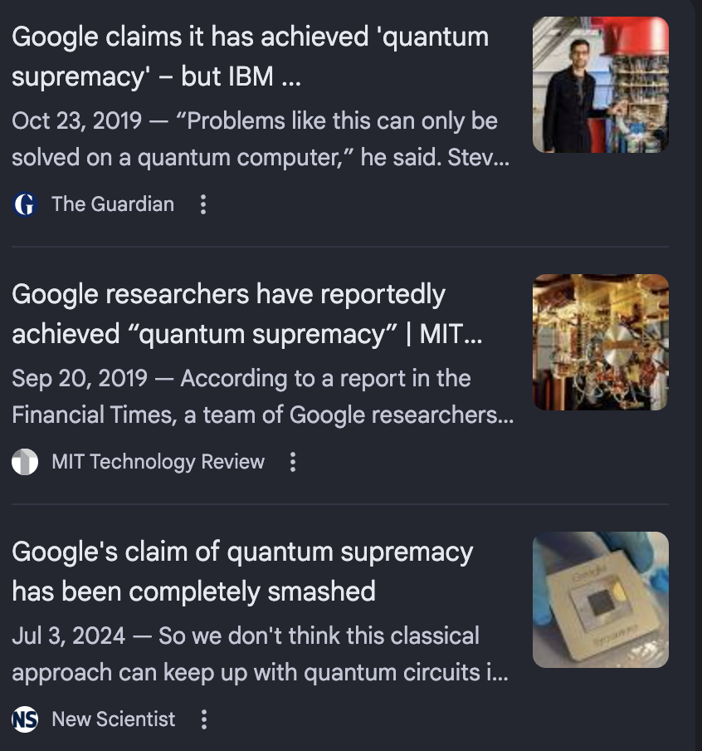
Quantum Hype vs. Reality
Quantum supremacy
  Beates classical computers on any task (even useless)
Quantum advantage
  Beats classical computers on practical tasks
Hype headlines: “Quantum Supremacy!”
  Misinterpreting quantum supremacy as general usefulness
Reality:
  Proof-of-concept on a narrow, experimental problem

Slide 13
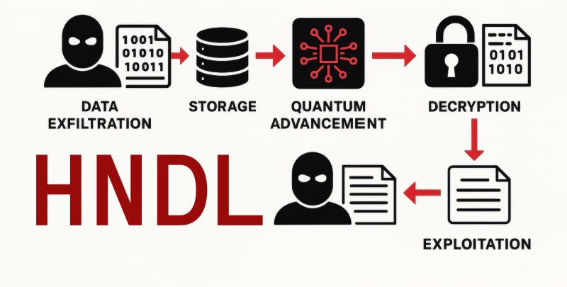
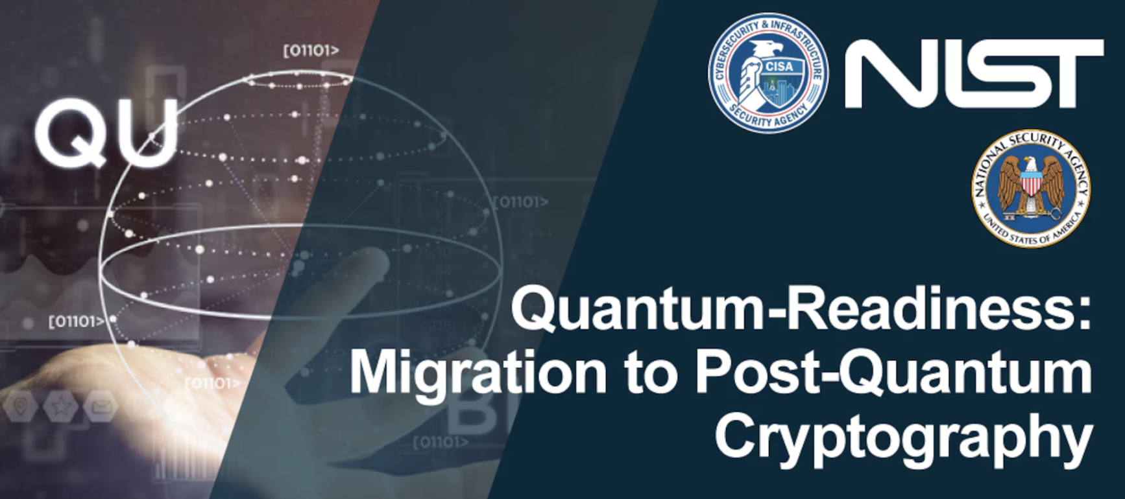
Post-Quantum Cryptography (PQC): Why It Matters
Q‑Day” Could Arrive 2030–2040
  Quantum computers break current encryption
The Threat: HNDL
  HNDL = Harvest Now, Decrypt Later
Why It’s a National & Personal Threat
  Emails, bank accounts, military, and government secrets
Solution:
  Uses quantum-safe encryption (PQC) to protect data today for the future

Slide 14
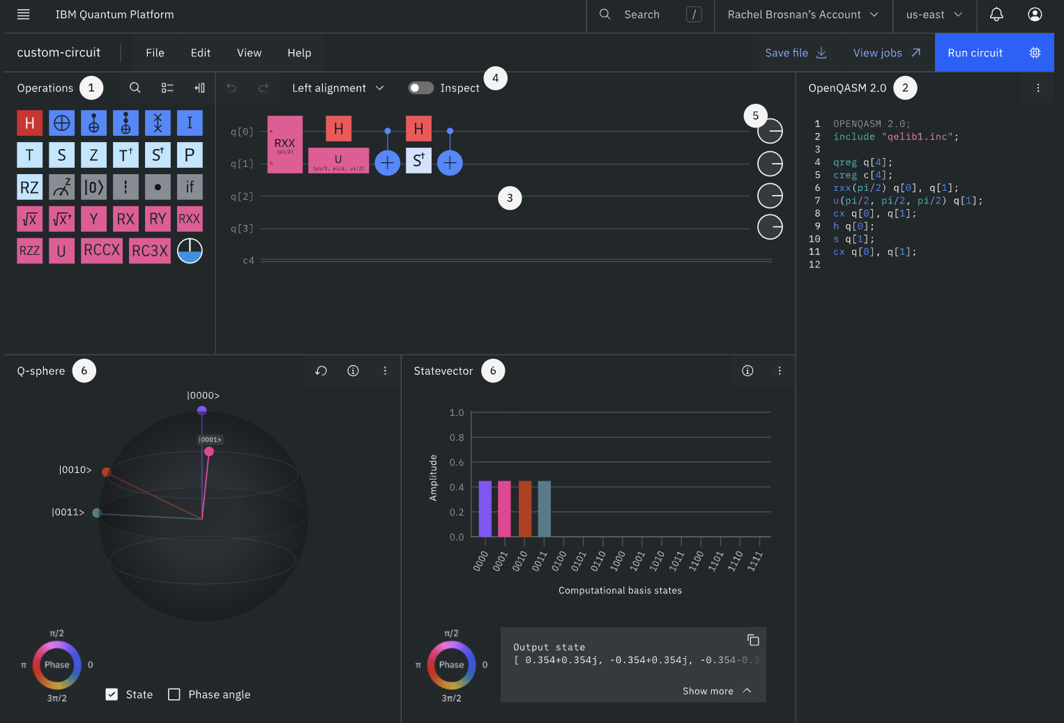
Try Quantum Computing Today
Access quantum computers for free online:
  IBM: ibm.com/quantum
  Google: quantumai.google
  Microsoft: quantum.microsoft.com
  AWS: aws.amazon.com/braket/
What you can do:
  Create entanglement in minutes
  Run experiments in your browser
  Drag-and-drop interfaces, no physics needed
Free quantum programming tools:
  Qiskit (IBM): ibm.com/quantum/qiskit
    Free, open-source simulator that runs on any PC
  Cirq (Google): quantumai.google/cirq
  Q# (Microsoft): github.com/microsoft/qdk
  Braket SDK (AWS) : aws.amazon.com/braket/getting-started/

Slide 15

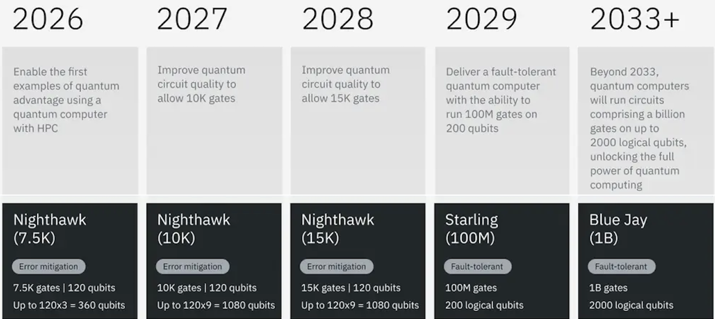
Your Quantum Timeline
Now–2030: Learn & Explore
  Learn quantum basics
  Try programming (Qiskit, Cirq, Q#)
  Run simulations
  Join clubs, or hackathons
2030–2040: Apply & Build
  Work with fault-tolerant / hybrid systems
  Contribute to projects or research
  Study advanced algorithms & error correction
2040+: Transform & Innovate
  Lead applications in medicine, energy, AI, security
  Solve problems classical computers cannot

Slide 16
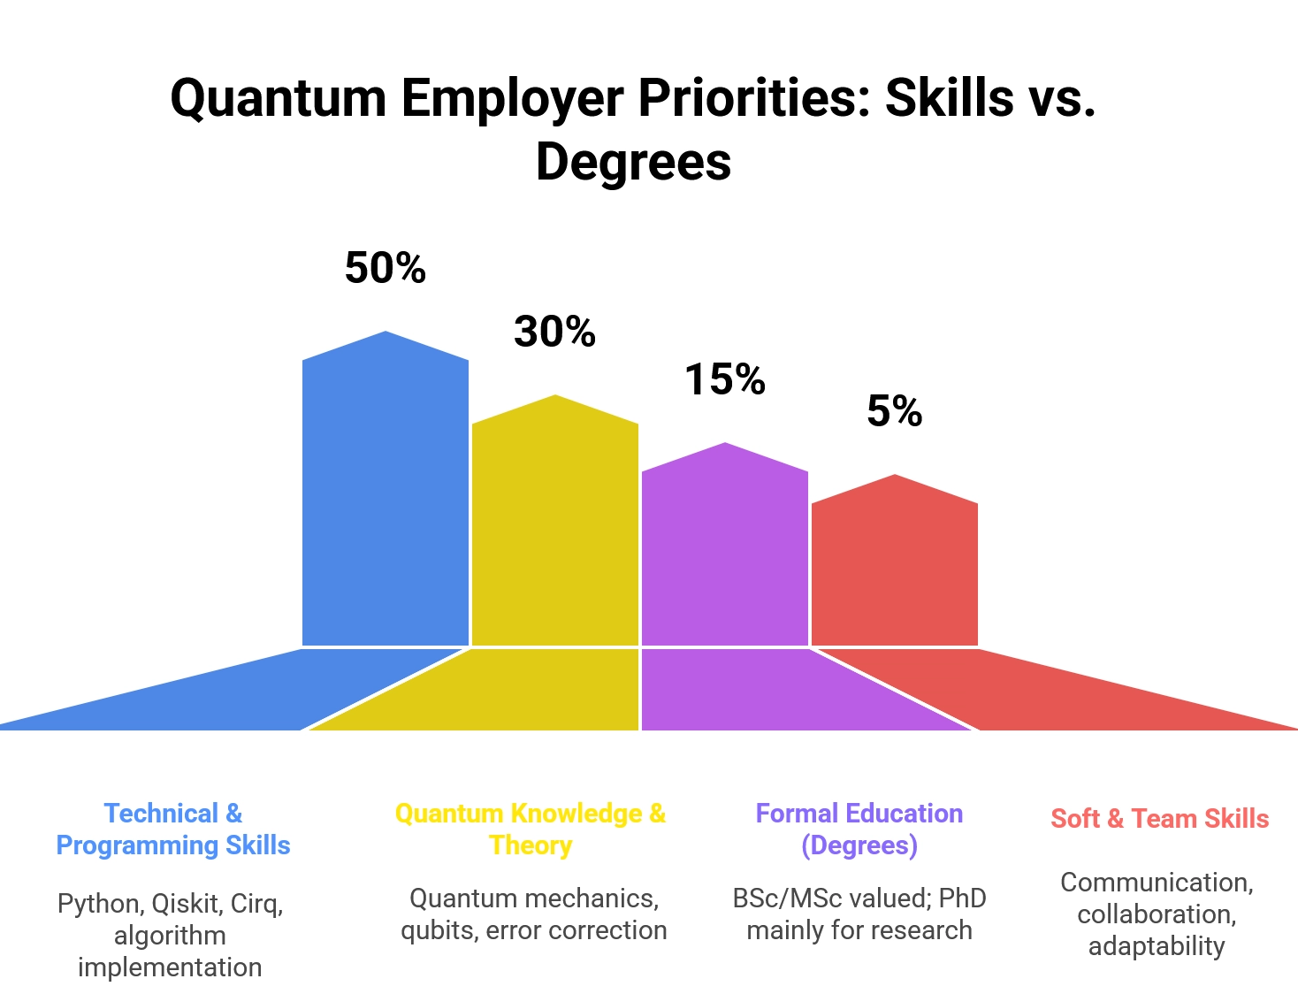
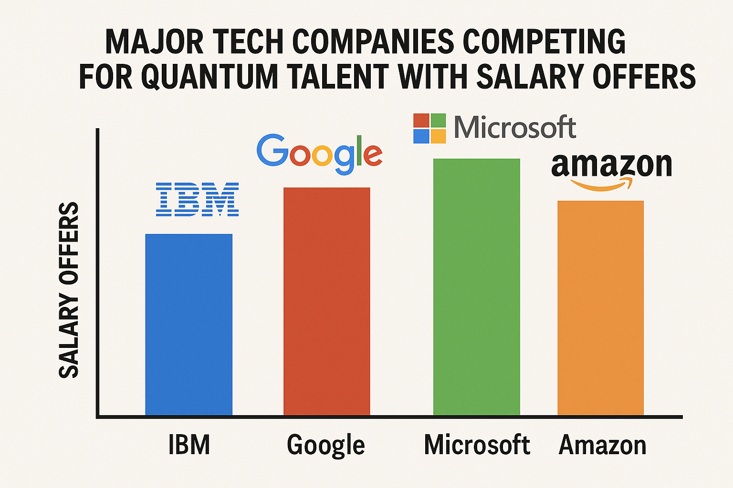
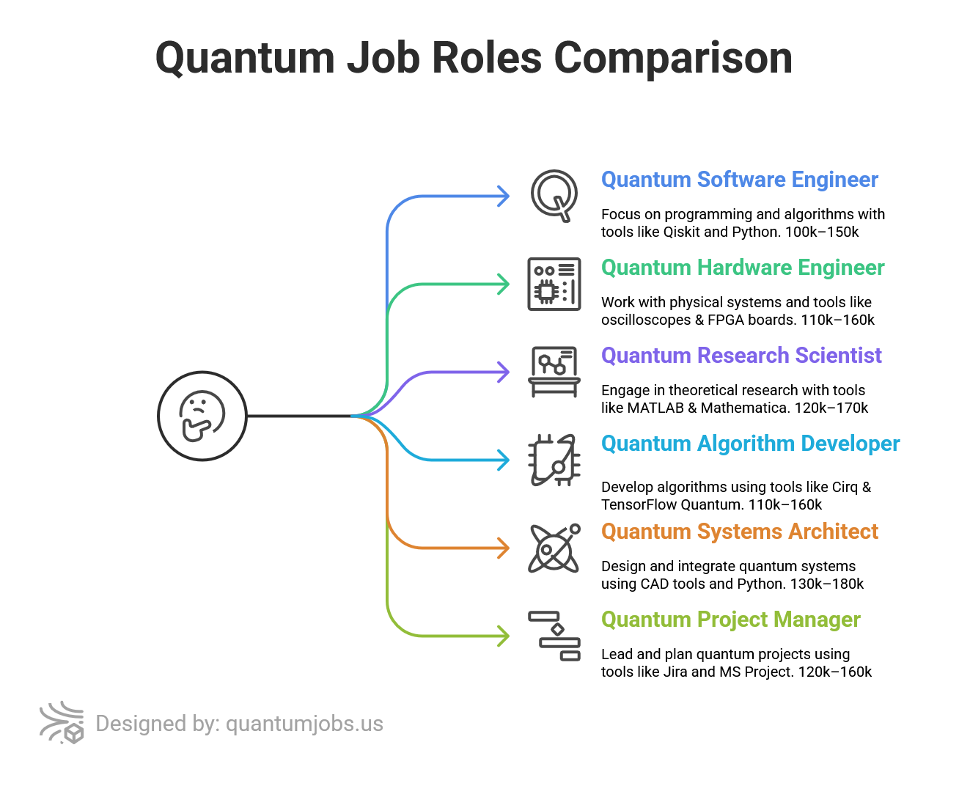
How Every Student Can Contribute

Slide 17
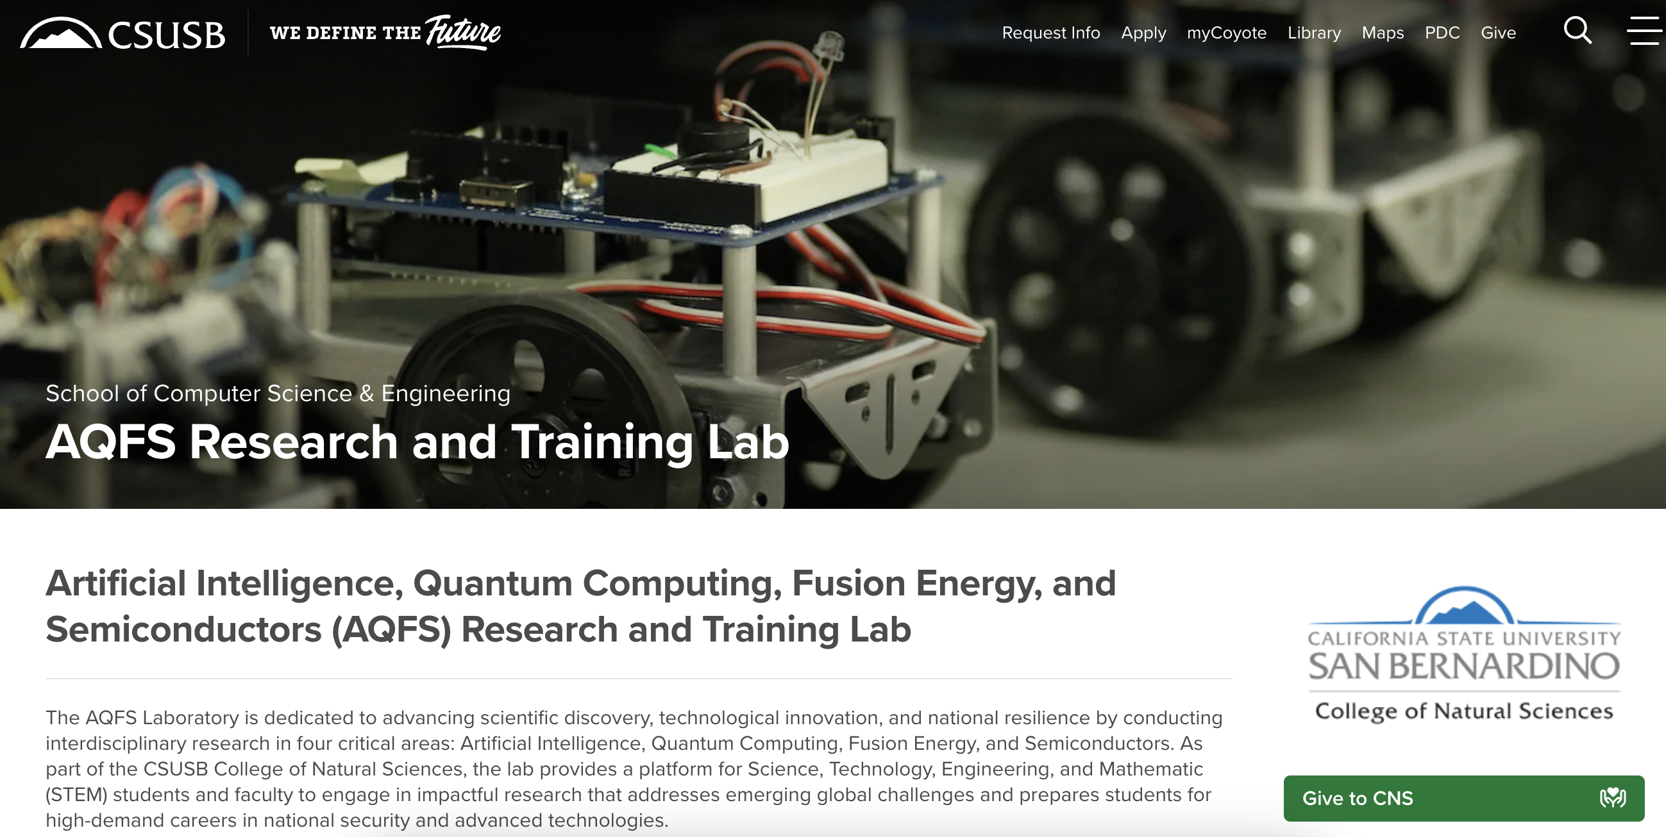
My Research
Dr. Nabeel Alzahrani, Ph.D. in Computer Science
alzahran@csusb.edu
www.csusb.edu/profile/alzahran

