Slide 1
Debugging Virtual Networks with Provenance
Alexander Wolosewicz (IL Tech), Raffay Atiq (SRI), Nishanth Shyamkumar (IL Tech),
Van Anderson (IL Tech), Vinod Yegneswaran (SRI), Ashish Gehani (SRI), Nik Sultana (IL Tech)

Slide 2
Short Bio
3rd year Ph.D. student.
Bachelor’s in CS.
Working on this project since ~September 2024.

Slide 3
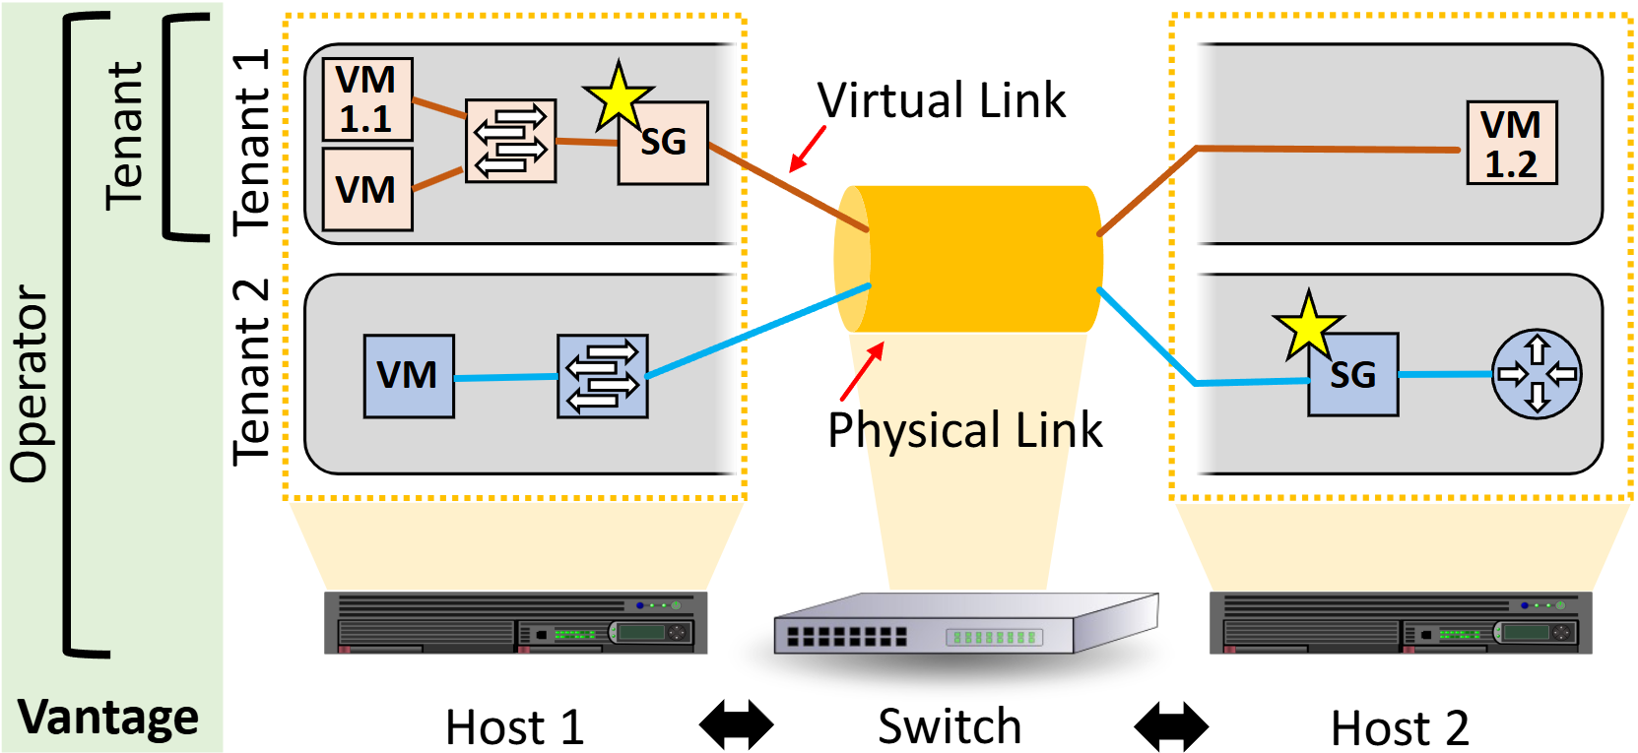
Introduction
Virtualization is present in many modern networks: Cloud, telecom, campus, testbed.
Problems can manifest both in the virtual (tenant) network and in the physical network (underlay).
When an issue occurs, vantage points enable diagnosing and debugging.
  Network operators have many vantage points.
  Tenants have significantly less.

Slide 4
Examples of Network Problems
Packet loss and reachability.
Performance anomalies – staying within SLOs.
Correct forwarding, loop detection, path conformance.
Causes include hardware/software faults, misconfigurations.
  ByteDance: 35.4% of outages misconfigurations (Liu et al. HotNets 24)

Slide 5
Research Problem
Tenants encounter issues in their virtual networks.
  May be self-induced, may be virtual bug, may be underlay.
Limited vantage point is an impediment.
When in doubt, escalate to operator.
  Operator support is a scarce resource.
Motivation: improving tenant visibility, conserve operator time.
Research Question: How can tenants diagnose/debug without operator support, preserving virtualization and permissions?

Slide 6
Existing Work
In the literature: operator-level, non-generic, or non-comprehensive.
  Netsight/ndb: comprehensive (packet histories), non-generic.
  VND/NetHint: tailored to virtual environments, but underlay-embedded (VND, needs operator work) or non-comprehensive (NetHint, congestion-only).
In the field: AWS, Oracle Cloud have static configuration checkers and flow-level logging.
  Static checks are non-comprehensive.
  Flow-level logging nice but potentially tedious or coverage-lacking.
Generic debuggers especially desirable for network research.

Slide 7
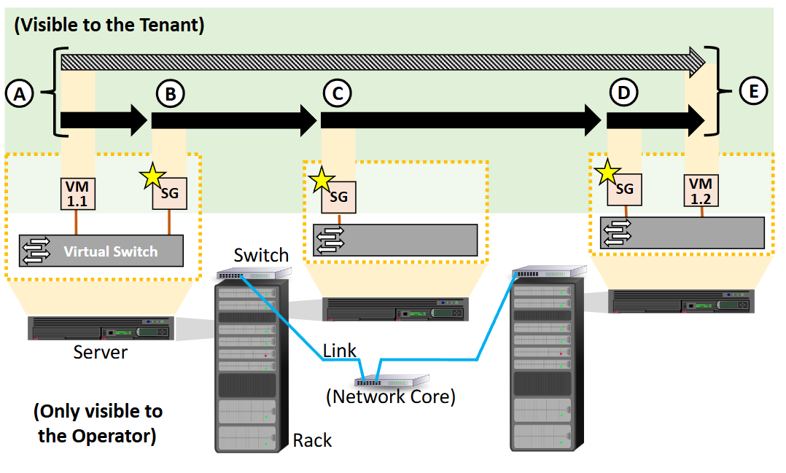
Design of Crinkle
Deploy tenant-level vantage points as specific VMs
These segment the virtual topology and allow for reasoning about virtual and physical correctness
As dedicated nodes, they do not require the rest of the topology or workload to change

Slide 8
Implementation
Virtual network: the FABRIC national networking testbed.
API: Python 3 extension of FABRIC’s API, FABlib.
  Upstreamed, so available to all FABRIC users!
Monitor nodes: Ubuntu 22 VMs running a C application using DPDK.
Buffer uses SPADE as the provenance recorder and database manager (PostgreSQL backend).

Slide 9
Monitor Nodes
Receives frame, checks if it has been tagged, tags if not.
  In-band filtering determines which packets get this treatment – those not meeting the filter are just forwarded.
Forwards frame (same order as received – goal is transparency).
Sends frame ID, node info, time, and frame metadata to buffer.

Slide 10
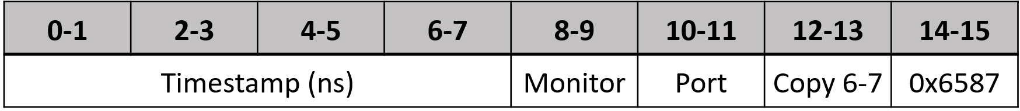
Frame Trailers
Per the design, need to uniquely identify frames while maintaining the modification-free property.
Frame trailers are invisible to process not actively looking for them – no length increment, so appear as padding.
Limitation: must avoid fragmentation.

Slide 11
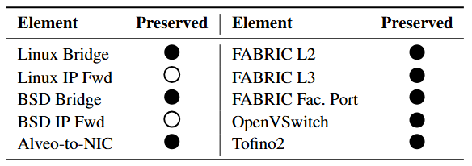
Trailer Preservation
Preserved in many contexts.
Linux/BSD IP forwarding rely explicitly on the IP length field.
Linux 5.15.0-143-generic.
BSD 14.0-RELEASE-p6.
OpenVSwitch 2.17.9.

Slide 12
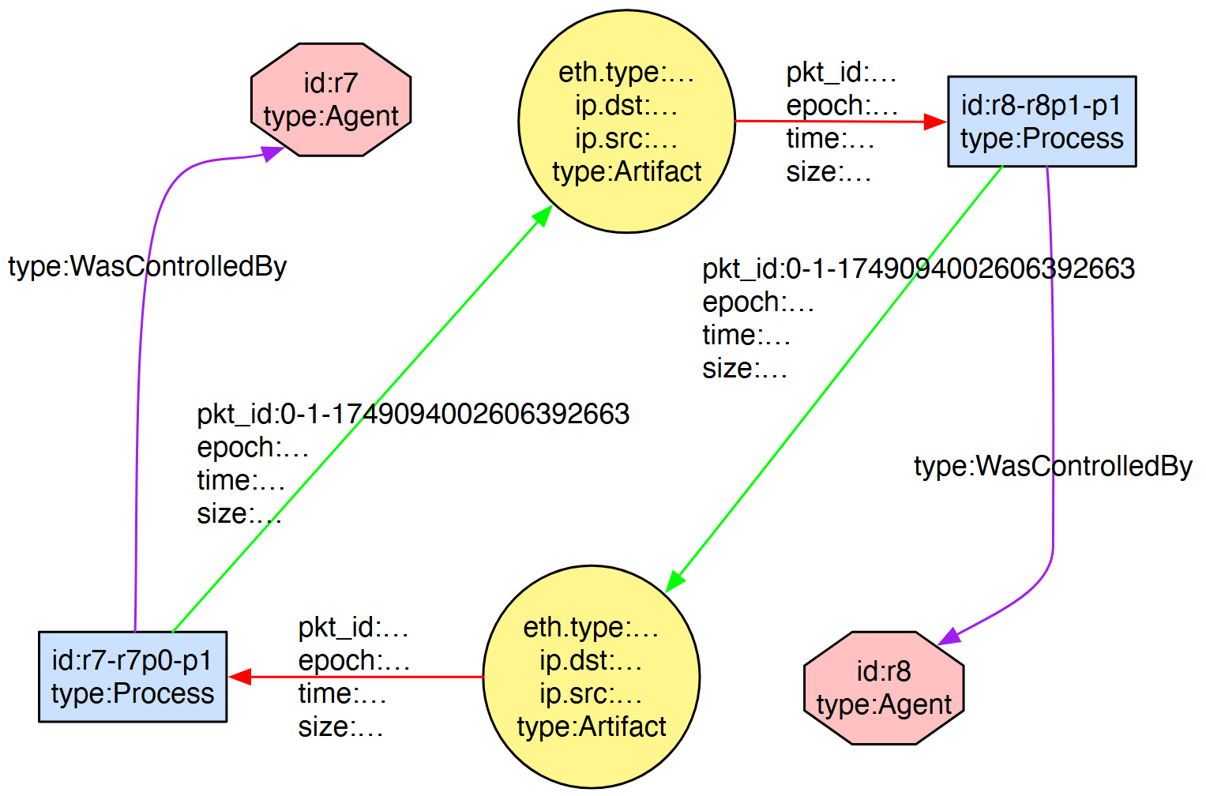
Provenance
Conforms to Open Provenance Model, adapted to networking.
With frame IDs, shows where it went, when, and what it was.
Sufficient information to debug a complete set of problems.

Slide 13
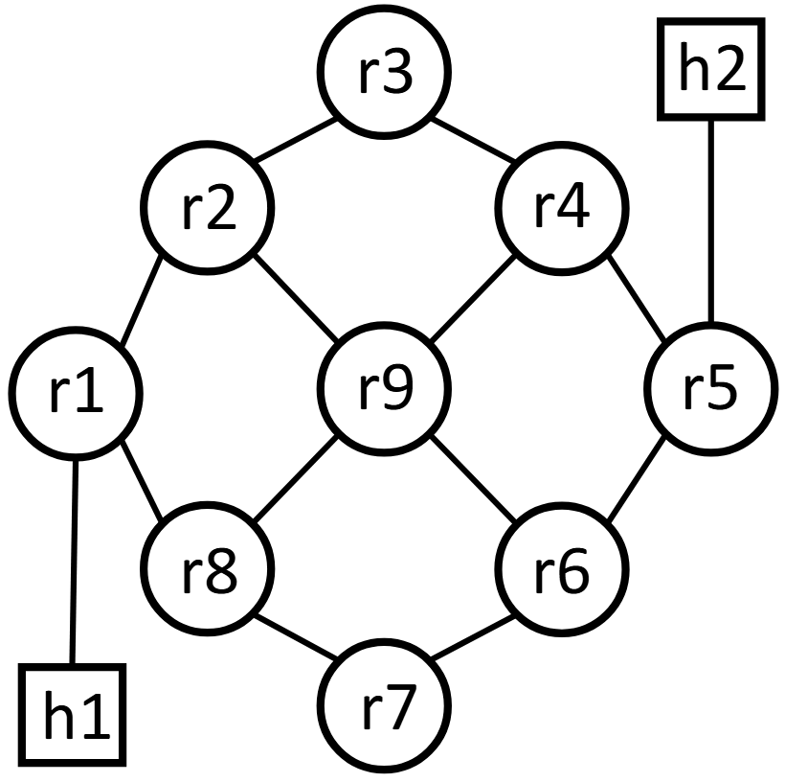
Debugging Problems
Timestamped packet provenance sufficient to debug latency, reachability, and misconfiguration issues.
Two example cases: misconfigured virtual switch forwarding and program bug causing header corruption.

Slide 14
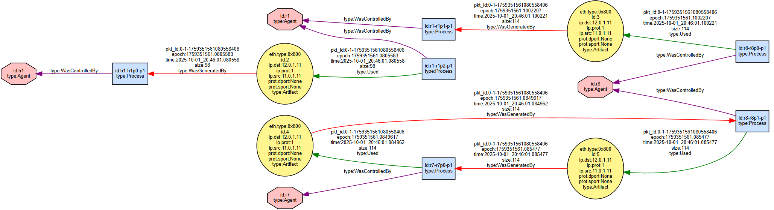
Bad forwarding
r7 receives a packet, reflects back to r8 where it drops.
get_graph(tstart="2025-10-15 19:54:48.0 ", tend="2025-10-15 19:54:59.0", tformat="%Y-%m-%d %H:%M:%S.%f")

Slide 15
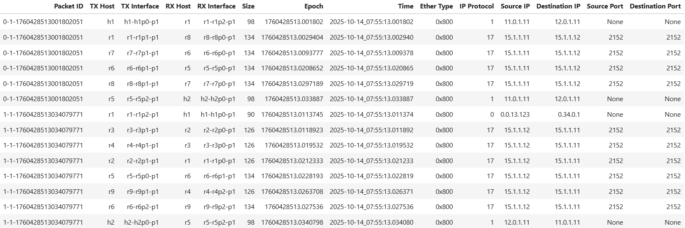
Tunnelling Error
P4 bug means no header emitted, corrupting downstream parsing.

Slide 16
User Evaluation
11 outside users used SG to debug some networking issues while 11 used common tools like ping and tcpdump.
Those with medium FABRIC and network debugging experience could debug up to 37.5% faster on the second exercise, with only a 15-minute demo video and a previous exercise (two of three solved with a single API call).
Results are promising. We’d like to run a larger study.

Slide 17
Performance Evaluation
SG nodes use DPDK version 25.07 (latest at the time), 4 cores (2.4 GHz), 1 GB RAM, Mellanox Connect-X 6 SR-IOV virtual function NICs.
FABlib version 1.9.2.

Slide 18
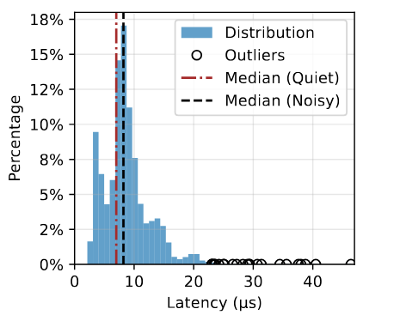
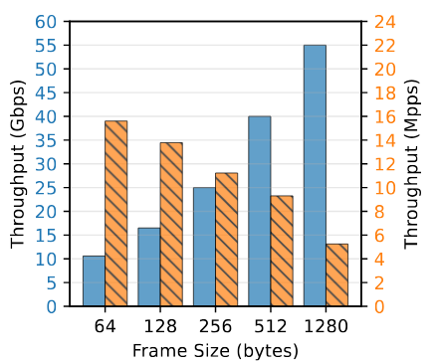
In-Band Performance
Left: Latency distribution in quiet environment (6,692 samples).
Right: Monitor throughput at varying frame sizes (AWS: 25 Gbps limit, 5-10 common).

Slide 19
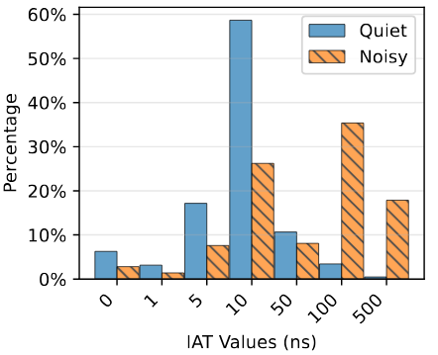
Insight into Underlay
Added traffic replaying to monitors.
Replay the same traffic multiple times to build a baseline of network consistency.
Experiment reveals impacts from high co-tenant traffic (overall less than link capacity).

Slide 20
Conclusions
Crinkle provides a highly-general, highly-capable debugging tool for virtual networks.
Readily available and successfully used outside our team.
Being tested on the new SPHERE testbed.
Artifact: https://crease.cs.iit.edu/knit11/artifact
Tutorial materials and video: https://crease.cs.iit.edu/

Slide 21
Acknowledgements
Mert Cevik, Komal Thareja , Ganesh Sankaran, and Paul Ruth (RENCI) for FABRIC assistance
Mami Hayashida, Hussamuddin Nasir, and Jim Griffoen (University of Kentucky) for FABRIC PTP assistance

