Slide 1
The Power of Play-Based Learning
Why Play Matters in Preschool
AGENDA
1
2
3
4
Why play is essential and what children learn
Free play vs. guided play vs. intentional teaching
Facilitating learning and supporting children with disabilities
Connecting play to IEP goals and objectives
Meryl Davidson–MCS Preschool Specialist

Slide 2
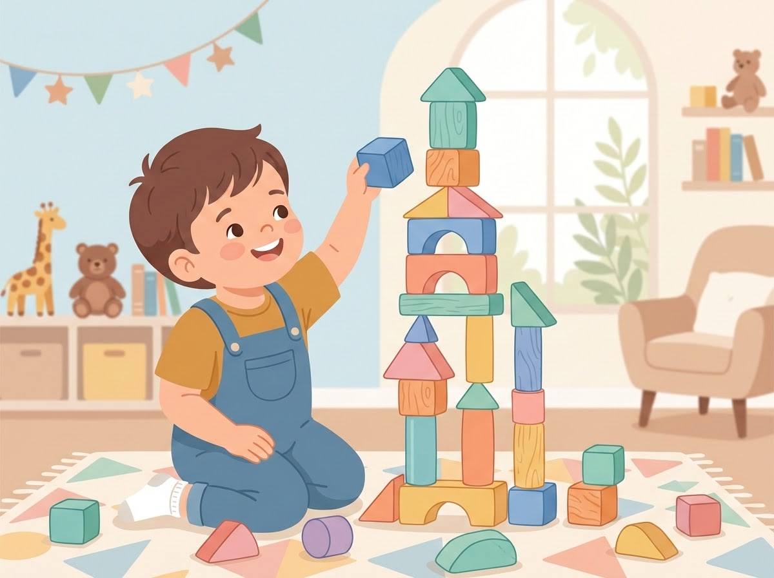
Let's Challenge a Common Belief
“They're just playing.”
Common Misconceptions
•"They're just playing with blocks."
•"They're not learning unless they're sitting at the table."
•"We need more worksheets so we can teach academics."
The Reality of Block Play
A child building with blocks is actively counting, comparing sizes, and solving structural problems. They are using spatial reasoning, negotiating with peers, practicing expressive language, developing fine-motor skills, and persisting through frustration.
"The activity may look like play, but the learning is real."

Slide 3
Defining Play-Based Learning
Play-Based Learning is NOT:
Play-Based Learning IS:
Children doing whatever they want all day
Intentional learning through meaningful, engaging experiences
Adults standing around watching
Environments where children actively participate, explore, and make choices
An environment with no learning objectives, planning, or assessment
Opportunities to solve problems, communicate, and interact
"NAEYC describes developmentally appropriate practice as a strengths-based, play-based approach to joyful, engaged learning."

Slide 4
The Continuum of Play-Based Learning
Child-Directed
High autonomy, intrinsic motivation
Adult-Directed
High structure, planned objectives
Free Play
Child-directed and voluntary. Children explore freely with minimal adult intervention or structured goals.
Guided Play
Child-led but adult-supported. Adults set up the environment and scaffold learning with open questions.
Direct Instruction
Adult-directed learning. High structure and defined learning tasks to target specific, academic goals.
"Playful learning is a continuum that includes varying levels of adult involvement and child direction, balancing child initiative with intentional teacher support."

Slide 5
Play and Learning Are Not Opposites
The Traditional False Dichotomy: PLAY vs. LEARNING
PLAY + INTENTIONAL TEACHING = PLAYFUL LEARNING
Intentional Adult Actions:
Set up the environment and introduce materials
Model language and ask open-ended questions
Offer choices and add challenges
Support peer interactions and scaffold skills
Observe, collect data, and connect play to learning goals
Playful learning is a continuum that includes varying levels of adult involvement and child direction.

Slide 6
Developmental Milestones (Ages 3–5)
Cognition & Mathematics
Developing active problem-solving skills, early mathematical concepts, and exploring the surrounding world.
Communication & Literacy
Expanding expressive communication, active vocabulary, and foundational early literacy skills.
Social-Emotional Skills
Nurturing deep peer relationships, learning empathy, and expanding social and emotional growth.
Executive Function & Motor
Refining critical fine and gross motor skills alongside initial self-regulation and executive focus.
Core Value: Play gives children the unique opportunity to practice ALL of these critical skills at the exact same time in a natural context.

Slide 7
Strengthening the Executive Function
Executive Function Practice in Play
A
B
C
Attention & Memory
Self-Control & Flex
Planning & Problems
Attention
“Look at what I'm doing.”
Working Memory
“What am I supposed to do next?”
Self-Control
“I want the truck, but I'm waiting.”
Flexibility
“That didn't work. Let's try something else.”
Planning
“First I'll build the tower, then I'll put the roof on.”
Problem-Solving
“The bridge keeps falling. What can I change?”
Harvard's Center on the Developing Child identifies executive-function and self-regulation skills as critical supports for learning and development.

Slide 8
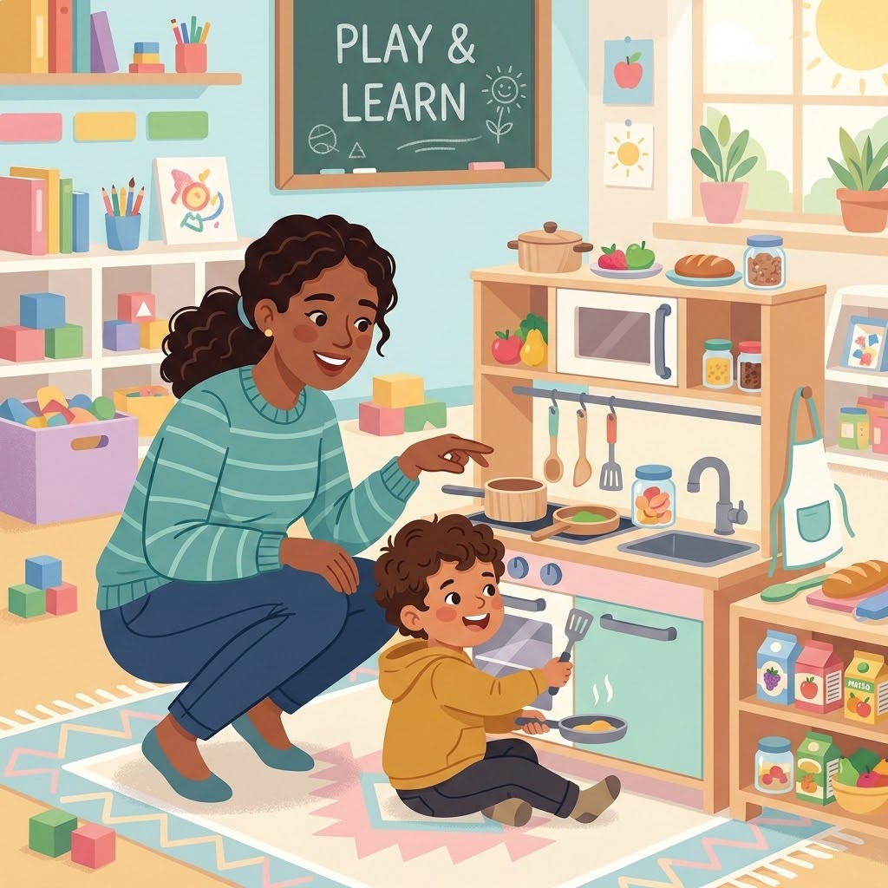
Supporting Communication Through Play
Example Interaction in Dramatic Play
Child: “More food.”
Teacher (Expands): “You want MORE food. Who are you cooking for?”
Child: “Baby.”
Teacher: “You're cooking food for the baby!”
Communication Skills Supported
•Requesting, labeling, and commenting
•Answering questions and following directions
•Vocabulary and sentence development
•Social communication and AAC use
•Imitation and turn-taking
“Play creates an authentic, motivating reason to communicate.”

Slide 9

Play as a Social Rehearsal Space
“I want that.” → Negotiation
“Let's build it again.” → Resilience
“It's my turn.” → Turn-taking
“You look sad.” → Recognizing emotions
“You can have it after me.” → Delayed gratification
“Can I play?” → Social initiation
“The tower fell!” → Coping with frustration
Takeaway: Play is a rehearsal space for life.

Slide 10
Laying the Foundations of Literacy
Play-Based Literacy Activities
Center Example Dramatic Play → Restaurant
Hearing and using new vocabulary
Telling stories and sequencing events
Children naturally engage in literacy:
Read a menu
Pretending and acting out experiences
Write an order
Recognizing environmental print and symbols
Make a sign
Practicing rhyming and sound awareness
Take a customer's order
Handling books and making marks or drawings
Use descriptive vocabulary

Slide 11
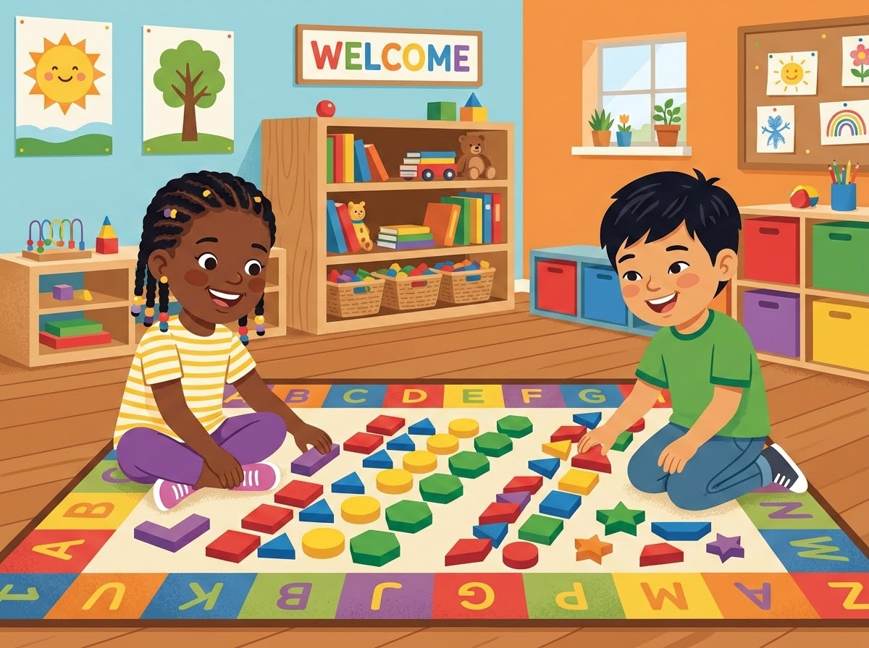
Mathematical Concepts in Block Play
Counting: “How many blocks?”
One-to-one correspondence: “One block for each person.”
Shapes: “That’s a triangle.”
Measurement: “Mine is taller.”
Patterns: “Red, blue, red, blue…”
Spatial concepts: “Put it UNDER the bridge.”
Problem-solving: “How can we make it stand?”
Takeaway: Math does not have to look like a worksheet.

Slide 12
Nurturing Problem-Solving Skills
Instead of solving problems immediately, PAUSE and ask:
“What happened?”
“What could we try?”
“Why do you think it fell?”
“What could make it stronger?”
“Should we try something different?”
Goal: We are teaching children how to think—not just giving them the answers.

Slide 13
Inclusion & Individualized Goals
Communication
Social Interaction
Fine Motor
Requesting a desired toy
Playing alongside a peer
Manipulating play materials
Gross Motor
Adaptive Skills
Self-Regulation
Moving through a play environment
Pretending to cook, clean, dress, or feed
Coping when play doesn't go as planned
Takeaway
IEP goals are embedded naturally within meaningful activities. The goal becomes part of the play.

Slide 14
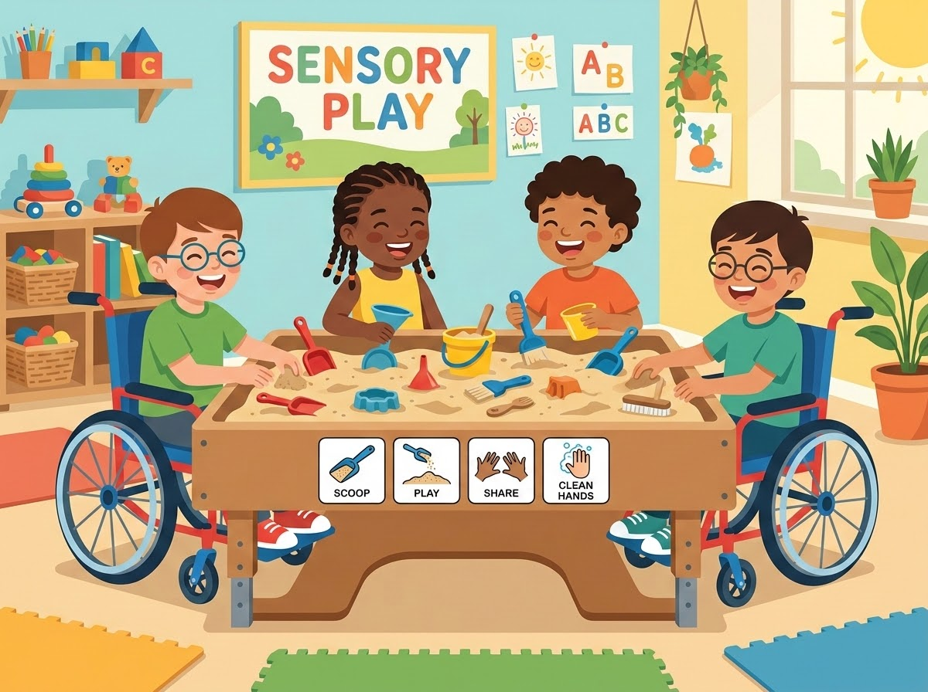
Adapting the Play Environment
Key Shift
Move from asking “Can this child play like the other children?” to asking “How can we adapt the environment so this child can participate?”
Adaptive Strategies
Visual supports and AAC
Peer and adult modeling
Adapted materials (larger/easier-to-grasp objects)
Sensory supports and optimal positioning
Reduced choices to prevent overwhelm
Wait time, hand-under-hand support, and repeated routines
Participation is the goal—not perfection.

Slide 15
Balancing Play Types
Free/Child-Directed Play
The child chooses, explores, directs, experiments, and creates entirely on their own.
Chooses Explores Directs Experiments Creates
Guided Play
The adult creates an intentional environment, holds a learning objective, follows the child's interests, adds language, asks questions, and scaffolds learning.
Child: Building a tower.
Teacher: “Your tower is getting REALLY tall.” (Pause) “How many blocks do you have?” (Child counts)
Teacher: “Let's see if we can make it taller than you!”
Takeaway: The adult joins the play without taking over.

Slide 16
The Role of the Educator
We are not babysitters. We are:
Observer & Collector
Observers and Data collectors
Intentional teachers
Scaffolder & Model
Language models and Scaffolders
Partner & Builder
Facilitators and Problem-solving partners
Relationship builders
Core Question to ask yourself constantly
“What can I teach or strengthen here?”

Slide 17
Shifting from Passive to Intentional Facilitation
Passive Supervision
Intentional Facilitation
“Be careful.”
“I see you have two blocks. What could you use to make the bridge longer?”
“Don't do that.”
“You both want the truck. What could we do?”
“Share.”
“You said 'car.' I heard you say 'red car.'”
“What color is that?”
“The tower fell. What should we try next?”
Takeaway: Same classroom. Very different teaching.

Slide 18
The "Add One More" Facilitation Strategy
Observe
What is the child doing?
Child's Action
Child is driving a toy car.
1
Join
Enter the play without taking over.
Your Response
“Vroom! Your car is driving.”
2
Add One More
Add one small layer of learning.
Add One More
“Your car is driving UNDER the bridge.”
3
Added skills: Language, vocabulary, spatial concepts, and joint attention.
Skills

Slide 19
Intentionality: Cycle of Play Instruction
Before Play
During Play
My Response
After Play
What is my learning objective?
What is the child showing me?
How can I build on what the child is already doing?
What did I learn about this child?
01
02
03
04
Key Takeaway
Play can be instruction AND assessment.
Assessment During Play
Data can and should be collected during play.
Example: “During block play, J. independently requested 'more blocks' 4 times.” (Instead of just “J. played with blocks.”)

Slide 20
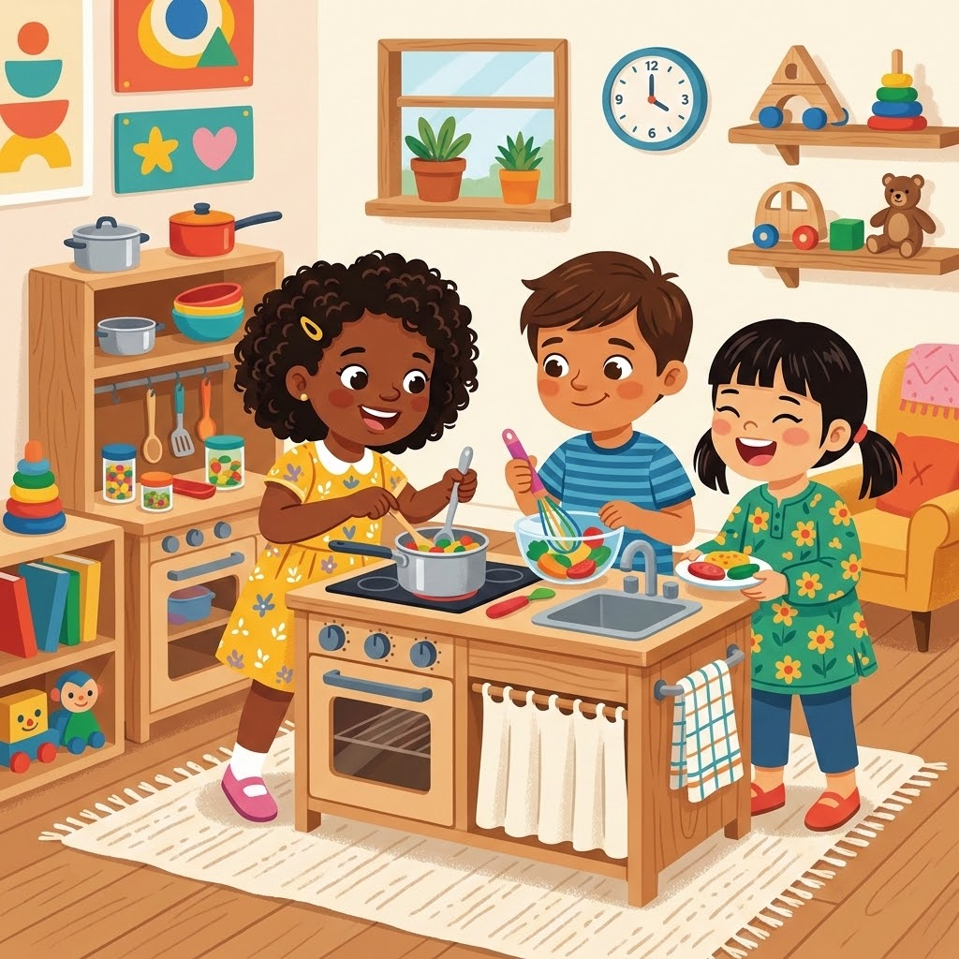
Practice Scenario: Dramatic Play Kitchen
Scenario:
Three children are playing in the kitchen center. One stirs a bowl, one puts food on a plate, one stands nearby watching.
Multi-Dimensional Learning Opportunities
Communication
“What are you making?”
Literacy
“Let's make a menu.”
Social
“Can I have a turn?”
Adaptive
“What do we need to clean up?”
Math
“How many plates do we need?”
Emotional
“You wanted the spoon. What can we do?”
Takeaway: One play activity offers multiple learning opportunities.
lightbulb

Slide 21
HANDS-ON ACTIVITY
1
What might children naturally do here?
Analyzing Centers
2
What developmental skills are being practiced?
In pairs, choose a center and discuss:
What could an adult say or do to extend learning?
3
Dramatic Play • Blocks • Art • Cars
Manipulatives • Library
Outdoor Play • Sensory/Kitchen
4
How could a child with a disability participate?
5
What IEP goal could potentially be embedded?
★ ACTION: Share one idea with the group.

Slide 22
Misapplications of Play-Based Learning
Pitfalls to avoid ❌
“Here are the toys. Go play.” (No facilitation)
Correcting every action
Adults standing around talking while children play
Expecting every child to participate in the exact same way
Constantly quizzing: “What color is that?” “What shape is that?” “How many?”
Turning every center into a rigid, teacher-directed lesson
Taking over children's play and directing the narrative
Takeaway: Intentional does not mean controlling.

Slide 23
Indicators of Successful Play-Based Classrooms
Children are:
Adults are:
Engaged & exploring
Observing & listening
Making choices
Modeling & questioning
Communicating & moving
Expanding language
Creating & solving problems
Supporting peer interactions
Interacting & practicing skills
Scaffolding & adapting environments
Making mistakes & trying again
Connecting play to specific learning goals

Slide 24
Transforming our Practice
Ask yourself:
1
2
3
Shift 1
Instead of:
“What did I teach today?”
Ask:
“What did children have opportunities to practice today?”
Shift 2
Instead of:
“Did they finish the activity?”
Ask:
“Were they engaged in meaningful learning?”
Shift 3
Instead of:
“Why isn't this child playing appropriately?”
Ask:
“What support would help this child participate?”

Slide 25
Developmental Day Classrooms
Strength in Diversity
Our Classrooms bring together children with different developmental levels, communication abilities, strengths, sensory needs, interests, and learning styles.
Integrated Goals in a Single Experience
Play allows children to learn together. In the exact same play experience:
Communication
Social
Cognitive
Motor
Social
One Child
Works on:
Requesting
Another
Works on:
Turn-Taking
Another
Works on:
Counting
Another
Works on:
Fine Motor
Another
Works on:
Social Interaction

Slide 26

Activating Your Play Lens
Questions to ask yourself upon entering a center:
👀
What do I notice?
🤝
Who could I connect?
❤️
What is the child interested in?
🧩
What problem could I help the child solve?
🎯
What skill could I target?
➕
What is ONE thing I can add?
💬
What language can I model?
✨
Your Play Lens is Active!
Observe
➔
Join
➔
Add One More
1
2
3

Slide 27
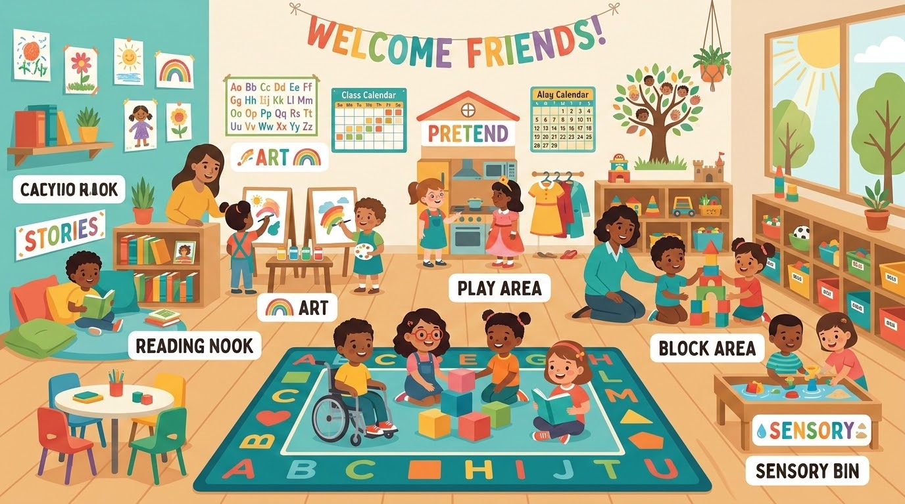
Play is the Foundation
Play is never “just play.” Through play, children develop critical thinking, communication, emotional regulation, social skills, early literacy, math, motor skills, problem-solving, resilience, executive functioning, and independence.
Play is the context.
The teacher makes the learning intentional.

Slide 28
Developmental Day Classrooms
Reflection
“The goal isn't to make preschool look like elementary school.
The goal is to make preschool the best place for preschool children to learn.”
👀
✨
🌱
When we see play differently,
we teach differently.
➔
When we teach differently,
children experience learning differently.
➔
A Foundation
for Life

Slide 29
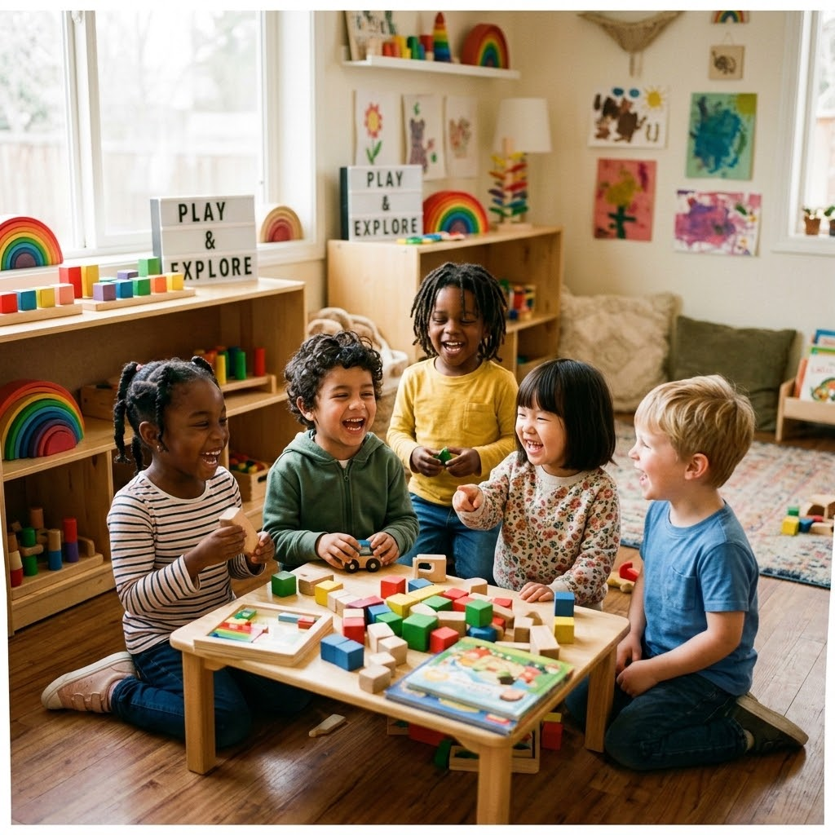
Our Shared Commitment
Let Kids Be Kids
Preschool is a sacred time for discovery. When we protect their right to play, we foster creativity, build confidence, and lay a joyful foundation for life.
Protect the Wonder of Childhood

