Slide 1
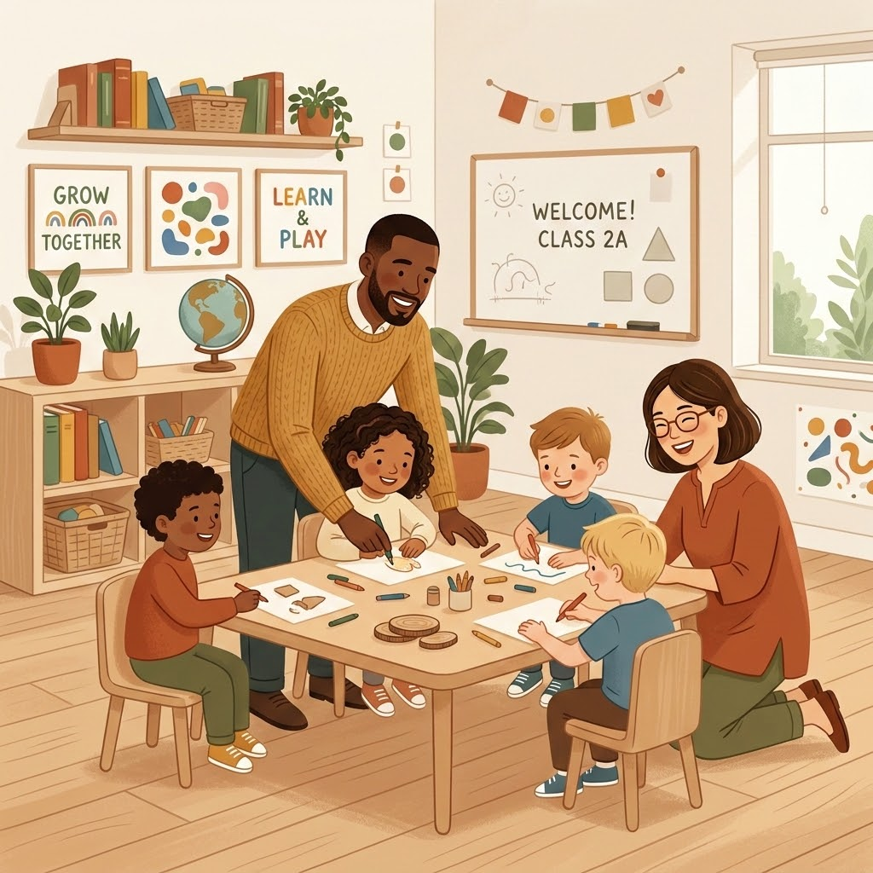
Teacher–IA Collaboration
One Classroom,
One Team:
Creating consistency between teachers and instructional assistants to unlock the full potential of shared learning environments.
Meryl Davidson–MCS Specialist

Slide 2
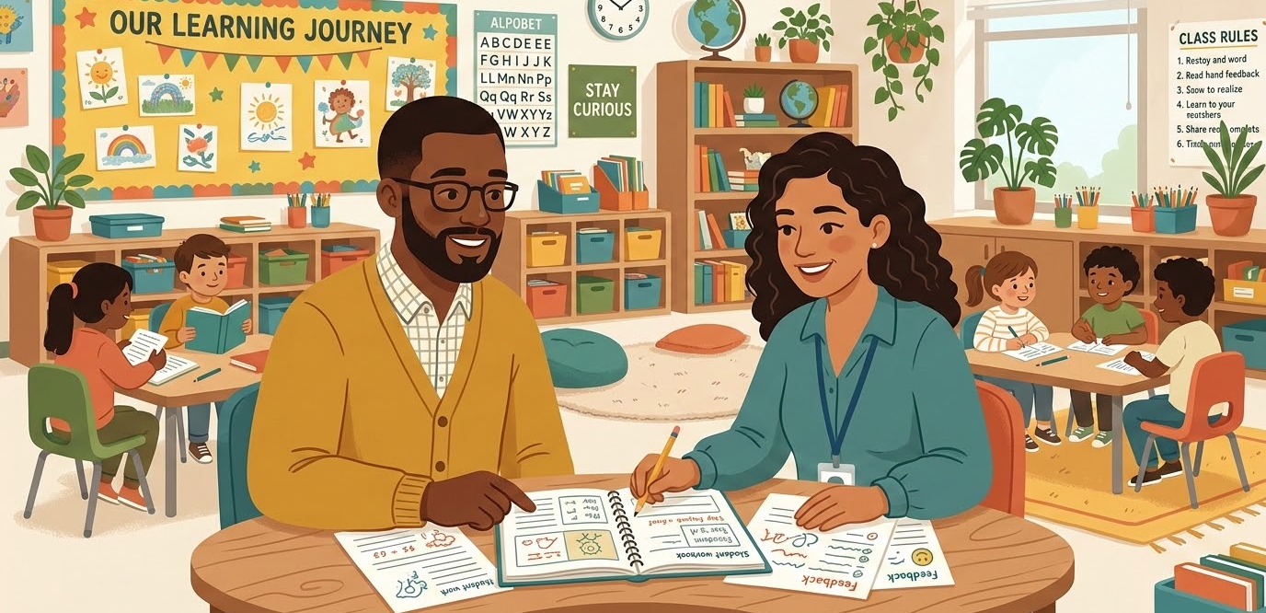
ROLE DEFINITION & COLLABORATION
One Team, Shared Responsibility
“Our students don't need one great educator and one helper.”
They deserve a powerhouse partnership. We combine different professional roles into a single, cohesive unit—sharing the responsibility to believe in and unlock the potential of every child.
Different Roles, Single Focus
By aligning our unique strengths and planning together, we ensure no student is left to learn in isolation. We work as co-educators to make success possible for all.

Slide 3
ROLE DEFINITION & COLLABORATION
We Are Both Educators
Defining unique professional responsibilities while maximizing collective classroom impact
SHARED EDUCATIONAL IMPACT
Both Adults Can & Should:
Interact Intentionally: Engage with students to facilitate play and learning.
Model & Reinforce: Demonstrate positive language, social skills, and expectations.
Extend Thinking: Ask strategic questions, support routines, and provide constructive feedback.
Observe & Support: Notice strengths, communicate student needs, and foster independence.
PROFESSIONAL ROLES
Primary vs. Shared Responsibility
The teacher holds primary responsibility for planning, instruction, assessment, and communication, while the teacher assistant operates as a vital, active partner in the collective instructional team.
SHIFTING PERSPECTIVES
“Teacher assistants should not be viewed simply as administrative or behavioral support.”
They are not just there to handle behavior, make copies, clean up, or help individual students in isolation—they are co-educators.

Slide 4

Teacher–IA Collaboration
A Powerful Partnership
What does a truly effective teacher–instructional assistant team look like?
Think about a classroom where the adults work exceptionally well together. What does that partnership look like?

Slide 5
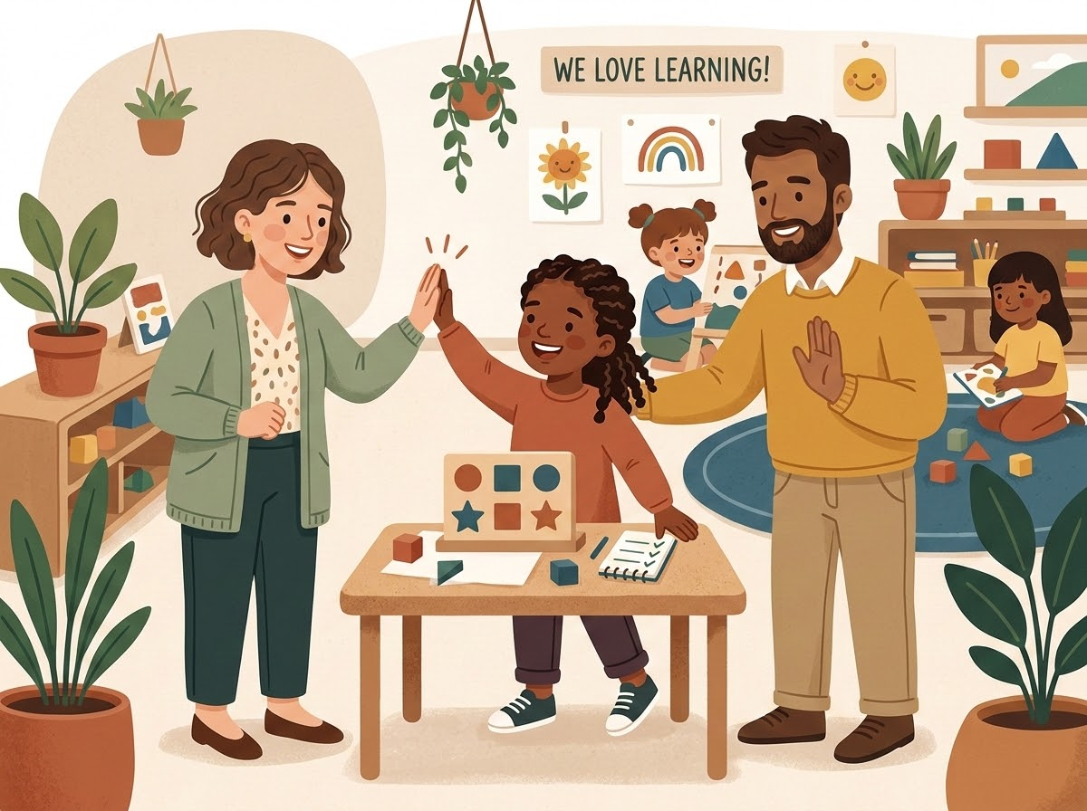
The Power of Collaborative Classrooms
Unlocking the immense potential of co-teaching and shared instructional spaces
Co-Teaching Impact
Key Classroom Benefits
Individualized Support: More personalized attention and constructive instructional feedback.
Active Engagement: Greater opportunities for student participation and focused learning.
Skills Mastery: Broader access to curriculum content and more frequent opportunities to practice skills.
Student Growth: Development of stronger relationships and significantly greater student independence.
The Teamwork Mandate
"Two adults in a classroom do not automatically create a team. The educators must intentionally work together to realize these benefits."

Slide 6

Partnering for Student Success
Different Responsibilities, Shared Classroom Impact
DAILY PRACTICE & COLLABORATION
KEY TAKEAWAY
“Different roles do not mean unequal value.”
The teacher and instructional assistant may have different responsibilities, but both adults can build relationships, teach, and model.
Interactive Support
Both educators can ask questions, provide feedback, encourage communication, and support behavior.
Student Growth
Additionally, both support independence, observe student needs, and celebrate student growth.

Slide 7
Classroom Partnerships
Shifting from a 'Teacher + Helper' model to a highly integrated 'Classroom Team'
Traditional Dynamic
Teacher + Helper
• The teacher teaches and makes all decisions.
• The assistant waits for directions.
• The assistant manages behavior, or works with one student all day.
Ideal Team State
Classroom Team
Asks: "How can we support him?"
• Both adults support behavior, intentionally rotate, and facilitate learning.
• The team communicates and problem-solves together.
• Ensuring the assistant fully understands the instructional plan.
"Which column most closely describes our classroom, and what is one small change that could move us toward the right side?"

Slide 8
Communication: Clear, Brief & Respectful
Maximizing collaborative classroom impact when time is limited
EX
Specific Direction in Action
VS
Shifting the Strategy
BEFORE THE ACTIVITY
“During independent work, could you circulate and watch for students struggling with the main idea? Let me know if you see a pattern.”
WHAT THE IA GAINS FROM THIS
• Learning Target: What students are learning
• Focus Area: What the teacher wants them to watch for
• Clear Mandate: What their specific role is
• Feedback Loop: What information is useful afterward
THE GENERAL APPROACH
“Just help whoever needs it.”
THE TARGETED APPROACH
“Can you work with the students who need the visual support and help them use the strategy we practiced?”
The goal is not necessarily more communication, but better communication. Specificity breeds confidence.
“The more specific the direction, the more confident and impactful the classroom team becomes.”

Slide 9
Communication During Instruction
Using simple signals, routines, and non-verbal cues to build a powerful two-way feedback loop
T
Teacher Signals
IA
IA Observations
DIRECTING ACTION QUIETLY
“Can you check on table two?” or “Can you take the next group?” or “Watch for understanding.”
WHY THIS STRATEGY WORKS
Protects Learning Flow: Minimizes verbal interruptions during direct teaching.
Bespoke Cues: Establishes simple, predetermined classroom signals.
Maintains Momentum: Directly delegates targeted support in real time.
VALUABLE STUDENT INSIGHTS
“I’ve noticed that she seems to understand the directions when I give them one step at a time.”
“He did really well when I gave him the visual before the transition.”
“I noticed he became frustrated when we moved from the manipulatives to paper-pencil work.”
These live observations are incredibly valuable for shaping teacher planning.
“Communication doesn’t always have to be verbal. Two-way partnerships thrive on shared insights.”

Slide 10
Plan Together—Even When You Don't Have Much Time
Planning together does not have to mean sitting down for an hour. Think about three distinct levels.
Level 1: 30-Second Huddle
Level 2: 5-Minute Planning
Level 3: Weekly Team Planning
QUICK ALIGNMENT BEFORE ACTIVITIES
WHO? Who is doing what?
WHERE? Where will we be?
WHAT? What are we watching for?
WHEN? When will we check in?
FAST & FOCUS-DRIVEN
DAILY OR MAJOR ACTIVITY FOCUS
• Key Learning: What's most important?
• Support: Who needs additional help?
• Routine: What will each of us do?
• Changes: Is anything different today?
CRITICAL BEFORE:
Small groups • Assessments • New units • Transitions • Inclusion • Changing student needs
INTENTIONAL WEEKLY CONVERSATION
Instruction & Students: What is being taught? Who is making progress or struggling?
IEP & Accommodations: Are students actually using their active supports?
Behavior & Independence: What patterns exist? Where can we begin fading support?
"Collaboration doesn't require endless hours—it requires targeted intention."

Slide 11
Building a Relationship That Hasn't Always Been Positive
Rebuilding collaboration and trust through small, intentional resets for the benefit of our students.
Acknowledging the History
Starting with a Reset
COMMON BARRIERS TO COLLABORATION
“We've never worked well together.”
“She doesn't listen to me.”
“He never tells me anything.”
“I'm always left out.”
“They don't trust me.”
“I've tried communicating, but nothing changed.”
SCRIPTS FOR A FRESH START
“I know we've had some challenges working together in the past. I'd really like for us to have a fresh start this year. I want us to figure out what works best for our students and for us.”
“I know we haven't always approached things the same way. I think we both care about our students, and I'd like us to find a way to work together more effectively.”
“You can't fix a difficult relationship by simply saying 'Let's communicate better.' You rebuild trust through small, consistent interactions.”

Slide 12

Don't Try to Fix Everything at Once
Rebuilding difficult professional relationships through small, focused, and consistent resets.
START WITH ONE OR TWO AREAS
Focus Over Friction
When a relationship has been difficult, don't begin with: “Here are the 12 things that need to change.”
Instead, identify one or two small areas. For example:
“Could we try doing a quick check-in before small groups each morning?”
Then actually do it. Over time, those small, intentional interactions begin to rebuild trust.
THE FOUNDATION OF TRUST
Trust is built through: Consistency + Respect + Follow-through
If I tell you I'll do something, I do it. • If you share information with me, I listen. • If we disagree, I address it respectfully. • If we make a plan, I follow it.

Slide 13
Problem-Solving Between Classroom Adults
Focus on "what is happening and what can we do" rather than "who is wrong."
A COLLABORATIVE PROCESS
The Problem-Solving Cycle
STOP & NOTICE: Pause and state raw facts. Instead of: "He was being awful," say: "He left the group three times during the 15-minute lesson."
PLAN & TRY: Brainstorm solutions and choose one strategy to implement consistently. Agree on what, who, when, and what to look for.
REVIEW: Regroup regularly to ask: "Did it work?" "What did we notice?" "What should we change?"
UNDERSTANDING THE WHY
Contributing Factors to Explore
Before picking a plan, consider what might be causing the behavior. You don't have to agree immediately on a single reason.
The task is too difficult / student needs a visual.
The student doesn't understand directions.
The transition was unexpected or sudden.
The student is tired or seeking attention.
The current support structure is not working.
THE COOPERATIVE MINDSET
"When something isn't working, shift from personal blame to collaborative analysis."
By focusing on observed facts and structuring actionable trials, classroom teams keep problem-solving professional, objective, and centered entirely on student success.

Slide 14
When the Adults Disagree
Disagreement isn't necessarily a problem. How you handle disagreement is what matters.
A RESPECTFUL DIALOGUE
Constructive Conversations
THE MINDSET: “We don't have to agree immediately to work respectfully together.”
STEP 1: “I see it a little differently. Can you tell me what you're noticing?”
STEP 2: “Here's what I've been noticing.”
STEP 3: “What do you think we should try?”
STEP 4: “Let's try one approach consistently and see what happens.”
PITFALLS TO ELIMINATE
Behaviors to Avoid
To maintain a professional partnership and protect the learning environment, classroom teams must actively avoid:
Arguing in front of students
Correcting one another publicly
Talking about one another to other staff
Making assumptions about intent
Keeping a running list of past mistakes
THE COOPERATIVE MINDSET
“When something isn't working, shift from personal blame to collaborative analysis.”
Respectful, structured communication ensures professional relationships remain strong, focusing resources and attention entirely on student learning and success.

Slide 15
Students Experience Our Collaboration
How adult alignment (or the lack of it) directly shapes the student's daily classroom environment.
Without Collaboration
When adults don't collaborate, students may experience disconnects:
Confusion & Anxiety: Mixed behavior messages, frustration
Inconsistency: Differing expectations across team members
Stalled Growth: Increased dependence, reduced independence
Missed Opportunities: Difficulty generalizing skills, lost learning
With Collaboration
When adults do collaborate, students experience a unified environment:
Consistency & Safety: A stable environment with aligned adults
Greater Access: Increased instruction, more practice opportunities
Independence: Encouraged skill generalization, active communication
Stronger Relationships: Deeper trust and security in the room

Slide 16


Self-Reflection
Taking a moment to evaluate classroom collaboration through the eyes of our students.
REFLECTION QUESTION
“If our students could describe how our team works together, what would they say?”

Slide 17
Our Shared Commitment
How we keep moving forward together, even when faced with challenges.
THE HEART OF OUR PARTNERSHIP
“The goal isn't to have a perfect partnership. The goal is to have a partnership that is strong enough to keep problem-solving when things aren't perfect.”
CENTRAL MESSAGE
Different Roles
Each educator brings unique strengths, skills, and perspectives to the classroom.
Shared Responsibility
Joint ownership of student success, classroom environment, and growth.
One Instructional Team
Working in unison to create a consistent, supportive, and safe learning space.

Slide 18
Collaborative Partnerships Across Settings
Roles of Teachers and Instructional Assistants
PS
Preschool
K-2
K-2 Classroom
Teacher Role teachers plan learning experiences
Assistant Role assistants join play and model social skills
Teacher Role teachers introduce new content
Assistant Role assistants reinforce taught skills and support small groups
3-5
3rd-5th Grades
EC
Exceptional Children's Classrooms
Teacher Role teachers provide direct instruction
Assistant Role assistants monitor engagement and encourage independence
Teacher Role teachers plan specially designed instruction
Assistant Role assistants support individualized prompting and adaptive needs
"Ultimately, the setting changes, but the partnership doesn't."

Slide 19

Preschool: Play, Routines & Developmental Learning
Embedding active, intentional instruction directly into everyday classroom play and routines.
Planning & Individualizing
Teacher Role
• Lead small-group activities focused on language, early literacy, or math.
• Model how to facilitate play and intentionally extend children's thinking.
• Observe and collect key information about developmental skills.
• Plan targeted, individualized supports based on IEP goals.
Modeling & Facilitating
Assistant Role
• Join play to model language, sharing, turn-taking, and problem-solving.
• Help children practice essential classroom routines and independence.
• Support active transitions while intentionally teaching expectations.
• Provide prompts and assistance rather than completing tasks for them.
Example in Action: Both Adults Teaching Simultaneously
The teacher guides four children on counting objects, while the assistant stays in the block center modeling communication prompts like “I built a tower” or “Can I have a turn?” Classroom collaboration ensures learning happens in every corner.

Slide 20

K–2: Small-Group Instruction & Increasing Independence
Focusing on academic instruction, differentiation, and helping students participate successfully.
PLANNING & DIFFERENTIATION
Teacher Role
• Introduce new phonics or math skills.
• Plan differentiated instruction across the classroom.
• Lead guided reading or targeted small-group instruction.
• Analyze student data and determine key instructional needs.
PRACTICE & ACCESSIBILITY
Assistant Role
• Reinforce skills that have already been introduced.
• Work with small groups to actively practice skills.
• Provide accommodations or visual supports for learning.
• Prompt students to use strategic tools independently.
• Monitor active engagement and provide positive feedback.
Example in Action: Shared Collaboration
The teacher introduces a new letter-sound skill to the whole group. During independent practice, the instructional assistant works with a small group to practice the skill using manipulatives and picture cards. The assistant doesn't create a separate curriculum—they help students access and practice what the teacher planned.

Slide 21

K–5 Exceptional Children's Classroom: Individualized Access & Intensive Support
Intensive and varied student needs require structured, intentional adult collaboration.
Specially Designed Instruction
Teacher Role
• Develop and implement specially designed instruction.
• Provide direct instruction based on IEP goals.
• Determine accommodations, modifications, and strategies.
• Analyze progress-monitoring data to guide lessons.
• Coordinate instruction across students with different needs.
Targeted Prompting & Practice
Assistant Role
• Provide individualized prompting and support.
• Help students use AAC or other communication systems.
• Support student practice of functional and academic skills.
• Reinforce behavior and sensory regulation strategies.
• Assist with transitions, personal care, and mobility.
• Collect observational or instructional data as directed.
Example in Action: Intensive Support & AAC Practice
The teacher provides specially designed functional communication instruction to a small group. The assistant supports AAC system use, provides wait time/prompts, and records data. Later, the assistant reinforces these skills during lunch and transitions. More intensive support doesn't make the IA the teacher; it multiplies student opportunities to practice.

Slide 22
Teacher & IA Roles During Center Time
Maximizing student growth through intentional collaboration and defined roles in every learning zone.
Center Zone
Teacher Role (Planning & SDI)
Assistant Role (Prompting & Practice)
1. Dramatic Play
Targets language, social skills, and pretend play through intentional instruction.
Models language, turn-taking, requesting, and peer interaction.
2. Block Center
Targets math, spatial concepts, problem-solving, and vocabulary.
Encourages students to explain, predict, problem-solve, and work together.
3. Art Center
Introduces skills, vocabulary, and supports IEP goals.
Encourages independence, communication, and exploration of materials.
4. Sensory Center
Targets descriptive language, concepts, and cognitive skills.
Engages students in conversation, exploration, and problem-solving.
5. Library/Book
Models comprehension, questioning, and early literacy skills.
Encourages students to describe, predict, answer questions, and retell.

Slide 23
Teacher & IA Roles During Center Time (Part 2)
Maximizing student growth through intentional collaboration and defined roles in every learning zone.
Center Zone
Teacher Role (Planning & SDI)
Assistant Role (Prompting & Practice)
6. Writing Center
Provides instruction related to writing, pre-writing, and IEP goals.
Prompts students to generate ideas, use materials, and work independently.
7. Students Needing Support
Identifies the student's instructional goal and determines appropriate supports.
Provides individualized support while intentionally working toward independence.
8. Peer Interaction
Plans opportunities for students to practice social and communication goals.
Facilitates peer interaction and gradually fades adult support.
9. Rotate Responsibilities
Provides instruction across different centers and students.
Rotates between centers to build relationships and observe different skills.
10. IEP Goals
Connects center activities to specific IEP goals and monitors progress.
Provides opportunities to practice goals naturally during play and routines.

Slide 24
Classroom Responsibilities
Is each task primarily for the Teacher, the IA, or Shared?
Supporting behavior & reinforcing expectations
Reflective Debrief
Building relationships & helping students communicate
"What happens when we assume something is only the teacher's job?"
Q1
Supporting independence & student access to instruction
Asking purposeful questions & monitoring engagement
"What happens when we assume something is only the IA's job?"
Q2
Collecting observational information & data
Supporting and implementing student accommodations

Slide 25
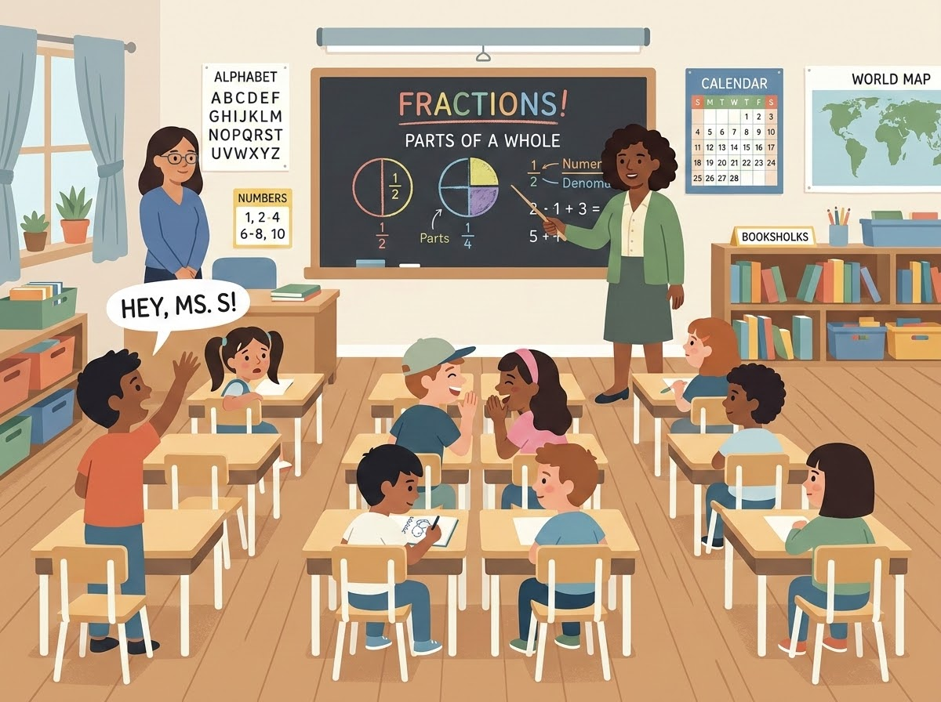
Case Study: Collaborative Support
Classroom Snapshot
Reflection & Analysis
Discussion Prompts
What do you notice?
What could the assistant or teacher be doing differently?
How could the adults work together without interrupting instruction?
The Scenario
The teacher is teaching a whole-group lesson while the assistant stands at the back of the room. One student is calling out, two are off task, and another is finished.
Teacher asks: "Can you keep an eye on things?"
Key Takeaway
Remember, the assistant should not have to wait for something to go wrong before becoming an active part of instruction.

Slide 26


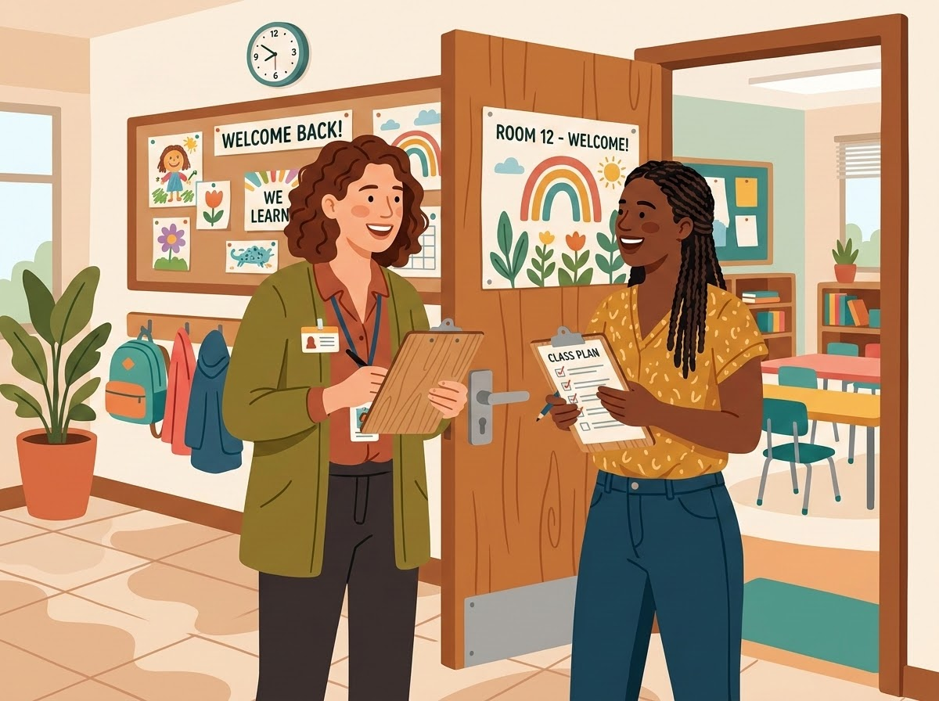
Co-Teaching Collaboration Framework
The 30-Second Huddle
WHO is doing what?
1
PRACTICAL HUDDLE SCRIPT
"I'll introduce the math activity. You circulate and listen. I'll take students for reteaching, you support early finishers. Let's check in after."
WHERE will each adult be?
2
WHAT are we watching for?
Partner Practice
Practice this 30-second huddle with your partners to ensure alignment before a lesson begins.
3
WHEN will we check back in?
4

Slide 27
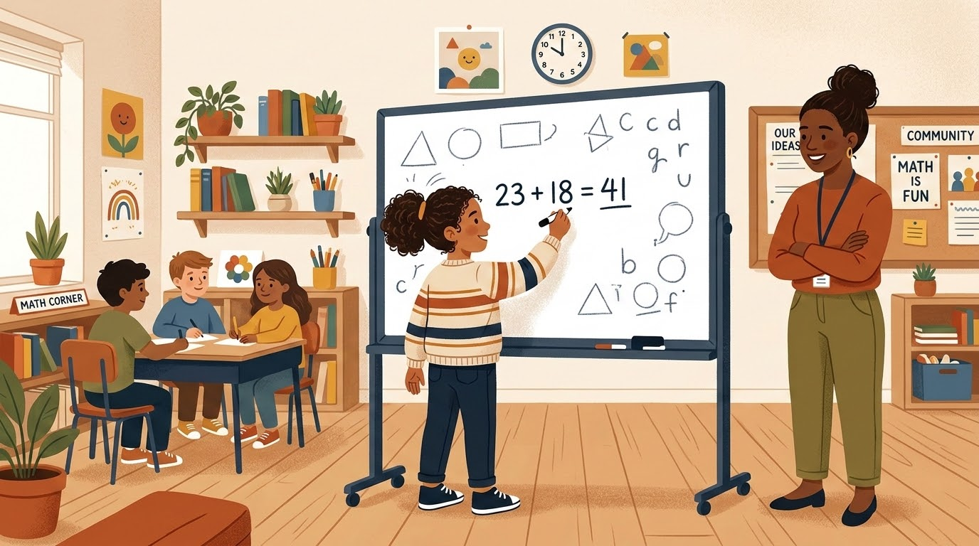
Case Study: Fostering Student Independence
Classroom Snapshot
Reflection & Analysis
Discussion Prompts
What changes when we shift from direct answers to guided prompts?
How does wait-time build a student's confidence to tackle obstacles?
In what ways can co-teachers align on when to step in and when to fade?
Key Takeaway
Empowering student independence is a strategic choice. True support means providing the minimal prompt necessary, letting the student practice, and intentionally fading our presence.
The Scenario
A student struggles with a multi-step task and stops working. Rather than stepping in immediately to solve it, the teacher pauses, prompts the student with a strategic question, and allows space for them to try.
Teacher asks: "What strategy could you try next?"

Slide 28
Case Study Debrief
Discussion Questions & Observations
1. What do you notice?
Analyze the different things happening in this situation. Consider:
Student Independence & confidence levels
Type of Adult Support being provided
Classroom Communication & prompting
Clarity of Expectations
Defined Teacher / IA Roles
2. What is Mr. James doing well?
Identify the strengths in his current approach:
Has built a strong relationship with Marcus, earning his trust
Recognizes when Marcus is struggling with tasks
Demonstrates a strong desire for Marcus to be successful
Shows constant willingness to provide support
3. What is Ms. Carter doing well?
Evaluate her strategic insights:
Has actively noticed a pattern in student behavior
Keeps her focus on long-term independence
Recognizes that current support may not produce the desired outcome over time

Slide 29
Case Study Debrief
Discussion Questions & Observations
4. What Could “Better Support” Look Like?
Have groups redesign the interaction to foster student independence:
Key Considerations
How can the IA guide without taking over?
What prompts build a student's metacognition?
How do we establish a classroom pattern of strategic wait-time?
INSTEAD OF...
Marcus
“I can't do it.”
IA
“Here, I'll show you.”
This immediate intervention removes the struggle, but deprives the student of the opportunity to problem-solve.
TRY SHIFTING TO...
Marcus
“I can't do it.”
IA
“What part feels difficult?”
STRATEGIC FOCUS
By asking a targeted question, the educator invites the student to isolate the hurdle, maintaining their agency and ownership of the learning process.

Slide 30
Reframing Our Classroom Language
INSTEAD OF SAYING...
TRY SHIFTING TO...
“Can you handle him?”
“How can we support him?”
“That’s your student”
“That’s our student.”
“Take him outside”
“What does the student need right now?”
“They never listen”
“What seems to be making this difficult?”
“I already told you”
“Let’s make sure we’re on the same page.”
“Just help them”
“What support would help them access the task?”
“Language shapes classroom culture.”

Slide 31
Partnership Reflection
Take a moment to privately rate your classroom team on a scale from 1 to 5.
Evaluation Scale
1
Operate Separately
Private Reflection
Consider These Prompts:
1. Identify one thing your team already does well.
2. Identify one thing you could improve.
3. Consider one thing you can personally do differently to support the partnership.
4. Identify one thing you need from your teammate to be successful.
2
Step 2
3
Step 3
4
Step 4
5
True Instructional Team

Slide 32
Team Commitment Templates
Work with your partner to complete these commitments and strengthen your classroom partnership.
Collaboration Commitments
Our Daily Agreements
We can count on each other to...
Write daily partnership expectations...
We will communicate by...
Define touchpoints & communication styles...
We will support student independence by...
Outline shared student support structures...
Classroom Partnership
Our Immediate Actions
One thing we will START doing...
Identify an actionable strategy to begin immediately...
One thing we will STOP doing...
Pinpoint classroom friction or habits to cease...

Slide 33
Our Team Commitment Worksheet
Teacher and IA partners: Work together to complete these shared agreements and actions.
Collaboration Commitments
Our Daily Agreements
We can count on each other to...
Write daily partnership expectations and core classroom duties...
We will communicate by...
Define touchpoints, preferred feedback styles, and daily check-in times...
We will support student independence by...
Outline shared student support structures and when to step back...
Immediate Action Plan
Our Partnership Growth
One thing we will START doing...
Identify an actionable strategy to implement in our next lesson...
One thing we will STOP doing...
Pinpoint a common classroom friction point, habit, or over-intervention to cease...

Slide 34

Maximizing Our Shared Impact
THE POWER OF PARTNERSHIP
Co-Creating Student Success
The most effective classrooms aren't the ones where two adults simply occupy the same space.
They're the classrooms where two adults intentionally use their strengths, actively communicate with one another, and establish clear support systems.
By working together as a cohesive instructional team, we create more opportunities for every student to learn, participate, and thrive.

Slide 35
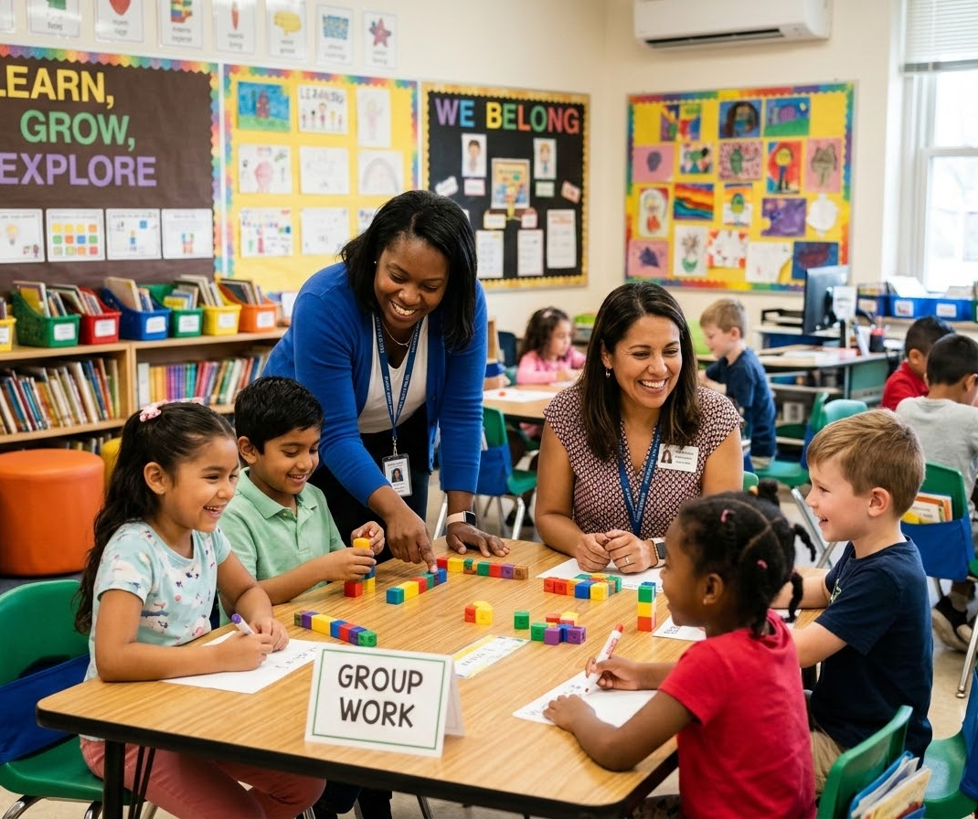
Thank You for Your Partnership
Building stronger teams to co-create inclusive, supportive environments for every child.
SUSTAINING OUR MOMENTUM
Next Steps for Your Team
Review Commitments: Revisit your worksheets regularly during weekly check-ins.
Share Feedback: Maintain an open, honest dialogue about classroom roles and student progress.
Celebrate Success: Acknowledge the small wins and daily milestones you achieve together.
"Great partnerships make great classrooms."

