Slide 1

Polishing the PWN
Lori Stewart, Ph.D.

Slide 2
What is the Prior Written Notice
A formal document provided to parents by the local education agency (LEA) or IEP team.
Under North Carolina Department of Public Instruction (NCDPI) guidelines and federal law, schools must issue this notice before proposing or refusing to initiate or change a child’s identification, evaluation, educational placement, or provision of services.
Understanding the Legal Foundation
Notes:
The PWN is perhaps the most important document of the IEP. It summarizes the entire meeting and is the first go-to for clarification.

Slide 3
IDEA-20 U.S.C. 1415 (b)(3), (b)(4), and (c)(1)
Key Requirements of the Statute
(b)(3) Schools must give parents prior written notice before they propose or refuse to change a child’s identification, evaluation, educational placement, or free appropriate public education (FAPE).
(b)(4) Notice must be written in the native language of the parents, unless it is clearly not possible to do so.
(c)(1) The notice must include an explanation of why the school proposes or refuses the action, a description of options considered, and data or reports used as a basis for this decision.

Slide 4

The PWN ensures transparency by formally documenting what the school plans to do, what it refuses to do, and the reasoning behind it.
https://www.youtube.com/shorts/wilUmIaCSjM?feature=share

Slide 5
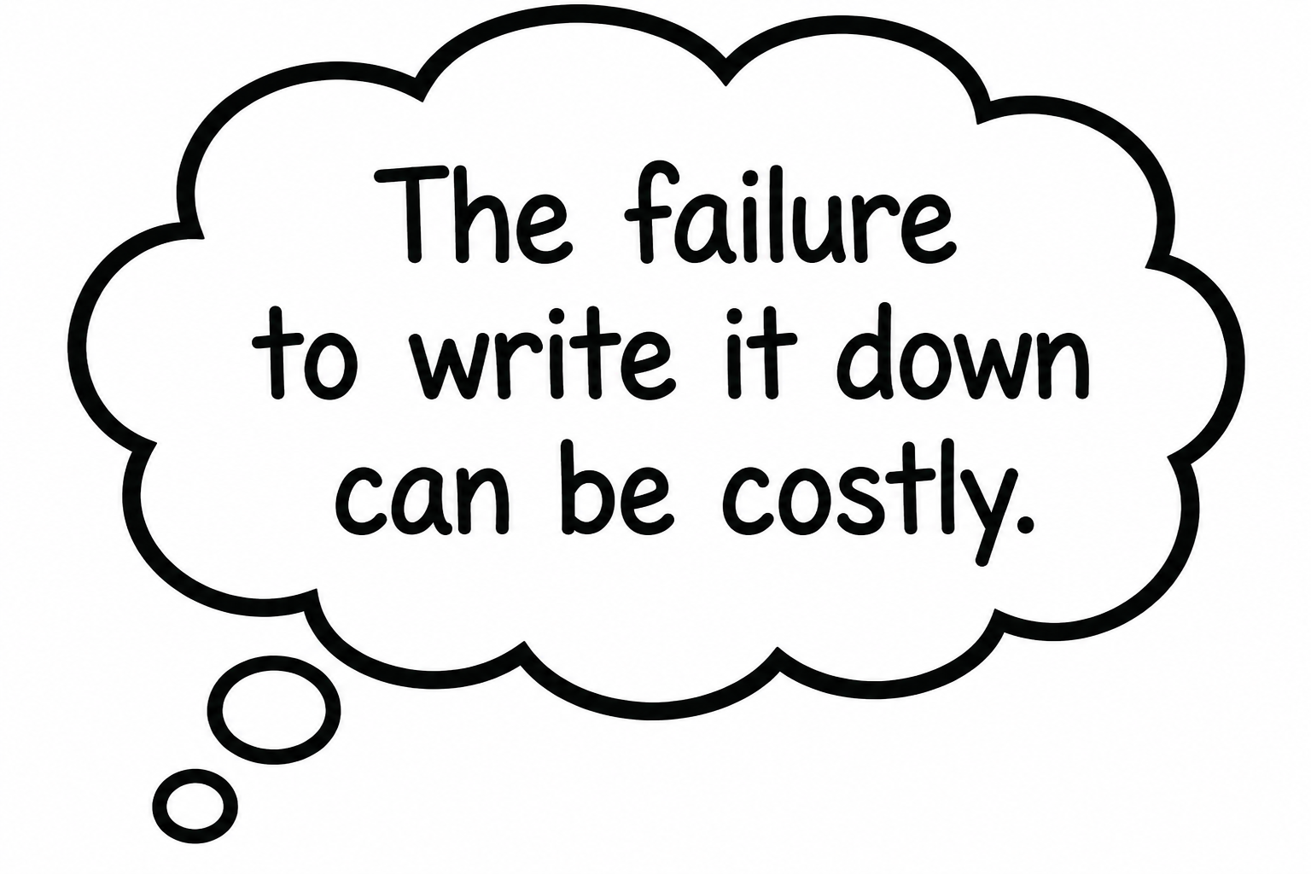
Functions of the PWN
Examples of when to develop a PWN:
Propose or refuse to evaluate or re-evaluate a child.
Decide if a child is eligible for special education services.
Change a child's educational placement (e.g., changing from a regular classroom to a specialized setting).
Add, change, or remove specific services, accommodations, or behavioral intervention plans.
Propose or refuse to change a child's Individualized Education Program (IEP) goals or exit them from special education altogether.
How parents use the PWN:
Make sure the document reflects exactly what was discussed in the IEP meeting.
When parents make a request to the school (such as asking for an independent evaluation or a specific related service), they have the right to request a PWN to document the district’s response.
If parents disagree with the team's decision, they can request that their concerns be documented in the PWN, or they can write their own statement to attach to the PWN document.
The PWN is provided after the team meeting but before the decisions are implemented, giving the parent time to consider their options and, if necessary, pursue dispute resolution.

Slide 6
Key Elements of the PWN
Description of action(s) proposed
Explanation of why the agency proposed to take the action(s)
Description of action(s) refused
Explanation of why the agency refused to take the action(s)

Slide 7
Key Elements of the PWN
Sources of Relevant Information
Sources for parents to contact to obtain assistance in understanding their rights, the IEP document, and special education protocols and procedures.
Description of other options that the IEP team considered and the reasons why those options were rejected
A description of other factors that are relevant to the agency’s proposal or refusal

Slide 8



“Do’s and Don’ts” of the PWN
NOOOOOO!!!!
Do not write “N/A” in any of the boxes of the PWN.
Avoid ambiguity or the use of vague terminology.
Do not assume parents understand the acronyms included in the PWN.
Do not forget that data should drive every decision made by the IEP team.
YES, PLEASE!!
Use clear and specific language to ensure parents understand the implications.
Include specific information or examples of data shared during the meeting.
Document parent input and any questions or concerns that they have during the meeting.

Slide 9

EXAMPLES

Slide 10
Proposals and why?
Description of action(s) proposed:
- Discuss Reevaluation results
- Eligibility
- Review of current Annual IEP
- Update present level of performance for Math, Written Expression, Social /
Emotional and Transition.
- Update annual goals in Math, Written Expression and Social/Emotional.
- Discuss referral to EIPD (Employment and Independence for People with Disabilities)
State why the team is meeting. There may be one or more objectives to the meeting.
State how the meeting is being held (e.g., virtually, in person, mix of both).
Include information on all topics discussed / decisions made.
Include any new information share by family.
The EC teacher reviewed current data and information, including attendance, grades, work samples, progress on local and state assessments and toward academic growth. The school psychologist reviewed previous assessments conducted in 2023, which were administered when [___] moved to Moore County and entered the current school district. At that time, both hearing and vision screeners were conducted. The Re-evaluation document includes information from previous parent summary conferences and social/developmental history, which were conducted in [___]'s previous school district in Asheboro, NC. Other information reviewed included previous speech screeners/evaluations, medical / health information, discipline reports, classroom based assessments from Unique Learning Systems (ULS), and IEP progress. Observational data was discussed. [___] does well in one to one academic settings, and continues to demonstrate improvement with her confidence and ability to participate in group activities.
Parent participated in today's meeting via phone conference. Introductions were made. [___]'s present levels of performance and his progress in the general education classroom and toward his current IEP goals were reviewed. Parent indicated that he seems to be showing some improvement in the area of reading, but math continues to be an area of concern. She asked team members if there were any resources available to parents that would provide examples so that she could support him at home with his math work. The general education responded with information about how parent could access this information at the start of each new lesson / unit. Mom described [___] as "independent" and "very determined" and shared that she feels he will have a bright future ahead of him. She asked the team if there are any after school tutoring programs accessible to students. The administrator responded that there are not currently any after school tutoring programs at the current site, but that she could provide parent with information about community resources for families to seek tutoring services.
Introductions were made and parents were offered a copy of the Parent Handbook. The purpose of the meeting was reviewed. Today the team has convened at parents' request to review and revise the current IEP. Parents have expressed concerns related to [___]'s current speech and physical therapy services. They would also like to discuss [___] 's assistive technology device and make a request for [___] to receive services from a one to one paraeducator.

Slide 11
Student strengths, parent concerns, and present levels of performance were reviewed. Mom indicated they are awaiting an appointment with a neurologist. There were no specific concerns at this time related to academics. In terms of her vision for [___]'s future, she stated that she wants for him to be "happy, healthy and living up to his full potential".
The team discussed goals for reading and math to address the areas of decoding, comprehension, word problems, and rate of change. The proposed goals are based on noted baseline scores and targeted areas of need in order for [___] to continue accessing the general education curriculum. Services for SDI were further discussed and team members proposed that [___] participate in co-teaching for ELA and Math, as well as focused interventions in reading and math in a special education setting based on most recent scores and progress. Members also recommended a CAL lab in both reading and math when attending high school for the best chance of success and supports from an EC teacher. Accommodations and supplementary aids were reviewed by the team. Accommodations to support [___] in reading and math across all settings in school based on noted deficits and interventions are include the new IEP. [___] explained that when he encounters difficulties in his classes, he will ask for support. He indicated that he did not used to seek help and did not show very much effort at the start of the school year. Now he is learning how to access supports and put forth effort in the school setting. [___] and guardian shared that he is consistently taking his new medication since January 2026 and it helps him to focus in school.
[___]'s Behavior Intervention Plan (BIP) is being discontinued as he is not showing any behaviors that were on the BIP. Based on teacher feedback and observations conducted by our Educational Diagnostician and Psychologist, [___] 's ability to resist impulses, be aware of his functioning in social settings, adjust well to changes in environment, people, plans, or demands and react to events appropriately is not described as problematic. A behavior goal and services in Social/Emotional will be provided for additional support.
Concerns regarding [___]'s attendance and its impact on her academic performance and progress toward IEP goals were documented in the IEP. The team updated [___] 's annual goals to better reflect her current levels of performance. Goals were developed collaboratively as a team in the following areas: Math, Reading. Services for Specially Designed Instruction (SDI) in the special education setting were proposed for reading and math for 45 minutes, 5 days per week in each subject area. In addition, the team proposed services for SDI in the general education classroom for reading and math for 30 minutes, 5 days per week in each subject area.
Present levels of performance in math were discussed and the EC teacher proposed goals and services to address this area of need. [___]'s math goals will address multi-digit computation in multiplication and solving multistep problems involving all mathematical operations. She will receive specially designed instruction from the EC teacher within the general education classroom setting for 30 minutes, 3 days per week. The EC teacher explained that these services will be implemented for the remainder of the current school year. As [___] will be transitioning to middle school for the 2026-27 school year, an IEP addendum will be scheduled prior to the end of the school year to review services for middle school. Supplementary aids and accommodations were proposed to support [___] in the classroom setting in accessing her academic curriculum. Accommodations were also proposed for state and local testing. Extended School Year was reviewed and the team determined that [___] does not require ESY at this time.
Proposals and why? (Con’t)

Slide 12
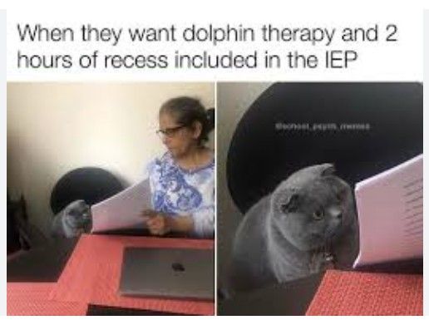
Refusals and why?
Description of action(s) refused:
Parents made the following requests during today's meeting:
1) Direct service for speech/AT to support [___]'s access to her AAC device.
2) Would like for [___] to be out of her wheelchair for two hours daily, either in alternate seating or utilizing her stander or gait trainer. They would like team to chart the time out of her chair daily.
3) Parents ask for direct service for physical therapy to support access the educational environment.
4) Services for a one to one paraeducator to support [___] in the educational environment to support with mobility, physical stretching, and/or social engagement.
Items one, two, and three were agreed to by the team, however at this time, the team refused the request for a one to one paraeducator.
Explanation of why the agency refused to take the action:
There is not sufficient data at this time to determine a required need for one to one support from a paraeducator. The team will revisit this request when the team convenes for the next IEP in October 2026.
Explain / define the request made by the family. If multiple requests, list each separately.
If no requests are made during the meeting, state this, but do not write “N/A”.
Respond to each request made with the team’s rationale for refusal (when appropriate, cite data which may refute the need for a particular request).
NOTE: Phrases such as “we don’t offer that here” or “we don’t have that program” are not defensible refusals. Proposals and refusals are always determined based on what a student requires.
Description of action(s) refused:
There were no actions refused by the team during today's meeting.
Explanation of why the agency refused to take the action:
Parent did not make any requests for action.
Description of action(s) refused:
When services were proposed at Highfalls Elementary, parent asked if there were autism classrooms at other school sites, specifically in the West End or Carthage area. She explained that her request was based on transportation concerns and indicated that her mother could assist with transportation in the other regions requested.
Explanation of why the agency refused to take the action:
The team refused services at other school sites in the areas requested, as the program being proposed is available at HFE, which is the site nearest the residence school. However, it was explained that special education transportation could be proposed as part of the IEP, as the program that [___] requires is at a school site other than her residence school.

Slide 13
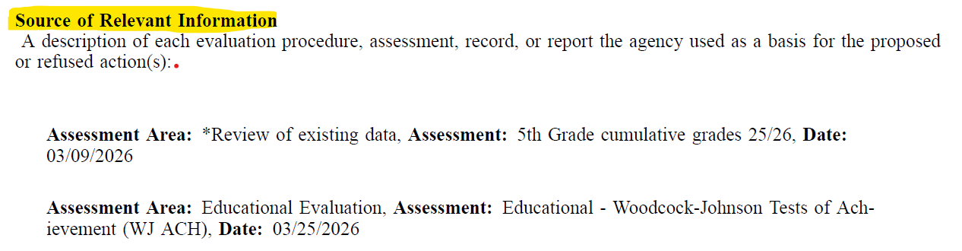
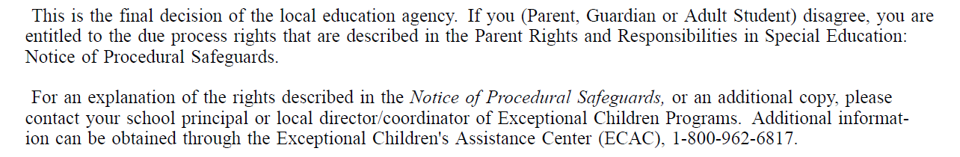
Sources of relevant information &
Sources for parents to seek assistance

Slide 14
Other options considered & why rejected
List alternative strategies, services, or placements brought up by team members.
Clear, data-backed reasons must explain why those specific alternatives were rejected instead of the chosen path.
When this section is blank or overly brief, it constitutes a procedural weakness that parents can challenge.
Why This Section Matters
It offers transparency and shows that the team looked at multiple solutions rather than just pushing a single pre-determined outcome.
Serves as concrete evidence if a family decides to file a state complaint, request mediation, or enter due process over a denied request.
Other factors relevant to the agency’s proposal or rejection
The team considered increasing [___]’s service time within the general education classroom. This option was rejected based on data collected from a trial push-in model during the reading block. Data from this trial demonstrated that [___] exhibits a low threshold for sustained attention and high rates of task avoidance when presented with grade-level curriculum that exceeds her current instructional tier. Her willingness to participate in the general education setting is highly dependent on specific preferred staff members, resulting in total task refusal when those staff members are unavailable.
While she currently transitions to the general education setting in the afternoons without significant behavioral disruption, data notes this is only successful because she is permitted to engage with a preferred leisure item (iPad) rather than accessing the core curriculum. The general education environment during academic blocks triggers severe task avoidance, resistance, and non-compliance due to the deficit gap, the team determined that increasing general education time would negatively impact her academic and behavioral progress.
The team considered developing a Behavior Intervention Plan (BIP) to support [___] in the educational setting. This was rejected as this time, as team members feel that [___] 's upcoming transition to a smaller, autism-specific program will provide the supports required within that structured environment. Should a BIP be required in the future, the IEP team can utilize data collected from the Functional Behavior Assessment (FBA) in the development of this plan.

Slide 15

Other options considered & why rejected
Other factors relevant to the agency’s proposal or rejection
The team considered moving forward with the eligibility determination using existing data, however rejected this as team members agreed that further evaluation was necessary.
The team proposed re-evaluation to consider the potential eligibility category of IDMD.
The team considered continuing to offer goals and services for OT, however [____] has made progress in meeting all of his goals. He is ready to move toward a support model which would address maintenance of skills in the educational setting. The OT would also support [_____] with accessing universal tools for written expression (e.g., speech to text, scribe tools).
[_____] has met all of his OT goals this year and is ready to move to a support model addressing maintenance of skills.
The team considered continuing school wide interventions in math, rather than proposing an IEP, but this was rejected. This was rejected by the team, as [___] has met eligibility for an IEP under the eligibility category of OHI and requires specially designed instruction (SDI) in the area of math.
The team considered [___]'s needs in the area of speech/language and whether direct services should be continued.
Because he has progressed and met all goals, team members rejected continuing direct service. Consultative services were proposed at this time.

Slide 16
NON-EXAMPLES

Slide 17
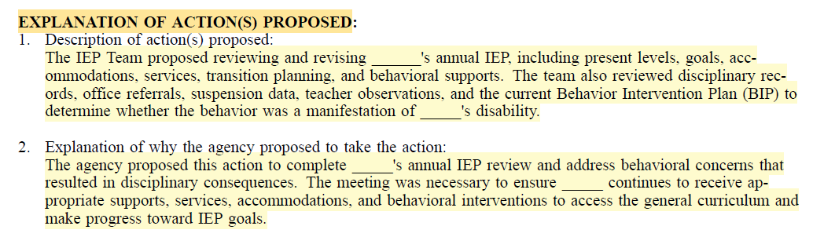
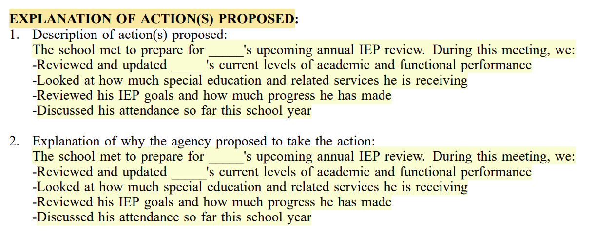
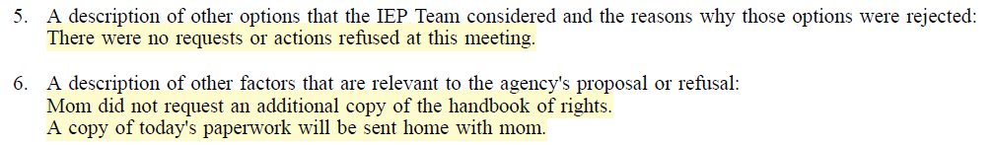

Slide 18
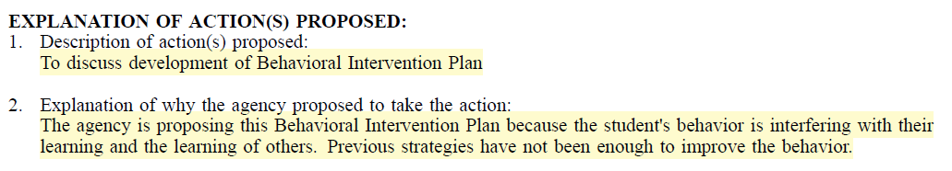
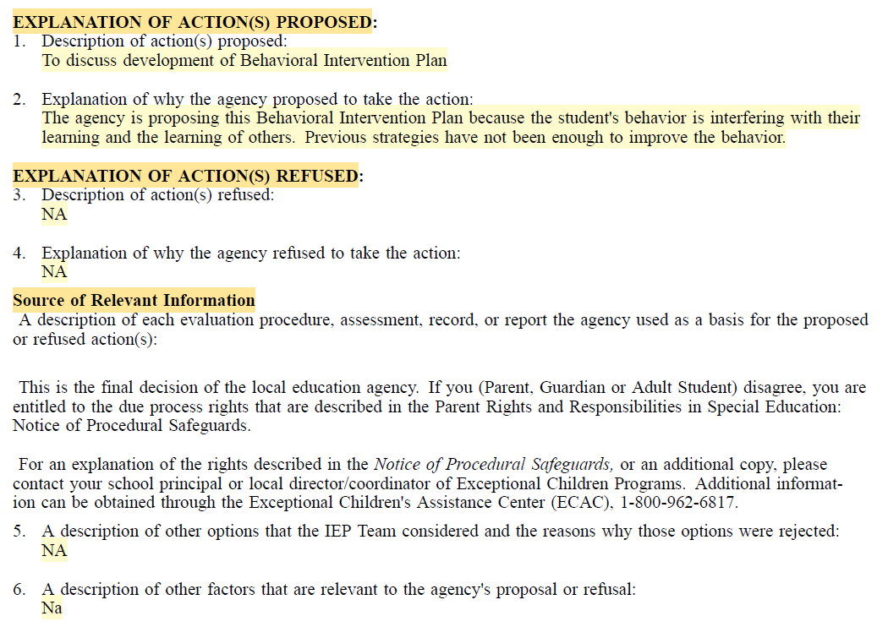

Slide 19
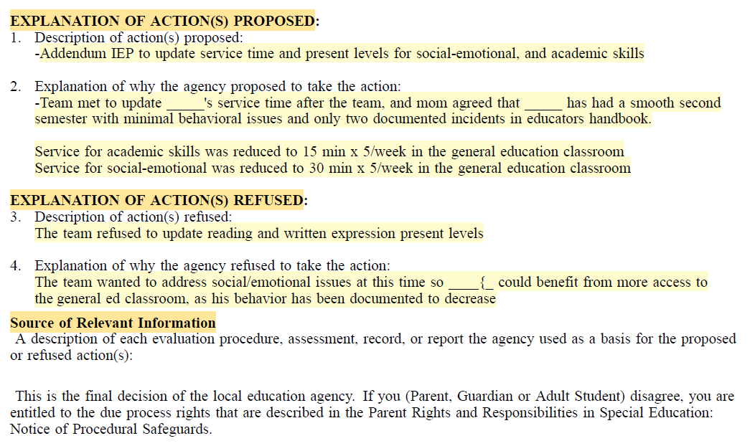

Slide 20

Key Takeaways
What is the Prior Written Notice
Grounded in Federal Law
When is the PWN Required
Why is the PWN Important
Key Elements of the PWN

Slide 21


Thank you
Dr. Lori Stewart
IEP Coordinator
lstewart@ncmcs.org

