Slide 1


What’s Your North Star?
Integrating MTSS and Continuous Improvement to focus collective effort

Slide 2

Getting Started

Slide 3

Objectives
Evaluate how well current MTSS and Continuous Improvement structures (e.g. teaming, communication) are positioned for integration and impact.
Explore examples of MTSS and Continuous Improvement teaming structures and communication pathways.
Apply this knowledge to identify adjustments to your current district-level team structures and communication systems.

Slide 4

Agenda
  Compass Partners
  Seeing the Connections
  Making Integration Happen
  Travelling North
Notes:
Welcome - 10mins
Connections - 20mins
Integration
Nesting - 20 mins
Teams - 5 mins
Travelling North - 5mins

Slide 5

In your context, what's the North Star that all of this work is supposed to serve?
What should MTSS and Continuous Improvement both be pointed at?
★ NAME YOUR NORTH STAR What is the thing MTSS and Continuous Improvement should BOTH be pointed at?
Notes:
Before we get into structures and data cycles, one question —

Slide 6

Compass Partners
  Everyone stand up and mingle to find a different partner for each compass direction — North, South, East, West.
  Introduce yourselves: name, district, role. Both partners write each other's name and district in the matching row.
  Can't find a partner for a slot? Head to the Lost Navigator’s corner.

Slide 7

Seeing the Connections

Slide 8
WHY TALK ABOUT MICIP AT AN MTSS CONFERENCE?
  These are different frameworks with different roles
  However, they also have commonalities and interact with each other throughout the district.

Slide 9
MICIP
The Michigan Integrated Continuous Improvement Process (MICIP) is the mindset, process and platform used to support district (and school) continuous improvement (CI).
MICIP is a pathway for districts to improve student outcomes by assessing the whole child needs, developing and implementing plans, and coordinating funds.

Slide 10
MDE MTSS Definition
MTSS: The utilization of all relevant whole child and system data to analyze, evaluate, and plan strategies that support sustainable systemic improvement and whole child learner outcomes.
Data-based decision making is inclusive of efficient data collection practices for multiple data sets and a formal continuous improvement process.
Data used are timely, valid, reliable, accurate and reviewed in ongoing cycles.
(MDE, MTSS Practice Profile 2020)

Slide 11
Other State’s
MTSS Definitions
MTSS is a systemic, evidence-based, continuous school-improvement framework in which data-based problem solving, and decision-making are practiced across all levels of the educational system (NY Department of Ed)
MTSS is a framework for school improvement that focuses on system level change across the classroom, school, and district to provide all students with the best opportunities to maximize achievement, both academically and behaviorally (Montana Department of Ed)

Slide 12
  These are different frameworks with different roles
    MTSS is the “what we do for all students and how we do it.”
    MICIP is the “how we decide, plan, and know if all our initiatives are working at the school and district level.” It is the district-wide process for assessing needs, planning, implementing, monitoring, and evaluating any priority, not just MTSS.
  However, they also have commonalities and interact with each other throughout the district.
MTSS AND MICIP

Slide 13
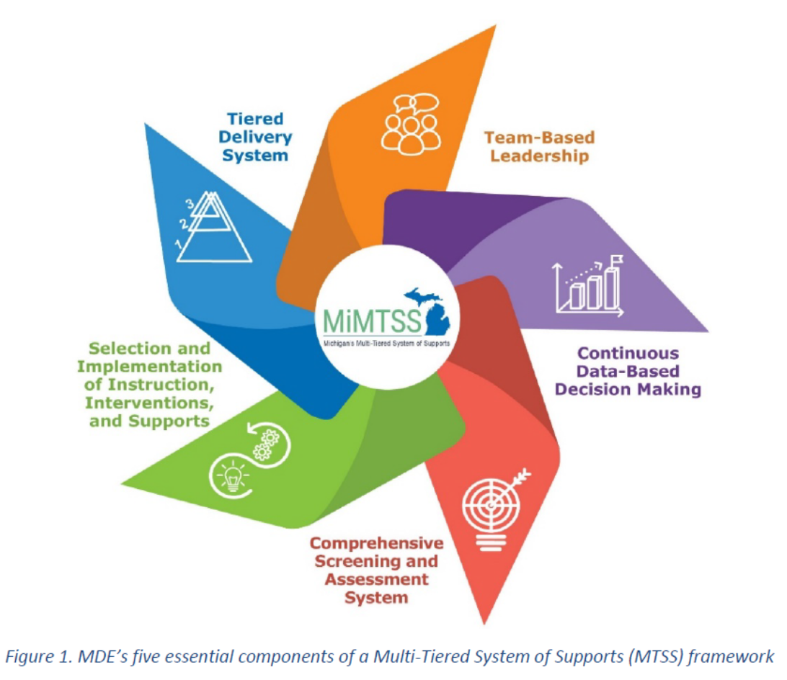
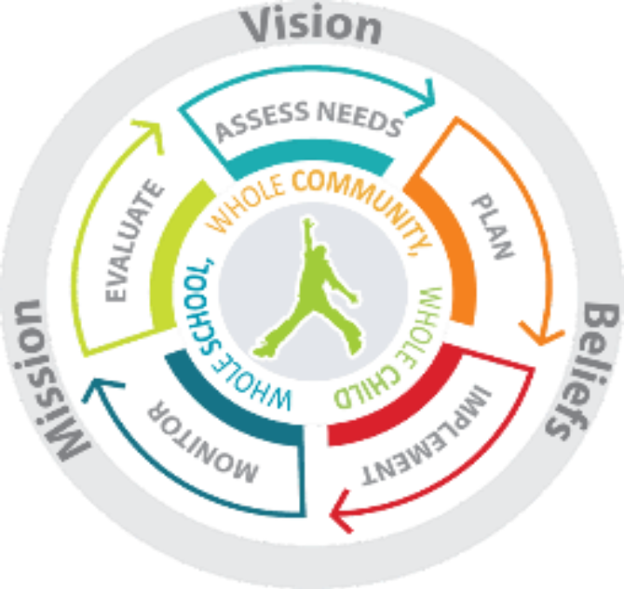
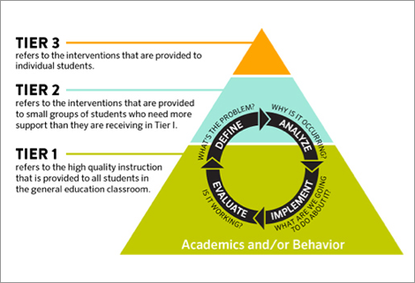

Say something about what you notice
Notes:
Make alternative for those who need accomodations

Slide 14

SAME OR DIFFERENT?
  Partner at your table to decide for each action or role:
Is this function part of MTSS, part of MICIP, or BOTH?
  Mark in your note catcher as you decide (This will help later!)

Slide 15
SAME OR DIFFERENT?
Compare to the “answer key” and reflect.

Slide 16

Same
  School improvement frameworks
  Shared mindset of ongoing evaluation and adjustment.
  Based on implementation science and improvement cycles.
  Look at many of the same types of data (e.g. scale/reach, capacity, fidelity, impact) in the same areas.
  Both utilize teams and seek to improve systems.
  Effective Tier 1 instruction involves continuous improvement work

Slide 17
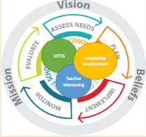
Different
While MTSS implementation provides a framework for addressing the needs of all learners using continuous improvement principles, it does not replace MICIP.
  MTSS is one strategy that a district should integrate into its broader MICIP continuous improvement plan.
  MICIP should include a plan for MTSS implementation, funding its implementation, and monitoring its success.
  MICIP is the avenue through which the continuous data-based decision-making component of MTSS is enacted.
    MICIP is a district-driven process made of continuous improvement cycles happening with a larger multi-year cycle. MTSS data cycles inform that larger cycle.

Slide 18
Resources
MDE: FAQ About How MTSS Supports Continuous Improvement As Identified Through MICIP
MDE: MICIP Platform Crosswalk for District-Wide Integrated MTSS Installation:

Slide 19

Compass Partners
Grab your handouts
Find your WEST partner
Discuss:
  What similarities or connections do you see between these two frameworks?
  What differences do you see?

Slide 20
Making Integration Happen

Slide 21

  MTSS is one of several district initiatives that should be nested inside the same MICIP process.
  Not run alongside it as a separate process.
  This can be harder to work through with MTSS than other strategies because of similarities and connections.

Slide 22
Assess Needs — Study whole child data (academic, non-academic, systems) to name the gap between current and desired state and identify root causes.
Plan — Define a measurable goal. Select an evidence-based strategy, identify strategy details and activities, fund the strategy, and communicate it.
Implement — Put the strategy into practice.
Monitor, and Adjust - Review implementation and impact data on a regular cadence, and change course based on the successes and barriers that surface. This runs as multiple short cycles inside the larger one.
Evaluate — At the end target date, determine whether the goal was met and decide how to move forward (revise, maintain, or archive it).

Slide 23

As you hear about this example district - Think about how MTSS teams and processes fit into this MICIP process?
Mark MTSS as close or far from each component of the MICIP Process.
  If not many examples of how teams or processes are connected - MTSS is far from the sun
MTSS
MTSS
MTSS
MTSS
MTSS
SOURCE: District Continuous Improvement: Aligning MTSS Goals and Activities within MICIP Platform, Michigan's MTSS Technical Assistance Center, April 2025

Slide 24
Compass Partners
Bring your handouts
Find your SOUTH partner
Discuss:
What is something you uncovered about how MTSS and MICIP work in your context?

Slide 25

TEAMS, TEAMS, TEAMS
It is important to review your teams and how they communicate because:
  Conflicting plans or messages
  It is harder to communicate successfully between many teams
  It is easy to miss a needed function/role
  It can be hard for everyone to understand which team does what
  There may not be enough interested staff to join all the teams

Slide 26
REFLECTION ACTIVITY
Draw a circle for each your teams related to MTSS and MICIP at district and school level.
Next to each team circle
  Write the purpose of the team and the group/level it focuses on (e.g. 6th grade, ABC Elementary Tier 1)
  List the type of data reviewed
  List who is on the team (roles)
To show communication and connections
  Draw arrows between teams that are connected by their work
  Label them with what they communicate

Slide 27
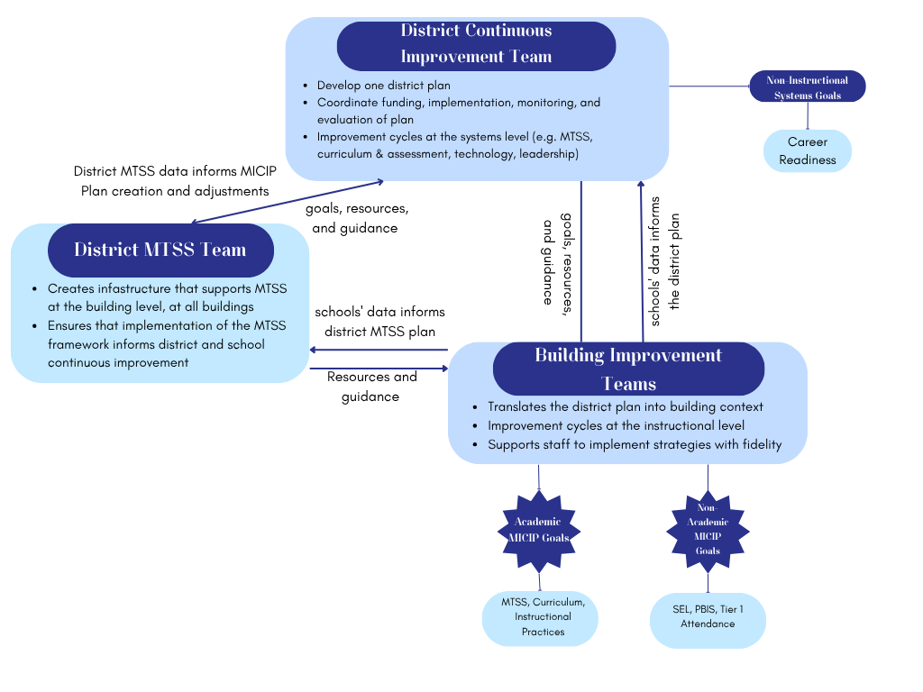
NOTICE
Career Readiness Committee
WONDER
STEAL
Notes:
5min for gallery walk if room allows

Slide 28
BACKSTAGE
Separate teams at the district level. One team at the building level.
  A standing, separate MTSS team that works at Tier 1 is the model most likely to create redundancy and confusion.
  The School Leadership Team should lead MTSS implementation at the building. Not a permanent separate MTSS team or a separate Implementation Team.
  The District-level and the building-level teams are NOT redundant with each other - they're different levels (district-wide coordination vs. building-level systems monitoring).
  Depending on the intensity of the MICIP process in the district - a separate district MTSS team that coordinates with MICIP leaders/process may work well.

Slide 29
What gaps have you identified?
What redundancies/overlaps do you see?
Where might there be communication breakdowns?
Notes:
5mins individual, 2mins table discussion

Slide 30
Travelling North
Notes:
2-3mins close

Slide 31
1 NEXT STEP?
Combine - Merge two teams doing overlapping work into one.
Clarify - Sharpen a team's purpose or the data source that drives it.
Connect - Build or repair a communication pathway.
Integrate - Nest your MTSS data-based decision cycles inside MICIP.
Communicate - Find time to learn more from and process this with someone in your context.
Notes:
5mins individual, 2mins table discussion

Slide 32
What is something you've learned about how MTSS and MICIP can better work together to better support meaningful student outcomes?

