Slide 1

MTSS • MICHIGAN SCHOOL SAFETY LEGISLATION • MENTAL HEALTH
Bridging the Gaps
Integrating Mental Health Supports and Michigan School Safety
Legislation within MTSS
PRESENTED BY
Vanessa Long, BSN, RN
School Nurse Consultant
Danielle Tagai, LMSW, C-SSWS, PSWC, CTRS-C
Regional Safe & Healthy Schools Coordinator
Safe & Healthy Schools
1

Slide 2
SESSION OBJECTIVES
Participants will:
1
Understand key provisions of current Michigan school safety legislation related to mental health.
2
Identify how mental health supports align within MTSS frameworks (Tier 1, 2, and 3).
3
Collaboratively discuss challenges and share best practices.
4
Begin outlining an action plan for integrating mental health supports in compliance with legislation.
Bridging the Gaps
2

Slide 3
ICEBREAKER
“
What’s one challenge or success you’ve experienced
related to mental health in schools?
Pair share or small table groups
Bridging the Gaps
3

Slide 4
LEGISLATIVE LANDSCAPE
Michigan Legislative Overview
Key provisions intersecting school safety and mental health
1
Student Safety Act Confidential tip line for students to report threats or mental health concerns; school personnel must respond and report appropriately (OK2SAY).
2
Comprehensive School Safety Plans PA 436 of 2018 requires updated emergency operations plans, including mental health protocols.
3
Behavioral Threat Assessment and Management Teams PA 272 of 2024 All schools must have a behavior threat assessment and management team in place not later than October 1, 2026.
4
Save Our Students ACT Suicide Prevention and Awareness
5
Professional Development Mandates Annual staff training on suicide prevention, trauma-informed practices, and behavioral threat assessment (Chase Edwards Law 2006).
Bridging the Gaps
4

Slide 5
PA 324 of 2006
“The board of a school district or board of directors of a public school academy is encouraged to provide age-appropriate instruction for pupils and professional development for school personnel concerning the warning signs and risk factors for suicide and depression and the protective factors that help prevent suicide.”
Goals
  To Prevent both fatal and nonfatal suicide behaviors amount youth.
  To increase pupil awareness of warning signs and risk factors for suicide and depression
  To improve access to appropriate prevention services for vulnerable youth groups.
2
4
Bridging the Gaps
20

Slide 6
PA 436 of 2018
“…in conjunction with at least 1 law enforcement agency that has jurisdiction over the school district, intermediate school district, or public school academy, conduct a review of the emergency operations plan developed…”
The emergency operations plan developed and adopted under subsection (2) must include guidelines and procedures that address at least all of the following:
(a) School violence and attacks.
(b) Threats of school violence and attacks.
(c) Bomb threats.
(d) Fire.
(e) Weather-related emergencies.
(f) Intruders.
(g) Parent and pupil reunification.
(h) Threats to a school-sponsored activity or event whether or not it is held on school premises.
(i) A plan to train teachers on mental health and pupil and teacher safety.
(j) A plan to improve school building security.
(k) An active violence protocol.
(l) Continuity of operations after an incident.
(m) A vulnerability assessment.
2
4
Bridging the Gaps
20

Slide 7
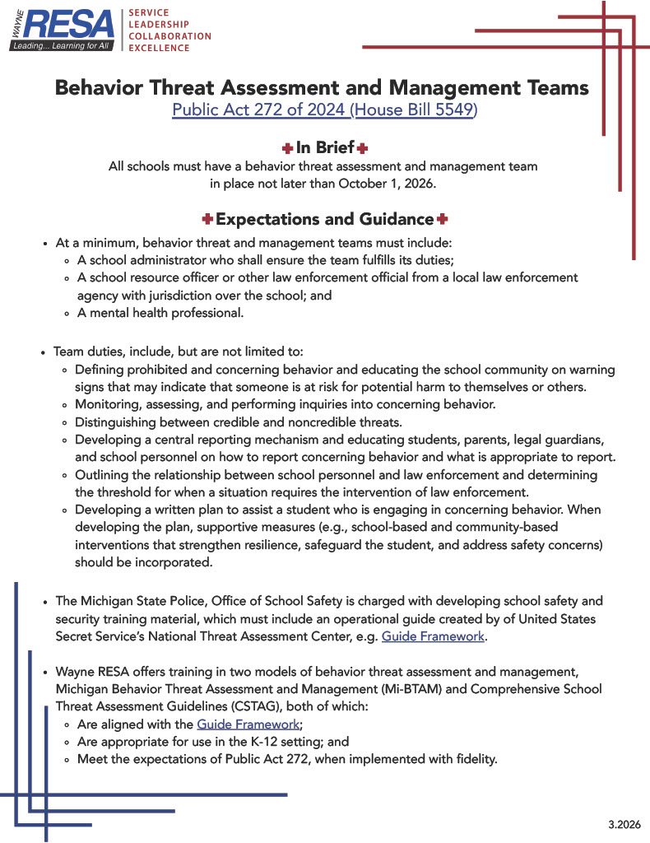
2
4
Bridging the Gaps
20

Slide 8
Save our Students Act
“…Identification cards for grades 6 to 12; national suicide prevention hotline telephone number; display of model information materials…”
2
4
Bridging the Gaps
20

Slide 9
PA 324 of 2006
“The board of a school district or board of directors of a public school academy is encouraged to provide age-appropriate instruction for pupils and professional development for school personnel concerning the warning signs and risk factors for suicide and depression and the protective factors that help prevent suicide.”
Goals
  To Prevent both fatal and nonfatal suicide behaviors amount youth.
  To increase pupil awareness of warning signs and risk factors for suicide and depression
  To improve access to appropriate prevention services for vulnerable youth groups.
2
4
Bridging the Gaps
20

Slide 10
BEHAVIORAL THREAT ASSESSMENT
What Is BTAM?
A proactive, evidence-based approach to preventing targeted violence in schools
1
Identify
2
Assess
3
Manage
Behaviors that elicits significant concern for their safety or the safety of others.
The concerning behavior in context, using information on the student's actions and circumstances.
Any risk by providing appropriate, student-focused supports, resources, and interventions.
PA 272 indicates at a minimum, behavior threat and management teams must include:
A school administrator who shall ensure the team fulfills its duties;
A school resource officer or other law enforcement official from a local law enforcement agency with jurisdiction over the school; and
A mental health professional
Bridging the Gaps
5

Slide 11
BEST PRACTICES
8 Steps to Implement BTAM
From NTAC's Enhancing School Safety Using a Threat Assessment Model (2018)
Establish a multidisciplinary team
Define prohibited & concerning behaviors
1
2
Establish a central reporting mechanism
Determine the threshold for law enforcement
3
4
Identify BTAM model for implementation
(Mi-BTAM or CSTAG)
Develop risk management & support options
5
6
Create & promote a safe school climate
Provide training (to all stakeholders i.e. students, parents, staff, community, etc.)
7
8
Bridging the Gaps
7

Slide 12
Guiding Principles for Support & Management
Address
Redirect
Create
Collaborate
Factors of concern and promote positive factors.
Possible motivations for violence.
An environment in which violence is less likely.
With community partners who can contribute.
EXAMPLES
EXAMPLES
EXAMPLES
EXAMPLES
Substance abuse intervention, mental/physical health support, family support, academic recovery, mentoring
Restorative problem solving or mediation, effective bullying intervention, opportunities to share strengths
Reduce/eliminate access to weapons, safety checks, modify schedules or access to locations
Leverage community partners, mental/physical health providers, families, law enforcement
Bridging the Gaps
8

Slide 13
IMPLICATIONS
What This Means for Schools
1
2
3
Required Roles of Multidisciplinary Team
Professional Development
School Policies & Plans
New/expanded responsibilities on threat-assessment teams, supporting mental health, and ensuring school safety.
Training in suicide prevention, trauma-informed practices, and behavioral threat assessment.
Emergency operations plans and safety protocols must be updated to embed mental health considerations.
Bridging the Gaps
9
Notes:
Supported by PREPaRE 1 – EOPs
BTAM/CSTAG
Columbia
Understanding Trauma

Slide 14
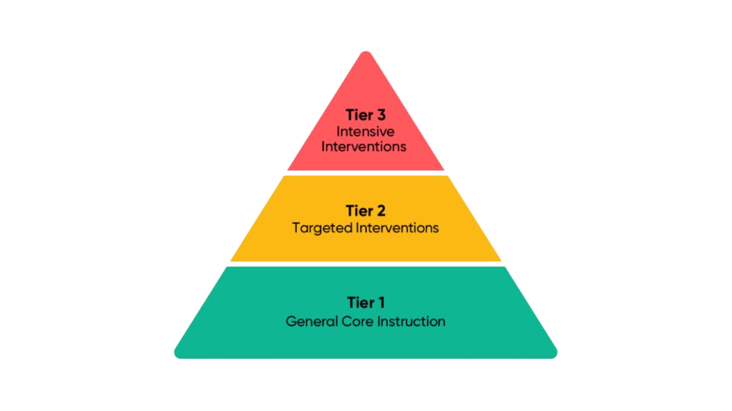
MTSS Refresher
Why It Matters
MTSS organizes prevention and intervention by intensity. Mapping legislative requirements onto Tiers 1–3 turns compliance into a coherent system of support, rather than a checklist.
Individual & Wraparound Supports
Small Group & Early Intervention
Complementary frameworks: Maslow’s Hierarchy of Needs and the CDC’s Whole School, Whole Community, Whole Child (WSCC) model.
Bridging the Gaps
10

Slide 15
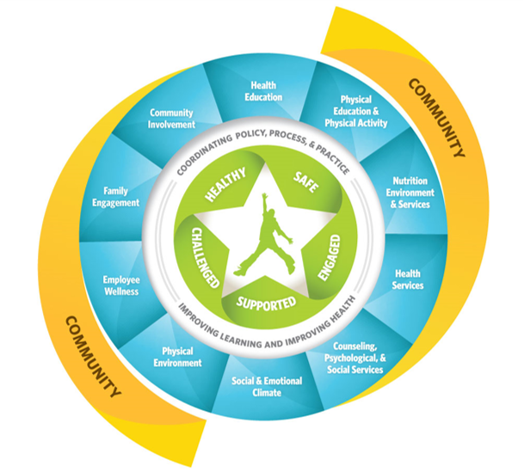
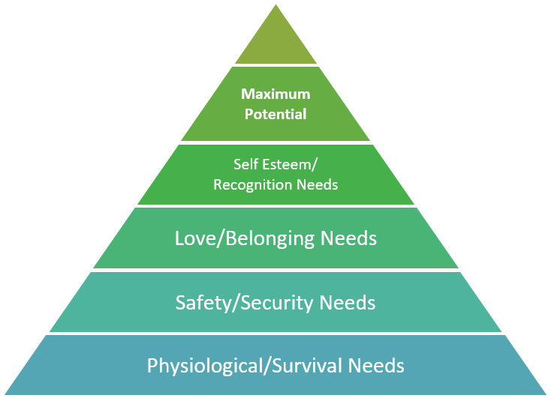

Slide 16
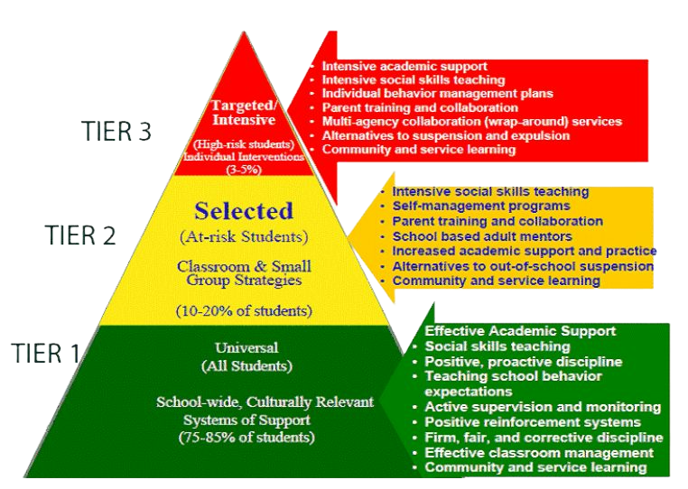
Mental Health Across Tiers
Individual & Wraparound Supports
Small Group & Early Intervention
Bridging the Gaps
10

Slide 17
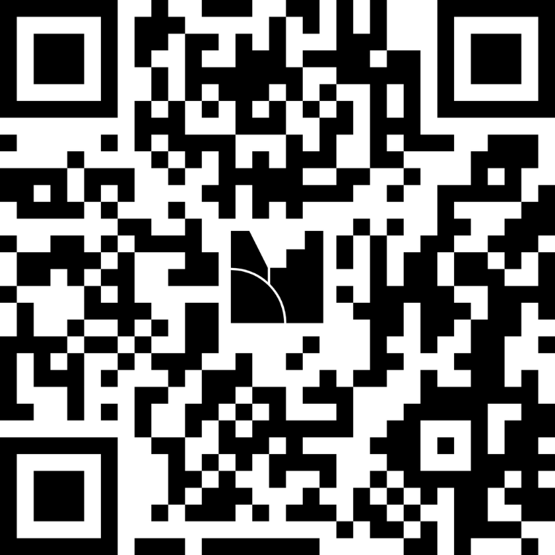
QUICK CHECK
Match the Tier
Match the strategies to support students’ mental health to the correct Tier
Tier 1: Universal Prevention
JOIN ON YOUR DEVICE
menti.com
Tier 2: Targeted Intervention
Code: ala8m7oo5xr1
Tier 3: Intensive Intervention
https://www.menti.com/ala8m7oo5xr1
Bridging the Gaps
14

Slide 18
Mental Health Across Tiers
Tier 1
Tier 2
Tier 3
Universal Prevention
Targeted Intervention
Intensive Intervention
SEL curriculum
Small group social skills & coping groups
Individual therapy or wraparound supports
Trauma-informed classroom practices
Check-in / Check-out
FBA / BIP process
School climate initiatives (Be Nice, Hope Squad, etc.)
Early warning systems (attendance, grades, behavior)
Threat assessment protocols
Behavioral expectations & acknowledgment systems
Staff consultation & coaching
Partnerships with outside agencies or CMH
Bridging the Gaps
11

Slide 19
ALIGNMENT
BTAM, MTSS & PBIS: Better Together
frameworks are behavior-based, proactive, and team-driven
BTAM
SHARED
MTSS/PBIS
Focuses on an individual student and their risk for engaging in violence or other harmful activities while delivering intervention strategies to manage that risk and support the student
Based on observable behavior
Focuses on building a continuum of supports to promote all students' social, emotional, behavioral, and mental health
Prioritizes proactive prevention
Uses multidisciplinary teams for decision-making
Seeks to identify, assess, and provide interventions and supports
Emphasizes supportive, caring relationships
Promotes safe and healthy school climates
Bridging the Gaps
12

Slide 20
GROUP DISCUSSION
Where are we seeing gaps?
Where are we seeing alignment?
Reflect on current practices and share with your table
Bridging the Gaps
17

Slide 21
SHARE-OUT
Group Share-Out
One idea, insight, or resource per group
Bridging the Gaps
19

Slide 22
Planning Worksheet
ACTIVITY
Collaborative Planning Activity
Legislative Requirements Check-In
Areas for Growth
1
2
MTSS Tier Connection
Initial Action Steps
3
4
Resources or Support Needed
Team Members / Collaborators Involved
5
6
Bridging the Gaps
18

Slide 23
NEXT STEPS
Guiding Questions for Getting Started
1
What teams or initiatives already exist to promote school safety, climate, or behavioral support?
2
What opportunities exist to combine, collaborate, enhance, or add as needed?
3
What are the specific desired outcomes or goals that can be achieved by aligning the work?
4
What specific practices, data, and systems are needed to achieve those outcomes?
Bridging the Gaps
21

Slide 24
WRAP-UP
Key Takeaways
1
Michigan legislation requires threat assessment teams, mental health liaisons, and ongoing staff training.
2
Mental health supports naturally align with MTSS Tiers 1–3.
3
Successful integration depends on collaboration across roles, not a single department.
4
Clear next steps turn legislative compliance into stronger student support systems.
Bridging the Gaps
20

Slide 25
RESOURCES
Resource Links
1
School Safety Toolkits
Michigan State Police, Office of School Safety.
2
Michigan’s Guidance for A Comprehensive School Mental Health System of Supports
Michigan Department of Education.
.
Aligning Behavioral Threat Assessment and Management with Multi-Tiered System of Support
United States Secret Service – National Threat Assessment Center (NTAC) & Center on Positive
Behavioral Intervention & Supports (PBIS)
3
MDE Multi-Tiered System of Supports (MTSS)
4
Bridging the Gaps
23

Slide 26
RESOURCES
Resource Links
5
Wayne RESA PBIS
6
Safe & Healthy Schools
Wayne RESA.
.
Behavioral Threat Assessment & Management Expectations & Guidance Document
Wayne RESA
7
Whole School, Whole Community, Whole Child
CDC.Gov
8
Bridging the Gaps
23

Slide 27
Thank You
Please take a moment to complete the session feedback / evaluation.
Danielle Tagai, LMSW, PSWC, C-SSWS, CTRS-C
Regional Safe & Healthy Schools Coordinator
Vanessa Long, BSN, RN
School Nurse Consultant
Bridging the Gaps
25

