Slide 1
Imposter Phenomenon
Karlene Tura Clark
Education & Human Development Librarian
NDLA 2026
Notes:
Please Note: This template has been created using the University of North Dakota brand guidelines. All colors and typefaces/fonts are within the brand guidelines and altering them isn’t suggested. Please visit UND.edu/brand for more information on using the UND brand or email identity@UND.edu with any UND branding questions.
TIPS:
Check out the Layout Dropdown for more layout design options
It’s recommended not going below 24-point font size for presentations
If your text overflows a placement text box it’s recommended to edit/delete down text content instead of increasing size of text box to accommodate more text
Guides are available under View tab > check Guides checkbox

Slide 2
A rose by any other name…
Imposter Experience
Fraud Syndrome
Imposterism
Imposter Syndrome
  “Syndrome” gives impression that individuals are patients or that this is a medical dysfunction, or a pathological syndrome.
Imposter Phenomenon
Better captures the complexity and multi-dimensional origins of the construct.
Notes:
TIPS:
Check out the Layout Dropdown for more layout design options
It’s recommended not going below 24-point font size for presentations
If your text overflows a placement text box it’s recommended to edit/delete down text content instead of increasing size of text box to accommodate more text
Guides for textboxes are available under View tab > check Guides checkbox

Slide 3
What is Imposter Phenomenon?
An internal experience of intellectual phoniness where a high-achieving person has an irrational fear that they will be revealed as a fraud due to persistent self-doubt.
They doubt the validity of their accomplishments, attributing them to external forces.
They worry they’ve misrepresented themselves, despite evidence to the contrary.
Dreading evaluations / terror of failure
Notes:
TIPS:
Check out the Layout Dropdown for more layout design options
It’s recommended not going below 24-point font size for presentations
If your text overflows a placement text box it’s recommended to edit/delete down text content instead of increasing size of text box to accommodate more text
Guides for textboxes are available under View tab > check Guides checkbox

Slide 4

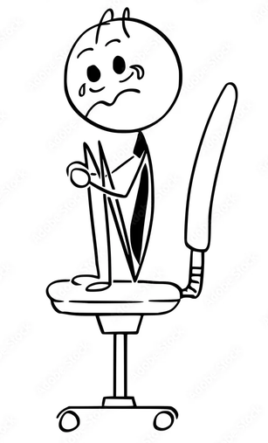
What it’s not
General nervousness
Low self-esteem
Feeling worthless or devalued
https://stock.adobe.com/pt/images/cartoon-stick-man-drawing-conceptual-illustration-of-crying-businessman-sitting-shocked-on-office-chair-business-concept-of-stress-or-crisis/196184006
Notes:
TIPS:
Check out the Layout Dropdown for more layout design options
It’s recommended not going below 24-point font size for presentations
If your text overflows a placement text box it’s recommended to edit/delete down text content instead of increasing size of text box to accommodate more text
Guides for textboxes are available under View tab > check Guides checkbox

Slide 5
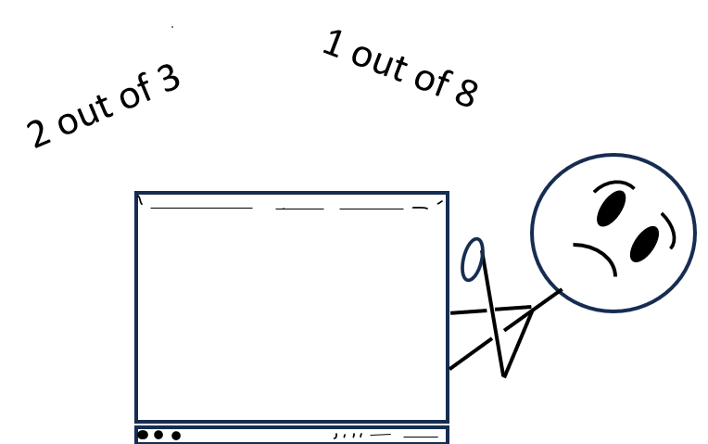
I thought I was the only one!
70%
Notes:
ALTERNATIVE TEXT:
Don’t forget to add Alternative Text to photos to help people with visual impairments understand what the photo is conveying.
Alt text is read aloud by screen readers or other assistive technology and can also be displayed if the image fails to display properly.
1.) Right-click the image, then select Edit Alt Text.
2.) Type a description of the image in the text box on the Alt Text pane.
Some tips for writing alt text for images:
Be brief: Usually one or two sentences.
Give context: Explain how the image relates to the page content.
Don’t duplicate text: Avoid using text that’s already in the slide.
End with a period: Make sure the alt text sentence ends with a period.
GENERAL POWERPOINT TIPS:
Check out the Layout Dropdown for more layout design options
To Insert Picture from File, click on the picture icon in the center of gray photo frame
It’s recommended not going below 24-point font size for presentations
If your text overflows a placement text box it’s recommended to edit/delete down text content instead of increasing size of text box to accommodate more text
Guides are available under View tab > check Guides checkbox

Slide 6
Subtypes
Internalized negative perceptions
Outcome Based
Knowledge Based
Perfectionism
  Competence is perfection
Soloist
  I did it myself
Superman (Super-person)
  I can do all things perfectly
Expert
  Jack of all trades
Natural Genius
  What I know comes naturally
Notes:
TIPS:
Check out the Layout Dropdown for more layout design options
It’s recommended not going below 24-point font size for presentations
If your text overflows a placement text box it’s recommended to edit/delete down text content instead of increasing size of text box to accommodate more text
Guides for textboxes are available under View tab > check Guides checkbox

Slide 7
What Causes IP?
Lack of Social Context
Isolation
Overwork
Lack of mentors
Unclear job expectations / lack of orientation
Supervisors not checking in
Notes:
TIPS:
Check out the Layout Dropdown for more layout design options
It’s recommended not going below 24-point font size for presentations
If your text overflows a placement text box it’s recommended to edit/delete down text content instead of increasing size of text box to accommodate more text
Guides for textboxes are available under View tab > check Guides checkbox

Slide 8
What Causes IP?
Internalized
Manifests as
Perfectionist tendencies
Low self-confidence
Believing overestimation
Anxiety
Depression
Dysphoria
Notes:
TIPS:
Check out the Layout Dropdown for more layout design options
It’s recommended not going below 24-point font size for presentations
If your text overflows a placement text box it’s recommended to edit/delete down text content instead of increasing size of text box to accommodate more text
Guides for textboxes are available under View tab > check Guides checkbox

Slide 9
What Causes IP?
Internalized / External
Manifests as
Trauma
  Minority group representation
  Childhood constant praise / no praise
  One-on-one situations
  PTSD
Perfectionism
Feeling that punishment awaits
Dysregulation, Depression, Anger
Emotional numbing / hyperarousal (startle response)
Avoidance
Autonomic Reactivity
Notes:
TIPS:
Check out the Layout Dropdown for more layout design options
It’s recommended not going below 24-point font size for presentations
If your text overflows a placement text box it’s recommended to edit/delete down text content instead of increasing size of text box to accommodate more text
Guides for textboxes are available under View tab > check Guides checkbox

Slide 10
What Causes IP?
External
Manifests as
Gaslighting
Lack of Psychological Safety
  Mass reduction in force / reorganization
  Shifting expectations
  Lack of role models
  Support system lacking
Anxiety / worry
Dreading evaluations
Not trying / taking chances
Notes:
TIPS:
Check out the Layout Dropdown for more layout design options
It’s recommended not going below 24-point font size for presentations
If your text overflows a placement text box it’s recommended to edit/delete down text content instead of increasing size of text box to accommodate more text
Guides for textboxes are available under View tab > check Guides checkbox

Slide 11
Good News!
23%
4%
Notes:
Please Note: This template has been created using the University of North Dakota brand guidelines. All colors and typefaces/fonts are within the brand guidelines and altering them isn’t suggested. Please visit UND.edu/brand for more information on using the UND brand or email identity@UND.edu with any UND branding questions.
TIPS:
Check out the Layout Dropdown for more layout design options
It’s recommended not going below 24-point font size for presentations
If your text overflows a placement text box it’s recommended to edit/delete down text content instead of increasing size of text box to accommodate more text
Guides are available under View tab > check Guides checkbox

Slide 12
Detriments
Physical
Mental, Neurological
Anxiety & Depression
Fatigue
Headaches
Insomnia
Chronic Stress Responses
Heightened Inflammation
Cardiovascular Disease
Diabetes
Emotional dysregulation
Hindered ability to learn & create memories (high cortisol)
Repeating activities / not completing (low dopamine)
Trauma responses
Notes:
TIPS:
Check out the Layout Dropdown for more layout design options
It’s recommended not going below 24-point font size for presentations
If your text overflows a placement text box it’s recommended to edit/delete down text content instead of increasing size of text box to accommodate more text
Guides for textboxes are available under View tab > check Guides checkbox

Slide 13
To meet accessibility standards, please add slide title here.
Freeze
Flight
Procrastinating
Unable to make decisions
“Spacing” out
Isolating
Silence
Avoiding opportunities
Perfectionism
Fawn
Fight
Extra work
Agreeing with everything
Combative / Argumentative
Impossibly high goals
Hyperfocus
Notes:
ALTERNATIVE TEXT:
Don’t forget to add Alternative Text to photos to help people with visual impairments understand what the photo is conveying.
Alt text is read aloud by screen readers or other assistive technology and can also be displayed if the image fails to display properly.
1.) Right-click the image, then select Edit Alt Text.
2.) Type a description of the image in the text box on the Alt Text pane.
Some tips for writing alt text for images:
Be brief: Usually one or two sentences.
Give context: Explain how the image relates to the page content.
Don’t duplicate text: Avoid using text that’s already in the slide.
End with a period: Make sure the alt text sentence ends with a period.
GENERAL POWERPOINT TIPS:
Check out the Layout Dropdown for more layout design options
To Insert Picture from File, click on the picture icon in the center of gray photo frame
It’s recommended not going below 24-point font size for presentations
If your text overflows a placement text box it’s recommended to edit/delete down text content instead of increasing size of text box to accommodate more text
Guides are available under View tab > check Guides checkbox

Slide 14
Detriments
Harsh self-criticism
Inability to assess personal competence
Self-sabotaging behavior
Neuroticism (not nervousness!)
Setting goals intentionally out of reach (such as Superhero complex)
Notes:
TIPS:
Check out the Layout Dropdown for more layout design options
It’s recommended not going below 24-point font size for presentations
If your text overflows a placement text box it’s recommended to edit/delete down text content instead of increasing size of text box to accommodate more text
Guides for textboxes are available under View tab > check Guides checkbox

Slide 15
Have you ever considered…
Constantly pointing out how you don’t deserve praise may feel insulting to the person giving it?
Notes:
ALTERNATIVE TEXT:
Don’t forget to add Alternative Text to photos to help people with visual impairments understand what the photo is conveying.
Alt text is read aloud by screen readers or other assistive technology and can also be displayed if the image fails to display properly.
1.) Right-click the image, then select Edit Alt Text.
2.) Type a description of the image in the text box on the Alt Text pane.
Some tips for writing alt text for images:
Be brief: Usually one or two sentences.
Give context: Explain how the image relates to the page content.
Don’t duplicate text: Avoid using text that’s already in the slide.
End with a period: Make sure the alt text sentence ends with a period.
GENERAL POWERPOINT TIPS:
Check out the Layout Dropdown for more layout design options
To Insert Picture from File, click on the picture icon in the center of gray photo frame
It’s recommended not going below 24-point font size for presentations
If your text overflows a placement text box it’s recommended to edit/delete down text content instead of increasing size of text box to accommodate more text
Guides are available under View tab > check Guides checkbox

Slide 16






Remediation - Self
Vulnerabilities are also strengths
Reframe and validate
No need to know everything
Social Engagement
Determine security
Counseling
Notes:
TIPS:
Check out the Layout Dropdown for more layout design options
It’s recommended not going below 24-point font size for presentations
If your text overflows a placement text box it’s recommended to edit/delete down text content instead of increasing size of text box to accommodate more text
Guides for textboxes are available under View tab > check Guides checkbox

Slide 17
Remediation - Self
Affirmations
I measure up to myself and no one else. I deserve the success I have achieved and feel proud of my accomplishments.
I am creative, innovative, and skilled in what I do.
I am allowed to take up space, and my ideas deserve to be heard.
My abilities are imperfectly perfect.
Mistakes aren’t the end of the world / I am allowed to make mistakes.
Quality Time
Nonwork activities – vacations, family, physical exercise, hobbies
Notes:
TIPS:
Check out the Layout Dropdown for more layout design options
It’s recommended not going below 24-point font size for presentations
If your text overflows a placement text box it’s recommended to edit/delete down text content instead of increasing size of text box to accommodate more text
Guides for textboxes are available under View tab > check Guides checkbox

Slide 18
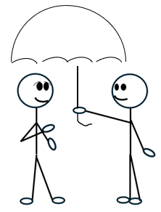
Remediation - Coworkers
The first year seems to make or break new librarians
Welcoming
Socialization
Psychological Safety
Move at the speed of trust
Notes:
TIPS:
Check out the Layout Dropdown for more layout design options
It’s recommended not going below 24-point font size for presentations
If your text overflows a placement text box it’s recommended to edit/delete down text content instead of increasing size of text box to accommodate more text
Guides for textboxes are available under View tab > check Guides checkbox

Slide 19
Time to…
Take a…
Set Boundaries
Breath
Embrace the “I Don’t Know”
Walk
Lunch
Bathroom break
  Say thank you – without adding qualifiers or passing the accolade to another.
Notes:
TIPS:
Check out the Layout Dropdown for more layout design options
It’s recommended not going below 24-point font size for presentations
If your text overflows a placement text box it’s recommended to edit/delete down text content instead of increasing size of text box to accommodate more text
Guides for textboxes are available under View tab > check Guides checkbox

Slide 20

Time to Shine
https://unsplash.com/photos/you-are-enough-text-_z1fydm6azE
Notes:
TIPS:
Check out the Layout Dropdown for more layout design options
It’s recommended not going below 24-point font size for presentations
If your text overflows a placement text box it’s recommended to edit/delete down text content instead of increasing size of text box to accommodate more text
Guides for textboxes are available under View tab > check Guides checkbox

Slide 21
Karlene Tura Clark
Karlene.clark@und.edu
Notes:
Please Note: This template has been created using the University of North Dakota brand guidelines. All colors and typefaces/fonts are within the brand guidelines and altering them isn’t suggested. Please visit UND.edu/brand for more information on using the UND brand or email identity@UND.edu with any UND branding questions.
DON’T FORGET TO CHECK THE PRESENTATION FOR ACCESSIBILITY!
To Check Presentation Accessibility:
1.) Click on Review Tab
2.) Click Check Accessibility
3.) Window will open on right side of the screen
4.) Click on specific result for steps to fix the error and an explanation on why it needs fixing

