Slide 1

Beyond Books: Launching and Managing a Library of Things
A Practical Guide for Modern Librarians

Slide 2

LIBRARY OF THINGS
What is a Library of Things (LoT)?
Core Concept
• A curated collection of high-utility, non-traditional circulating items.
• Shifts focus from passive consumption to practical community creation.
• Promotes sustainable neighborhood sharing, equity, and access.
Common Categories & Core Items
▪ Home & Yard: Power tools, lawn care, and culinary equipment like Mixers.
▪ Recreation & Outdoors: Board games, camping gear, and Fishing Equipment.
▪ Community Access: Laptops, Wi-Fi hotspots, and State Park Passes.
▪ Crafts & Creators: Sewing machines, knitting loom sets, and 3D pens.

Slide 3

LIBRARY OF THINGS
Developing Core Policies
Borrowing Framework
• Age Limits: Restrict power tools or high-value assets to ages 18+.
• Card Status: Require library accounts to be active with zero blocks.
• Checkout Caps: Limit to 1 or 2 LoT items at any given time per household.
Circulation Logistics
• Loan Windows: Standardize checkout periods without automatic renewals.
• Returns Protocol: Mandate manual desk drop-offs; strictly ban book drop bins.
• Late Penalties: Implement higher premium daily rates ($2–$5) to drive urgency.

Slide 4

LIBRARY OF THINGS
Risk Management & Liability
Legal Safeguards
• Liability Waivers: Mandatory physical/digital signatures required before checking out any high-risk tools or recreational equipment.
• Safety Briefs: Embed printed safety operational instructions and laminated user manuals directly inside the product packaging.
Financial Accountability
• Component Auditing: Staff use visual itemized check-lists at return counter to systematically count small component pieces.
• Replacement Tiers: Clear transparency tables separating fees for single missing structural parts versus complete total asset loss.

Slide 5

LIBRARY OF THINGS
Operations
Maintenance & Staff Workflows
• Technical Inspections: Ensure batteries remain charged, structural cords are inspected for fraying, and firmware stays updated.
• Sanitization Standards: Formulate strict deep-cleaning protocols for kitchen appliances and textiles before re-shelving.
• Workflows: Factor dedicated parts-counting and evaluation buffer time into basic daily circulation desk shift structures.
Storage & Display Infrastructure
• Backroom Storage: Keep actual physical objects secure behind the main desk; utilize graphic display cards/binders on public shelves.
• Clear Packaging: Standardize on heavy-duty transparent storage bins, locking totes, or specialized clear hangable bags.

Slide 6
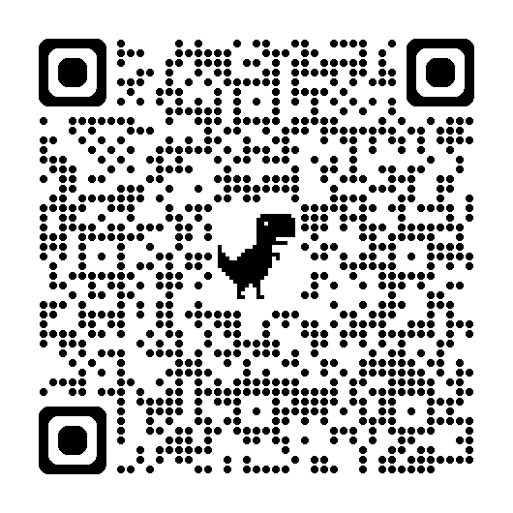
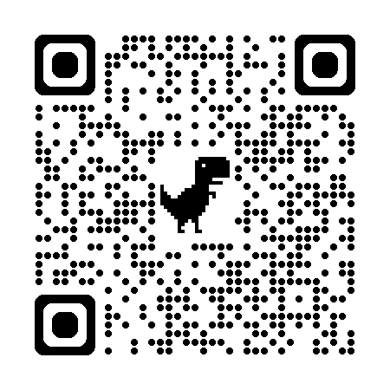
LIBRARY OF THINGS
Next Steps for Your Library
Phase 1: Research
• Survey broad community interests to target high-demand needs (e.g., Mixers, Fishing Equipment, Park Passes).
• Perform spatial audit of existing storage rooms.
• Secure launch funding via targeted internal budget lines or specialized library innovation grants.
Phase 2: Build
• Draft tailored administrative policies and patron liability waiver agreements.
• Procure initial batch of durable, high-demand equipment.
• Conduct thorough staff training sessions on check-out/intake validation workflows.
Phase 3: Launch
• Host an interactive, hands-on community preview or open-house showcase event.
• Market heavily through digital newsletters and social media networks.
• Track usage metrics closely and iteratively adapt borrowing rules.
Scan this QR code for an ALA grant opportunity!
Scan this QR code for an NDSL grant opportunity!

Slide 7

LIBRARY OF THINGS
Let’s Talk About It!
What do we have for LoT?
Policies
Lending
Fines/Fees
Patron Experiences
Learning Opportunities
Successes
Questions

