Slide 1
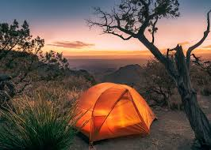
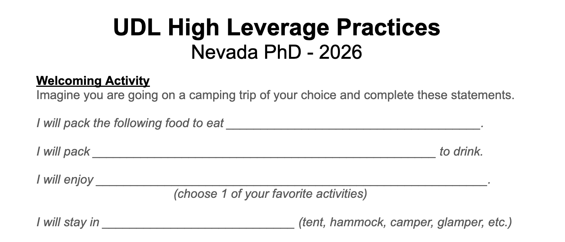
Imagine you are going on a camping trip…
While we get settled
Complete the following sentence stem starters

Slide 2
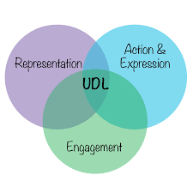

UDL High Leverage Practices
Nevada PhD 2026
Notes:
UDL principles used in this session:
Lighting
Various groupings
Hamburger Fold Activity
Personal Story
Images and descriptions

Slide 3
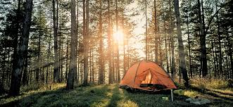
M
Turn & Talk: Share Your Ideal Camping Experience
Learner Variability
Notes:
RYAN

Slide 4
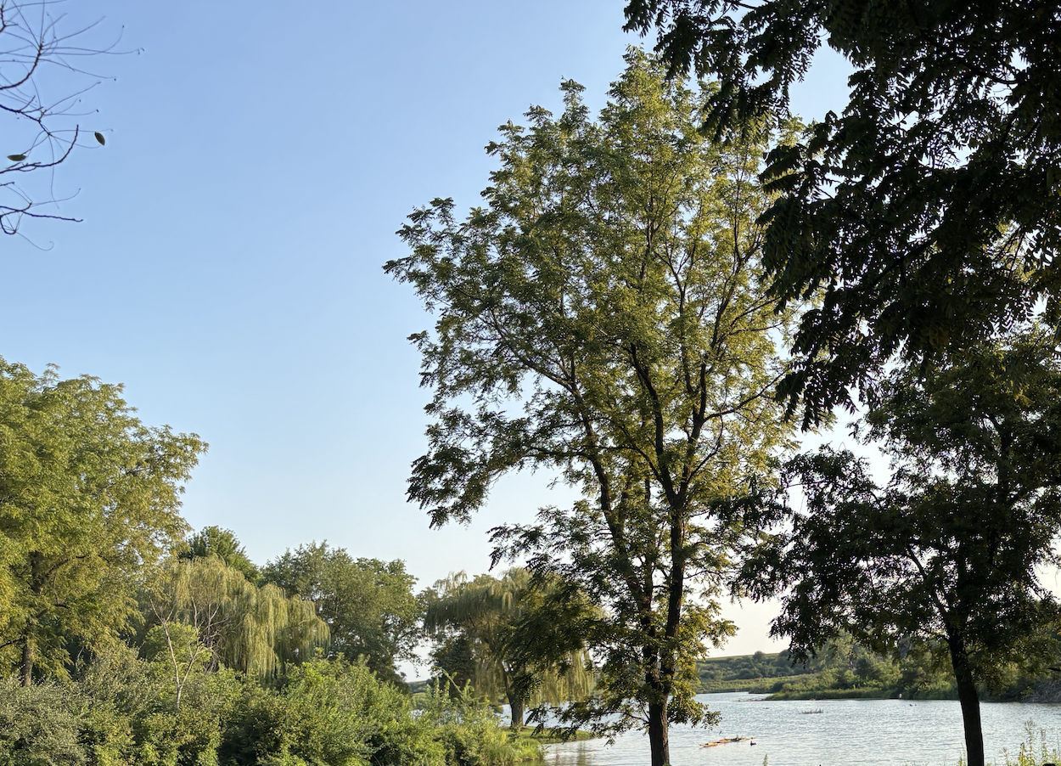
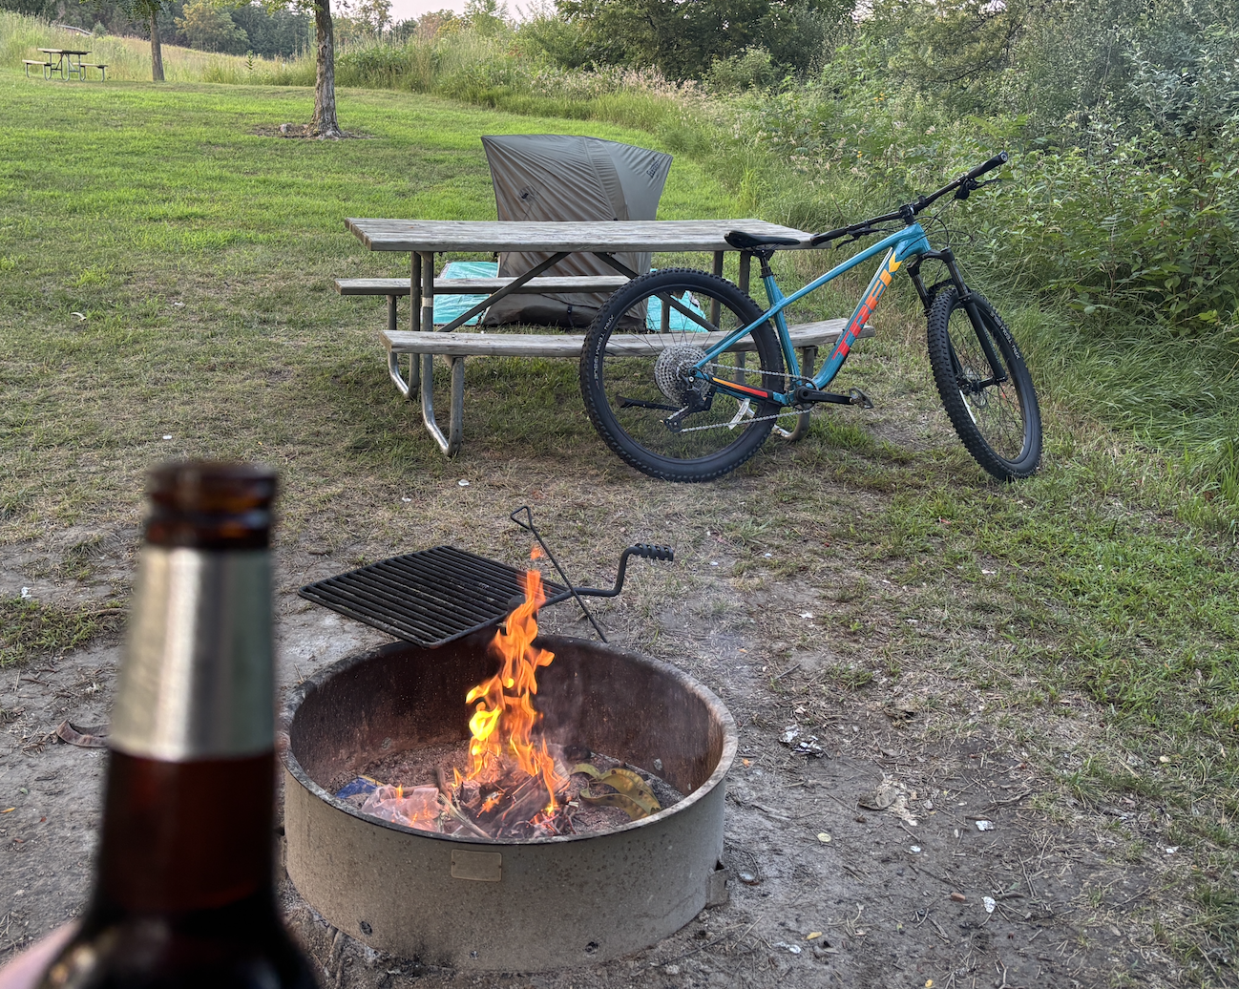
If you were with Brown 2 weeks ago…
Willow Lake - Loess Hills
1 person tent
Cookie Monster
Local bottled beverage
from Pisgah, Iowa
Warmed can of soup
(beef & barley)
Fire toasted bagel sandwich
Question #1: How many of you would really enjoy this camping experience?
Question #2: What’s the point here? Learner Variability

Slide 5
Intended Outcomes:
Explore Learner Variability
Provide Context & Connection for UDL
Introduce the 3 Domains of UDL
Model Examples of Incorporating UDL
Learn About & Implement 2 - 3 High Leverage Practices
Acknowledging Learner Variability
⭃
M
Notes:
MEG
7.2 Optimize relevance, value and authenticity
Disclaimer: Foundational Learning

Slide 6
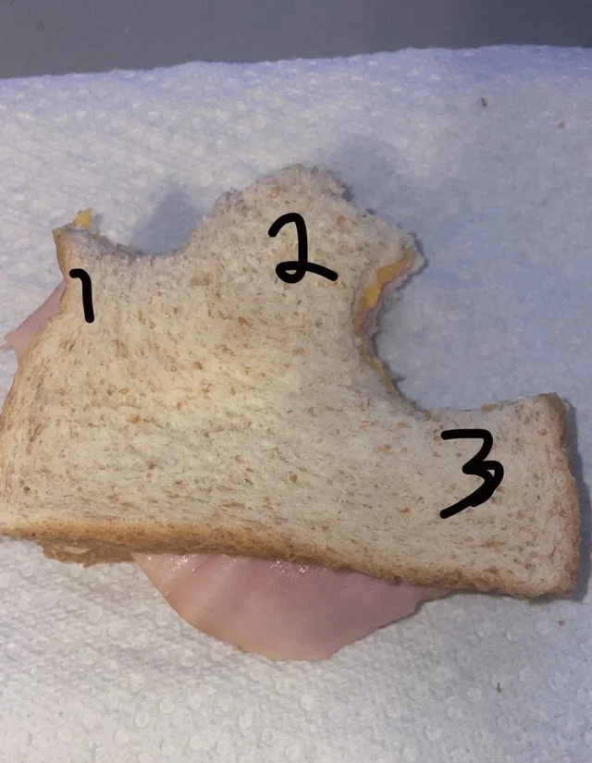
Learner Variability?
What is your next bite?
Raise your hand when
I call out your number

Slide 7
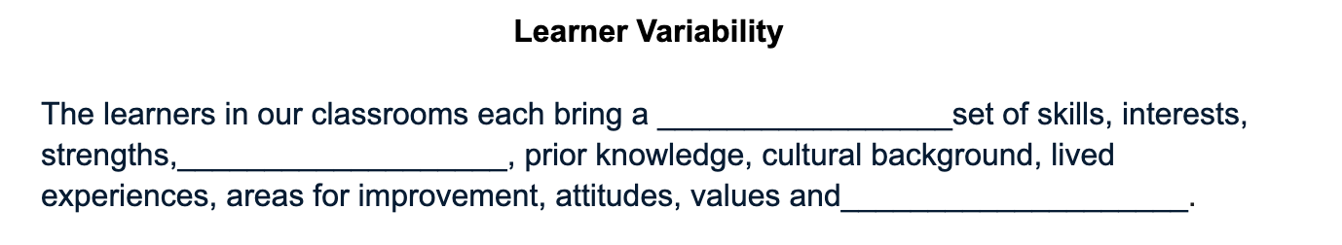
Throughout the presentation you can use your
Scaffolded Notes
BOLD FACE & UNDERLINED words go in the BLANKS

Slide 8

Learner Variability
R
The learners in our classrooms each bring a unique set of skills, interests, strengths, dispositions, prior knowledge, cultural background, lived experiences, areas for improvement, attitudes, values and capabilities.
The UDL Guidelines offer structure and specific, practical examples for how to address and accommodate learner variability - (that naturally exists in all classrooms)
Notes:
RYAN

Slide 9
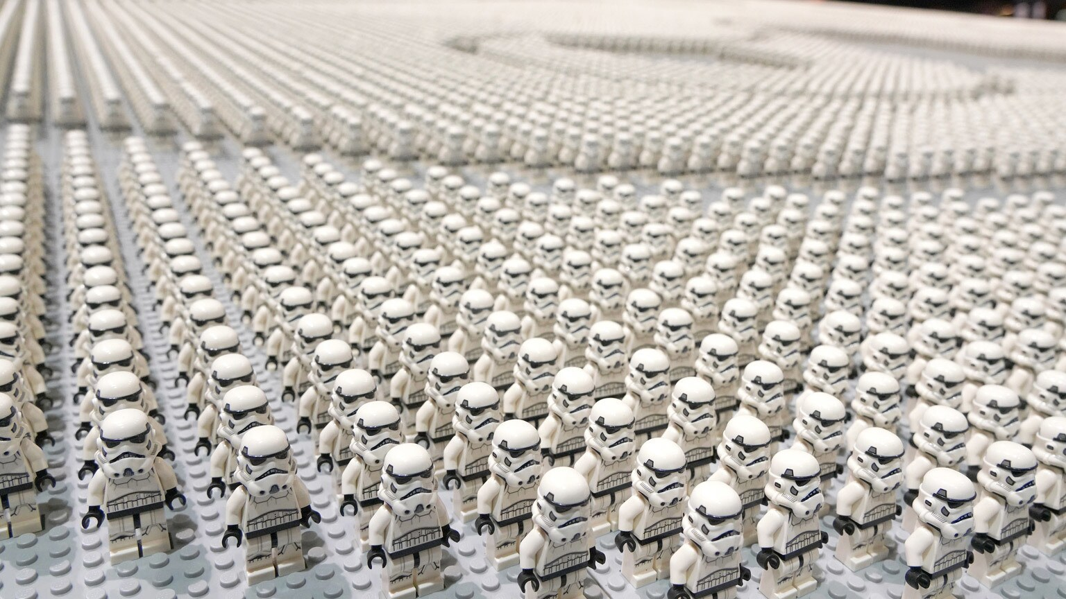
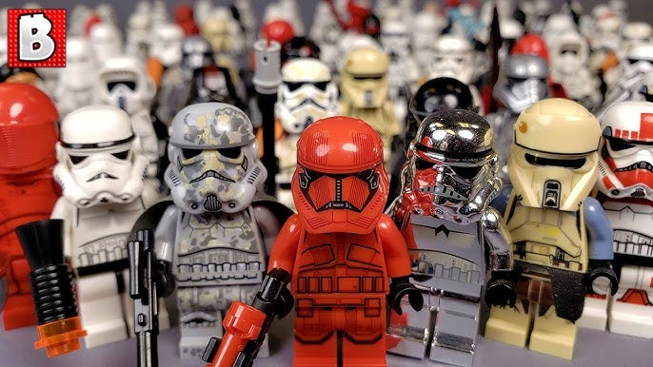
R
It would be easy if….
…but the reality is…
Notes:
RYAN

Slide 10
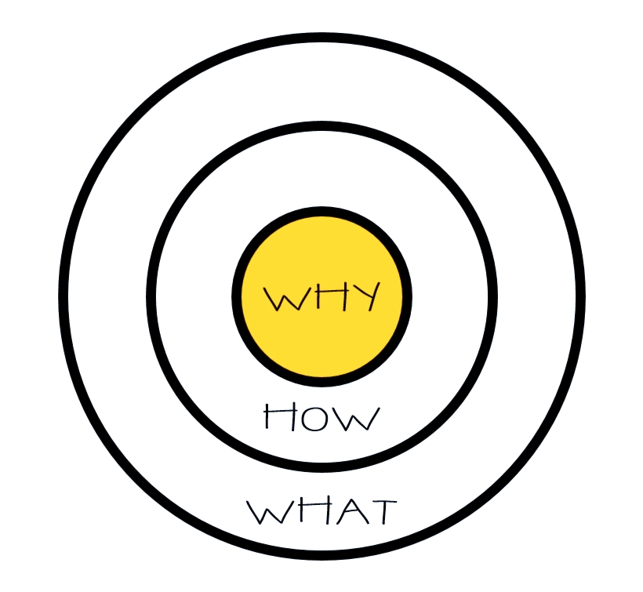
Connecting to Our Why
R
Notes:
RYAN

Slide 11
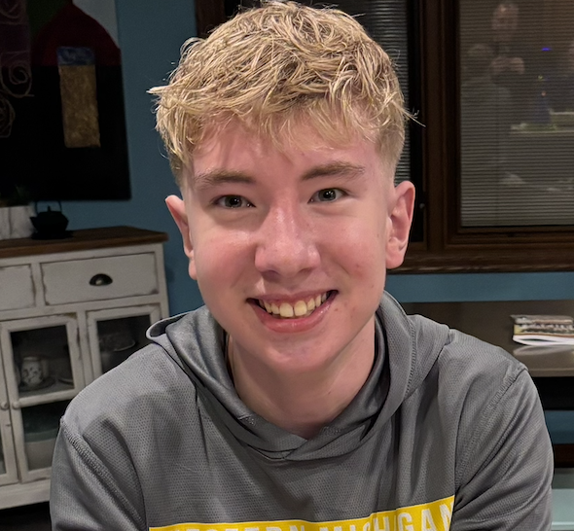
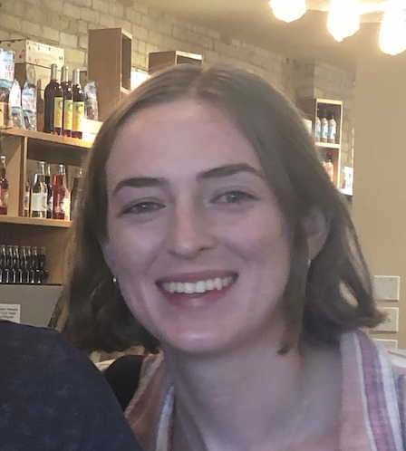

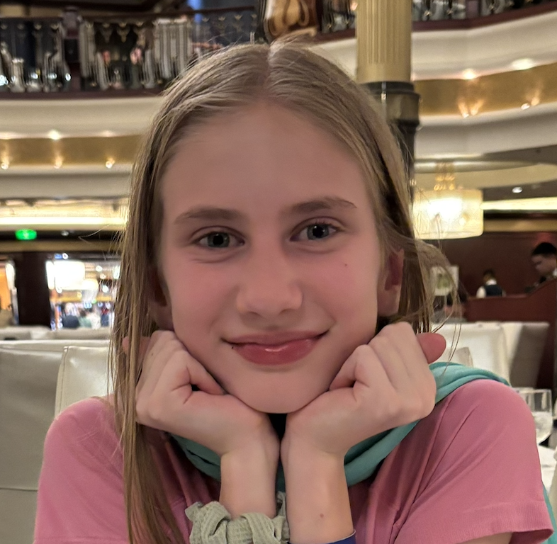
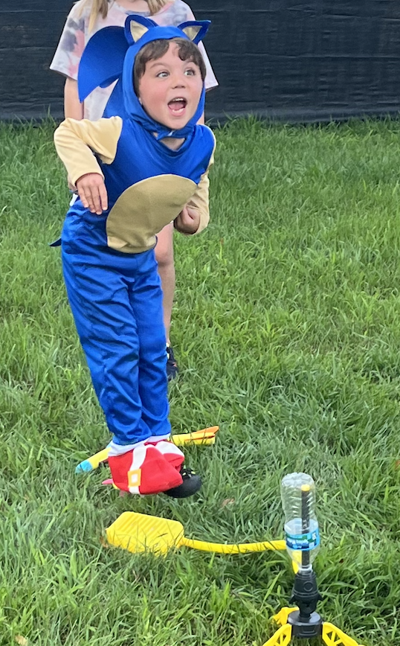
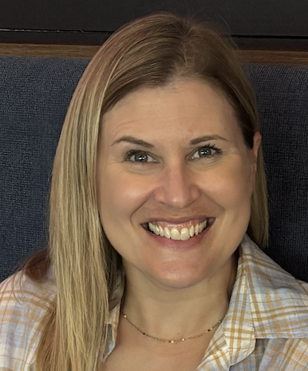
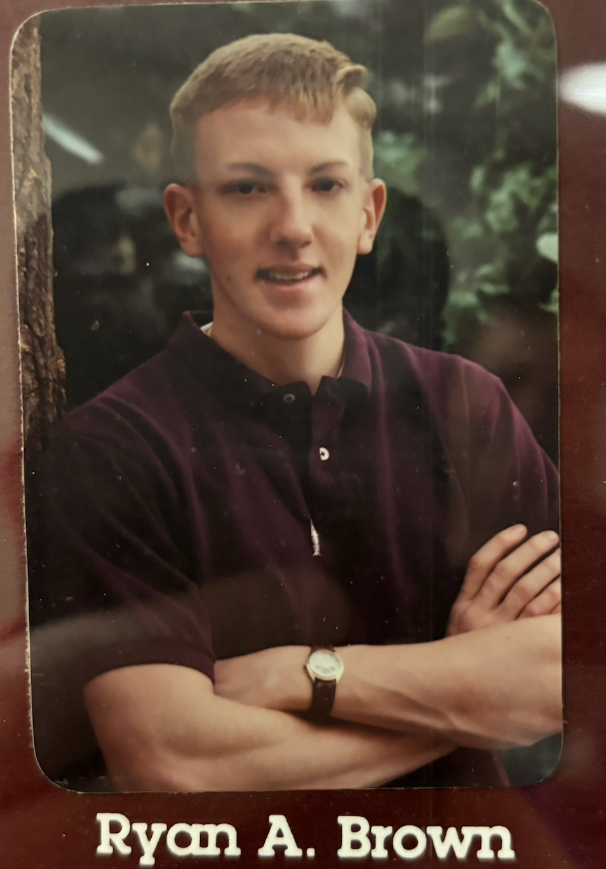
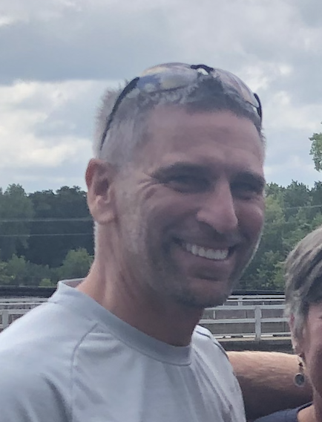
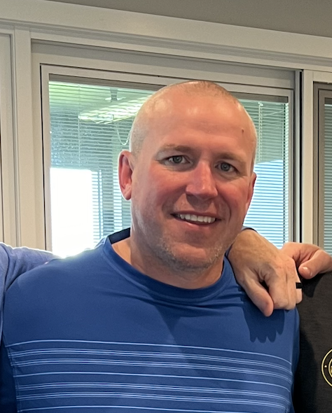
WHY….
R
Your own children
Your niece or nephew
⭃
Your friends from HS
Your nephew’s son
Notes:
RYAN

Slide 12

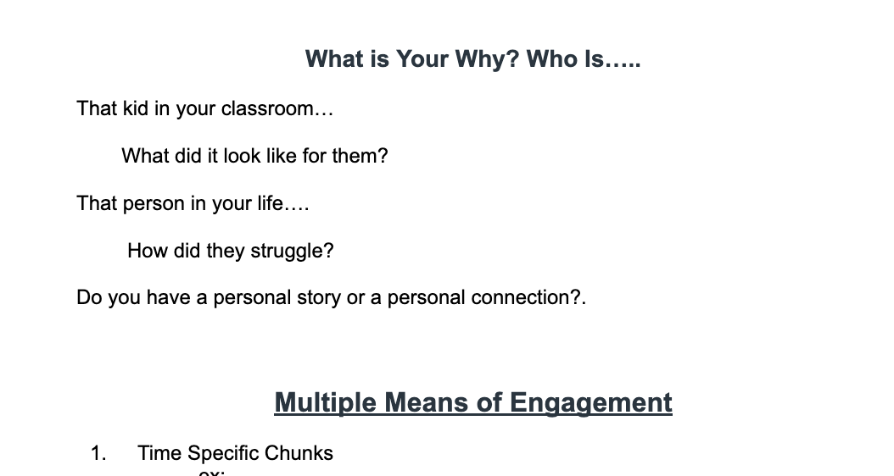
R
Who is…..
That kid in your classroom…
what did it look like for them…
That person in your life….
how did they struggle?
Do you have personal story….
Bottom of Page 1 of your handout
1 - 2 minutes
Be prepared stand & pair up and discuss
⭃
Notes:
RYAN
9.3: Promote individual and collective reflection

Slide 13





WHY….
M
Who is this kid in your class?
Who is this kid in your class?
The student we don’t see…
Who is that person
in your life?
⭃
Maybe its you?
Notes:
MEG

Slide 14
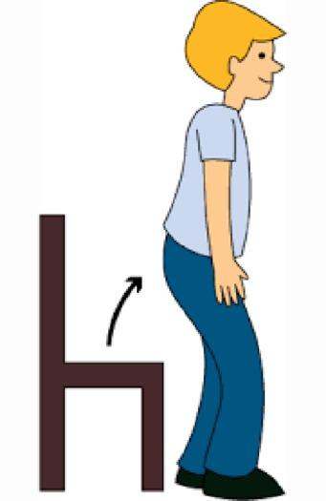


Stand Up
Pair Up
2 minutes to share

Slide 15

Please Return to Your Seat
1 minute
⭃

Slide 16
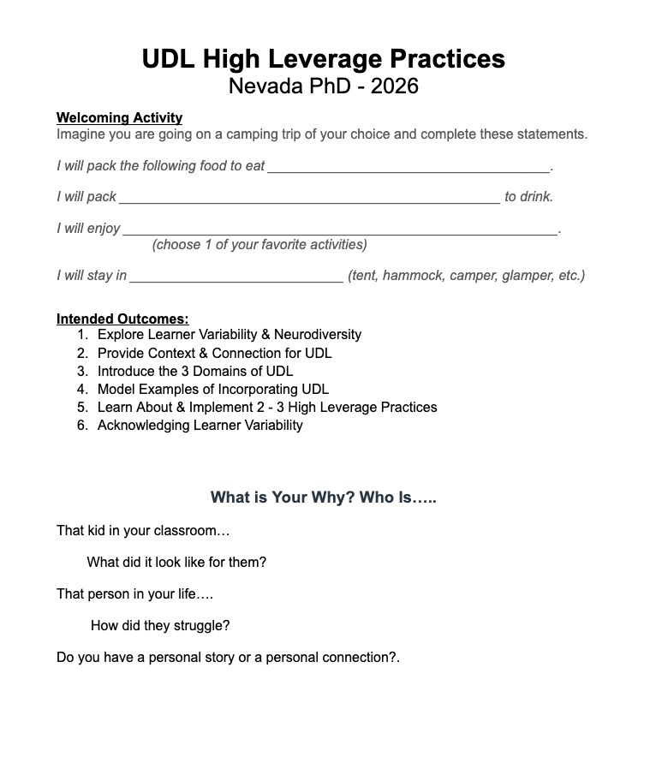
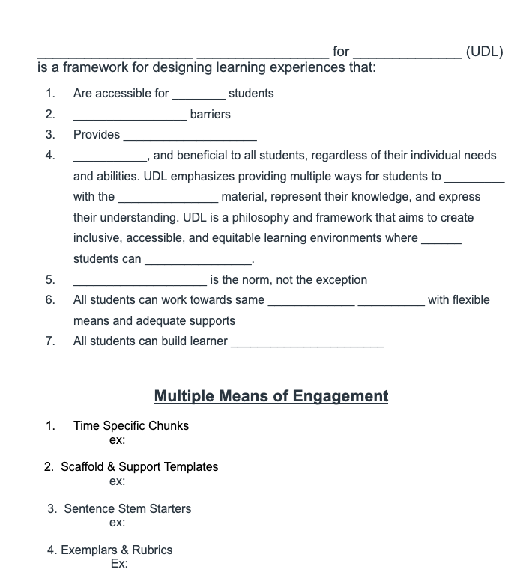
Turn to Page 2 of Your Hand Out
Page 1
Page 2

Slide 17

Universal Design for Learning (UDL) is a framework for designing learning experiences that:
Are accessible for all students
Reduce barriers
Provides flexibility
Usable, and beneficial to all students, regardless of their individual needs and abilities. UDL emphasizes providing multiple ways for students to engage with the learning material, represent their knowledge, and express their understanding where all students can thrive.
Variability is the norm, not the exception
All students can work towards same firm goals with flexible means and adequate supports
All students can build learner agency
R
Notes:
MEG
Read out loud to group. Emphasize the ALL students.

Slide 18
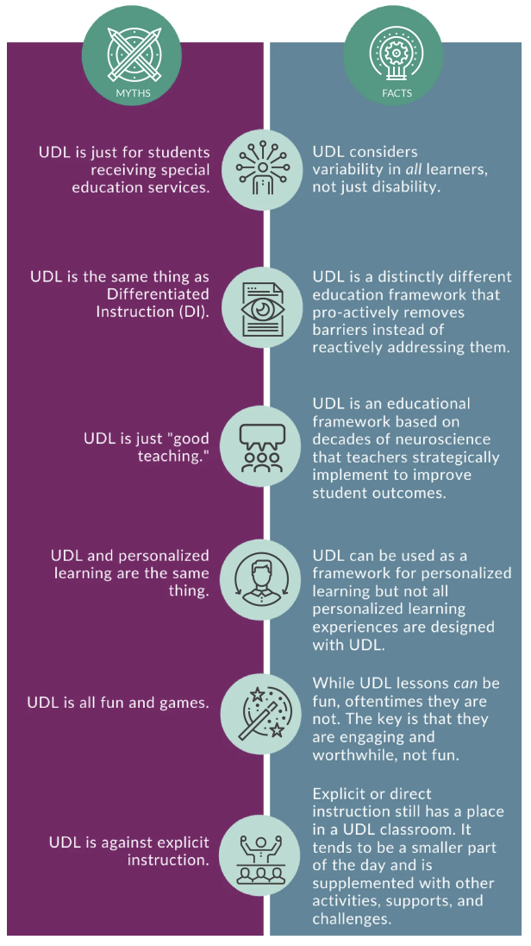
What UDL Is
M
It is important to be clear about what UDL is and what it isn’t.
Notes:
RYAN

Slide 19
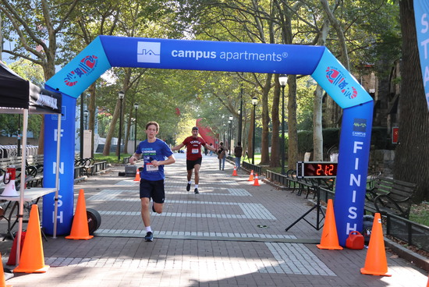
Firm Goals with Flexible Means
Designing for the Average is …
Designing for No One.
Learner Variability is the norm,
flexible means reduces barriers so
ALL students can experience
success.
However, before we can design flexible options and choices that reduce barriers, we need to be crystal clear about the goal (often a standard, objective or skill to be proficient).

Slide 20
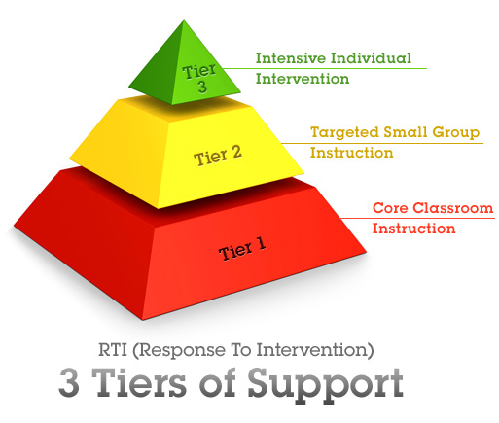
What UDL Is: RTI, MTSS
R
UDL is Tier 1
(universal instruction for all students)
Notes:
RYAN

Slide 21
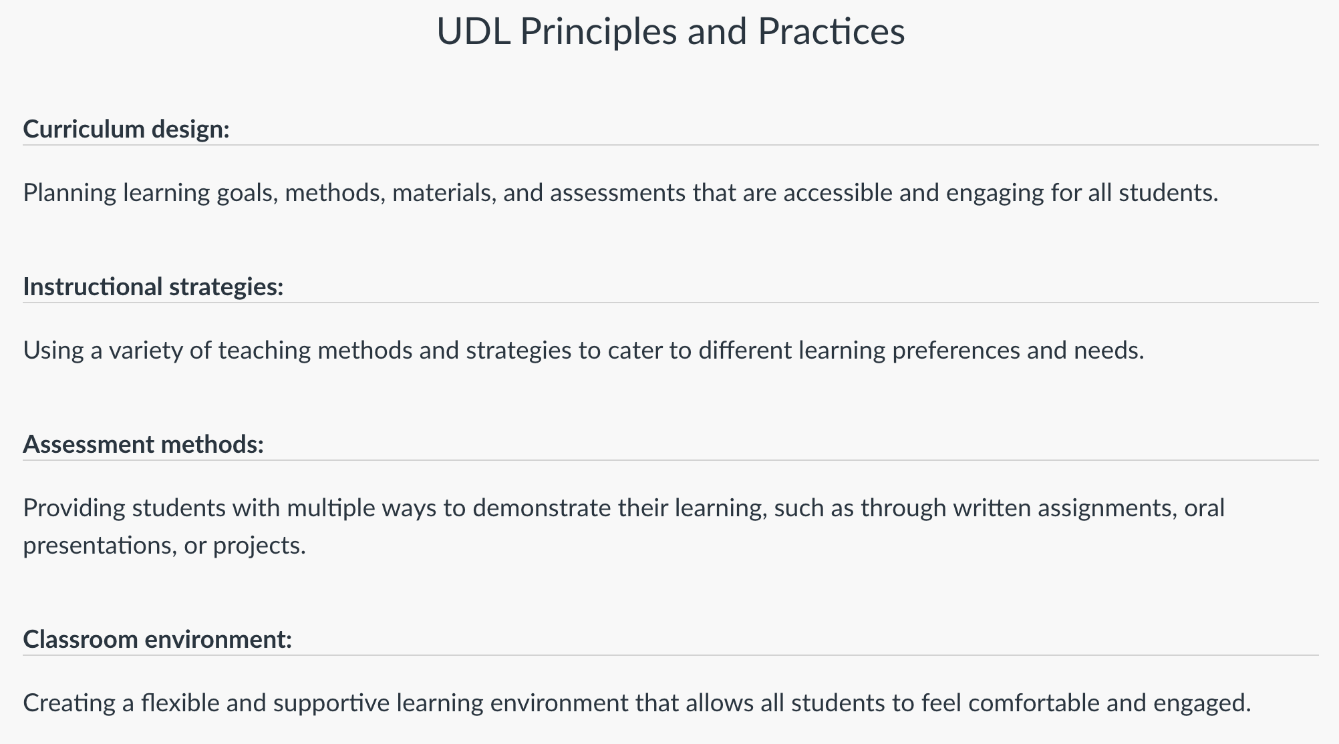
UDL Principles & Practices
M
CURRICULUM DESIGN
INSTRUCTIONAL STRATEGIES
ASSESSMENT METHODS
CLASSROOM ENVIRONMENT

Slide 22
What UDL Is Not
IEP/504
Accomodation
Differentiation
Batting 1,000
but you can improve your batting average

Slide 23
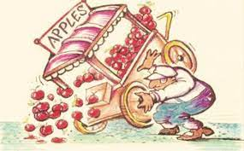
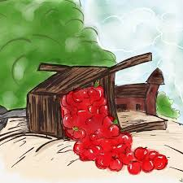
What UDL Is Not

Slide 24
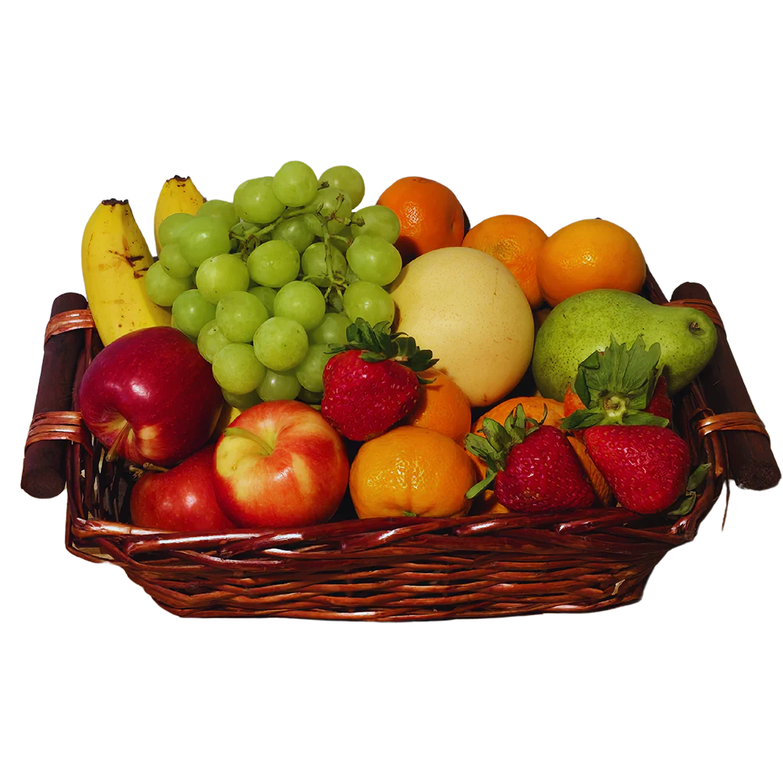
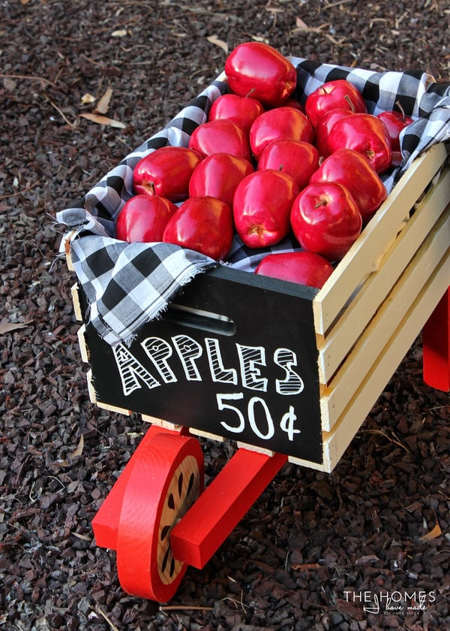
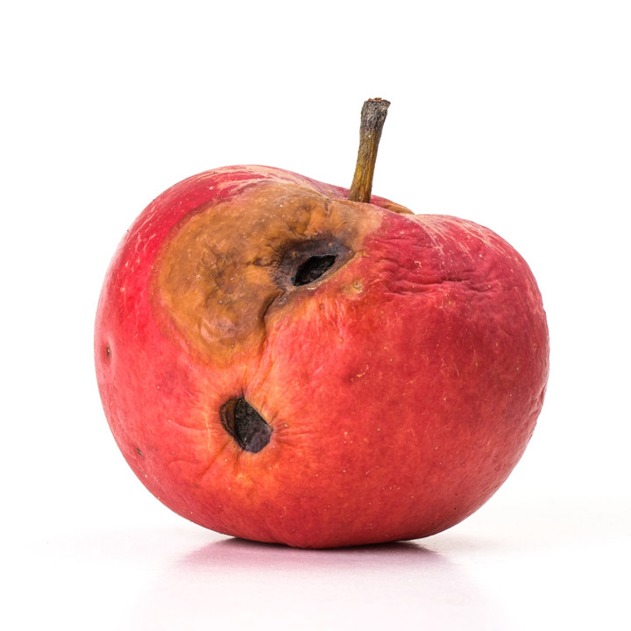
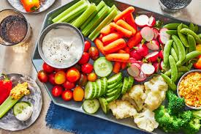
What UDL Is….

Slide 25
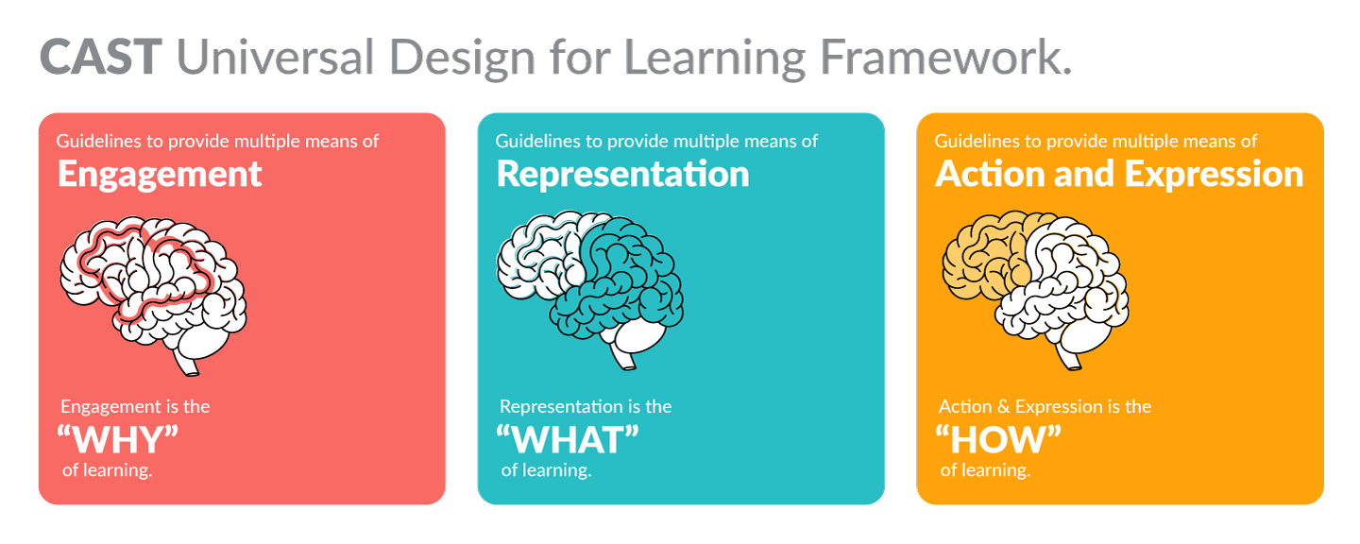
M
3 UDL Domains
1
2
Notes:
MEG
An instructional strategy used to activate students' brains with the goal of maximizing engagement in the learning process. It integrates the principles of social-emotional learning and neuroscience which transforms the classroom experience into a highly energetic learning environment.

Slide 26
2026 HS UDL PD Learning Journey
Suggested High Leverage UDL Practices:
M
Multiple Means of Engagement
Choice & Autonomy
Time Specific “chunking”
Scaffolds & Support Templates
Sentence Stem Starters
Exemplars & Rubrics
Diverse Collaborative Groups
Authentic Tasks that allow for personal expression
Cultural, Social & Timely connection to world event
Personal Reflection & Goal Setting
Accessible Technology & AI
Multiple Means of Representation
Display of Information & Visual Hierarchy
Alt Text & Closed Captions
Scaffolded Notes for Lecture
Touch Equivalents & Physical Models & Tangible Artifacts
Visual Cues of Auditory Instruction
Stop & Check for Understanding
Templates for Vocab, Formulas, Outlines & Concepts
Accessible Technology & AI
Notes:
Those in RED are the focus of this presentation.

Slide 27
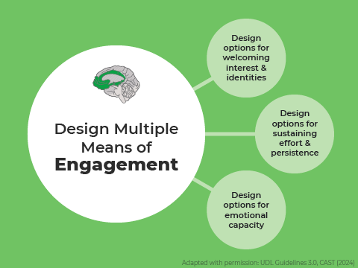
Multiple Means of Engagement
Focuses on stimulating motivation and sustaining student interest by offering choices, varying the level of challenge, and fostering collaboration to ensure inclusivity for diverse learners.

Slide 28
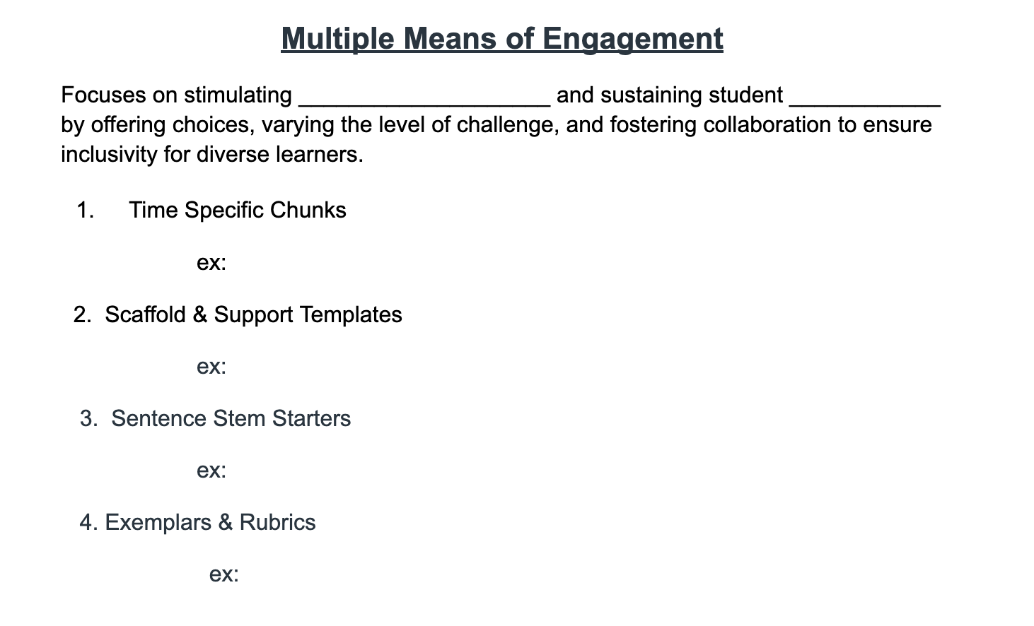
Feel free to
Write in
The presented examples
OR
Thoughts that come to Your Mind

Slide 29
Time Specific Chunks
Multiple Means of Engagement

Slide 30
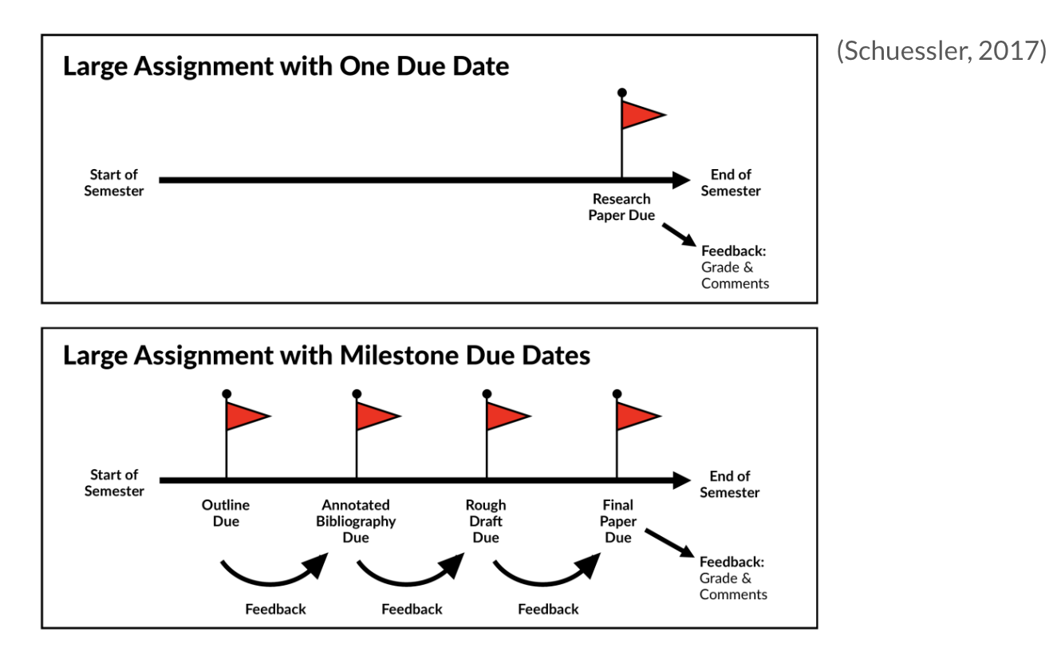
Break Up Projects
R
Project/Paper Due
Project/Paper Due
Check In #1
Check In #2
Check In #3

Slide 31
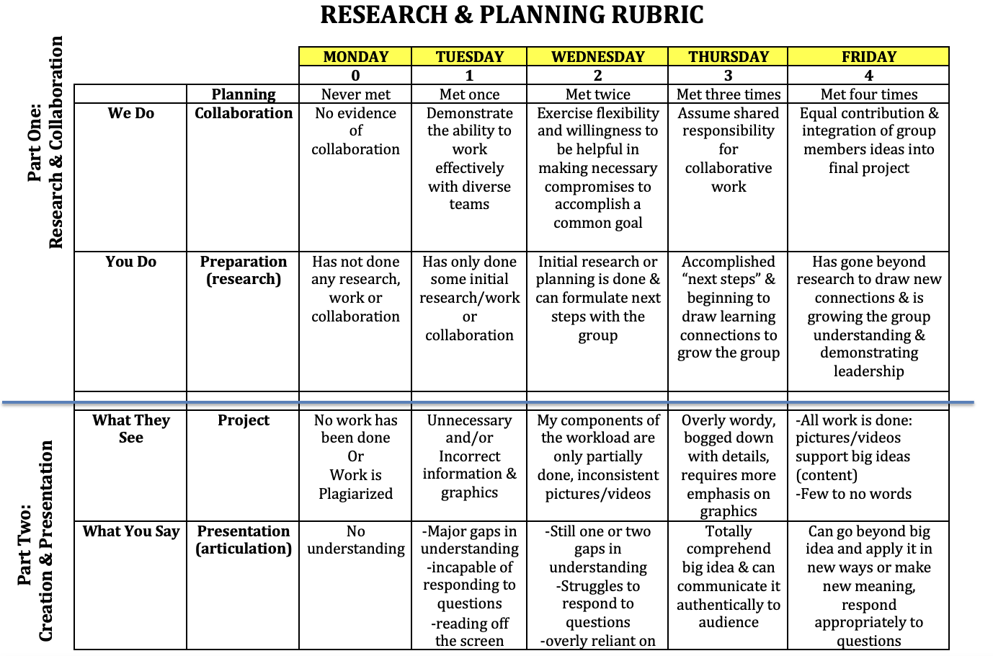
Encourage organization of long-term goals into short-term objectives.
(Recommendation 3)
R
RAB
RAB
RAB
RAB
RAB
RAB
RAB
RAB
RAB

Slide 32
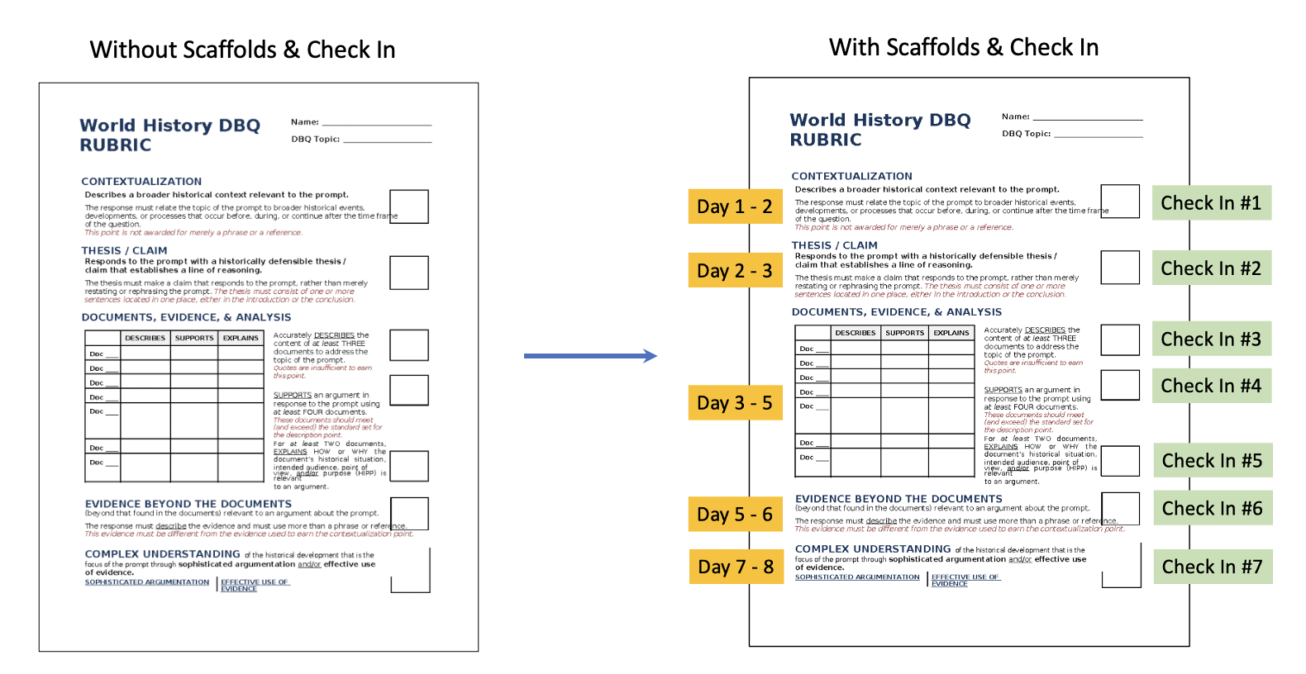
3. Provide Scaffolds: Checklists, step-by-step instructions, or peer/teacher guidance.
R

Slide 33
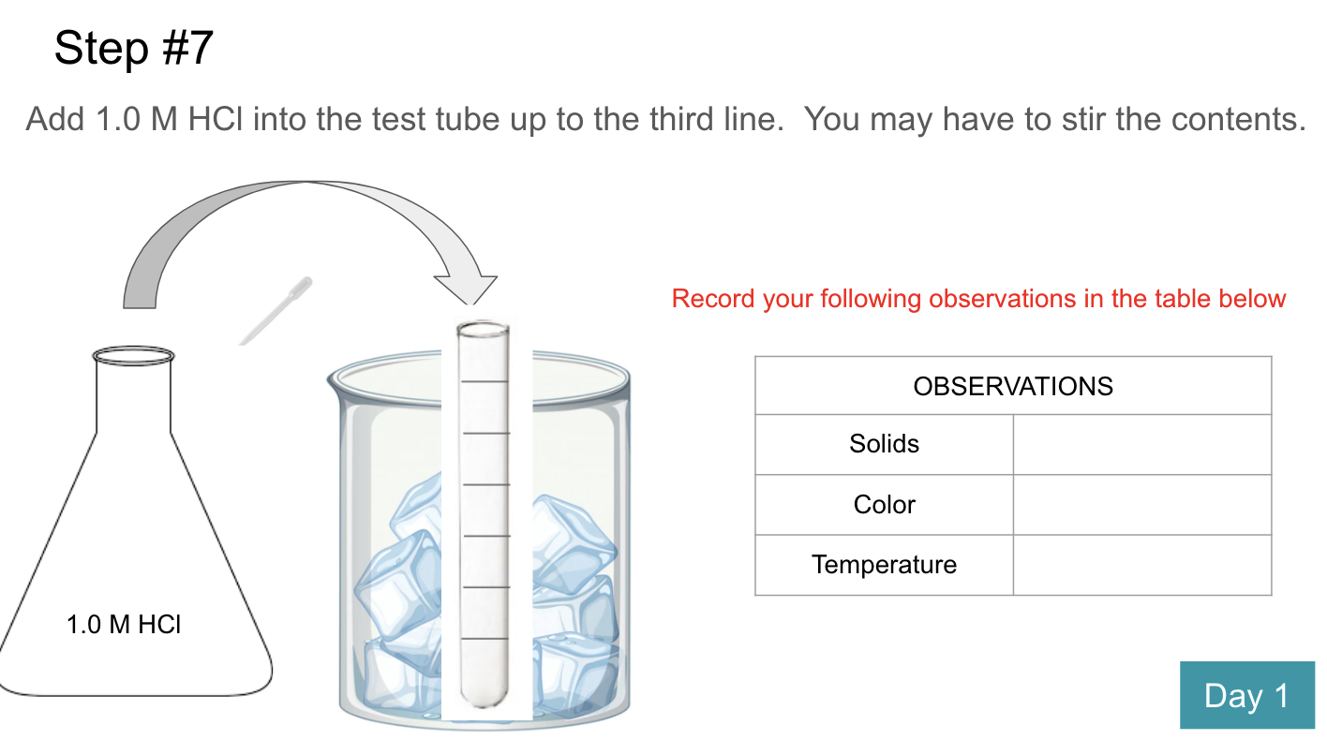
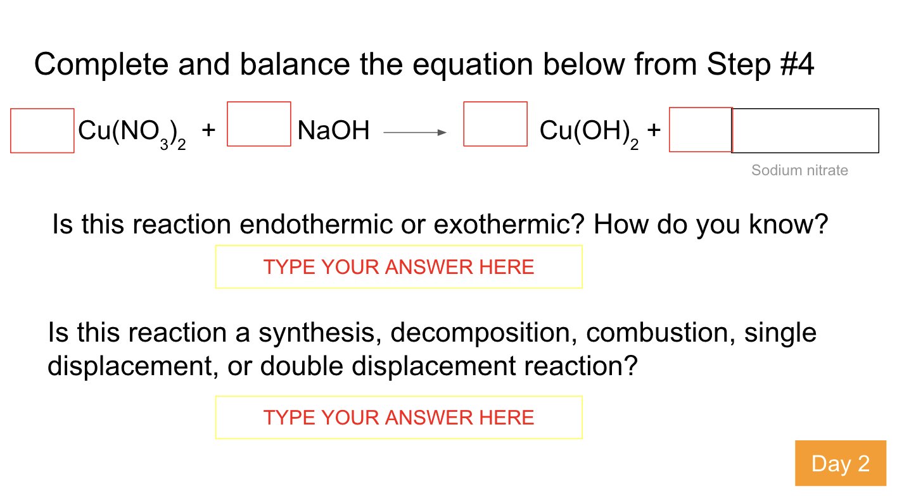
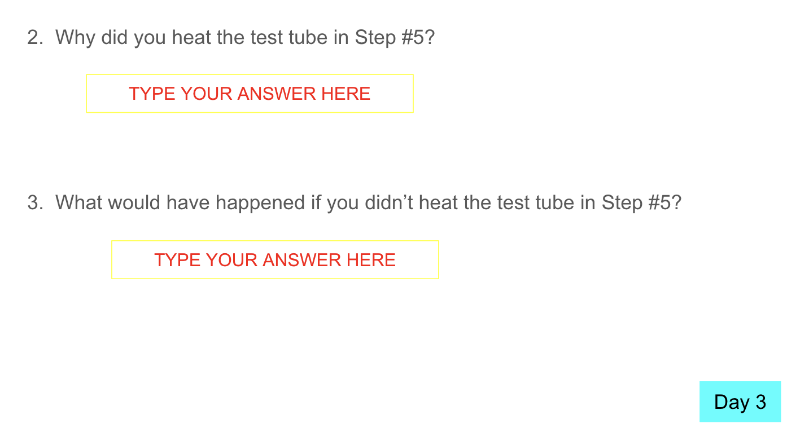
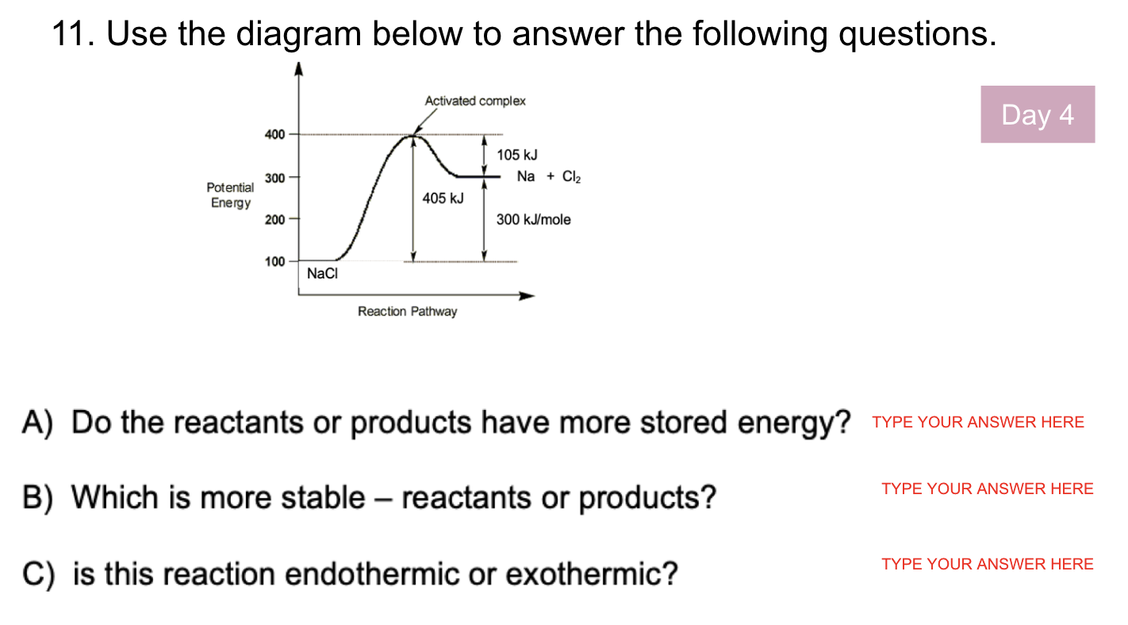
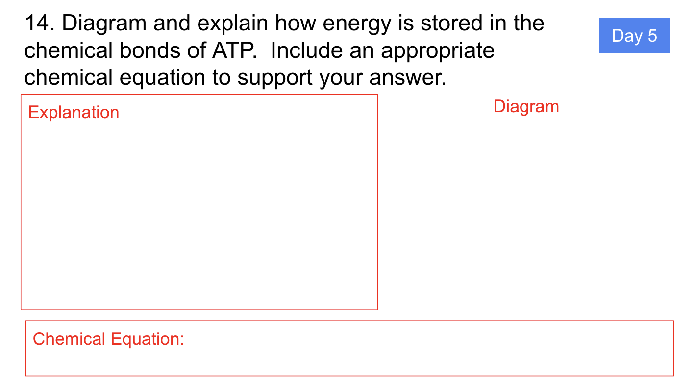

Slide 34
2. Scaffold & Support Templates
Multiple Means of Engagement

Slide 35
Scaffolded Note Template
M
Notes:
Provide a bank of templates (mind map, storyboard, flowchart, Venn diagram) for planning ideas.
Purpose: Students choose the tool that best fits their thinking, increasing active involvement in planning.

Slide 36
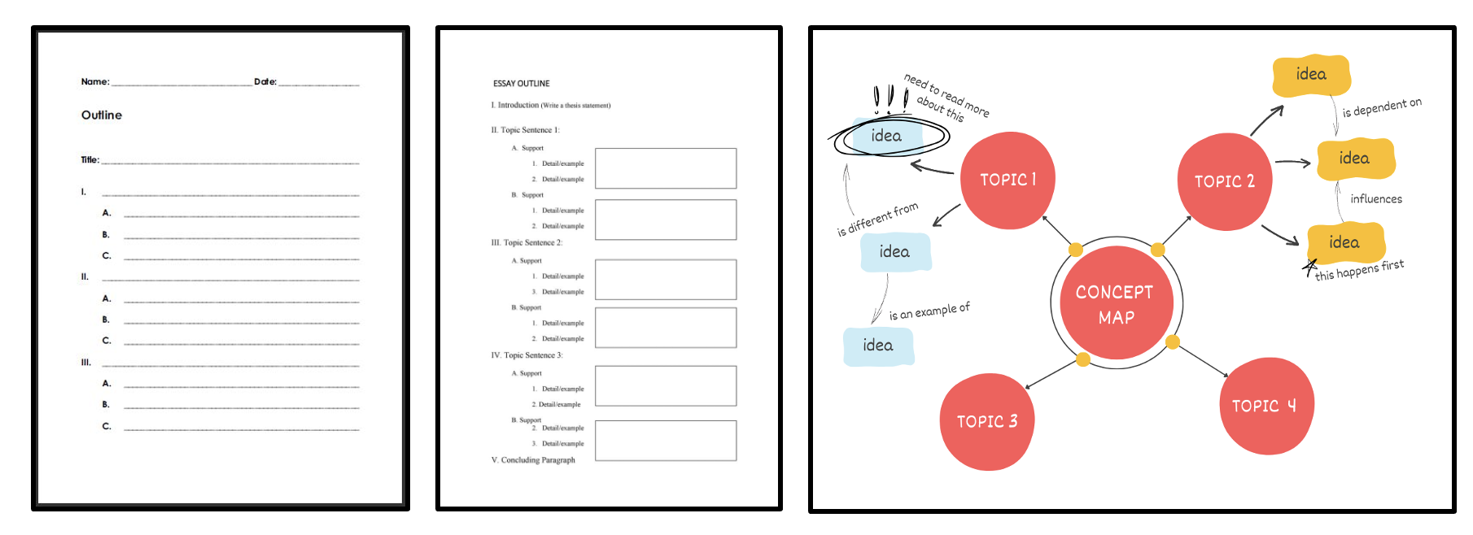
Outline vs. Template vs. Concept Map
R
Voice & Choice
Templates for Organization and Ideation

Slide 37
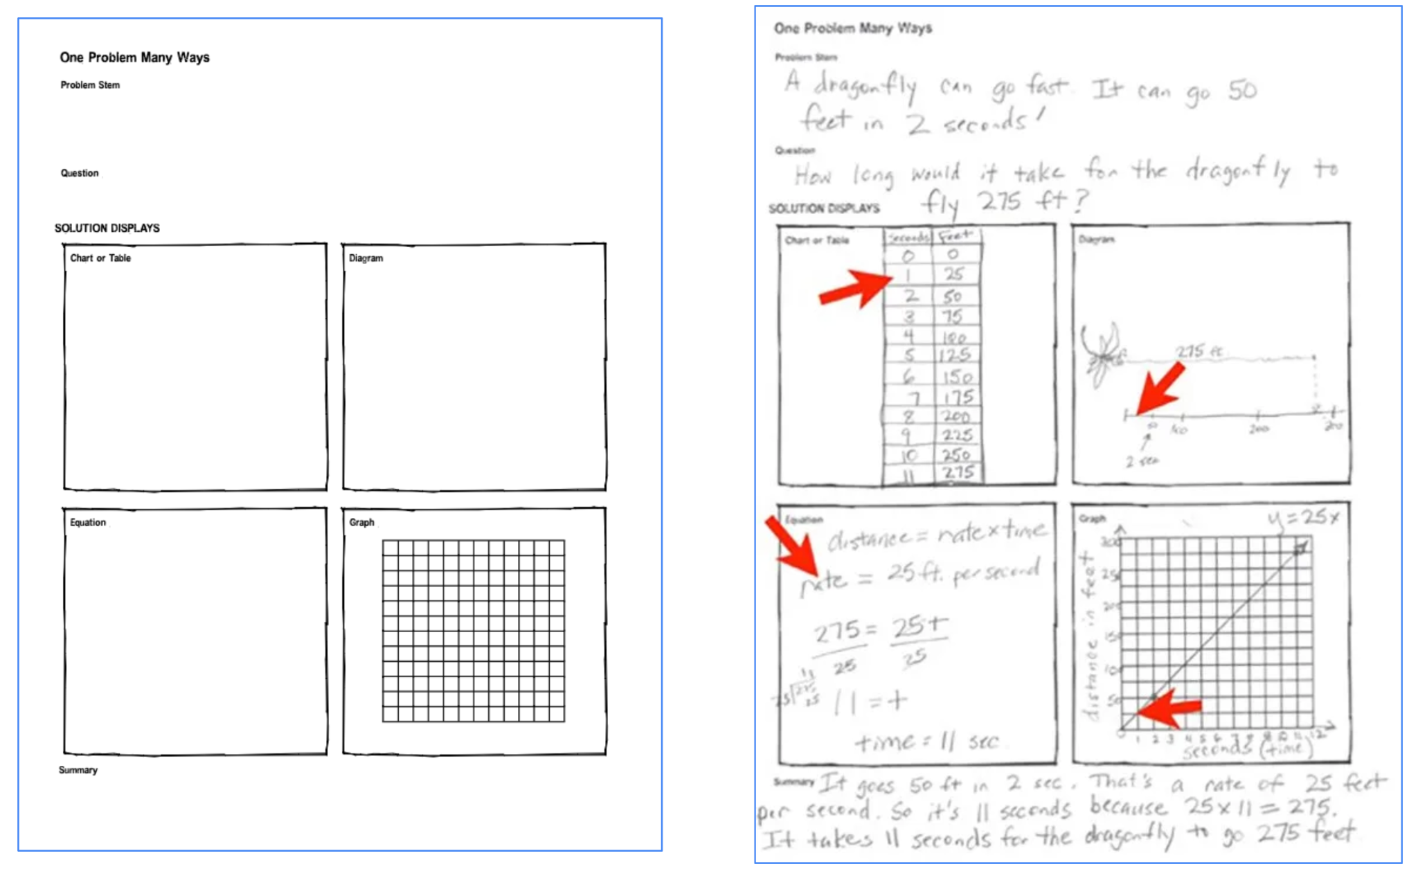
R

Slide 38
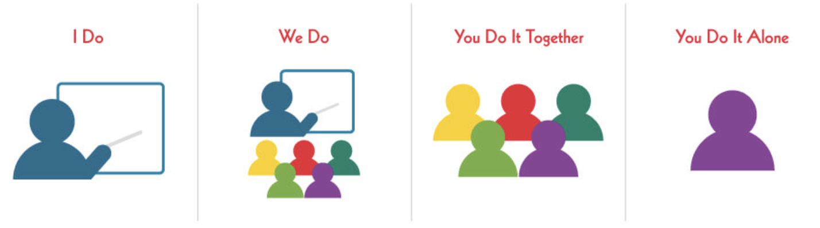
Gradual Release of Information & Responsibility
(Recommendation 4)
R

Slide 39
3. Sentence Stem Starters
Multiple Means of Engagement

Slide 40
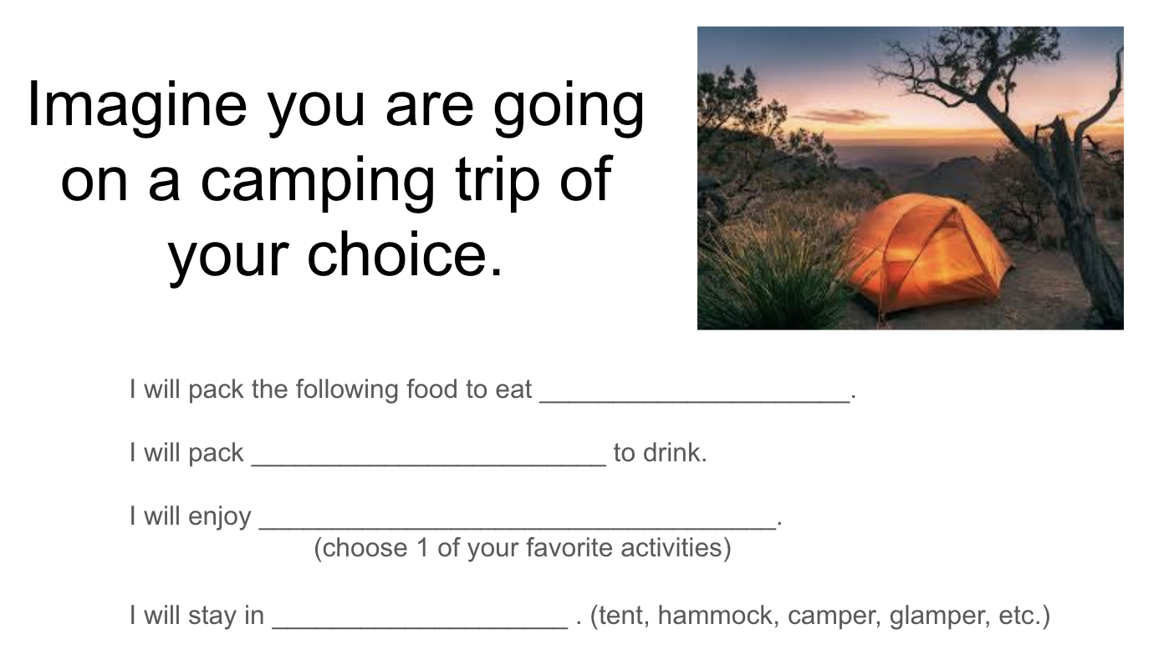

Slide 41
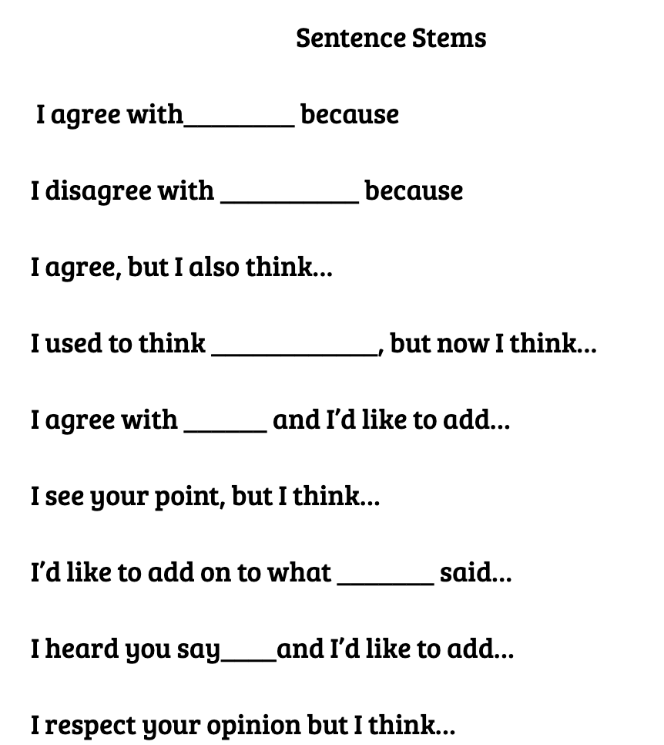
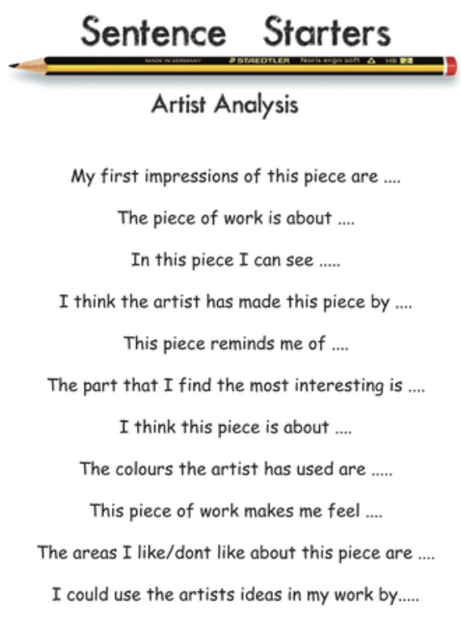
ES & MS Example

Slide 42
4. Exemplars & Rubrics
Multiple Means of Engagement

Slide 43





R

Slide 44



Rubric & Exemplars

Slide 45




Rubric & Exemplars

Slide 46



Slide 47

Multiple Means of Representation
"What" of learning by presenting information in varied, flexible formats to support how students perceive and comprehend content.

Slide 48

Feel free to
Write in
The presented examples
OR
Thoughts that come to Your Mind

Slide 49


Display of Information and Visual Hierarchy
Multiple Means of Representation
Helps Reduce Cognitive Load

Slide 50

Visual Hierarchy
R
Recommendation 6:
What students see matters:
-Arrangement of elements
-Design & Layout
-Order of importance
-Visual weight
-Visual contrast
-Text font
-Text size
-Text color
-Distracting elements
-Negative space
Examples of Visual Hierarchy
Notes:
Visual balance

Slide 51

A single typeface should be used throughout a design, limit the variety of fonts
R
Bigger and bolder means more important - use sparingly for the most important
Note that underline text is reserved only for hyperlinks

Slide 52
Offer information in accessible formats so that the following perceptual features can be customized:
Font, Size & Line Spacing
Recommendation 1:
R
Top Recommended UDL Fonts:
Arial
Verdana
Calibri
Helvetica
Tahoma
Century Gothic
Trebuchet MS
Lexend (designed specifically for reading fluency)
16 point Arial text and with NO line spacing
This is written in 16 point text.
This is written in 14 point text
This is written in 12 point text
This is written in 10 point text
16 point text Legend and 1.5 line spacing
This is written in 16 point text.
This is written in 14 point text
This is written in 12 point text
This is written in 10 point text

Slide 53
Offer information in accessible formats so that the following perceptual features can be customized:
Character Width & Paragraph Spacing
Recommendation 2:
R
88
UDL recommends line lengths of 45 -75 characters for comfortable reading, with around 60
to 70 being ideal for desktops - including spaces. Try to avoid extremes: very short lines break
words awkwardly, while very long lines cause eye fatigue as readers search for the next line.
Likewise, use paragraph spacing of 2 times the font size. Both of these strategies help reduce cognitive load. Proper line length helps readers maintain their place and reduces strain, making content more accessible.
96
93
94
96
24
1 time font size space (Arial font size = 17)

Slide 54
Character Width & Paragraph Spacing
R
65
UDL recommends line lengths of 45 -75 characters for comfortable
reading, with around 60 to 70 being ideal for desktops - including
spaces. Try to avoid extremes: very short lines break words
awkwardly, while very long lines cause eye fatigue as readers
search for the next line.
Likewise, use paragraph spacing of 2 times the font size.
Both of these strategies help reduce cognitive load. Proper
line length helps readers maintain their place and reduces
strain, making content more accessible.
64
59
61
25
2 times font size space (Arial font size = 20)
57
59
58
39

Slide 55
Background Color, and Text Color
Recommendation 3:
To make your content accessible:
Have high contrast between all text and its background color.
Black text on a white background is recommended for paragraphs of text
Avoid colored text on a colored background. When text and background color are too similar, it can be difficult for your audience to process the information.
Examples of High Contrast
Examples of Low Contrast
This sentence is easy to read.
This sentence is not as easy to read.
This sentence is easy to read.
This sentence is also difficult to read.
This sentence is easy to read.
This sentence is even more difficult to read.
This sentence is easy to read.
This sentence is the most difficult to read.
Notes:
Contrast is the difference between two colors.
If your text is dark, your background should be light, and vice versa.

Slide 56



R
Visual Distractions
Eye Popping…Funny…Maybe even culturally relevant….
but You are so not listening to me right now…..

Slide 57

Negative Space
Recommendation 8:
R
If you want to draw attention to a specific piece of content, try to give it some breathing room.
White space is not Wasted Space
Less distraction = Greater ability to focus (decreases cognitive load)

Slide 58
2. Visual Cues of Auditory Instruction
Multiple Means of Representation

Slide 59


Slide 60

R

Slide 61

R

Slide 62
3. Stop & Check for Understanding
Helps Reduce Cognitive Load

Slide 63
Active vs. Passive
During Direct Instruction
= Passive
= Active
BEFORE
Introduction
Topic 1
Topic 2
Topic 3
Q & A
2
12
14
12
5
45 minutes
45 minutes
AFTER
Introduction
Reflection
Discussion
Groups
Final
Thoughts
Topic 1
Share Out
Topic 2
Topic 3
Q & A
5
5
1
5
5
10
7
2
5

Slide 64

Good for You & Good for Students

Slide 65


Within a Reading and/or Canvas Assignment

Slide 66




Within a Formative Assessment

Slide 67


During a Video

Slide 68
4. Scaffolds & Templates
Multiple Means of Representation

Slide 69





Example Brown (ChemCom)
Brain Derived Neurotrophic Factor
Notes:
RYAN

Slide 70


Anchor Charts
An anchor chart scaffolds learning by turning fleeting spoken instructions into a permanent & visible classroom tool.

Slide 71



Elementary / MS Examples of Scaffolds

Slide 72

Without a template
Complete the diagram below and explain what the Double Slit Experiment proved

Slide 73


Question WITH prompts….
Complete the diagram and statements below

Slide 74


A Template without Scaffolds & Prompls
R
Adjust reading level, visual aids, or hands-on supports.
Open Ended But Also Very Difficult
Tool: Brisk

Slide 75


More Accessible & More Achievable end to learning goal
R
Still Kept 1 - 2 Next Level Processing Questions.

Slide 76

Provide Scaffolds for Notes & Lecture
R
Focus on Important Details
Enhances Memory Retention
Provides Hierarchical Structure
Reduces “transcription lag”
Reduces “transcription fatigue”

Slide 77


multiple representations of notation where appropriate
(e.g., formulas, word problems, graphs).
Recommendation 3
R
CRISS Strategies

Slide 78
Multiple Means of Representing One Problem Many Ways
R

Slide 79

Visual Representation for Proofreading & Editing
M

Slide 80

5. Choice Boards

Slide 81


Slide 82

Student Groups of 4 - each student picks their responsibility

Slide 83

A “nod” to Dodd (Hamilton)
https://www.udlforlittlelearners.com/

Slide 84


Slide 85


Closing Activity
Draw 1 card
From the Deck
Aces sith with Aces
Kings sit with Kings
Queens sit with Queens
https://signaturepractices.casel.org/suit-yourself/

Slide 86




Hearts:
Something from the heart. How did you feel? What did it mean to you?
Clubs:
Things that grew—new ideas, new thoughts, a new point of view.
Diamonds:
Gems that last forever. What are some of the gems of wisdom gathered from people or content?
Spades:
Used to dig in the garden. Generate conversation about planting new ideas or things participants dug up during class.

