Slide 1

Be the DJ of Your Day!
Presented by: Meg Frideres
Content from Crucial Learning

Slide 2



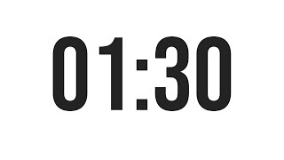
How many of you feel like your day has a soundtrack?
What song plays in the morning when you get up? During school? As you leave your building?

Slide 3
How many of you feel like your day has a soundtrack?
And you didn’t get to choose it?

Slide 4
Goals for this session
Identify what is making “noise” in your life
Create a remix to bring calm from the chaos

Slide 5
4 Key
Tracks
Tuning Out the Noise
Your Personal Remix
Managing the Paradox
Chaos to Flow

Slide 6
TRACK 1
TUNING OUT THE NOISE

Slide 7
POLL
What steals the most focus
from your day?
Go to:https://strawpoll.live/
Enter PIN: 165093

Slide 8
Constant notifications
Context switching
Unclear priorities
Meetings without purpose
Mental load and worry
Digital rabbit holes
Fatigue/low energy
Family demands
Common
Focus-Stealers

Slide 9

What’s the impact of these distractions?

Slide 10
THE EFFECTS
Overwhelm- “I have too much to do” (73%)
Lack of Energy- “I feel drained” (73%)
Stress- “I feel worried about all I have to do” (73%)
Decreased Efficiency- “I work much slower” (72%)
Less Fulfillment- “I’m not feeling fulfilled at the end of the day” (54%)
Disappointment- “I’m letting myself or others down” (50%)

Slide 11

FOCUS & DISTRACTION
77% of workers report work-related stress
59% can’t stay focused for 30 minutes without disruption
Up to 40% productivity loss from multi-switching
2-3 hours lost to interruptions

Slide 12
THE PROBLEM
Multitasking vs. Task Switching
(Myth) (Reality)
Notes:
Task Switching: the act of stopping one activity and starting another, requiring your brain to shift attention, rules, and goals

Slide 13
CHAT
What costs have you experienced due to task switching?

Slide 14

SWITCH COSTS
“Restart cost”
Time
Energy
Attention drain
Memory

Slide 15

ANOTHER SIDE EFFECT: MENTAL CLUTTER
Uncaptured ideas
Open loops
Half-decisions
Thinking we will remember it later

Slide 16

THE SHIFT
Noise Clarity
Reaction Intention
Overwhelm Control

Slide 17



First Step
Name your biggest noise source.
What’s ONE thing you are going to do to quiet it?

Slide 18
TRACK 2
YOUR PERSONAL REMIX

Slide 19
DEFINITION
Remix: a variant of an original recording (as of a song) made by rearranging or adding to the original.

Slide 20
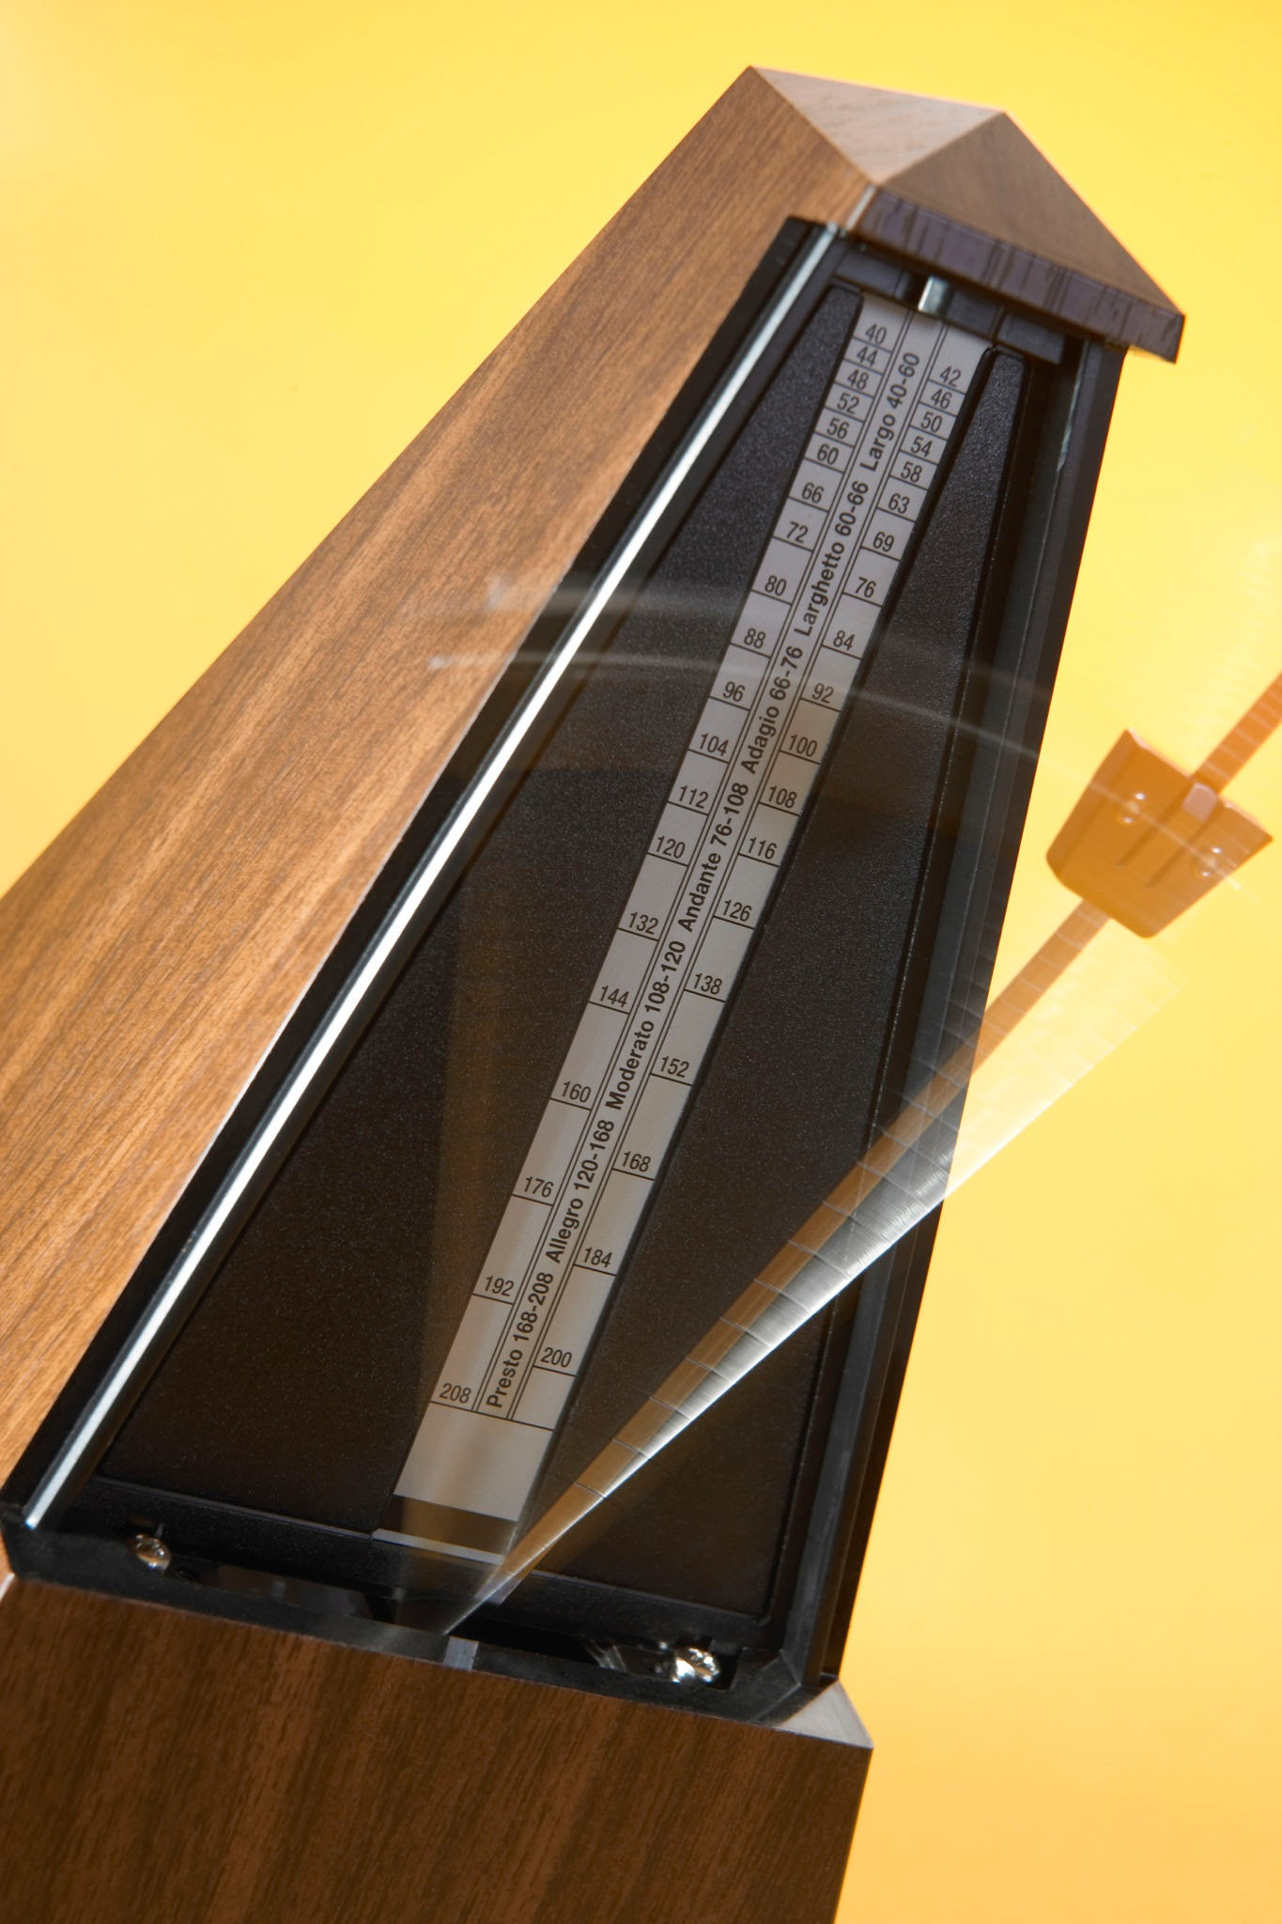
CLARITY
clears the sound
______________
HABITS
keep the beat
Notes:
Clarity comes from step one

Slide 21
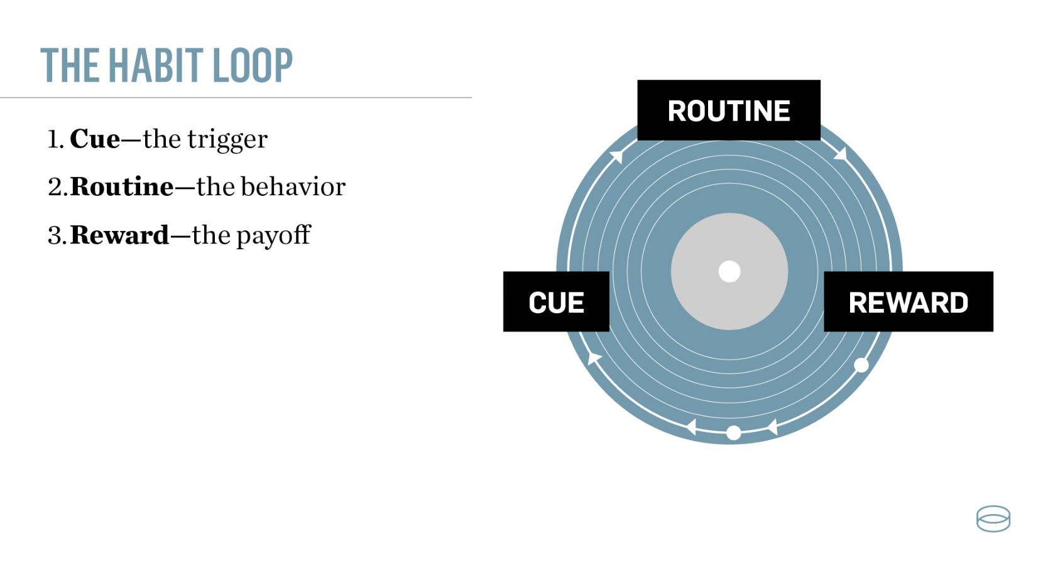

Slide 22

WILL POWER IS NOT ENOUGH
Most daily actions are automatic
Context beats intention
Repetition creates stability

Slide 23
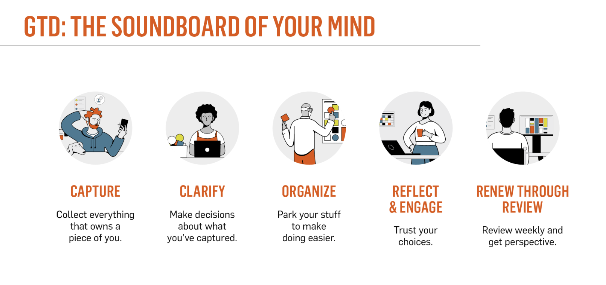
HABIT SUGGESTION: Getting Things Done Method
David Allen's Getting Things Done

Slide 24
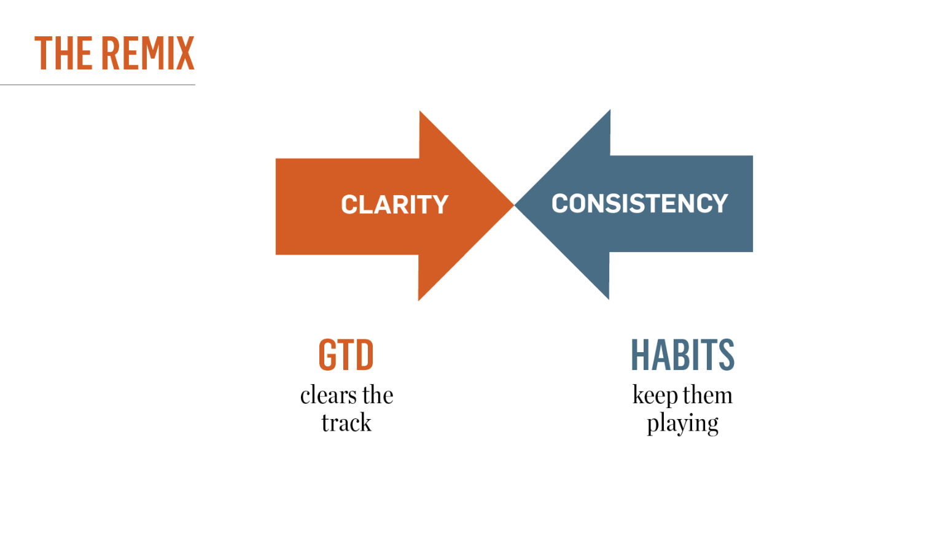

Slide 25
Second Step
Name a habit that is problematic.
What is ONE thing you can do to change it?
What’s ONE daily routine that would help you be successful?

Slide 26
TRACK 3
MANAGING THE PARADOX
Notes:
Definition of PARADOX: a statement, person, or situation that seems to go against common sense or self-contradictory, but actually reveals a deeper truth or valid meaning

Slide 27


Slide 28
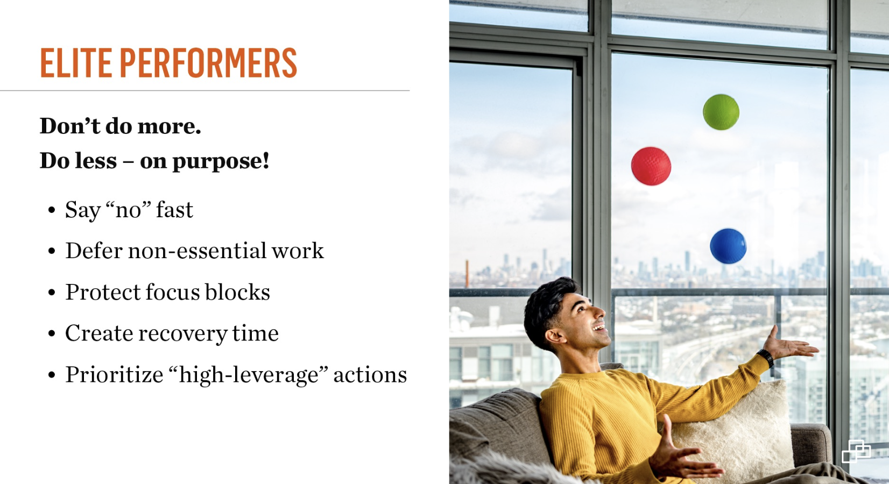

Slide 29


Slide 30


Slide 31


Slide 32
Third Step
What’s ONE ball you’ve been juggling that may not belong in your mix right now?

Slide 33
TRACK 4
CHAOS TO FLOW

Slide 34


Slide 35
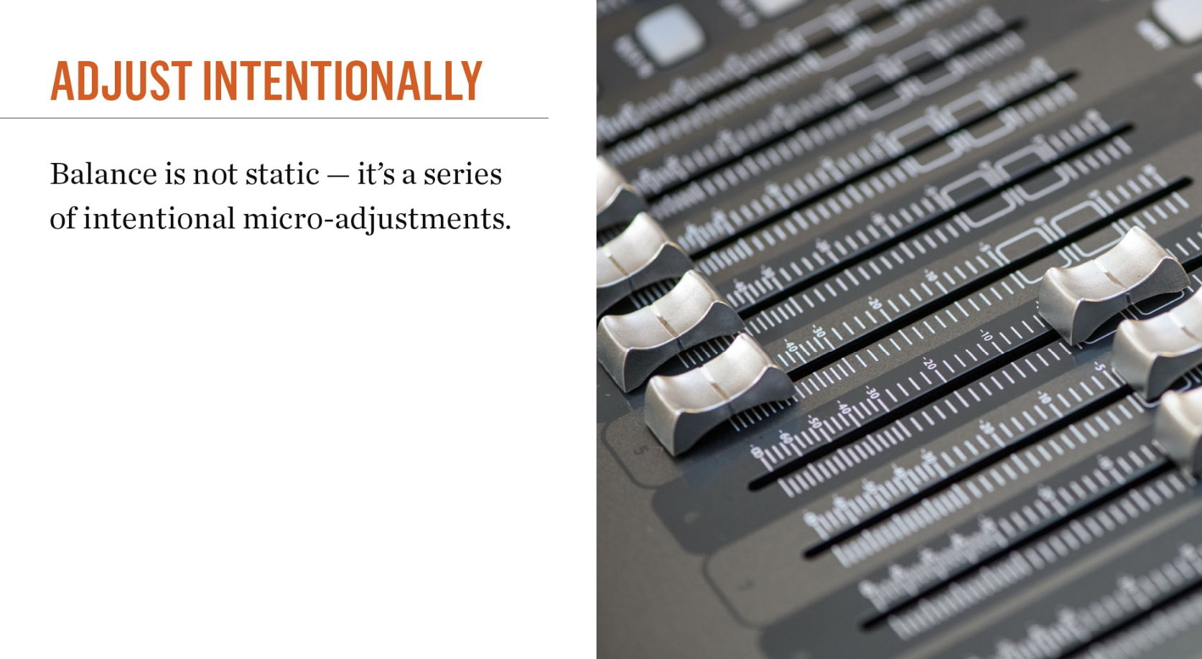

Slide 36
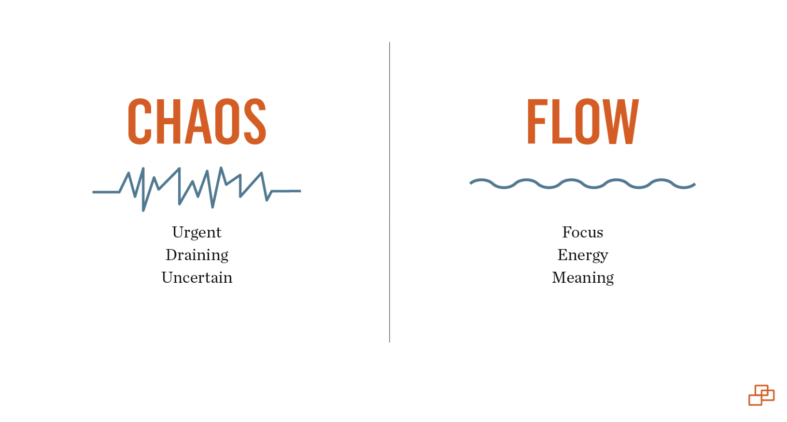

Slide 37
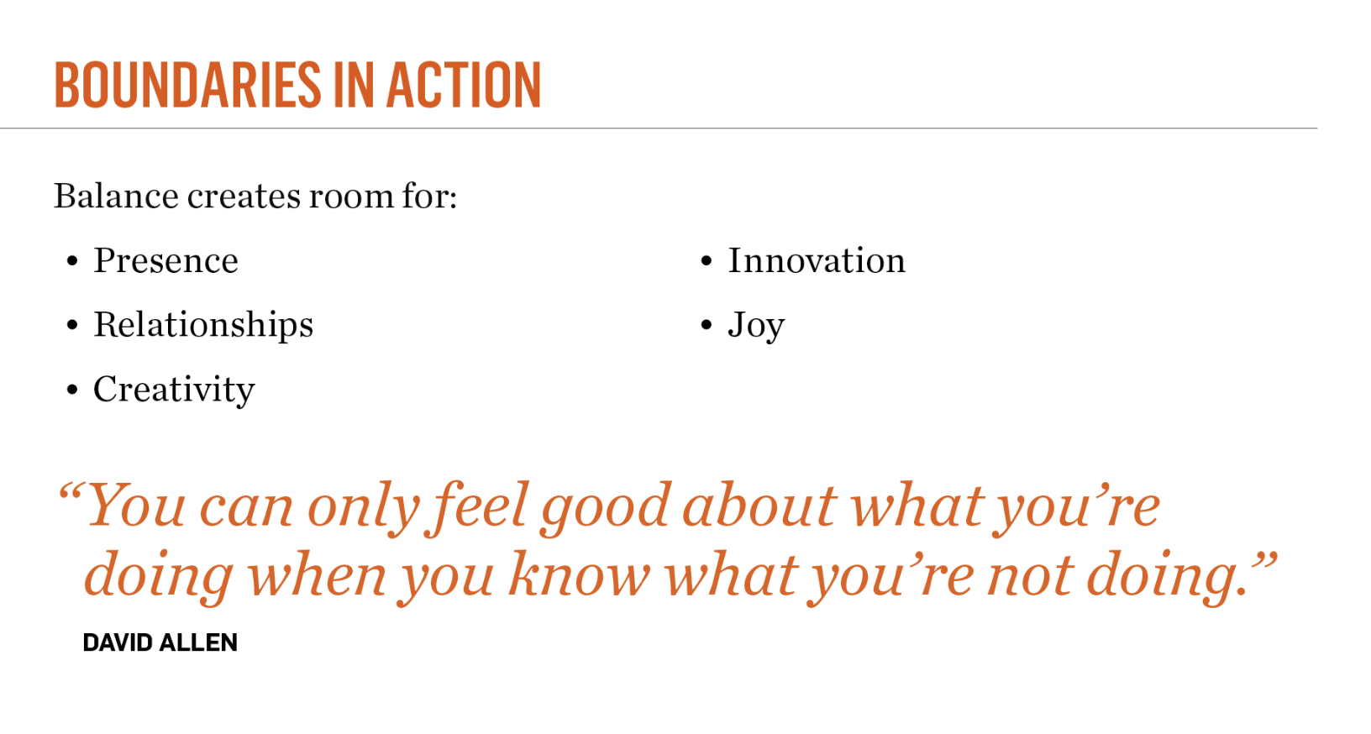

Slide 38
Final Step
What’s ONE slider in your life that needs to go down so another can go up?

Slide 39

THANKS TO….
https://cruciallearning.com/

