Slide 1


LETHALITY ASSESSMENT PROTOCOL
RESPONSE, RISK, RESPONSIBILITY
Proactive, Not Reactive.

Slide 2
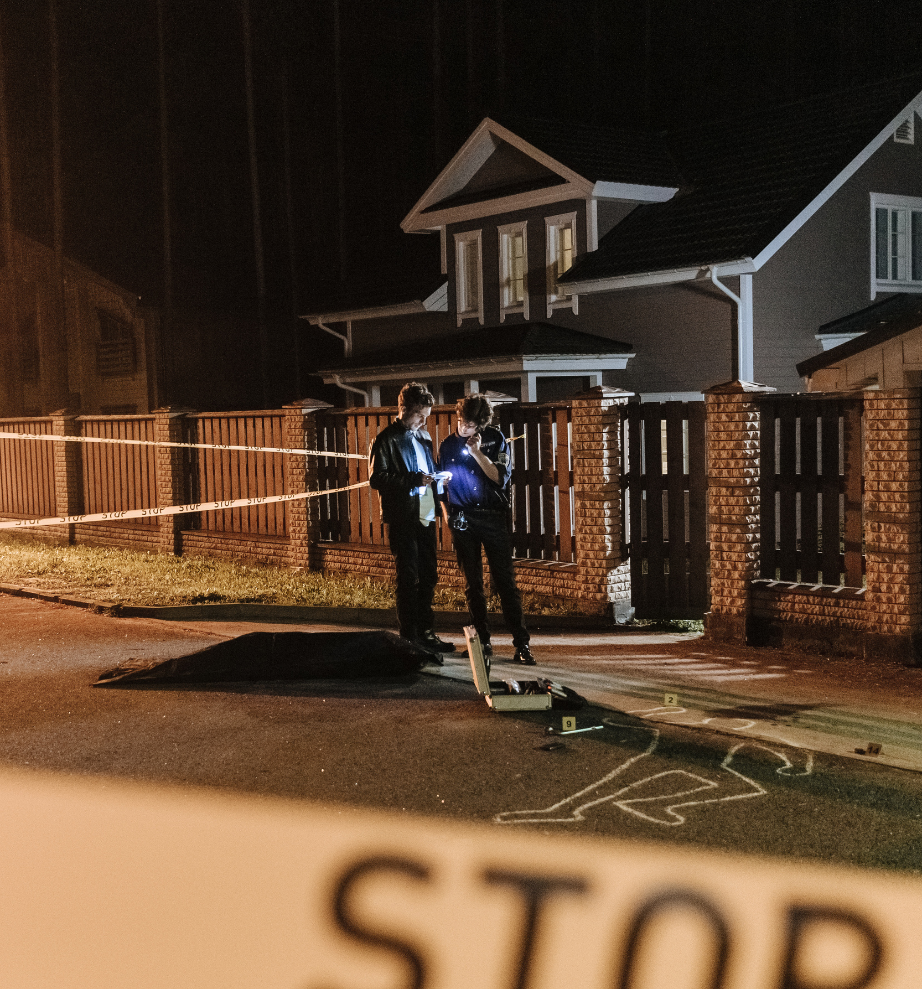

What is LAP?
LAP is a life-saving tool used across Oklahoma to identify victims of intimate partner violence (IPV) who are at the highest risk of homicide. By swiftly connecting individuals with local service providers for immediate safety planning and advocacy, LAP seeks to interrupt the cycle of violence before it turns deadly. This proactive approach delivers vital support and information at the most crucial moment, when it can save lives.
“At the core of the LAP process is a willing partnership between law enforcement and a local victim service provider.”

Slide 3

Our Team
We train law enforcement on LAP because it saves lives by identifying high-risk intimate partner violence (IPV) and connecting victims to help before it’s too late.
Why LAP?
01.
02.
03.
04.
Identify High-Risk Cases
Supports Officer Response
Connect Victims to Services
Saves Lives
Helps law enforcement recognize when a victim is at risk of serious harm or death.
Gives officers a structured tool to guide their response in dangerous situations.
Provides an immediate bridge to advocacy & safety planning.
Reduces IPV fatalities through early intervention and support.

Slide 4


LAP in OK
The Lethality Assessment Protocol (LAP) has been mandated by Oklahoma law for more than a decade.
Mandated in 2014
Updated in 2021
In 2014, the state legislature required the Oklahoma LAP be completed by law enforcement on the scene of intimate partner violence incidents.
It was added to the Oklahoma Victim’s Rights Act.
In 2021, the law was updated to require law enforcement to use the LAP form on the OAG website. OAG expanded the triggering questions from three (3) to five (5).
It also added detail to the referral process whenever a victim screens-in as high-risk.

Slide 5
The Statute
21 O.S. § 142A-3
D. Upon the preliminary investigation of a domestic violence crime involving intimate partner violence, the first peace officer who interviews the victim of domestic abuse shall assess the potential for danger by asking a series of questions provided on a lethality assessment form available on the Oklahoma Attorney General website. The lethality assessment form shall include the following questions:
  Has the person ever used a weapon against the victim or threatened the victim with a weapon?
  Has the person threatened to kill the victim or children of the victim?
  Does the victim think the person will try to kill the victim?
  Has the person ever tried to choke the victim?
  Is the person violently or constantly jealous or does the person control most of the daily activities of the victim?
  Has the victim left or separated from the person after living together or being married?
  Is the person unemployed?
  Has the person ever tried to kill himself or herself?
  Does the victim have a child that the person knows is not his or her own child?
  Does the person follow or spy on the victim or leave the victim threatening messages?
  Is there anything else that worries the victim about his or her safety and if so, what worries the victim?
E. If the results of the lethality assessment indicate a referral is suggested, the assessing officer shall implement the protocol referral process to a domestic violence advocate from a certified or tribal program as follows:
  Advise the victim of the results of the assessment;
  Advise the victim that based on the results of the assessment the officer will call the domestic violence hotline to allow the victim to speak with an advocate;
  If the victim does not want to speak with an advocate, the officer shall document the refusal on the form.
F. Regardless of the results of the lethality assessment, referral information for shelters, domestic violence programs and other social services shall be provided to the victim.

Slide 6

Oklahoma is a
Top Ten State
In women being murdered by men in single victim/single offender homicide incidents since 1996.
Violence Policy Center - When Men Murder Women Reports 1996-2023

Slide 7
We’re Not OK
By asking the right questions and identifying IPV, even when it’s not obvious, you help ensure that victims receive the proper legal protection, safety planning, and support services they need.
01.
02.
03.
The Risk
Intimate Partner Homicide
Leading Casue of Death
51.5% of Oklahoma women and 46% of Oklahoma men will experience sexual violence, physical violence, and/or stalking from an intimate partner at some point in their lifetime.
From 2015 to 2025, 393 Oklahomans were victims of intimate partner homicide. That is an average of 44 deaths per year.
Of those 393 deaths, 63.9% were due to a firearm. 15.5% were due to a cut/pierce. 11.2% were due to blunt force trauma. 9.4% were other COD.

Slide 8
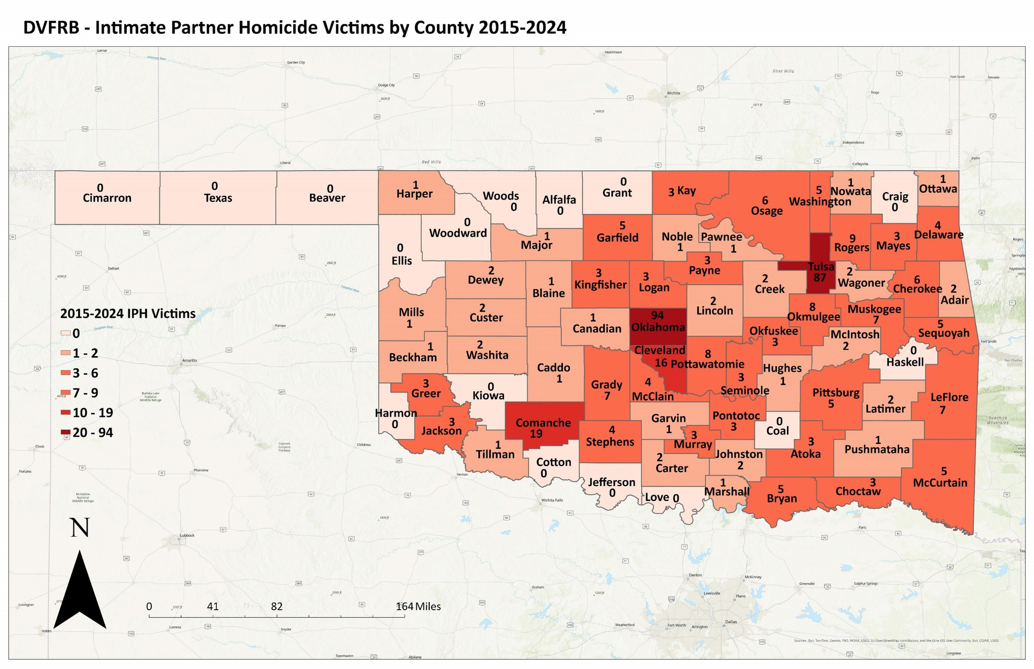

Slide 9
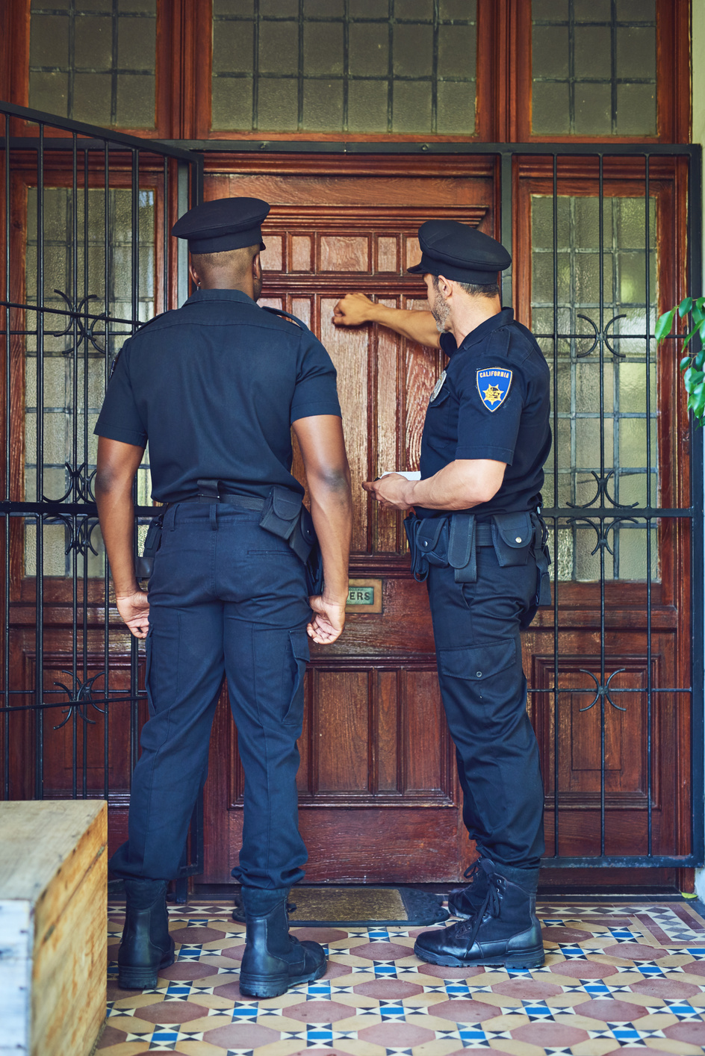


LAP Breakdown
From the 1, 2, 3...
01.
Incident Information
Complete the identifying information at the top of the form, including agency, officer, offender information, and case information. If a case or report number is not yet available, it may be added later.
02.
Lethality Assessment Questions
Document the victim’s response to the LAP questions exactly as provided. These responses are used to determine whether the victim screens in under the protocol
03.
Victim Safety Concerns
This section captures any additional safety concerns expressed by the victim that may not be reflected in the assessment questions. Victim-identified concerns should be documented in detail.

Slide 10

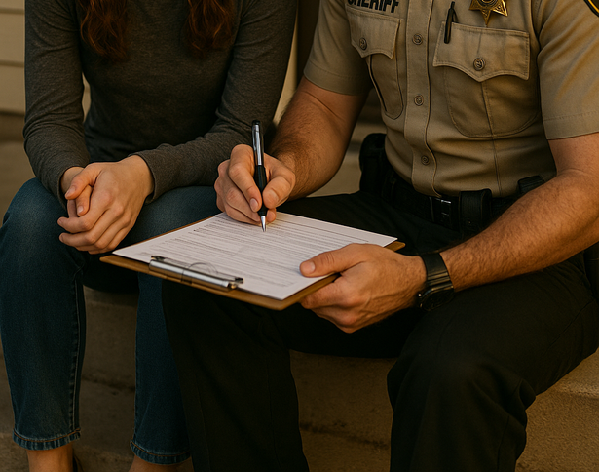

LAP Breakdown
To the 4, 5, 6, & 7
04.
Screen-In Determination
Indicate whether the victim screened in based on the protocol criteria and responses provided during the assessment.
05.
Officer Assessment
This section allows the responding officer to document observations, circumstances, or professional judgment that may impact the screen-in determination. Any rationale for triggering or not triggering the protocol should be recorded.
06.
Referral & Safety planning
If the protocol is initiated, document the referral to the local Domestic Violence/Sexual Assault Program, Tribal Domestic Violence/Sexual Assault Program, or SAFELINE, as applicable. This section also records whether the victim spoke with an advocate and whether a safety plan was provided.
07.
Resource information
Contact information for local victim service providers and the SAFELINE Hotline is provided for quick reference and referral purposes.

Slide 11




Where Will Judges Encounter LAP?
and What Does it Mean?

Slide 12

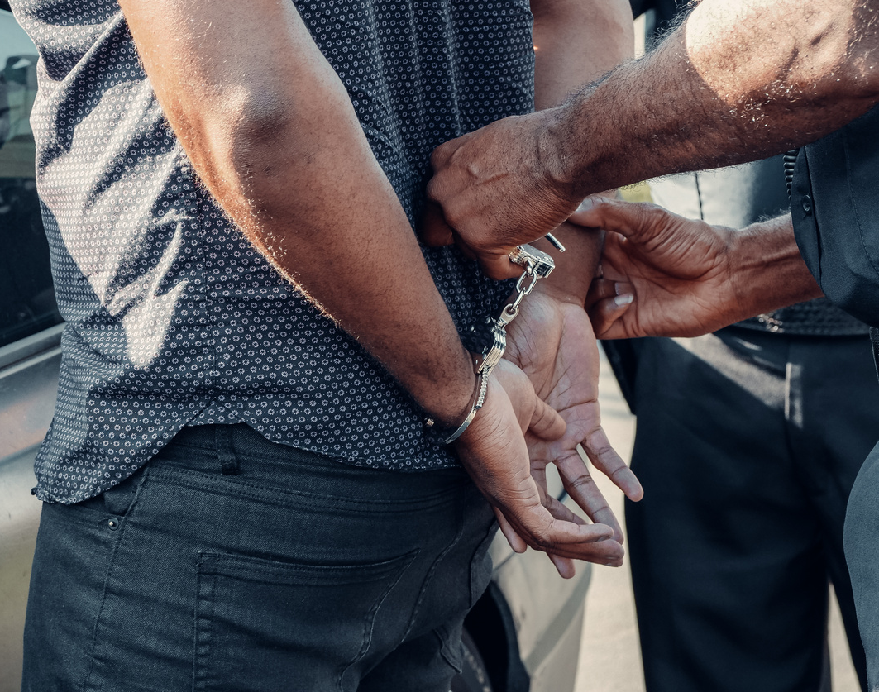


Bond Considerations
LAP results can provide judges with critical information about the level of danger an offender may pose to the victim, children, and community. This information can assist judges in making informed decisions regarding bond, protective conditions, and other court orders that prioritize victim safety and reduce the risk of further harm.

Slide 13

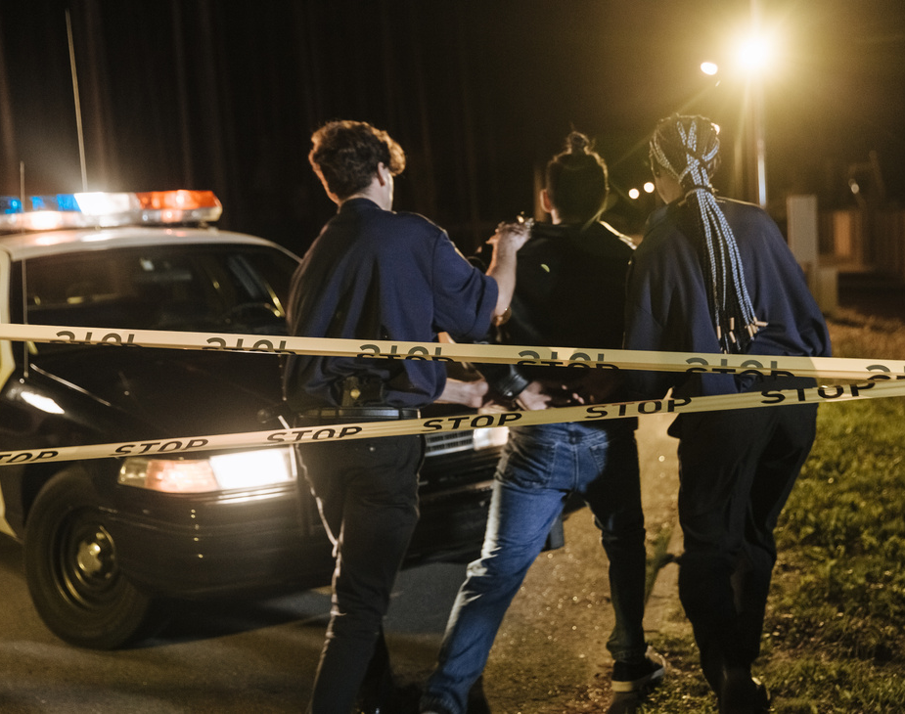


Prior Bad Acts
LAP forms often capture patterns of abuse, threats, and escalating violence that may be relevant when the court considers admissibility of prior acts evidence. This information can provide important context regarding the nature of the relationship, the progression of violence, and the circumstances surrounding the alleged offense.

Slide 14


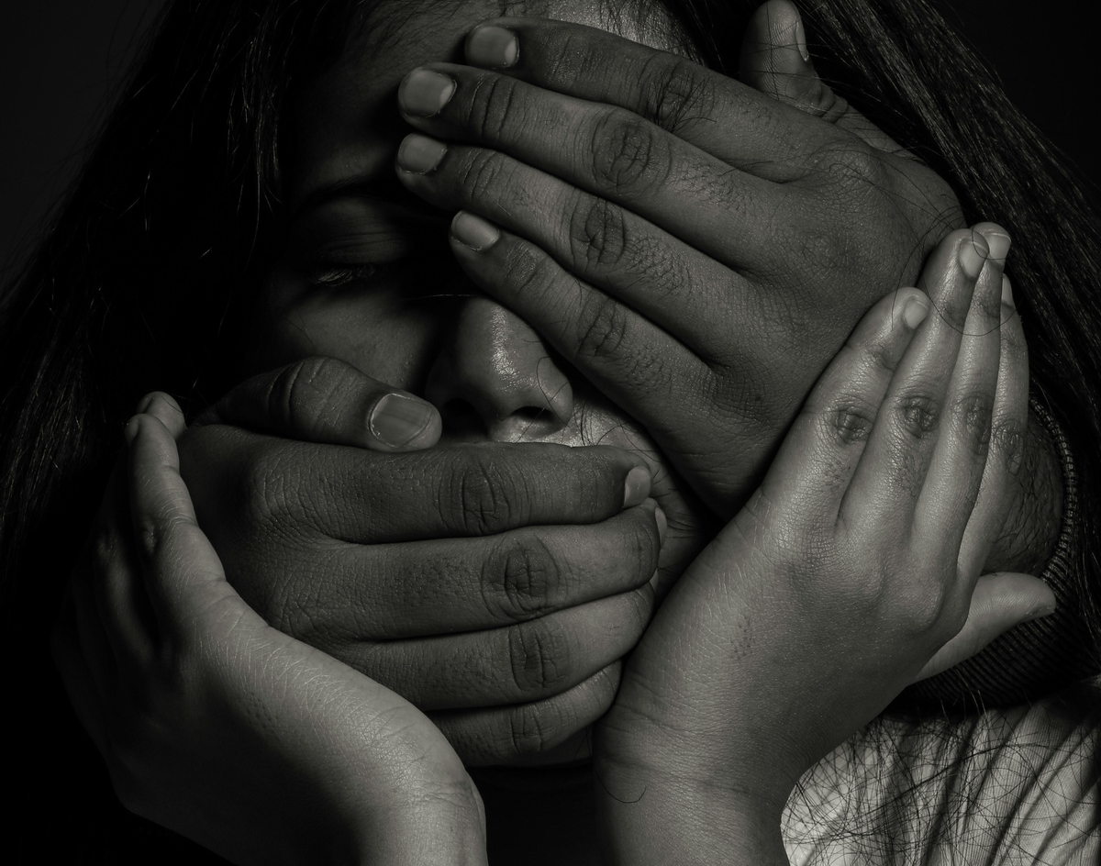

Victim Recantation
Victim recantation is common in domestic violence cases. LAP data can provide insight into why victims may minimize or withdraw their statements, highlighting the fear, control, and danger dynamics that influence their decisions.

Slide 15

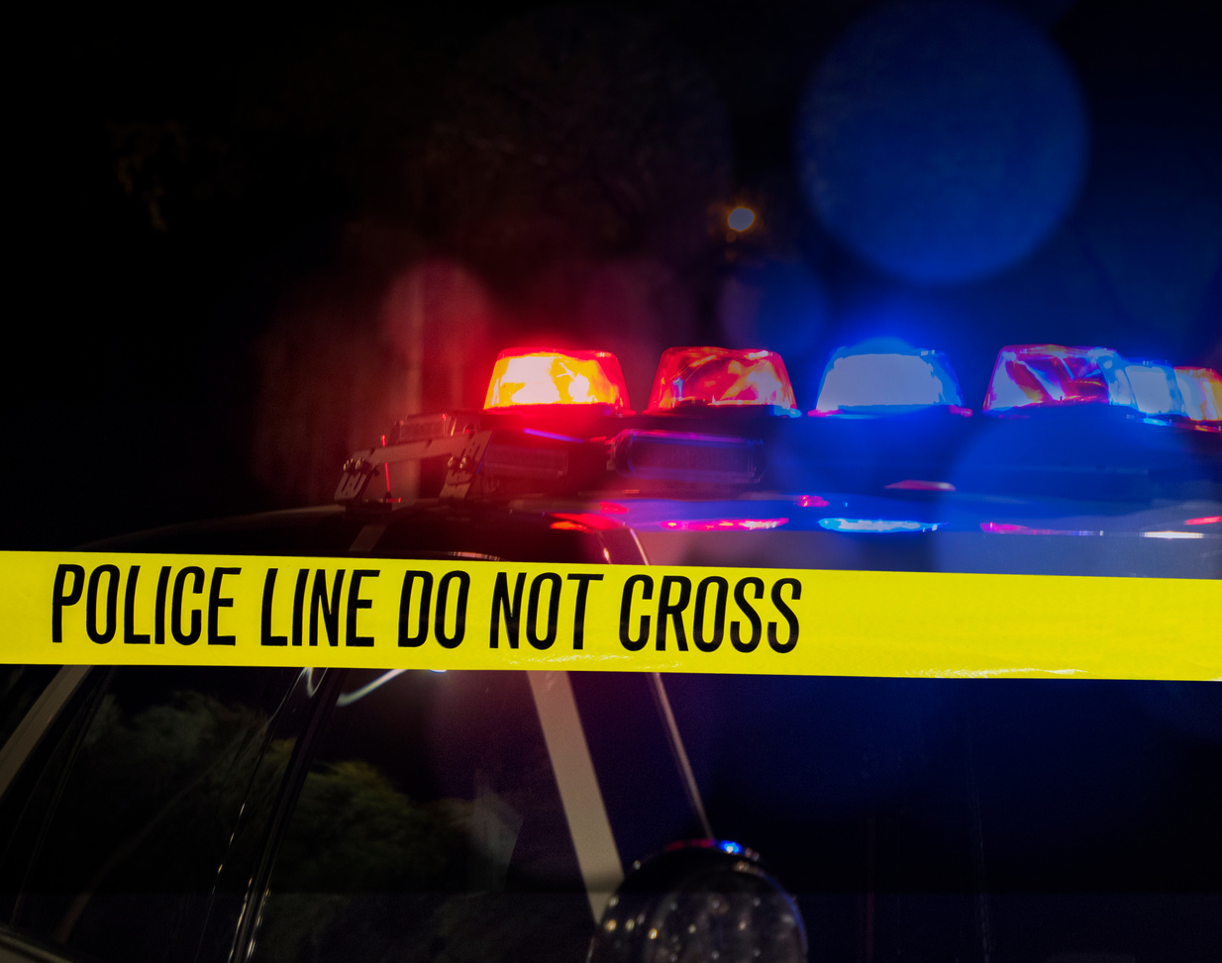

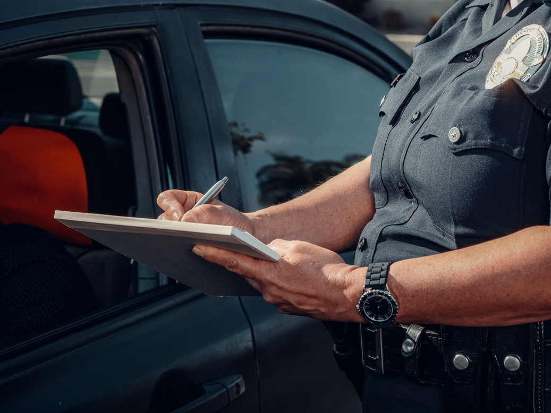
Courtroom Testimony
LAP documentation may provide additional context during court proceedings. Officers may be asked to explain the circumstances of the LAP administration, the risk factors identified, and the response actions taken based on the information gathered.

Slide 16
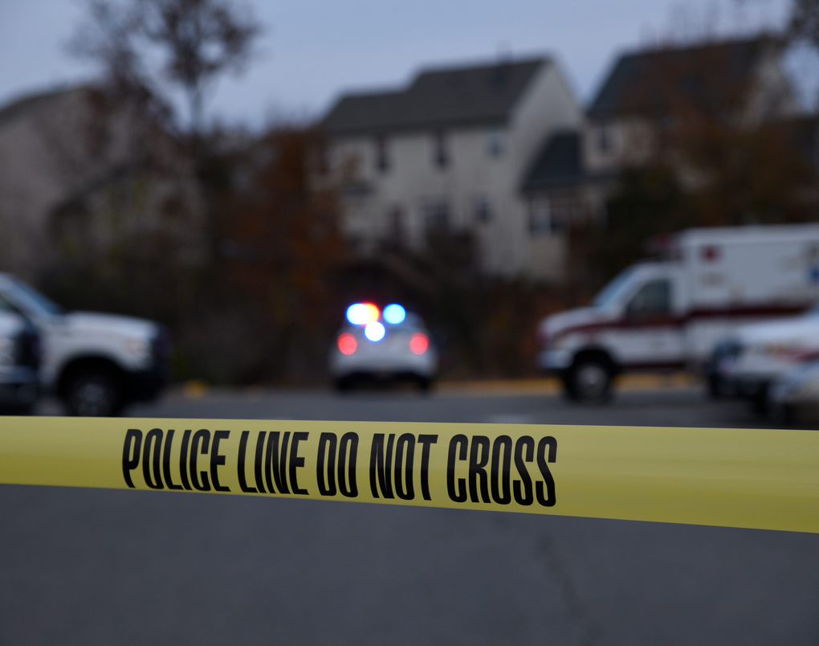
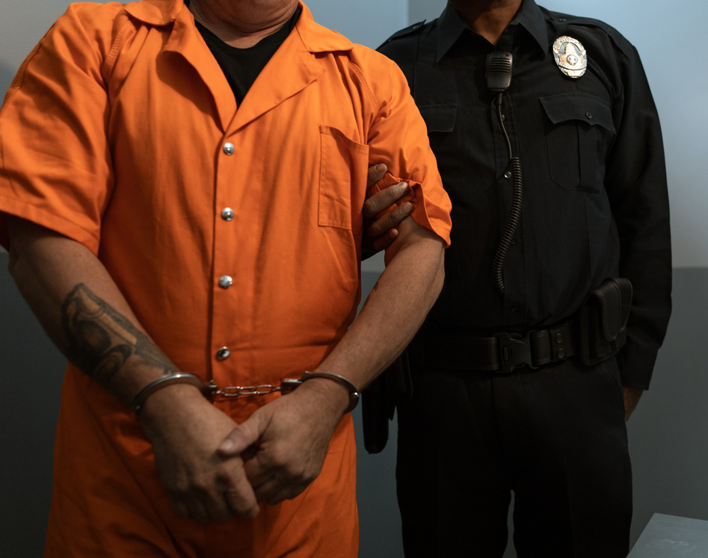
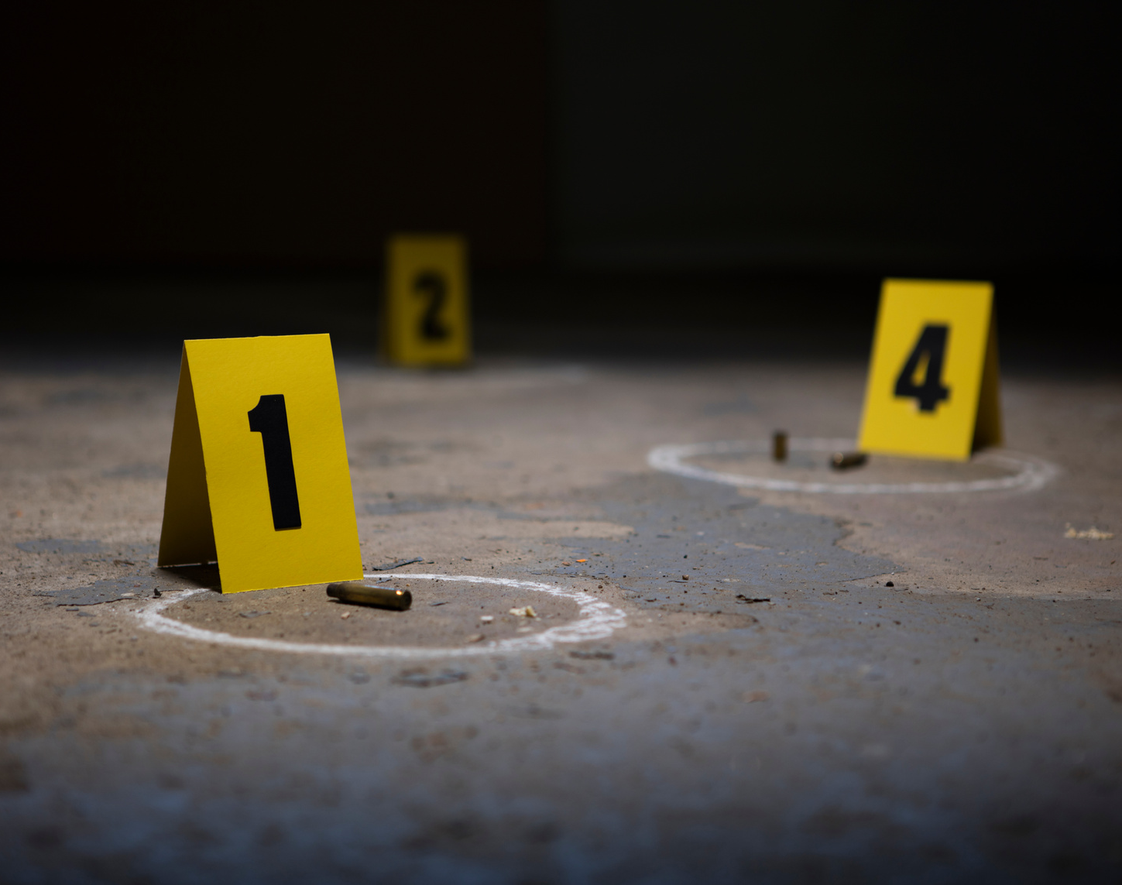
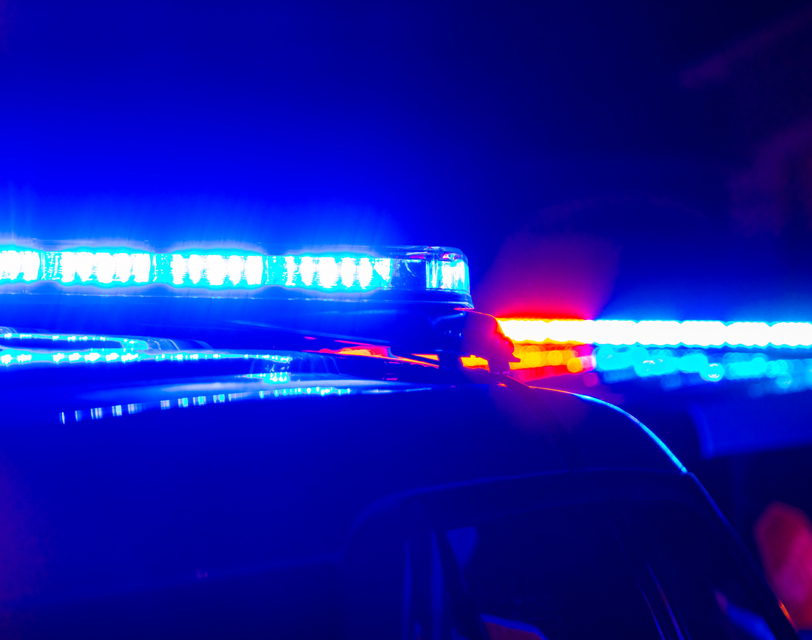
DV Propensity
November 1, 2026
12 O.S. § 2415 (OSCN 2026)
“A. In a criminal case in which the defendant is accused of an offense involving domestic violence or abuse, evidence of the commission of another act of domestic violence or abuse by the defendant is admissible and may be considered for its bearing on any matter to which it is relevant.”

Slide 17

Your Role in LAP
LAP provides additional context about risk, victim behavior, and offender patterns.
You are uniquely positioned to consider how patterns of coercion and control influence victim decisions, case progression, and safety concerns.
When LAP information is expected and consistently included in case materials, it strengthens communication between law enforcement, prosecutors, advocates, and the courts.
The courtroom is one of the places where LAP’s purpose is realized, by ensuring risk factors and patterns of abuse are not overlooked.
This is Proactive, Not Reactive.

Slide 18

Thank You.
Let’s Get to Work.
Our team is here as a resource and partner. We provide statewide training on LAP, what it is, how it is used, when it is initiated, and how it can help inform a more complete understanding of risk, victim safety, and offender behavior. We welcome your questions and are here to support you.
lap.training@oag.ok.gov

