Slide 1
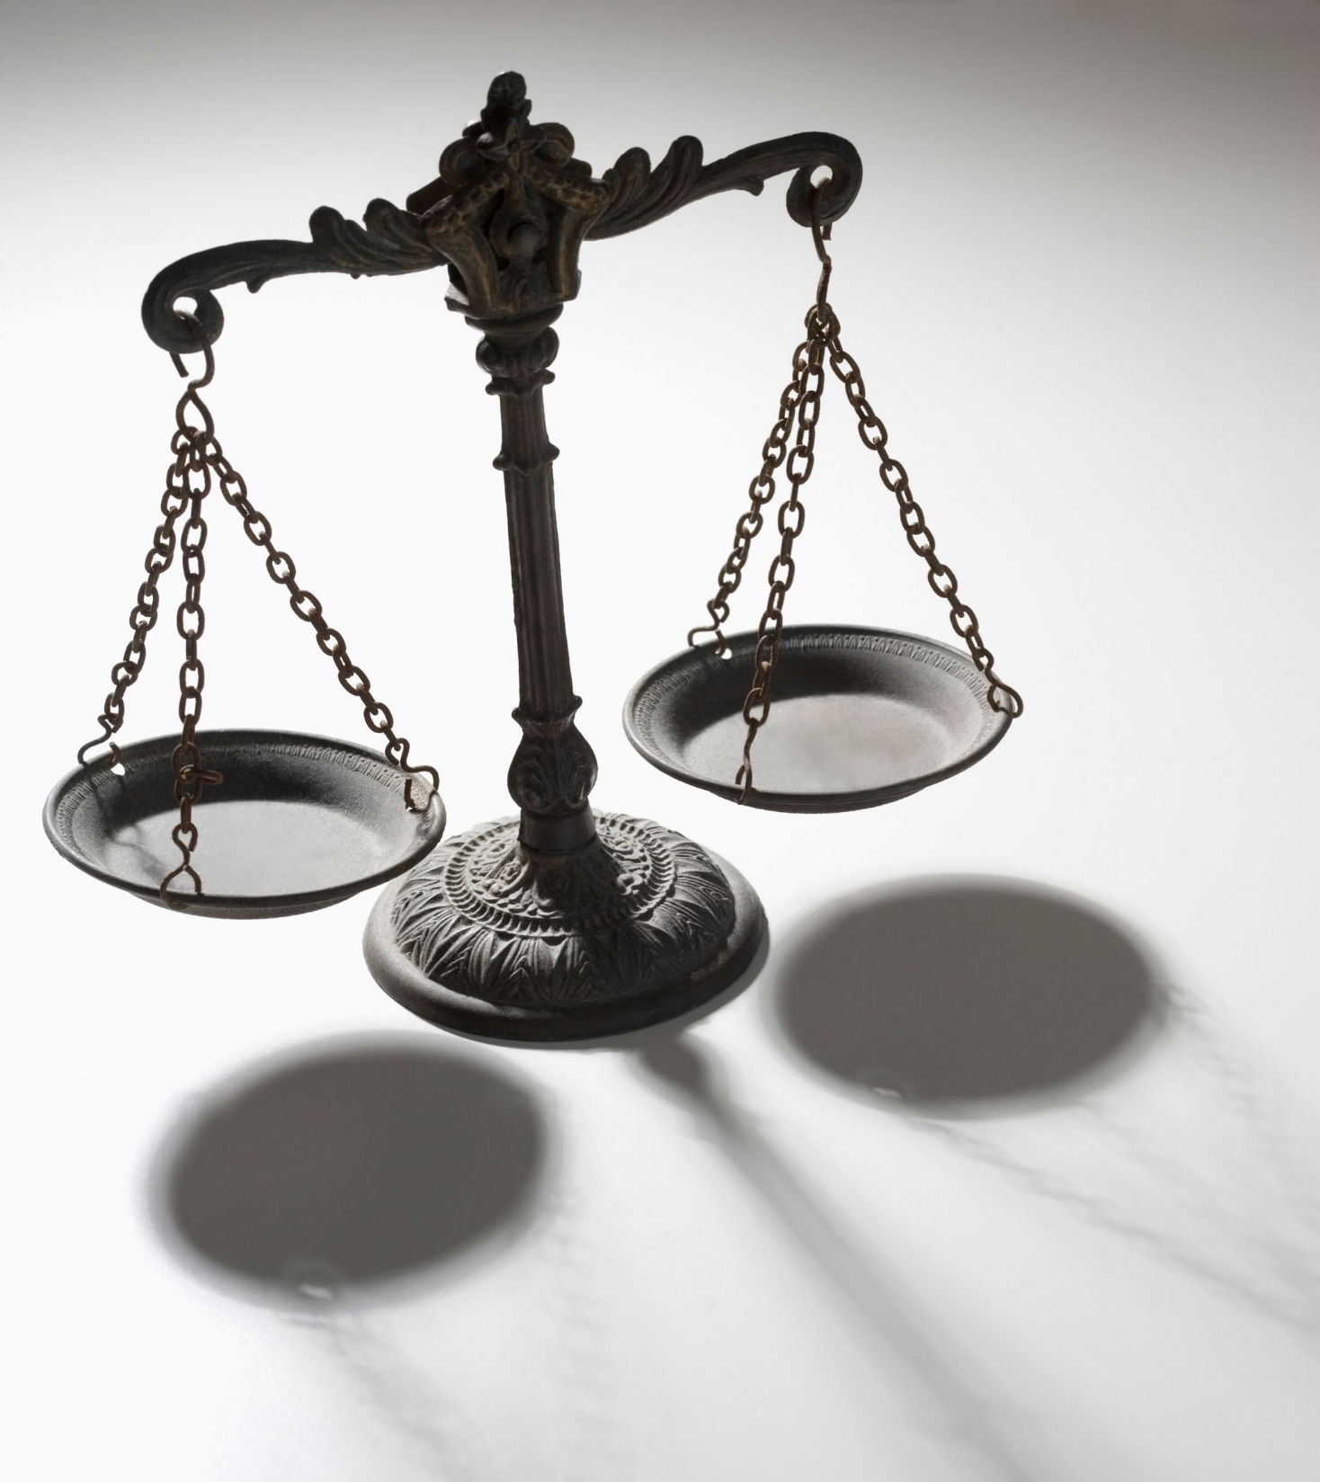
Current Issues in the Regulation of
Judicial Conduct & Ethics
Prof. Sarah CraveNS
OklahoMA Judicial Conference
2026 Presentation

Slide 2

Current Issues in the Regulation of Judicial Conduct & Ethics
Presentation Overview

Slide 3

Selection Issues

Slide 4
Selection Issues
In re Levey Cohen (FL): disseminating unverified accusations about opponent
Inquiry Concerning Peffer (FL): falsehoods in attempting to gain endorsement
In re Foxworth Roberts (LA): misleading statements re past military service and re burglary
In re Medley (LA): misleading campaign ad video
Matter of Muller (NY): failure to disclose/disqualify in cases involving campaign committee members, etc.
Disciplinary Counsel v. Rudduck (OH): change of approach re endorsement of political candidates
Inquiry Concerning Moon (FL): miscellaneous misconduct

Slide 5

On the Bench Conduct

Slide 6
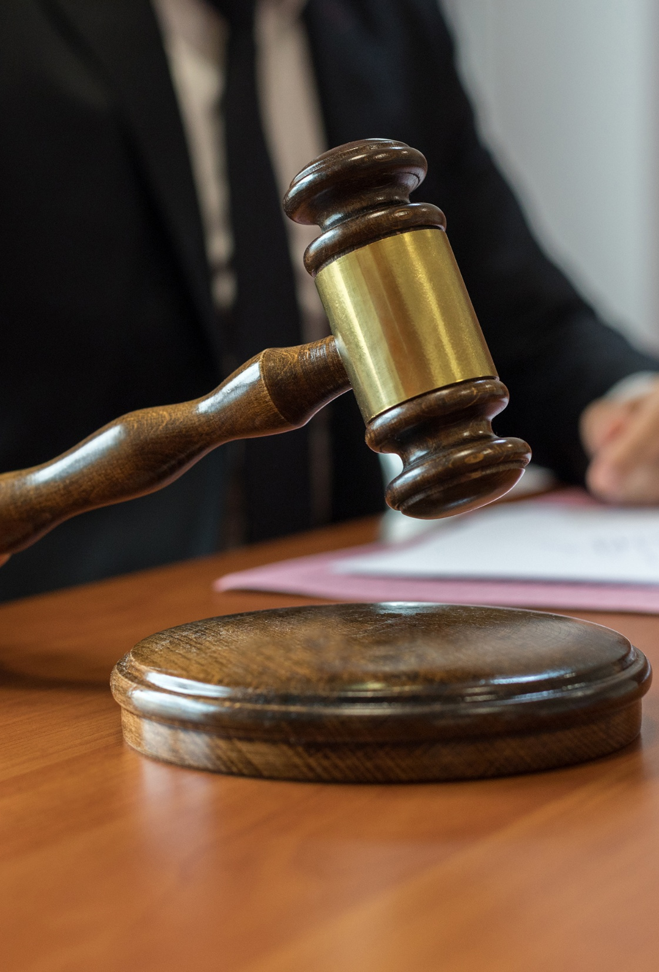
Abuse of Position/Power
Public Admonishment of Driessen (CA): “authority higher than God”
In re Tveit (WA): hiring judge’s own children
In re Bevins (KY): abuse of contempt / demeanor issues
Public Reprimand of Garza (TX): pattern of issuing summons requiring individuals to appear to resolve personal disputes other members of the community

Slide 7

Failure to Follow the Law
Matter of Ballou (NV): repeated refusals to enter judgments as ordered by supreme court
Matter of Davis (NV): independent research on facts
Matter of Loehr (NY): ticket-fixing for family members
Sexual Harassment
Matter of Quam (MN): multiple instances inappropriate sexual contact / inappropriate sexual conduct with law clerk(s)

Slide 8

Chronic or Extreme Delays / Failure to Respond
Matter Concerning Heryford (CA): decisional delays and related false salary affidavits
Matter of Murray (CA): ten year pattern of decisional delay and neglect
In re McGaugh (MO): failure to rule and to respond to Commission
In re Bordeaux (GA): repeated failures to rule and inappropriate blame-shifting

Slide 9

Ex parte communication
Matter of Lilley (NY): ex parte communications, false communications, deletions of evidence after preservation order
Bias
Matter of Pitts-Davis (NY): rescheduling to avoid performing same-sex marriage [But see Hensley v. State Jud’l Conduct Comm’n (TX)]
Matter of Cochran (CA): embroilment, discourtesy, and bias in a domestic violence hearing

Slide 10

Demeanor/Speech
Public Reprimand of Eggen (TX): berating and demeaning juveniles and their parents; biased treatment
Inquiry Concerning Jordan (FL): scolding attorneys and inappropriate engagement with relative of litigant
Public Admonishment of Monguia (CA): inappropriate remarks about shooting people in the courtroom

Slide 11

Conduct in Chambers /
With Staff
Matter of DiBenedetto (AK): delay to watch sports on TV in chambers; reenactment of testimony/proceedings for staff
Matter of Novak (NE): inappropriate demeanor and communications with staff and others
Matter of Valdez (NM): inappropriate (non-sexual) touching and comments on personal appearance
Inquiry Concerning Carrozzo (CA): practicing law on behalf of assistant (with whom the judge had become involved)

Slide 12

Miscellaneous /
Multiple Matters (On & Off)
Matter of DeHaven (WV): allowing criminal non-attorney co-defendant to act as advocate for spouse; taking girlfriend to jail for arraignments
In re Colbert (LA): ex parte communications, improper TRO without petition; aggressive harassment and intimidation of LEO and invocation of judicial status during traffic stop
In re Sims (LA): improper demeanor; misuse of court vehicle; improper advocacy; and failure to follow the law

Slide 13
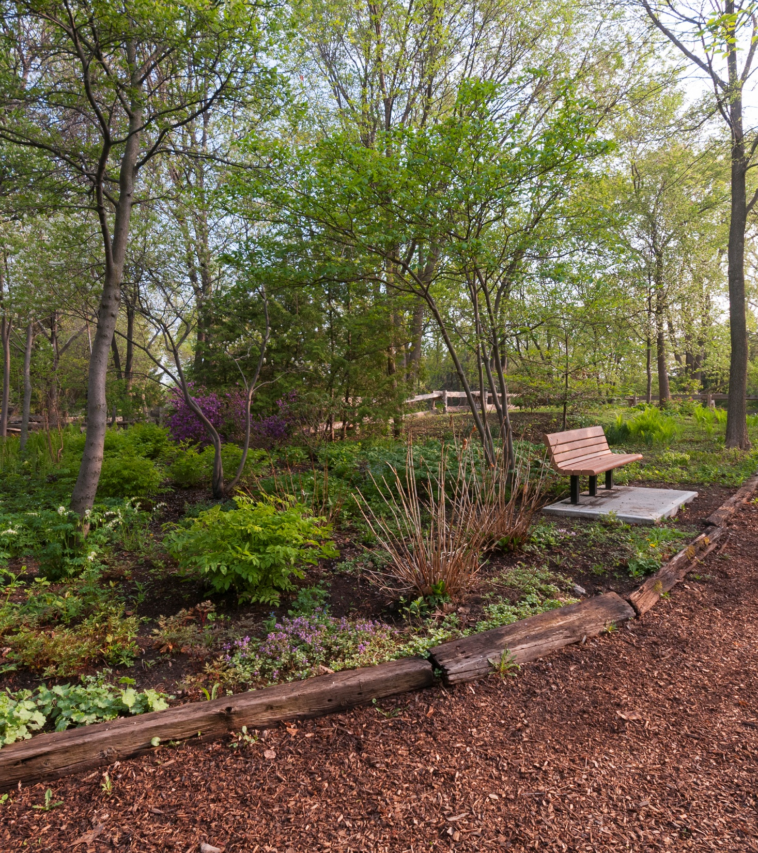
Off the Bench

Slide 14

Abuse of Power /
Abuse of Prestige
Matter of Kesick (NY): misuse of judicial title in person email address
In re Kimble (NC): improper invocation of judicial status during DWI stop
Matter of Klein (NY): use of position to attempt to influence law enforcement for friend and to influence school school board for family
Public Admonition of Gonzalez (TX): taking positions on issues while both on bench and in practice

Slide 15

Sexual Harassment
In re Crook (SC): requesting employee comments on pornographic photos
Matter of Hoffman (NJ): nonconsensual sexual touching of subordinate employee outside of work

Slide 16
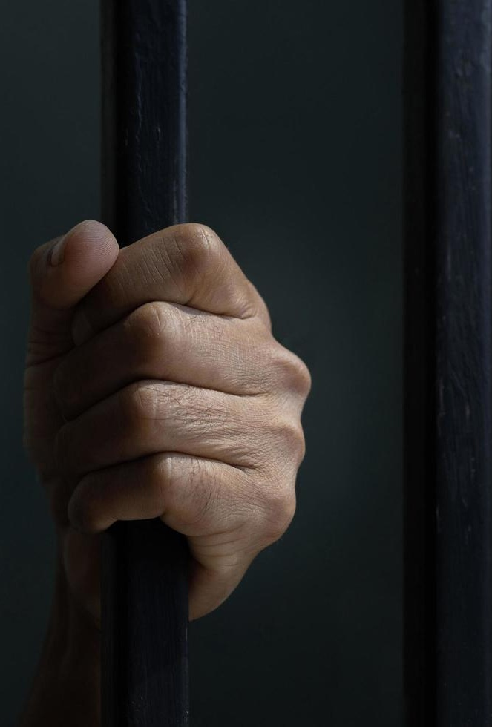
Criminal Conduct
Matter of Worke (MN): arrest for DWI (w/o other misconduct)
Inquiry Concerning Mitchell (TX): indictment for official oppression following physical altercation with delivery driver
Inquiry Concerning Britton (TX): indictments related to incident while improperly practicing law (assault, coercion, concealment, hindering arrest, etc.)

Slide 17
Miscellaneous
Matter of Mitchell (CA): unauthorized entry into other judges’ chambers
In re Ruzumna (WA): misappropriation of seal and stamp in attempt to fraudulently obtain parking discount
Miss. Comm’n on Jud’l Perf. v. Moore (MS): improper public comments in violation of prior MOU
Inquiry Concerning Guerra (TX): failure to complete required judicial education
Inquiry Concerning Clermont (FL): improper practice of law, use of judicial status, and voluntary testimony as character witness
Matter of Ridgeway (NY): prohibited political donations
Matter of Luoni (WV): gambling during workday

Slide 18

Special Topic:
Judges Under Threat

Slide 19

Types of Threats
Physical threats to judges and their family members
Verbal threats / phone or online harassment (aimed at both judges and their family members)
Criticism of judges and the judiciary (undermining the rule of law)
Misconduct complaints
Impeachment resolutions
Other efforts to unseat judges by political or other means

Slide 20
Some
Relevant
Rules
Preamble (generally)
Rule 1.2 – Promoting Confidence in the Judiciary
Rule 2.4(A) & (C) – Not be swayed by … fear of criticism. Not …convey the impression that [others are]…in a position to influence the judge.
Rule 2.10 – Public statements on pending/impending cases; pledges, promises, or commitments; public statements relevant to official duties; responses to allegations; etc.
Rule 3.1 comment [1] – re extrajudicial activities concerning the law and the administration of justice. (see also Rule 3.2)

Slide 21

Questions?
CONTACT:
scravens@uark.edu or
SMRCRAVENS@GMAIL.COM
234-738-2665

