Slide 1
Tri-County Technical College’s Approach to Cleaning Up LibGuides

Slide 2
Our history with Springshare
Started in 2011 with LibGuides
Multiple people have been responsible for LibGuides overall management
Currently use LibGuides, LibAnswers (chat, chatbot, analytics), LibCal (location hours), LibWizard.
Scope: 75 LibGuides in 1 group
  36 research, 24 resource, 6 course, 9 general
Much accretion of outdated code, various styles

Slide 3
Recent Updates
Chatbot – Added a node to the logic tree
LibGuides
  Updated subjects (46) to align with current programs (affects A-Z list as well)
  Created a taxonomy of subjects for topical grouping (“New authority list” tab)
  Deleted assets with zero mappings; trained librarians on using assets
  Accessibility checking; fixed alt-text issues and addressed contrast issues with custom CSS changes for Bootstrap 5
Migrated to Bootstrap 5 in early May 2026

Slide 4
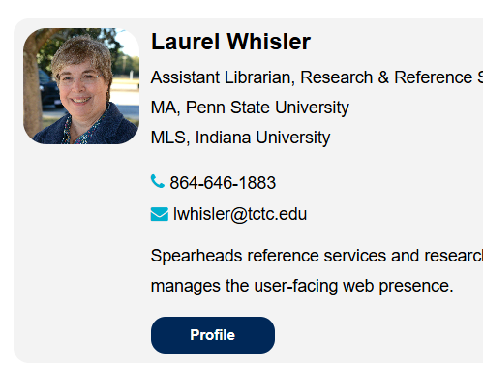
Bootstrap 5 Migration Challenges
Customizations:
    Header
    Footer
    Brand colors
    Contact cards for “About us” page
Custom coding:
    Interfered with functionality
    Old coding needed cleaned up
    Few comments to explain the code

Slide 5
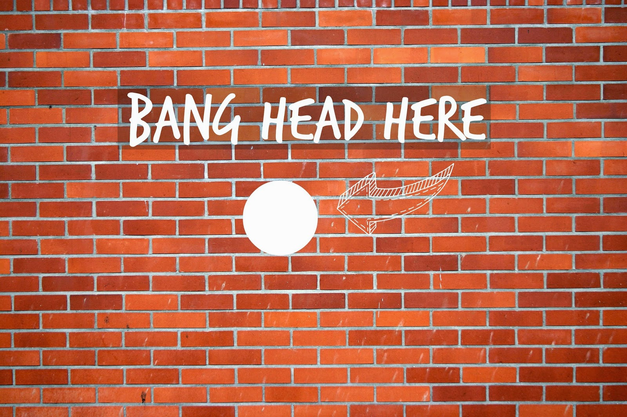
Bootstrap 5 Migration Steps
Springshare Training Recordings
LibGuides: Preview your site with Bootstrap 5
Converting a Bootstrap 3 Header to Bootstrap 5
Creating a Bootstrap 5 Header from Scratch
More Fun with CSS & Bootstrap 5
LibGuides CMS Admin Essentials (Bootstrap 5 Migration updates)
Issues:
Double banner
I wasn’t sure what code was outdated or inefficient
I could figure out the HTML but lacked CSS knowledge
Colors and spacing were off
Custom navigation bar was distorted

Slide 6
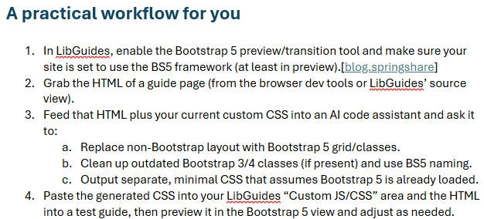
Bootstrap 5 Migration Success
I asked Perplexity!
(https://www.perplexity.ai/)
While there is no direct conversion from Bootstrap 3 to 5, Perplexity created a roadmap and wrote prompts that I used with Claude Sonnet.

Slide 7
Bootstrap 5 Migration Success
An outline of the prompts:
Analyze current header/footer and plan BS5 migration
Generate bootstrap 5-compliant header HTML/CSS
Generate bootstrap 5-compliant footer HTML/CSS
Clean up and consolidate LibGuides custom CSS
Check against Bootstrap 5 preview in LibGuides

Slide 8
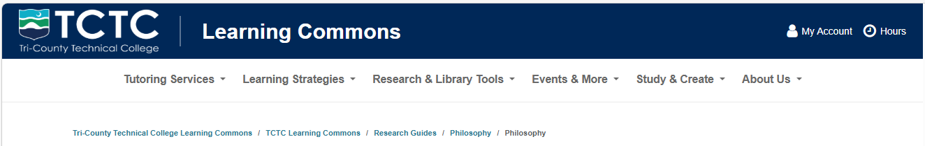
The result for the header?
From:
(Ignore the yellow highlighting.)
To:

Slide 9
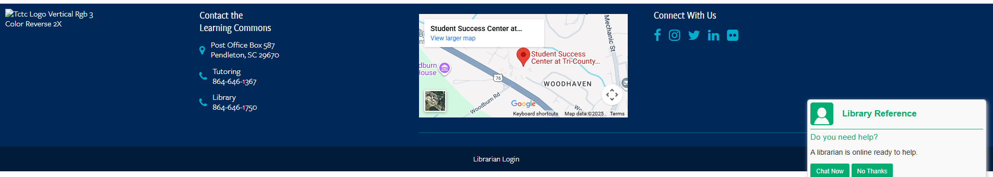

The result for the footer?
From:
To:

Slide 10
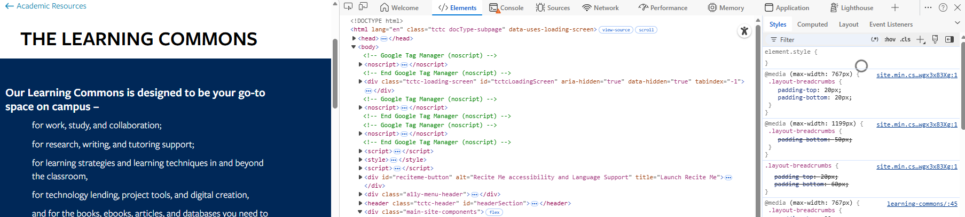
Takeaways
Using AI to write the code was remarkably quick, easy, and effective
Adjustments were easy!
  Upload a screenshot and the inspect element code (right-click/inspect) with a description of how it should look instead.

Slide 11
Thank you!
Questions?
lwhisler@tctc.edu
https://www.tctc.edu/life-at-tctc/academic-resources/learning-commons/
864-646-1883

