Slide 1


From URLs to IRL: Building and Sustaining Pro Bono Relationships Through Online Tools
Purpose:
To explore how legal aid organizations can use digital tools to scale pro bono engagement while still creating a volunteer experience that feels responsive, supported, and connected.
Jessie G. Campbell
Directing Attorney – Pro Bono / Private Attorney Involvement
Lone Star Legal Aid
jcampbell@lonestarlegal.org
Danielle Gobbo
Senior Manager of Community Growth
Paladin
danielle@joinpaladin.com

Slide 2
Let’s start with the room
How does pro bono happen at your organization today?
?
Uses a portal to post or place opportunities?
?
Runs virtual clinics?
?
Uses ABA Free Legal Answers in some capacity?
?
Recruits or manages volunteers primarily by email?
?
Works with volunteers they have never met in person?
?
Has found something that works really well?

Slide 3
Digital pro bono is not one thing
The volunteer experiences one relationship with your organization.
01
02
03
04
05
Texas Portal
Virtual clinics
ABA Free Legal Answers
Email
Training + support
Find and take matters
Serve clients remotely
Provide legal help online
Recruit, communicate, follow up
Prepare and support volunteers
The systems may be separate. The relationship is not.

Slide 4
From URL to relationship
A digital volunteer relationship is a journey.
1
2
3
4
5
6
7
Discover
Understand
Respond
Support
Connect
Close the Loop
Re-Engage
⌕
?
✉
☏
◦◦
✓
↻
Make opportunities accessible
Provide clear details
Respond quickly, set expectation
Clear access to help
Human moments
Thank, share, learn
Encourage the next yes
While many things are now digital, a volunteer’s experience at every stage influences whether they engage again.

Slide 5
The portal gets someone to “yes”
The portal is one part of the journey to say yes – the relationship determines whether they say yes again.
?
Can I do this?
?
How much time will it take?
What exactly am I committing to?
?
?
?
?
Will I know what I’m doing?
Will someone help me if I get stuck?
Is this matter right for me?
?
?
?
?
?
Clear opportunity drafting builds trust before anyone has spoken.
Notes:
Technology can make drafting and distribution more efficient, but efficiency should not come at the expense of clarity.

Slide 6
Table conversation: What makes volunteers click “yes”?
Three minutes at your table.
What information makes someone say:
“Yes, I can do this.”
And what makes them say:
“I’m not sure – maybe I’ll come back later.”
What creates hesitation?
1
What information matters most?
2
What is most often missing?
3

Slide 7
The Texas Portal Experience: Scale is Possible
The portal creates reach. The broader experience creates confidence.
~70%
What do you think makes that level of engagement possible?
of Lone Star Legal Aid’s cases* are taken within one month of posting to Paladin

Slide 8
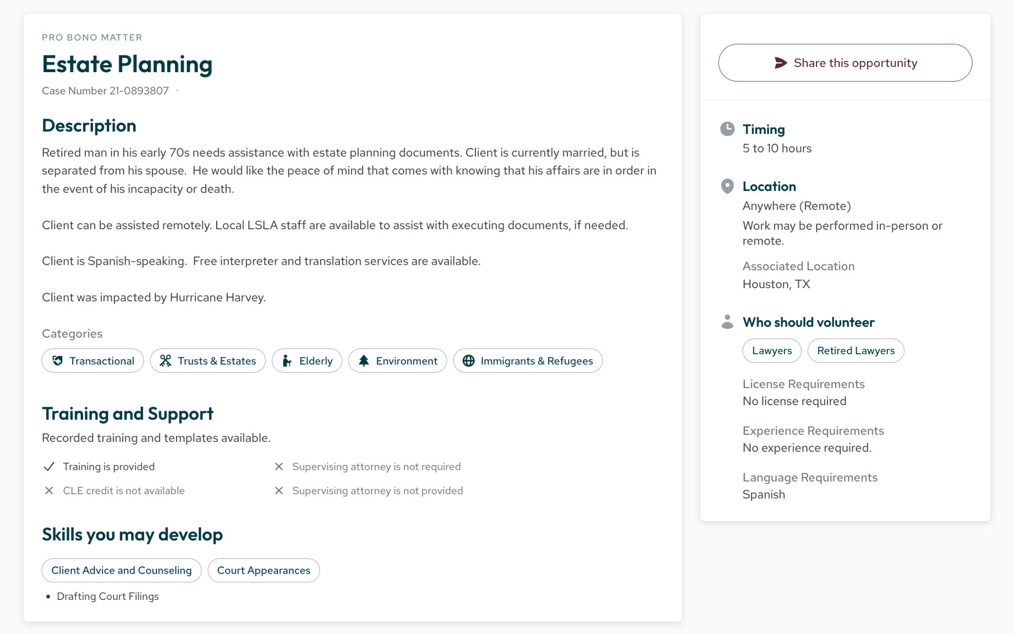
Lone Star Legal Aid: 2023 Postings on Texas Portal

Slide 9
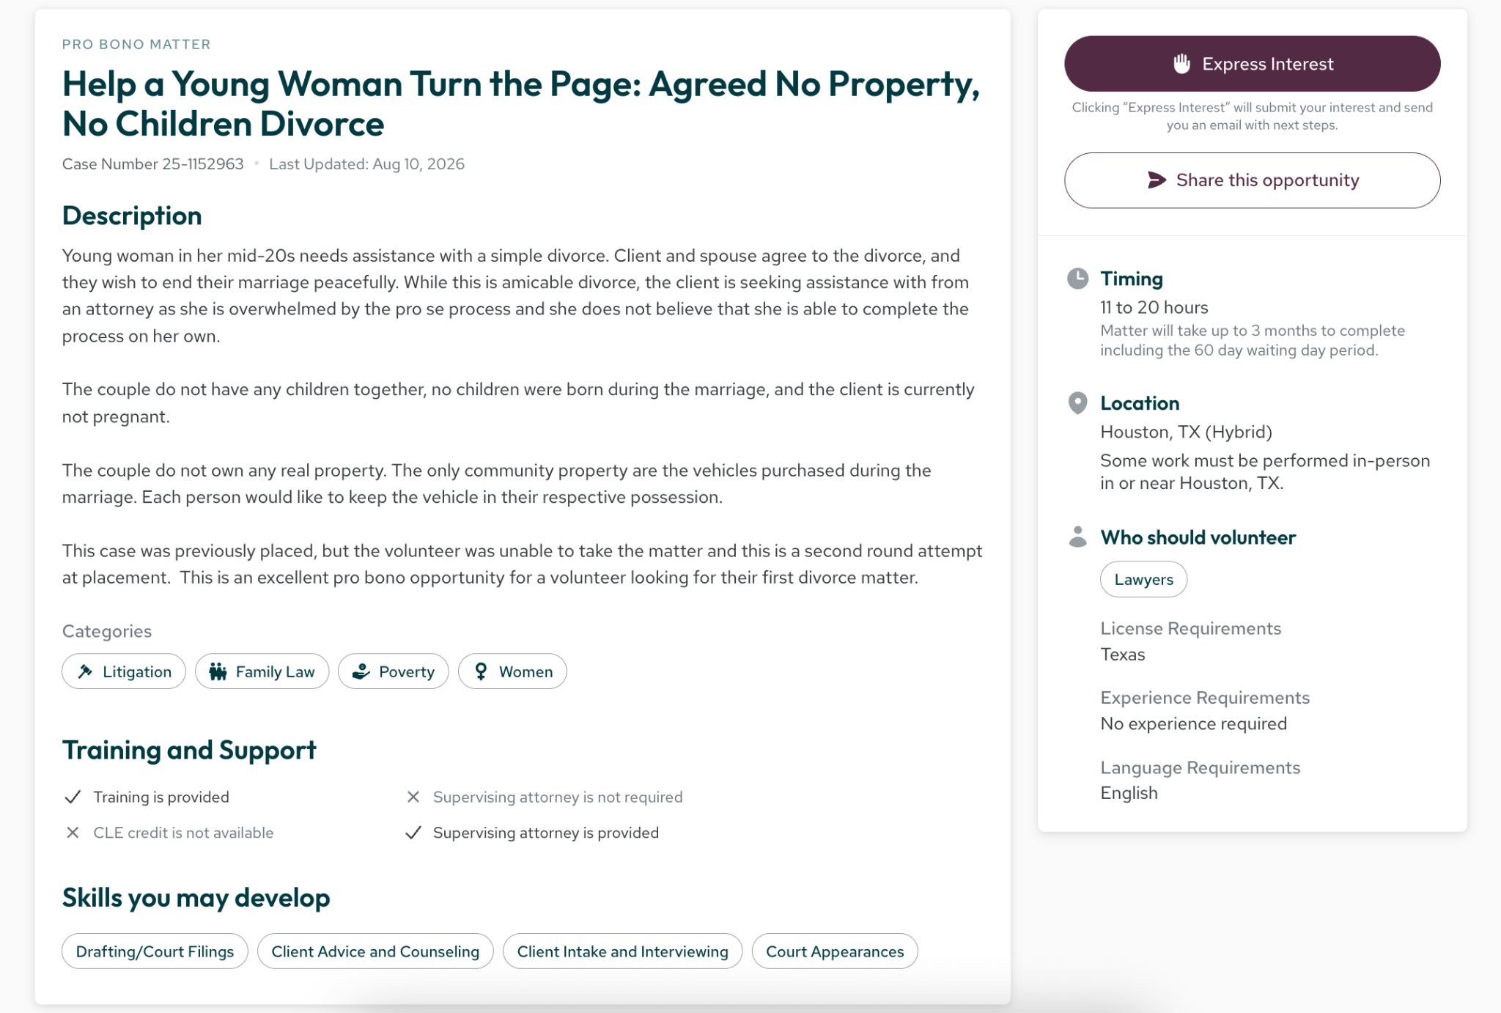
The Power of A/B Testing to Instill Confidence

Slide 10
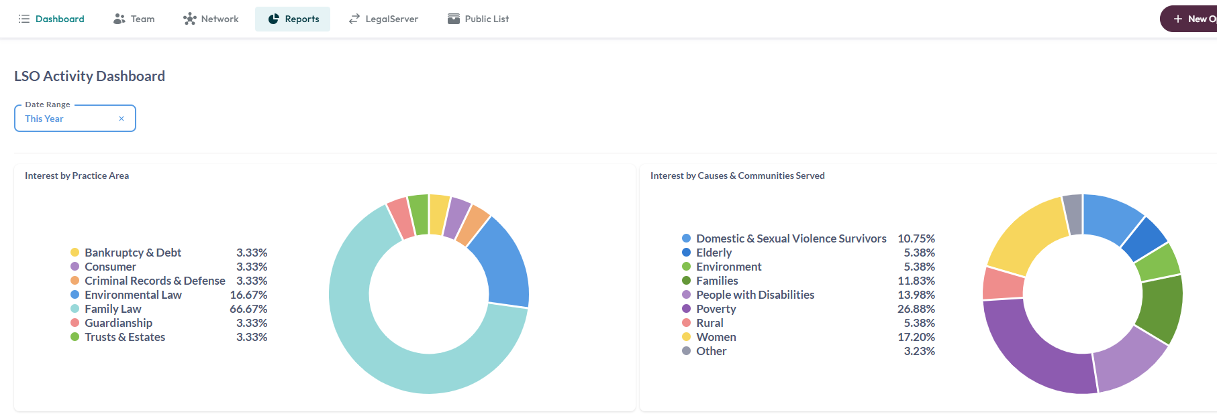
Data-Informed Engagement

Slide 11
Virtual clinics + ABA Free Legal Answers (e.g.)
Digital pro bono does not always stop at recruitment.
Virtual clinics
ABA Free Legal Answers (e.g.)
Staff presence
Meaningful service
Live help
Supportive structure
Peer connection
Connection to mission
Clear escalation paths
Online delivery
If the service is digital, where does the relationship happen?

Slide 12
Connection does not have to mean in-person
Connection has to be intentional
Personal welcome
Strong communication
Virtual office hours
Live support during a clinic
Training and mentorship
Recognition + outcomes
Inviting them back

Slide 13
After the Yes: Good Digital Stewardship
A volunteer says yes through a portal. Then what?
1
2
3
Acknowledge quickly
Set realistic expectations
Make help easy to find
Acknowledge within 48 hours. Confirm interest, next steps, timing, and a point of contact.
Clarify timing, responsibilities, support, and boundaries.
Make it clear who to contact when questions or changes arise.
A good experience is one where volunteers know what to expect.

Slide 14
Choose your high-touch moments
Different digital pro bono models require different relationship strategies.
Which three moments would you prioritize for human connection?
A
Before a volunteer takes the opportunity
B
Immediately after they take it
C
Before client contact
D
During the representation
E
When the matter closes
F
When asking them to volunteer again
5–7 minute table discussion

Slide 15
What will you change?
Make one commitment you can take back to your organization.
Where is one digital interaction that could be better?
Where is one human interaction you could intentionally add?
OR
Design the experience so technology gives us more capacity to connect, not less.

Slide 16
Thank You!
Questions, Thoughts, Concerns?
Jessie G. Campbell
Directing Attorney – Pro Bono / Private Attorney Involvement
Lone Star Legal Aid
jcampbell@lonestarlegal.org
Danielle Gobbo
Senior Manager of Community Growth
Paladin
danielle@joinpaladin.com

