Slide 1
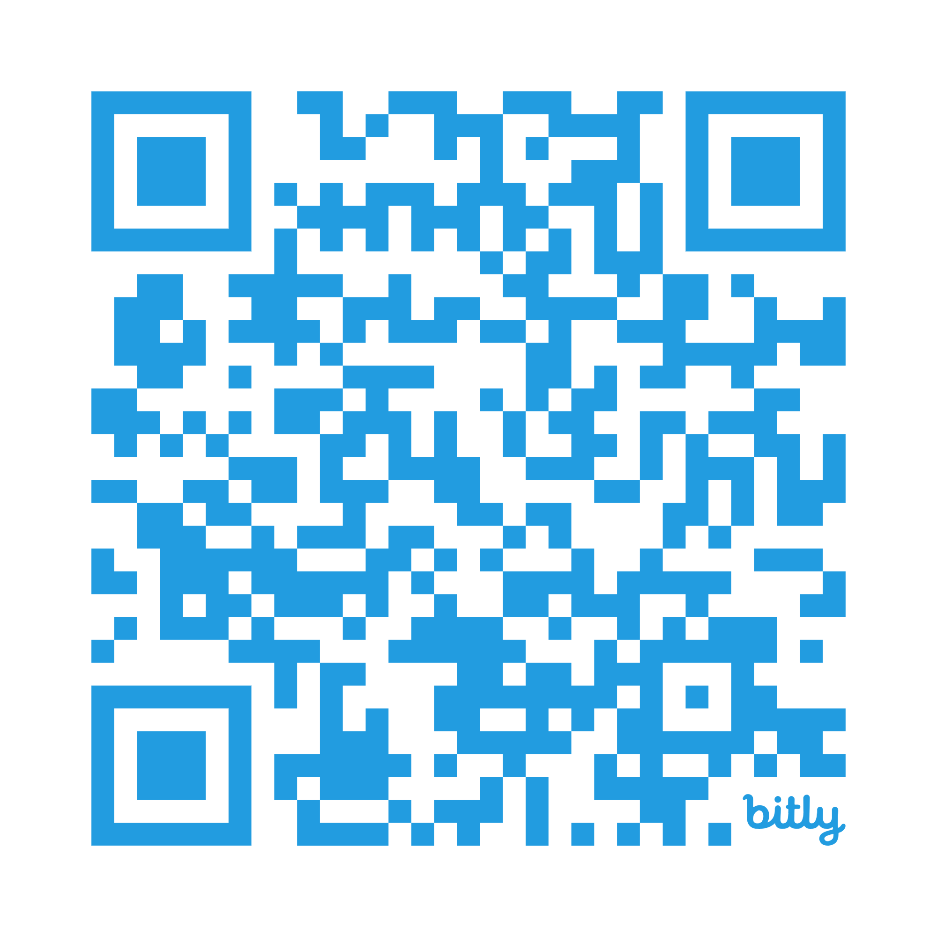
Hey AI,
Help Me Write
Better Test Questions!
https://bit.ly/Renew26AIWrite
DO NOW: Take this quiz to assess your assessment skills!

Slide 2

https://bit.ly/Renew26AIWrite
Notes:
After intro, survey by raised hands, what you teach
elementary?
Middle?
High?
Specials?
Other support?
Administrators?

Slide 3
Today’s Objectives
Do Now: Quiz Questions
Using AI
Quick quiz of typical test questions
Review and Discuss
How can I save time by using AI to write better test & quiz questions?
Accuracy in Assessment
Writing Effective Questions
What are the characteristics of a valid & reliable assessments?
Leveraging AI to write high quality…
Selected response questions
Constructed response questions
Performance assessments
https://bit.ly/Renew26AIWrite
Notes:
We all know why we assess... to guide instruction, diagnose gaps, and evaluate learning . The real challenge is doing this well without it taking all our time. Today is about using AI to make this process more efficient and more effective.
If our assessment design is flawed, AI can't fix it. It will just give us bad questions, faster...aka “Garbage in, garbage out”. We must start with a quality design

Slide 4
Using AI to write tests is easy…
BUT...that doesn’t mean that the assessment is statistically
valid
reliable
unbiased
Nor does it mean the questions are
of high quality
aligned with curriculum targets/standards
measuring student learning
https://bit.ly/Renew26AIWrite

Slide 5
Incomplete Sentence
The grammatical giveaway
https://bit.ly/Renew26AIWrite
The “Red Planet”
Venus
Mars
Jupiter
Saturn
Photosynthesis is an example of an:
Plant
Autotrophic biological process
Solar panel
Organism

Slide 6
The Silly Distractors
https://bit.ly/Renew26AIWrite
What is the primary function of mitochondria in the cell?
Energy production
Protein synthesis
Time travel
Cell phone

Slide 7
The “All/None of the Above” logic
Which of the following are properties of liquid water?
It freezes at 0 degrees Celsius.
It expands when frozen.
It has a pH of 7.
All of the above.
Which of the following are prime numbers?
1
4
8
None of the above.

Slide 8
The double negative
The “long novel” correct answer
Which of the following is NOT a non-renewable
energy source?
Solar
Coal
Oil
Natural gas
Which of the following is a fruit?
Carrot
Potato
Lettuce
A juicy, red tomato.

Slide 9
The “long-winded” stem
There are 10 preservice teachers in the Department of Education who recently registered for the college-sponsored weight-loss program. At the beginning of the program each weighed, and 10 had a mean weight of 139.4 pounds. Suppose there were 3 men in this group and that their mean weight was 180 pounds. What was the mean weight of the other preservice teachers at the beginning of the program?
115 pounds
122 pounds
140 pounds
159.7 pounds

Slide 10

LET’S TRY IT!
Let’s give it a try before we dig in deep.
Open your preferred generative AI tool.
Instruct the LLM to create a short 5-10 question quiz.
Review the results and compare to the most common pitfalls we identified.
Rate the results for rigor (1-5) and quality (1-5)
Notes:
Summary of process they just performed!

Slide 11
Assessment Accuracy
-How can we write valid, reliable test questions?
-How can AI help?

Slide 12
Accurate Measurement
“An effective classroom assessment
collects accurate information about student learning,
then uses the provided insights to facilitate learning–and foster students’ hopes.”
~Dimich
Notes:
Read quote
Grading is not the purpose of assessment. Grades can be a useful way to target students for assistance, and of course grades are important for communicating to students, parents, and others (ex: college admissions offices)
but the real power of assessment is facilitating learning–”sitting beside” students.
And to do this well, we as teachers need accurate information from our assessments.

Slide 13
Writing Highly Accurate Test Questions
Only evaluate …
  the material taught to students
  important learning objectives
Have enough items to demonstrate consistency (more = better!)
Include multiple types of questions, each appropriate for the task
Use language familiar to students
  eliminate arcane language, and bold critical words
Include clear directions for each task
Share scoring criteria and rubrics with students during testing
Notes:
So how do we ensure we’re writing and administering accurate assessments–tests, quizzes, and other measures that yield both reliable and valid data?
There is no one way–it’s a complex process (psychometricians are usually PhD’s!) Consistent results across repeated tests No assessment is 100% reliable–
there are always variables! But using these principles can help increase accuracy.
Reliability:
As we all know, writing accurate assessments is not enough.
We must administer them to students in away that ensures validity and reliability.
Provide ample time for completion (guidelines)
Create a supportive and comfortable environment
Ensure clear instructions and scoring guides
More tips here

Slide 14
Ensuring Equity
BIAS DESTROYS ASSESSMENT VALIDITY!
Discover your own potential biases
Ask colleagues or AI to review test items for bias
- sample reviewing worksheet
Teach students test-taking strategies
Gather student feedback on your assessments
- post-test questions
Notes:
AI “flags” questions for
your review.
Use this process whenever you design your assessments to ensure they are
Fair
Valid
Inclusive
Include guidelines to check for bias in your Notebook LM or upload with your prompt
Step 1: Upload your
assessment document
into AI
Step 2: Prompt AI to evaluate
your assessment
for bias

Slide 15
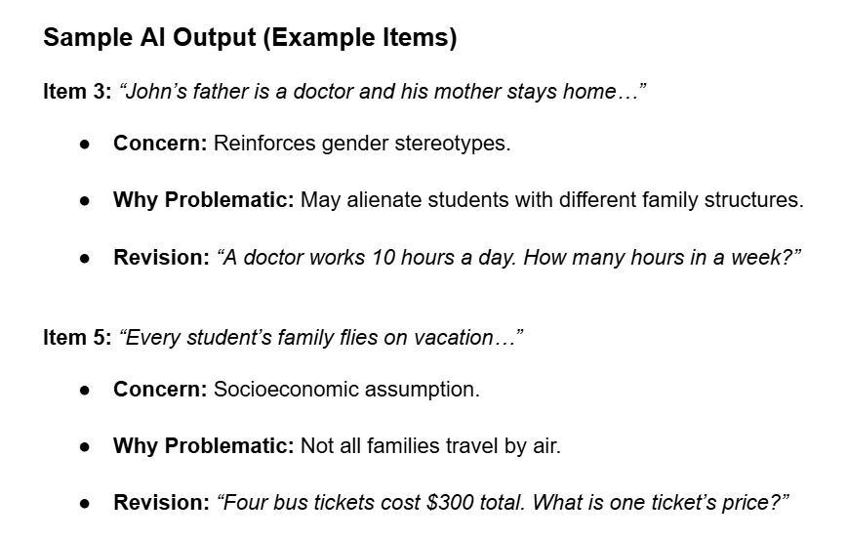
Use AI as a “bias review partner”
✔ AI acts as an extra reviewer using a bias worksheet
✔ Teachers get specific feedback and revisions, not just flags
✔ Helps ensure tests measure the intended standard, not cultural familiarity or background.
Handout w/ prompt & examples
Notes:
Other common types of selected response questions

Slide 16

Use AI as a bias “review partner”
Example Prompt:
I am uploading a classroom assessment. Review each test item for potential bias using the following criteria:
Does the item contain language that is uncommon, regional, or may have different meanings across cultural/gender groups?
Does it portray anyone in a stereotypical or demeaning way?
Does it include religious references that are not directly tied to the learning standards?
Does it assume all students share the same socioeconomic or family background?
Does it reference cultural knowledge unique to one group that is not part of the content standards?
Does it measure group membership or cultural familiarity more than the actual learning objective?
Could it create barriers preventing any group of students from showing their knowledge and skills?
Does it include emotionally charged or offensive language or symbolism?
For each flagged issue, please:
Identify the test item and explain which bias concern it triggers.
Explain why it could be problematic for fairness or validity.
Suggest a revision that removes the bias while still assessing the intended content.
Summarize overall: Was bias present? What specific steps would improve fairness?
Present the output as a clear bias review report, organized item-by-item, followed by an overall summary
Notes:
Other common types of selected response questions

Slide 17
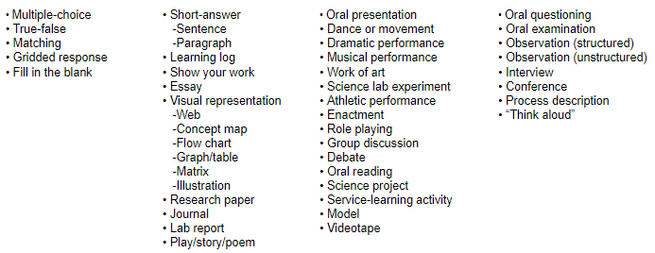
Types of Assessment Questions
Selected Response
Constructed Response
Performance Tasks
Observations/Conversation
Notes:
The first main type of assessment questions–also the most common.
We’ll focus on these a bit more than any others, as they are so popular (and useful!)

Slide 18

OK, I’m ready!
How can I
use AI to write
high quality,
reliable,
and valid
test questions?
Notes:
Yes, AI can make quizzes and tests, but how “good” are they?
Most likely they will be, at minimum, functional if used “as is”
If a teacher edits it (as they always should), using their expertise in the content and knowledge of their classroom and students, they can even be very good.

Slide 19
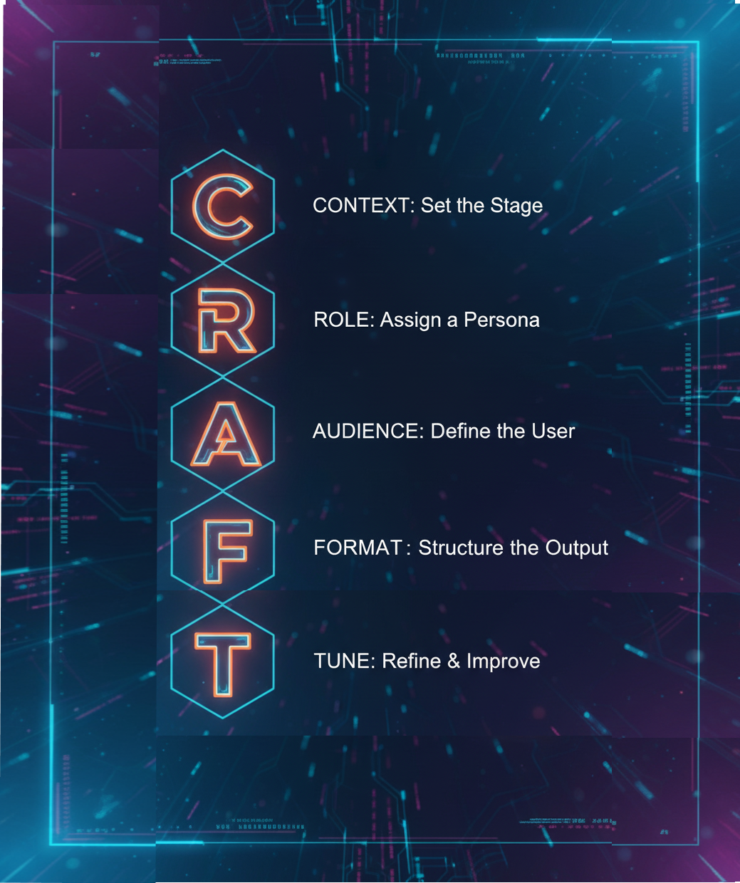
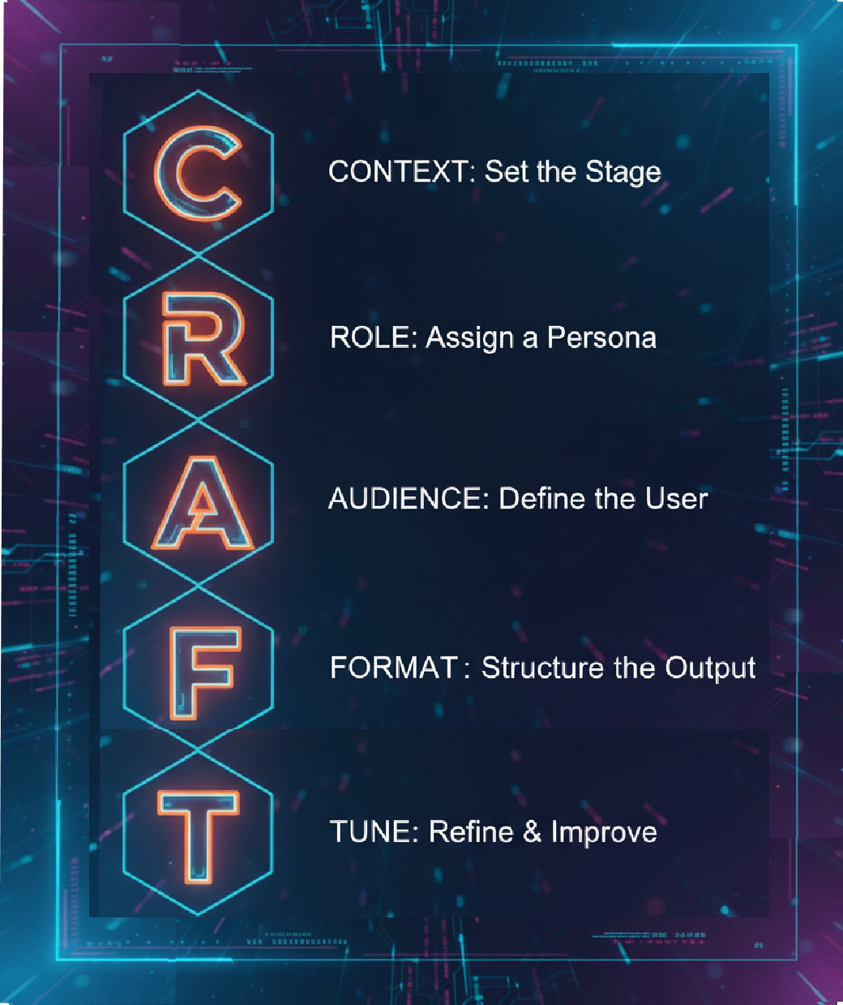
Prompt the AI!
CRAFT your prompts
Think of using AI as a cyclical process, not a one-time command.
The CRAFT method guides you from your initial idea to a polished, classroom-ready assessment.

Slide 20
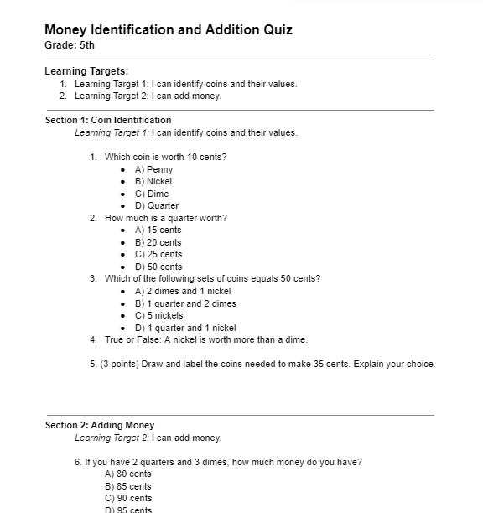
“Feed” the AI!
The More You Give, the Better You Get:
Upload a test blueprint
Upload standards and learning targets
Upload Bloom’s Taxonomy or Depth of
Knowledge Levels
Upload lecture notes, handouts, slides,
textbook chapters, etc.
Upload a test format or template
Sample AI co-created test

Slide 21
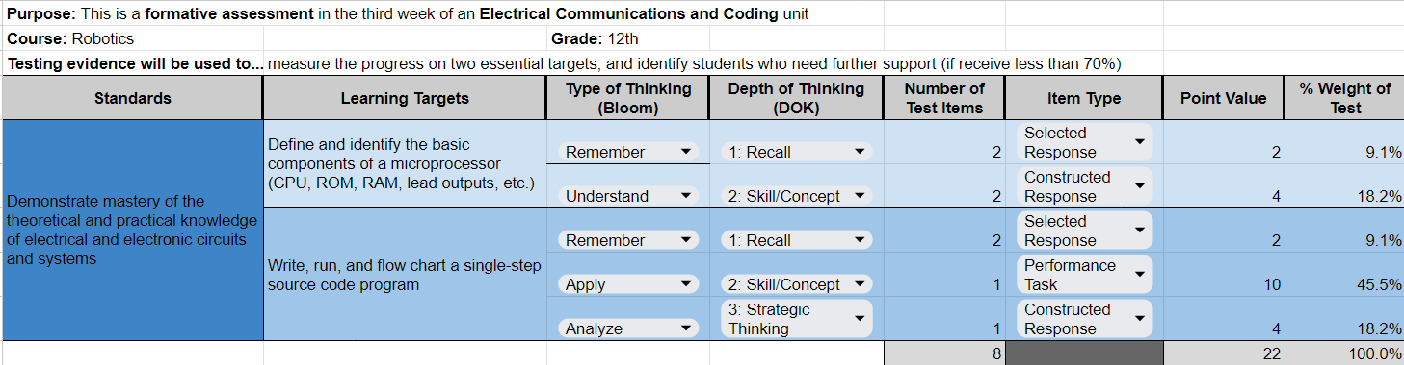
“Blueprint” Your Assessments
Identify exactly what you’re assessing
(ie, learning targets)
Choose an appropriate assessment method, matching the rigor to the target
“Blueprint” your assessment before instruction–
both summative and formative
Blueprint Template

Slide 22






App Smash!
COMBINE AI Platforms
Utilize your resources and save even more time:
  Notebook LM
  Google Drive
  Gemini GEMs
    EduGems!

Slide 23
App Smashing Assessment/Question Writing
Collect & organize resources for high quality assessment writing:
  Google Drive
  Device desktop folder
  Notebook LM, etc.
Pro Tip: Use the same process for your assessment content resources!

Slide 24
How to App Smash Question Writing
2. Attach the Notebook (or files) to your prompt in your preferred AI tool
3. Prompt the AI to write your question(s), include as many
details as possible:
      upload/attach the resources
      provide an example
      include details of
        Question style
        Number of questions
        Standard
        Rigor
        Topic

Slide 25
How to App Smash Assessment Writing
4. Revise and Fine Tune check the results for accuracy and quality
  Bias check
  Grade level readability score
5. Create alternate versions
Questions for re-takes/make-up tests
Accommodated Questions
  SPED
  EL students
Pro Tip: attach list of accommodations to tailor the
assessment questions to your students!

Slide 26
LET’S TRY IT!
CRAFT and App Smash
Prompt:
Context: Generate a set of high quality assessment questions about [standard]
Role: Act as an expert [Subject Area/Topic] assessment strategist and designer.
Audience: The students are [Grade Level] who have just learned about [Topics].
Format: Using the concepts extracted from the attached source material
[Paste/Attach pdfs or NotebookLM], write four [DOK Level 2] multiple-choice questions aligned to [Standard] that meet [Bloom’s “Understanding” Level of Thinking]. For each question, provide four answer options where each distractor represents a specific common misconception.
Tune: (Ask it to refine one or more questions.) Make question 1 a DOK level [1]” or “Rewrite the quiz to focus more on [topic]. Or “Revise [certain phrase/wording to match a grade level readability score of [8.6]”
Notes:
Summary of process they just performed!
Here is my very rudimentary AI revision of our original quiz.

Slide 27
NEXT LEVEL!
COMBINE with a GEM!
SAVE your prompt and resources in a custom Gem:
  Gemini GEMs
    EduGems!

Slide 28
LET’S TRY IT!
CRAFT and App Smash
Prompt:
Context: Generate a set of high quality assessment questions about [DCI, SEP, CCC] according to the [attached assessment blueprint]. The focus of these questions will be [the section in rows 7-9].
Role: Act as an expert [Subject Area/Topic] assessment strategist and designer.
Audience: The students are [Grade Level] who have just learned about [Topics].
Format: Using the concepts extracted from the attached source material [Paste/Attach pdfs or NotebookLM], create [3 multiple-choice questions with plausible distractors that target common misconceptions, 2 fill in the blank, and 1 short-answer question with a 3-point scoring rubric]. Provide a detailed answer key. Format the output with an Answer Key and a 'Distractor Analysis Table' detailing what each wrong answer indicates about students’ understanding.
Tune: Refine the three multiple choice questions so that they match Bloom’s [Remember] Thinking Level and a [Level 1: recall] Depth of Knowledge level. Provide a rationale that explains why or how these questions match these rigor levels.
Notes:
Summary of process they just performed!

Slide 29
Writing Effective Questions:
Selected Response
Multiple choice, true-false, matching, fill-in-the-blank
Notes:
The first main type of assessment questions–also the most common.
We’ll focus on these a bit more than any others, as they are so popular (and useful!)

Slide 30

Selected-Response Questions
Benefits:
Quick to grade and easy to analyze.
Covers lots of content efficiently.
Assesses recall and some deeper understanding.
Reveals common misconceptions.
Provides objective, consistent scoring.
Familiar format for standardized tests.
Useful for quick formative checks.
Pitfalls:
Often test surface recall; harder to test complex reasoning
Encourages memorization over thinking.
Guessing can distort results.
Wording may unintentionally bias results.
Overuse limits critical thinking.
Strong distractors take time to write.

Slide 31
Increasing Cognitive Level
Selected-response questions can assess
higher-level learning by…
Present a text, asking questions based on its meaning, theme,
word choice, grammar, etc.
Use data, graphs, or visuals for analysis
Require explanation / justification of choices
Use “choose the best answer” questions
See here for examples
Notes:
To increase the cognitive level of questions, consider these strategies:
Present a scenario and ask multiple questions about it. This could be a reading passage with questions about meaning, theme, etc.
Provide data, graphs, pictures, cartoons, maps, or diagrams and ask analysis or application questions. For example, you might present a historical political cartoon and ask questions about its meaning and context.
Lastly, consider requiring students to explain their choice. For instance, you might ask, "What evidence from the text supports your answer?" This pushes students to think more deeply about their selection.

Slide 32
Selected Response
Question Writing Advice
STEM (the question)
Keep stems short and clear
Ask a full question
State questions positively
(avoid “which of these is NOT…”)
**Detailed guidance with examples**
Notes:
How do we ensure we’re writing MC questions that do what they’re supposed to do…measure a student’s learning
Do NOT do this the way I used to do it (maybe you can relate?):
create a question, however it happens to come into your head
Make the write answer A,B, or D, because students always choose C when they don’t know
Think up a couple choices that kind of make sense
Add one ridiculous answer (like “Tik Tok”) to make kids laugh…
Realize later 2 answers would have worked, or the crafty kids figured it out due to a grammar glitch
Instead, keep a few basic “Rules” in mind…
[Read slide]
Note that these have been heavily researched and proven to help with accuracy. NOT saying they are “rules”, never to be broken…
You will see many standardized tests (SAT, ACT, M-STEP) break these, BUT they have entire teams of psychometricians who pilot, test, revise, etc. for accuracy–teachers don’t have that luxury!

Slide 33
Selected Response
Question Writing Advice
DISTRACTORS (answer choices)
Give 3-5 choices
Ensure only one correct answer
Include only plausible choices (no “gimmes”)
Keep each very short (even just 1 word)
Keep each choice consistent in style, length, & syntax
Limit “all/none of the above”
**Detailed guidance with examples**
Notes:
How do we ensure we’re writing MC questions that do what they’re supposed to do…measure a student’s learning
Do NOT do this the way I used to do it (maybe you can relate?):
create a question, however it happens to come into your head
Make the write answer A,B, or D, because students always choose C when they don’t know
Think up a couple choices that kind of make sense
Add one ridiculous answer (like “Tik Tok”) to make kids laugh…
Realize later 2 answers would have worked, or the crafty kids figured it out due to a grammar glitch
Instead, keep a few basic “Rules” in mind…
[Read slide]
Note that these have been heavily researched and proven to help with accuracy. NOT saying they are “rules”, never to be broken…
You will see many standardized tests (SAT, ACT, M-STEP) break these, BUT they have entire teams of psychometricians who pilot, test, revise, etc. for accuracy–teachers don’t have that luxury!

Slide 34
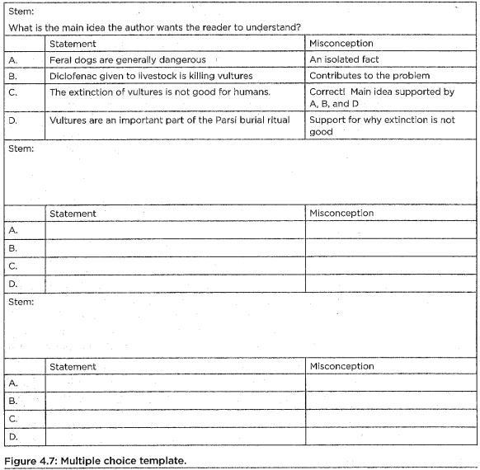
Planning Data-Rich
Multiple Choice Questions
Create a template to help write each multiple choice question so the results are more useful than just “right or wrong”
Include, for analysis:
Your students’ actual misconceptions as distractors
“Levels” of incorrect answers
Notes:
It may sound odd, but planning your MC questions can save you time and effort
AND allows your questions to actually yield more info than “who chose the right answer” vs. “who chose the wrong answer”
Imagine the power of looking at your test result and not only realizing what percentage of your student got the Qs correct–but how many still think that _________. Very useful!
You know your students and you know your content…what misconceptions do you normally get in class?
This all implies you will actually analyze and use the results–which is new for many of us (I used to Scantron only to see “most missed” Q’s…not finer details!)
FROM AI Discussion suggestions:
So far, we've talked about using AI to generate questions, create different versions of a test, and even develop reading passages. But now, we're going to move into one of the most powerful—and I think, professionally satisfying—uses for this technology: assessment analysis.
Think about the last test you wrote. You probably had a good gut feeling about which questions were easy and which were the real head-scratchers. You knew which ones were just simple recall and which ones required some serious critical thinking. But what if you could quantify that? What if you could get a detailed, consistent analysis of every single question to ensure your assessment is truly balanced and measuring what you intend it to measure?
That's where a leveling analysis comes in. We want to look at each question through a few different professional lenses. The big ones are Bloom's Taxonomy—are we asking students to Remember, Understand, Apply, Analyze, Evaluate, or Create?—and Webb's Depth of Knowledge (DOK), which helps us understand the cognitive complexity from simple recall (DOK 1) to extended strategic thinking (DOK 4).
Doing this for a 25-question test can be tedious. But with AI, we can do it in seconds. This helps us see if we've accidentally written a test that is 80% simple recall, or if we have a good distribution of cognitive demand.
So, I've developed a prompt that you can use to get this analysis for your own answer keys. This is designed to be a simple copy-and-paste tool. You’ll feed the AI your questions and answers, and it will give you back a structured, table-based analysis that you can use to refine your assessment.
Here is the prompt. I want you to copy this and save it in a document you can easily access—your new 'AI Prompt Library'."

Slide 35
True-False Question Writing
Ask at least 2-3 T-F about each learning objective
Include common misconceptions as the False options
Avoid “tricky” qualifying words (frequently, generally, usually, all…)
Avoid negative statements (“Michigan was not founded in 1837”)
Notes:
Other common types of selected response questions

Slide 36
Matching & Fill-in-the-Blank Question Writing
Matching
State directions clearly (especially if using choices more than once)
Keep the list of choices short and simple
Fill-in-the-Blank:
Omit only significant words
Avoid turning into “word puzzles”
  Do not omit too many words
Ensure only one correct response is possible
Notes:
Other common types of selected response questions

Slide 37

LET’S TRY IT!
Use the CRAFT method to create a short assessment
Prompt:
Context: I am creating a formative assessment on [DCI, SEP, CCC]
Role: Act as an expert [Subject/Topic] assessment designer.
Audience: The students are [Grade Level] who have just learned this concept.
Format: Create [5 multiple-choice questions with plausible distractors that target common misconceptions, 2 fill in the blank, and 1 short-answer question with a 3-point scoring rubric]. Also, provide a detailed answer key.
After AI gives you your results, it’s time to Tune: Ask it to refine
one or more questions. Example: “Make question 2 more
rigorous” or “Rewrite the quiz to focus more on [topic].”
PRO TIP: COPY AS MARKDOWN
PRO TIP: COPY AS MARKDOWN
Notes:
Summary of process they just performed!

Slide 38
Writing Effective Questions: Constructed Response
Short answer
Essay
Modeling
Drawing
Notes:
“constructed response” means: students “constructing” their responses.
Main types are short answer and essay questions, but could be anything students “construct” to answer a prompt (a graph, chart, drawing, showing work in math, maps, or other writing tasks)

Slide 39
Short Answer & Essay
Benefits:
Can assess complex skills
Demonstrate student knowledge in-depth (+no guessing)
Allows for partial credit
Reveal misconceptions & errors in thinking
Students tend to study for understanding
  When students know essays are on a test, they tend to memorize less and instead study more broad concepts/connections
Challenges:
Advantage for students with good writing / handwriting skills
Scoring is
  Time-consuming
  Potentially subjective
Statistical reliability may be compromised
  Fewer questions are asked, reducing reliability
Notes:
[Read slide]

Slide 40
Writing Short Answer
& Essay Questions
Match the task to the depth of knowledge assessed (chart here)
Provide up-front context, reference material, and clear instructions
Use specific verbs (e.g., compare, define, summarize…& avoid “discuss”)
Avoid opinion questions (unless assessing specific thinking/discernment)
Avoid giving options! Students answering different questions destroys validity
Help students prepare in advance for all essay tests (example)
Notes:
Match the task with the depth of knowledge being assessed. For example, "identify" asks students to recall knowledge, while "demonstrate" requires them to use knowledge.
Avoid opinion questions, instead, provide context by including background information relevant to setting up the question. This could be a text, quote, visual, or focus statement.
Give clear instructions and well-defined parameters - students should know exactly what to do and how to be successful. Clearly state the task and requirements, such as time frame, and required length, and "use complete sentences."

Slide 41
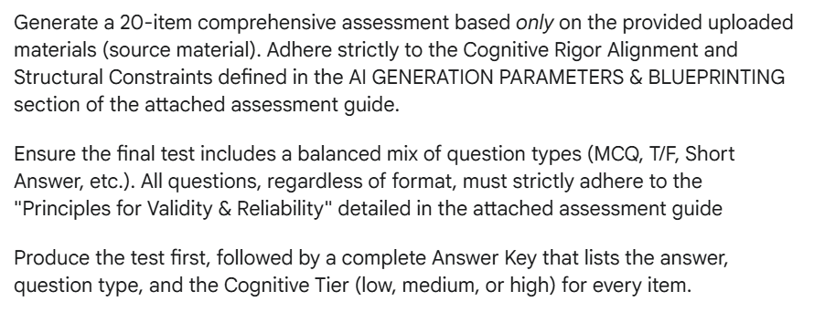
Teach AI to Write Valid & Reliable Questions of ALL Types
Upload “question parameters guide” into AI, which includes best practices for valid, reliable questions of all types. This ensures AI knows exactly what you expect, and that it follows best practices.
Then upload your testing materials (blueprint, notes, handouts, etc.)

Slide 42
LET’S TRY IT!
Use a guide to help AI write valid, reliable questions
Upload the question parameter guide into AI as an attachment
Upload your teaching material(s)
Paste the test-writing prompt into the AI, adjusting it to fit your needs
As a follow-up, ask it to rework as you see fit
Notes:
Summary of process they just performed!

Slide 43
Assessing in the age of AI: Performance Assessments
Performance
Observation
Notes:
We’re only briefly covering these–not because they are not important, but because they are not the “tests” that most teachers rely on. (Although maybe they should be in the age of AI?)

Slide 44
Performance Assessments
Definition: Assessment tasks requiring students to demonstrate learning/skills in authentic, “real world” contexts
  Projects, presentations, problem-solving tasks (sample)
Benefits:
Active student engagement and increased motivation
Assesses complex knowledge/skills application
Measures beyond traditional tests
Integrates well with other assessment types
Difficult to plagiarize / cheat
Notes:
Make a point to say this section is brief.
Performance assessments offer several benefits. They require active engagement from students and are often compelling, increasing motivation. They can assess the application and integration of complex knowledge or skills, going beyond what traditional tests can measure. Performance assessments also blend well with other assessment tasks. For example, you might include short multiple-choice questions at checkpoints in the process of a larger performance task.

Slide 45
Performance Assessments
Challenges:
Time-consuming to create, administer, and score
Potential for low reliability and scoring subjectivity & inconsistency
May disadvantage certain students if not carefully designed
Best practices:
Find a "big idea" from the standards, then craft task (sample process)
Provide clear expectations and scoring rubrics
Include revision and self-assessment components
Grade group work or affective skills separate from academic (example)
Notes:
[READ SLIDE]

Slide 46
Observational Assessments
Examples: Anecdotal records, checklists, student interview, rating scales
Definition: Systematic, intentional observation of student skills
Benefits: Captures real-time performance, suits young learners
Challenges: Potential observer bias; can be time-intensive
Best practices: Focus on learning target(s), use structured formats, use multiple observations
Notes:
Other aspects of reporting: behaviors, study skills, ability to work with others
Specials enrichment classes
Still need to share expectations and the evaluation process
Focus on collecting data over time and having multiple data points

Slide 47
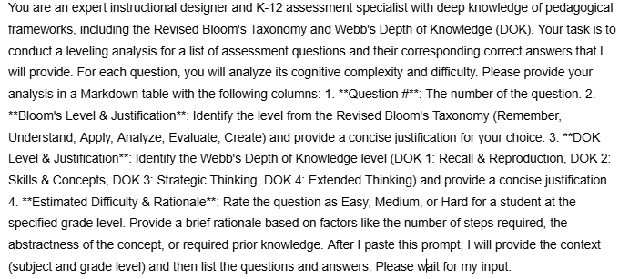
AI can help you “level” your questions to ensure rigor & to help analyze results!
Upload your desired levels into AI (Bloom’s Taxonomy or DOK levels)
Upload your assessment questions and answer key.
Tailor the Prompt to analyze your questions as desired.
Notes:
Explain: "Most first-draft AI questions are DOK 1/Remember. Your 20% expert job is to push the rigor. AI can help you do that."

Slide 48
AI: Your Feedback & Grading Partner
Example: Summarize and Analyze Your Observation Notes
Goal: Make sense of observation notes taken during group work or a class debate.
How: Paste your raw, messy notes into AI ("Group B: off-task for 5 min; Ellie only spoke once; Mike dominated; Jamal off topic"). Ask AI to expand your notes and compare to your rubric
The Result:
AI organizes and analyzes your raw data, clearly identifying trends in participation, off-task behavior, or areas for intervention
AI helps write personalized paragraphs of feedback for each student (or group)

Slide 49
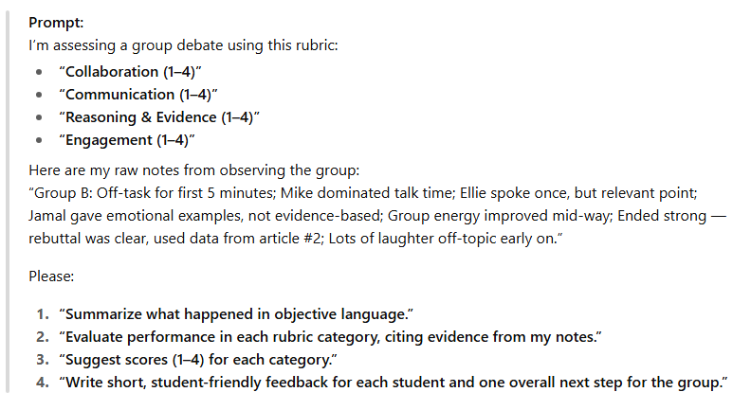
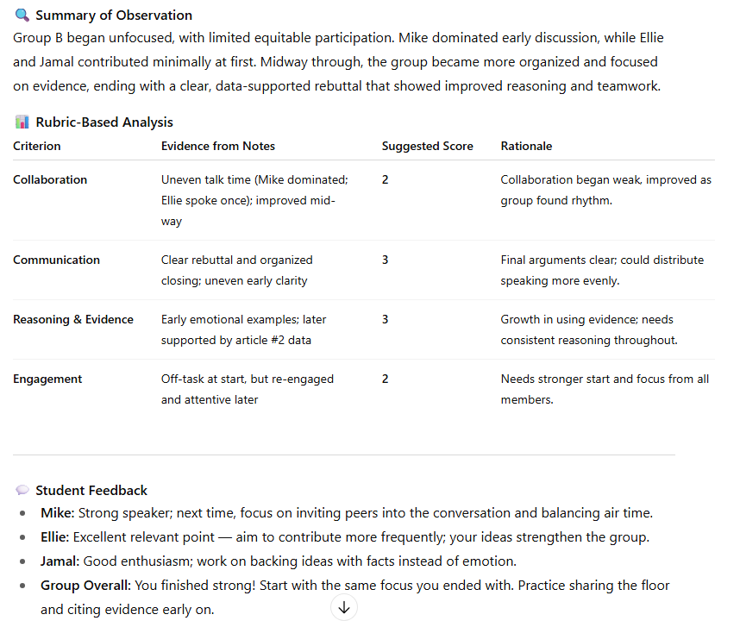
AI: Your Feedback & Grading Partner

Slide 50
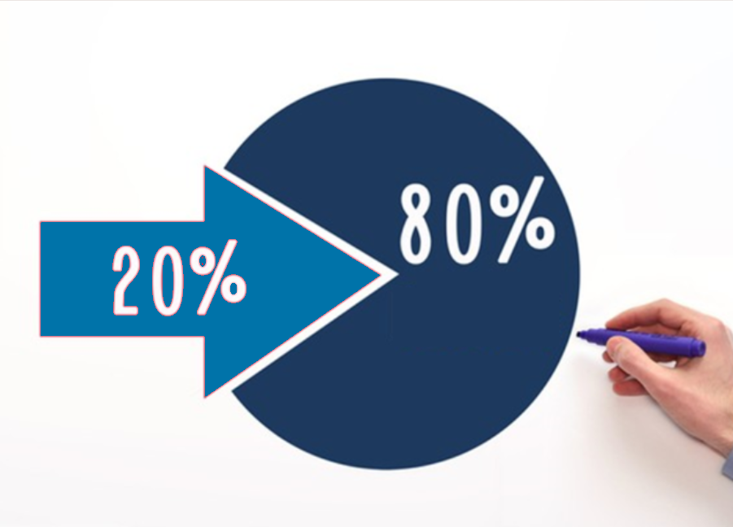
Remember the “80-20 Rule”
AI does 80% of the heavy lifting—it drafts questions, aligns them, created an answer key, and generates a rubric.
But YOU are the expert!
Your job is that final 20%—reviewing every question for your context, checking vocabulary, ensuring the questions truly match your instruction, and refining the rubric.
“The AI drafts; the teacher edits and owns.”

Slide 51
Thank you!
Kim Nichols
Student Services Consultant
Calhoun ISD
nicholsk@calhounisd.org
269-789-2449 (office)

