Slide 1
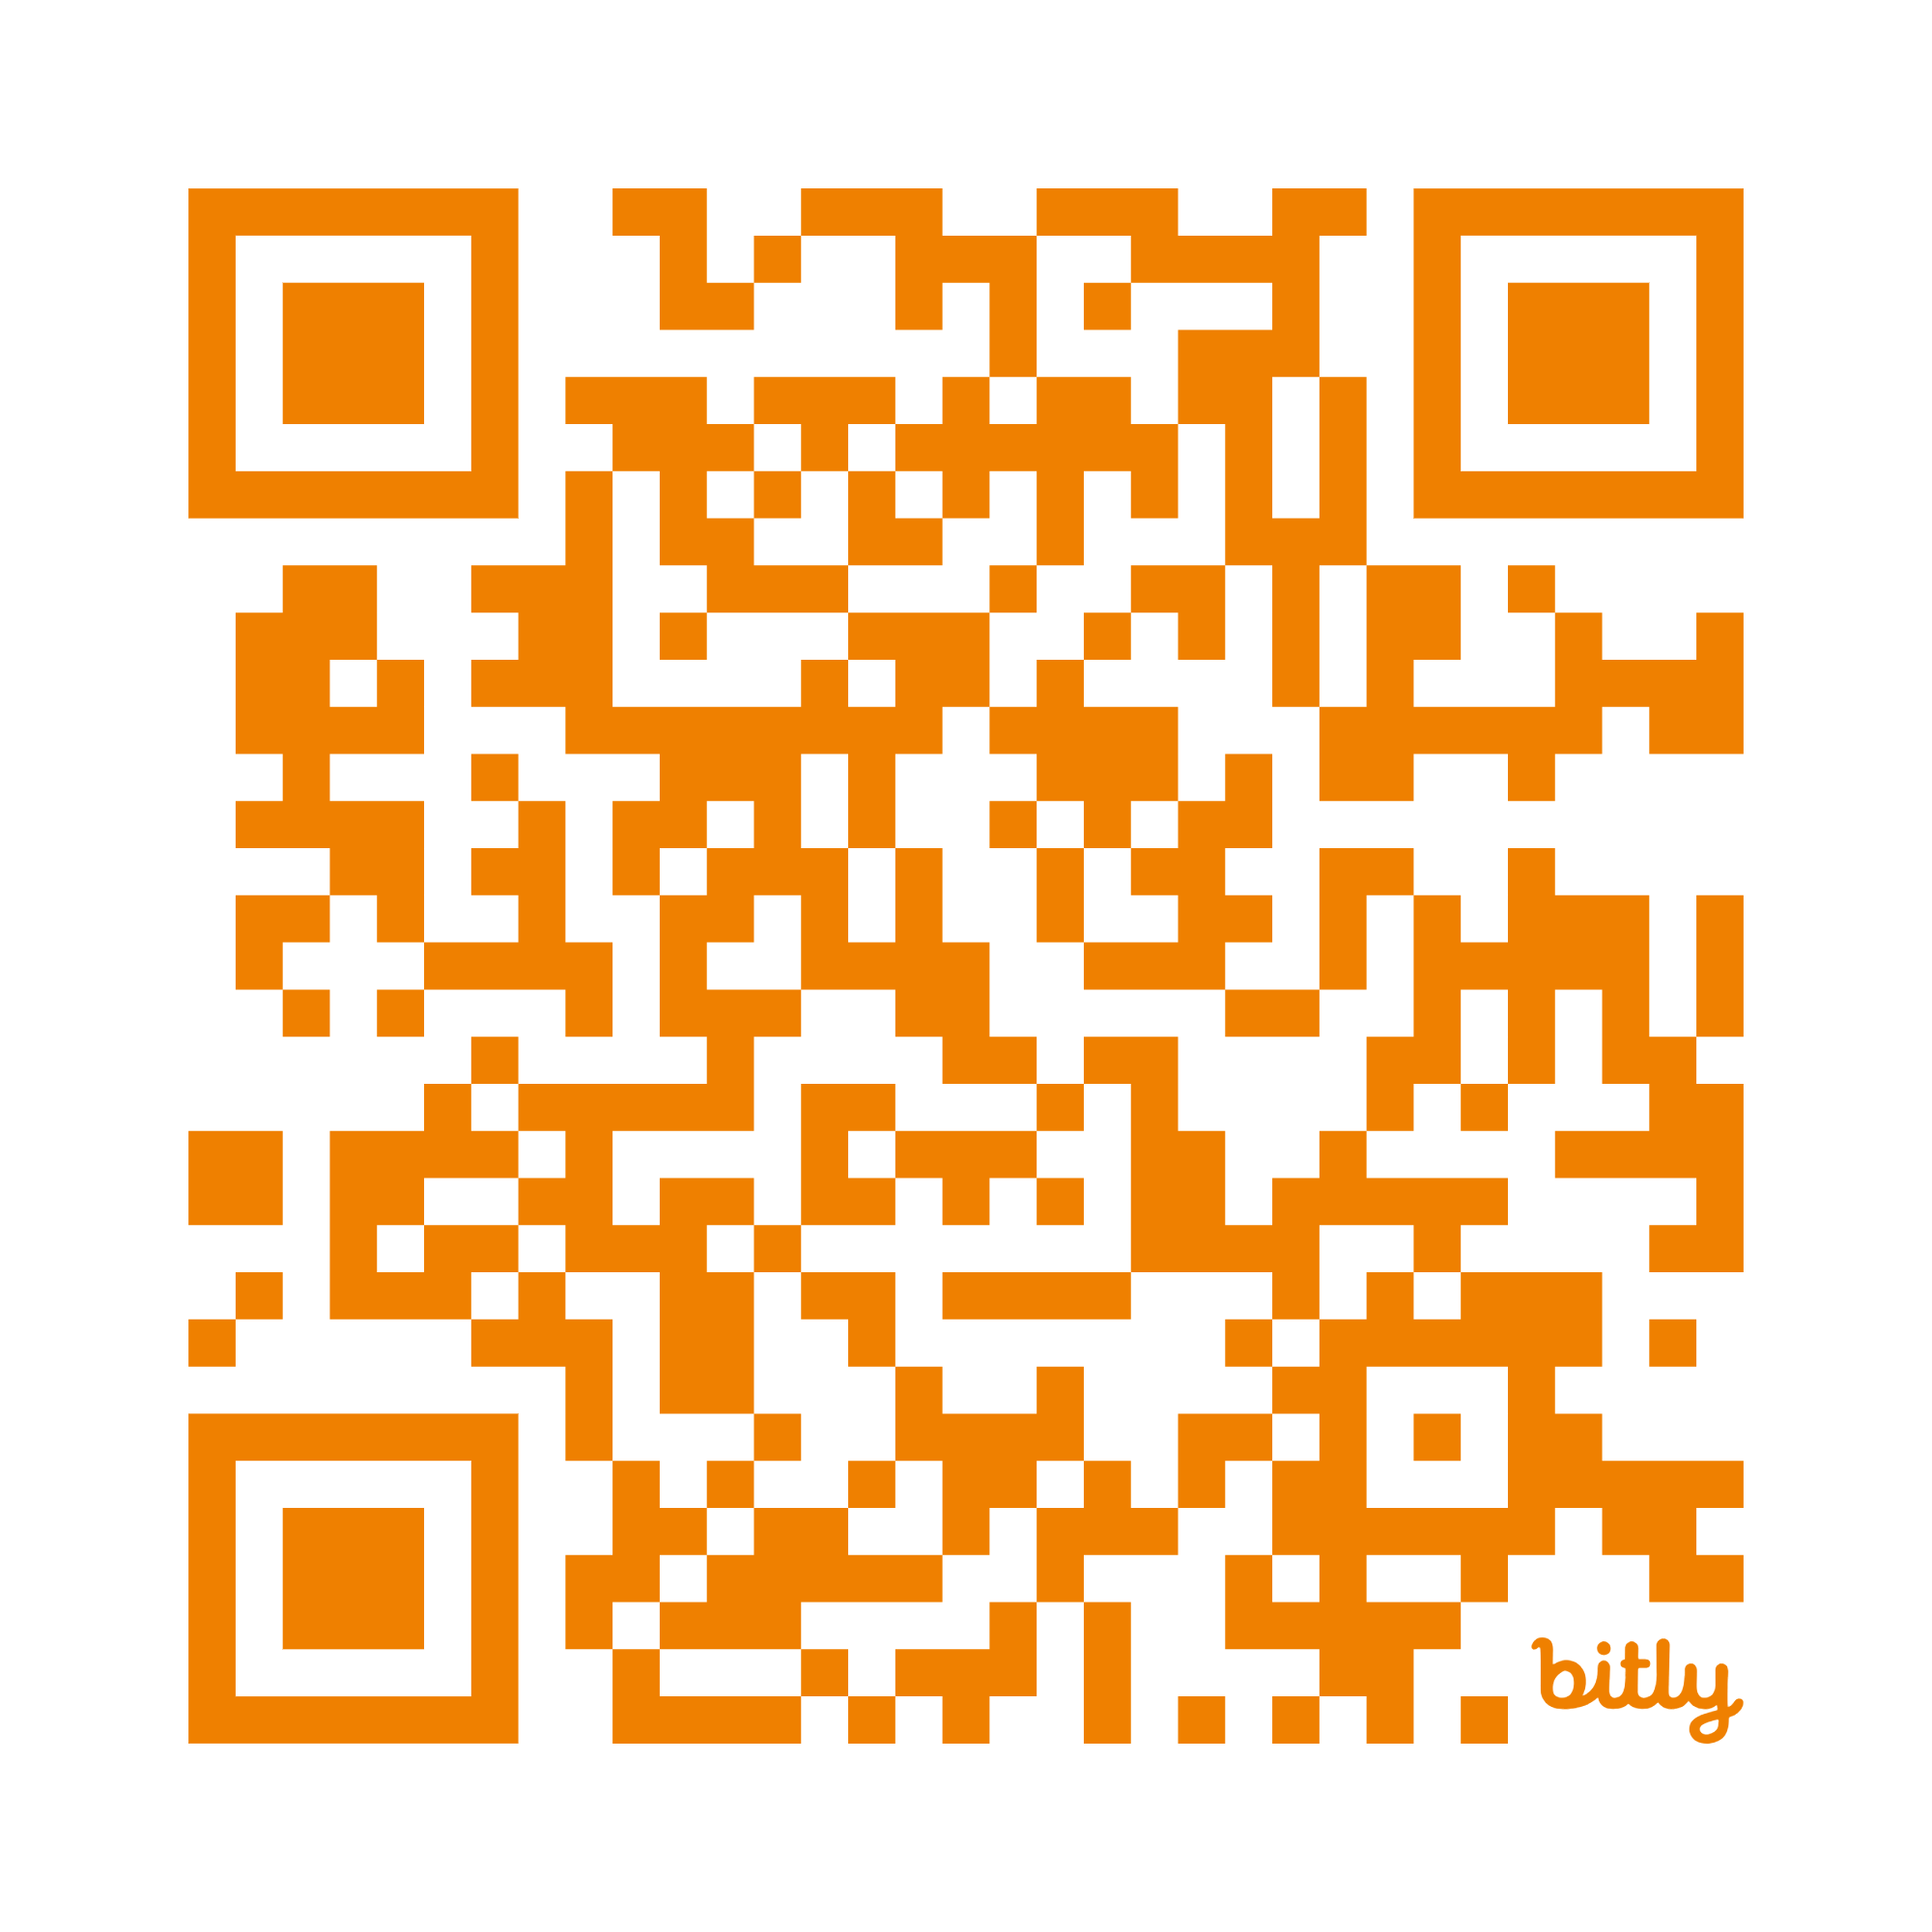
Hey AI,
Help Me Write DIGITAL
Test Questions!
https://bit.ly/Renew26Digital
DO NOW: Open this link & add your name to the list
(don’t write over anyone’s name)

Slide 2

https://bit.ly/Renew26Digital
Notes:
After intro, survey by raised hands, what you teach
elementary?
Middle?
High?
Specials?
Other support?
Administrators?

Slide 3
Today’s Objectives
Do Now: Flexible Quiz
Do Now: Item Bank Quiz
Quick quiz of typical paper/pencil test questions in DnA
Quiz 2.0: Take the digitally enhanced version in DnA
Reflection and Discussion
Review: Use AI to write Better Questions
Time to Practice
Leveraging AI to write high quality questions
THEN use AI to upscale into digitally interactive questions
Simple example for “upgrading” test questions using generative AI
https://bit.ly/Renew26Digital
Notes:
We all know why we assess... to guide instruction, diagnose gaps, and evaluate learning . The real challenge is doing this well without it taking all our time. Today is about using AI to make this process more efficient and more effective.
If our assessment design is flawed, AI can't fix it. It will just give us bad questions, faster...aka “Garbage in, garbage out”. We must start with a quality design

Slide 4
A tale of two assessments:
https://bit.ly/Renew26Digital
Paper/Pencil vs. Technology Enhanced Items (TEI)

Slide 5

https://bit.ly/Renew26Digital
Flex Assessment:
The standard bubble test
7 Question Quiz
Bubble test can be digital too!
START →

Slide 6
https://bit.ly/Renew26Digital
Use the CRAFT method and app smashing
Write BETTER Test Questions
Convert to TEI
Simple Prompt Created a higher quality assessment
Revised DEMO 7 Question Quiz

Slide 7
Item Bank Assessment: The Power of Technology-Enhanced Items
01
Same standards.
02
Same content.
03
Different experience.
Complete the interactive assessment.
START →

Slide 8

Turn & Talk
What Changed vs. What Stayed the Same?
Discuss with a partner:
What changed?
What stayed the same?
What are the benefits?
What are the challenges?
What questions do you have?
Notes:
Which assessment gave you more opportunities to demonstrate understanding?
Where did you notice increased rigor?

Slide 9
Analyzing What Changed
Paper/Pencil vs. Digitally Interactive/TEI
Traditional
• Select an answer
• Recall
• Recognition
• Passive
Tech-Enhanced
• Construct an answer
• Apply
• Decision Making
• Interactive
Same standards. Increased Rigor. Reliable. Valid.

Slide 10
Conversion Workflow in 4 Steps:
01
02
03
04
Step 1
Start with current questions.
Step 2
Leverage AI to write high quality questions:
Assess standards, improve rigor, increase validity, remove bias, etc.
Step 3
Convert upscaled questions into technology-enhanced items compatible with Renaissance DnA.
Step 4
Create questions in Renaissance DnA Item Bank for digital administration.

Slide 11
DnA Prompt Framework
Standard Alignment & Rigor Rules
Generate High Quality Questions via AI And App Smashing
slide deck
resource folder
Renaissance DnA
Types of Questions in DnA
Question Styles and Example Prompt
Compatible DnA Formats
Select from these interactive visual item types:
Drag and Drop
Multi Select
Matching
Sequencing
Hotspot
Fill in the Blank

Slide 12
Your Turn: Hands-On AI
MCQ to TEI Conversion Practice
Use AI to:
Step 01
Improve quality
Choose
5–10
Questions
Increase rigor
Convert to digital items
Ensure DnA compatibility

Slide 13
Success Criteria: Rigor, Alignment, & Tech Accessibility
Before publishing, ask yourself:
Does this still assess the standard?
Did rigor improve?
Does technology add value?
Could a student succeed without unnecessary technical barriers?
Is this item accessible?

Slide 14
Collaborative Activity
Share Your Work: Collaborative Prompt & Question Review
Share Your Work with a neighbor:
QUESTION
TECHNOLOGY
PROMPT
01
One question you improved
02
One technology-enhanced item you created
03
One prompt that worked well

Slide 15
Key Takeaways
Putting Teachers in the Design Driver's Seat
01
Quality questions first.
02
AI accelerates design.
03
Technology enhanced versions.
04
Input into Renaissance DnA.

Slide 16
Challenge
Implement One TEI Assessment
Over the Next Week...
Over the next week...
Step 1: Technology Integration
Convert one existing classroom assessment into a technology-enhanced assessment using AI.
Step 2: Reflective Loop
Start small. Reflect. Refine. Repeat.

Slide 17
Key Takeaways Leverage AI for high quality questions
Leverage AI for high quality test questions that …
  the material taught to students
  important learning objectives
  Have enough items to demonstrate consistency (more = better!)
  Use appropriate questions for the task
  Use familiar language…
Organize Resources in Google Drive or Notebook LM
Attach resources and use multiple generative AI tools (App Smash)
Upscale to TEI questions
Assess in Renaissance DnA
Notes:
Read quote
Grading is not the purpose of assessment. Grades can be a useful way to target students for assistance, and of course grades are important for communicating to students, parents, and others (ex: college admissions offices)
but the real power of assessment is facilitating learning–”sitting beside” students.
And to do this well, we as teachers need accurate information from our assessments.

Slide 18
Use Prompts to Write
Better Test Questions
Increase Rigor
Link Standards
Use a variety of question types
Share scoring criteria and rubrics with students during testing
Fine Tune, Check for Bias, Revise
Notes:
So how do we ensure we’re writing and administering accurate assessments–tests, quizzes, and other measures that yield both reliable and valid data?
There is no one way–it’s a complex process (psychometricians are usually PhD’s!) Consistent results across repeated tests No assessment is 100% reliable–
there are always variables! But using these principles can help increase accuracy.
Reliability:
As we all know, writing accurate assessments is not enough.
We must administer them to students in away that ensures validity and reliability.
Provide ample time for completion (guidelines)
Create a supportive and comfortable environment
Ensure clear instructions and scoring guides
More tips here

Slide 19
Round 2: Generate TEIs from the Results
Instruct the AI to upscale your questions further by converting them to digitally interactive questions
Provide details regarding the types of questions available in Renaissance DnA
Add the document to your organized resources
Create the questions in DnA’s Item Bank
Notes:
AI “flags” questions for
your review.
Use this process whenever you design your assessments to ensure they are
Fair
Valid
Inclusive
Include guidelines to check for bias in your Notebook LM or upload with your prompt
Step 1: Upload your
assessment document
into AI
Step 2: Prompt AI to evaluate
your assessment
for bias

Slide 20
Renaissance DnA Resources
Detailed Slide Deck for Creating Item Bank Questions
Video Tutorial Playlists
  Item Bank Basics
  Creating Questions
Help Guides: Creating Item Bank Tests

Slide 21
Thank you!
Kim Nichols
Student Services Consultant
Calhoun ISD
nicholsk@calhounisd.org
269-789-2449 (office)

