Slide 1





AI with Integrity:
Creating a Culture of Responsible Use

Slide 2



Scott Monroe
Cheif Information Officer
Jillian Pratt
Director of Digital Learning & Library Services

Slide 3


Did you know when you use AI, you are killing ALL of the polar bears?
-5th Grade Student, tasked
to use Adobe Express Image Generation

Slide 4
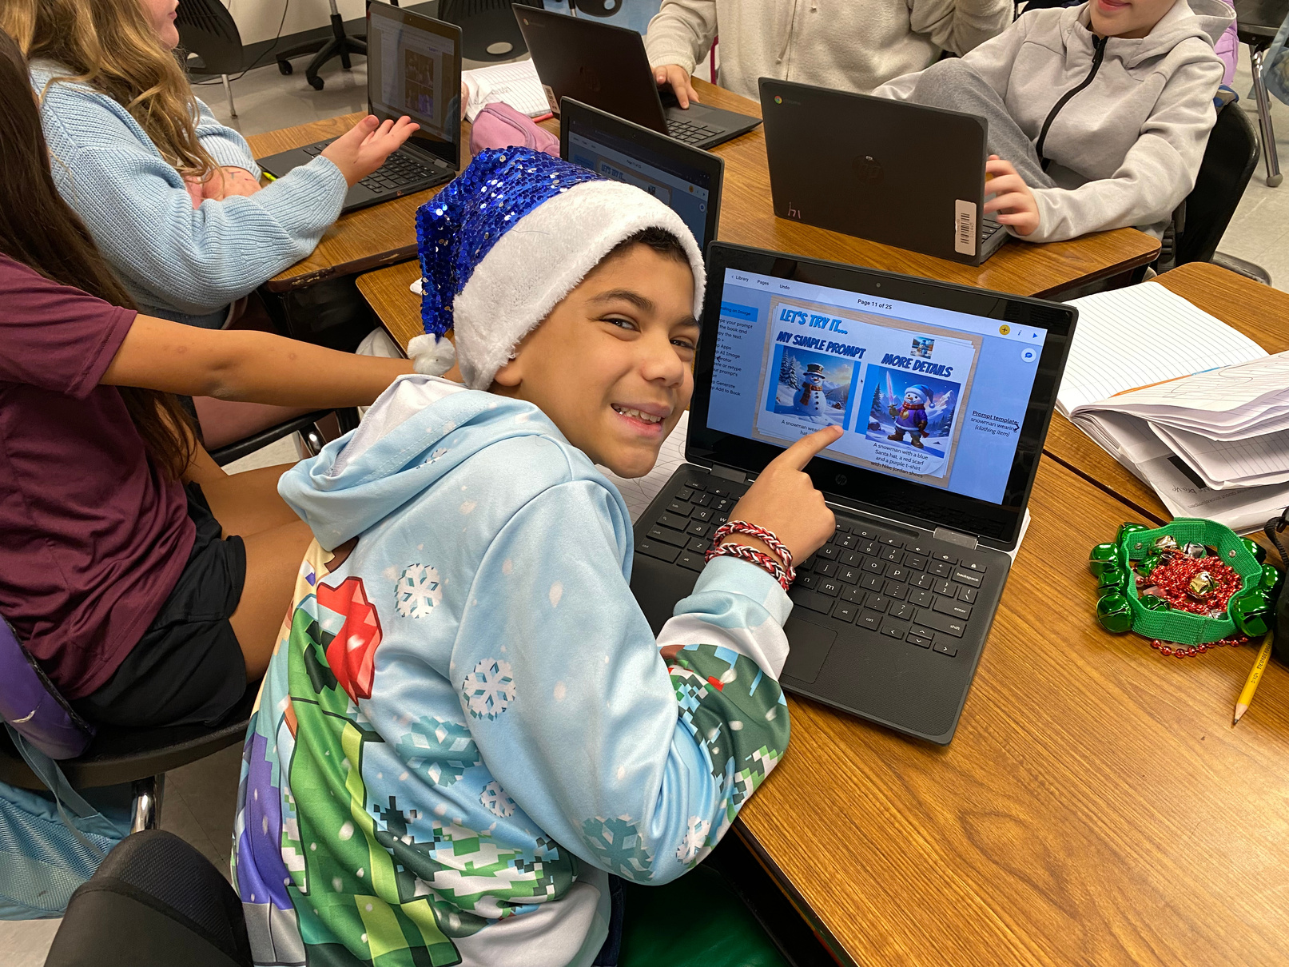


Student Perception
  2023
  2026
  curiousity
  caution

Slide 5
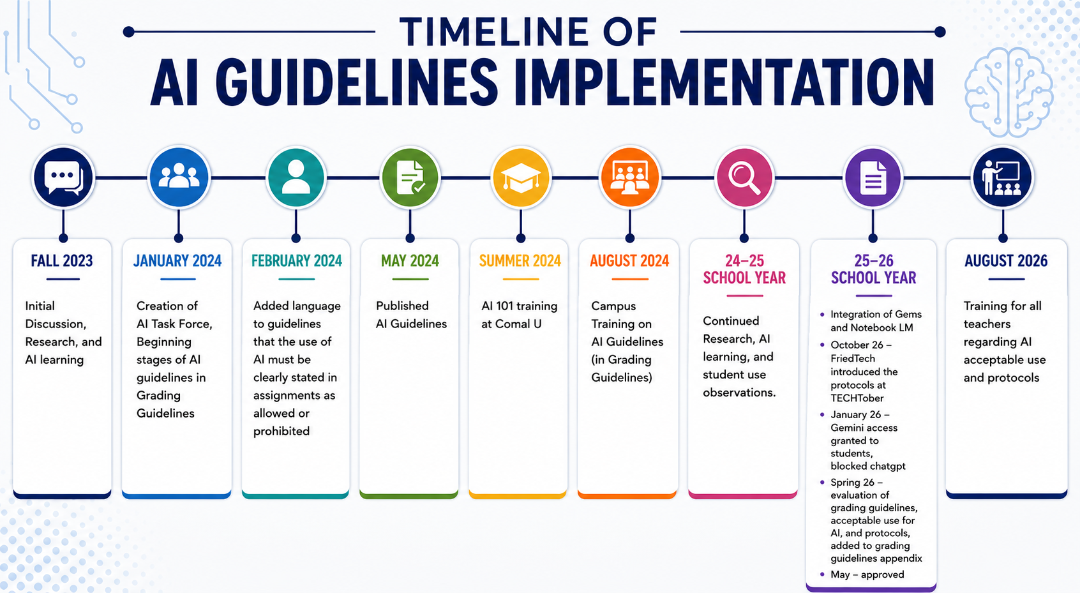

Slide 6
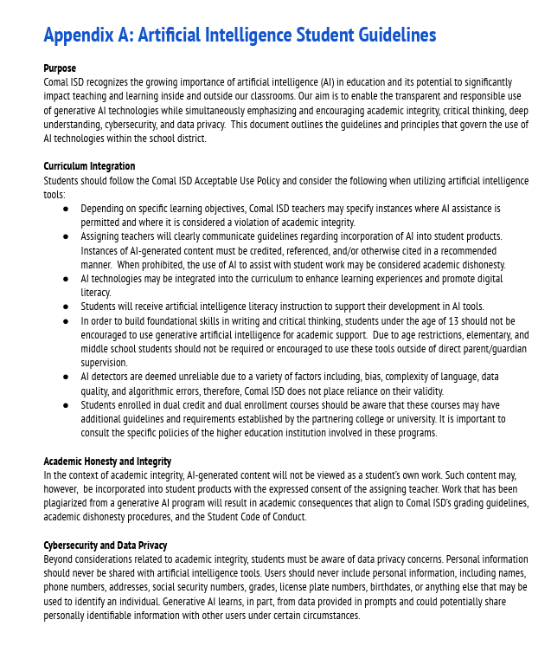
Grading Guidelines
est. May 2024

Slide 7
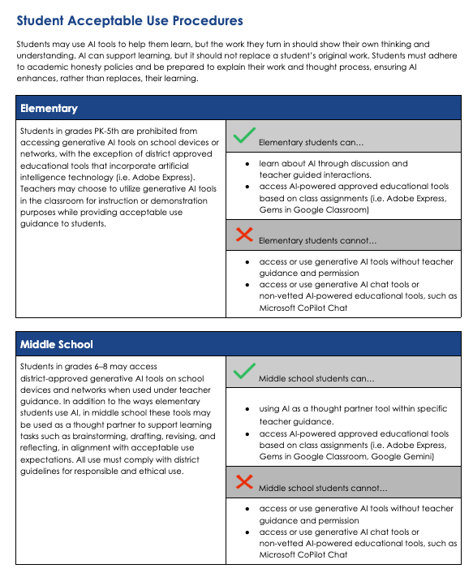
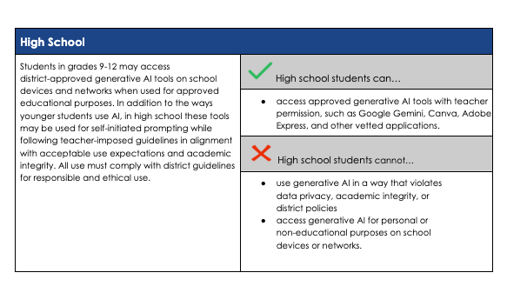
Adapted from Lubbock ISD

Slide 8
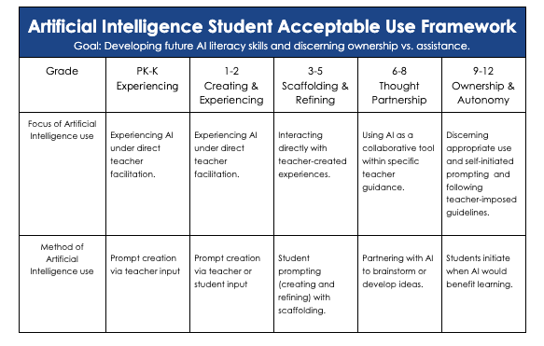

Slide 9
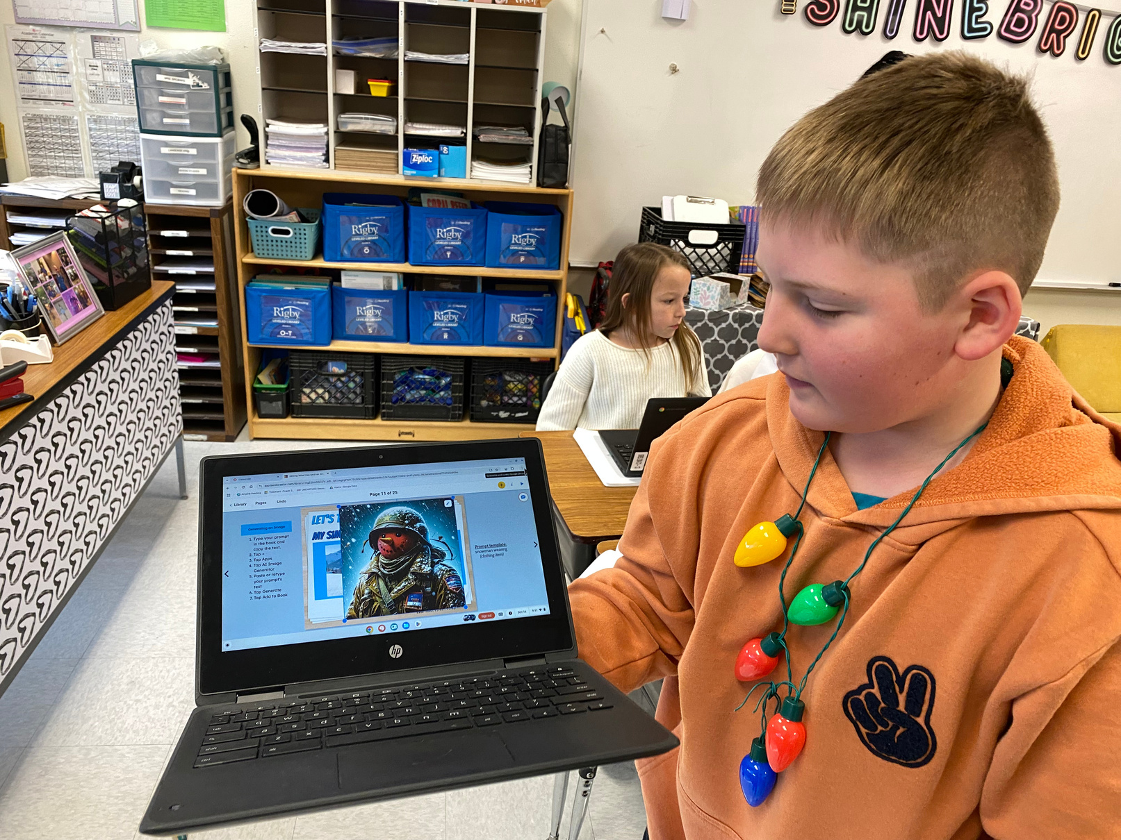
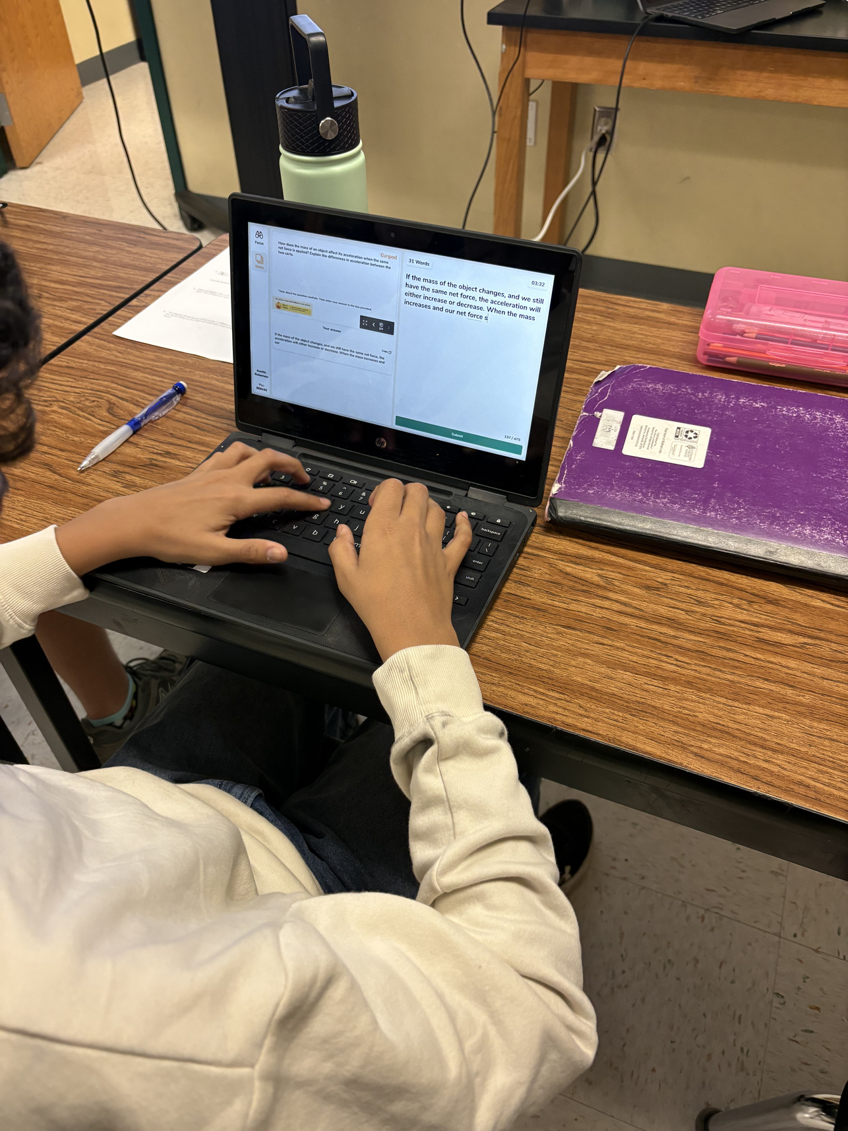
Intentionality

Slide 10
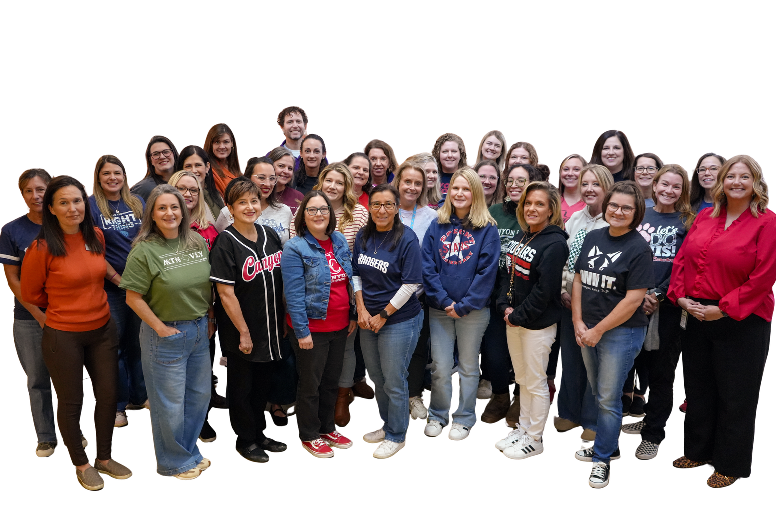

AI Literacy & Ethics
Prepare students to be responsible users and creators of AI, not just consumers of technology

Slide 11
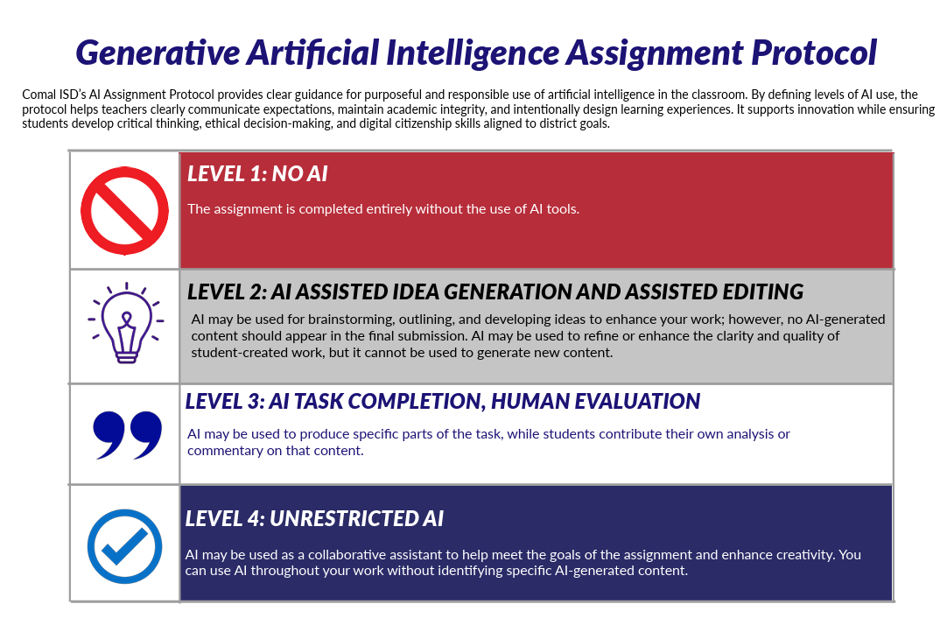


Adapted from Lubbock ISD

Slide 12


  Check grammar, punctuation, and spelling.
  Improve sentence fluency and readability.
  Suggest stronger transitions between paragraphs.
  Identify repetitive words or phrases.
  Generating/brainstorming ideas
  Organizing Ideas
  Creating Outlines
  Refining student-created work
  Providing feedback and encouraging revisions

Slide 13


  Compare/contrast articles
  Generate summaries
  Suggest Improvements
  Generate graphics
  Draft thesis and questions
Upload resources to:
  Generate summaries
  Explain concepts
  Create study guides
  Analyze data
  Create timelines
  Generate FAQs
  Identify themes across articles/documents
  Research Assistant
  Problem Solving Coach
  Debate (Devil’s Advocate Gem)
  Source Synthesizer
  Literacy Analysis Coach
  Historical Perspectives

Slide 14
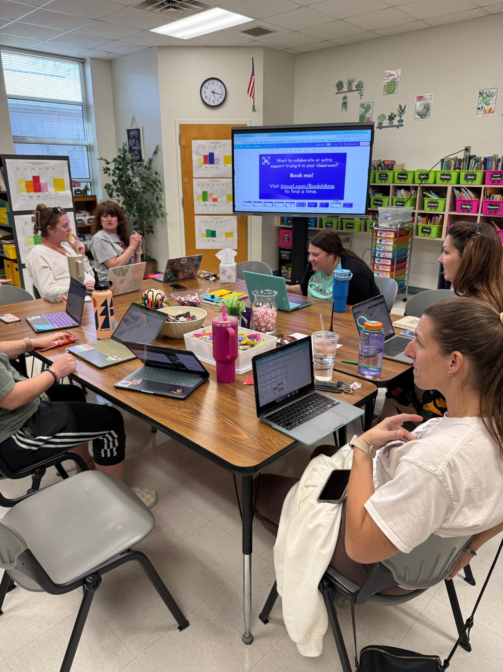
Professional Development
  Develop AI Literacy for teachers
  Meet them WHERE THEY ARE
  Bite sized learning opportunities
  Give them something to remember or use immediately
  Hands on Practice
Teachers crave efficient and effective PD.

Slide 15
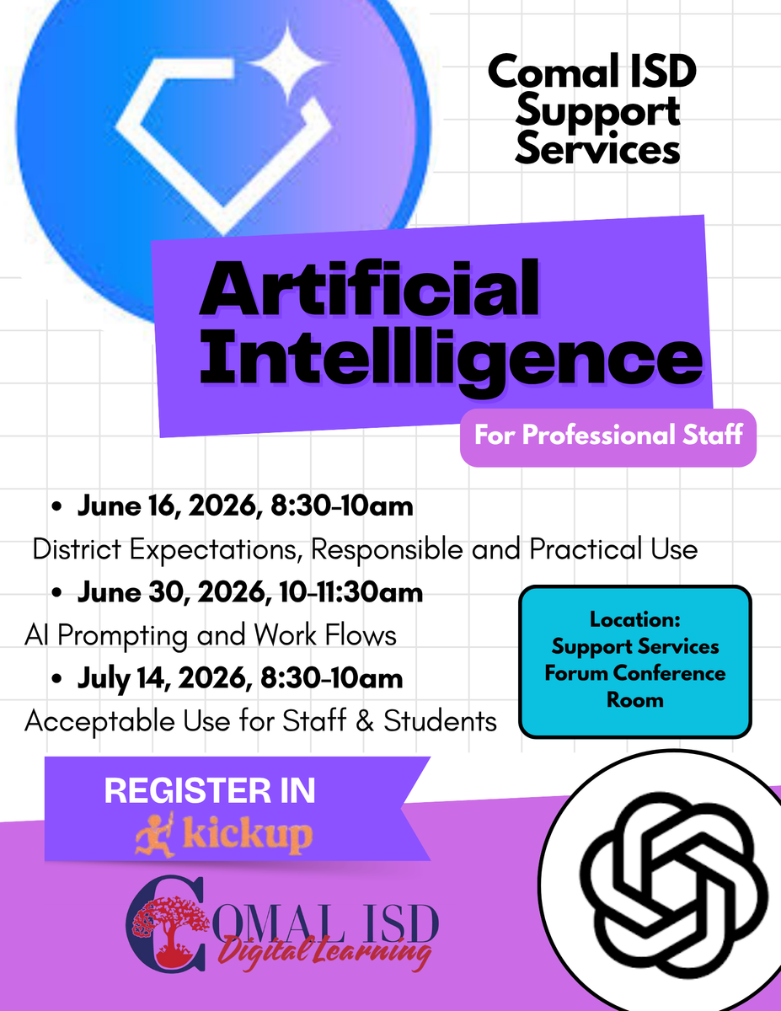
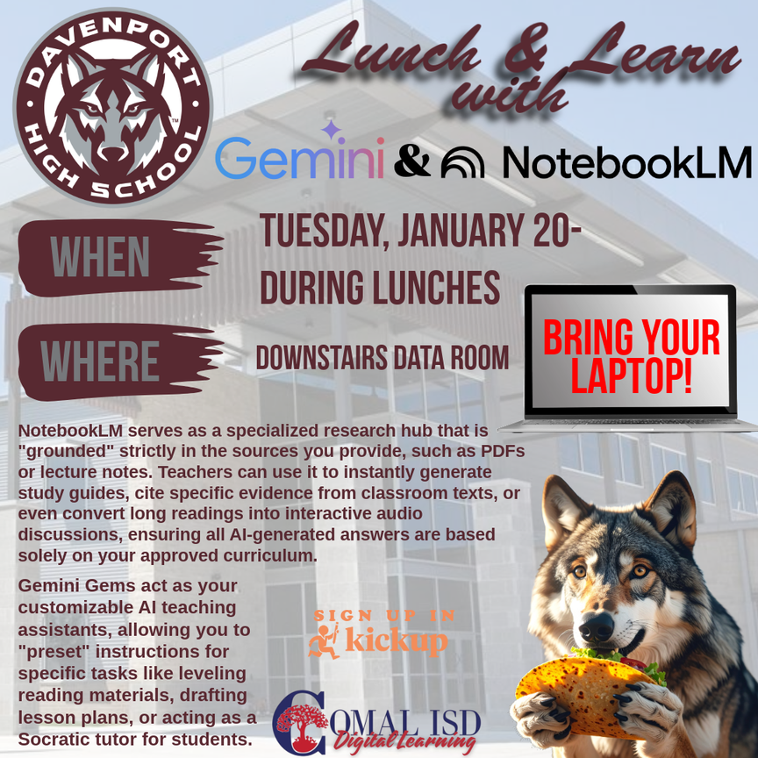



Slide 16



@comaldl

