Slide 1

Data Storytelling in Practice:
Going Beyond the Numbers
An Interactive Discussion on
Strategies for Education Data Communication
Copyright Notice
All rights reserved: This material may not be reproduced or distributed without the
express written permission of the Education Service Center Region 11.
6/23/2026 – 10:00 AM
Copyright © 2025 Education Service Center Region 11

Slide 2
Introduction
Copyright © 2025 Education Service Center Region 11

Slide 3

Introduction
Context: TETL 2026
K–12 is data-rich and system-heavy
We excel at collecting and reporting data
But a gap remains: analysis ≠ communication
Dashboards inform—but rarely drive action
Leaders need insights, not just information
Copyright © 2025 Education Service Center Region 11
Notes:
Welcome, everyone—and thank you for being here at the Texas Education Technology Leadership Conference.
As technology leaders, you’re surrounded by data.
From student information systems and learning management platforms to cybersecurity reports and usage analytics—K–12 organizations have more data than ever before.
And to be clear, we’ve gotten really good at handling it. We can collect it, process it, aggregate it, and build dashboards that look impressive.
But here’s the problem. There’s still a gap between having data… and actually using it to drive decisions.
Because analysis does not automatically lead to understanding—and it definitely doesn’t guarantee action.
Too often, our dashboards inform…but they don’t inspire. They show what’s happening, but not what to do next.
And that’s the shift we need to make as leaders. It’s not about producing more data. It’s about translating that data into clear, meaningful insights that people can act on.
That’s where data storytelling comes in.
Today, we’re going to focus on how to bridge that gap—so you can move from reporting information to actually driving impact.

Slide 4
Introduction
Learning Objectives
Define the components of effective data storytelling
Analyze data visualizations for clarity, insight, and risk
Evaluate metrics for quality and decision-making value
Apply storytelling in a way that drives action and outcomes
Copyright © 2025 Education Service Center Region 11
Notes:
Let’s take a quick look at what you’ll walk away with from today’s session.
By the end of our time together, you’ll be able to define what actually makes data storytelling effective—not just the pieces, but how they work together.
You’ll also be able to analyze dashboards and data visuals a bit differently.
Not just what do they show—but are they clear, are they useful, and are they potentially misleading?
From there, we’ll shift into evaluating metrics. Because one of the biggest challenges I see is not a lack of data—but a lack of meaningful metrics that actually support decisions.
So we’ll look at how to determine whether a metric is truly valuable…or just taking up space on a dashboard.
And finally, you’ll apply all of this. The goal is to help you take complex data and turn it into something that actually drives action—whether that’s informing a leadership decision, guiding a campus, or supporting student outcomes.
As we go through the session, I’d encourage you to think about your own reports, dashboards, or data conversations—and where these skills could apply.

Slide 5

Introduction
Agenda
Welcome and Session Overview
Foundations of Data Storytelling
Foundations of Effective Metrics
Communicating Metrics for Impact
Interactive Activity: From Data to Action
Key Takeaways and Next Steps
Q&A and Closing
Copyright © 2025 Education Service Center Region 11
Notes:
Here’s a look at our agenda for today’s session.
We’ll begin with a brief welcome and overview to set the stage for our discussion.
Next, we’ll define data storytelling and explore why it is essential for transforming information into meaningful insights and informed decisions.
We’ll then discuss the importance of knowing your audience and how tailoring your message ensures clarity, relevance, and impact.
From there, we’ll review best practices in data storytelling, along with common pitfalls to avoid when communicating data.
In the second half of our session, we’ll shift our focus to the foundations of effective metrics—examining how to design measures that are purposeful, actionable, and aligned to organizational goals.
We’ll also explore strategies for communicating metrics effectively using clear visuals and compelling narratives.
To apply what we’ve learned, you’ll participate in an interactive activity that guides you from data to insight to action.
We’ll conclude with key takeaways, next steps, and time for questions.
Let’s get started.

Slide 6
Foundations of Data Storytelling
Copyright © 2025 Education Service Center Region 11

Slide 7
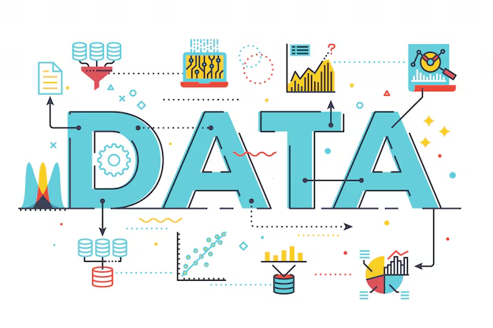
Foundations of Data Storytelling
What is Data Storytelling?
Data + Visuals + Narrative = Data Storytelling
Data explains what is happening
Visuals show patterns and meaning
Narrative answers why it matters
  Goal: move audiences from information → insight → action
Copyright © 2025 Education Service Center Region 11
Notes:
Now let’s define what we actually mean by data storytelling.
At its core, it’s the combination of three things—data, visuals, and narrative.
But more importantly, each of those plays a different role.
Data tells us what is happening. It gives us the facts and the foundation.
Visuals help us see patterns—trends, comparisons, outliers—things that are hard to catch in a table.
And then narrative is what ties it all together. That’s where we answer the most important question: why does this matter?
Because without that piece, we’re just showing information—we’re not creating understanding. And ultimately, the goal is to move people through a progression.
From information…to insight…to action.
That last step is the one that’s most often missing. We show the data, maybe even highlight the insight—but we stop short of driving a decision. And that’s why this matters.
Because data, on its own, doesn’t persuade. People don’t make decisions because they saw a chart. They make decisions when they understand what it means—and what they’re supposed to do next.
So as we go through the rest of the session, this is the lens we’re going to use: Are we just showing data…or are we actually telling a story that leads to action?

Slide 8
Foundations of Data Storytelling
Why Data Storytelling Matters in EdTech
Technology decisions depend on how data is communicated
Stakeholders don’t act on dashboards—they act on clarity
Poor communication leads to misalignment and missed impact
Strong storytelling drives adoption, investment, and change
Where this shows up:
LMS usage, Digital adoption, Cybersecurity, AI initiatives
Copyright © 2025 Education Service Center Region 11
Notes:
Now let’s talk about why this actually matters—specifically in your role as technology leaders. Because the reality is, most of the decisions you’re responsible for don’t come down to the data itself. They come down to how that data is understood.
You can have the right data on LMS usage, device access, cybersecurity readiness, or even AI implementation… …but if it’s not communicated clearly, it doesn’t lead to the right decisions. And that’s where we start to see problems.
Stakeholders don’t act on dashboards—they act on clarity. If a superintendent, a board member, or a campus leader doesn’t immediately understand what the data is saying and what it means for them… nothing happens. Or worse—decisions get made based on partial understanding. That’s where misalignment starts.
Technology investments don’t get fully adopted. Initiatives lose momentum. Or we solve the wrong problem entirely.
On the flip side, when data is communicated well—it drives action. It influences decisions, builds alignment, and accelerates change. And you see this across all the areas you’re working in:
LMS usage…digital adoption…cybersecurity…AI initiatives…
In all of those cases, the difference between success and stagnation often comes down to one thing. Not the data itself, but how well it’s communicated.

Slide 9
Foundations of Data Storytelling
Know Your Audience
The same data tells different stories to different stakeholders
Misalignment happens when we assume shared understanding
Too much detail confuses, too little lacks trust
Your job:
Translate data for the decision-maker
  Not: What does the data say?
  But: What does this mean for them?
Copyright © 2025 Education Service Center Region 11
Notes:
One of the biggest reasons data fails to drive action has nothing to do with the data itself—it’s the audience.
Because the same data can tell very different stories depending on who’s looking at it.
A superintendent is thinking about outcomes and accountability.
A principal is thinking about where to focus support.
A CTO is thinking about systems, reliability, and cost.
And if we present the same dashboard the same way to all of them—we create misalignment.
We assume shared understanding…when it’s not actually there. And that shows up in a couple of ways.
Sometimes we give too much detail—every chart, every filter, every metric. And instead of clarity, it creates confusion.
Other times, we oversimplify—and the audience doesn’t trust what they’re seeing because they don’t have enough context.
So the goal isn’t just to present data. It’s to translate it.
Your job as a leader is to take the data and answer a very specific question:
What does this mean for this audience—and what do they need to do with it? Because if that part isn’t clear…nothing happens.

Slide 10
Foundations of Data Storytelling
Audience Perspectives in Education
Same data → different stories → different decisions
Superintendent: ROI & outcomes → Should we continue investing?
CIO/CTO: Systems & risk → Is this secure and scalable?
Instructional Leaders: Teaching impact → Is this improving instruction?
Campus Leaders: Implementation → Where do we need support?
Board/Community: Accountability → Are we using funds responsibly?
Copyright © 2025 Education Service Center Region 11
Notes:
Let’s make this even more concrete. When we say ‘know your audience,’ what we really mean is this:
The same data doesn’t just get interpreted differently—it leads to different decisions.
Take a single dataset—maybe LMS usage or digital adoption.
A superintendent is looking at that through the lens of return on investment and outcomes.
They’re asking: Is this worth continuing?
A CIO or CTO is thinking about systems and risk.
Is this secure? Is it scalable?
Instructional leaders are focused on teaching impact.
Is this actually improving instruction?
Campus leaders are thinking operationally.
Where do we need to support teachers right now?
And your board or community is focused on accountability.
Are we using resources responsibly?
So the story isn’t just about explaining the data.
It’s about aligning the message to the decision each audience needs to make. Because if you don’t…you might be giving the right data—but telling the wrong story.

Slide 11
Foundations of Data Storytelling
A Better Way to Build Data Stories
Start with the decision
  What needs to happen?
Identify the insight
  What actually matters?
Design the communication
  What should they see—and why?
Focus on clarity over volume
2–3 insights > 20 data points
Copyright © 2025 Education Service Center Region 11
Notes:
Up to this point, we’ve talked about the problem—and how audience and interpretation play a role.
So now the question becomes: What does this actually look like in practice? Here’s a simple way to think about building a data story.
Step one—start with the decision. Not the data. Not the dashboard. What decision needs to be made? Because if you don’t know that, everything else is just noise.
Step two—identify the insight. Out of all the data available, what actually matters? Not everything that’s measurable is meaningful. Your job is to surface the one or two things that change how someone thinks about the problem.
And then step three—design the communication. What do they need to see—and what do they not need to see? Because more data doesn’t create clarity. It usually does the opposite. And this is where a lot of data communication breaks down.
We try to show everything to be thorough…but in doing that, we dilute the message.
So a good rule of thumb is this: If your audience remembers 2 or 3 things—and knows what to do next—you’ve done your job.
If they remember nothing…you probably showed too much.

Slide 12
Foundations of Data Storytelling
Why Data Stories Fail
False certainty → jumping to conclusions (correlation ≠ causation)
Biased narrative → cherry-picking data
Weak foundation → poor data quality or missing context
Audience mismatch → too complex or too vague
No decision → insight without a next step
Copyright © 2025 Education Service Center Region 11
Notes:
Even when we have good data and good intentions, this is where things tend to break down. There are a few consistent failure modes I see.
First—false certainty. We see a pattern and immediately assume cause and effect. But correlation doesn’t equal causation. Without context, we risk making confident… but incorrect decisions.
Second—biased narrative. This is where we unintentionally cherry-pick data that supports the story we want to tell. The problem is—it might be convincing in the moment, but it erodes trust over time.
Third—weak foundation. If the data itself has gaps, inconsistent definitions, or different collection methods, the insight becomes shaky. And if we don’t acknowledge that, we mislead our audience.
Fourth—audience mismatch. We’ve talked about this already—but this is where it shows up. Too much complexity, too much jargon, or not enough context—and the message gets lost.
And finally—no decision. This is probably the most common one. We present the data, maybe even highlight an insight…but we never clearly say what should happen next. And when there’s no direction, there’s no action.
So if you’ve ever sat in a meeting where data was presented and nothing happened…it’s usually one of these five things.
And the question to ask is: Which one showed up—and how would you fix it?

Slide 13
Foundations of Effective Metrics
Copyright © 2025 Education Service Center Region 11

Slide 14
Foundations of Effective Metrics
Even Great Storytelling Can’t Fix Bad Metrics
Clear communication can’t rescue unclear measures
If the metric is flawed, the story will be flawed
Many dashboards fail because the metrics aren’t decision-ready
Copyright © 2025 Education Service Center Region 11
Notes:
Up to this point, we’ve focused on how data is communicated. And that’s critical.
But here’s the reality: Even great storytelling can’t fix bad metrics.
You can have a clear narrative, strong visuals, and a well-tailored message…but if the underlying metric is flawed, incomplete, or misaligned, the story breaks.
And this is where a lot of dashboards struggle. It’s not just a communication issue—it’s a measurement issue.
We track things because we can…not because they help us decide something.
So before we talk about how to present data, we need to step back and ask: Are we even measuring the right things?
Because if the metric doesn’t support a decision, it won’t matter how well we communicate it.
So next, we’re going to shift into how to design metrics that actually drive decisions.

Slide 15
Foundations of Effective Metrics
Start With Purpose → Define the Question
Metrics exist to answer a question — not to fill a dashboard
The “why” clarifies what decision a metric should support
Every metric should trace back to a specific business question
Start with questions, not available data
Strong questions naturally determine the right metric
Copyright © 2025 Education Service Center Region 11
Notes:
Metrics don’t start with data — and they definitely don’t start with dashboards. They start with purpose.
Before we measure anything, we need to understand: why does this metric exist? Who is it for, and what decision is it supposed to support?
Because if we skip that step, we end up tracking what I’d call busy metrics. Things like counts of emails, meetings, or raw activity volume.
And those aren’t useless — but they’re limited. They tell us what happened, not whether it mattered.
Pause
So the shift is this: We move from “what do we have data on?” to “what are we trying to understand or improve?”
That’s where purpose comes in — it acts like a filter. If a metric doesn’t clearly connect back to a purpose, it’s probably just noise.
Pause
Now once we have purpose, the next step is to translate that into a clear business question. Because metrics don’t actually answer “topics” — they answer questions.
And this is where a lot of reporting breaks down. Teams often start with: “Here’s the data we have — what should we report?”
That’s a data-first mindset… and it usually leads to unfocused dashboards.
Instead, we flip it. We start with the question.
Pause
And strong questions in education and service delivery sound like things we actually care about, such as:
Are we resolving family requests equitably across regions?
Is our service getting faster over time?
Are certain types of requests increasing?
Are outcomes aligned with student needs?
Pause
Once the question is clear, the metric usually becomes obvious.
If the question is about timeliness, we look at things like time to resolution or percent resolved within a target window.
If the question is about equity, we break outcomes down by region, category, or access point.
If the question is about demand, we look at intake trends over time.
Pause
So the sequence matters: Purpose → Question → Metric
Not the other way around.
And when we follow that sequence, three things improve immediately:
our reporting becomes clearer,
our dashboards become more focused,
and our conversations become much more aligned.
So as we move forward today, we’ll use a simple checkpoint before any metric or visualization: What question is this actually trying to answer — and why does it matter?

Slide 16
Foundations of Effective Metrics
SMART + CLEAR Frameworks
SMART
Specific, Measurable, Achievable, Relevant, Time-bound
Focus: precision & accountability
+
CLEAR
Collaborative, Limited, Emotional, Appreciable, Refinable
Focus: adaptability & collaboration
Copyright © 2025 Education Service Center Region 11
Notes:
Alright — now we move from defining what a good metric is to structuring how we actually build one.
We’re going to look at two frameworks that help guide that process: SMART and CLEAR.
Most people are familiar with SMART. It’s been used for a long time in goal-setting and performance tracking because it forces clarity.
The key value of SMART is that it turns vague ideas into something measurable and accountable.
So instead of saying “improve student literacy,” we get something like: increase 3rd grade reading proficiency from 68% to 75% by May 2026.
Now we have something we can actually track, evaluate, and report on.
So SMART is really about precision — making sure we know exactly what success looks like and when we’re measuring it.
But in education systems and service environments, precision alone isn’t always enough.
Because we’re not just dealing with controlled inputs — we’re dealing with people, changing needs, and evolving conditions.
That’s where CLEAR becomes useful.
CLEAR doesn’t replace SMART — it adds a second lens that focuses on how usable and sustainable a metric actually is in practice.
So while SMART asks: “Is this well-defined?” CLEAR asks: “Is this actually workable in the real world?”
Let’s break it down briefly:
Collaborative — was this metric built with the people who use or are affected by it?
Limited — are we focused on what matters most, or trying to track everything?
Emotional — does this connect back to purpose in a way that resonates with stakeholders?
Appreciable — can progress be broken into visible, smaller steps instead of only end results?
Refinable — can we adjust the metric as we learn more over time?
So CLEAR is really about usability and adaptability, not just definition.
And here’s the key takeaway: You don’t choose SMART or CLEAR — you use both.
SMART gives structure to the metric itself.
CLEAR shapes how that metric is built, understood, and evolved.
Together, they ensure we’re not just creating metrics that are technically correct…but metrics that are meaningful, usable, and sustainable in practice.

Slide 17
Foundations of Effective Metrics
What Makes a Good Metric?
Valid & Reliable (measures the right thing, consistently)
Understandable (easy to explain and interpret)
Actionable (supports decisions or improvement)
Comparable over time (stable definition enables trend analysis)
Aligned to purpose (connects back to a business question)
Copyright © 2025 Education Service Center Region 11
Notes:
Now we get to a really important question: What actually makes a good metric?
Because once we’ve defined purpose, built a question, and structured a metric — we still need a way to evaluate whether that metric is actually any good.
At the simplest level, a metric is just a measurement. But not all measurements are useful.
What separates a useful metric from a noisy one is a set of core quality checks.
The first is validity and reliability. A good metric has to measure the right thing — and it has to measure it consistently. So if different teams define something like “resolved request” differently, then we lose reliability — because we’re no longer comparing the same thing. And if we’re measuring something like “student engagement” but only using attendance, then we may be missing the actual construct we care about — that’s a validity issue.
Next, a good metric has to be understandable. If a metric requires a long explanation or multiple caveats before someone can interpret it, it’s unlikely to be used effectively. A simple test is: Can I explain this clearly in one sentence to someone outside my team?
Then we want metrics that are actionable. Meaning: can someone actually use this to make a decision or drive improvement? Some metrics are informative but passive - they describe a condition but don’t point toward action. A strong metric should connect directly to something we can influence.
We also need metrics to be comparable over time. Because without consistency in definition, we lose the ability to track change — and ultimately, we lose the ability to measure improvement. So stability in how we define and calculate metrics is just as important as the metric itself.
And finally, everything has to be aligned to purpose. Every metric should trace back to a goal, a strategy, or a specific question we’re trying to answer. If it doesn’t support a decision, clarify understanding, or inform action — it’s probably adding noise rather than value.
So when we put this together, a strong metric is one that is: valid and reliable, understandable, actionable, comparable over time, and aligned to purpose.
And when those conditions are in place, something important happens: Metrics stop being just reporting artifacts…and start becoming tools for improvement and decision-making.
And now that we’ve established what good looks like, the next question becomes: What goes wrong when these qualities aren’t present?

Slide 18

Foundations of Effective Metrics
Why Metrics Fail
Vanity metrics (activity ≠ impact)
Misaligned measures (don’t match the question)
Lack of context (no baseline or comparison)
Overcounting / double counting (inflated results)
Equity blind spots (averages hide disparities)
Copyright © 2025 Education Service Center Region 11
Notes:
Now that we’ve talked about what makes a good metric, we need to look at the other side of the equation.
Because even well-intentioned metrics can fail — and when they do, it usually falls into a few predictable patterns.
The first is vanity metrics. These are metrics that look impressive but don’t actually tell us whether anything improved. For example, the number of trainings delivered might sound positive — but it doesn’t tell us whether behavior changed as a result. It’s activity, not impact.
The next is misaligned measures. This is when the metric doesn’t actually match the question or goal it’s supposed to represent. For instance, using attendance as a proxy for teacher effectiveness — or measuring program success only by how many students were served. In both cases, the metric is pointing in a slightly different direction than the intent.
Then we have lack of context. A number on its own doesn’t mean much. A 75% rate, an increase in referrals, a drop in attendance — none of that is interpretable without comparison. We need baselines, trends, or benchmarks to understand whether something is actually good or concerning.
Next is overcounting or double counting. This is more of a technical issue, but it shows up often in real systems — especially when multiple tools or teams are logging similar activity. The result is inflated numbers that can create confusion or reduce trust in the data.
And finally, we have equity blind spots. This is one of the most important failure modes. Because a metric can look fine overall, but hide very different experiences underneath it. If we only look at averages, we can miss differences across regions, campuses, or student groups — and that limits how well we can actually improve outcomes.
So when you put all of these together, the common theme is this: Metrics fail when they look complete on the surface, but don’t actually help us understand or improve what’s happening underneath.

Slide 19
Communicating Metrics
for Impact
Copyright © 2025 Education Service Center Region 11

Slide 20
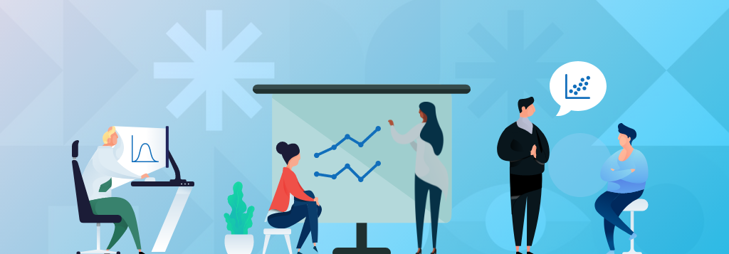
Communicating Metrics for Impact
Communicating Metrics Effectively
Simplify visuals to highlight the signal, not the noise
Always pair metrics with context (baseline, target, or comparison)
Emphasize trends over single data points
Use narrative titles to communicate the takeaway
Copyright © 2025 Education Service Center Region 11
Notes:
Now that we’ve talked about how to design strong metrics — and how they can fail — the next step is just as important: How we communicate them.
This ties right back to our data storytelling concepts. Even a well-designed metric can lose its impact if it’s not presented clearly.
And in many cases, the challenge isn’t the data — it’s how the data is communicated.
The first principle is to simplify visuals to highlight the signal, not the noise. It’s very easy to overload a chart with too much information — too many colors, labels, or metrics competing for attention. But the goal of a visualization isn’t to show everything — it’s to make the key insight obvious.
Next, metrics should always be paired with context. A number on its own doesn’t mean much. We need to anchor it to something: a baseline, a target, or a comparison point That’s what allows someone to interpret whether the number is good, concerning, or changing.
Third, we want to emphasize trends over single points in time. Single data points can be misleading. What really matters is direction: Are things improving? Declining? Staying consistent? That’s what supports better decisions.
And finally, one of the most overlooked techniques: Narrative titles. Instead of labeling a chart “Survey Results” or “Q3 Data,”
we use the title to communicate the takeaway. For example: “Satisfaction Improved 12% Since Spring” Now the audience doesn’t have to interpret first — they immediately understand the message.
So the overall idea is this: Good communication reduces the amount of work your audience has to do. It makes the insight clear, the context visible, and the takeaway immediate.
Ultimately, metrics aren’t just meant to be reported, they’re meant to be understood and acted on.

Slide 21
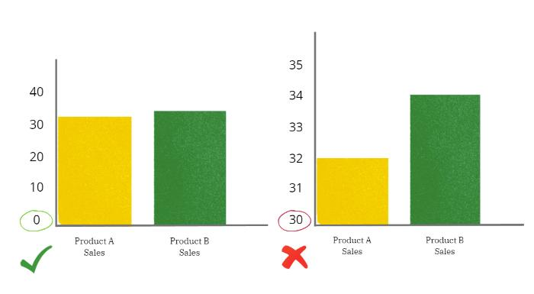
Communicating Metrics for Impact
Copyright © 2025 Education Service Center Region 11

Slide 22
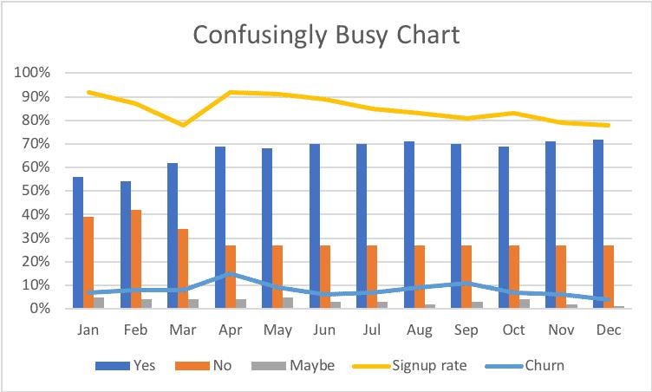
Communicating Metrics for Impact
Copyright © 2025 Education Service Center Region 11

Slide 23
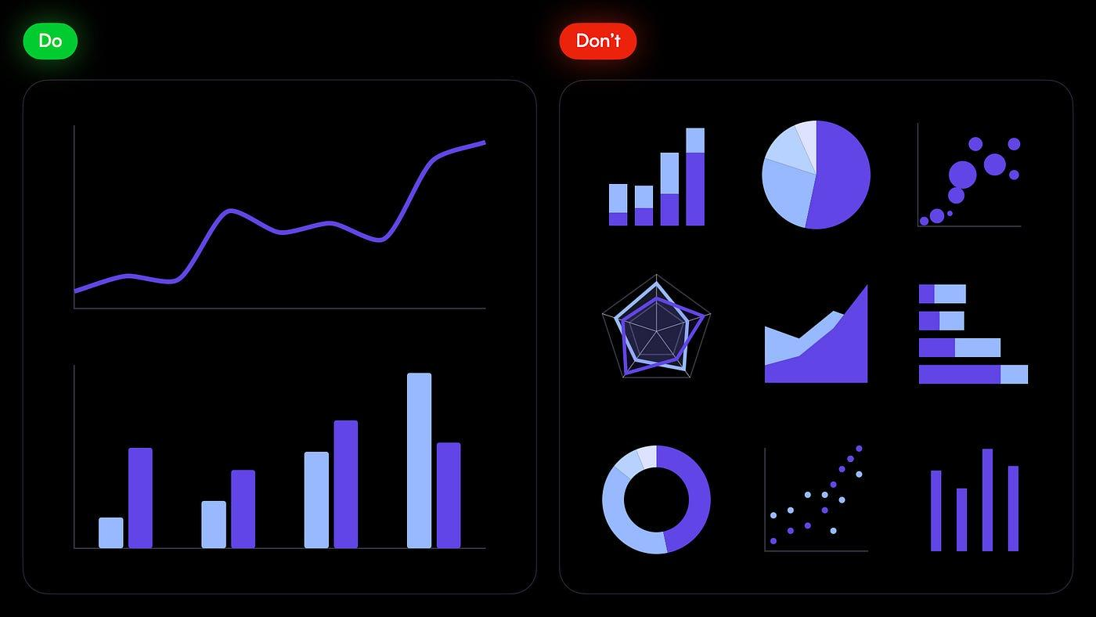
Communicating Metrics for Impact
Copyright © 2025 Education Service Center Region 11

Slide 24
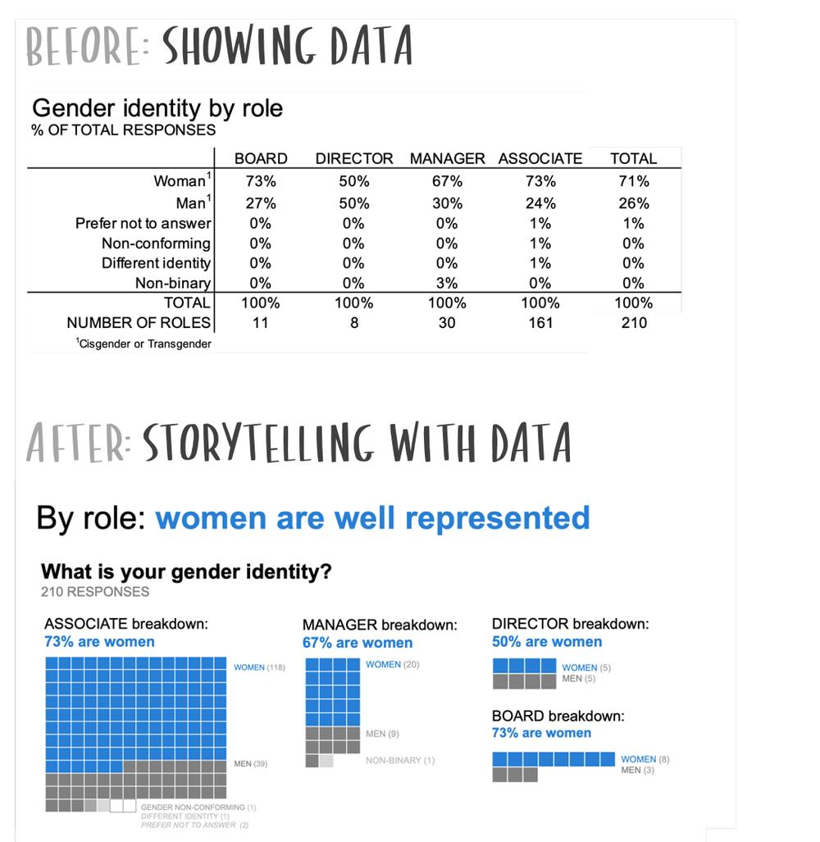
Communicating Metrics for Impact
Copyright © 2025 Education Service Center Region 11

Slide 25
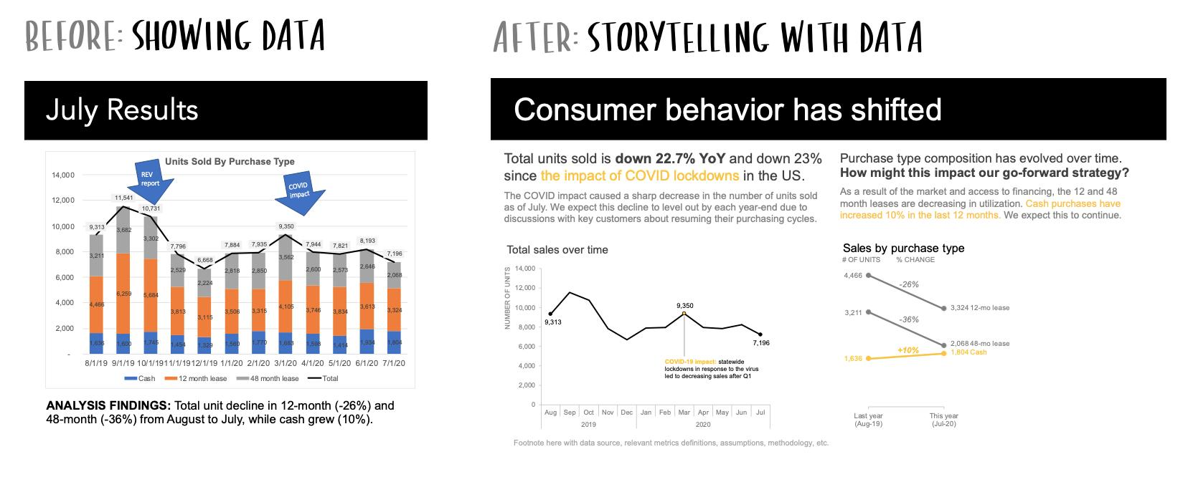
Communicating Metrics for Impact
Copyright © 2025 Education Service Center Region 11

Slide 26
Communicating Metrics for Impact
Activity: From Data to Action
Take a common metric you use (or from the list →) and move it to action:
What is the key takeaway?
What question does it answer?
Who owns it?
How can it be improved?
What possible actions should follow?
Example Metrics:
  % of help-desk requests resolved in </= 2 days
  Student chronic absenteeism rate
  Family survey overall satisfaction score
  Work with a partner, or individually
Copyright © 2025 Education Service Center Region 11

Slide 27
Conclusion
Copyright © 2025 Education Service Center Region 11

Slide 28
Conclusion
Key Takeaways
Start with purpose and the decision you need to make
Turn data into clear questions and actionable insights
Design metrics that are meaningful, not just measurable
Communicate with clarity, context, and intent
Use data to drive action (not just reporting)
Copyright © 2025 Education Service Center Region 11
Notes:
As we wrap up, I want to bring this back to a few key ideas.
First — everything starts with purpose and decision-making. If we’re not clear on what decision we’re trying to support, the metric won’t have direction.
Second — strong data work is really about asking the right questions and turning those into actionable insights. Not just reporting numbers, but understanding what they mean and what they require us to do.
Third — good metrics aren’t just measurable… they’re meaningful. They reflect what actually matters — not just what’s easy to count.
Fourth — how we communicate data matters just as much as the data itself. Clarity, context, and intent determine whether people understand and use what we present.
And finally — the goal of all of this is action. Not dashboards. Not reports. Action.
At the end of the day, data only has value if it leads to better decisions and better outcomes for students and families.

Slide 29
Conclusion
Call to Action
Refine one metric using SMART + CLEAR
Improve one report with a clear takeaway and context
Use a narrative title in your next presentation
Share one idea from today with your team
Copyright © 2025 Education Service Center Region 11

Slide 30

Conclusion
Questions
Copyright © 2025 Education Service Center Region 11

Slide 31
Conclusion
Thank you!
From the ESC Region 11 Data Team:
Tom Call, Director
Joey Brindle, Coordinator
Jason Balters, Research & Data Analyst
Ron Neff, Web Application Developer
Alex Cullpepper, SQL Developer & TxTracts
Isaac Setford, Web Application Developer
Michael Hopper, Web Application Developer
Copyright Notice
All rights reserved: This material may not be reproduced or distributed without the
express written permission of the Education Service Center Region 11.
Copyright © 2025 Education Service Center Region 11

