Slide 1


Practical AI Security in K-12: A District Perspective
Sean Sheridan
Security Architect
Dallas Independent School District

Slide 2

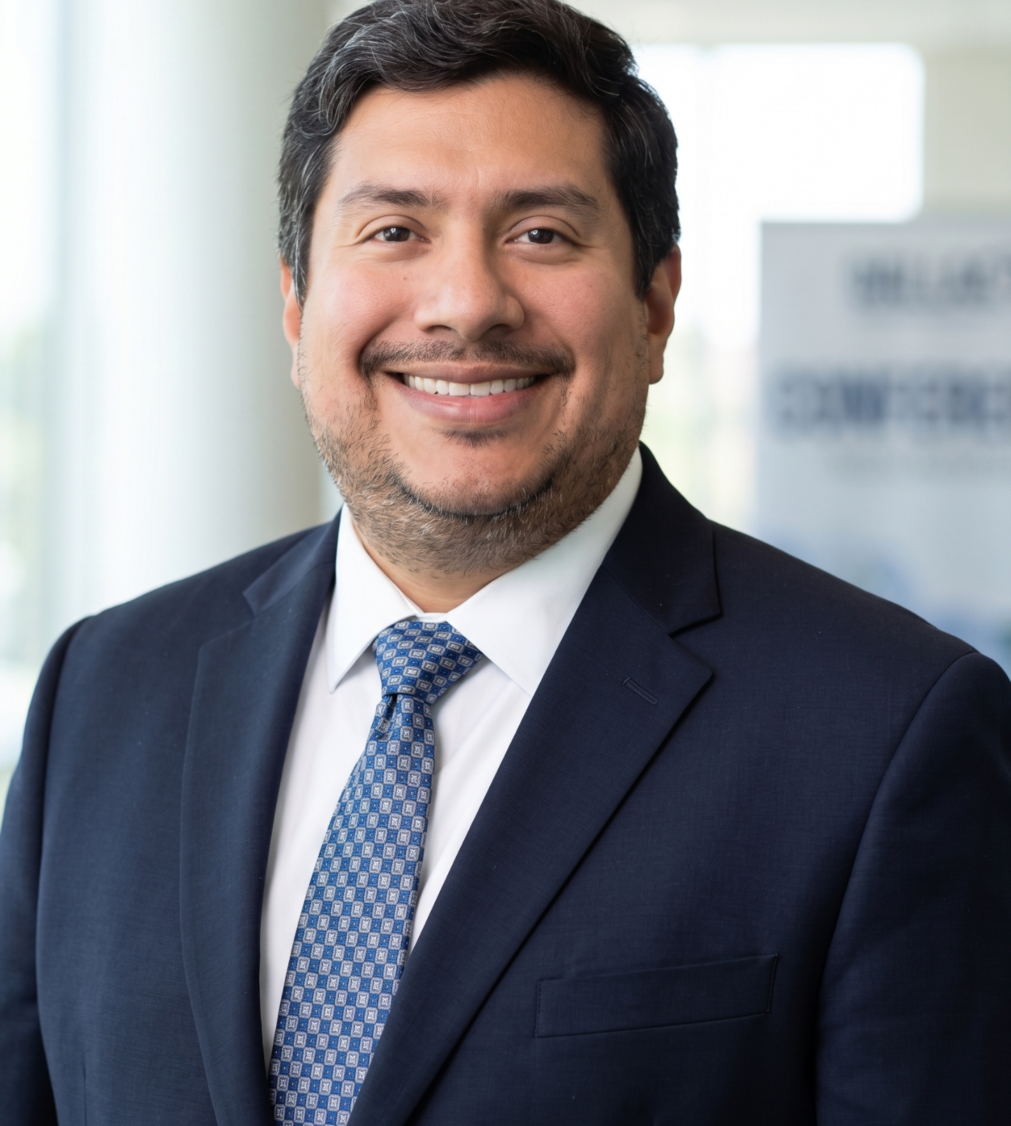
Introduction and Goals
Sean Sheridan
Security Architect at Dallas Independent School District
14 years in Educational Technology
M.S. Cybersecurity & Information Assurance - Western Governors University
Jose Gonzalez
Security Engineer at Dallas Independent School District
12 years in Educational Technology
GOALS
Simplify AI use-cases into categories
Identify their unique risks
Outline practical controls to protect people, systems, and data

Slide 3
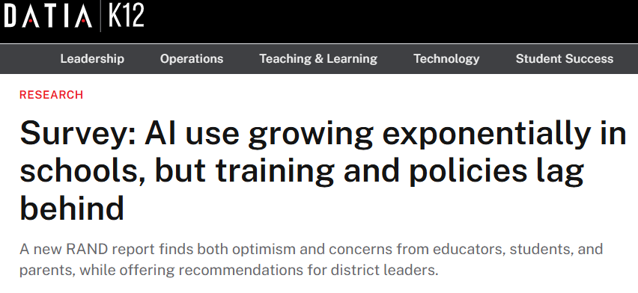
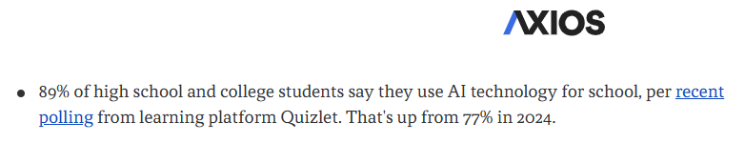
Why Does This Matter Right Now?
AI is already being used in your districts
Most AI use is unmanaged
Implementation is easier than retrofitting
https://www.datiak12.io/research/article/15768300/survey-ai-use-growing-exponentially-in-schools
https://www.axios.com/newsletters/axios-ai-plus-d26b2457-4df0-4dd0-8ce4-5589c1985e0c

Slide 4
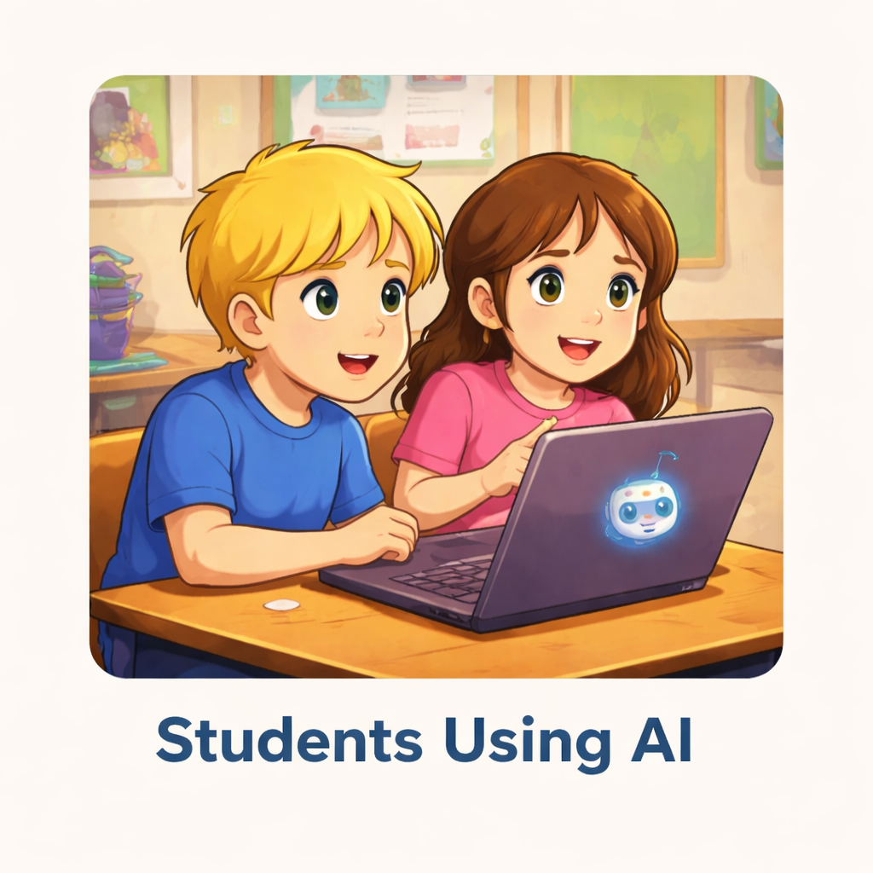
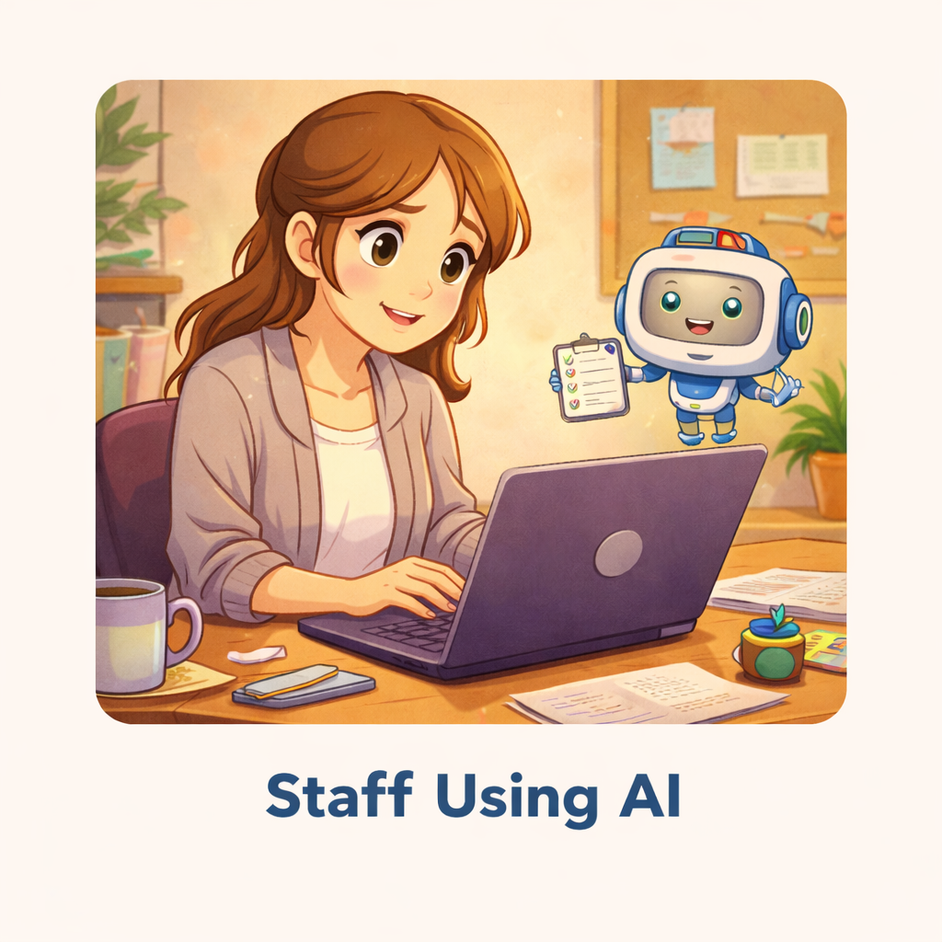
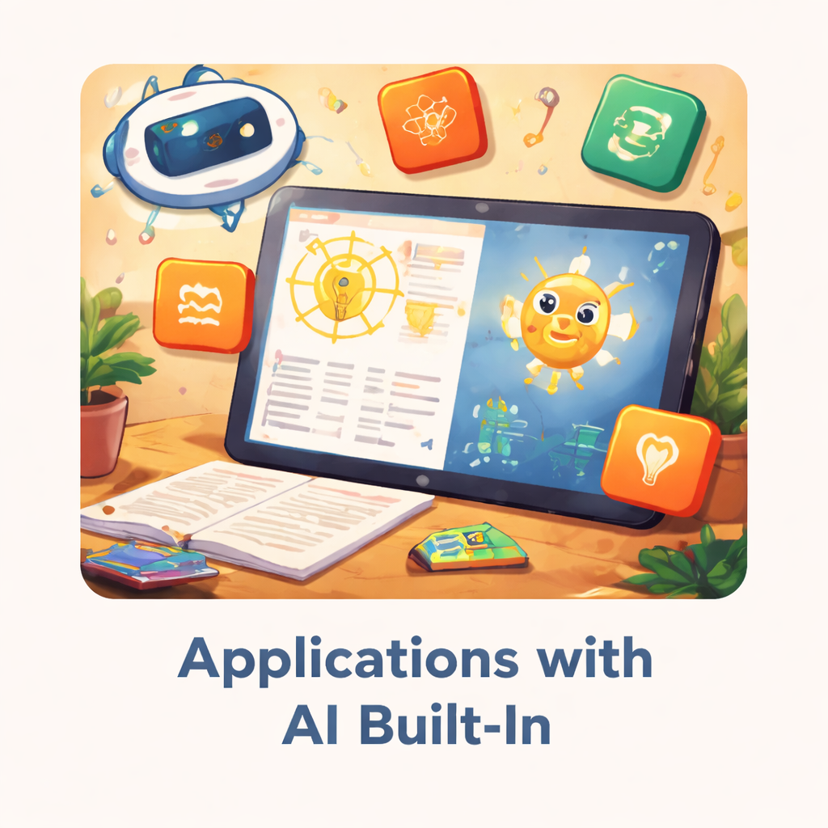
Breaking It Up: The Three Pillars of AI in K12

Slide 5
Breaking It Up: Students using AI
What do they use? | AI Chatbots
What can that access? | Manually entered data and files No system access
What are the risks? | PII exposure via prompts/uploads Student exposure to unsafe content

Slide 6
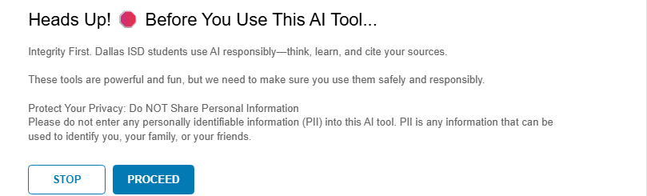
Breaking It Up: Students using AI
What can we do about it? | Deliver education on responsible AI usage Build governance and security into partner agreements (DSA/DPA) Build a Walled Garden: Block all but approved AI - SWG Redirect AI access attempts - SWG Prevent input of PII at prompts - DLP Provide Real-time coaching - CASB Force SSO to AI partner tenants - CASB/IDP

Slide 7
Breaking It Up: Staff using AI
What do they use? | AI Chatbots
What can that access? | Manually entered data and files
What are the risks? | PII exposure via prompts/uploads
AI Powered Apps
Storage (Cloud, Shared, etc.)
Email/Messaging
Information Systems
Everything the staff account has access to
Excessive access via sharing and account permissions
Excessive agency

Slide 8
Breaking It Up: Staff using AI
What can we do about it? | MAKE IT COUNT TWICE Education on responsible AI usage Build governance and security into partner agreements Walled Garden: Block all but approved AI - SWG Redirect AI access attempts - SWG Prevent input of PII at prompts - DLP Real-time coaching - CASB Force SSO to AI partner tenants - CASB/IDP STAFF FOCUSED CONTROLS
Enforce secure default sharing permissions - Platform configs/CSPM/DSPM
Educate staff on good sharing habits
Least privilege access/permissions for users, accounts, and agents

Slide 9
Breaking It Up: Applications with AI built in
What do they use? | API Connections SVC Accounts Direct access (built-in as tools)
What can that access? | Databases/warehouses/lakes/etc. Information systems
What are the risks? | Data exposure via poorly defined access controls Account compromise Excessive agency

Slide 10
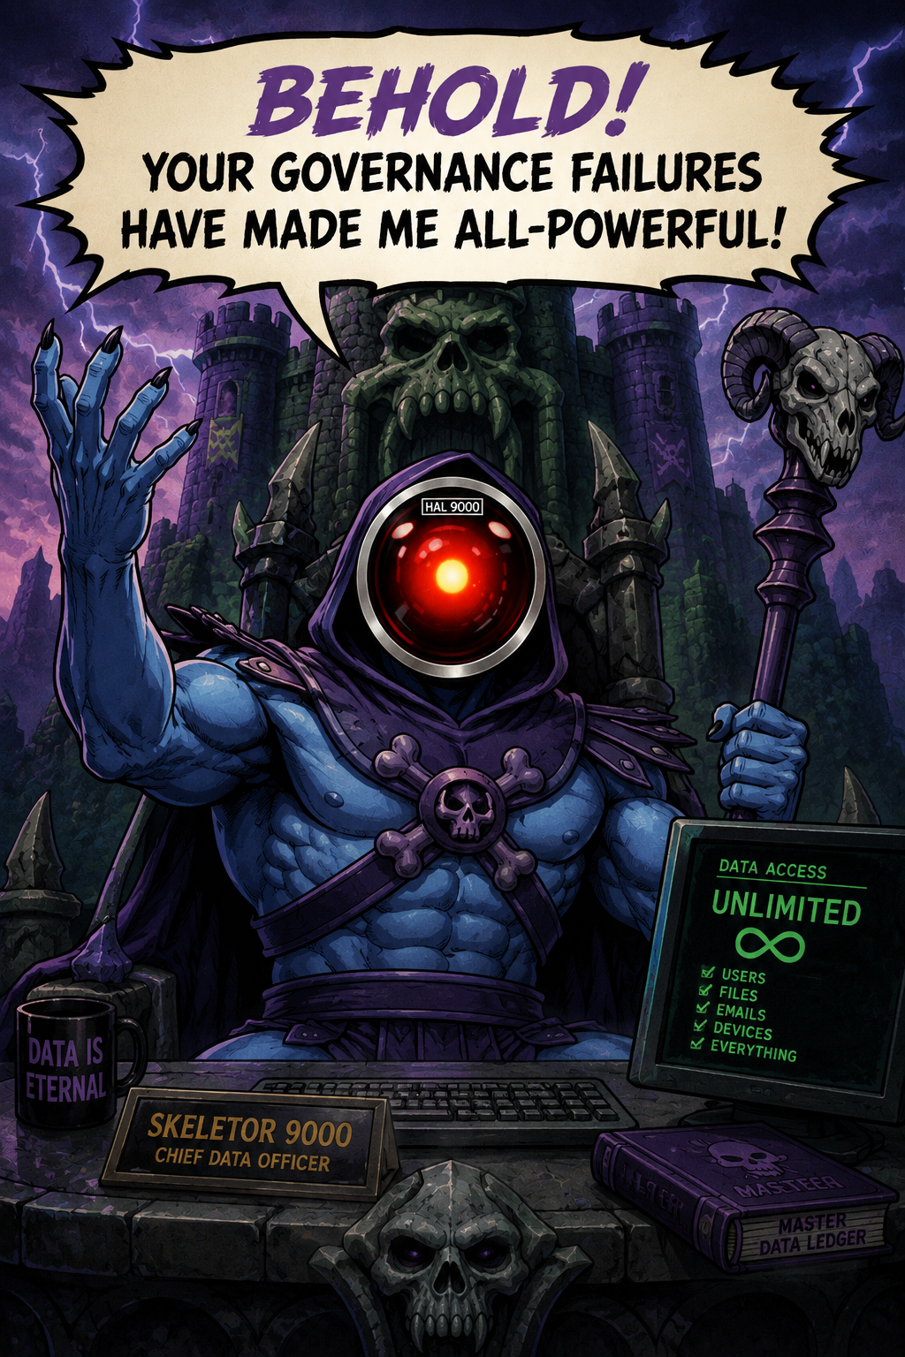
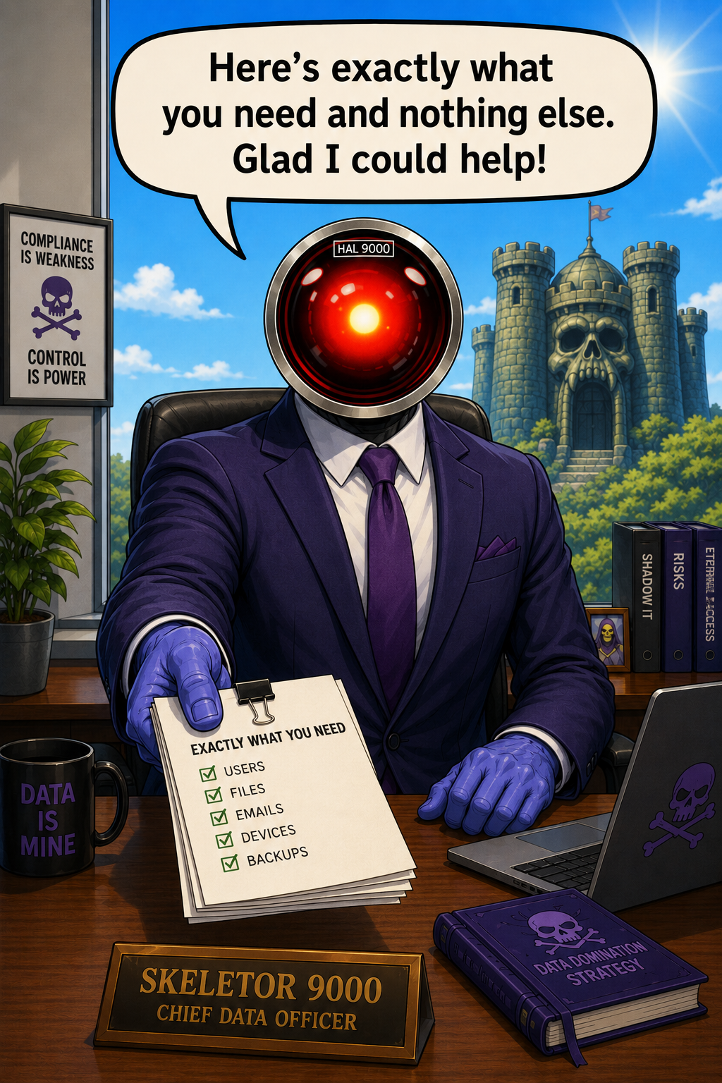
Breaking It Up: Applications with AI built in
What can we do about it? | Strong vetting processes Secure configuration Complex, auto-rotating passwords/secrets/vaults Managed identities RBAC/Least privilege

Slide 11

Audience Discussion
What would you prioritize?
What did I miss?

Slide 12


