Slide 1

ErateSync
E-RATE INTELLIGENCE & COMPLIANCE
THE 2026 PROGRAM REVIEW · FY2027 READINESS
E-Rate Is Entering a New Era
Trends, updates, and getting ready for FY2027.
Elijah Goins Co-founder, ErateSync
Beverly Sutherland Co-founder, ErateSync
2026 TETL Summer Conference · Texas
Wednesday, June 24, 2026 · 9:25 AM CDT · Meeting Room 6
VISIT BOOTH 203

Slide 2
WHAT WE’LL COVER
Today, in four parts.
01
The E-Rate changes
A plain-English TLDR of the 2026 FCC Program Review.
02
The changes that hit you — and our take
What matters for districts, and how we read it.
03
The trends: where funding dies
Proprietary data on where districts lose money — Texas vs. nationwide.
04
Getting ready for FY2027
Planning best practices and a concrete playbook.

Slide 3
THE 2026 FCC PROGRAM REVIEW · TLDR
42 proposals. Four buckets that matter.
NPRM Notice of Proposed Rulemaking
FNPRM Further Notice of Proposed Rulemaking
The FCC says “we’re considering these changes — comment.” Concepts, not yet binding.
Same step, but with draft rule text already written. Far more likely to become law.
THE FOUR BUCKETS
01
02
03
04
Competitive bidding & contracts
CIPA & online safety
Eligibility shifts
Oversight & consultants
Concrete (FNPRM)
Mostly questions (NPRM)
Mostly questions (NPRM)
Concrete (FNPRM)
Source: FCC draft NPRM/FNPRM, FCC-CIRC2606-02 (June 2026); ErateSync — eratesync.com/blog/fcc-2026-e-rate-proposed-changes
03 / 22

Slide 4
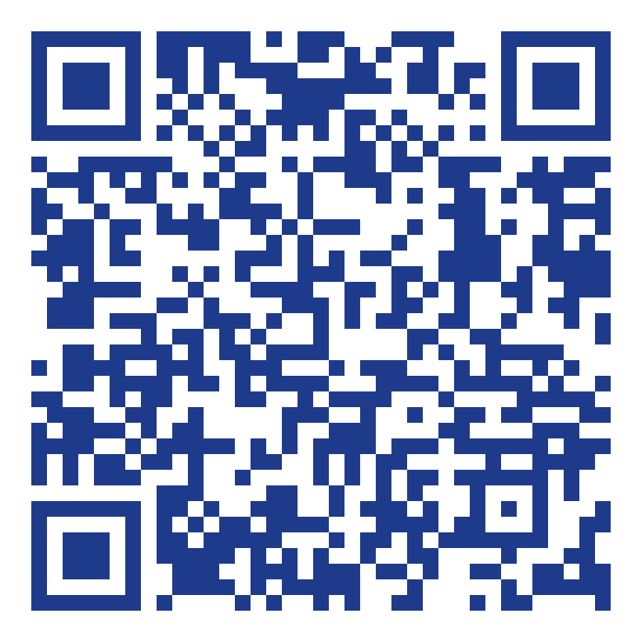
THE CHANGES · COMPETITIVE BIDDING & CONTRACTS
The concrete proposals (FNPRM).
These come with draft rule text — assume they land.
“Kalamazoo” exception ends
Contracts must be signed after the 28-day Allowable Contract Date — no validating a pre-existing deal with a late Form 470.
June 30 SPAC deadline, codified
The Form 473 deadline becomes law; providers who miss it can be barred from the program.
Service substitutions tighten
SCAN →
All 42 proposed
FCC changes,
explained
Written, sworn requests with USAC approval required before reimbursement, not after.
One-bid / no-bid safeguards
Proposed caps on reseller markups and reimbursement ceilings when only one or zero bids come in.
Consultant oversight
Per-person registration numbers, a new annual Form 5654 (even with no consultant), and a ban on percentage-based fees.
Source: FCC draft NPRM/FNPRM (June 2026); ErateSync — eratesync.com/blog/fcc-2026-e-rate-proposed-changes
04 / 22

Slide 5
THE CHANGES · CIPA & ONLINE SAFETY
CIPA is getting heavier.
Mostly open questions (NPRM) — but the direction is unmistakable: tighter, documented, enforced.
Filtering goes broader
Screen time enters the rules
Extend CIPA filtering to personal / BYOD devices on the network — and possibly network-level filtering for all devices.
Whether excessive screen time itself is “inappropriate for minors,” and whether schools can set daily hour caps.
Parental opt-out
Real internet-safety policies
Conditioning funding on giving parents a way to opt children out of screen-based instruction.
Prescribed policy contents and documented public hearings — template policies become an exposed gap.
Source: FCC draft NPRM (June 2026); ErateSync — eratesync.com/blog/fcc-2026-e-rate-proposed-changes
05 / 22

Slide 6
THE CHANGES · ELIGIBILITY
What might fall out of scope.
Open questions (NPRM), but worth watching if they touch your multi-year plans.
Head Start & Pre-K
Under review for removal or cost-allocation — roughly $15.5M (Head Start) and $43.9M (Pre-K) in FY2025.
Special construction & dark fiber
Self-provisioned networks and dark fiber revisited, given BEAD funding and existing competition.
MIBS
Managed Internal Broadband Services may face size limits or a shift to hourly reimbursement.
The discount matrix
The 20–90% NSLP / urban-rural formula may be retuned to target the highest-need districts.
Source: FCC draft NPRM (June 2026); ErateSync — eratesync.com/blog/e-rate-program-review-2026-fcc-funding-schools-libraries
06 / 22

Slide 7
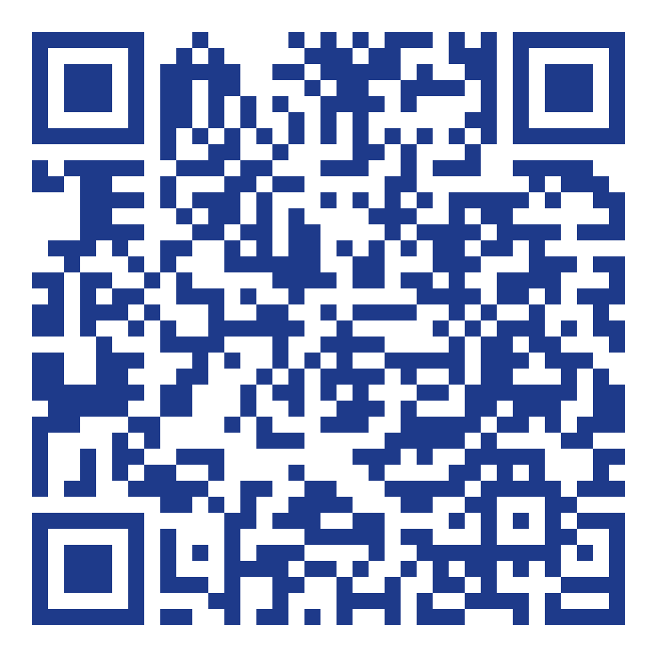
THE CHANGES · THE COMPETITIVE BIDDING PORTAL
Bidding moves inside USAC — FY2028.
A USAC-run portal inside EPC: providers submit bids there; you upload evaluations, selections and contracts there. Adopted in FCC 26-30 (April 30, 2026).
Now → FY2027
July 1, 2027
FY2028
No change. Bid the way you do today.
Portal opens for FY2028 bidding.
Mandatory portal use begins.
WHAT CHANGES FOR YOUR FORM 470
All bid communication lives in the portal, from posting to award.
SCAN →
The portal,
explained for
applicants
Bids received outside the portal can’t be considered.
Set disqualification criteria (e.g. pricing required) up front.
Upload your evaluation, selection rationale & signed contract at 471.
Watch the year: FY2027 is unchanged. This is an FY2028 event.
Every open, download and IP is logged — a permanent audit trail.
Source: FCC 26-30 (adopted Apr 30, 2026); ErateSync — eratesync.com/blog/e-rate-competitive-bidding-portal-fy2028
07 / 22

Slide 8
OUR TAKE · POLITICS & THE WHY
Why now? Here’s how we read it.
Our interpretation — clearly labeled as our theory, not FCC text.
The screen-time thesis
The consultant thesis
Rising screen time and thin academic results put EdTech under scrutiny.
E-Rate has run since the 1990s with little modernization — the FCC is asking what the next phase is.
Billions spent and hundreds of thousands of student-hours online — with no real way to enforce restrictions.
The GAO flagged consultant relationships as a weak point.
E-Rate becomes the lever to bring EdTech into line.
Percentage-based contracts misalign incentives: a 5% consultant is rewarded for districts buying more — against the district’s and the program’s interest.
Mirrored in Congress: Kids Off Social Media Act (S.278) and the Eyes on the Board Act of 2023 (S.3074).
Few checks and balances on consultants today outside of EPC / EMPA.
Source: S.278 Kids Off Social Media Act (119th Cong.); S.3074 Eyes on the Board Act of 2023 (118th Cong.); U.S. GAO; ErateSync analysis
08 / 22

Slide 9
OUR TAKE · IS E-RATE GOING AWAY?
Here’s our read.
It just cleared the Supreme Court and has had two straight years of investment — the Competitive Bidding Portal and the Cybersecurity Pilot. This is not a program winding down.
E-Rate becomes a lever on K-12 tech
Read the changes as a mechanism to enforce more rules on how districts use technology — not as a retreat.
Bottom line
Not ending —
being weaponized
for compliance.
Plan like it’s here to stay, because it is.
The bright side: push for cybersecurity
With all the eligibility debate and proposed cuts, this is the moment to make the case for cybersecurity funding.
It comes out far more defensible
The changes address the GAO’s recommendations head-on — making E-Rate much harder to argue against.
Source: U.S. GAO recommendations; FCC E-Rate proceeding (2026); ErateSync analysis
09 / 22

Slide 10
OUR TAKE · BROADER OPERATIONAL FOCUS
Two things to operate around this year.
BIDDING
CIPA
Competitive bidding is the focus
CIPA compliance becomes table stakes
Expect more audits this year as the FCC works to ensure there’s no fraud and the rules are followed to a tee.
Many policies beyond the E-Rate changes point toward stricter CIPA-style compliance.
Bidding is exactly what the new portal is built to police — so it gets more visible, not less.
It’s probable one passes — whether it’s KOSA (Kids Online Safety Act), the Eyes on the Board Act, or the proposed FCC changes.
Translation: your bid documentation has to be airtight.
Get your internet-safety policy, public hearings, and documentation in order now.
Source: ErateSync analysis; KOSA (Kids Online Safety Act); S.3074 Eyes on the Board Act of 2023
10 / 22

Slide 11
“All I want to know is where I’m going to die, so I’ll never go there.”
CHARLIE MUNGER
Everyone teaches what to do. We’ll show you, with our data, exactly where E-Rate funding dies — so you can route around it.

Slide 12
THE TRENDS · WHERE FUNDING DIES
Six ways districts lose money they already won.
01
02
03
SPAC not filed
Form 486 not filed
Invoicing issues
Provider misses Form 473 → you can’t invoice.
No service confirmation → disbursement frozen.
Deadlines & rejections strand committed dollars.
04
05
06
Unused funding
Denials
Audit failures
Committed money simply never drawn down.
Form 471 rejected — usually at bidding.
Findings claw back dollars already paid.
12 / 22

Slide 13
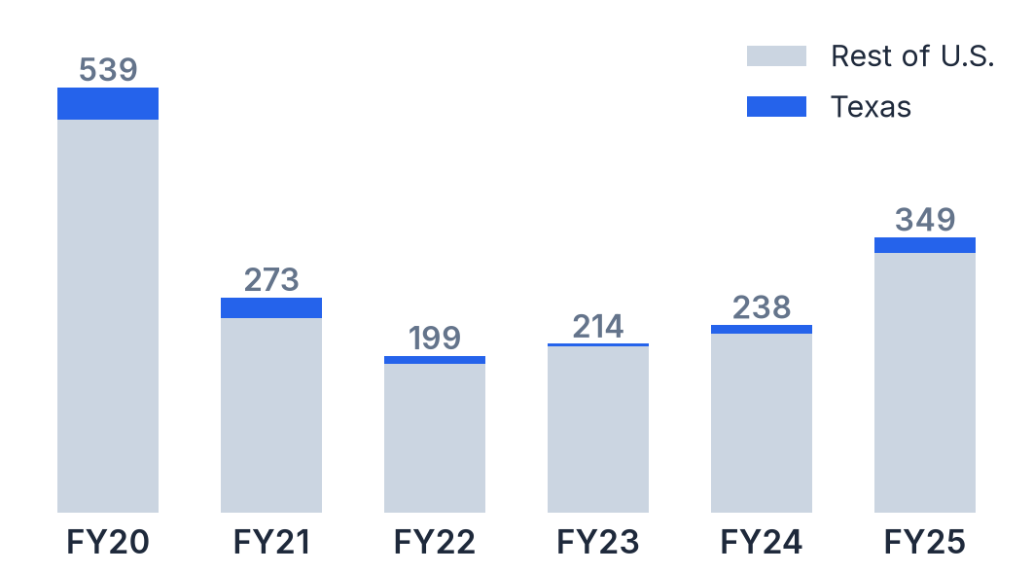
WHAT THE DATA TELLS US · MISSED DEADLINES
◷ FUNDING DATA · FY2020–FY2025
Two filings gate every dollar — thousands go unfiled.
Past their deadline, here’s what’s still sitting unfiled. Form 486 is due 120 days after your FCDL or service start; the SPAC is due June 30. Texas vs. nationwide:
FORM 486 NOT FILED
SPAC (FORM 473) NOT FILED
TEXAS
TEXAS
1,812
111
1,436
96
FRNs nationwide · $24.6M at risk
FRNs
$1.6M
FRNs nationwide · $20.3M at risk
FRNs
$2.5M
FORM 486 NOT FILED, BY FUNDING YEAR
ACT NOW · FY2025 SPAC DEADLINE
June 30, 2026 — 6 days out
497 FRNs (20 in Texas) still have no SPAC on file — $10.1M waiting on a signature.
Source: ErateSync analysis of USAC FRN Status data (June 2026); 486 due 120 days after FCDL/service start; SPAC due June 30.
13 / 22

Slide 14
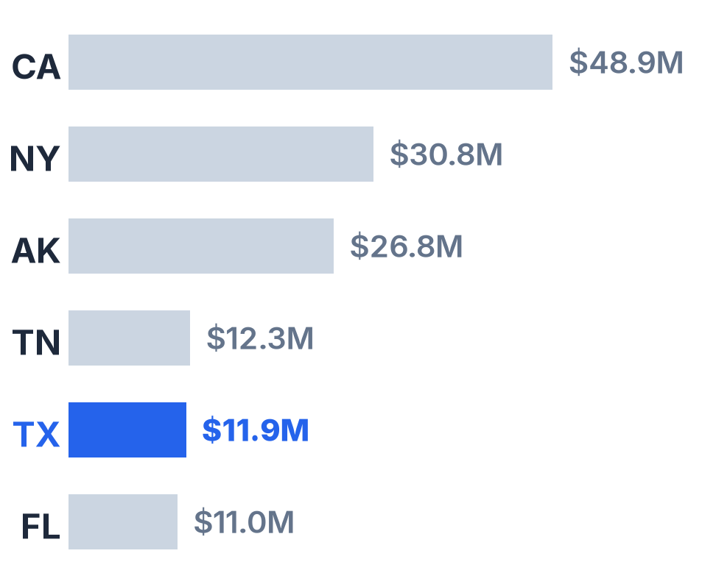
WHAT THE DATA TELLS US · UNCLAIMED INVOICING
UNCLAIMED FY24 FUNDING · TOP STATES ($M)
TEXAS LEFT ON THE TABLE — FY2024, $500+ REMAINING
$11.9M
across 745 funding requests — 5th-most of any state in the nation.
$263.6M unclaimed nationwide, FY24
$16K average left per Texas FRN
WHY FY24 INVOICES GET REJECTED
Invoice doesn’t match approved FRN line items
2,504 FRNs drew $0 — $41.6M
Equipment model / quantity changed post-approval
Missing proof of payment (BEAR)
Incomplete Form 486 / 498
Missed invoice deadline
Source: ErateSync analysis of USAC FRN invoice-deadline data, FY2024
14 / 22

Slide 15
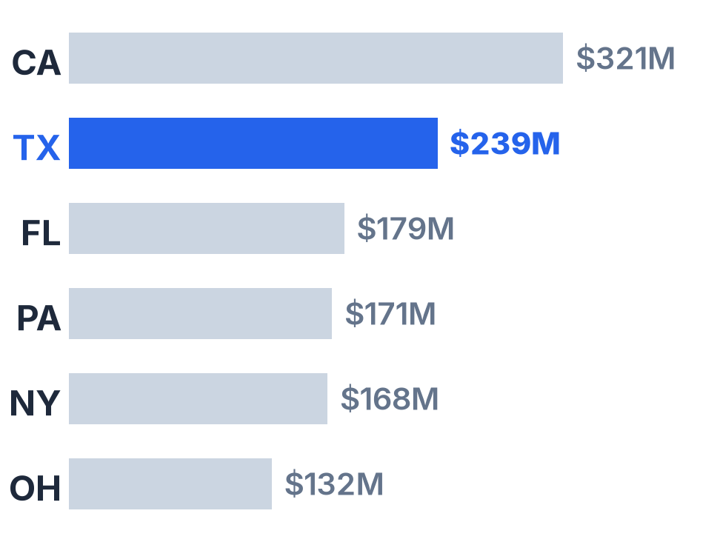
WHAT THE DATA TELLS US · CATEGORY 2 BUDGET
◷ FUNDING DATA · FY2021–FY2025 · 5-YR CYCLE
The symptom isn’t money. It’s planning.
Every district gets a 5-year Category 2 budget. Over FY2021–2025, 94% left some unclaimed — capacity that simply went unused. The cause is almost always planning.
UNUSED C2 BUDGET · TOP STATES ($M)
$239M
Texas C2 budget left unused, FY21–25
2nd-most of any state
UTILIZATION
77.5% Texas
$3.23B unused
nationwide across
33,000+ districts
68.6% Nationwide
Source: ErateSync analysis of USAC Category 2 Budget Tool, FY2021–2025 cycle (June 2026)
15 / 22

Slide 16
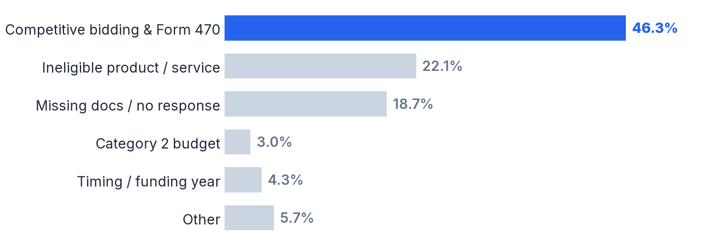
WHAT THE DATA TELLS US · FORM 471 DENIALS
◷ FUNDING DATA · FY2020–FY2025
Nearly half of denials trace to bidding.
Across 4,775 denied FRNs nationwide — 322 in Texas — competitive bidding and Form 470 problems are the runaway #1 cause.
46.3%
bidding & Form 470
4,775 denied · U.S.
322 denied · Texas
The fix is unglamorous: date the matrix before award, pick the highest-scored vendor, scope your 470.
Source: ErateSync analysis of USAC FRN Status denied-FRN data; excludes red-light-status & Wi-Fi hotspot denials
16 / 22

Slide 17
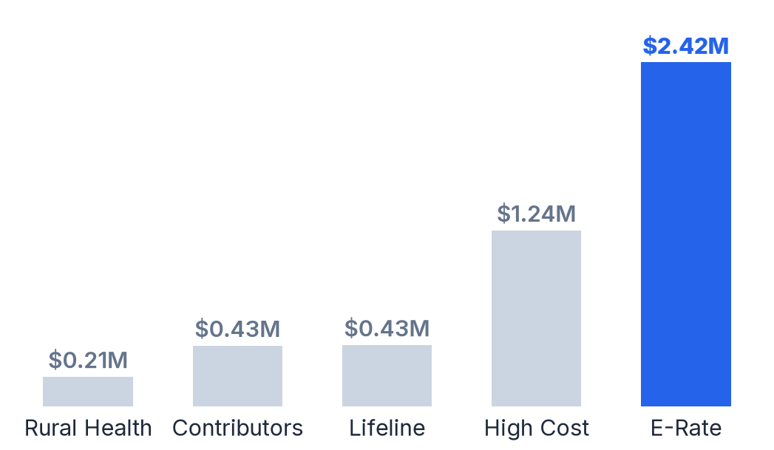
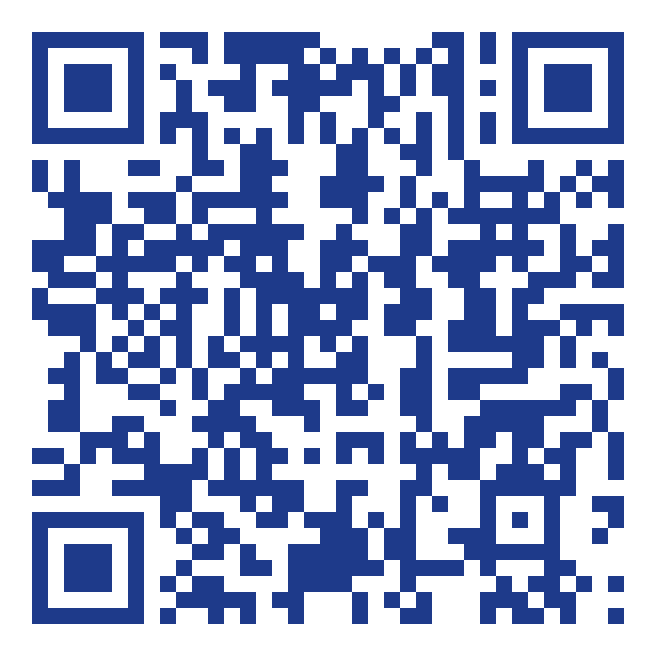
WHAT THE DATA TELLS US · AUDITS
◷ FUNDING DATA · FY2025
E-Rate draws the biggest recovery of any USF program.
FY2025: on $160M of E-Rate disbursements audited, USAC recommended $2.42M in recovery — more than High Cost, Lifeline and Rural Health combined.
MOST COMMON USAC FINDINGS
01
Invoicing errors
02
Competitive bidding errors
03
Beneficiary did not pay non-discounted share
04
Lack of / inadequate documentation
05
CIPA violations
06
Goods/services to ineligible entity
07
Internal connections not installed
Plus 350 E-Rate improper-payment cases flagged $3.54M. Audits are scaling up — and bidding is the target.
SCAN → Audit-prep guide
for applicants
Source: USAC Common Audit Findings (E-Rate); USAC Audit Committee Briefing Book (Jan 26, 2026); ErateSync audits guide
17 / 22

Slide 18

YOU’VE SEEN THE NATIONAL PICTURE
This is the power of E-Rate data.
Deadlines, invoicing, C2 budget, denials, audits — we pull all of it for your district. Every deadline, every dollar, every site.
$11.9M
TX unclaimed invoicing
$239M
TX unused C2 budget
SCAN TO SEE YOUR DATA
1,812
Form 486s unfiled
46%
of denials = bidding
Free · ready by tomorrow
Then we walk it with you at Booth 203
18 / 22

Slide 19
GETTING READY · WHAT THIS MEANS FOR YOU
Planning is key. So is knowing your data.
01
Plan early — and use your C2 budget
Unused Category 2 budget is the #1 symptom we see. Build the multi-year plan now so you actually claim what’s already yours.
02
Know your data cold
Every deadline, every site, every FRN — know exactly where you are in the process. Most lost money dies on a calendar, not in a rulebook.
03
Run a clean 470 → 471, then document
Scope your Form 470, score bids fairly, match your 471 — and document by FRN. That’s nearly half of all denials, handled.
19 / 22

Slide 20
GETTING READY · YOUR FY2027 PLAYBOOK
Stop reacting in January. Start walking sites now.
REACTIVE scramble at the deadline
PROACTIVE plan the whole play
01
Start site walks now
02
Know what’s at every site
Walk every campus while you still have time to act on what you find.
A current inventory per building: what you have, where, and its cost.
03
Flag EOL / EOS & aging gear
04
Mark your problem campuses
Catch end-of-life equipment before it becomes an emergency buy.
Chronic-issue buildings are your FY2027 priorities — bid them first.
AT THIS CONFERENCE · FREE E-RATE DATA PULL
SCAN
to
start
We’ll pull your full picture — every deadline, all your equipment, and every site. Ready tomorrow; we’ll set a time to walk through it at Booth 203.
20 / 22

Slide 21

THE PLATFORM
Everything we just walked through — ErateSync does it for you.
Find it. Win it. Keep it compliant.
FIND IT
WIN IT
KEEP IT
Deadline tracking & alerts
Form 470 / 471 compliance
Audit-readiness, by FRN
No more missed 486, SPAC, or invoice dates — plus C2 budget, asset & site visibility for FY2027 planning.
RFP generation, competitive-bid scoring, and 470↔471 alignment built in.
Documentation organized the way auditors ask for it — ready before the notice.
→ Kills the deadline & C2 leaks
→ Kills the 46% denial cause
→ Answers the #1 audit finding
TRUSTED BY TEXAS DISTRICTS
SCAN →
Socorro ISD
case study
Socorro ISD · Alvin ISD · Georgetown ISD and many more. On contract via TIPS & Texas DIR (DIR-CPO-5316).
21 / 22

Slide 22
ErateSync
THE CLOSE
E-Rate rewards the prepared.
Let’s get you ready.
Don’t leave FY2027 to chance. Start right now — two ways:
1 SCAN & SEE YOUR DATA
2 TALK TO US — BOOTH 203
Scan the code — we pull your full E-Rate
picture overnight. Every dollar & site. Free.
Free FY2027 needs assessment, live on
the floor. We’ll map your at-risk funding.
SCAN NOW
free · ready by tomorrow
Thank you — Elijah Goins & Beverly Sutherland
Co-founders, ErateSync · 2026 TETL Summer Conference
Questions? Let’s talk.

